Slide 1
TicX
Grace Knudsen, Austin Lam, Elizabeth Martens, Rachel Litscher, Brendan Lorn
Notes:
Grace

Slide 2
Description
TicX is a website that aggregates concert information from multiple ticket websites and provides a visual display of the aggregated data.
TicX allows users to search and filter concerts based on user-selected criteria and displays the results on an interactive map.
TicX allows users to save their personal live event history, and view their past attendance on an interactive map.
Notes:
Grace

Slide 3
Background
TicX originated out of a team member’s desire to view aggregated concert events from a variety of data sources in one place, preferably on a single map
Idea expanded to service other team members’ interests: for instance, someone who loves to travel may want to view their favorite artist’s tour on a map in order to plan a trip to a new city around the tour
Business proposition: There is a clear path to monetizing the site via partnerships with event data providers and referral of users to specific ticket purchasing platforms
Notes:
Rachel

Slide 4

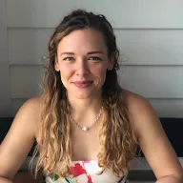

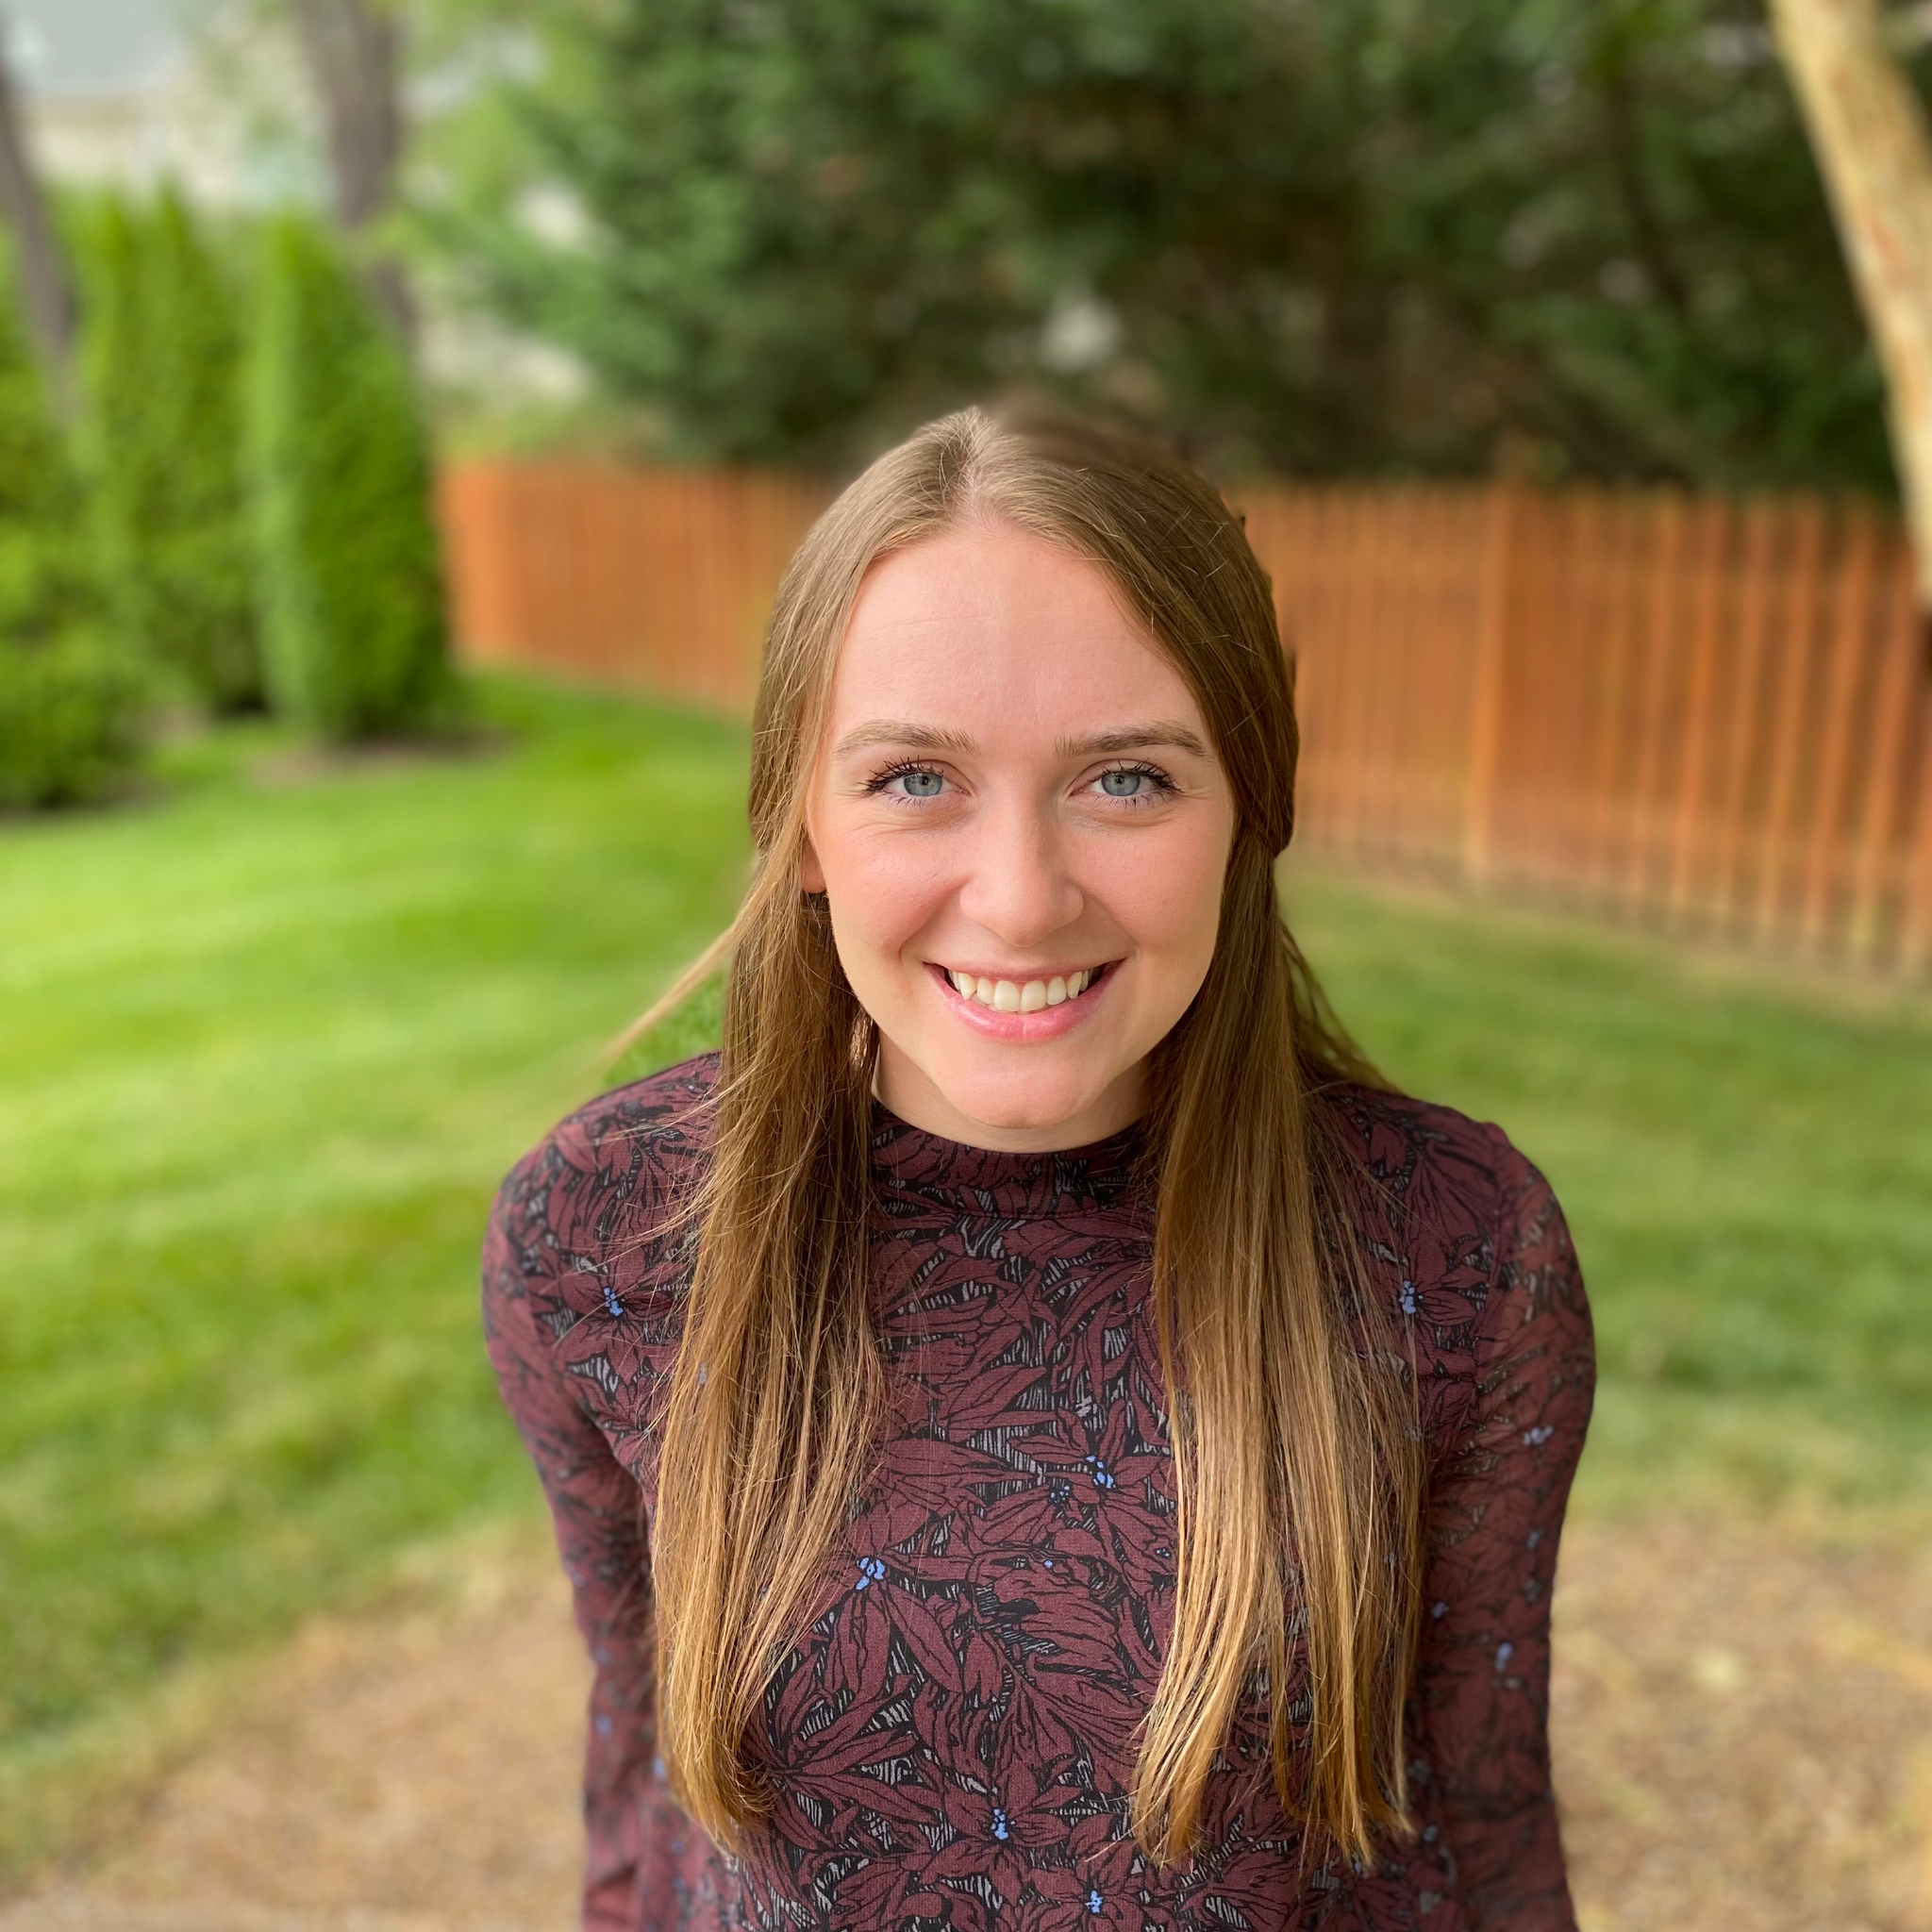
Who is this for?
The local concert enthusiast: Looking for a unified feed showing them the concerts in their local area. Interested in live events both for well known artists and up-and-coming artists. Makes last minute plans to attend a nearby concert when a free evening pops up
The suburban occasional concert attendee: Interested in whether a specific artist is coming to their city on their tour. If the artist is coming to the city, this person would want to understand the location of the venue so that they can plan an evening agenda accordingly.
The artist superfan: Interested in mapping out their travel to see their favorite band live, and wants to be able to see the locations and dates of concerts, as well as where each lands on the map, so that they can follow along!
The epic traveler: Interested in seeing where on the map their favorite artists are headed so that they can plan travel to see them
Notes:
Rachel
User profiles:
Grace
Looking for a unified feed showing them the concerts in their local area
Not interested in navigating to different websites for each ticket seller
On a million ticket seller and venue email lists and doesn’t want to sort through all of the marketing content being pushed to them
Interested in live events both for well known artists and up-and-coming artists
Makes last minute plans to attend a nearby concert when a free evening pops up
Does not have a personal vehicle, so event location and accessibility via public transport is important
Is often looking for concerts on their mobile device
Elizabeth
Interested in planning a weekend in their city weeks or months in advance, and may not be very familiar with the city. They would use the site to search for events during a particular weekend or other time period and near a hotel or other familiar landmark.
Interested in whether a specific artist is coming to their city on their tour. If the artist is coming to the city, this person would want to understand the location of the venue so that they can plan an evening agenda accordingly.
Wants to track the venues that they have visited for previous events in order to refresh their memory on who they saw where, how they got to the show, where they ate or drank before or after the show, etc…
Austin
Interested in mapping out their travel to see their favorite band live, and wants to be able to see the locations and dates of concerts, as well as where each lands on the map, so that they can follow along!
Wants to be able to share their concert attendance on social media
Wants to be able to track their concert attendance, as well as filter and map their concert attendance for their favorite artist.
Rachel
Interested in seeing where on the map their favorite artists are headed so that they can plan travel to see them
Interested in searching for events that are happening in cities they’re visiting when they’re visiting
Likely to plan concert attendance a week to several months in advance
Often not familiar with the city they will be attending a concert in, so may want to visualize the location and/or understand where it is relative to city landmarks or their airbnb.

Slide 5






Technology Stack
VSCode and IntelliJ
Vue.js / Vuetify
Flask.py
mySQL
Docker
Issue tracking: GitLab
Notes:
Austin
How did you build the system?
IDEs and toolsHow did you build the system?
IDEs and tools
Technical details/Design Choices
Difficulties you encountered during the project and how you overcame them
Technical details/Design Choices
Difficulties you encountered during the project and how you overcame them

Slide 6
Demonstration
https://ticx.discovery.cs.vt.edu
Notes:
Elizabeth

Slide 7
Reflection
What we struggled with:
User dev environment setup across operating systems
Docker/ deployment documentation
Certain sprints being more FE focused, relying more heavily on the skills and mentorship of specific teammates
What went well:
Teamwork, mentorship, pairing, communications
Notes:
Brendan Lorn
2 Windows, 3 Mac
Docker documentation on VT CS Cloud
Difference in experience on more FE focused sprints
Pair/Group Programming

Slide 8

Thank you
Elizabeth Martens
Scrum master
Data analytics
Brendan Lorn
Docker guru
Grace Knudsen
Front end
developer
Austin Lam
Back end
developer
Rachel Litscher
Product owner
Front end developer
Notes:
Brendan Lorn

