Slide 1

Virginia Cooperative Extension – Mecklenburg County
Career Explorations and Interactions

Slide 2
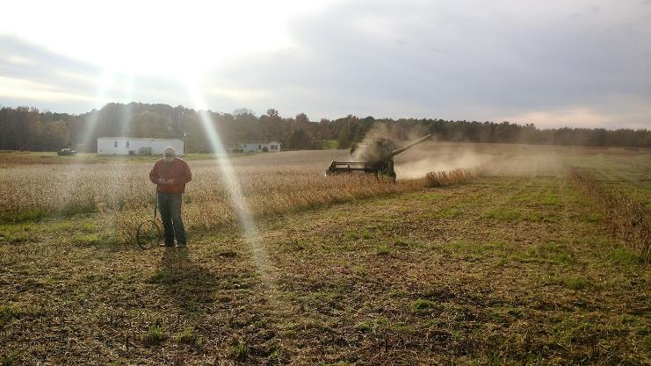
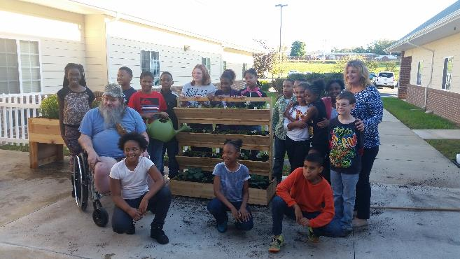
Local Program Areas
Agriculture and Natural Resources – Taylor Clarke
Family and Consumer Sciences – Amy Hawkins
4-H Youth Development – Jennifer Bowen
SNAP-Ed/Family Nutrition Program – Nancy Jimmerson

Slide 3
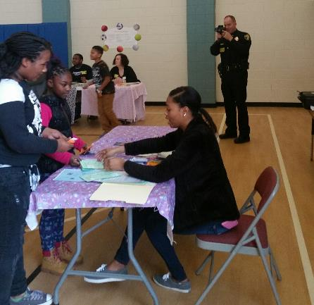
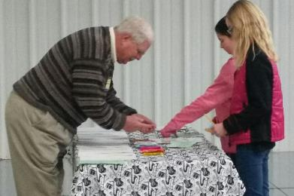
In-school 4-H programs
Science Enrichment
  45 minutes/monthly
  4th and 5th grades at Clarksville, Chase City, and LaCrosse Elementary Schools
21st Century Grant After-School Programs
Kids’ Marketplace
Reality Store – planned for spring

Slide 4
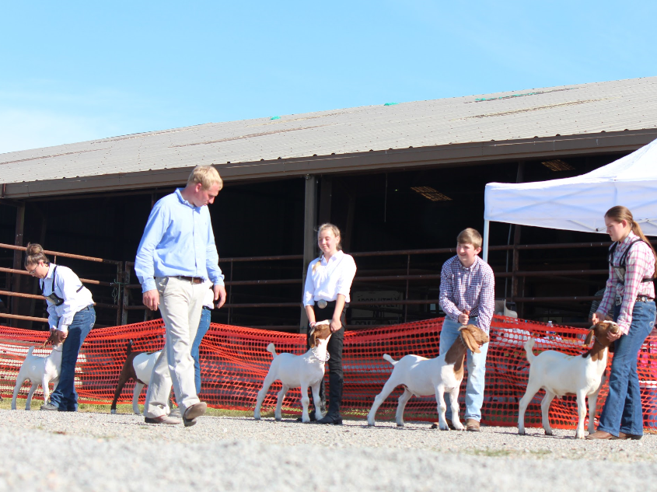
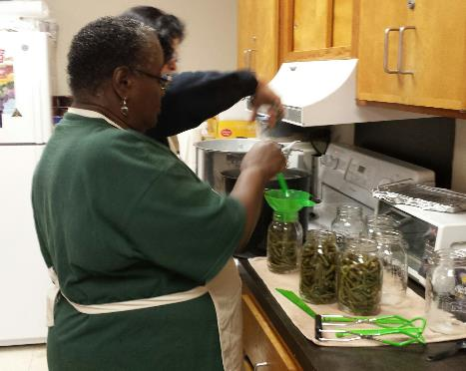
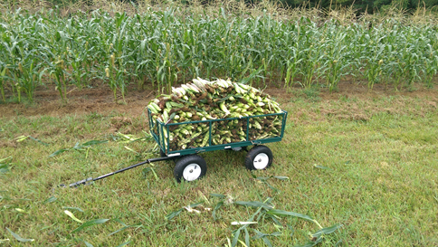
Existing Programs with Opportunities for
Career Exploration
Community/Demonstration Garden - Boydton
4-H Club Programs
  Mecklenburg 4-H Livestock Club
  Mecklenburg 4-H Fur and Feathers Club
  Sewing Club

Slide 5
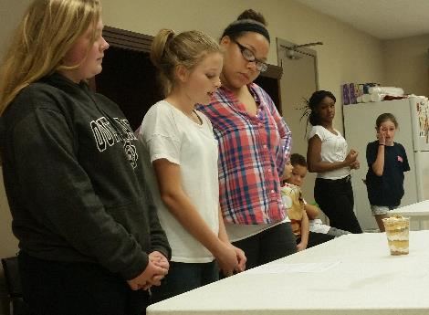
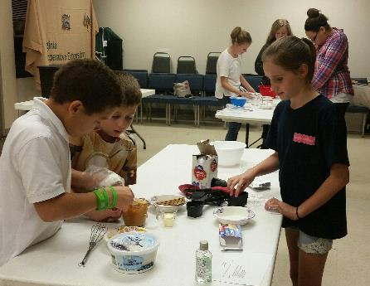
Existing Programs with Opportunities for
Career Exploration
4-H Food Challenge Program
Teen Leadership Programs
  Leadership Retreat (Youth Engaged in Learning about Leadership – NY 4-H)
  Junior 4-H Camp Teen Leader Recruitment and Training

Slide 6
Planned Programs
Innovative Leadership Academy
4-H SPIN Programs (volunteers needed – currently 17 programs with curricula)
Summer Programs
  Junior 4-H Camp
  Camp Loud and Clear (Partnership with Longwood)
  Summer program in Boydton community garden
  St. John Baptist Church Summer Program – installation of raised beds and container gardens
  Cloverbud Super Science Club – partnership with library

Slide 7

Additional Possibilities
Unpaid internships for high school students
  Exposure to all program areas
4-H programs specifically designed or adapted to meet local needs aligned with National Mission Mandates: Citizenship, Healthy Living, STEM

