Slide 1



Measuring the economic impact of conservation agriculture adoption in rural India using linear programming and economic surplus analysis.
Reed B.F.,¹ Chan-Halbrendt C.,¹ Halbrendt J.,¹
Roul P.²
¹ Dept. of Natural Resources and Environmental Management, University of Hawaii, USA
² Orissa University of Agriculture and Technology, Bhubaneswar, India
Notes:
Research funded by USAID and partner

Slide 2
Introduction
Conservation Agriculture (CA) increase sustainable yields
100 million ha worldwide (Pretty et al., 2007)
Adoption remains low among smallholders in many less developed countries due to unclear benefits at farm- and regional- levels (Pannell et al., 2006; Wall, 2007).
Notes:
And improve producer livelihoods in the process.
It is for these reasons that in the last three decades,
Thus an analysis that can provide insight into benefits at multiple levels can be a valuable adoption tool.

Slide 3
Farm (Household) Scale
Provincial or State Scale
Economic development, poverty reduction.
A powerful tool for CA adoption
Notes:
Therefore an analysis of benefits at the farm and provincial or state levels could be a powerful tool for supporting adoption of CA.
Such obstacles could be overcome by analysis of CA benefits at multiple scales. At the farm scale, careful consideration of farmer preferences regarding adoption objectives combined with analysis of available CA options can provide valuable estimates of the household-level benefits that could be expected following adoption. At the provincial or state level, off-farm benefits are of interest. Specifically, the economic impact adoption of CA could have on local governments, and its implications for development, poverty reduction and food security are of primary interest. Thus, an analysis that can provide assessment of a broad scope of benefits at the farm and state level could be a powerful tool for the prediction and promotion of CA.

Slide 4
Objectives
Identify combination of crop production systems that optimize smallholder objectives.
Estimate state-level economic impact of adoption at rates of 1%, 3% and 5%.
Notes:
Based on farmer preferences for the key objectives of profitability, soil quality, labor cost savings.

Slide 5
Research Tools
    Multi-objective linear programming (MOLP) model
      Combination of production systems maximizes profit, soil quality and minimizes labor costs, according to farmer preferences.
    Economic surplus analysis
      Net benefit to producers and consumers; reflects change in total economic welfare resulting from the introduction of new technologies (Laxmi et al., 2007; Shiferaw, 2005).
Notes:
To accomplish this, we used 2 research tools
MOLP to determine…
ES Analysis used to estimate…

Slide 6
Study site
    State of Odisha, India…
    High poverty – nearly 50% headcount poverty rate (Haan, 2011)
    Smallholder agriculture: Over 50% farms < 2ha, avg. 1.25 ha (NIAM, 2011)
    Data collected from Tentuli village and on-station trial plots near Kendujhar (Lai et al., 2012)
Notes:
State of Odisha India selected due to
16.3 million people
Prevalance of smallholder farming
Farmer preference data for adoption objectives

Slide 7
MOLP: Model Coefficients
    12 production systems * 3 objectives = 36 coefficients.
    Production systems are traditional maize-based systems, 11 of which integrate one or more CA practices:
        minimum tillage
        legume intercropping
        crop rotation
        residue management (cover cropping).
      Objectives Maximize profit, soil quality; minimize labor costs according to weighted farmer preferences for each (Lai, et al. 2011)
Notes:
2 main elements in the model – production systems of which there were 12, 3 objectives for total of 36 coeefficents.
Maximize Profit: crop yield * (market price -fertilizer and herbicide costs).
Maximize Soil Quality: additive index of pre-planting, post-harvest change in soil N and OC at 10 cm.
Minimize Labor Costs: hourly wage rates * average time requirements.

Slide 8
MOLP: Model Output
 | MCMu | MCH | MCN (FP) | MRMu | MRH | MRN | ICMu | ICH | ICN | IRMu | IRH | IRN
Profit (.4083) | 10.216 | 7.217 | 4.248 | 8.584 | 6.321 | 3.448 | 12.130 | 9.720 | 4.751 | 12.809 | 9.466 | 5.720
Soil Quality (.3174) | 0.366 | 0.081 | 0.482 | 0.483 | 0.306 | 0.820 | 0.412 | 0.068 | 0.676 | 0.512 | 0.636 | 0.874
Labor Cost (.2742) | 6.997 | 7.035 | 5.959 | 4.364 | 4.401 | 3.326 | 7.539 | 7.577 | 6.501 | 4.432 | 4.470 | 3.395
% of area | 0% | 0% | 0% | 0% | 0% | 0% | 0% | 0% | 0% | 63% | 0% | 37%
Notes:
Example of model output, gives a feel for how it works.
Prod systems on top, objectives to right.
Model determines optimal solution for each objective for a total of 3 target solutions. Then minimizes maximum deviation from each solution given weighted preferences for each objective. Results in an optimal combo of production systems.

Slide 9
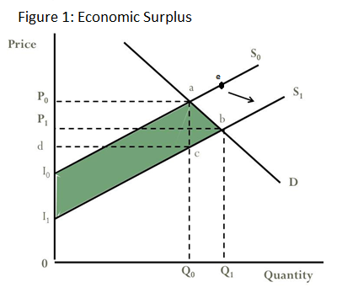
Economic Surplus
  Net change in total economic surplus = I₀ a b I₁
Notes:
In Figure 1, S₀ is the linear supply curve before adoption of the new technologies and S₁ is the supply curve after adoption. P₀ and Q₀ are the initial equilibrium price and quantity. Once adoption occurs, production increases and supply shifts outward (S₁), resulting in P₁ and Q₁, the new equilibrium price and quantity. The area beneath the demand curve and between S₀ and S₁ represents the total increase in economic surplus due to the shift in supply. This area can be thought of as the maximum benefits available to all market entities from the introduction of the introduced technology.

Slide 10
Results and Discussion
  Reduced tillage, maize/cowpea intercrop in the first season with a second season mustard cover crop on ~ 60% of cultivated area (~ 40% fallow) provides the optimum benefit at the farm level.
Comparison of Farmer Practice and Model Output
Objectives | FP | Model | Difference | % change
Profit (INR/m2) | 4.248457 | 10.20204 | 5.95 | 140.14%
Soil Quality | 0.481938 | 0.644951 | 0.16 | 33.82%
Labor Cost | 5.959473 | 4.050729 | -1.91 | -32.03%
Notes:
Compared to current farmer practice (MCN), adoption of this combination of production systems increases profit by an estimated 140% due to increased maize yield and the addition of cowpea and mustard yields. This combination of CA practices also improves soil quality by an estimated 34% due to increased soil cover and legume intercropping. Furthermore it decreases labor costs by about 32% due in large part to the introduction of a reduced tillage regime.

Slide 11
Results and Discussion
  According to economic surplus analysis, adoption of model results among smallholders (farm size <2 ha) at 1%, 3% and 5% would produce:
NET CHANGE IN ECONOMIC SURPLUS in USD
1% | $19,812,669.06
3% | $59,783,614.41
5% | $100,215,369.39
Notes:
Economic surplus analysis indicates that if this combination of CAPS was adopted on 1% of total cultivated land for maize in the first growing season, mustard in the second season, and pulses in both seasons, it would result in an estimated net economic gain of $19,812,669 dollars (₹1,166,173,701 INR) for the state of Odisha. At an adoption rate of 3%, the total economic benefit for Odisha would equal $59,783,614 (₹3,518,863,544 INR) and at 5%, net economic surplus would reach $100,215,369 (₹5,898,676,643 INR).

Slide 12
Conclusions
  It is predicted that the recommended production system (reduced tillage, maize + cowpea intercrop with a 60/40 mustard/fallow cover crop) will provide the best economic returns for farmers.
  This system has high likelihood of adoption given farmer preferences.
  Significant incentive exists at the farm and state levels for adoption of conservation agriculture among smallholders in Odisha.
Notes:
Findings could be strengthened with multi-year trial plot data.
Results could lead to the provision of improved seeds or subsidies for the purchase of CA machinery and improved legume seeds, or payments to offset risks for early adopters (Wall, 2007).

Slide 13
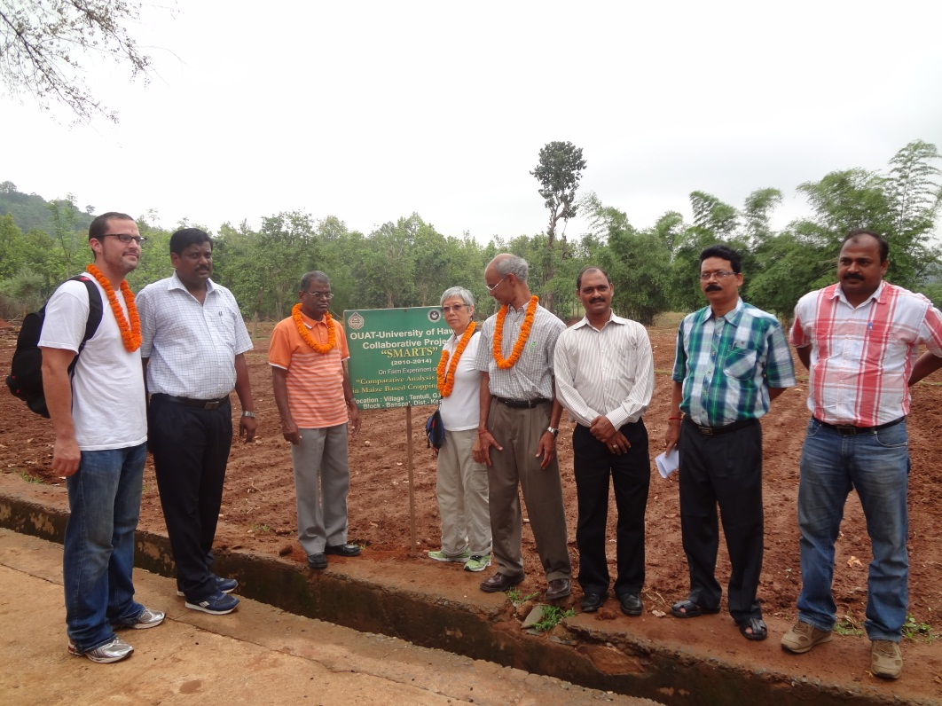
Thank you.

Slide 14
References
Haan, A.D. (2011). “Rescuing exclusion from the poverty debate: group disparities and social transformation in India.” International Institute of Social Studies Working Paper No. 517. The Netherlands: Institute of Social Studies.
Lai C., C. Chan-Halbrendt , J. Halbrendt , D. Naik, and C. Ray (2012). “Farmers Preference of Conservation Agricultural Practices in Kendujhar, Odisha using Analytical Hierarchy Process.” 22nd Annual International Food and Agribusiness Management Association World Forum and Symposium, Shanghai, China, June 11-14, 2012.
Laxmi, V., O. Erenstein, and R. K. Gupta. (2007). "CIMMYT. Assessing the impact of natural resource management research: The case of zero tillage in India’s rice–wheat systems." The Impact of Natural Resource Management Research: Studies from the CGIAR. CAB International, Wallingford, UK 68-90.
Reed, B.F, C. Chan-Halbrendt, B. B. Tamang and N. Chaudhary (2013). “Economic analysis of conservation agriculture production system adoption in Odisha, India using a multi-objective linear programming model and economic surplus analysis.” Unpublished Results.

Slide 15
References
Mythili, G. (2008). “Acreage and Yield Response for Major Crops in the Pre- and Post- Reform Periods in India: A Dynamic Panel Data Approach.” Published by IGIRD-ERS/USDA Project: Agricultural Markets and Policy, Mumbai, India.
Shiferaw, B, H.A. Freeman and S.M. Swinton (eds) (2005). Natural Resource Management in Agriculture: Methods for Assessing Economic and Environmental Impacts. CAB International, Oxfordshire, UK. pp155-174.
Kumar P., A. Kumar, S. Parappurathu and S.S. Raju (2011). “Estimation of Demand Elasticity for Food Commodities in India.” Agricultural Economics Research Review 24: 1-14.
NIAM (2011). “A study on agricultural marketing system in Odisha.” Published by the National Institute of Agricultural Marketing, Jaipur, Rajasthan, India.
SANREM (2012). Conservation Agriculture Production Systems (CAPS). Last updated: January 2011. Available online at: http://www.oired.vt.edu/sanremcrsp/professionals/research-themes/caps/.

