Slide 1
Behavior App
Lawrence Glick Richard Patten
CS 4624 - Multimedia, Hypertext, and Information Access
Instructor - Dr. Fox
Virginia Tech, Blacksburg VA 24061
Final Presentation - 04/25/19
The contents of this presentation are not confidential
Notes:
Richard

Slide 2
Outline
Market / business info
Client requirements, screenshots
Long term development
Semester review
Acknowledgements

Slide 3
Why should this app exist?
Market: Parents or Adults w/ limited video game knowledge seeking to promote positive behaviors in others.
Role in market: App acts as middleman and coaching tool between game key distributor (API) and market.
Client’s Vision: Alternative tool to behavior therapy for the average parent.

Slide 4

Client’s Requirements
An android app that includes the following features:
1. Cloud Authentication
Database set up
Live updating
Unique acc. registration
Secure log in
Log out
2. Main Screen
Quest card list
Wishlist game
Popular game list
Access profile, quests, wishlist
3. Profile Networking
Profile page
Send invite
Receive invite
Accept invite
Remove link
View linked accounts
4. Quests
View tasks
Create task
User
Description
Task is sent to linked user
Task is recorded in DB
Task can be completed
5. Wishlist
Search for game to add
Add game to wishlist
Update main screen
Update DB w/ added game

Slide 5
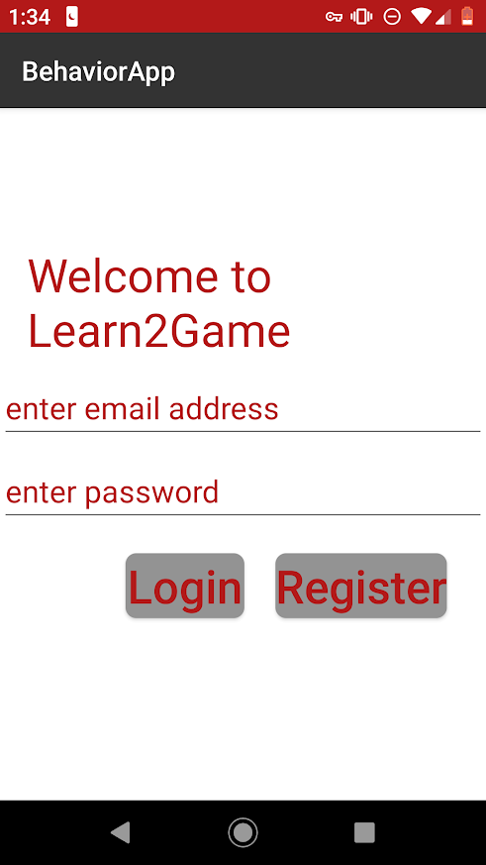
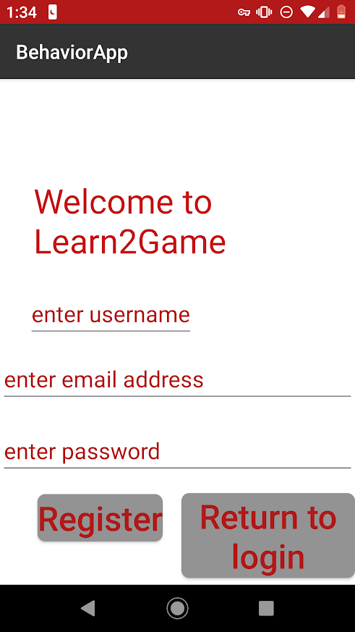
Authentication

Slide 6
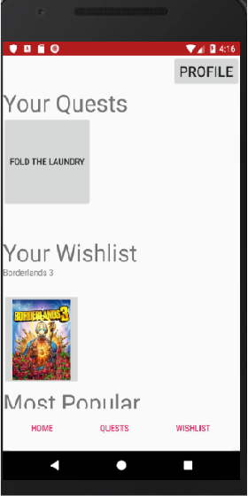
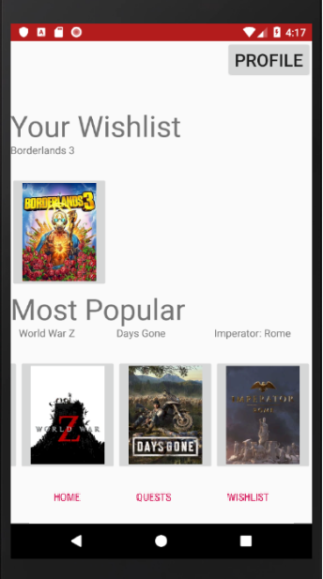
Main Screen

Slide 7
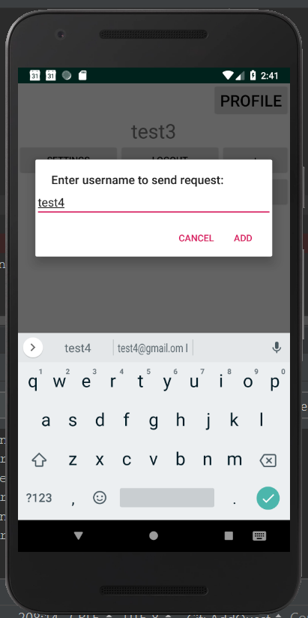
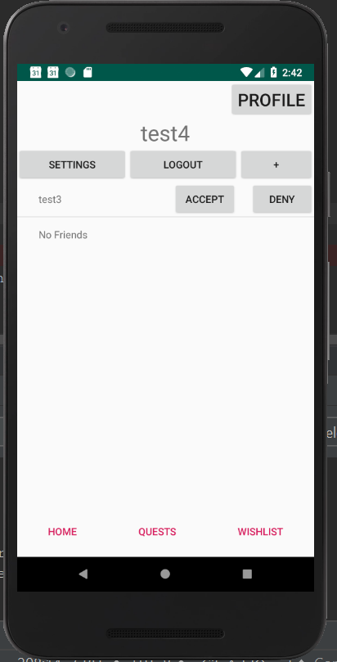
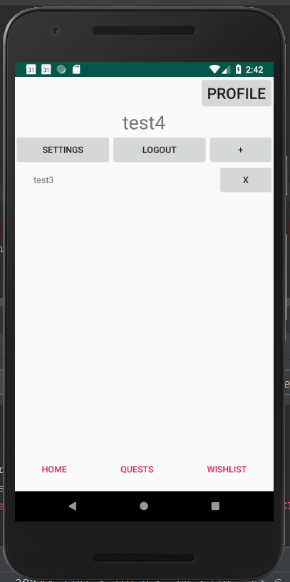
Linking Profiles

Slide 8
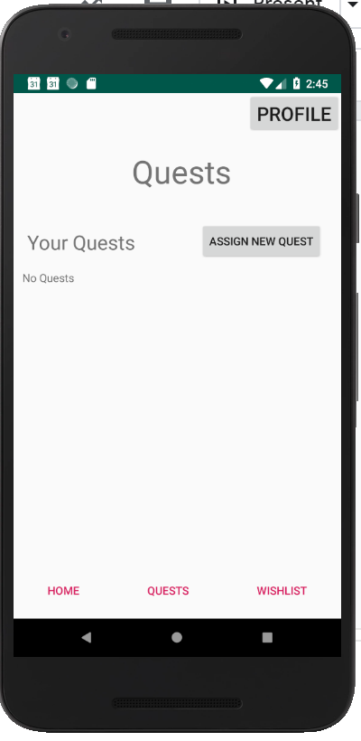
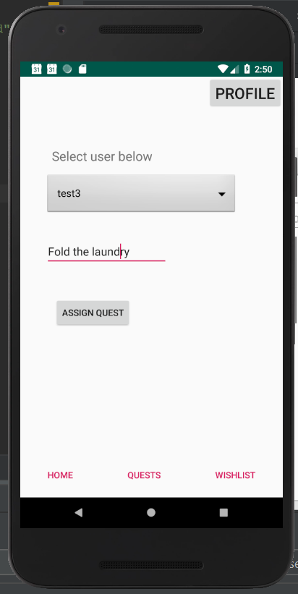
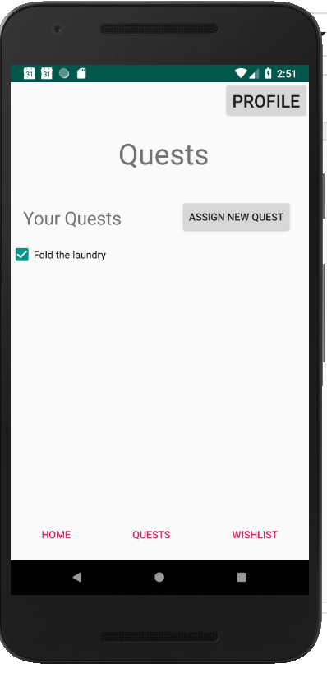
Quest Assignment

Slide 9
Not included in client’s requirements
(Long-term development moving forward)
Transactions, extended functions
UI/UX (artwork, layout, color, consistency, etc.)
Legal review for minors
User testing
Security review
Submission to Google Play Store

Slide 10
Review of semester & challenges
2 person team
  Limited time to finish all deliverables
  Increased complexity of Android development
API Key
  Received late in semester
Project scale
  Year+ project , multiple parts
  Development occurred alongside planning
  Features needed to be realistically scaled back

Slide 11
Acknowledgements
Clients / Co-workers:
Project Management- Loran Hauserman
Behavioral Science Expert - Josh Hauserman
*App does not generate game keys; codes are purchased from distributor on behalf of the user and sent.
Notes:
Lawrence

