Slide 1
Analyzing and Visualizing Disaster Phases from Social Media Streams
Group VizDisasters:
Liangzhe Chen, Xaio Lin, Andrew Wood
Client: Seungwon Yang
Information Storage & Retrieval
Final Presentation
12/4/2012
Virginia Tech

Slide 2
Motivation
CTRnet: archiving disaster-related online data in collaboration with the Internet Archive
Tweets during disasters: quick alternative to cell phones
  Large dataset to pull from for researchers & responders

Slide 3
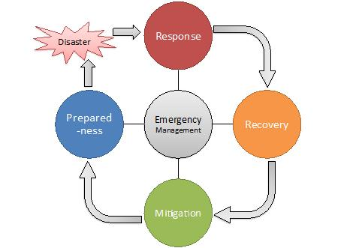
Four Phases of Emergency Management
Four phases:
  Response
  Recovery
  Mitigation
  Preparedness
Professional and personal activities

Slide 4
Four Phases in Tweets
Reporting situation / sharing information
  Majority
  For hurricane: rain, flood, wind, cloud, weather forecast
  Photographs (Instagram)
Reporting personal activities
  Very few

Slide 5
Four Phases in Tweets
Reporting professional activities
Response | More than 4,700 people in as many as 80 shelters in 7 states overnight; more than 3,000 #RedCross workers (37 from KC region) at #Isaac
Recovery | FEMA announces that federal aid has been made available for the state of Louisiana. #Isaac
Mitigation | FEMA mitigations advisers to offer rebuilding tips in St. Bernard and Ascension Parishes. http://t.co/ZziRGOGw #Isaac
Preparedness | Very cool app! MT @redcross: Our hurricane app has info on #RedCross shelters, a toolkit w flashlight, alarm http://t.co/E7o1rtJK #Isaac

Slide 6
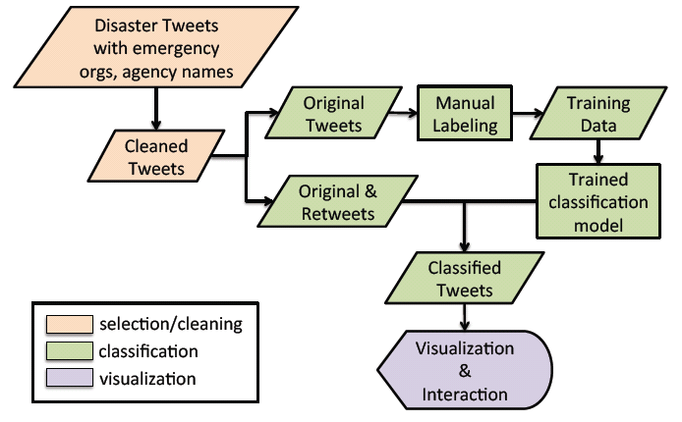
Our Approach

Slide 7
Our Approach
Machine learning
  Extract professional activities
  Classify professional activities into four phases
Visualization
  Phase view, tweet view, social network view, map view
Use case / Demo

Slide 8
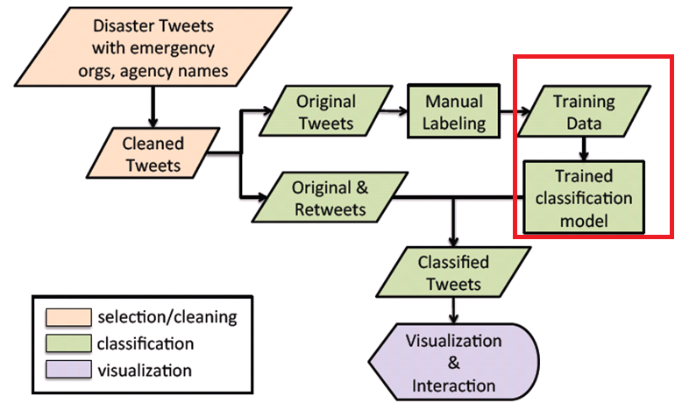
Learning Professional Activities in Four Phases

Slide 9
Learning Professional Activities in Four Phases
Preprocessing
Building dataset
Vectorization
Classification
Algorithms
Evaluation

Slide 10
Building dataset
Focus on tweets about professional activities
Based on keywords of known organizations
  FEMA
  Red Cross (RedCross)
  Salvation Army (SalvationArmy)

Slide 11

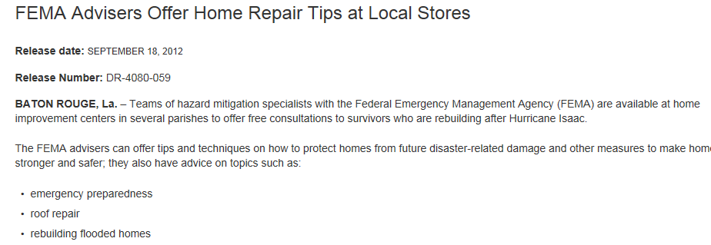
Building dataset
Combining tweet and resource title
Mitigation specialists are offering free rebuilding tips in five parishes. http://t.co/hwXajm6X #Isaac

Slide 12
Building dataset
Overview of Issac dataset
  About 56,000 English tweets during hurricane Issac
  5,677 tweets with reference to FEMA, Red Cross or Salvation Army
  1,453 without re-tweets
  1,121 manually labeled explicitly with one of the four phases, response, recovery, mitigation or preparedness

Slide 13
Vectorization
tf transform
idf transform
Normalization
Stemming (Porter stemmer)

Slide 14
Algorithms
Naïve Bayes
Naïve Bayes Multinomial
Random Forest
SVM Multiclass

Slide 15
Evaluation
Tuned classifier, 10 fold cross-validation
 | Accuracy | Weighted F Measure
Naïve Bayes | 70.47% | 0.723
Naïve Bayes Multinomial | 77.87% | 0.782
Random Forest | 76.27% | 0.754
SVM Multiclass | 80.82% | Reported slightly lower than naïve bayes multinomial

Slide 16
Evaluation
Preprocessing v.s. Accuracy
TF | IDF | Normalization | Naïve Bayes Multinomial | SVM Multiclass
 |  |  | 76% | 80.1%
 |  | X | 77% | 80.4%
 | X |  | 60% | 78.8%
 | X | X |  | 78.1%
X |  |  | 75% | 80.4%
X |  | X | 78% | 80.8%
X | X |  | 63% | 78.9%
X | X | X |  | 79.0%

Slide 17
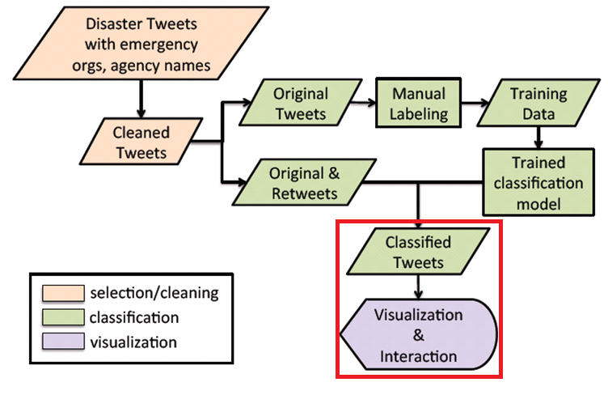
Visualizing Four Phases

Slide 18
Visualizing Four Phases
Phase view
  ThemeRiver, D3 library
Tweet view
  JqGrid Library
Social Network View
  Gephi
Map View
  Google Geocoding API

Slide 19
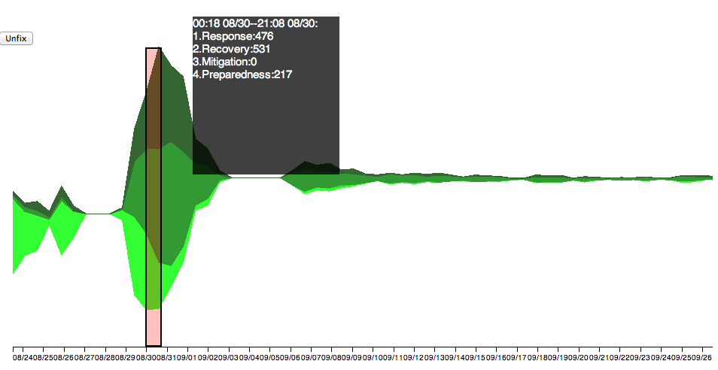
Phase view

Slide 20
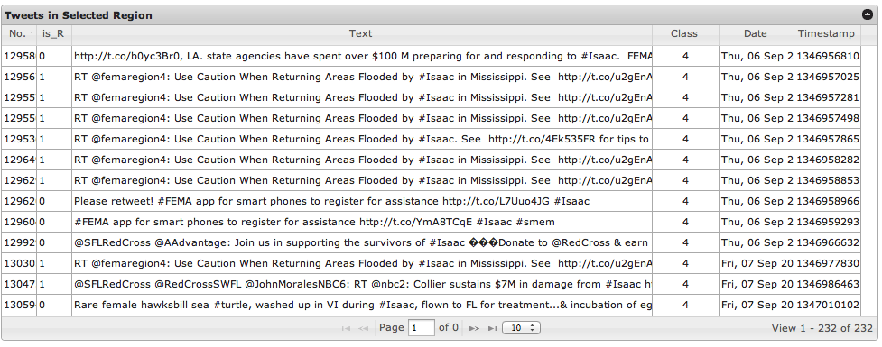
Tweet view

Slide 21
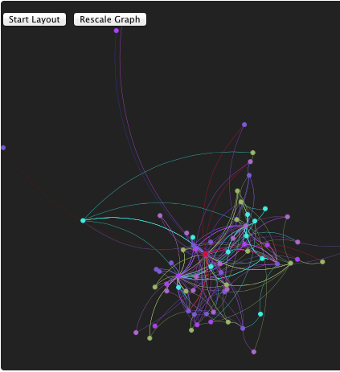
Social Network View

Slide 22
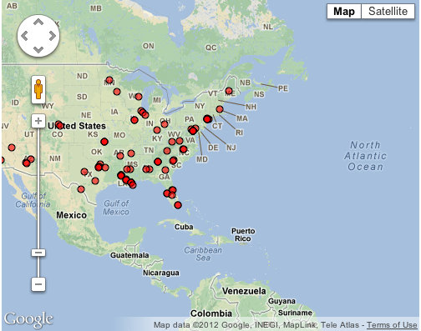
Map view

Slide 23
Use Case & Demo
http://spare05.dlib.vt.edu/~ctrvis/phasevis/

Slide 24
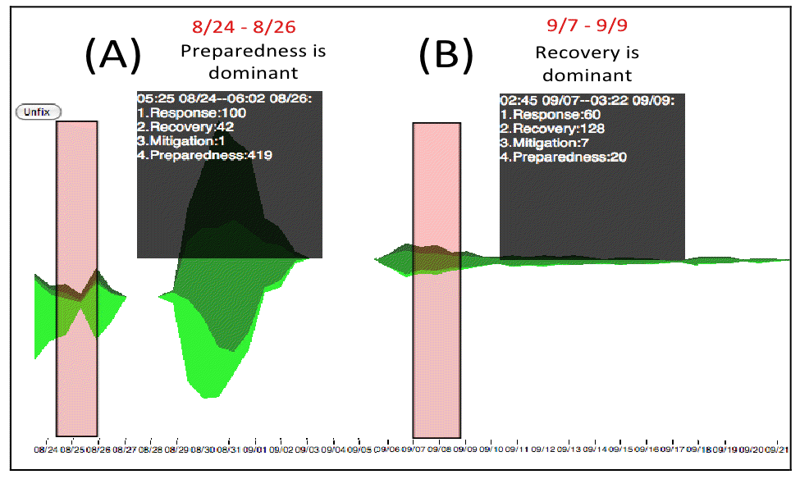
Use Case

Slide 25
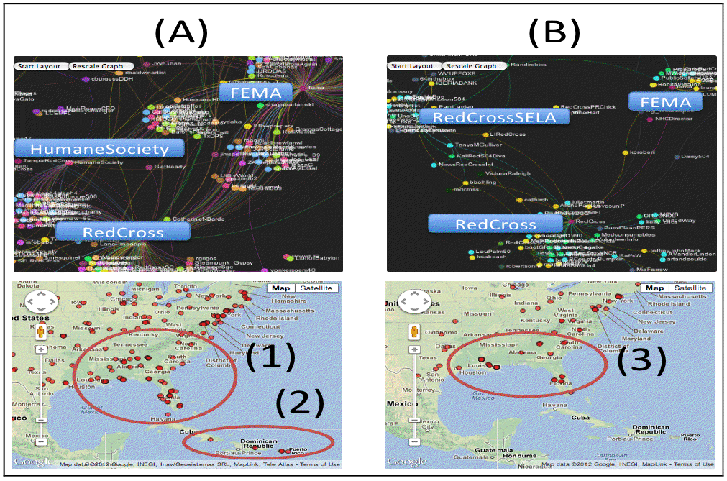
Use Case

Slide 26
Summary and Future Work
Summary:
  Analysis/classification of disaster tweets into phases
  Multi-view visualization
Future challenges:
  Automated professional organization extraction
  Processing of personal tweets
  Application to other disasters

Slide 27
Acknowledgements
Haeyong Chung
Sunshin Lee

