Slide 1
Contemplative Practices
Amanda Thompson, Andrew Katz, Brandon Nalls, Dave Kindel, Ryan Anderson
CS4624
Blacksburg, VT
3/3/2014
Client: Dr. Douglas Lindner

Slide 2
Background
What are contemplative practices?
Why do we need them?

Slide 3
Goals
Promote Contemplative Practices at VT
Website
Composite video
  10 Minute Video + Shorter Version (1-5 minutes)
  Advertising

Slide 4
Timeline
Feb. 15: Website features/layout; goals for website laid out
Feb. 28: Mockup website; Scan through hdd's
Mar. 15: Design on website; Preliminary list of content to be included
Mar. 30: Website initially filled in with design. Some photos up. Working blog. Working news.
Apr. 15: Website essentially done (only minor changes left). Working gallery. Able to embed video. Preliminary.
Apr. 30: Website Complete, filled in with content and photos. Video embedded + working. Video complete.

Slide 5
Work completed
Contacts within Contemplative Practices
Wireframing
Raw video analysis

Slide 6
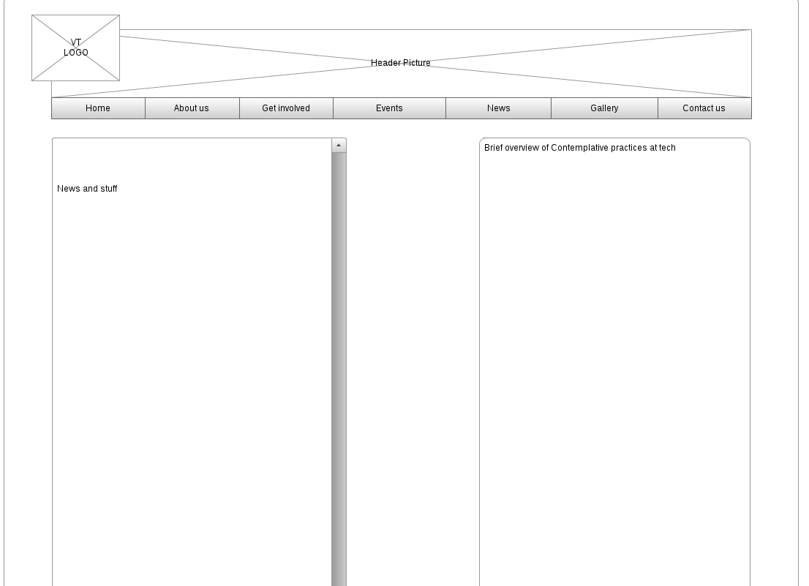
Home Page

Slide 7
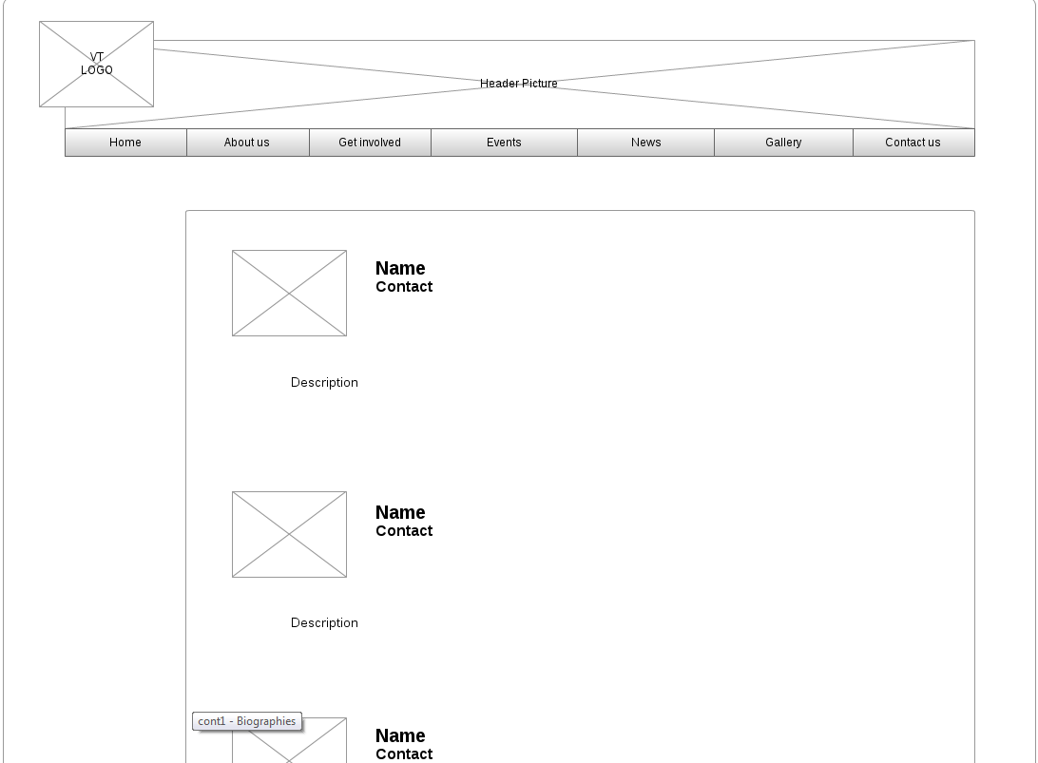
Biographies

Slide 8
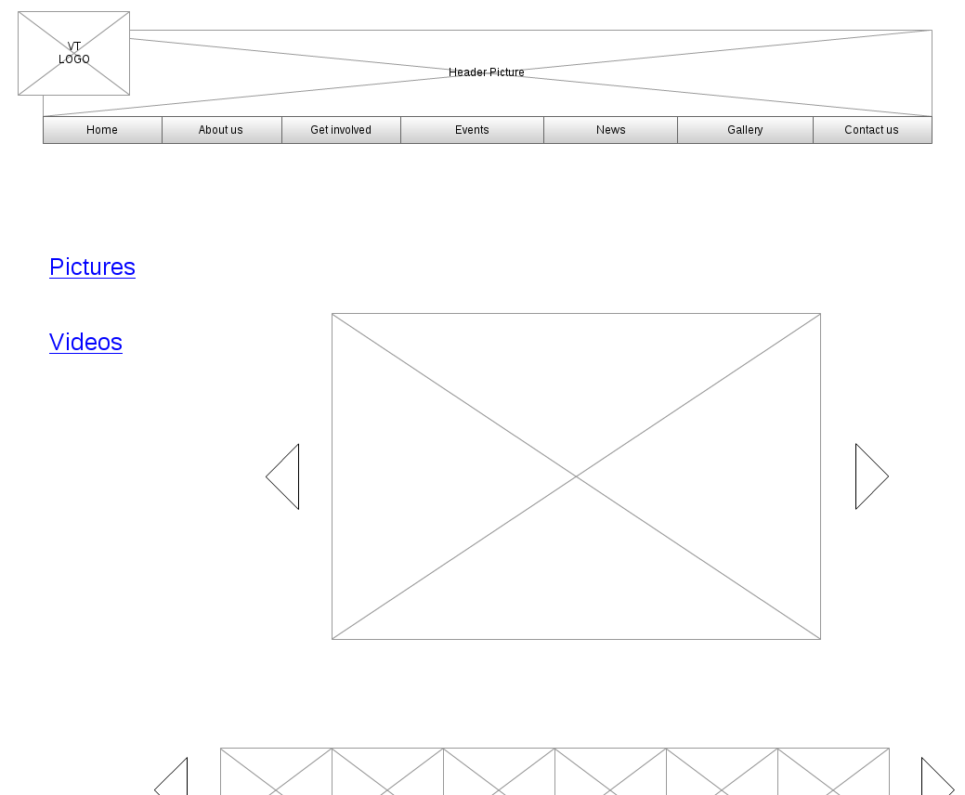
Gallery

Slide 9
Work to be done
Implement Website Design
Content - work with contacts
Edit video
Artwork

Slide 10
Questions?

