Slide 1
Horse Selection

Slide 2
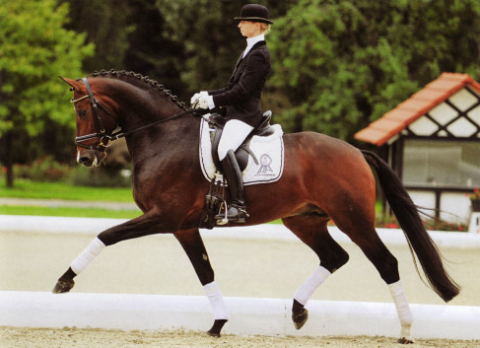
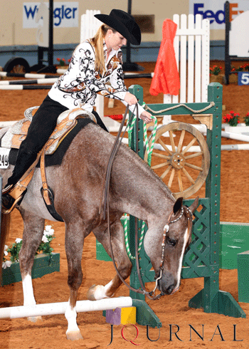
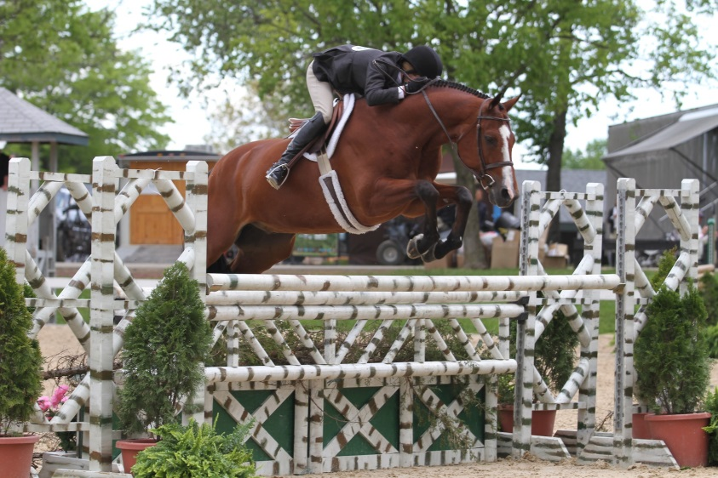
Purpose of Horse Judging
When choosing a horse…
Discipline/Type of Riding
Type
Conformation (Balance/Structure)
Age/Experience/Temperament
Color/Height/Sex

Slide 3
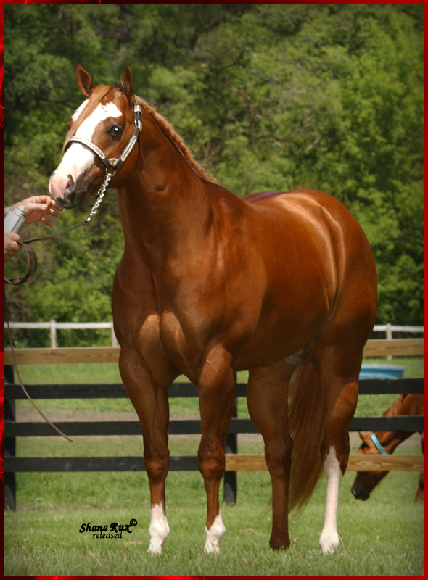
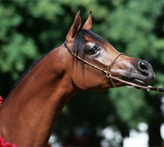
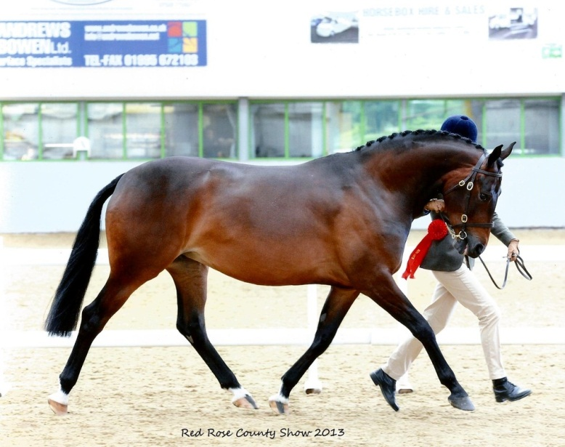
3 Types
Stock
Hunter
Breed

Slide 4
Stock Type
AQHA,APHA,ApHC
Ranch/Pleasure/All Around/Hunter
Emphasis on balance and muscle
4 Criteria (IN ORDER!)
Balance
Structure
Muscling
Breed/Sex Characteristics

Slide 5
Balance
MOST important!
ALL parts of the horse must be equal
Balance is from end to end
Equal head/neck
Equal Middle
Equal Hip

Slide 6
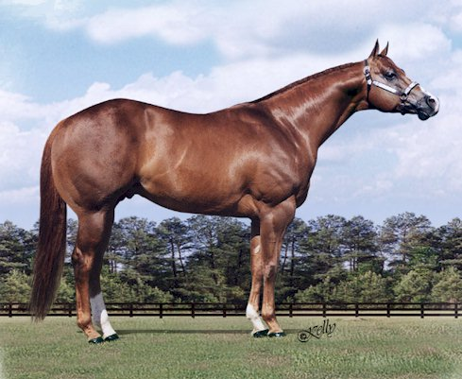
This horse is very equal or balanced from end to end

Slide 7
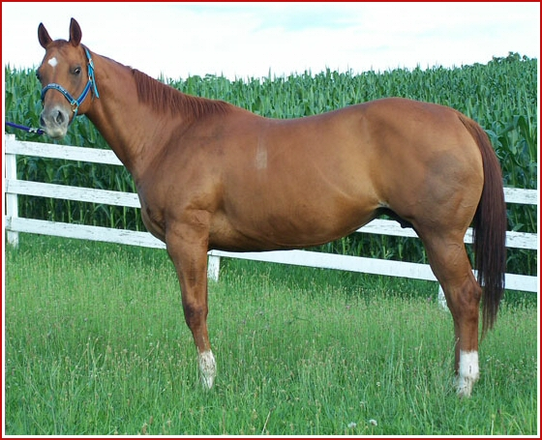
This horse is not balanced. He is long in the neck and back and short in the hip

Slide 8
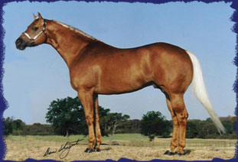

Slide 9
Balance
When also determining balance, you will also need to look at the hip and shoulder angle
The longer and more laid back a shoulder is the further the horse can reach from it
The hip and shoulder should match
The horse should make a trapezoid shape
Short on top
Long and Sloped in the Hip and Shoulder
Long Underneath

Slide 11
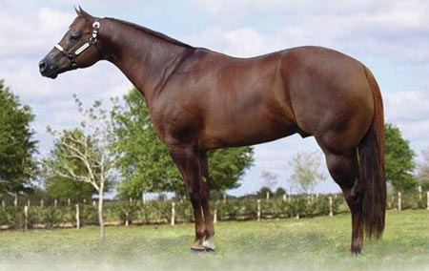

Slide 12
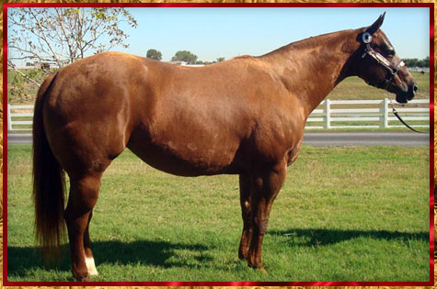

Slide 13
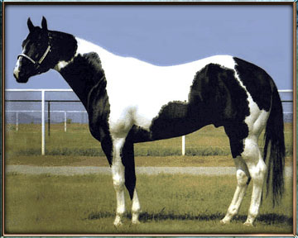

Slide 14
Structure
The horse MUST be structurally correct
NO crooked legs!

Slide 15
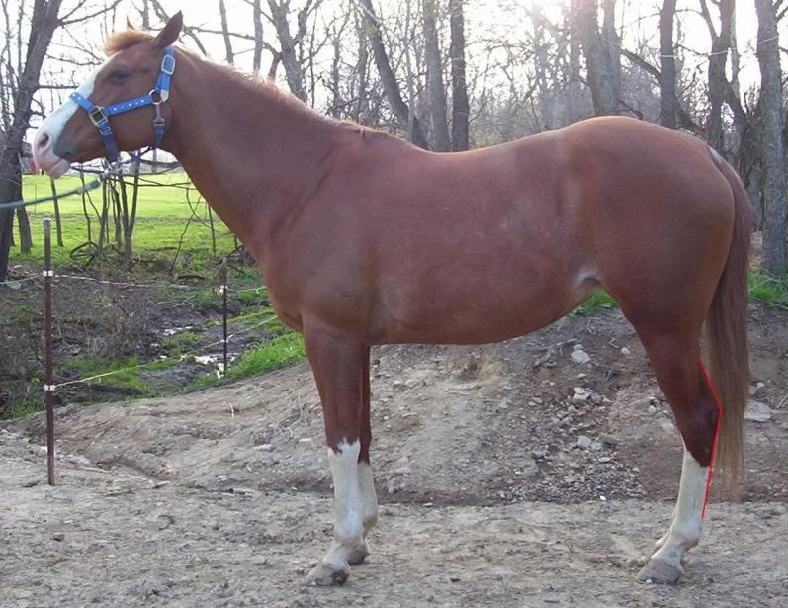

Slide 16
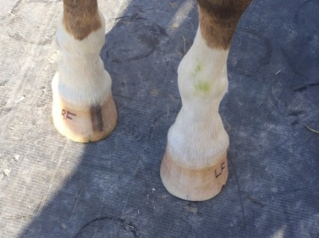

Slide 17
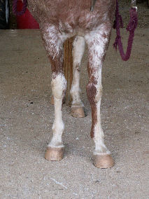

Slide 18
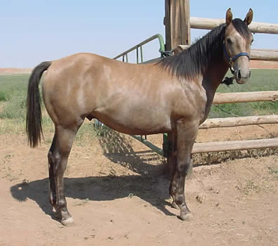

Slide 19
Muscling
Good amount overall
Not heavier on the front or hind
Muscle ties in long and low
Equal in front and back

Slide 20
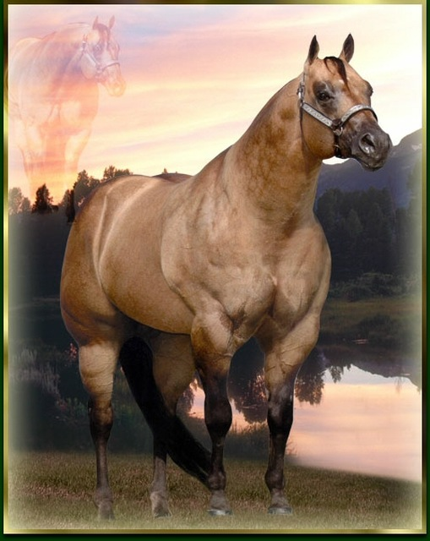

Slide 21
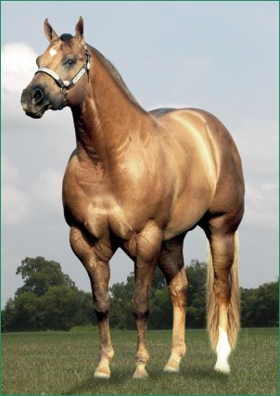

Slide 22
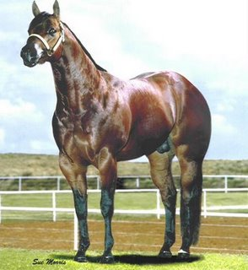

Slide 23
Breed/Sex Characteristics
Mares look like mares!
Stallions look like stallions!

Slide 24
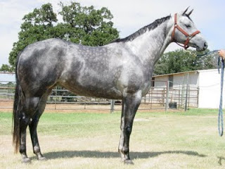

Slide 25
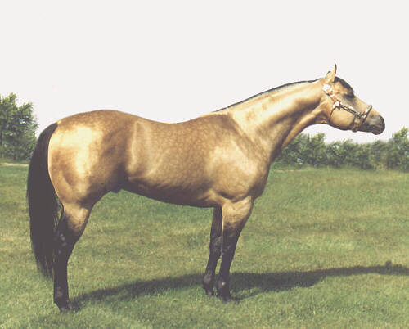

Slide 26
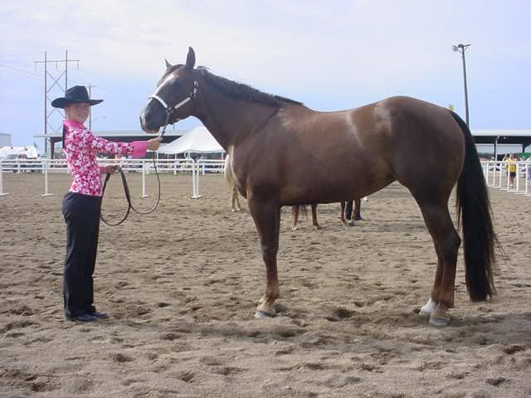

Slide 27
Tracking
True Tracking
Look for faults
Wing in
Wing out
Wire walking

Slide 28
Hunter Type
Same criteria
Balance
Structure
Muscling
Breed/Sex charateristics
MUCH less emphasis on muscling
Very flat
Want to be balanced and look like it can jump a course of jumps

Slide 29
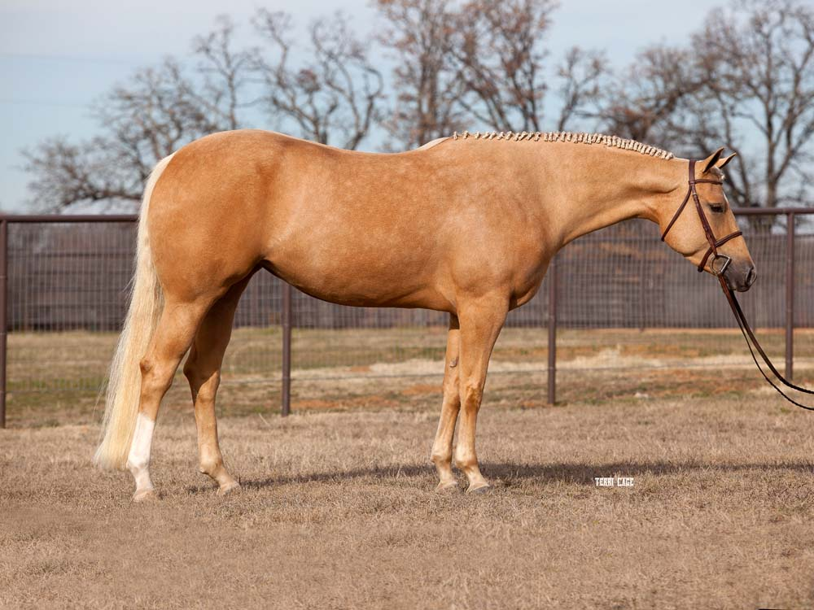

Slide 30
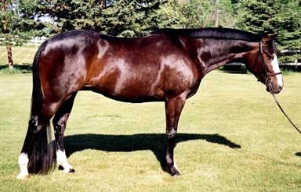

Slide 31
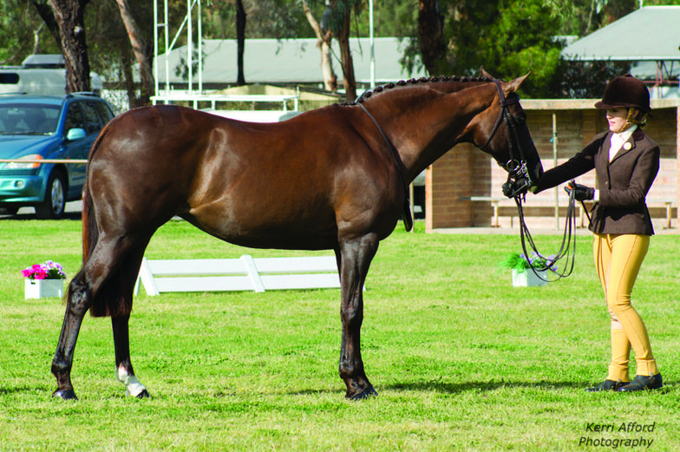

Slide 32
Breed Specific
Arabian
Morgan

Slide 33
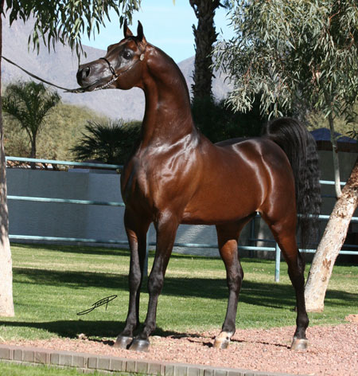
Arabians
Head
Important
Clean, sculpted, dished
Big eyes
Neck
Long, arched
Set high
Clean
Tail Carriage
High
Back
Short
Croup comparatively horizontal (not level)

Slide 34
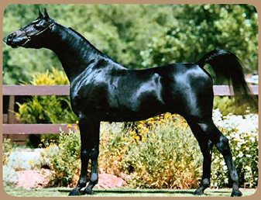

Slide 35
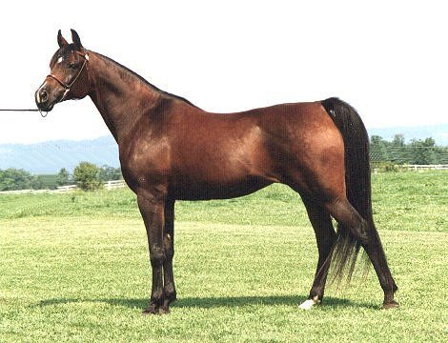

Slide 36
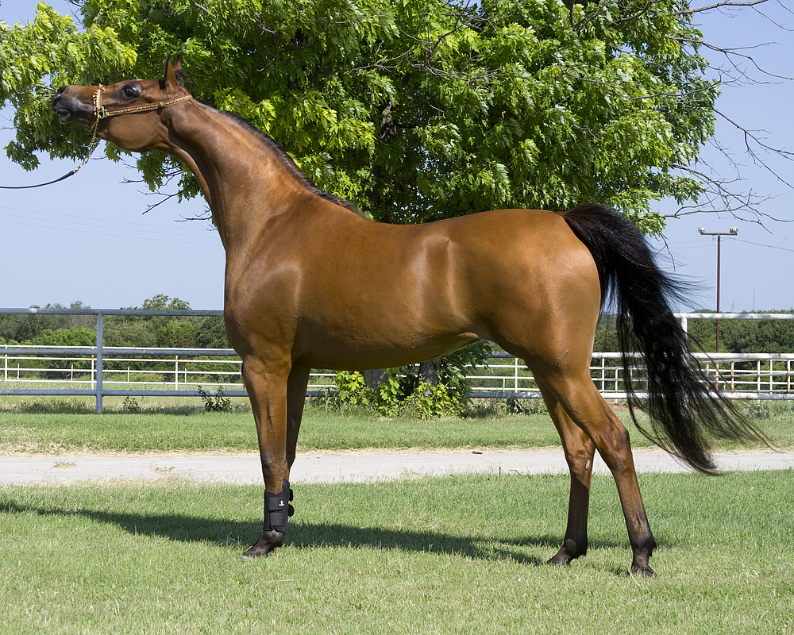

Slide 37
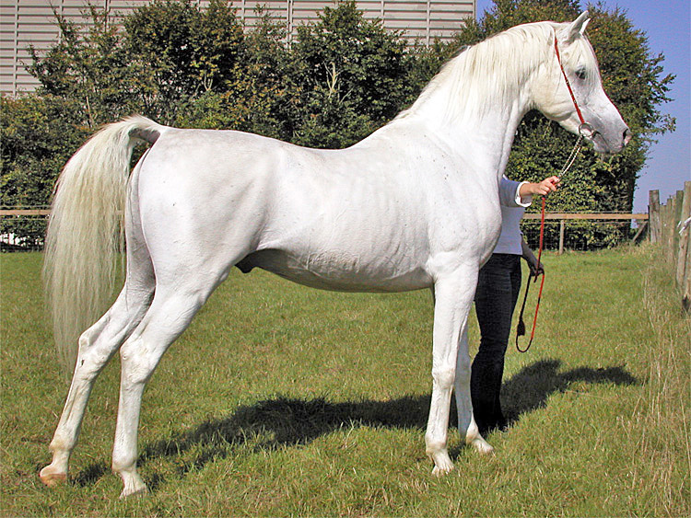

Slide 38
Morgan
Morgan Type
Gender Characteristics
Quality
Head and Neck
Large eyes
Broad forehead
Small muzzle
Neck set high, with substance but not thick/coarse
Upright shoulder is a MAJOR fault
Body Character
Deep chest
Long croup with little slope
Tail set high

Slide 39
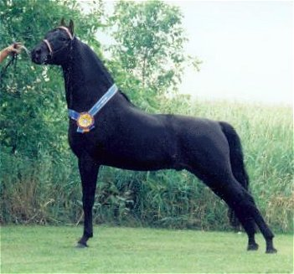

Slide 40
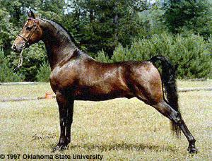

Slide 41
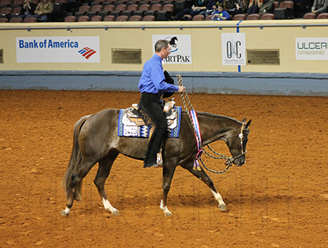
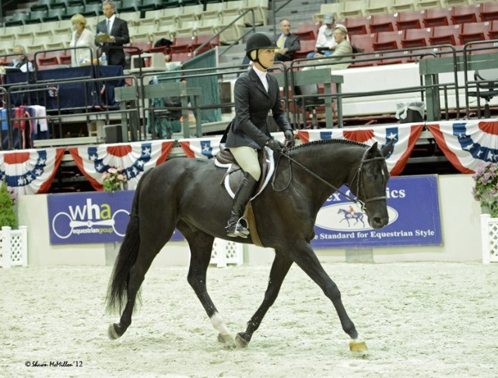
Movement
Look for faults
Look for how the horse is cued, reacts to the cues
Look for easy movement
Dependent on what you are looking for in a horse

Slide 42
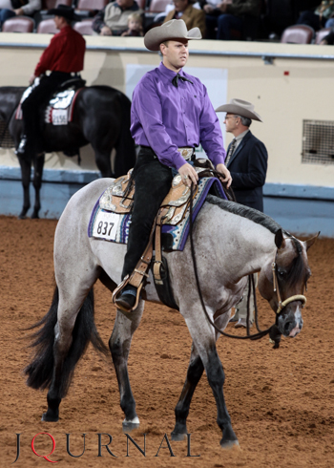
Western/All Around
Soft, flat movement
Slow strided, but big strided
True Gaits
https://www.youtube.com/watch?v=_yP1egescmw

Slide 43
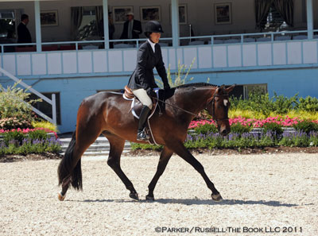
Hunter
Soft/Flat movement
Floaty
Big Strided but not too fast
Calm and cool over fences
Square knees
https://www.youtube.com/watch?v=Zpv7PSKVzHo

Slide 44
Good Resources
Breed Organizations
Current Owners/Trainers
Shows
Judges

