Slide 1
Library Tweet Support
Daniel Imondo
CS4624 – Multimedia, Hypertext, and Information Access
Dr. Fox
Virginia Tech, Blacksburg VA 24061
4/26/2021

Slide 2
Outline
Project Description
Demo
Future Work
Acknowledgements
References

Slide 3
Refresher
Last Fall, CS5604 built a system to manage 3 collections
  Tweets
  Webpages
  Electronic theses and dissertations

Slide 4


Project Description
Expand the searching features of the tweets side of this site
Format the search results to more effectively display tweet information.
I was able to complete these revised goals!

Slide 5



The Stack.
System is mainly built using:
  Docker containers
  Kubernetes
  ElasticSearch
  React.
  Flask (!Python 3.6!)
  CSS

Slide 6
Docker and Flask
Docker is heavily used on the authentication and administration portion of the site which I did not work on
Flask is used to serve and route the dynamic pages created with React components

Slide 7
ElasticSearch and React.
ElasticSearch is used to query the indexed MySQL database using the ElasticSearch React API.
List created by this query is returned and formatted using plain CSS with Flexbox.
Previously the project used bootstrap formatting.
I felt custom CSS could help refine the visual.

Slide 8
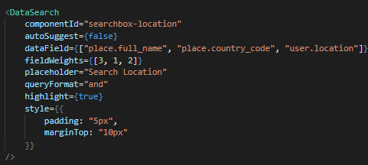
Example of an ElasticSearch Searchbox I used

Slide 9


Demo
IMPORTANT NOTE:
I had no part in creating the sample data used. And some of the tweets seem to be a bit insensitive (as is the nature of Twitter).
Some of the data is corrupted; data seems to have been imported from Instagram, or with other languages.

Slide 10
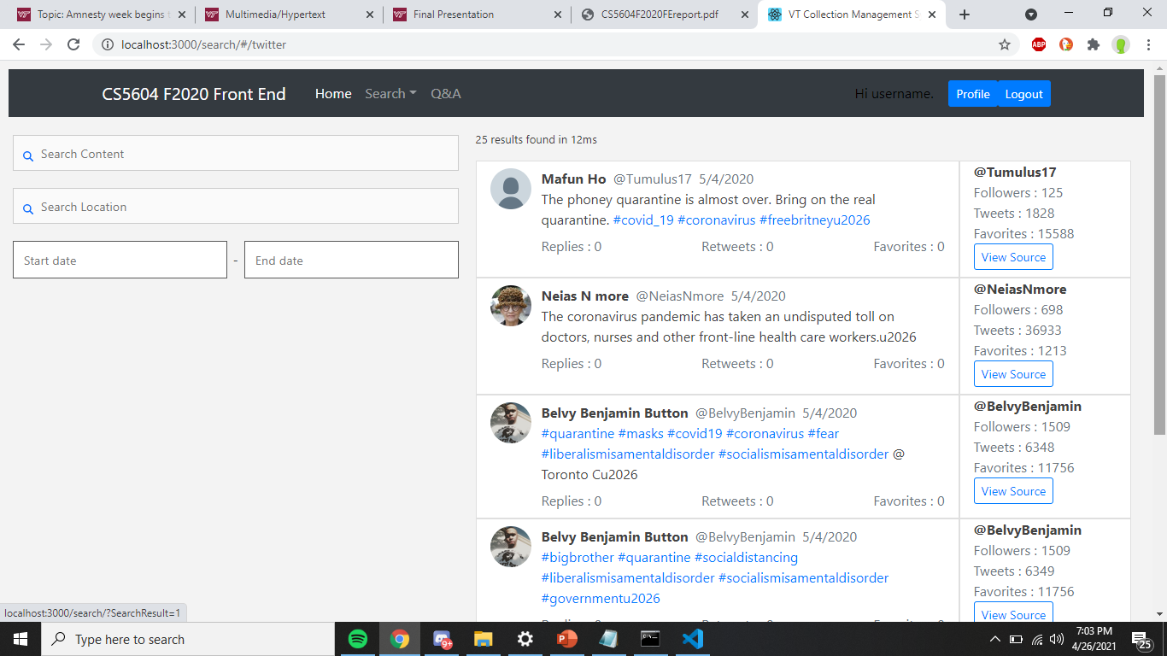

Slide 11
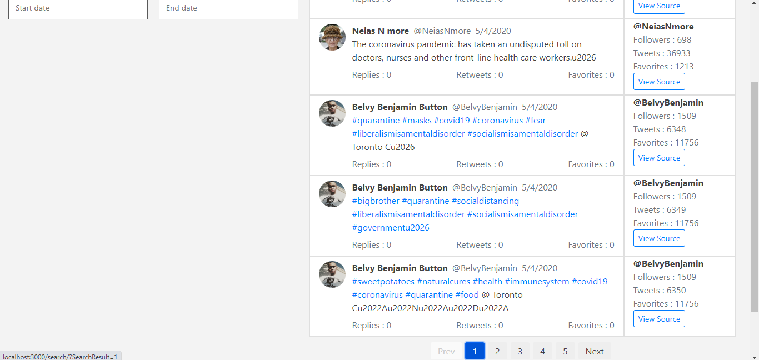

Slide 12
Anatomy of a Search Result:
Profile Picture
User Information
Link to Original Tweet
Main tweet data

Slide 13
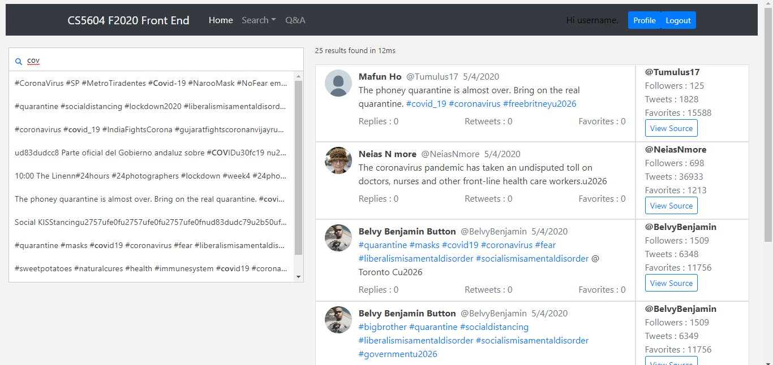

Slide 14
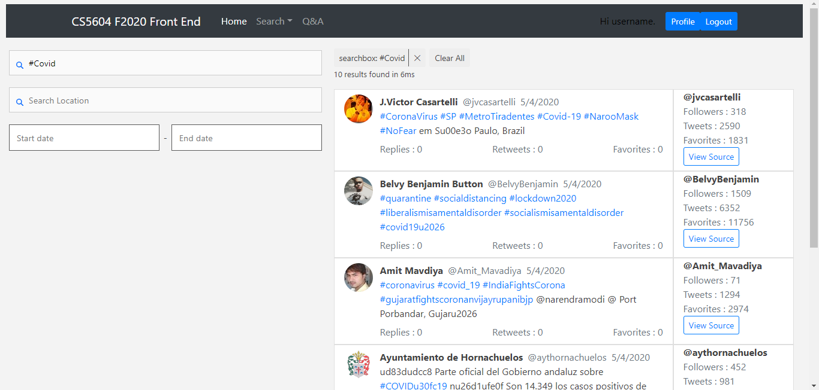
Search Terms

Slide 15
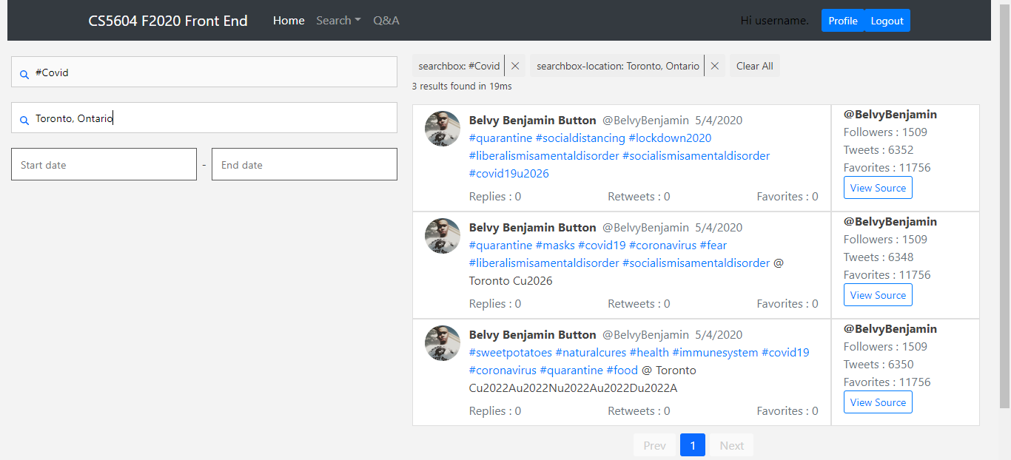
Multiple Search Terms

Slide 16
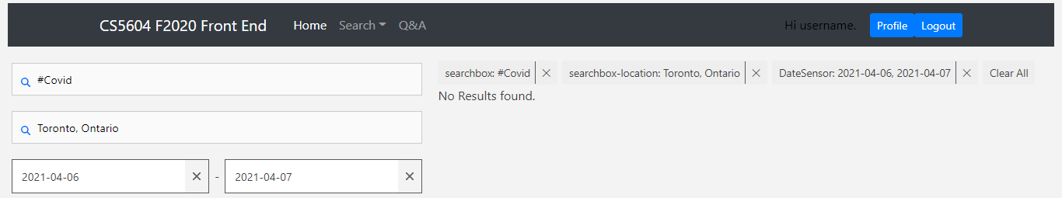
All Search Terms, no Results

Slide 17
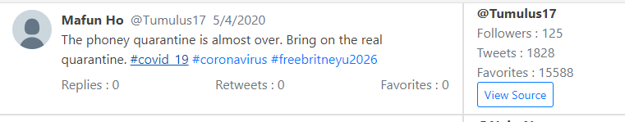
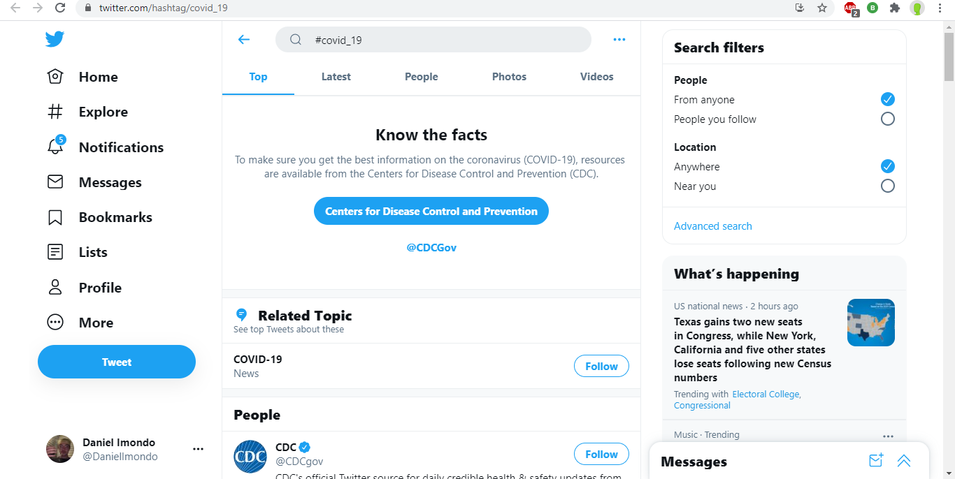
When you click a hashtag

Slide 18
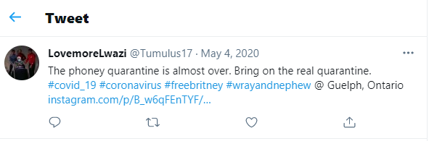
When you click “View Source”

Slide 19
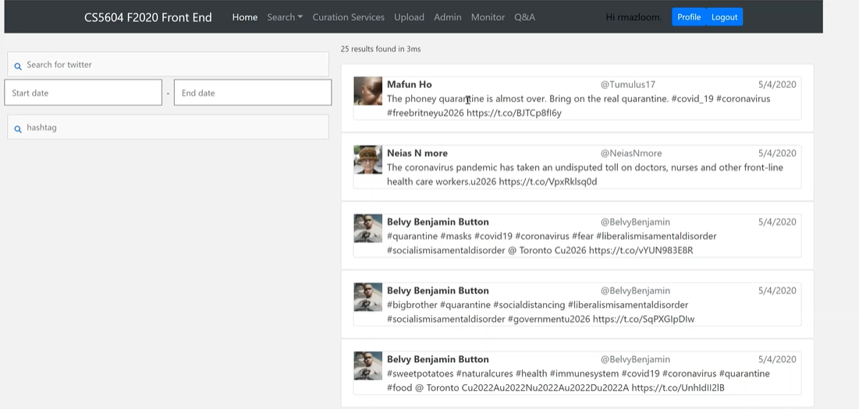
What did it look like before?

Slide 20

Future Work
I will be working on documentation of this project that will be a part of my final report.
Indexing and importing the large collection of tweets that the library has will be by them.

Slide 21
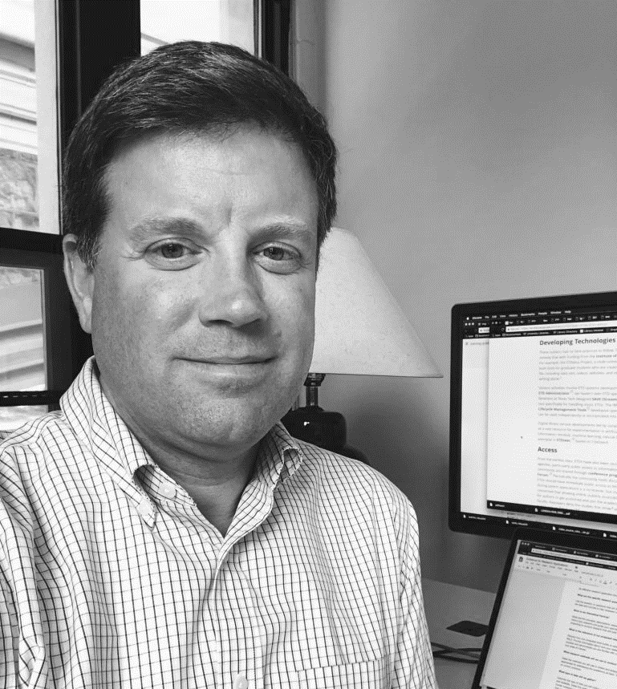
Acknowledgements
Client: Bill Ingram, Assistant Dean & IT Director, University Libraries, waingram@vt.edu
Additionally: Thank you to the previous frontend team for creating stepping stones for me to walk on!

Slide 22
References
CS 5604 2020: Information Storage and Retrieval TWT - Tweet Collection Management Team: https://vtechworks.lib.vt.edu/handle/10919/101520
CS5604 (Information Retrieval) Fall 2020 Front-end (FE) Team Project https://vtechworks.lib.vt.edu/handle/10919/101526
Social Feed Manager https://library.gwu.edu/scholarly-technology-group/social-feed-manager

Slide 23

Any Questions?

