Slide 1
Object Detection and Topic Modeling
CS 5604
Dr. Edward Fox
Virginia Tech, Blacksburg VA 24061
Dec. 1, 2022
CS5604 Team 3
Nila Masrourisaadat, Raj Sahu, Alan Devera, Nirmal Amirthalingam, Chenyu Mao

Slide 2
Overview
5 teams were tasked to build an information storage and retrieval system from scratch to make Electronic Theses and Dissertations (ETDs) more accessible to the researchers, experimenters, and curators.
Our team (Team 3) was tasked with detecting objects (Object Detection) within ETDs as well as determining topics (Topic Modeling) to store in a repository (Team 1) for better search and recommendation of ETDs (Team 2).

Slide 3
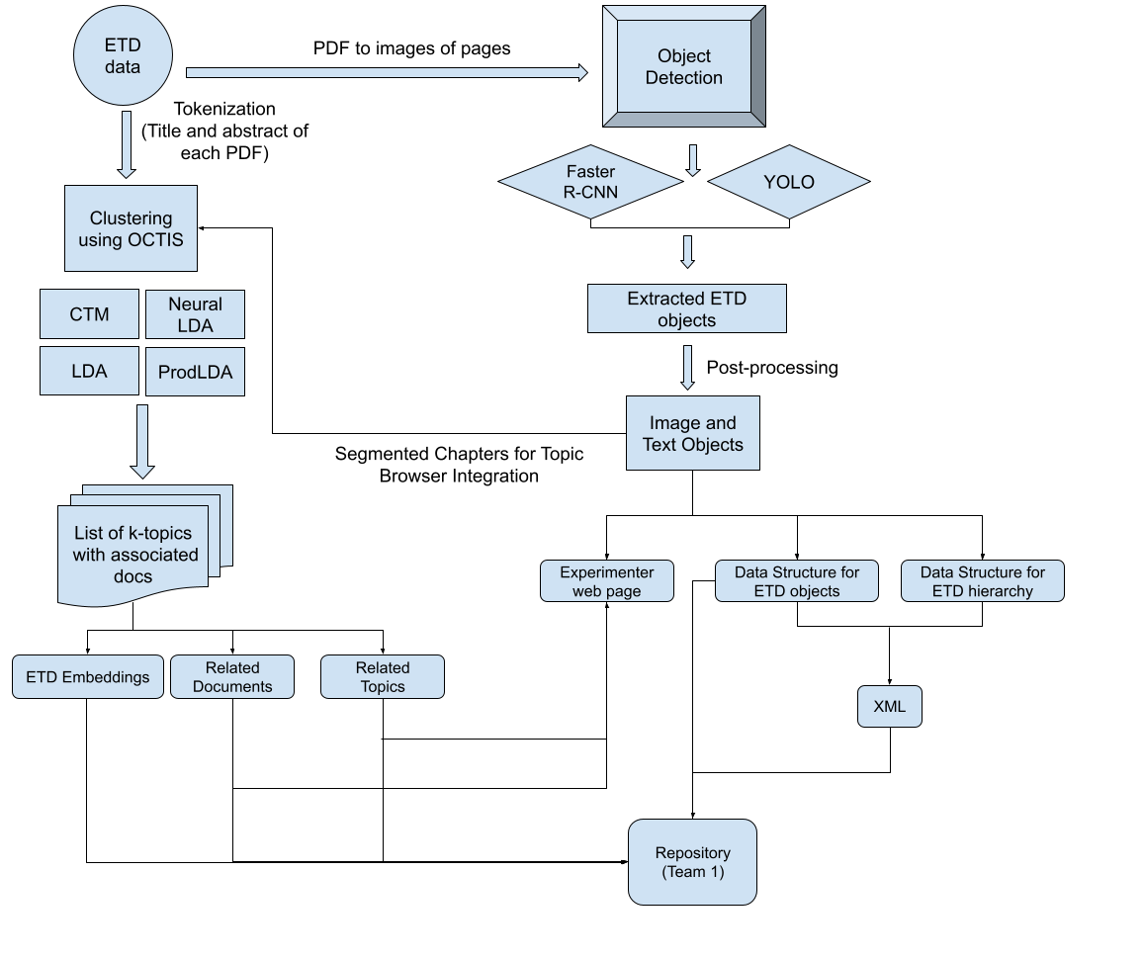
Overall Pipeline

Slide 4
Object Detection
Object Detection overview
ETD filtering rules
Issues and challenges faced
Services
5k ETDs
Demo
Future work

Slide 5
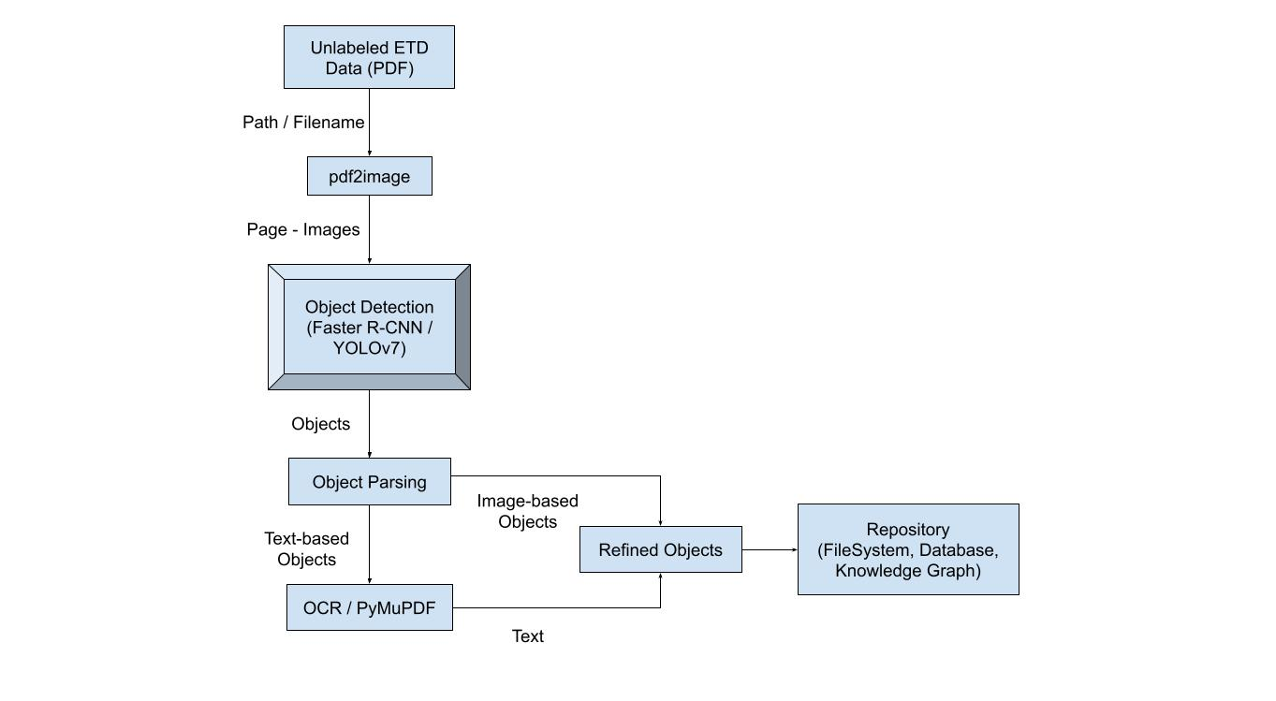
Object Detection Pipeline

Slide 6
Tools Used
Pdf2image
PyMuPdf
YOLOv7
Detectron2 (Faster R-CNN)
Flask
Docker
VT CS Cloud

Slide 7
YOLOv7 & Detectron (Faster R-CNN)
YOLOv7:
A real-time object detector that has greatly advanced the CV & ML world
Fastest, and most accurate object detector to date
Uses CNN to predict bounding boxes and class probabilities considering the entire image at one step
Detectron2 :
A framework for object detection built on top of PyTorch
Has support for object detection, activity recognition, semantic/instance segmentation
Trains an object detection model on custom datasets using pre-trained weights
All models in Detectron2 are pre-trained on the COCO dataset
***For our experiments, we would be using faster R-CNN models present in Detectron2

Slide 8
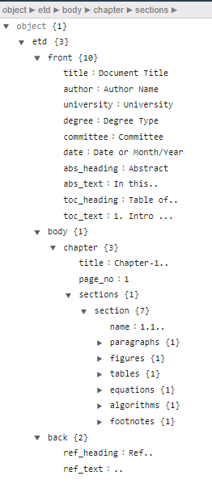
XML Schema
Each PDF has its ETD ID as the root element
3 sub-elements - front, body, and back
Image-based objects
  Figures
  Tables
  Equations
  Algorithms
Image-based objects have captions / numbers associated with them
The rest are text-based objects
Notes:
top-bottom order for pages which is required to create the XML tree

Slide 9
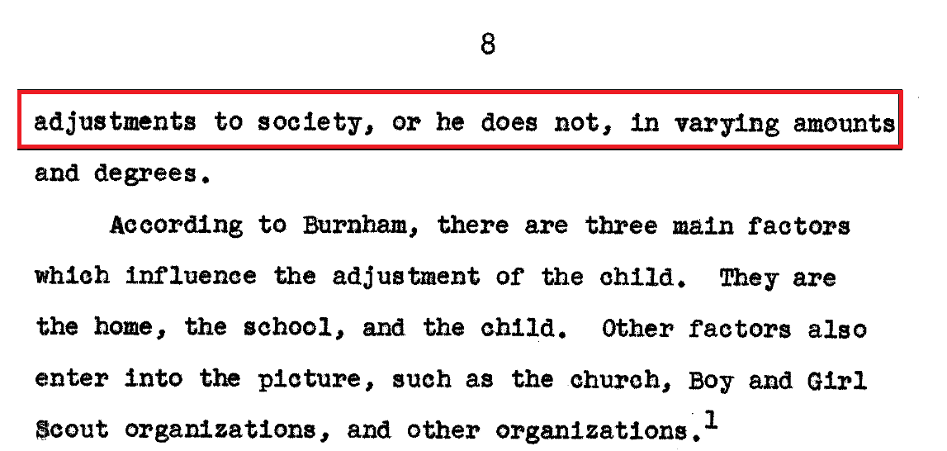
False positives
Problem:
Last line of the paragraph in the previous page is detected as a chapter title
Solution:
Checked the first letter of the title (capital)
Avoided the text overflow for consecutive pages by checking the punctuation
Check if it is a subset of table of contents

Slide 10
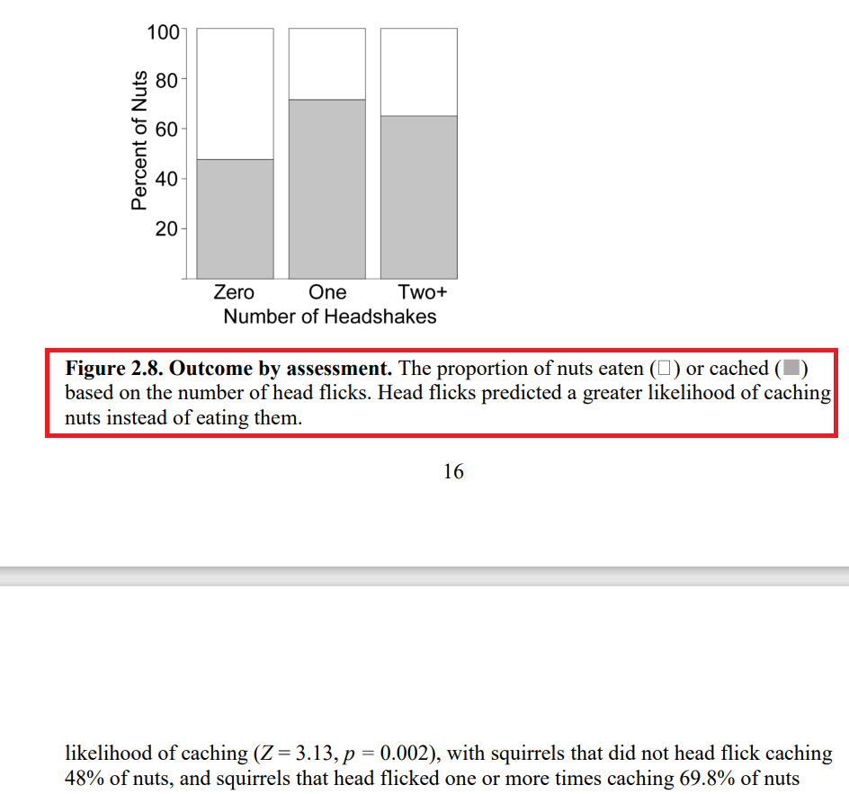
False positives
Problem:
Image-based objects (figures, tables) and their corresponding captions might not be on the same page
Solution:
Determined the relationship between figure/table and their corresponding caption
Paired images with their corresponding captions according to them being on top or bottom of images

Slide 11
False positives
Problem:
Chapter titles appear on multiple pages for the same chapter in some cases
Solution:
Checked if two consequent chapter titles are the same

Slide 12
ETD Filtering Rules
Post-processing rules are as follows:
Linked image object with the previous caption object in the list
  Determined the relationship between figure/table and their corresponding caption
  Paired images with their corresponding captions according to them being on top or bottom of images
  Checked the orientation of the pages in case of being horizontal and changed to vertical
Filtered chapters/sections titles
  Checked the first letter of the title (capital)
  Checked if the y-coordinate of the bounding box is within half of the page’s height
  Avoided the text overflow for consecutive pages by checking the punctuation
  Checked if two consequent chapter titles are the same
  Created null section tag in case of titles not being detected
Eliminated false positives based on matching with ToC
  Extracted and saved all the detected chapter/section titles, ToC, page numbers
  Filtered out the chapter and section titles that have been incorrectly detected
Refine chapter title detection by removing outliers
  Find if the keyword “chapter” is in the list of all detected chapter titles
  Difference in font size between chapter titles and other objects
  Check the indentation level - left / center alignment

Slide 13
Team 3 Deliverables - Objects
Discussing with the other teams, and assessing the overall requirements of the class, we are providing the following outputs:
Output for a given ETD | Description/Contents
Page images | Each page of ETD is saved as a .jpg file
Detected images | Consists of sub-folders for each image-based object class (figure, table, equation, algorithm) saved as .jpg files
JSON object | Each object - text and image-based, is saved (unordered set as per the detection sequence)
Parsed XML | Detected objects in a tree structure with XML elements set to the clean text for text-based objects, and the image path for image-based objects
Notes:
sending objects sequentially
hierarchy - XML, otherwise just values - JSON metadata

Slide 14
Team 3 - Services
We are providing 3 services that are containerized - to be used for workflow automation and our frontend webpage
Generate page images given an ETD ID
Generate outputs given an ETD ID - using YOLOv7
  Detected images
  JSON objects
  XML
Generate outputs given an ETD ID - using Faster R-CNN (Detectron2)
  Detected images
  JSON objects
  XML
Notes:
Frontend flask app deployed on cloud but not linked with service yet

Slide 15
5k ETDs - Inference and Storing in DB
Currently using the save detected object API (from team 1) to store objects in DB
Finished running on 5000 ETDs
Average inference time ~ 3 minutes (GPU)
Save detected object (POST) API -
https://team-1-flask.discovery.cs.vt.edu/v1/objects/<etd_id>/<type_name>
<etd_id>/page
<etd_id>/text
<etd_id>/image
<etd_id>/xml
Notes:
Workflow automation not set up yet
Single script does everything now
Running it on our container

Slide 16
5k ETDs - Inference and Storing in DB
Type | File | Metadata
page | <page_number>.jpg | -
text | - | {keys = type, text, page_num, bbox}
image | <etd_id>_<class>_<count>.jpg | {keys = type, path, page_num, bbox}
xml | <etd_id>.xml | -
Get objects by ETD ID API
https://team-1-flask.discovery.cs.vt.edu/v1/etds/<etd_id>/objects?type=<type_name>
Notes:
Image - 4 classes (figures, tables, equations, algorithms)
Text - 20 classes

Slide 17
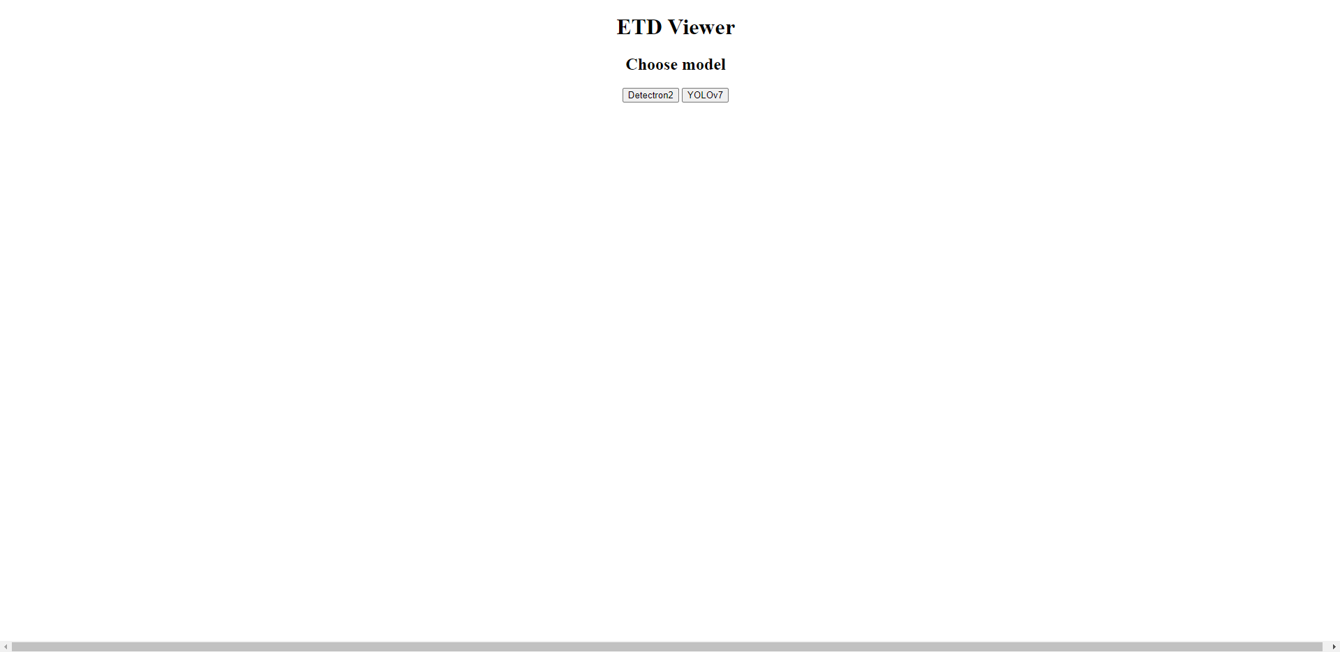
Experimenter UI Choosing a model
2 Models:
YOLOv7
Detectron2 (Faster R-CNN)

Slide 18

Experimenter UI Upload ETD
Experimenter has the option to upload a pdf of the ETD that they want to perform object detection on

Slide 19

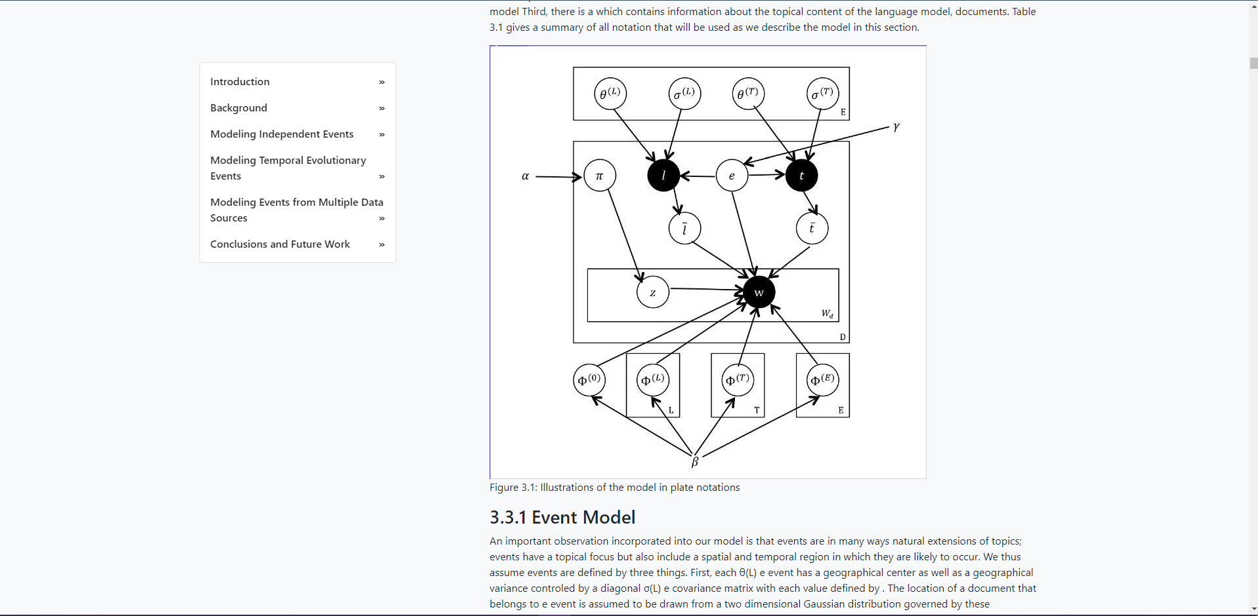
Experimenter UI ETD Browser
Sidebar to navigate to different chapters and sections
Images are linked to their respective captions

Slide 20
See the video demonstration using the file ETDViewerDemo.mp4

Slide 21
Milestones/Timeline
Work done till IR-2
  Implemented basic XML schema for detected objects
  Developed post-processing rules/filters for YOLOv7
  Front-end wireframes for the Experimenter Web Page
Work done for IR-3
  Added support for Faster R-CNN
  Finalized working models and parser logic for YOLOv7 and Faster R-CNN (base models)
  Deployed both models on the cloud server (containerized)
  Team 1 deliverables
  Working prototype of the Experimenter Web Page using Flask that supports both models
Work done in November and December
  Experiment with a bigger subset of the ETD dataset
  Run inference on 5k ETDs using team 1’s API to store into their DB
  Dockerized services for object detection and enabled CI/CD features for the frontend

Slide 22
Future Work - Object Detection
  Integrate Flask app / Experimenter UI with the frontend and workflow services
  Update our pipeline to support “Add an ETD” once team 1 provides the API for saving metadata
  Set up workflow automation - team 5
  Add support for scanned documents - modify existing pipeline
  Add more post processing rules based on the results of the 5k dataset
  Improve UI layout and add more functionality

Slide 23
Topic Modeling
Background
Pipeline
Chapters
Experimenter pages + Demo
Services
Milestones
Wrap-Up Tasks

Slide 24
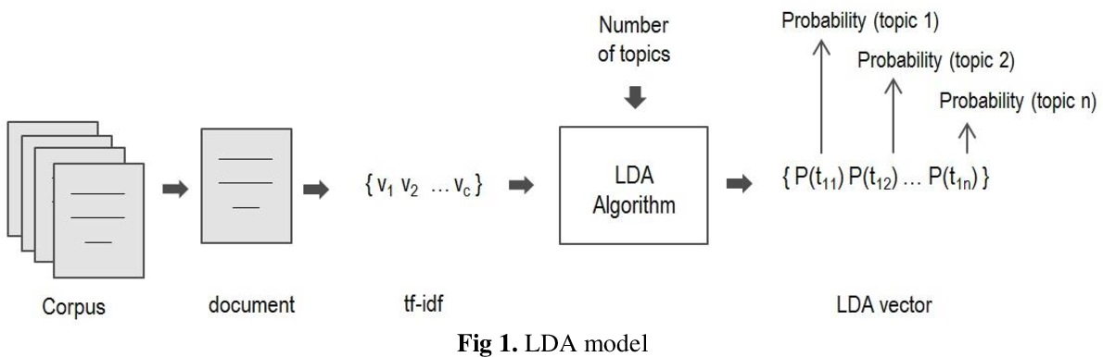
Background - Vector Distance
Input ETD -> Octis -> Vectors
Vectors [ 0.31, 0.47, 0.02, … , 0.21 ]
Shape : (1, 50)
Similarity = Euclidean Distance of two vectors
Diagram reference : “Latent Dirichlet Allocation complement in the vector space model for Multi-Label Text Classification.”

Slide 25
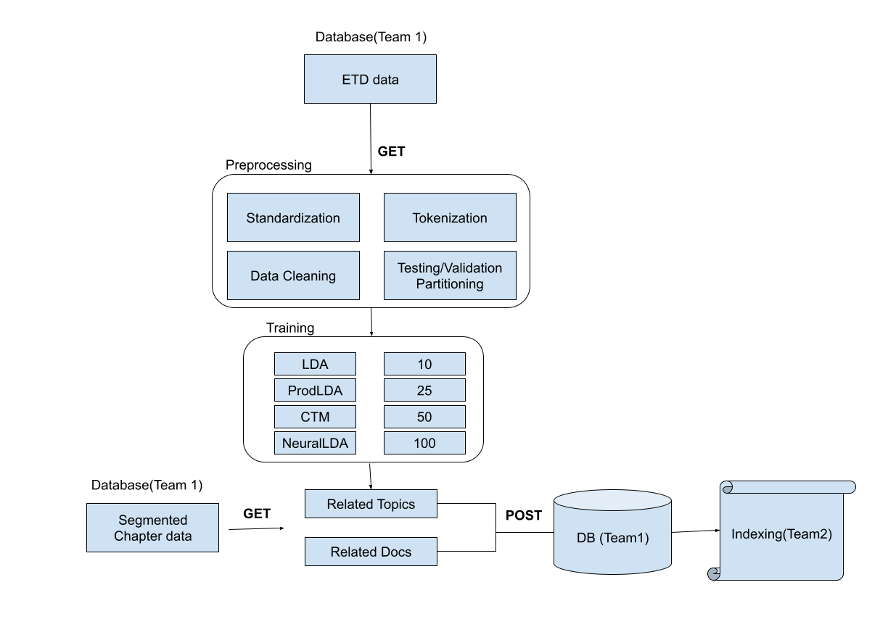
TM - Pipeline
Dataset preprocessing
Topic Model training
Inference Learning
Topic and Documents Visualization

Slide 26
TM - Deliverables
Output | Description
Related Topics & Related Docs | For a given ETD id or Chapter id, find the most similar topics and documents respectively.
Topic Browser (Experimenter) | Allow a user to browse all topics, click on one and read associated documents. ( Documents by Topic - Chapters by Topic )
Notes:
Slight modification
Instead of sending a zip folder, we are now sending objects sequentially, as they are detected
If you want order or hierarchy - XML, otherwise just values - JSON metadata

Slide 27
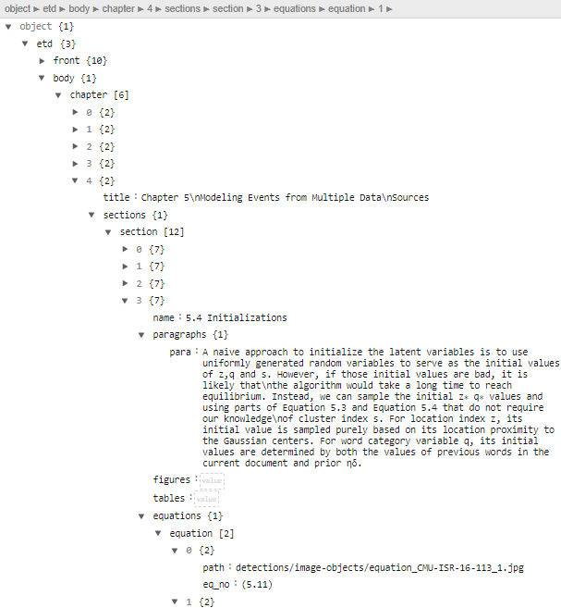
TM - Chapters - Initial Experiment
Extract all <para> tags to form a chapter from an ETD’s XML.

Slide 28
TM - Chapters - Initial Experiment - Dataset
Old Table schema :
id | Title | Abstract | Author | Year | University
1 | ETD Title 1 | ETD Abstract1 | A1,A2 | 1900 | Virginia Tech
2 | ETD Title 2
3 | ETD Title 3

Slide 29
TM - Chapters - Initial Experiment - Dataset
New Table schema :
id | Type | Parent | Title | Abstract | Author | Year | University
1 | ETD | NULL | ETD Title 1 | ETD Abstract 1 | A1,A2 | 1900 | Virginia Tech
2 | ETD | NULL | ETD Title 2
3 | ETD | NULL | ETD Title 3
4 | Chapter | 1 | Chap Title 1 | Chap Abstract 1
5 | Chapter | 1 | Chap Title 2 | Chap Abstract 2

Slide 30
TM - Chapters - Initial Experiment - Issues
Dataset size → 10x (Assuming each ETD has 10 Chapters)
For same memory, reduce Overall number of ETDs and the vocabulary size.
Reduced quality of topic categorization and search

Slide 31
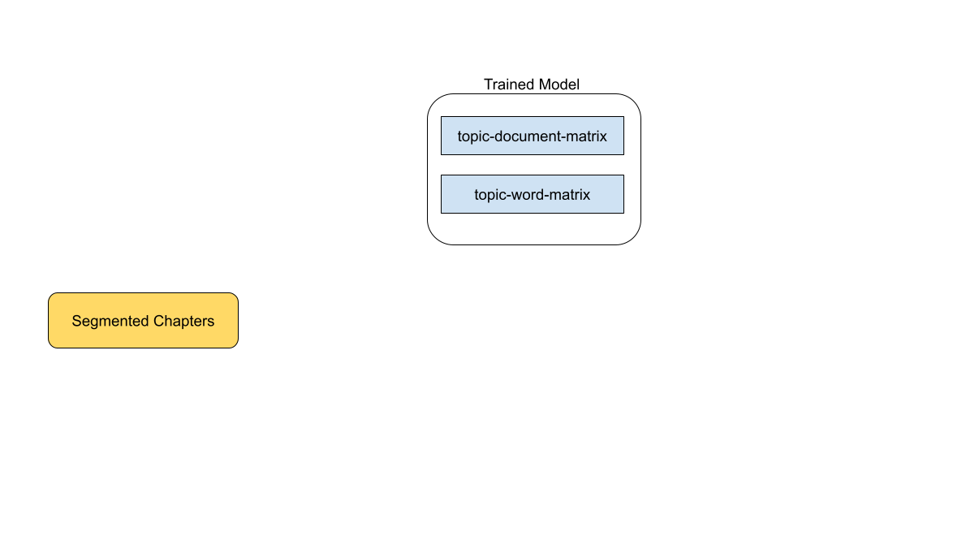
TM - Chapters - Inference

Slide 32
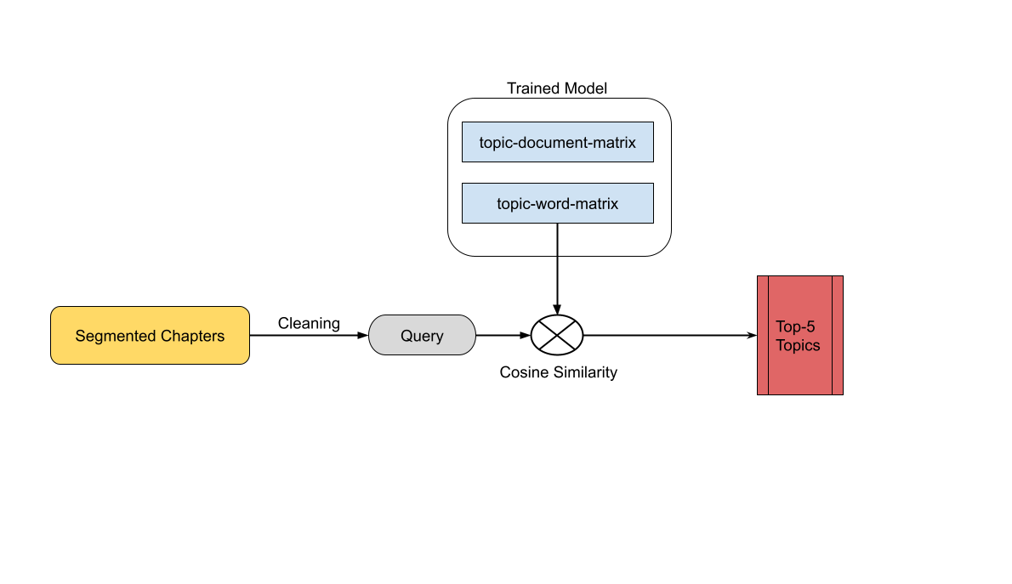
TM - Chapters - Inference - Related Topics

Slide 33
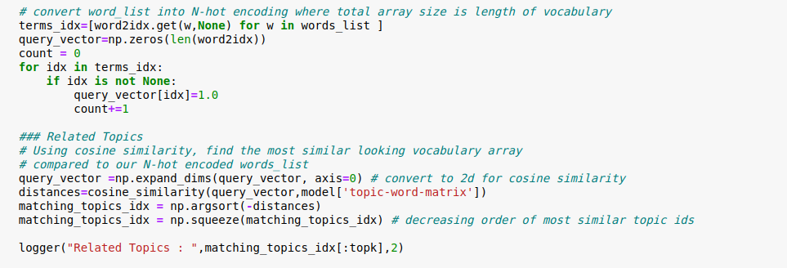
TM - Chapters - Inference - Related Topics

Slide 34
TM - Chapters - Inference - Related Topics
Cleaned chapter text

Slide 35
TM - Chapters - Inference - Related Topics
Cleaned chapter text
N-hot encoding

Slide 36
TM - Chapters - Inference - Related Topics
Calculating similarity

Slide 37
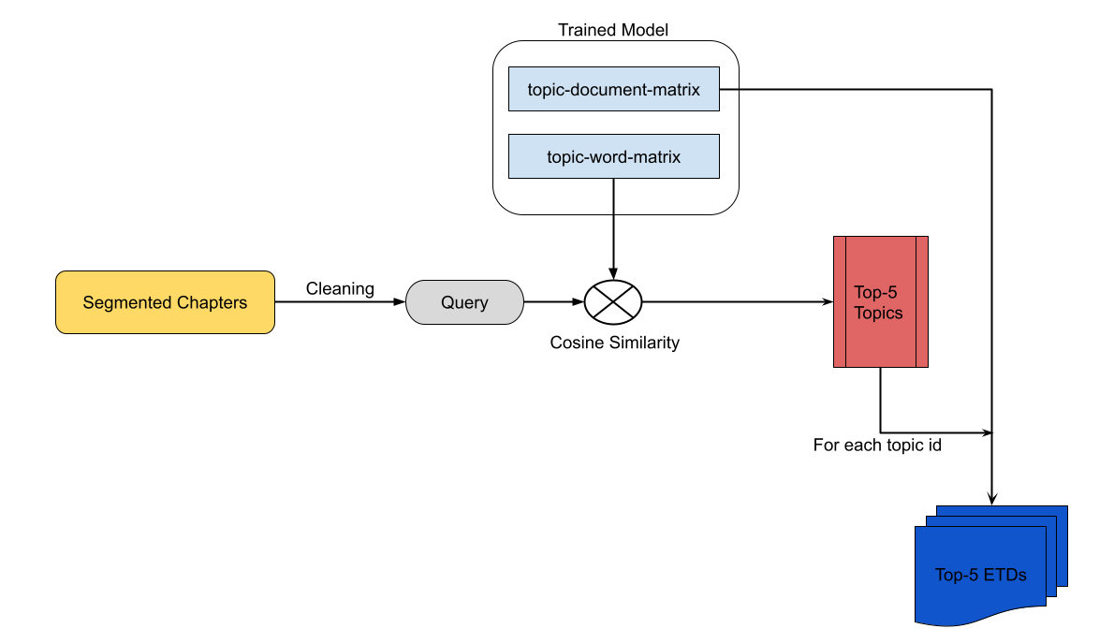
TM - Chapters - Inference - Related ETDs

Slide 38
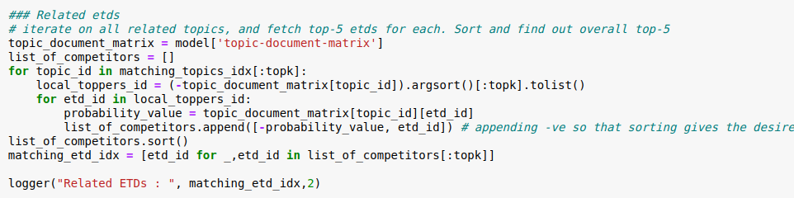
TM - Chapters - Inference - Related ETDs
Top-5 topic ids

Slide 39
TM - Chapters - Inference - Related ETDs
Top-5 topic ids
Top-5 etds / topic

Slide 40
TM - Chapters - Inference - Issues
Quality of output ∝ Accuracy of Segmentation

Slide 41
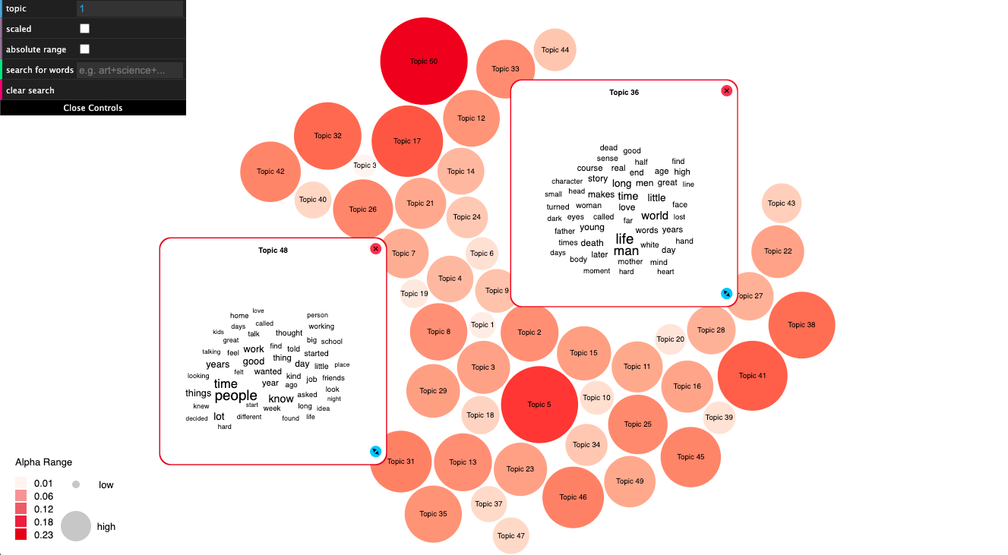
Experimenter pages - Topic Bubbles
Intuitive and Interactive visualization
Source : https://github.com/sihwapark/topic-bubbles

Slide 42
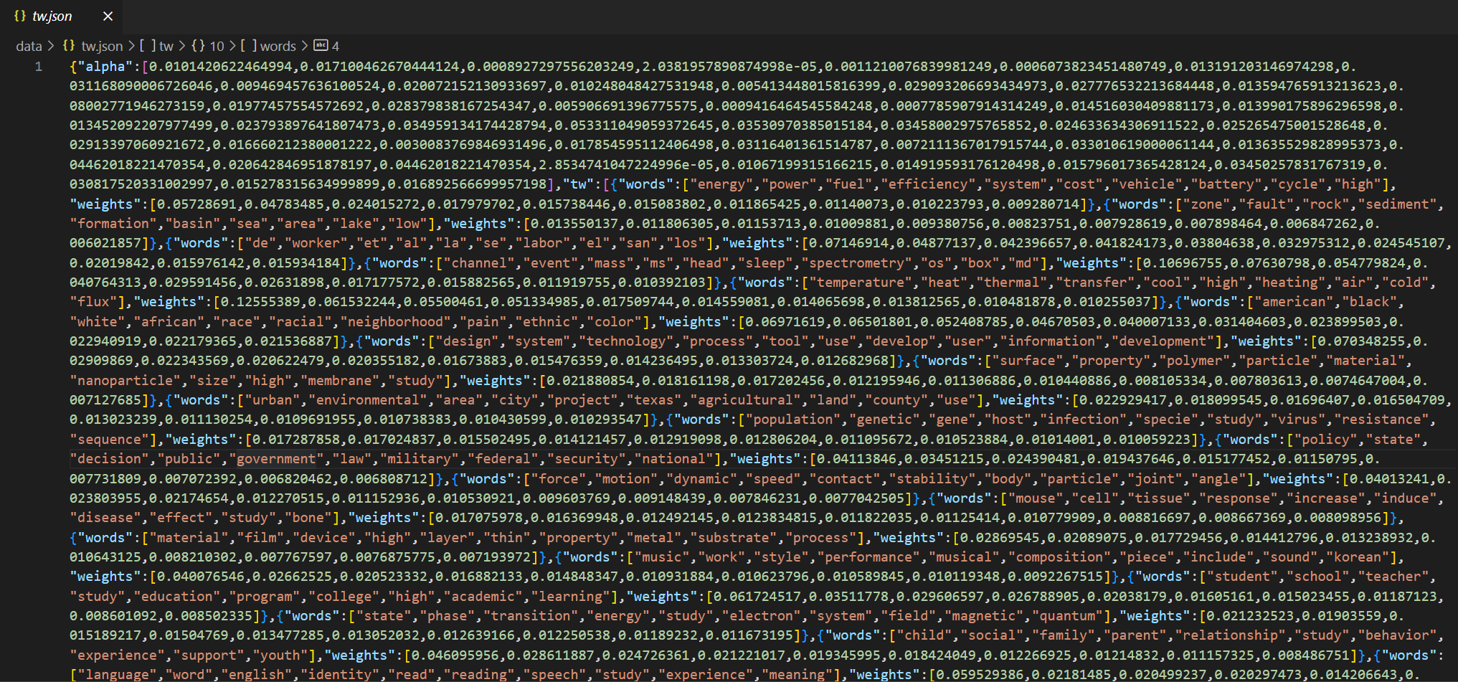
Experimenter pages - Topic Bubbles - Data Preparation
tw.json
topic_weights {
alpha : [ 𝞪₁,𝞪₂,....𝞪_{t}],
tw : [
{words : [w₁,w₂,....w_{n}],
weights : [ f₁,f₂,....f_{n} ] }
]
}

Slide 43
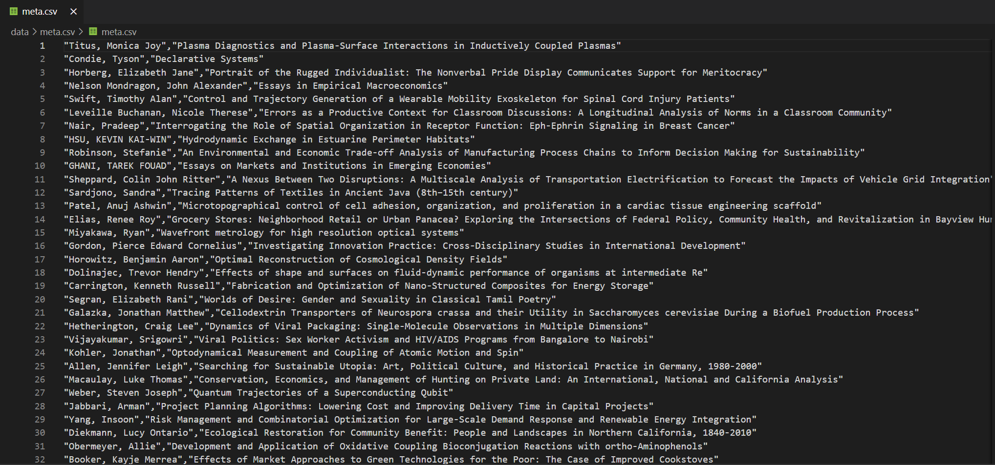
Experimenter pages - Topic Bubbles - Data Preparation
meta.csv
author | title
name₁ | etd₁
name₂ | etd₂
name₃ | etd₃

Slide 44
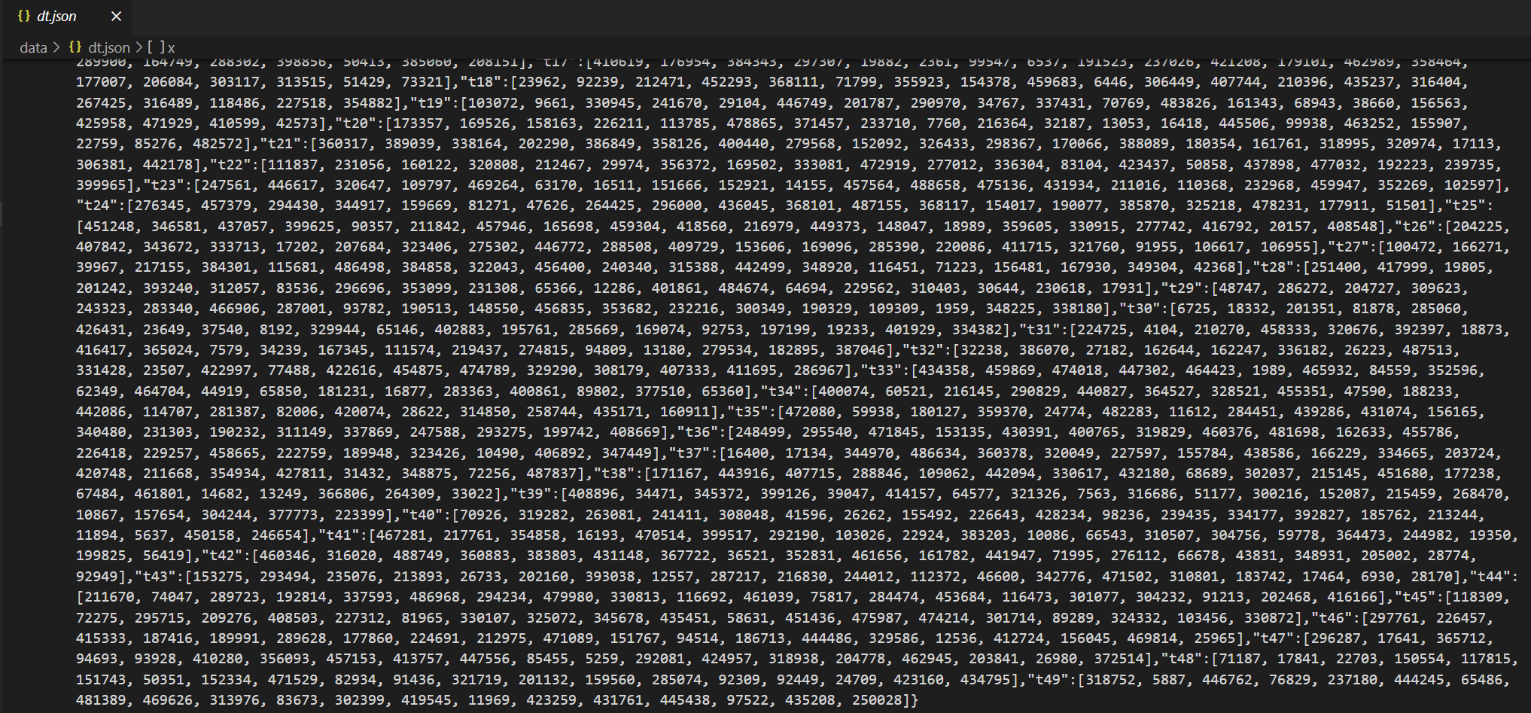
Experimenter pages - Topic Bubbles - Data Preparation
dt.json
topic_documents {
topic₁ : [ id₁,id₂,....id₂₀],
.
.
topic₅₀ : [ id₁,id₂,....id₂₀],
}

Slide 45

Experimenter pages - Topic Bubbles - Demo

Slide 46
TM - Services
We are providing 2 services that will be containerized - to be used for workflow automation and our frontend webpage
Given a dataset, train TM model to generate vectors.
Generate related topics and documents for an ETD and all its chapters.
Ps : The Frontend flask application (hosted on Cloud CS) is not linked with service yet.

Slide 47
Milestones/Timeline
Work done till IR-2
  Train on complete 500k ETD dataset and integrate with UI
  Perform similarity search (topic+document) through FaisNN
  Display top-5 topics when topic search query is used
Work done for IR-3
  Chapter dataset generation, pre-processing
  Integrating chapters into topic model
  Preprocessing chapter data for OCTIS
  Code refactoring and optimization for reducing load time
Work done for Final Report
  Topic Bubble Experimenter UI
  Generate and save Related topics+Docs data for 5k dataset for all ETDs and Chapters

Slide 48
Wrap-Up Tasks
  Set up workflow automation - team 5
  Integrate Flask app / Experimenter UI with the frontend and workflow services.
  Build the Bubble UI for all the models (CTM, LDA, NeuralLDA and ProdLDA)

Slide 49

QUESTIONS?

Slide 50
BACKUP

Slide 51
Object Detection
What has been accomplished
Deliverables
ETD filtering rules
Issues and challenges faced
Milestones
Upcoming tasks and goals

Slide 52
What Has Been Accomplished
The basic XML schema has been implemented for all object types
Retrieved a trained YOLOv7 model to run inferences
Post-processing rules for YOLOv7 detections
Experimented on 10 randomly sampled PDFs for testing
Front-end wireframe (Experimenter and page after search)
Docker container with GPU access enabled

Slide 53
What Has Been Accomplished
Set up Docker containers for YOLOv7 and Detectron2 frameworks
Implemented YOLOv7 and Faster R-CNN algorithms for ETDs
Implemented post-processing rules for detected objects
Converted the unordered set of detections to XML
Experimented on multiple randomly sampled ETDs
Experimenter Web Page UI
Team 1 deliverables - DB tasks (read/write)

Slide 54
Issues / Test Cases - OD
Detections are not always in the top-bottom order for pages which is required to create the XML tree
Notes:
Solved by sorting using y-axis
Solved by keeping track of the current / last chapter and checking for updates
In implementation phase now
‘’

Slide 55
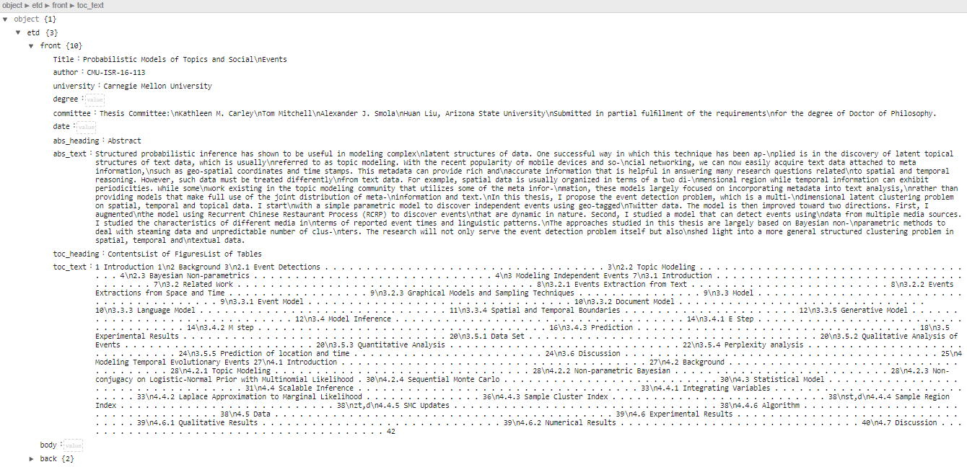
Front sub-element

Slide 56
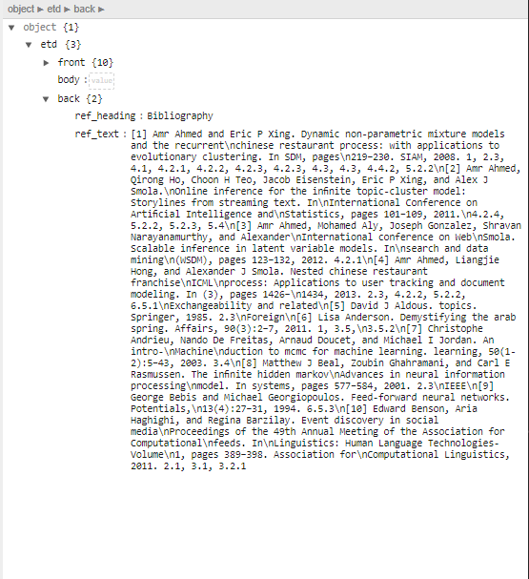
Body sub-element
Back sub-element

Slide 57
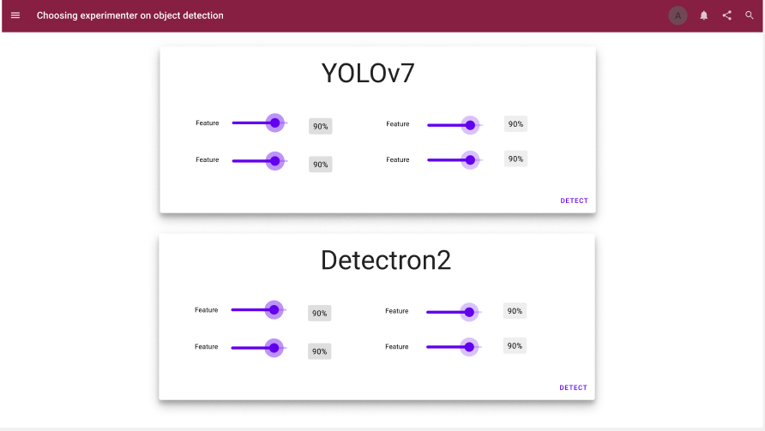
Front End - Object Detection
End product - Experimenter web page

Slide 58
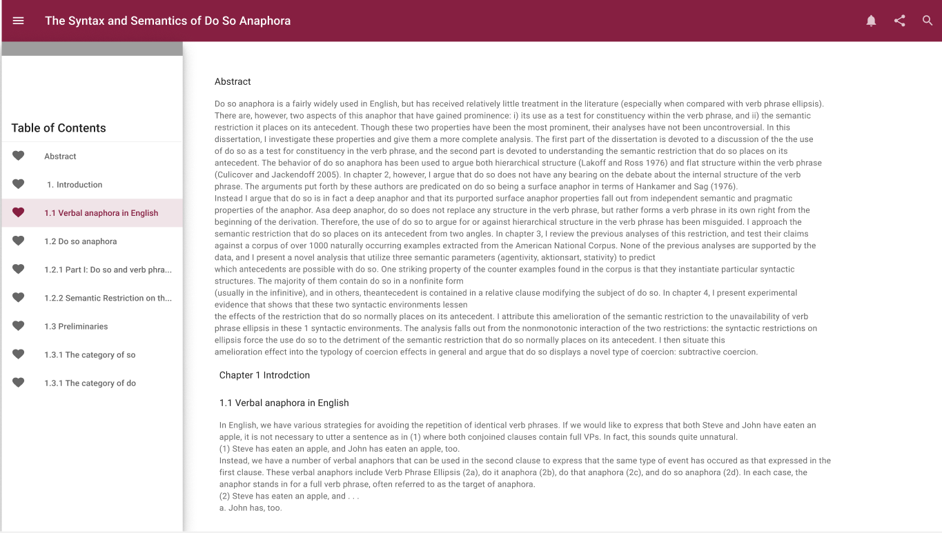
Front End - Object Detection
End product - Parsed ETD web page

Slide 59
Upcoming Tasks and Goals - OD
Link image-based objects to their captions based on a distance metric (like Euclidean)
  Figures - figure captions
  Tables - table captions
  Equations - equation numbers
Recognizing the right chapter and section titles (delimiters)
Fix errors and debug
Deal with subsections and sections as they constitute the same object / class
Building the web pages (Experimenter + Parsed ETD)

Slide 60
Issues/Test Cases - OD
False positives:
Chapter/section titles being incorrectly detected
  Paragraph’s last line
  New chapter tag for the same chapter title
  Chapter and paragraph is being created but not the section
Images/tables being linked to wrong caption
Chapter/section titles detected don’t match with the titles in the ToC
Notes:
Solved by sorting using y-axis
Solved by keeping track of the current / last chapter and checking for updates
In implementation phase now
‘’

Slide 61
Experimenter UI - YOLOv7 Detection

Slide 62

Experimenter UI - Faster R-CNN Detection

Slide 63
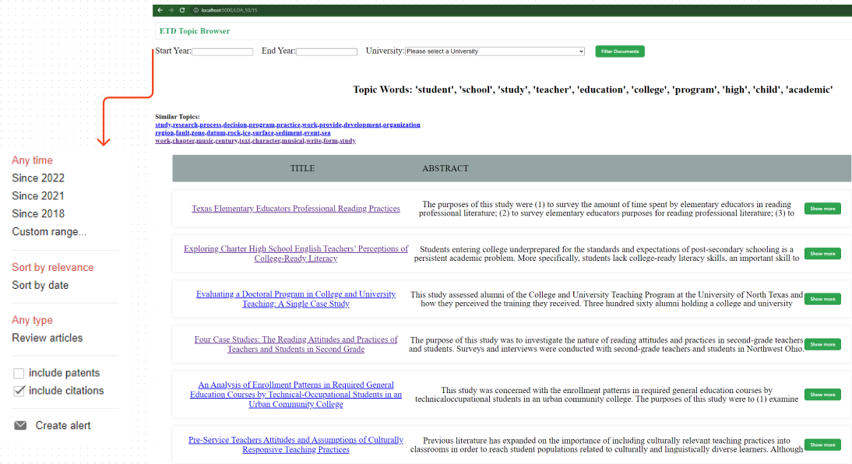
UI improvements
Filter Layout
  Year range
  Author names
  University
  Faculty
  Committee

