Slide 1
Crisis Event Language Model
Bhargava Elavarthi
Kunal Nakka
Srikaran Bachu
Multimedia, Hypertext & Information Action
CS4624
Virginia Tech Blacksburg, 24060

Slide 2
Agenda
In Depth Project Overview
Our Tech Stack
Key Features
Live Demo
In Depth Feature Overview
Final Steps
Client Overview
Q & A

Slide 3
Project Overview
Goal: build crisis-specific classifiers using a pre-trained language model (BERT)
Users can provide zip files with text data
Data can be entered manually on the site
Models can be trained in real time
Up to date list of models for easy access for users

Slide 4
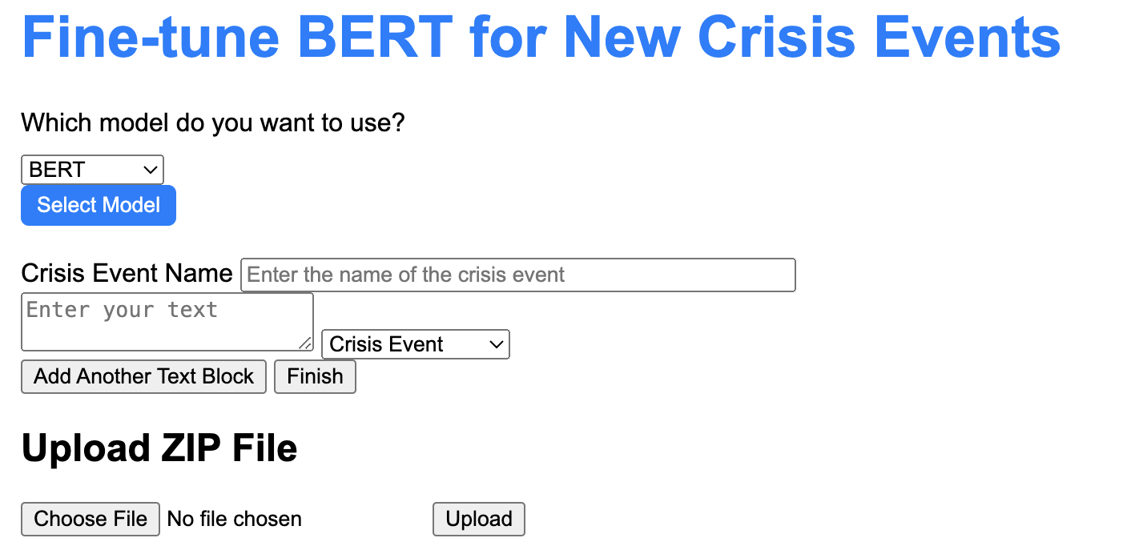
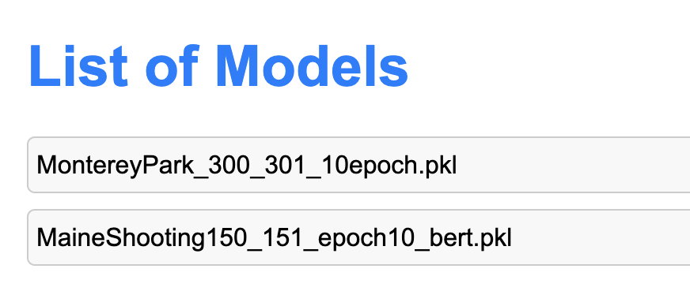
Key Features
Zip Files
Manual user input
Hands-on pre-trained model list
User & Developer Manuals

Slide 5
Tech Stack
Frontend:
HTML & CSS based webpages
Includes User & Dev Manuals, key features: File upload & manual text input
Backend:
Flask backend handling all data processing
Links Python based Bert model to user interface for input

Slide 6

Live Demo

Slide 7
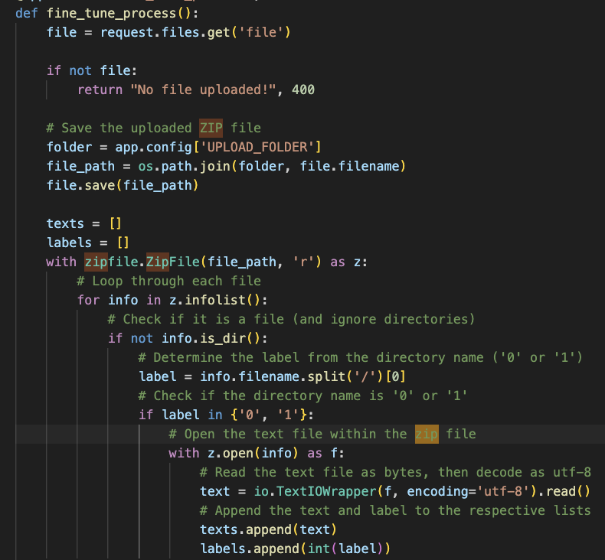
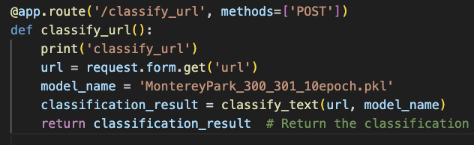
In Depth Feature Overview
User-Friendly ZIP File Upload
Text Classification

Slide 8
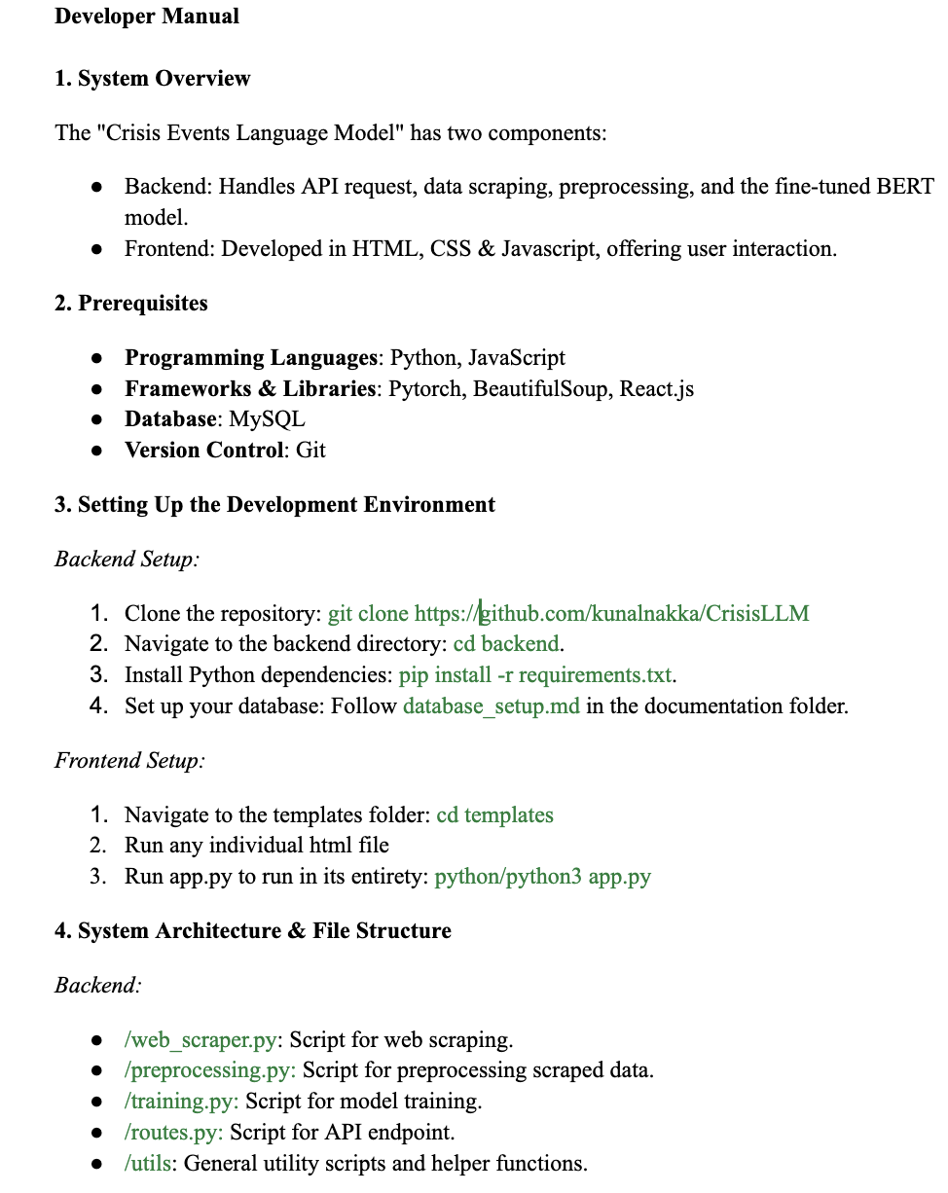
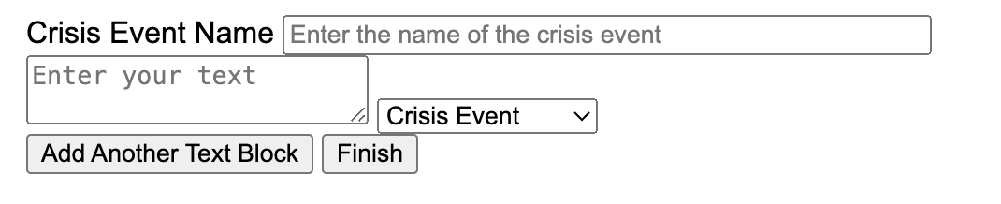
In Depth Feature Overview
Manual User Input
User & Developer Manual

Slide 9
Final Steps
Hosting
  Must store all models
Further training models
  Train on larger amounts of data
  Incorporate an even larger variety of models

Slide 10
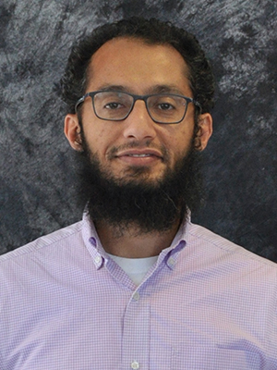
Client
Dr. Mohamed Farag
Research associate in the Center for Sustainability Mobility (CSM)
Thank you to our professor and client Dr.Farag for meeting with us
weekly and helping us stay goal oriented even after losing a teammate,
without his help we wouldn’t have been able to finish this project
effectively.

Slide 11
Questions?

