Slide 1

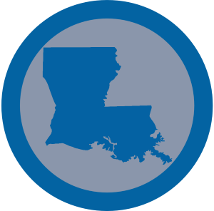
Louisiana French
Joe Chu, Will Duong, Abhi Oddula, Rahul Ramki, Saharsh Shrivastava
Project Overview
Client Overview:
]
Received NSF grant in 2018 to research the linguistic effects of Hurricane Katrina
Have generated a corpus of 28 interviews of transcribed dialogue of interviewees speaking in Louisiana French
Want to analyze verb frequencies within this corpus
Goal/Purpose Statement:
The goal of our project is to identify ferb frequencies within the interview corpus. Given a verb bank, our responsibilities are to automate the process of finding and counting each conjugation of each verb within the bank.
Stakeholders:
Dr. Katie Carmichael and Dr. Aarnes Gudmestad from the VT Department of English and Department of Modern and Classical Languages and Literatures
Objectives:
Automate tasks for our clients to save them time from manual parsing
  Generate verb frequencies for the verbs included in the dataset
Assist in the overall research by helping our clients analyze the dialogue of Louisiana French speakers
Develop a user manual for our clients if, in the future, they decide to add more interviews to their dataset
Timeline:
February 8 - Meeting and understanding of project requirements with client
February 26 - Presentation 1
March 4 - Demo of current progress to client and professor
March 6 - Completed verb ‘avoir’ script as a pilot to our project
March 10 - Started implementation with TreeTagger
March 26 - Presentation 2
April 8 - Demo of current progress with Dr. Gudmestad
April 11 - Presentation 3
April 12 - Progress on final deliverable
April 30 - Final Presentation and VTURCS
Project Design
Technology Purposes:
Python for scripting
TreeTagger for parts of speech tagging
TreeTagger wrapper (Python) to use the TreeTagger commands easier
Jupyter Notebook for a neat display of metadata for client
Sublime Text for text editing
Microsoft Excel for data storage
Initial Implementation
The initial implementation of our project was to simply use a python script to brute-force the entire interview corpus line-by-line and interview-by-interview. We would then use the results we got an compare it to a web-scrapped verb table that we built in excel. We that this was extremely inefficient and shifted towards a more efficient way.
Final Project Design:
Our final implementation of the project is to combine our knowledge of python along with a software called TreeTagger. TreeTagger is a parts of speech tagging software that is used for multiple languages for many other research projects. For our project we used the Standard French language to be a foundation for the analysis of verb frequency in Louisiana French. We have used python scripts to feed the TreeTagger lines from the corpus and calculate us a dataset collection based off of the verb frequency.
Testing:
TreeTagger tested with the English Parameter file and ran with English sentences
TreeTagger tested with the Standard French Parameter file and ran with interview corpus
Results from the data collected from testing the interview corpus verified by client.
Cases regarding cédille, accent grave, aigu, circonflexe, tréma.
.
.

