Slide 1


STUDENTS AS CONTRIBUTORS
IN
OER CREATION
VIVA’s 2022 Open and Affordable Community Forum
October 14, 2022
Virginia Commonwealth University, Richmond, VA
Anita Walz • Kindred Grey • Erin Hopkins • Donald Orth
Virginia Tech
bit.ly/oer_student_reviewers
Notes:
30 seconds (Anita)

Slide 2

GETTING TO KNOW YOU

Slide 3
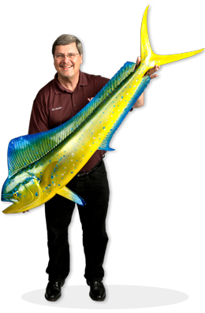
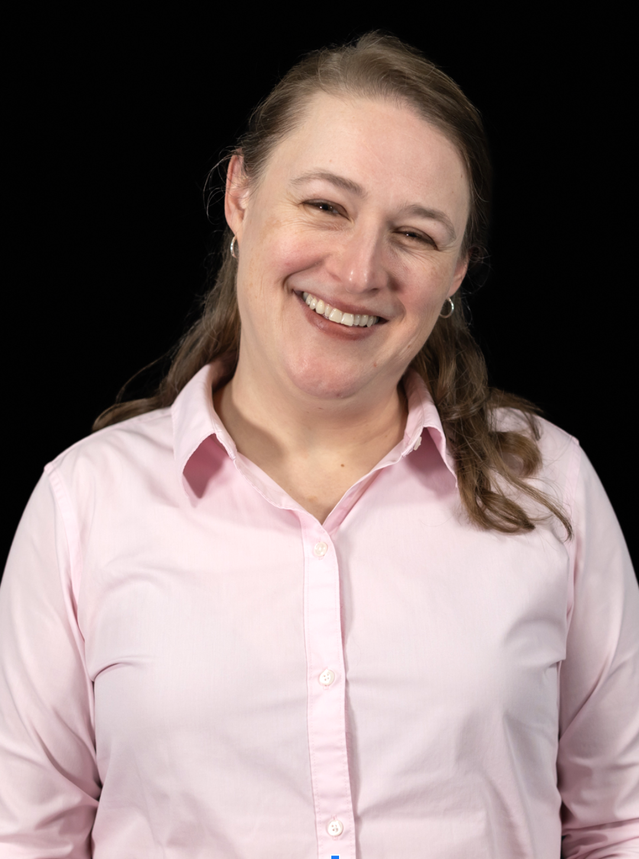

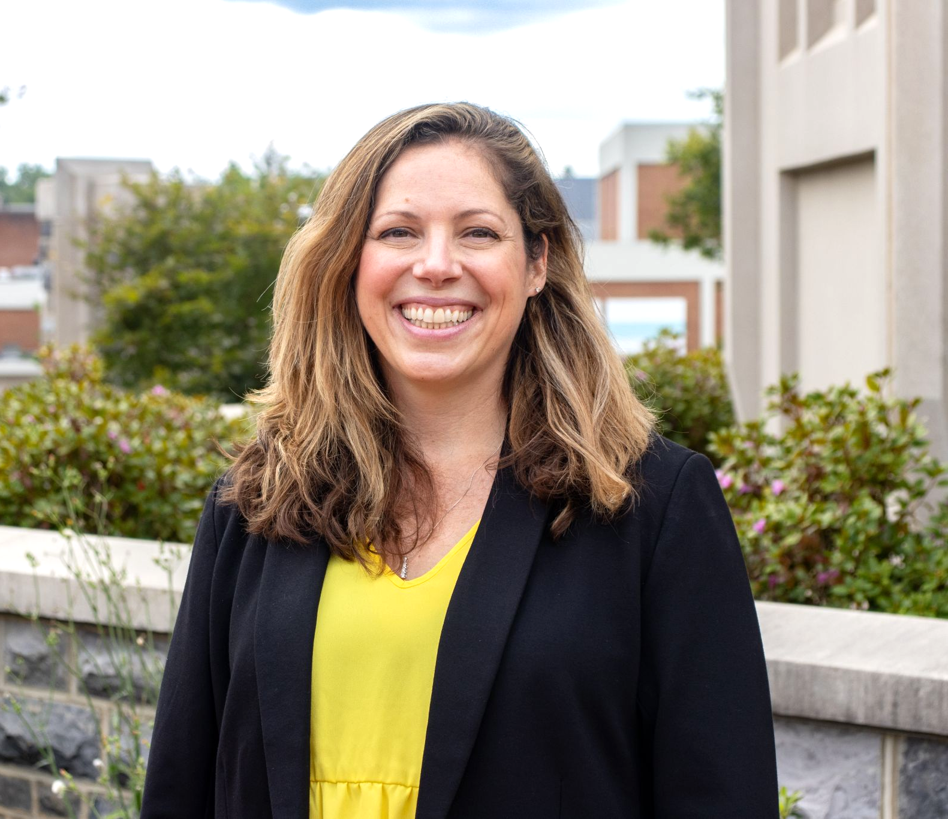
GETTING TO KNOW US
Anita Walz
OER Project Manager
University Libraries
Kindred Grey
OER Assistant
University Libraries
Donald Orth
Professor & Author
Dept. of Fish & Wildlife
Erin Hopkins
Professor & Author
Dept. of Apparel, Housing, & Resource Management

Slide 4
PRESENTATION OUTLINE
Open textbook publishing process
Student review process
Hearing from authors: Projects and perception of student review process
Student feedback
Your questions and discussion

Slide 5
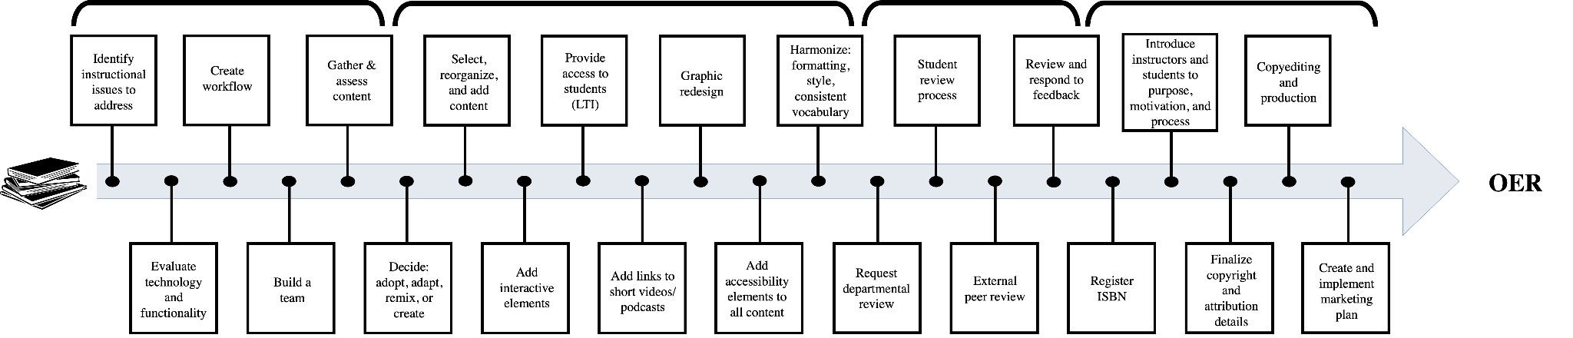
WHEN DOES STUDENT REVIEW FIT IN?
Planning/
Organization
Content
Development
Feedback
Production
Student review

Slide 6

RECRUITING STUDENTS
Ask authors for names of students
Contact students and ask if they’re interested in paid review opportunity
Set up a zoom meeting to introduce the work and “interview”
  Decide and notify!
Planning an initial onboarding meeting
Give students a schedule (~2 weeks/chapter)
  Always ask what fits with their schedule
Check in on Zoom every month

Slide 7
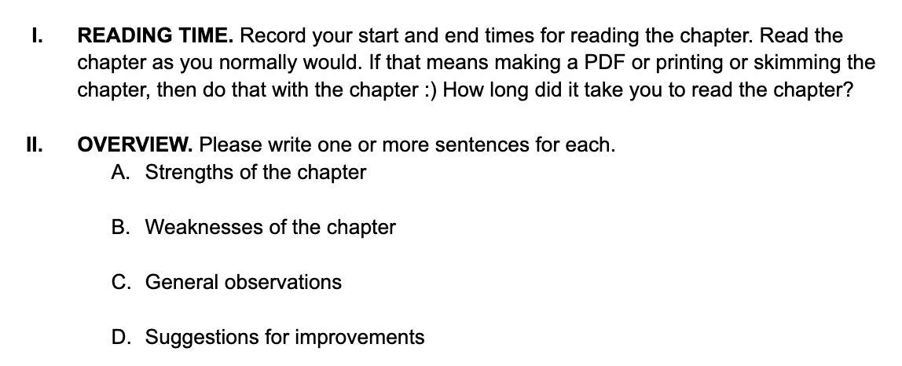
STUDENT REVIEW RUBRIC
Student feedback
  Rubric
  Annotated PDFs

Slide 8
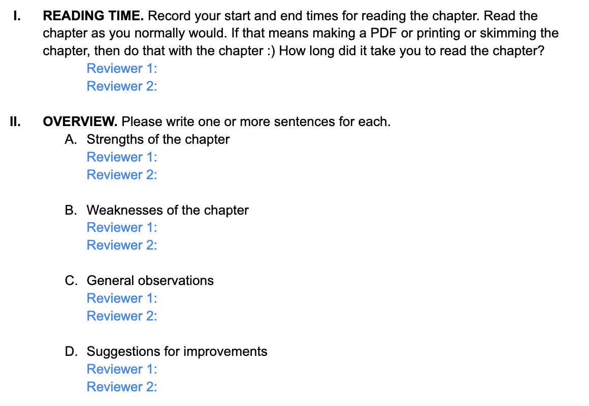
ANONYMITY AND PROJECT (OR FILE!) MANAGEMENT
Set up Google Drive
  Folder 1: Author has access
  Folder 2: Students have access
Combine student reviews
  Project manager combines reviews into one document, citing reviewers as “Reviewer 1”, “Reviewer 2”, etc.
Share with author

Slide 9
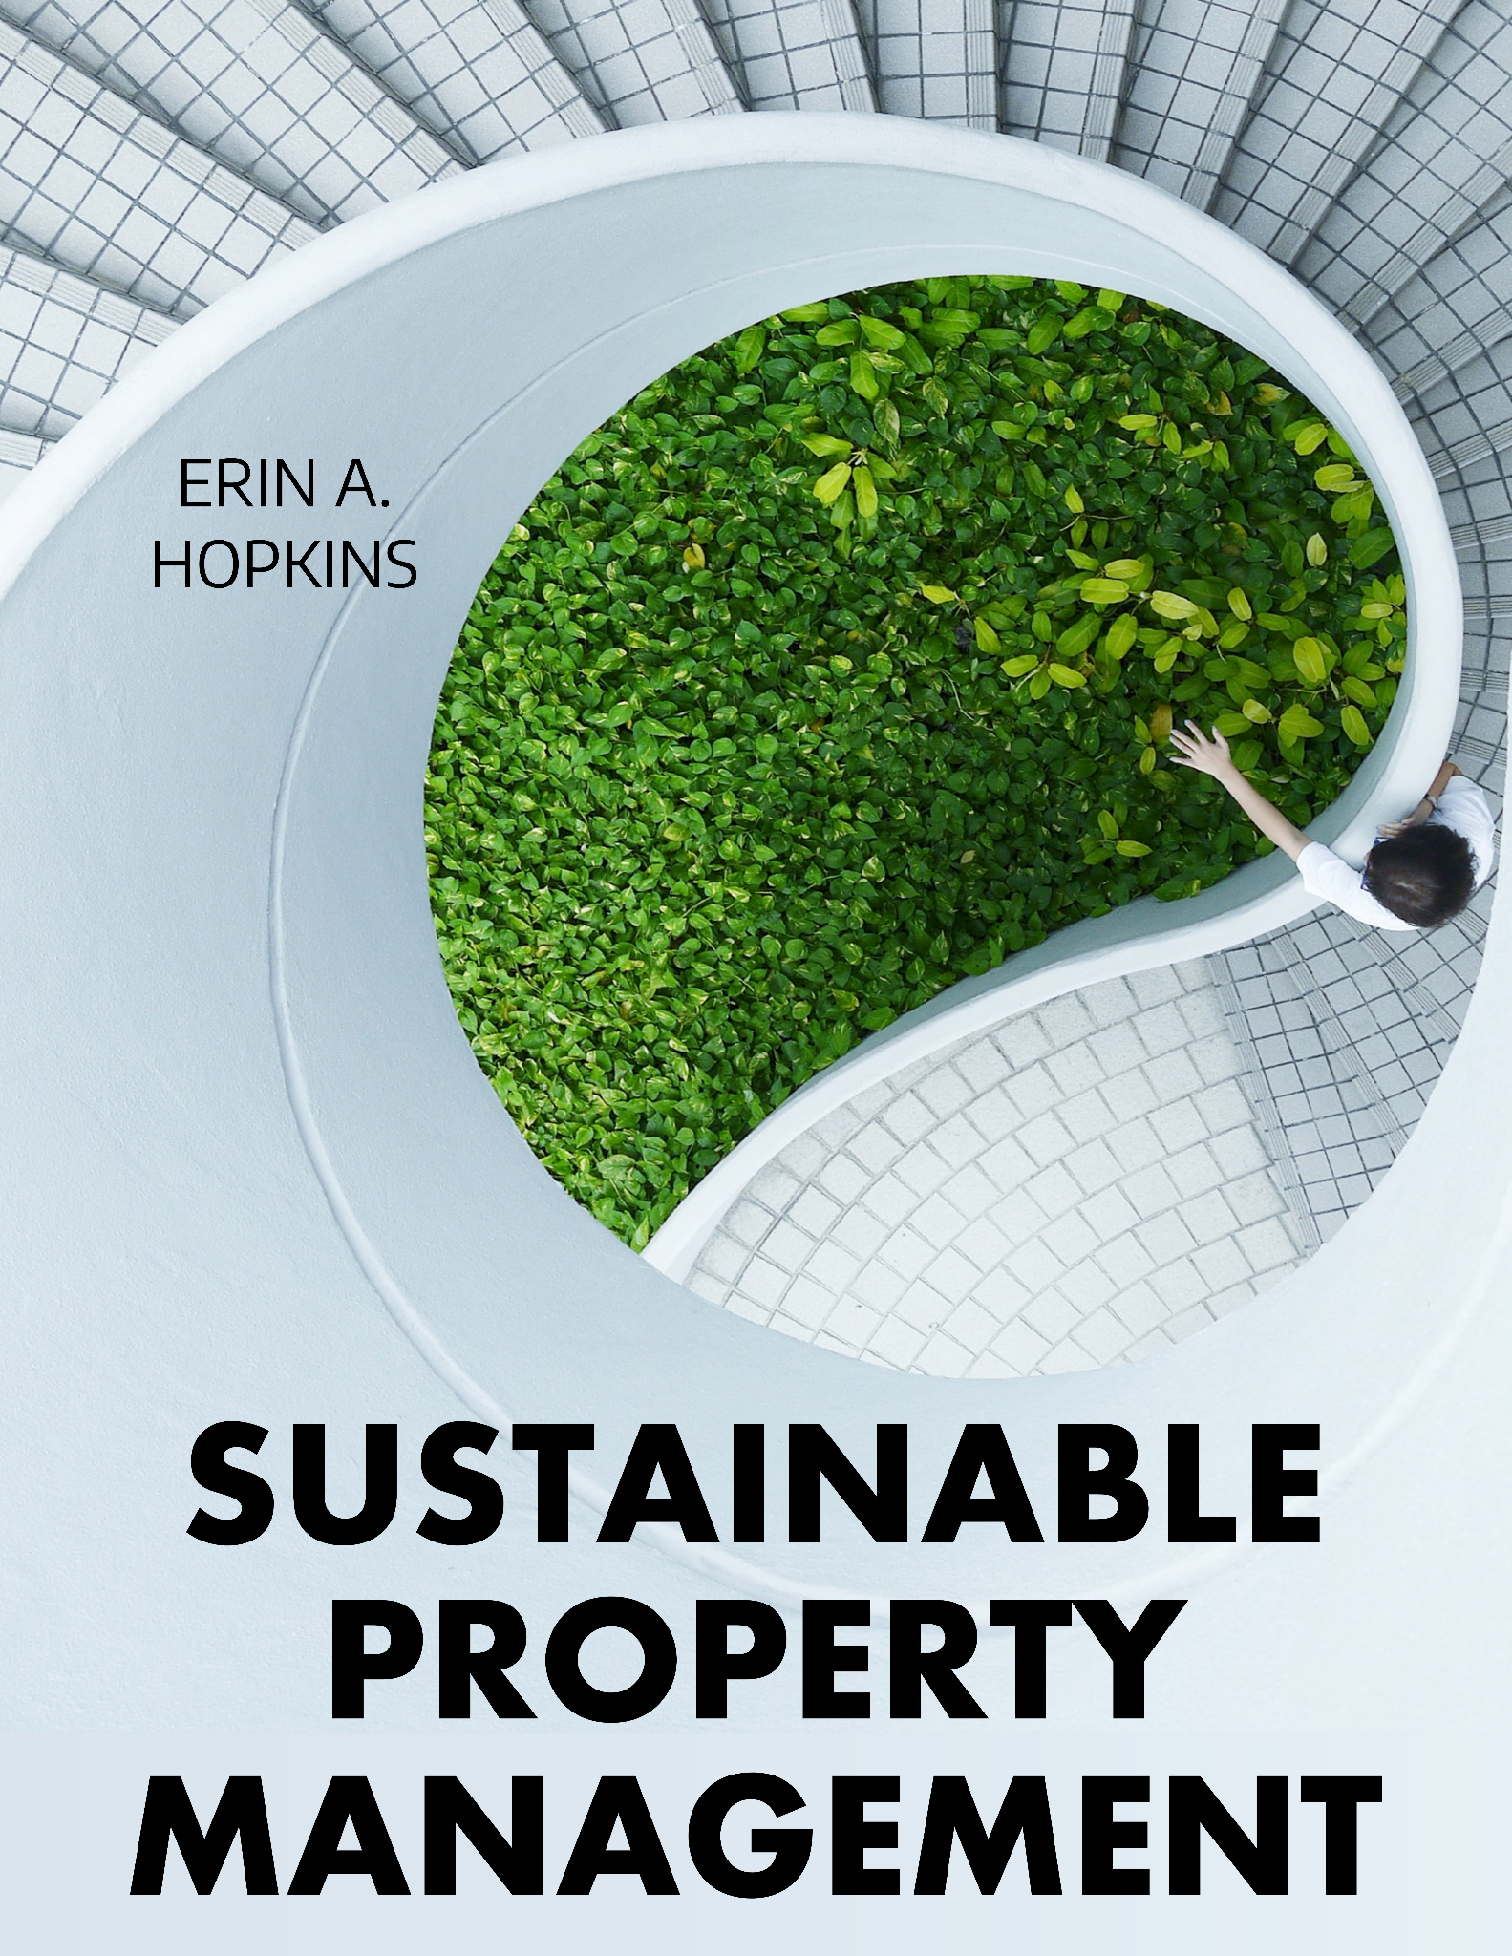

PROJECT OVERVIEW: Erin Hopkins
Goals
  For students to understand how ecologically sustainable concepts may be implemented throughout the various categories of property management operations while also considering the other spheres of sustainability
  Have a free resource to use in developing this understanding
Outcome
  A textbook consisting of 8 chapters with a glossary, indexing, as well as ancillaries

Slide 10

PROJECT OVERVIEW: Don Orth
Goals
  Explore diversity of fish, fishing, and conservation efforts for a broad audience of undergraduate students. Examine characteristics of successful conservation and recovery plans.
Outcome
  An open educational textbook with 15 chapters on contemporary issues from various parts of the world.

Slide 11
HEARING FROM AUTHORS
What characteristics were you looking for when you recommended your list of prospective student reviewers?
Do you know who from your list are your actual reviewers? If not, was it helpful that your student reviewers were anonymous?
At what point in the process did you incorporate feedback—while still writing your book, or after it was complete? What are pros and cons for these different approaches in timing?
What sort of recurring themes came up in the student reviews? Were the reviews helpful?
How did you evaluate student comments and decide whether or not to address them? What makes these an actionable comment?
How did student reviewer comments differ from expert reviewer comments? Were you more or less motivated to incorporate one or the other set of comments?
How do you think your book would differ without the student review process?
Is there anything else you want to share?

Slide 12
HEARING FROM AUTHORS
What characteristics were you looking for when you recommended your list of prospective student reviewers?
Do you know who from your list are your actual reviewers? If not, was it helpful that your student reviewers were anonymous?
At what point in the process did you incorporate feedback—while still writing your book, or after it was complete? What are pros and cons for these different approaches in timing?
What sort of recurring themes came up in the student reviews? Were the reviews helpful?
How did you evaluate student comments and decide whether or not to address them? What makes these an actionable comment?
How did student reviewer comments differ from expert reviewer comments? Were you more or less motivated to incorporate one or the other set of comments?
How do you think your book would differ without the student review process?
Is there anything else you want to share?

Slide 13
HEARING FROM AUTHORS
What characteristics were you looking for when you recommended your list of prospective student reviewers?
Do you know who from your list are your actual reviewers? If not, was it helpful that your student reviewers were anonymous?
At what point in the process did you incorporate feedback—while still writing your book, or after it was complete? What are pros and cons for these different approaches in timing?
What sort of recurring themes came up in the student reviews? Were the reviews helpful?
How did you evaluate student comments and decide whether or not to address them? What makes these an actionable comment?
How did student reviewer comments differ from expert reviewer comments? Were you more or less motivated to incorporate one or the other set of comments?
How do you think your book would differ without the student review process?
Is there anything else you want to share?

Slide 14
HEARING FROM AUTHORS
What characteristics were you looking for when you recommended your list of prospective student reviewers?
Do you know who from your list are your actual reviewers? If not, was it helpful that your student reviewers were anonymous?
At what point in the process did you incorporate feedback—while still writing your book, or after it was complete? What are pros and cons for these different approaches in timing?
What sort of recurring themes came up in the student reviews? Were the reviews helpful?
How did you evaluate student comments and decide whether or not to address them? What makes these an actionable comment?
How did student reviewer comments differ from expert reviewer comments? Were you more or less motivated to incorporate one or the other set of comments?
How do you think your book would differ without the student review process?
Is there anything else you want to share?

Slide 15
HEARING FROM AUTHORS
What characteristics were you looking for when you recommended your list of prospective student reviewers?
Do you know who from your list are your actual reviewers? If not, was it helpful that your student reviewers were anonymous?
At what point in the process did you incorporate feedback—while still writing your book, or after it was complete? What are pros and cons for these different approaches in timing?
What sort of recurring themes came up in the student reviews? Were the reviews helpful?
How did you evaluate student comments and decide whether or not to address them? What makes these an actionable comment?
How did student reviewer comments differ from expert reviewer comments? Were you more or less motivated to incorporate one or the other set of comments?
How do you think your book would differ without the student review process?
Is there anything else you want to share?

Slide 16
HEARING FROM AUTHORS
What characteristics were you looking for when you recommended your list of prospective student reviewers?
Do you know who from your list are your actual reviewers? If not, was it helpful that your student reviewers were anonymous?
At what point in the process did you incorporate feedback—while still writing your book, or after it was complete? What are pros and cons for these different approaches in timing?
What sort of recurring themes came up in the student reviews? Were the reviews helpful?
How did you evaluate student comments and decide whether or not to address them? What makes these an actionable comment?
How did student reviewer comments differ from expert reviewer comments? Were you more or less motivated to incorporate one or the other set of comments?
How do you think your book would differ without the student review process?
Is there anything else you want to share?
Notes:
12 minutes (moderated by Anita)
Suggestion: Always have Erin answer first. This will get rid of the awkward silence/wasted time after we ask them a question.

Slide 17
HEARING FROM AUTHORS
What characteristics were you looking for when you recommended your list of prospective student reviewers?
Do you know who from your list are your actual reviewers? If not, was it helpful that your student reviewers were anonymous?
At what point in the process did you incorporate feedback—while still writing your book, or after it was complete? What are pros and cons for these different approaches in timing?
What sort of recurring themes came up in the student reviews? Were the reviews helpful?
How did you evaluate student comments and decide whether or not to address them? What makes these an actionable comment?
How did student reviewer comments differ from expert reviewer comments? Were you more or less motivated to incorporate one or the other set of comments?
How do you think your book would differ without the student review process?
Is there anything else you want to share?

Slide 18
HEARING FROM AUTHORS
What characteristics were you looking for when you recommended your list of prospective student reviewers?
Do you know who from your list are your actual reviewers? If not, was it helpful that your student reviewers were anonymous?
At what point in the process did you incorporate feedback—while still writing your book, or after it was complete? What are pros and cons for these different approaches in timing?
What sort of recurring themes came up in the student reviews? Were the reviews helpful?
How did you evaluate student comments and decide whether or not to address them? What makes these an actionable comment?
How did student reviewer comments differ from expert reviewer comments? Were you more or less motivated to incorporate one or the other set of comments?
How do you think your book would differ without the student review process?
Is there anything else you want to share?
Notes:
12 minutes (moderated by Anita)
Suggestion: Always have Erin answer first. This will get rid of the awkward silence/wasted time after we ask them a question.

Slide 19

HEARING FROM STUDENTS
Getting to know my discipline better
Increased subject expertise
Impacts for my future career
The value of doing work that directly impacts others
Importance of feeling empowered to give honest feedback
(look for in future work environment)
What students appreciated
Flexibility in scheduling and timelines
How learning materials are created (and how I take this process for granted)
Thinking about how to write more clearly

Slide 20
HEARING FROM PROJECT MANAGERS
Anita—You’ve worked in OER adaption/creation for a number years. What advice would you give to new authors/project managers wanting to incorporate student feedback?
Kindred—You’ve provided feedback as a student and now manage other students. How has your role changed over the years?

Slide 21

OTHER ROLES FOR STUDENTS
(besides a formal review process)
Other types of content
  Glossaries
  Media
  Question banks
In-class studies
  Focus groups
  Surveys
  Direct feedback from students to instructors
Graduate students as subject matter experts [paid]
  Rubric-only feedback from graduate-level students
Students providing input [paid]
  General feedback on how students learn
  Identifying up-to-date examples
Notes:
1 minute (Anita)

Slide 22
Would you recommend adding student reviewers to your project?
[ one final question ]

Slide 23

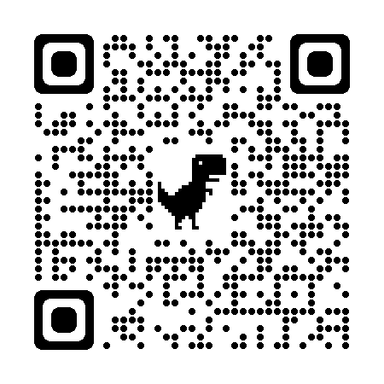

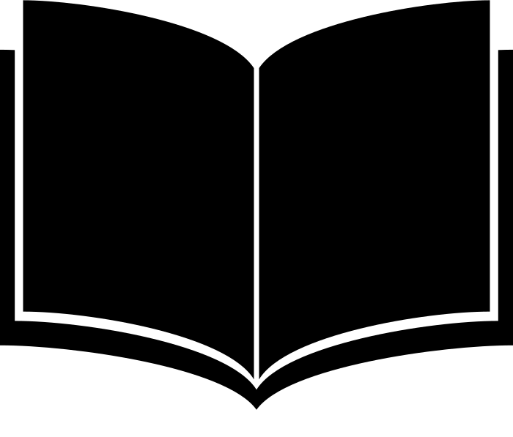
Scan here to access editable materials (like the rubric!)
[ questions? ]
Anita Walz · arwalz@vt.edu
Kindred Grey · kindred@vt.edu
Erin Hopkins · erinz1@vt.edu
Donald Orth · dorth@vt.edu

Slide 24
SOURCES
SLIDE 1: https://unsplash.com/photos/IBXcdiq-o0A
SLIDE 5: https://vtechworks.lib.vt.edu/handle/10919/101980
SLIDE 6: https://unsplash.com/photos/ute2XAFQU2I
Slide 19: https://unsplash.com/photos/Lks7vei-eAg
SLIDE 21: https://unsplash.com/photos/g1Kr4Ozfoac
SLIDE 23: https://unsplash.com/photos/h4KYT7X1HM4 ; https://thenounproject.com/icon/arrow-2683389/ ; https://thenounproject.com/icon/book-16437/

