Slide 1
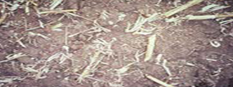
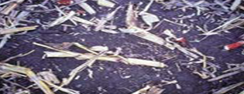
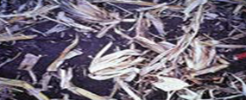
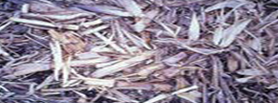
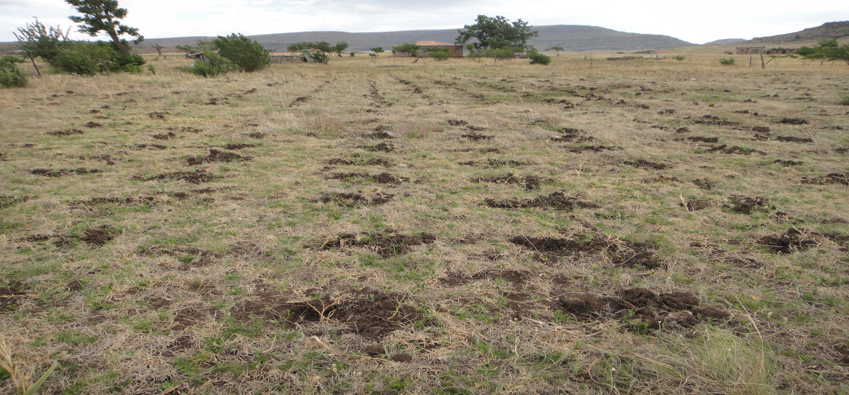
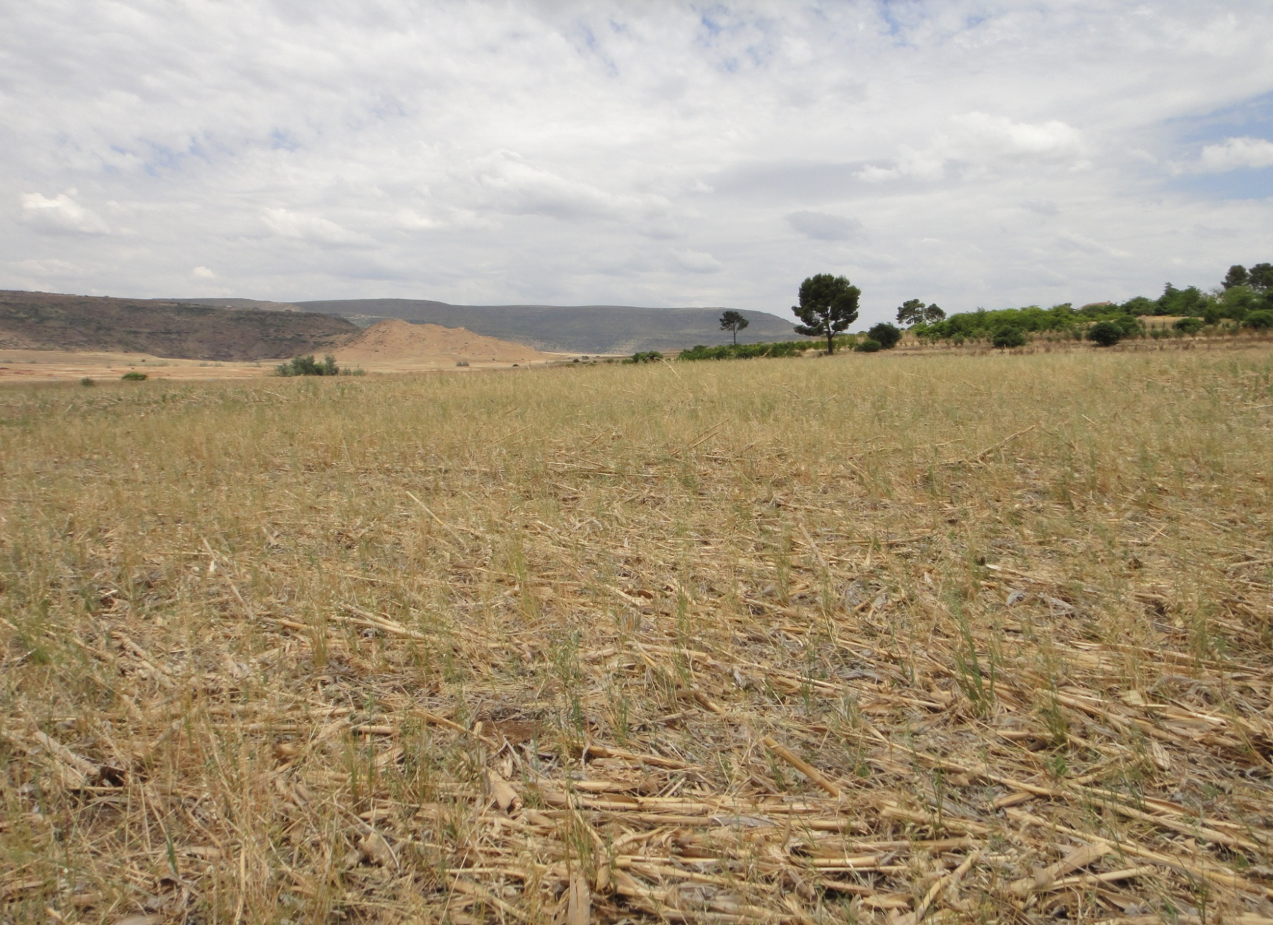




Conservation Agriculture in Lesotho: Residue Use Patterns Among CA adopters vs. Non-Adopters
E. Bisangwa¹, M.D. Wilcox², D.M. Lambert¹, M. Marake³, F.R. Walker¹, N. Eash¹, K. Moore⁴ and W.M. Park¹
¹University of Tennessee – Knoxville, TN; ² Purdue University-West Lafayette, IN; ³ National University of Lesotho – Roma, ⁴ Virginia Tech – Blacksburg, VA
Background
Recent efforts by the Government of Lesotho, non-government organizations (NGOs), and international attention have focused on developing conservation agriculture (CA) practices adapted to the cultural, economic, and agro-ecological conditions in Lesotho.
Understanding the influence of the introduction of CA technologies on soil erosion, yields, labor allocation and gender roles is of critical importance for successfully deploying sustainable agriculture technologies. This research is a collaborative effort between The National University of Lesotho and The University of Tennessee.
Data
This research uses household survey data from more than 430 households in ten Botha Bothe district villages in Lesotho, where likoti and mechanized CA has been introduced by non-governmental organizations and Extension, respectively.
Three key information sources were used to increase the precision of the sample (1) population Census data; (2) the importance of agriculture in terms of employment and subsistence; and (3) information about ongoing CA Extension efforts in the Botha Bothe district.
The survey instrument consisted of fourteen pages and included questions regarding: household demographics, assets, income and consumption; farm management and agricultural production/marketing 2010/2011; rural services and credit; knowledge and attitudes associated with agriculture and social networks. The survey was designed to take up to one hour to complete per respondent. Sample size was determined using a 95% confidence interval, a 5% margin of error.
Table 4: Mean Percentage of Respondents Reporting Using Crop Residues
Item | CA Status
 | Non-Adopter | CA Full Time | CA New | CA Abandon
Sample size | 326 | 55 | 34 | 12
Residue removed for fuel | 24.9% | 12.9% | 11.2% | 10.8%
Residues removed for animals | 34.6% | 25.9% | 38.8% | 24.2%
Residues left for animals | 24.2% | 31.5% | 30.3% | 37.5%
Residues left for cover | 16.3% | 29.8% | 19.7% | 27.5%
Results
Adoption of CA (Table 1)
427 farmers were grouped into four categories: non-adopters (76%), adopters (13%), new adopters (8%), and abandoners (3%).
Crop residue at time of planting (Table 2)
Eighty percent of conventional fields had less than 25% residue cover at the time of plowing/planting
Sixty percent of CA fields had residue cover above 25% at the time of planting
Attitudes toward farming techniques (Table 3)
In general, the opinions of farmers currently practicing CA were more often aligned with the main tenets of CA than those that had never tried CA or had abandoned CA.
Full-time CA adopters are split on the use of plowing as a necessary land preparation method.
Post-harvest use of crop residue (Table 4)
Across all CA adoption categories, the majority of farmers report that animals consume crop residue, either in the fields or at home.
A larger proportion of full-time CA adopters and those that have recently abandoned CA report leaving crop residue as cover than any farmers in other categories.
Research Objective
To examine the residue use patterns among CA adopters and non-adopters
Main Tenets of CA
1) minimizing soil disturbance,
2) maintaining residue on soil surface and
3) mixing/rotating crops
Table 2 : Percent of fields by type of management and residue cover at the time of planting in 2009/10
Item Number of Fields | Maize Residue at Planting | Conventional | CA
Number of Fields |  | 638 | 65
25% residue cover |  | 80% | 40%
50% residue cover |  | 13% | 26%
75% residue cover |  | 4% | 11%
90% residue cover |  | 3% | 23%
Table 1 : CA Adoption Status Descriptions
Non-Adopter | CA Full Time | CA New | CA Abandon
Farmers who have not practiced any form of CA in the last two years | Farmers practicing CA on at least one field over the last two years | Farmers using CA for the first time | Farmers who used CA but now only use conventional
76% | 13% | 8% | 3%
Table 3 : Attitudes toward specific farming techniques
Description of attitudes : | Non-Adopter | CA Full Time | CA New | CA Abandon
Should maintain cover crop in field: No Response Disagree Neutral Agree | 1.2% 10.1% 7.4% 80.7% | 1.8% 3.6% 10.9% 83.6% | 2.9% 5.9% 2.9% 88.2% | 0% 8.3% 0% 91.7%
Crop rotation always best practice: No Response Disagree Neutral Agree | 1.8% 3.4% 3.7% 90.5% | 0% 1.8% 1.8% 96.4% | 0% 5.9% 2.9% 91.2% | 0% 0% 0% 100%
Crop residue only fed to livestock: No Response Disagree Neutral Agree | 1.5% 48.8% 8.3% 40.5% | 0% 67.3% 5.5% 27.3% | 0% 58.8% 20.6% 20.6% | 0% 58.3% 16.7% 25%
Land preparation begins with plowing: No Response Disagree Neutral Agree | 0% 28.5% 2.8% 67.8% | 0% 47.3% 9.1% 43.6% | 0% 29.4% 23.5% 47.1% | 8.3% 33.3% 16.7% 41.7%
Conclusions and Future Directions
Farmers’ attitudes toward cover crops, crop rotation and residue maintenance suggest that they are open to using these techniques. Additional analysis needs to be concluded to determine if they are actually employing these techniques.
In general, farmers, even those who have adopted CA techniques on at least one of their fields, still view plowing as a necessity for land preparation.
Future studies are necessary to analyze the social dimension of leaving residue in fields and whether CA adoption affects residue use on conventional fields
Photo Credit: Forbes Walker
Basins prepared by local farmer, near Maphutseng, November 2011
Photo Credit: Forbes Walker
For more information or for copy of a conference paper
on this subject, please contact:
Mr. Eric Bisangwa (ebisangw@utk.edu)
Dept. of Agricultural & Resource Economics
University of Tennessee-Knoxville
Maize residue at Maphutseng, November 2011

