Slide 1
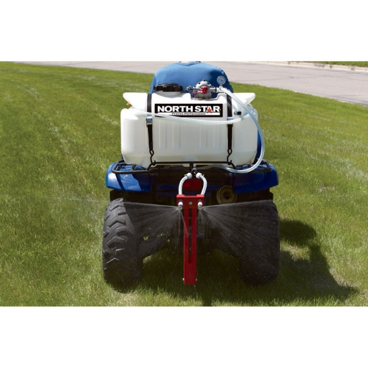
Calibrating Boomless Sprayers
Andy Overbay
Smyth County PAR
2016

Slide 2
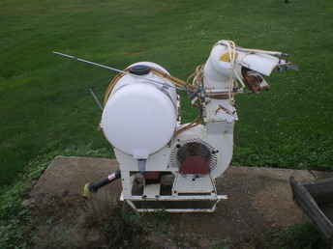
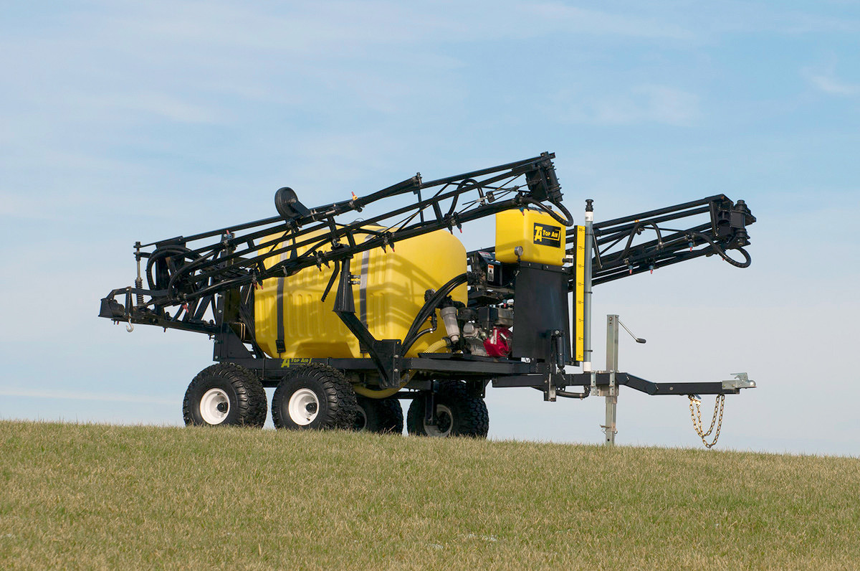
Why Boomless?
Good trade off

Slide 3
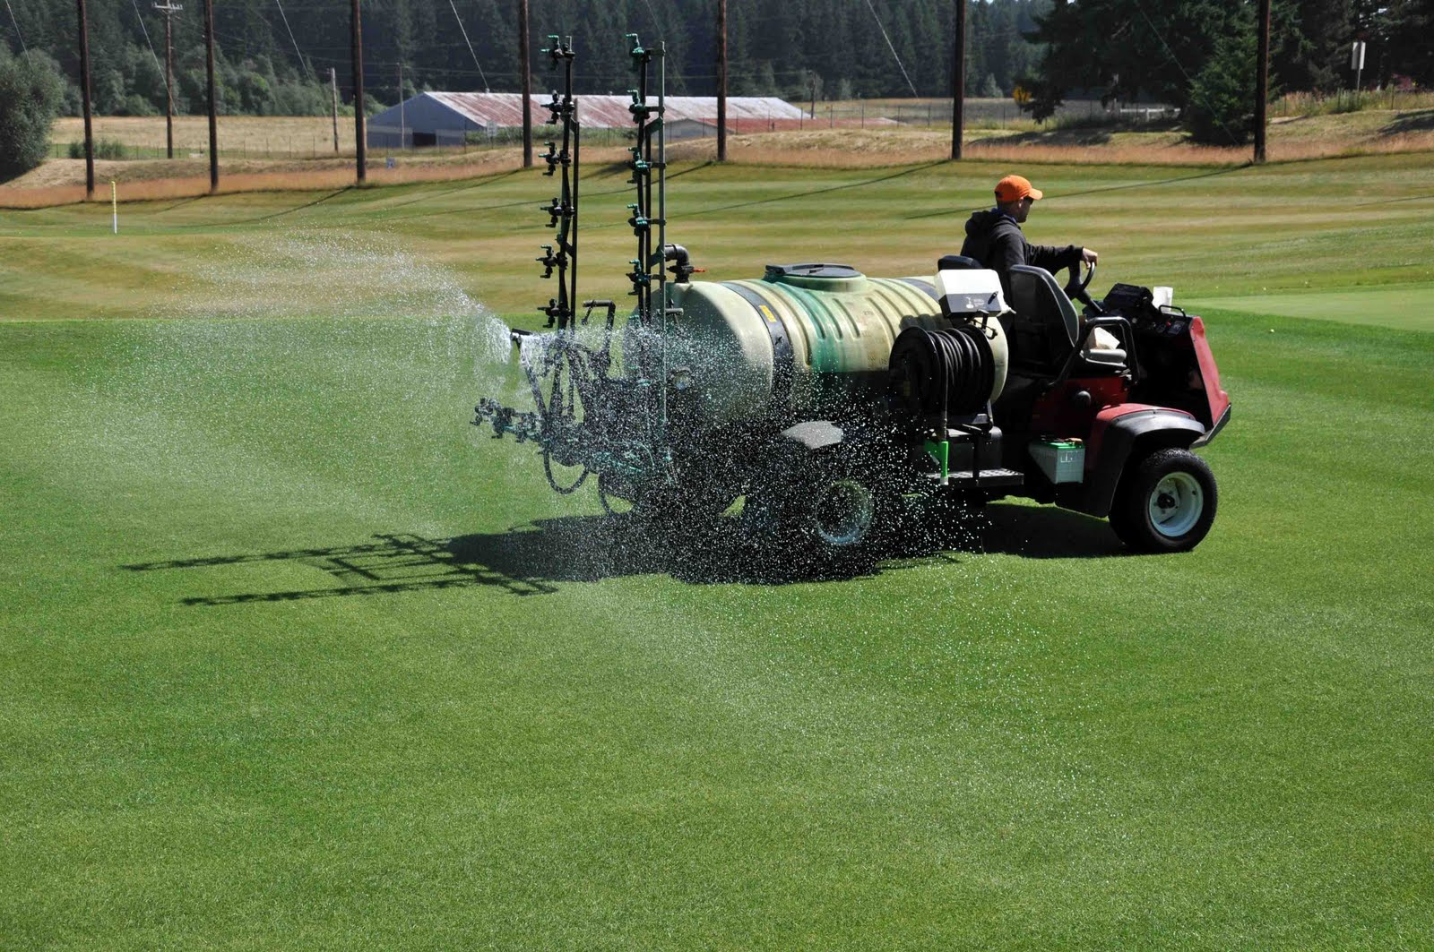
How to Calibrate
How Wide?
Width x 80-85%

Slide 4
Calibration Table
Spray Width (Feet) | Calibration Distance (feet)
40 | 85.1
36 | 94.5
30 | 113.4
28 | 121.5
24 | 141.8
20 | 170.2
18 | 189.0

Slide 5
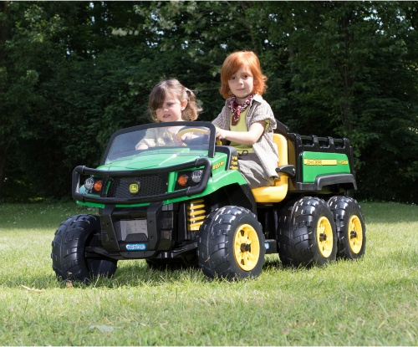
Measure the Course; Time at spraying speed

Slide 6
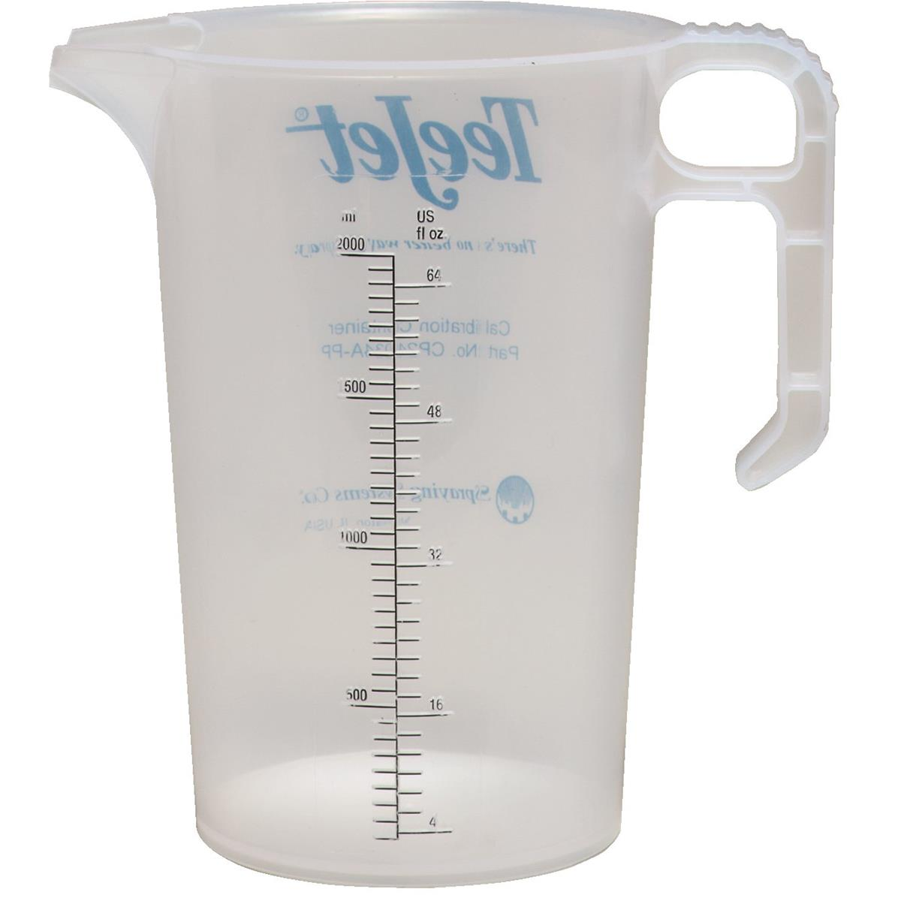
Measure Nozzle output

Slide 7
Divide result by 10
Ounces collected
Divide amount by 10
Gallons per acre

Slide 8
Summary
Sprayer width/.85 is 30 Feet
Distance = 113.5 Feet
Took 23 seconds to run distance (half load)
In 23 seconds, nozzle expelled 180 ounces
180/10 = 18
18 gallons per acres is the sprayer’s output

