Slide 1
Partnering with Virginia Cooperative Extension for STEM Enrichment
Ruth Wallace, Sr. Extension Agent, 4-H Youth Development, Buckingham County
Jennifer Bowen, Sr. Extension Agent, 4-H Youth Development, Mecklenburg County
Jake Morgan, Extension Agent, 4-H Youth Development, Prince Edward County

Slide 2
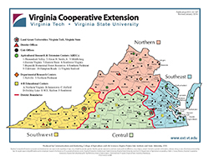
Virginia Cooperative Extension: The best kept secret in the Commonwealth
VCE brings the resources of Virginia’s land-grant universities, Virginia Tech and Virginia State University, to the people of the Commonwealth.
107 offices throughout the state covering every county, 11 agricultural research and extension centers, and 6 4-H educational centers
Program areas:
  Agriculture and Natural Resources
  Family and Consumer Sciences
      SNAP-Ed
  Community Viability
  4-H Youth Development
Notes:
Ruth

Slide 3
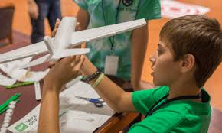

4-H National Mission Mandates
Citizenship
Healthy Living
STEM
Notes:
Jennifer – what is 4-H

Slide 4
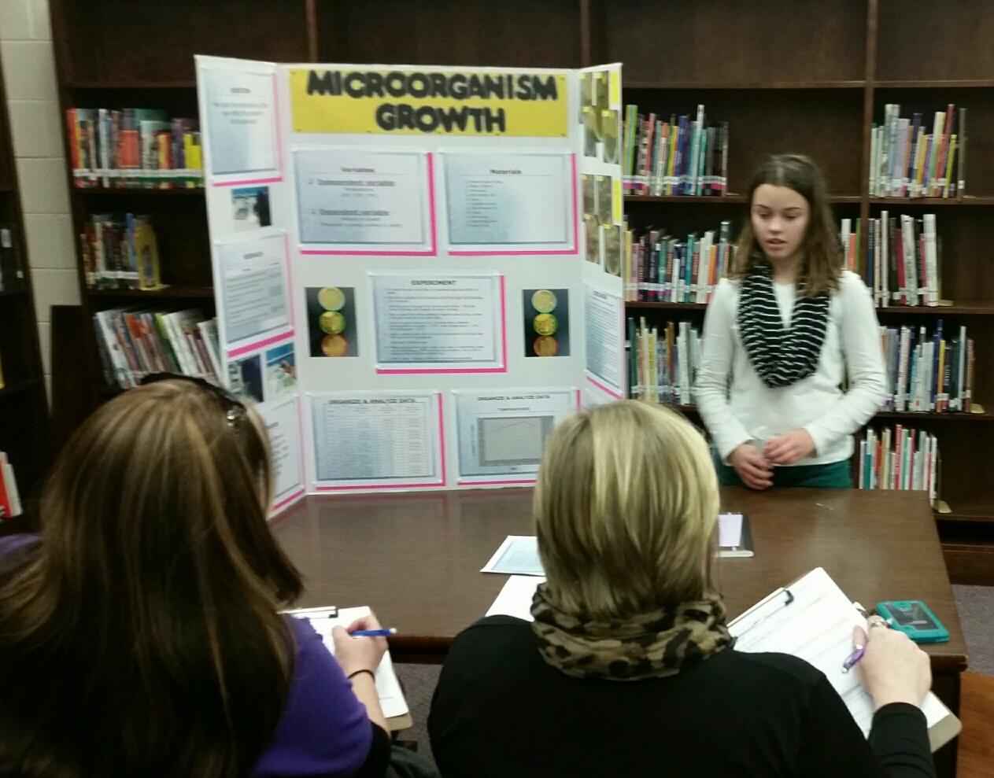
Ways to Partner in the Classroom
Traditional In-School Clubs
School Enrichment
  Ongoing
  Stand-alone programs
4-H Science Fair Partnership
After-School Programming
Resources and Training
All 4-H programs are SOL-based and can be tailored to meet the needs of each classroom.
Notes:
Ruth

Slide 5

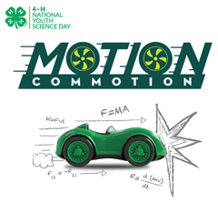


What can we offer?
National Youth Science Day Programs
  Drone Discovery
  Rockets to the Rescue
  EcoBot Challenge
  Wired for Wind
  Motion Commotion
  And more
Custom Designed Programs
Special Partnerships
Notes:
Jennifer
Special Partnerships – Jake

Slide 6
For example…
Tower Engineering
  Become structural engineers
  Build a small scale model of your tower using the materials provided
Notes:
Along with towers, structural engineers help design bridges, tunnels, ships, airplanes, warehouses, and even houses. When structural engineers design something, they must take into account the technical aspects of construction, environmental concerns and limitations, as well as the aesthetic properties of design. Structural engineers often build small scale models to test their designs, in
particular, to test the forces a structure will experience under different conditions.
A tower is a building or structure that is higher than its length or width. Towers can stand alone or be attached to adjacent structures.
Structural engineers must consider all the loads a building must bear. The dead load (the weight of the actual structure), the live load (the weight of the objects inside a structure, such as people and furniture), and environmental load (the natural conditions a structure must endure, such as extreme temperatures, high winds, and earthquakes).
When selecting designs and materials the engineers need to consider the balance between the forces of compression and tension. Tension is the pulling force created by stretching a material or pulling it apart. When materials are put under tension they become strong and inflexible. Compression is the opposite of tension. Compression is a pushing force created by pushing or squeezing a material together. Generally, in most structures compression supports most of the load in a building, as gravity is always pulling everything downward. Most materials can bear a lot of compression in one direction end to end but very little in another. If a straw is compressed end to end then it is very strong, but when squeezed on its side the straws cannot support much and folds flat. Engineers need to know how to use the building materials they are given so a balance of tension and compression can support the loads that the structure will be under.
What things do you think engineers have to think about when they are designing and building a tower? (Some examples include how to reach the required height, how to achieve balance, how to make the base wider than the top, how to make the tower sturdy enough to withstand wind, and what design to use so the tower is good to look at.)
National Afterschool Association. (n.d.). STEM Gems: Tower engineering challenge. Retrieved from https://naaweb.org/resources/stem-gems

Slide 7
Your Towers
Which tower will stay standing the longest?
Which tower is the tallest?
Which tower used the least resources?
Which tower is the most eye catching?
Notes:
Sample Processing Questions
Have any of you ever been in a tower/sky scraper? Can you describe it? Where were you?
What is the definition of a tower? Does what you built fit the definition?
What can you share with us about the tower your group built?
What problems did you encounter while building your tower? How did you overcome them?
What would you choose to change about your tower, if I let you do it again?
Based on your experience with this small tower, what things do you think structural engineers need to think about when designing a tower/sky scraper?

Slide 8
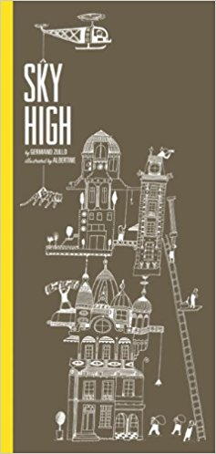
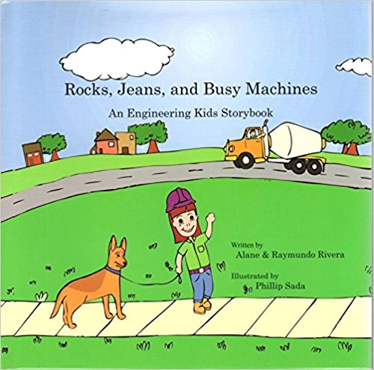
Connections to Other Academics
Math
measuring dimensions of the tower, counting number of pool noodle sections used, etc.
Reading/ Language Arts
skills through reading short stories that involve towers such as:
Sky High written by Germano Zullo and illustrated by Albertine
Rocks, Jeans, and Busy Machines: An Engineering Kids Storybook
by Alane Rivera and Raymundo Rivera
and writing their own!
Social Studies/History
talking about and investigating existing tall towers such as:
Big Ben,
the Eiffel Tower,
the Leaning Tower of Pisa,
the Empire State Building,
and the tallest building in the world – the BURJ DUBAI in Dubai, United Arab Emirates
(1/2 mile tall – 162 floors)

Slide 9
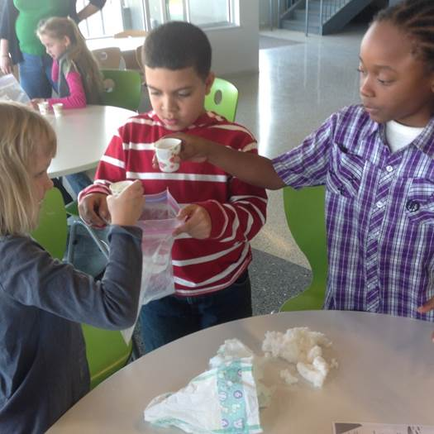
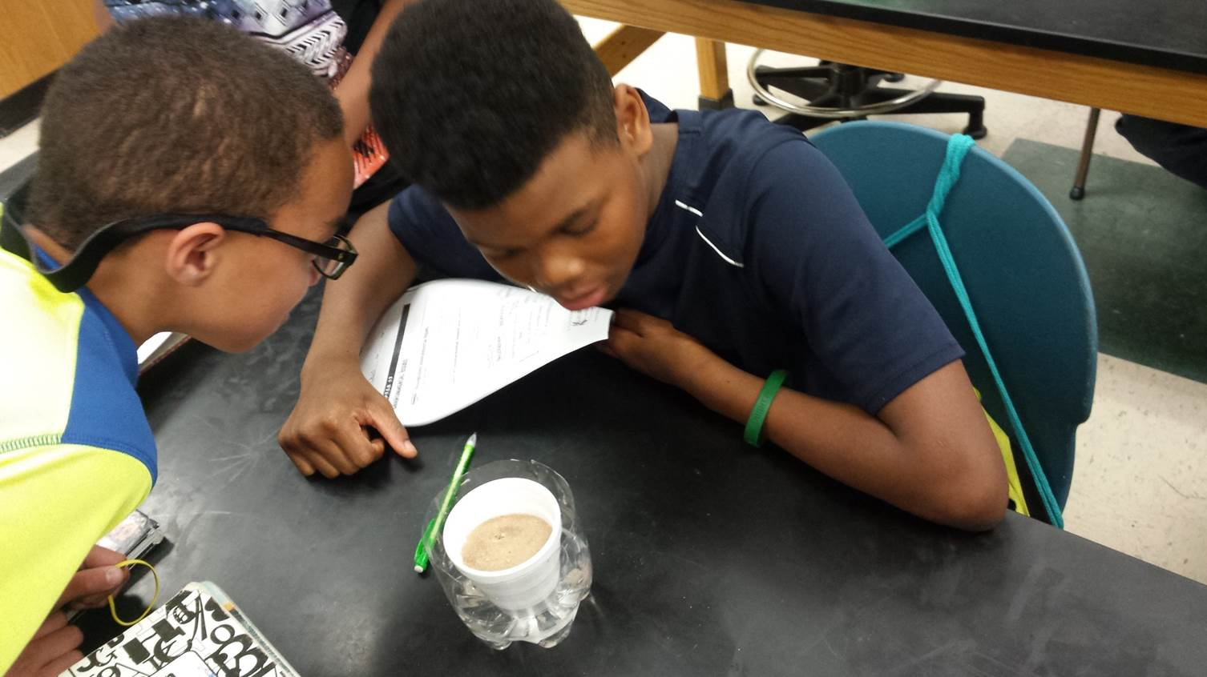
Getting Started in Your County
Contact your local Extension Office
www.ext.vt.edu (Click on “Local Offices”)
Notes:
Jennifer

