Slide 1
Network of Epidemiology Digital Objects
Naren Sundar, Kui Xu
Client: Sandeep Gupta, S.M. Shamimul
CS6604 Class Project

Slide 2
Outline
Problem Statement
Requirement Specification
Related work
What a human would do?
Modeling
Evaluation

Slide 3
Client Problem Statement
CINET
Computational and analytic environment for network science research and education.
Goal: A RDF graph building service
Web crawling for contents related to epidemiology
RDF representation to interconnect digital objects

Slide 4
Client Problem Statement
Requirement: Build a connected network of:
Papers
Wiki pages
Websites
Videos
Other digital objects pertaining to epidemiology
Representing using RDF for future graph analysis.

Slide 5
Refined Problem Statement
Strongly connected digital objects & metadata
Include metadata to model the connection
Better represent the underlying correlation among digital objects
Given a search request, provide resulting DO network:
Include all related digital objects
Strongly connected DOs are more related

Slide 6
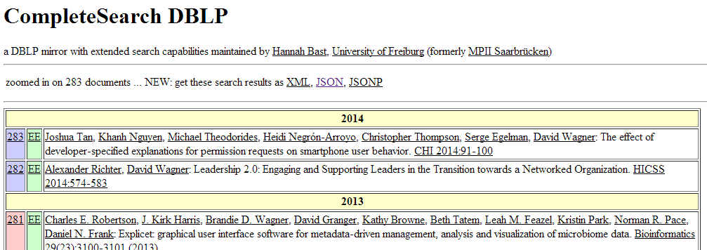
Refined Problem Statement
Automated process
Web exploration
Network construction
Restricted digital objects
Research papers
Web crawling (search engine from dblp)

Slide 7
Meta-data for DO
Authors, key words, publisher, year
Given papers {Paper1} {Paper2} {Paper3}
P1: author1, author2, publisher 1, 2011, {keywords}
P2: author2, author3, publisher 2, 2012, {keywords}
P3: author 3, publisher 2, 2011, {keywords}
The resulting network through the meta-data:
author1
author2
2011
author3
Paper2
2012
Paper1
Paper3
publisher1
publisher2

Slide 8
Requirement Specification
Undirected crawling or normal search engine not sufficient:
Results un-organized
Little specialization
Ambiguity
Relations and connections not available

Slide 9
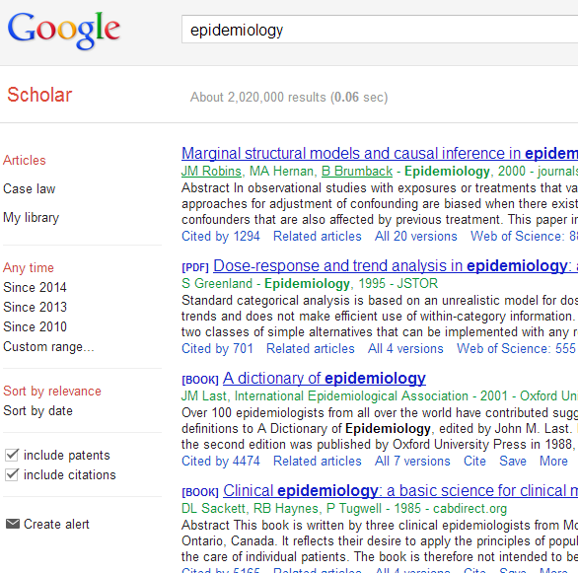
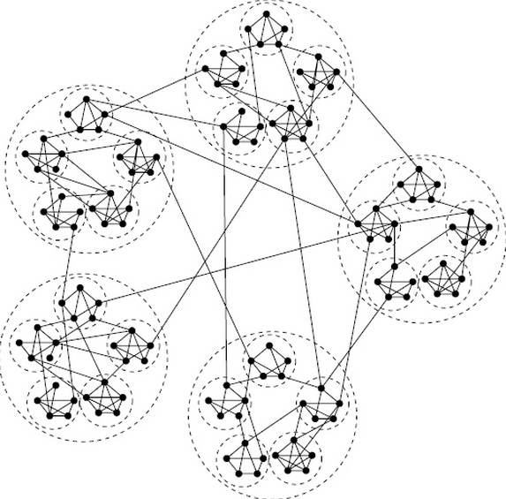
Requirement Specification
What’s available
What we want
Notes:
What we get vs what we want
Return a collection of networks centered on same query
List of papers – underlying network
Loosely linked between, strongly inside, different areas, but related to original search

Slide 10
Related Work
Web crawling topics
Building efficient, robust and scalable crawler
Traversal order of the web graph
Re-visitation of previously crawled content
Avoid problematic and undesirable content
Crawling “deep web” content
Christopher Olston and Marc Najork. 2010. Web Crawling. Found. Trends Inf. Retr. 4, 3 (March 2010), 175-246.

Slide 11
Why can a human do this better?
A user is interested in “Disease propagation”
Set N = {Disease propagation}
Search using N and gets R
Splits R into A and B
Selects A as relevant; extracts terms and connections; augments N
Ignores or stashes away B
Repeat from 1 with updated network N

Slide 12
Desired Property 1: Connected Growth
A relevant paper shares nodes and edges in the network N
Not all of the paper becomes relevant at once
What is shared changes over time
Author1
Keyword1
Abstract1
Coauthor1
Keyword2

Slide 13
Desired Property 2: Grouping
Only a small fraction of a document is shared with network N
The rest is used to group papers
Paper1
Paper4
Paper2
Paper3
Paper5

Slide 14
Modeling: Digital Object
Is represented as a set of edges
D_{i} = {(x₁,y₁),…, (x_{n},y_{n})}
Connections are determined by predicates over kind of vertex
(x,y): Paper p, authored by x, is published in y
From a generative point-of-view, an edge in a paper comes from
A shared network
Or, a local network

Slide 15
Modeling: Split-View of Digital Object
A paper’s edges can be split into two parts
D_{i} = S_{i} + E_{i}
Shared set: S_{i}
Local set: E_{i}
D_{i}
S_{i}
E_{i}

Slide 16
Modeling: Grouping
Each D_{i} belongs to a group
Groups are determined w.r.t. unshared edges E_{i}
No need to determine number of groups beforehand
D_{i}
S_{i}
E_{i} in G_{k}

Slide 17
Modeling: Network
Connectivity
Allow (x,y) only if x is reachable from root nodes
Smoothness
Allow (x,y) only if path connecting to x from root has decreasing weights
Edge is either shared or local based on
satsifying connectivity and smoothness constraints when shared.

Slide 18
The Entire Process
Model
Human
Start with root nodes, e.g., “Disease propagation” in N
Generate search query from N
Crawl and add new digital objects
Learn random variables for sharing (Si, Ei) and grouping (Gi)
Goto step 2
Set N = {Disease propagation}
Search using N and gets R
Splits R into A and B
Selects A as relevant; extracts terms and connections; augments N
Ignores or stashes away B
Repeat from 1 with updated network N

Slide 19
Evaluation: Against a Search Engine
Goal: Relevance
Set a starting topic
Perform k related queries
Let R_{i} be the sets of query results ranked by the search engine
Learn network N
For each paper p selected by N
Get best rank of p according to R_{i}
Compare ranks against relevance determined by N
Are there lowly ranked results that are higher in N and vice versa?

Slide 20
Evaluation: Against a Digital Library
Goal: Completeness
Pick a digital library for digital objects with a categorical browsing service
Pick a starting point
Learn network N
Evaluate completeness of network N against the digital library

Slide 21
Thank You!
Questions?

