Slide 1
Front End
Final Presentation
CS 5604 Information Storage and Retrieval, Dr. Edward Fox
Rachel Kohler, Patrick Sullivan, Reza Tasooji
Dec. 6, 2016
Virginia Tech, Blacksburg, VA 24061

Slide 2
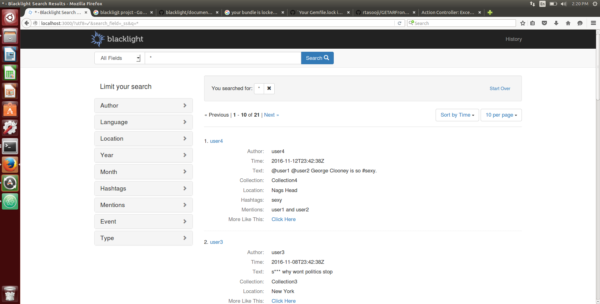
Overview
Notes:
Rachel
First we’d like to give you a high level idea of what our team accomplished over the course of this semester, before diving into more detail about our processes and implementations.

Slide 3
What we accomplished this semester
Choose a front end development framework that would work for our needs
Build a knowledge base for Rails and Blacklight
Learn and finalize the data
Build the front end for an information retrieval system from scratch which displays accurate data in an efficient way
Notes:
Rachel
Here are some of the large undertaking we accomplished this semester. We started the semester with no previous work to build from. This meant, we had the task of developing this interface completely from scratch.
We knew we could not use Hue and Blacklight was suggested, but no one had ever tried to implement the interface for this system in Blacklight and we weren’t even sure if it was possible. Therefore, our first major effort was focused on choosing a development tool.
After choosing the tool and proving it would work, we had to learn the various components of this tool including Ruby on Rails and some Solr. The information learned has been complied in our final report to smooth the steep learning curve for future teams.
Another large undertaking of our team was coordinating with the other teams to produce a schema and data mapping. Our team had to become very familiar with all other team’s data and coordinate the effort to consolidate and present coherent information to the end user.
Finally, the majority of our semester was spent building a working interface from the ground up. The final deliverable of our team is an interface which presents accurate information to a variety of users in an understandable and efficient way.

Slide 4
Verification of Tools and Platforms
Previous Semester:
HUE
Recommended:
Blacklight
Others:
Elasticsearch
Kibana
Fusion
Custom using Solr API
GETAR needs a front end to be a viable information retrieval system.
Many user tasks that must be included in the verification process: query, refine search, browse, visualize, analyze, etc.
The front end is the communications channel between the IR system backend and the user.
Notes:
Our first task of the semester was to choose a UI interface platform to start developing.
Our Frontend is communications channel with user, so it has a large effect on the user’s evaluation of the retrieval system.
We made a GETAR frontend that supports user tasks: query, refined search, visualize, and analyze.
These are the options that we were presented with in choosing a frontend for the IR system. We only started with a recommendation the Blacklight platform as a frontend. We did investigate these other possibilities, but found that Blacklight will meet all our requirements.

Slide 5
Blacklight versus HUE
 | HUE | Blacklight
Category | Tool / GUI | Framework / GUI
Audience | Collection admins, Data scientists | Depends on chosen design
Goals | Collection visualization, advanced analysis. | Search engine, Document viewing, Query results
Coupling | Integrated with backend (Cloudera Search) | Low Coupling. Multiple instances possible.
Notes:
HUE is heavyweight and premade with tasks in mind, while BL is an open framework where customizing views and formatting documents are possible.
BL audience is anyone who you design the UI for, anything can be hidden or shown as you would like.
HUE has UI that includes SQL and other advanced knowledge, which is no good for K-12 students who would use frontend.
HUE is built to display entire collection sets, individual documents will show the literal column headers and all information. BL has configurations for showing and hiding any features of documents.
HUE is integrated with Cloudera Search, where the performance of one directly affects the other.
Blacklight is lightweight and only requires communications with Solr API, this also means we can multiple instances of BL connected to any one Solr.

Slide 6
Ruby on Rails
Server-side web application MVC framework for Ruby
Pros:
  Same web application can have different environment with different gems.
  Different gems can be added in anytime
Cons:
  Rails is a framework.
Notes:
What is going to present: Ruby on rails as a MVC framework.
Rails cons: as framework changing what is already there will be challenging and some time impossible. Because it is framework this is what you get it.

Slide 7
Rails Architecture
Rails Framework
Browser
Web Server
Public
Routing
Controller
View
Model
Database
Notes:
Reza

Slide 8
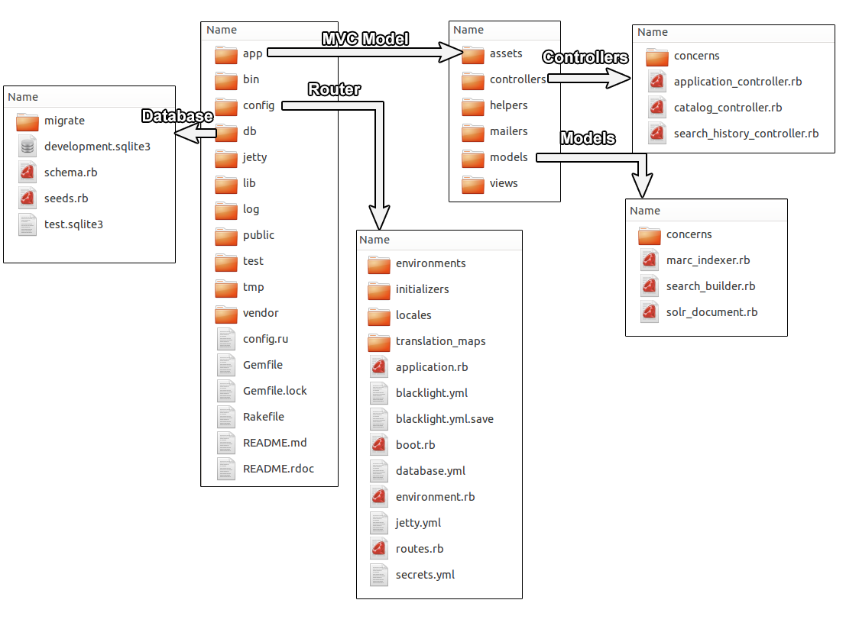
Rails Architecture
Notes:
Little information about Database and advantage of having this structure.
Our front-end have it’s own database to hold user information. This has nothing to do with databaseon cloudera and all information can be stored in local database using sqlite. The database can be any relational database the one that we used is sqlite. Why because it is not server based database such as mysql and it local database. Patrick will go in more detail about this.
These are the files that we need to change for views. controllers .

Slide 9
Ruby gems
Bundle-gem: Clean way to manage different gems and their dependencies.
Rsolr: A Ruby client for Apache Solr.
Blacklight: Provides a basic discovery interface for searching an Apache Solr index.
Date range limit: Integer range limiting
Devise: Flexible authentication solution
Blacklight advanced search for implementing more like this search handler
GeoBlacklight: Discovery and access for geospatial data
D3 on rails for visualization using AJAX
Notes:
We explored and used different gems through semester. Here are some of the gems that we added to achieve our goals. Some of these gems comes with any rails framework but some of them needs to be added.
Bundle-gem: with this we hope next group does not have any problem figuring what we used. They can easily add or edit or even completely remove some gems. The good part about bundler is provided and environment to explore different gems without breaking previews funtionality.
Now, some of these gems are now working fine and they are fully implemented but for some of them such as D3 and geoblacklight, we explored gems but they are not implemented in final report which we are going to cover why such as geo blacklight and D3.
BlacklightG

Slide 10
Blacklight as a Gem
Features:
Stable URLs
Provides JSON, RSS, and Atom (XML) responses.
Faceted searching
Search queries can have different sets of fields
Results sorting
Records can shared via email, SMS or exported as formatted citation
Pros:
  Does not require local access to Cloudera
  Works with any version of Apache Solr
  Has facet search result
  Has easy CRUD functionality
Cons:
  Learning curve of Rails architecture and framework
Notes:
Reza

Slide 11
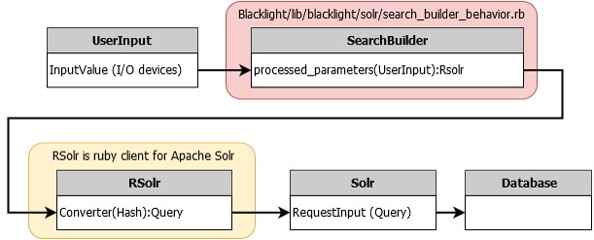
Blacklight
Router:
Blacklight.yml
Router.rb
Controllers:
Catalog_controller.rb
Notes:
Reza

Slide 12
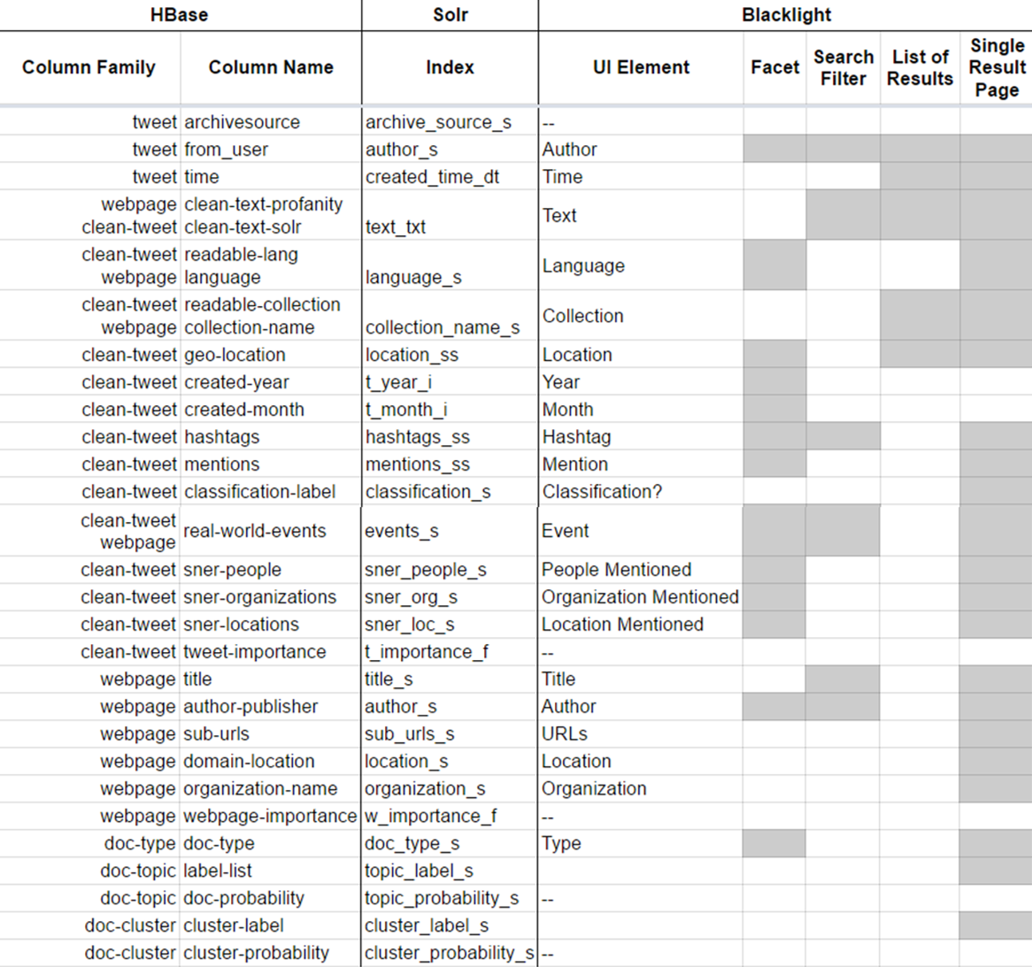
The Data
Notes:
Rachel
Our team was responsible for working with the SOLR team to generate a complete schema for the data collected and generated by the various teams as well as mapping this data from the schema to the various representations and elements in the interface.
The SOLR team generated a schema from the various columns in HBase. Our role was to modify and generate a final schema that would serve the needs of the end users by indexing and storing the correct fields for future display. This was an iterative process that involved much collaboration between all teams.
After generating the final schema, our team also had to undertake the task of mapping this data to the UI elements. We had to decide what data to show, where to show it, and in what way. This was also an iterative process that involved collecting feedback from the other teams and making necessary changes. We produced a data mapping document to support and document this work.

Slide 13
The Interface
Notes:
Rachel
So know I want to talk a little bit about how the out interface supports this data

Slide 14
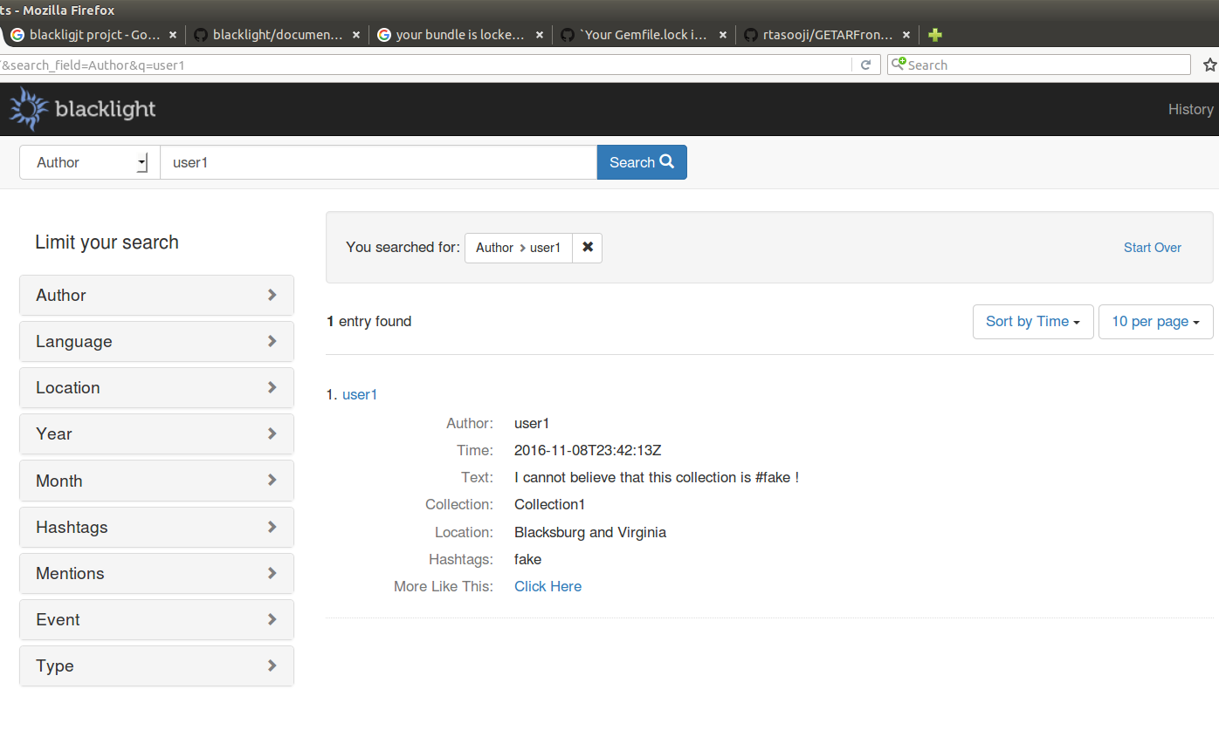
Query
And
Results
Notes:
Rachel
The interface supports query capabilities which are consistent with the users’ mental models of a retrieval system. The user enters a keyword or phrase and the interface will show the user the results which are relevant to that query. The ranking of results represent the ranking function that has been provided by the Solr team. Each result displays only some of the information available for the document so as to keep the results page uncluttered and easy to browse through.

Slide 15
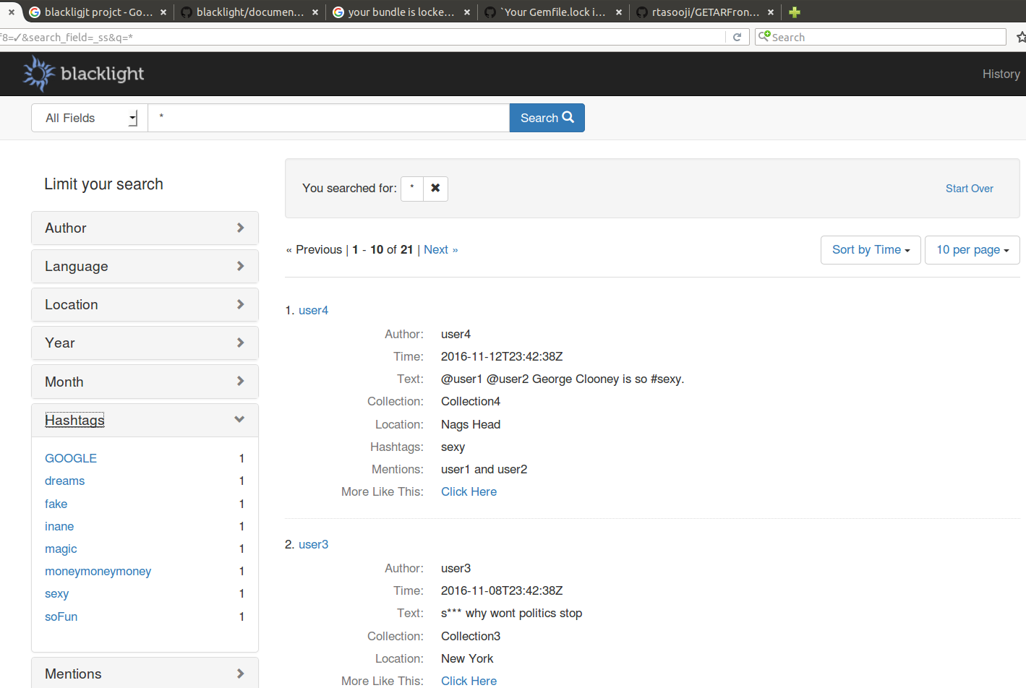
Faceted Search
Notes:
Rachel
Users may narrow search results for a query using search facets. Selecting a facet will show only those documents that are relevant to or categorized within the selected facet(s). The number next to the facet indicates how many of the results are within that facet. These facets can be selected individually or used in combination and multiple selections can be made per facet. Multi-value columns in HBase have been split to display as individual facets.

Slide 16
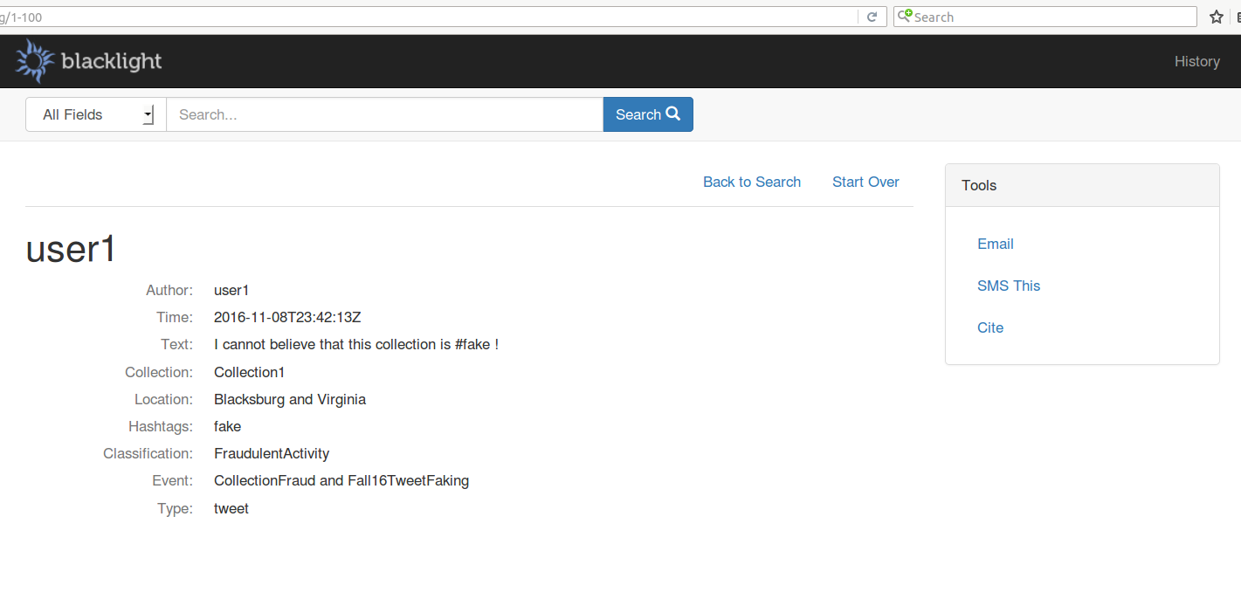
Additional Information
for a
Document
Notes:
Rachel
Users may explore additional information about a document by selecting the document. All HBase columns which were determined to be relevant to an end user are displayed on this page and data is displayed in a human readable and comprehendible format. Data labels are consistent across all pages and UI elements so as the meet the users’ needs of consistency and supported expectations. Information is presented so as to prevent profane content from reaching an end user.
While there are other interface features, these are the main features which support the user in working with this system.

Slide 17
User Authentication (UA) and Activity Management
User signup using email
User login with email and password
User can save documents and searches
User activity is logged in server log
Notes:
We enabled User authentication that is typical of most websites.
Users signup using their email and make their own password.
Users can save documents and search to their accounts to use later on different computers
All user activity and Solr responses are logged.

Slide 18
UA with Devise
Blacklight can use many different user authentication management systems, but is designed for Devise UA
Users Table
Username, password, email, type, IP address
Useful for user studies
Searches Table
User ID, user type, query parameters, time
Useful for planning new features
Bookmarks Table
User ID, user type, document ID, title
Useful for document impact and importance
Tables can be modified, created as needed
Notes:
These are the three main categories of information that we store in SQLite database tables
Users table has account information, as well as the user type and their login ip address.
This can be managed and analyzed for studying the users that interact with the IR system.
The searches table shows what a specific user queries the collection for. Useful for understanding typical user behavior on IR system.
The bookmarks table shows a user’s saved documents. These documents are chosen by the user to have a high value and contain valuable information.
We made this flexible, we can add tables and modify these tables as much as we need to improve the IR system.

Slide 19
Future Work
User Authentication
GeoBlacklight and Leaflet
Visualizations
Notes:
While there are a few miscellaneous tasks we could not complete due to time restrictions and external team dependencies, we would like to mention some high level objectives we think the team that follows us should focus on implementing. We believe these will go a long way to enhancing the interface.

Slide 20
User Authentication, Activity, and Management
Improvements from the users:
Security from outside IP addresses
User types can have specialized views
Improvements from the queries / searches:
Analyzing user activity, experience
Plan areas for additional features
Improvements from the documents:
Bookmarked documents indicate overall impact
Relevance feedback for particular query
Notes:
User Authentication activity and management is the real-time interaction of users with the IR system
User information can improve the IR system by allowing us to permit or restrict certain user types or IP addresses from certain views or even accessing the IR system.
The recorded queries of users can aid the IR system by showing ‘gaps’ in collection knowledge on a certain category. This also provides a way of refining the user experience to match or support the tasks they commonly perform.
Saved document information, such as bookmark counts, allow us to implement one type of relevance feedback into our IR system. Documents that are commonly bookmarked can be given additional impact value and count as more relevant for their terms in the document.

Slide 21
GeoBlacklight
and
Leaflet
Implemented for Solr jetty
For GETAR and IDEAL:
Requires Solr 4.7+ (Current version 4.1)
schema.xml
solrconfig.xml
Better tool to explore in future: Leaflet for Ruby
Notes:
Leaflet open source interactive map
Or just use geographic information using d3

Slide 22
D3 for rails
Json in Blacklight
Using Json result from Blacklight for visualization in D3
Search result
/catalog.json?search_field=all_fields&q=auckland
Facet list
/catalog/facet/subject_topic_facet.json
Our Current progress
Implemented D3 for simple Json data
Notes:
Rachel
Recently, we have gone through an effort to set up D3 visualizations in the the Blacklight interface. While we do not currently have any data to visualize, we went ahead and completed the necessary steps to implement a working visualization in Blacklight which visualizes simple JSON data for a proof of concept and to provide additional support for the team that follows our work. Details on how to implement D3 visualizations in Blacklight will be provided in our final report.

Slide 23
Conclusion
Special thanks to
Dr. Fox
Sunshin Lee (congratulations on defense!)
SOLR Team
Notes:
Rachel
In conclusions, our semester effort have led to a complete working user interface for this information retrieval system. Additionally, our final report will be a valuable resource to help smooth the learning curve for the next team. We’ve enjoyed working with the other teams on this project and are proud of the accomplishments we have achieved this semester.

Slide 24
Acknowledgements
IDEAL¹ project
NSF Grants:
IIS-1319578
GETAR² project
NSF Grant:
IIS-1619028
http://vtechworks.lib.vt.edu/handle/10919/47942
http://www.ctrnet.net/sites/default/files/GETARsummaryWeb.pdf
Notes:
Rachel
In conclusions, our semester effort have led to a complete working user interface for this information retrieval system. Additionally, our final report will be a valuable resource to help smooth the learning curve for the next team. We’ve enjoyed working with the other teams on this project and are proud of the accomplishments we have achieved this semester.

Slide 25
Questions?

Slide 26
Appendix
Some functions for Blacklight in Catalog_controller.rb:
config.add_facet_field
config.add_index_field
config.add_show_field
Config.add_search_field
To display the result correctly, each field needs to have their own flags in schema.xml

Slide 27
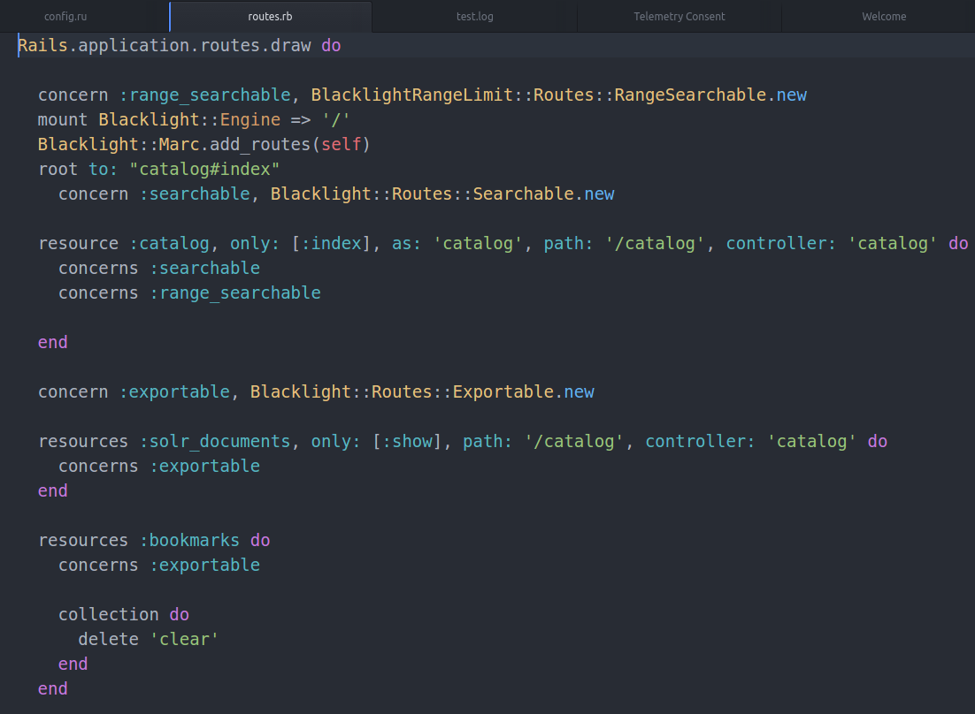
Appendix
Router.rb:

Slide 28
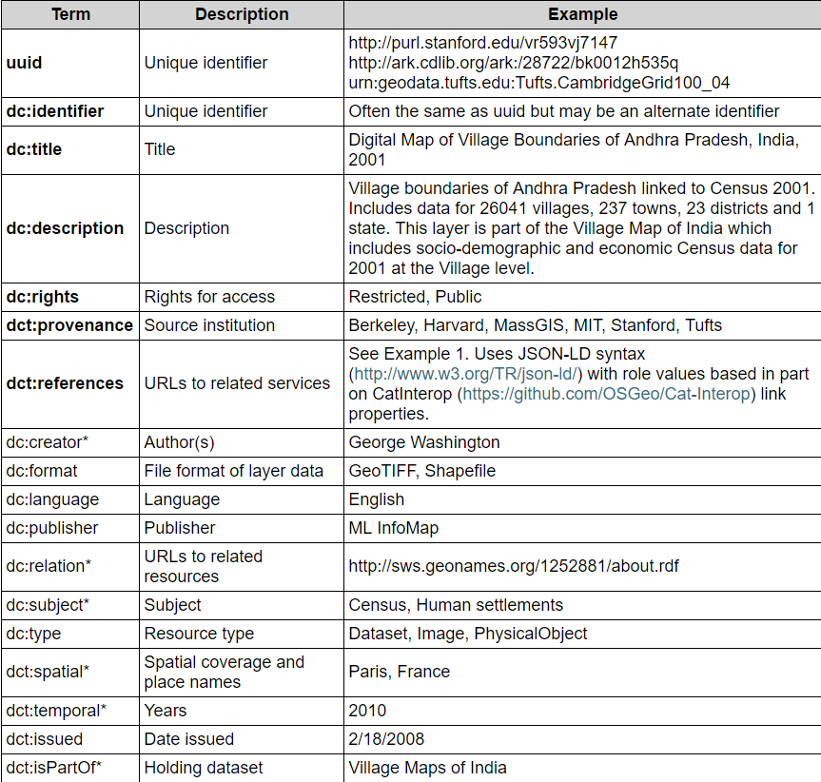
Appendix
GeoBlacklight Schema:
Dublin Core Metadata Initiative
Source: http://journal.code4lib.org/articles/9710

Slide 29
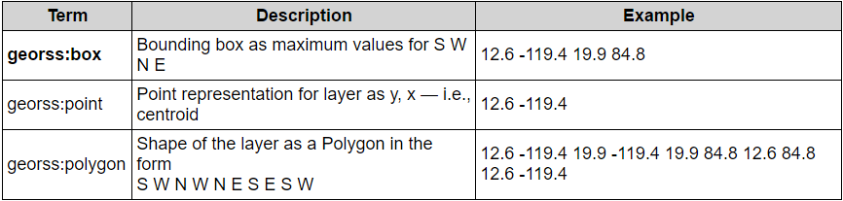
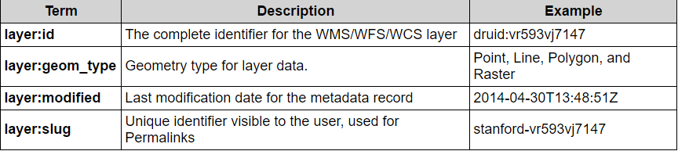
Appendix
GeoBlacklight Schema:
Geospatial features:
Layers information:
Source: http://journal.code4lib.org/articles/9710

