Slide 1

Text and Data Mining for Systematic Reviews
Investigating Trends to Update Collaboration Services
Virginia Pannabecker
Virginia Tech, University Libraries

Slide 2

Background:
Researchers with limited time
Notes:
When discussing project planning for systematic reviews and meta-analyses with faculty and graduate students, librarians sometimes hear wistful inquiries about automated approaches. Systematic reviews (SRs) require management, analysis, and synthesis of large amounts of data, perhaps particularly those including numerous studies with qualitative text-based data. To investigate how text and data mining approaches might be used in SRs to increase project efficiency, the author conducted, and will report on the results of a literature review.

Slide 3

Research Questions
In Systematic Reviews and Meta-Analyses:
To what extent are text and data mining used?
What theoretical approaches or protocols are described to guide text or data mining?
What tools, techniques, and specific methods are used to accomplish text and data mining?
What potential do these methods show for increased efficiency?
Question Mark Cookies 4, via Flickr, by Scott McLeod, licensed with a CC BY 2.0 licence.

Slide 4


Methods
Web Searches:
Text and data mining for systematic reviews - first 5 pages
Text data mining research papers - first 2 pages
Followed related links
Total: 79
Advanced search: ‘any’
Skimmed list of 111 tools for ‘mine’
Total: 5 - Pimiento, PubReminer, SWIFT-Review, Systematic Review Assistant (prototype), and Weka

Slide 5
Methods
Literature Searches: keywords and index terms for text mining, data mining, systematic reviews, meta-analyses, evidence synthesis
Example PubMed Search: (mining[tiab] OR "data mining"[mesh] OR "information extraction") AND ("systematic review" OR "systematic reviews" OR meta-analysis OR meta-analyses OR meta analysis OR meta analyses OR metaanalysis OR metaanalyses OR "evidence synthesis" OR "knowledge synthesis" OR meta synthesis OR metasynthesis OR meta-synthesis OR sysrev_methods [sb])
CINAHL: 48 | Cochrane: 45 | Engineering Village: 1761 | Google Scholar: 200
PsycINFO: 12 | PubMed: 426 | Web of Science: 854 | Total w/Web: 3425

Slide 6
Results
3425 Records
- 880 Duplicates
2545 Records
Categorized via keyword searching of records:
58+ of publications discussing use of TDM techniques for SRs or MAs
24+ SR or MA studies using TDM techniques

Slide 7
Results -
Journals Publishing More than 1 Methods Articles
Journal | Number of Studies
Systematic reviews | 7
Research synthesis methods | 5
Journal of Biomedical Informatics | 3
Journal of clinical epidemiology | 3
Journal of the American Medical Informatics Association | 3
Artificial intelligence in medicine | 2
Information and Software Technology | 2

Slide 8
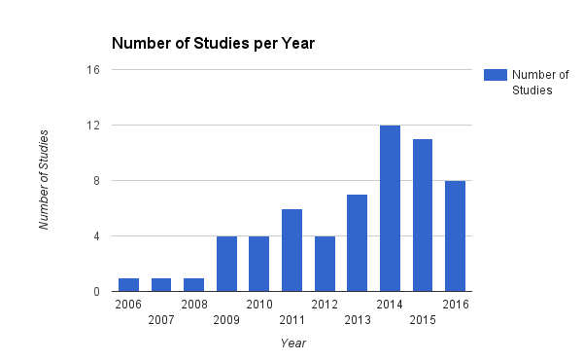
Results - Methods for Using TDM in SRs and MAs

Slide 9
Results - SRs or MAs Using TDM
Disciplines
Business - 2
Computer Science - 1
Education - 1
Health and Medicine - 19
Life Sciences - 1
TDM methods are used for: developing a search strategy, reviewing records for inclusion, identifying themes, extracting data

Slide 10
Key Readings
1.Paynter, R., et al., EPC Methods: An Exploration of the Use of Text-Mining Software in Systematic Reviews. 2016, Rockville (MD): Agency for Healthcare Research and Quality (US).
2.O’Mara-Eves, A., et al., Using text mining for study identification in systematic reviews: a systematic review of current approaches. Systematic Reviews, 2015. 4: p. 5.
3.O'Mara-Eves, A., et al., Erratum to: Using text mining for study identification in systematic reviews: a systematic review of current approaches. Systematic reviews, 2015. 4: p. 59.
4.Jonnalagadda, S.R., P. Goyal, and M.D. Huffman, Automating data extraction in systematic reviews: a systematic review. Systematic reviews, 2015. 4: p. 78.
5.Lefebvre, C., et al., Methodological developments in searching for studies for systematic reviews: past, present and future? Systematic reviews, 2013. 2: p. 78.

Slide 11
Text Mining Practices
Paynter, et al reference p. 1: Miner G, Elder J IV, Hill T, et al. Practical text mining and statistical analysis for non-structured text data applications. Waltham (MA): Elsevier, Inc.; 2012 Jan 25. 1000 p. - as a source for text mining practices.
Document classification - grouping and categorizing info based on trained models
Document clustering - grouping and categorizing info with data mining clustering
Information retrieval - retrieval and storage of docs, including searches
Concept extraction - grouping of words and phrases into similar groups
Information extraction - identification and extraction of facts and relationships from text
Natural language processing - (also: computational linguistics) tasks such as tagging parts of speech
Web mining - data and text mining on the Internet

Slide 12
Text Mining Uses for SRs
Paynter, et al reference: note that TDM is being used, or tested to support systematic review studies at each step:
Literature Search
Screening Records
Abstracting Data
Quality Appraisal
Review Updating

Slide 13
Results - Concerns regarding the use of TDM in SRs
Maximizing recall to ensure comprehensive study
Imbalanced datasets: Systematic Reviews often select only a very small number of studies (or sometimes no studies) out of hundreds or thousands reviewed
Understanding how text and data mining tools work - by those using the tools for SRs
Source for further discussion of these concerns: O’Mara-Eves, A., et al., Using text mining for study identification in systematic reviews: a systematic review of current approaches. Systematic Reviews, 2015. 4: p. 5.
[This slide was updated on September 28, 2016, following the September 27, 2016 presentation.]

Slide 14
Results - TDM Tools, Techniques, Methods Used with SRs and MAs
Tools to Consider
Table 5 (p22-23) and Appendix E (E1-E16) in Paynter, et al. 2016 - selected low-training, free, recommended tools include:
  Abstrakr
  PubReminer
More Tools
Systematic Review Toolbox
Additional Tools: ContentMine

Slide 15
Text, Data Mining, and Open Access
Licensing agreements for databases, lack of an API, or unavailability of papers may limit some applications of TDM for SRs or otherwise.
See the Association for Research Libraries’ Issue Brief on Text and Data Mining and Fair Use in the United States.
A good reason to encourage faculty to continue depositing manuscripts and datasets in institutional or other repositories.

Slide 16
Next Steps
Explore social sciences and policy text and data mining use and tools
Try one or more of these tools with researchers to investigate their ease of use and benefit for various contexts:
Quick Review to inform longer review protocol and process; to decide the value in conducting a longer, more thorough review
General Literature Review
Scoping Review
SR / MA

Slide 17
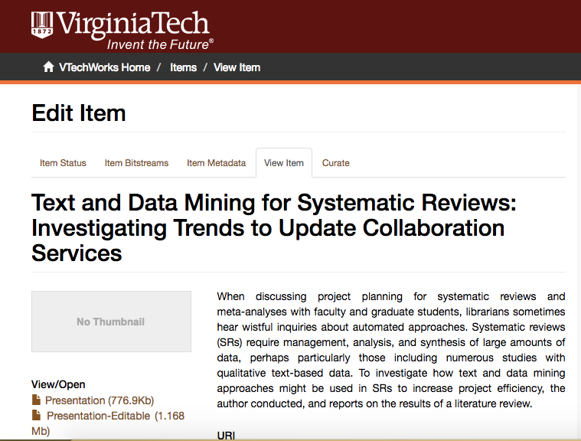
Files / Supplementary information
Files archived in the VTechWorks Institutional Repository: http://hdl.handle.net/10919/73042

Slide 18
Key Readings
1.Paynter, R., et al., EPC Methods: An Exploration of the Use of Text-Mining Software in Systematic Reviews. 2016, Rockville (MD): Agency for Healthcare Research and Quality (US).
2.O’Mara-Eves, A., et al., Using text mining for study identification in systematic reviews: a systematic review of current approaches. Systematic Reviews, 2015. 4: p. 5.
3.O'Mara-Eves, A., et al., Erratum to: Using text mining for study identification in systematic reviews: a systematic review of current approaches. Systematic reviews, 2015. 4: p. 59.
4.Jonnalagadda, S.R., P. Goyal, and M.D. Huffman, Automating data extraction in systematic reviews: a systematic review. Systematic reviews, 2015. 4: p. 78.
5.Lefebvre, C., et al., Methodological developments in searching for studies for systematic reviews: past, present and future? Systematic reviews, 2013. 2: p. 78.

Slide 19
References
Recommended Reading for Overview
[1-5]
Studies on Text and Data Mining Methods for Systematic Reviews
[1-57]
Systematic Review / Meta-Analysis Studies Using Text or Data Mining Methods
[58-81]
Full Reference list in VTechWorks Institutional archive record:
http://hdl.handle.net/10919/73042

