Slide 1
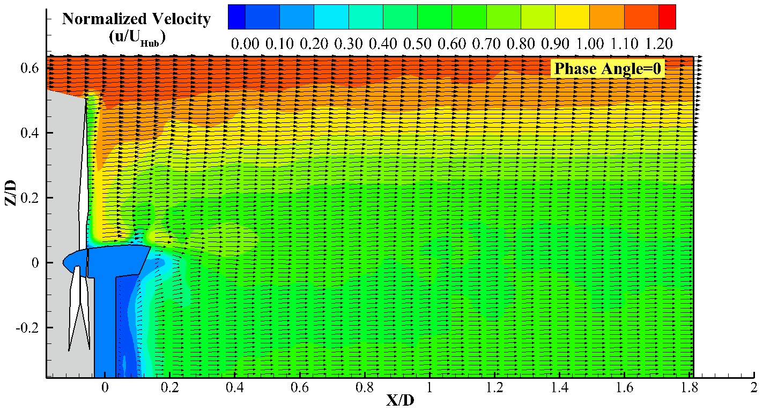
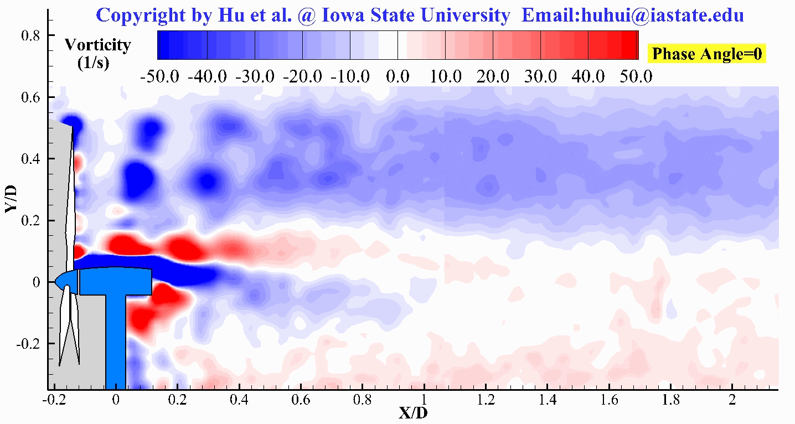
Analysis of Turbine Wake Characteristics using Proper Orthogonal Decomposition and Triple Decomposition Methods
Pavithra Premaratne, Wei Tian, Hui Hu
Advanced Flow Diagnostics and Experimental Aerodynamics Laboratory
Department of Aerospace Engineering
Iowa State University
2242 Howe Hall, Ames, Iowa 50011-2271

Slide 2
Contents
Motivation and Objectives
Experiment setup
Predicting velocity deficit in the wake
Triple Decomposition (TD)
Proper Orthogonal Decomposition (POD)
Future work (DMD)

Slide 3
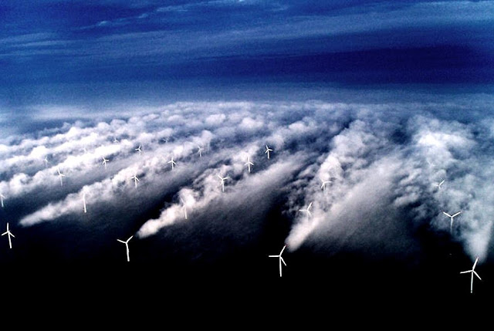
Motivation and Objectives
The study of wake behind a wind turbine is crucial in determining the wind farm layouts.
The study focuses on understanding the momentum recovery process through quantitative and qualitative analysis.
Image courtesy:
http://nstergiannis.blogspot.com/

Slide 4
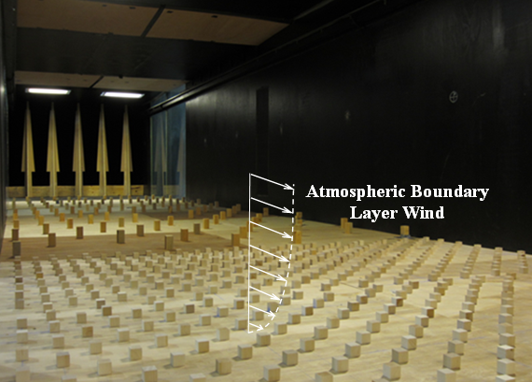
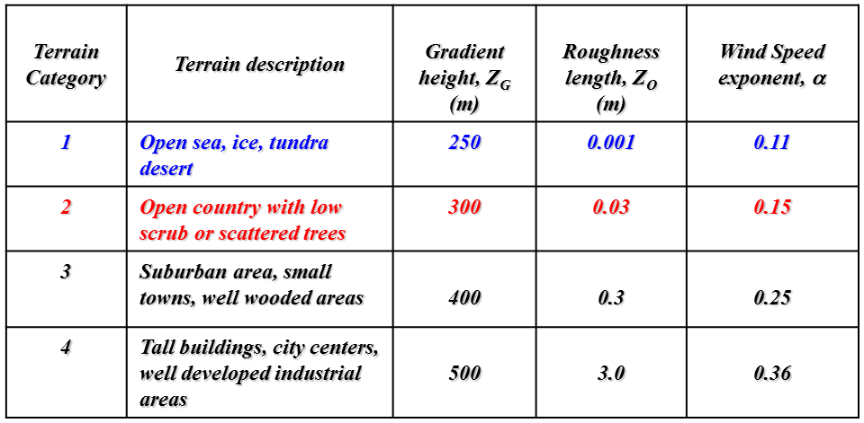
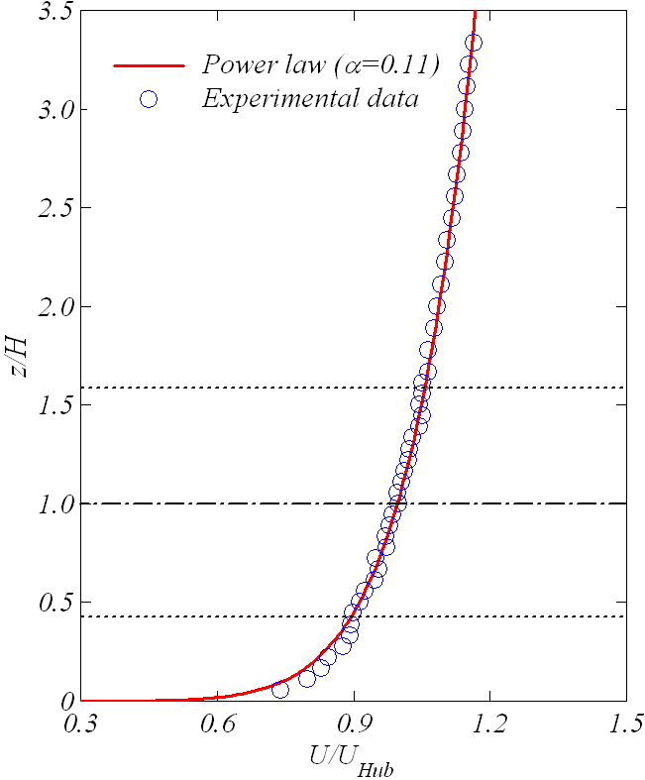
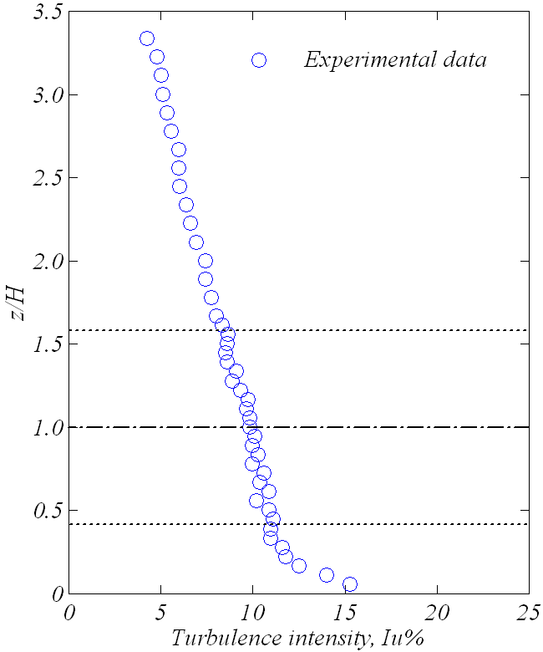
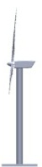
Simulation of Atmospheric Boundary Layer (ABL) Winds
Offshore wind farm (9.5% at hub height)
Architecture Institute of Japan
Hansen & Barthelmie, Wind Energ.2012;15:183–196

Slide 5
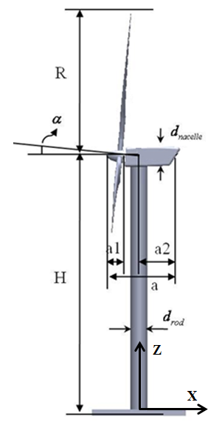

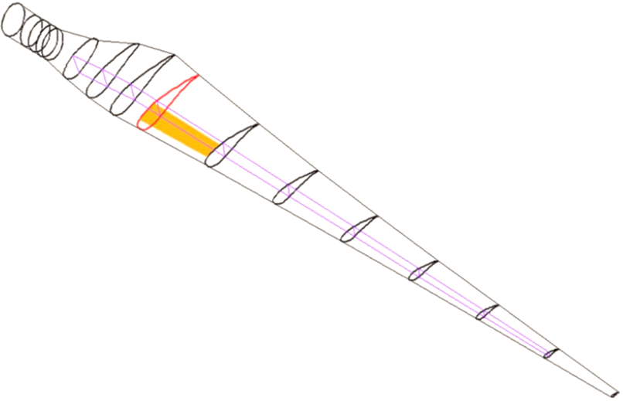

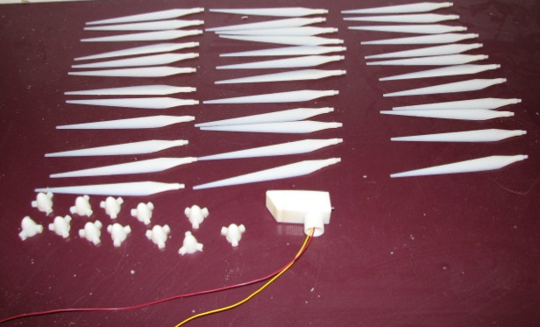

Wind Turbine Models
Parameter | R (mm) | H (mm) | d _{pole} (mm) | d _{nacelle} (mm) | α (deg.) | a (mm) | a1 (mm) | A2 (mm)
Dimension | 127 | 226 | 18 | 18 | 5º | 68 | 20 | 35
127 mm
1:350 scaled model to simulate a 2MW wind turbine
ERS-100 prototype of wind turbine blade developed by TPI

Slide 6
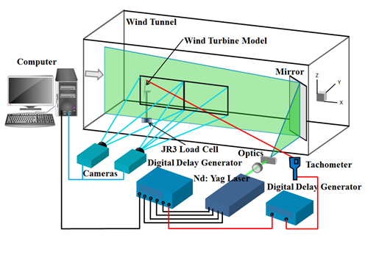
Experimental Setup
Test conditions:
Velocity at hub height U_{Hub} = 4.5 m/s
Chord Reynolds number, Re≈ 7,000
Rotation speed of wind turbine:
ϖ = 0 ~2200 rpm
Tip-speed-ratio, λ = 0 ~ 6.0
Measured parameters:
Wake flow field distributions
1000 snapshots for free run case
300 snapshots for phase lock case

Slide 7
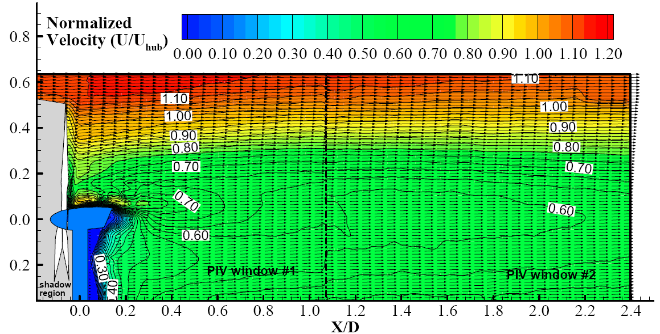
Velocity and Vorticity Distributions
Normalized Velocity distribution of ensemble average
Vorticity distribution of Phase Locked

Slide 8
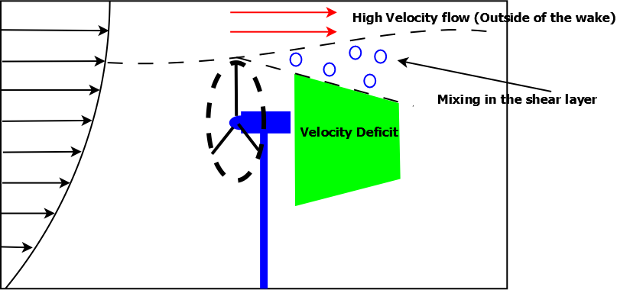
Wake Aerodynamics
Velocity deficit results in a shear layer
Turbulent mixing can be observed
High turbulence mixing shortens momentum recovery distance
Sanderse, Aerodynamics of wind turbine wakes:pg13-14

Slide 9
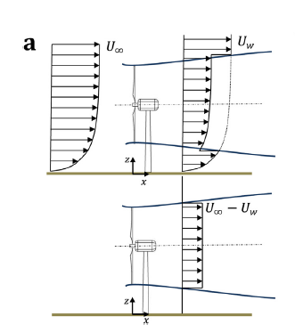
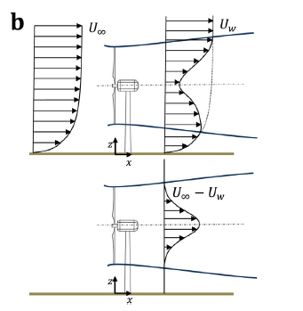
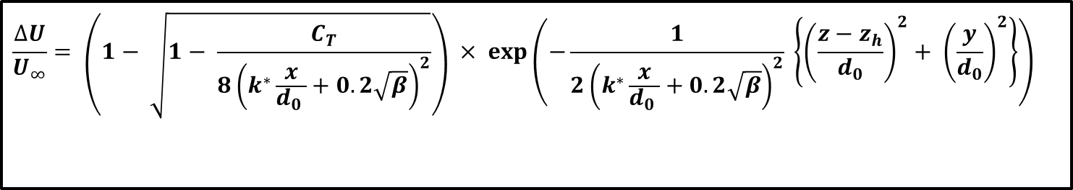
Analytical Wake Models
Top hat distribution
Gaussian distribution
$$\frac{∆U}{U_{∞}}= \left(1− \sqrt{1− \frac{C_{T}}{8{\left(k^{∗}\frac{x}{d_{0 }}+0.2\sqrt{β}\right)}^{2}}}\right) × exp\left(−\frac{1}{2{\left(k^{∗}\frac{x}{d_{0 }}+0.2\sqrt{β}\right)}^{2}} \left\{{\left(\frac{z−z_{h}}{d_{0}}\right)}^{2}+ {\left(\frac{y}{d_{0}}\right)}^{2}\right\}\right)$$
Bastankhah & Porte-Agel, A new analytical mode for wind-turbine wakes, Renewable Energy.2014;70:116-123

Slide 10
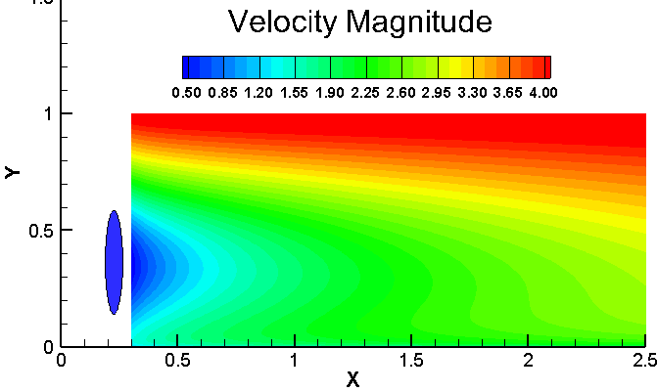
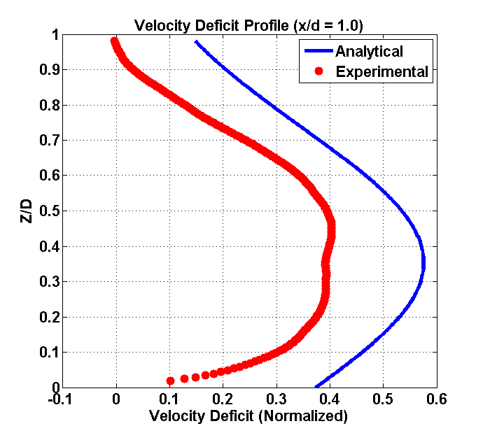
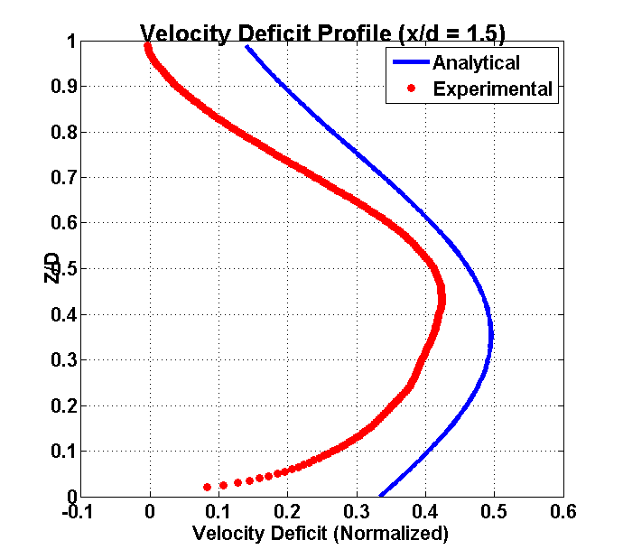
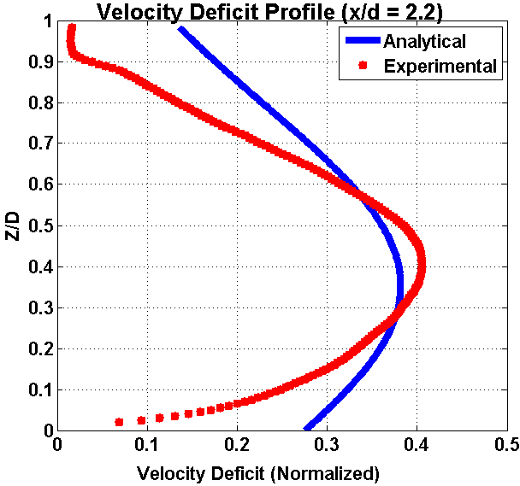
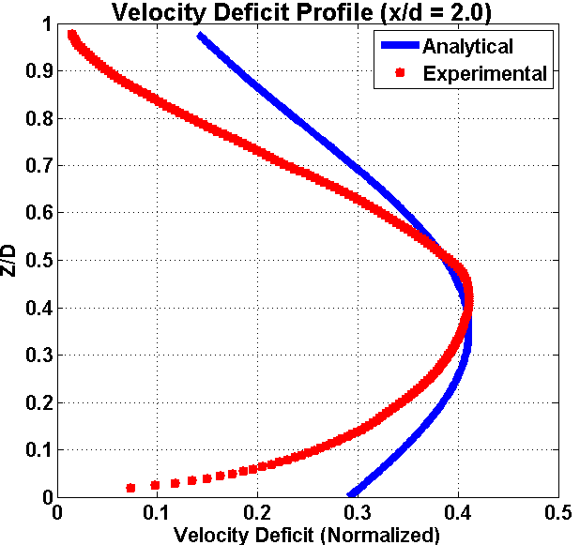
Predicting Velocity Deficit
Z / D
X/D
Z/D

Slide 11
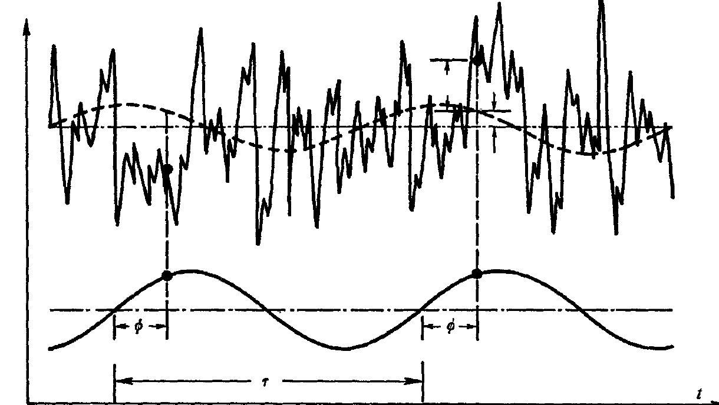
Phase-locked PIV measurement results in turbine wake
Triple decomposition method:
Hussain (J. Fluid Mech. vol. 41, part 2, pp. 241-258, 1970)
u
u'
u is instantaneous velocity, the right terms correspond to mean value, contribution of organized wave and random fluctuating respectively.
Then the phase-averaged velocity is obtained:
The phase averaging process is equivalent to a low-pass filter which keeps the mean flow and the organized wave at a single frequency and removes the other higher frequency fluctuations.

Slide 12
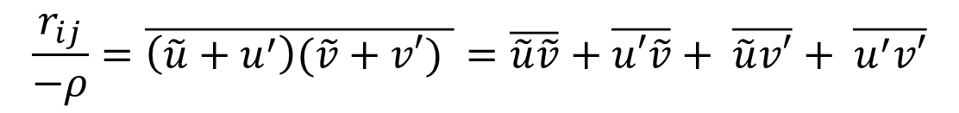
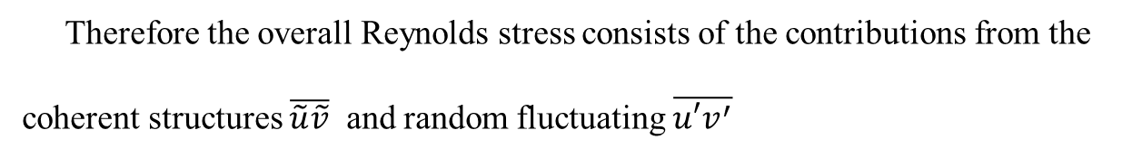
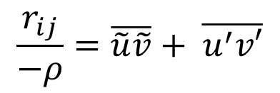

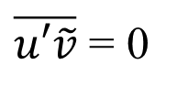
Phase-locked PIV measurement results-Reynolds shear stress
The Reynolds stress contribute a major part of the momentum transfer in turbine wake flow
Triple decomposition method to Reynolds stress:
$$\frac{r_{ij}}{−ρ}=\overline{\left(\tilde{u}+u^{′}\right)(\tilde{v}+v′) }=\overline{\tilde{u}\tilde{v}}+\overline{u′\tilde{v}}+ \overline{\tilde{u}v′}+ \overline{u^{′}v′}$$
Where:
Additionally, coherent structures are uncorrelated with random parts :
$\overline{u′\tilde{v}}$ = 0
$$\overline{\tilde{u}v^{′}}=0$$
$$\frac{r_{ij}}{−ρ}=\overline{\tilde{u}\tilde{v}}+ \overline{u^{′}v′}$$
So:
Therefore the overall Reynolds stress consists of the contributions from the
coherent structures $\overline{\tilde{u}\tilde{v}}$ and random fluctuating $\overline{u′v^{′}}$

Slide 13
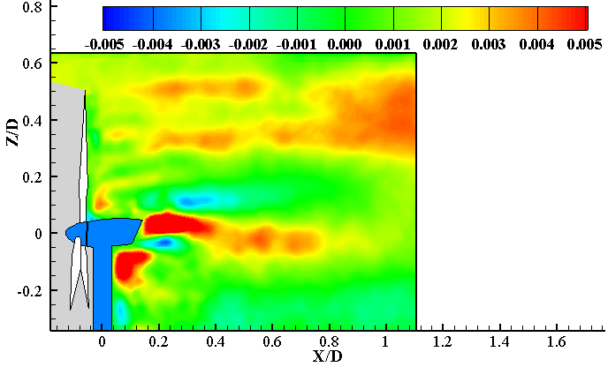
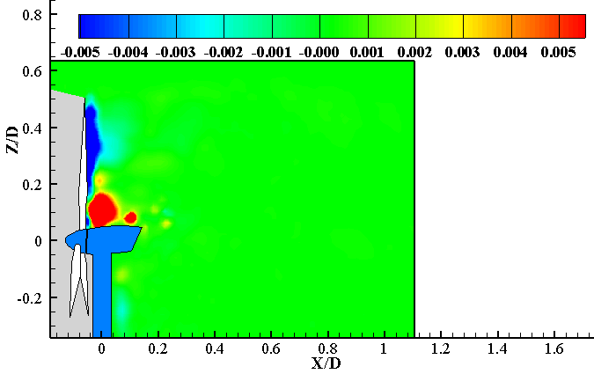




Ensemble Averaged PIV measurement results-Reynolds stress
$$−ρ(\overline{u^{′}v′})$$
$$−ρ(\overline{\tilde{u}\tilde{v}})$$
$$−ρ(\overline{u^{′}v^{′}+ \tilde{u}\tilde{v})}$$

Slide 14
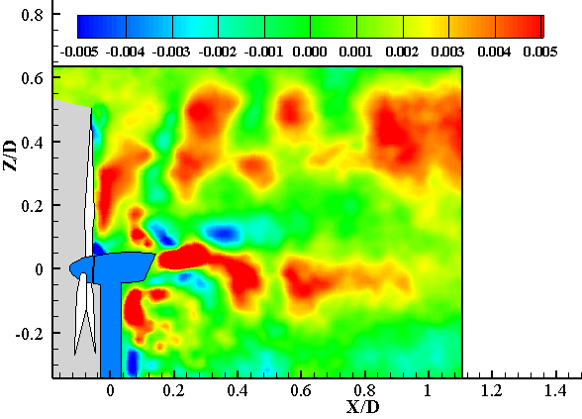
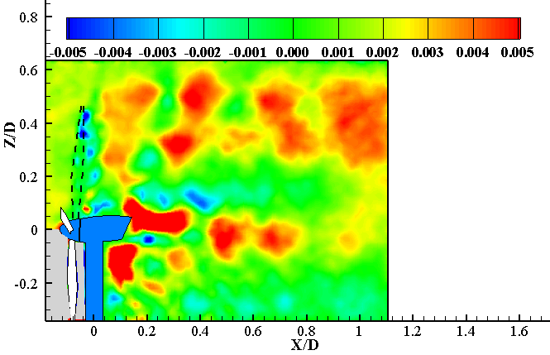
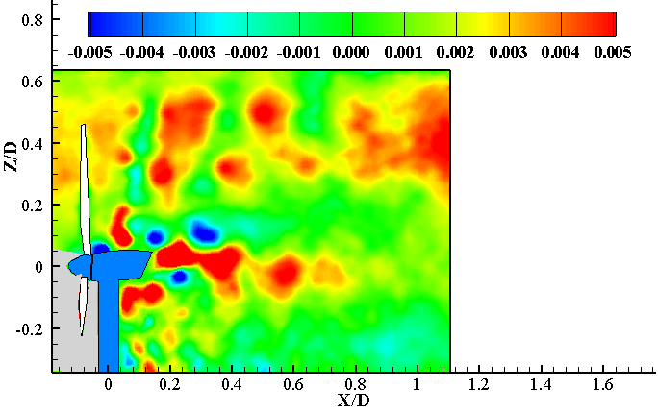
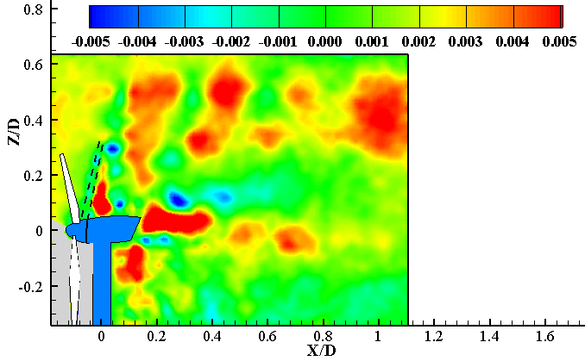
Decomposed Reynolds Stress $(−ρ<u^{′}v^{′}>)$
Phase angle = 0 deg.
Phase angle = 30 deg.
Phase angle = 90 deg.
Phase angle = 60 deg.

Slide 15
POD (Proper Orthogonal Decomposition)
POD is used to extract dominant large scale structures buried in a flow.
The flow is decomposed to modes using linear decomposition and reconstructed using singular value decomposition (SVD).
The magnitude of the eigenvalues represent the kinetic energy which the modes are ranked based on.
Large scale structures can be represented with the first few modes.

Slide 16
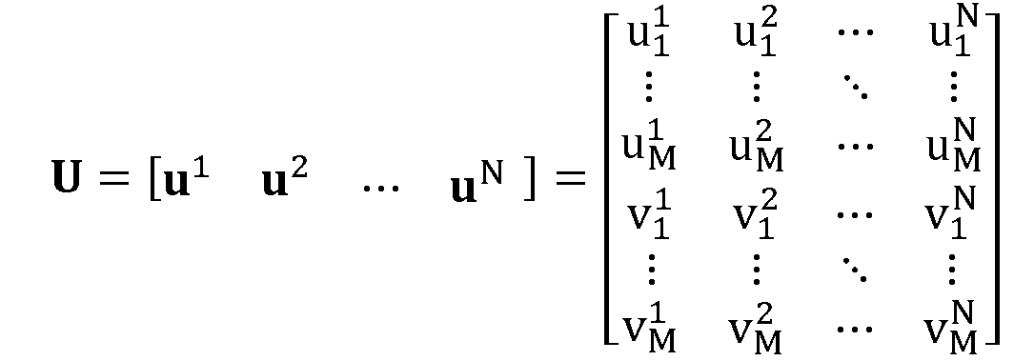


Method of Snapshots
(1) Arrange all of fluctuating velocity components in a matrix U as:
where M is the number of spatial discrete points and N is the number of the PIV snapshots, which represent the spatial and temporal resolutions of the PIV data respectively.
(2) The eigenvalues and eigenvectors of the auto-covariance matrix are calculated as:
Ma, Geisler, Agocs & Schroeder, “Investigation of coherent structures in active flow control over a backward-facing step by PIV”, 2014. 16th International symposium on Flow Visualization, Okinawa, Japan.

Slide 17
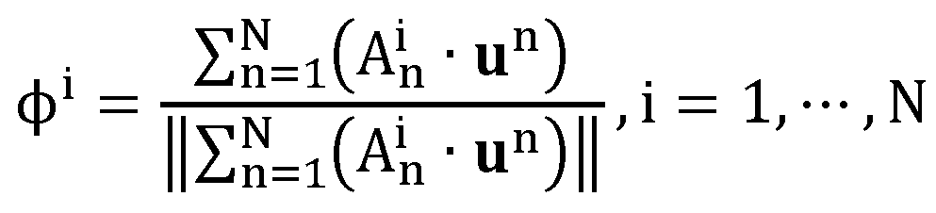

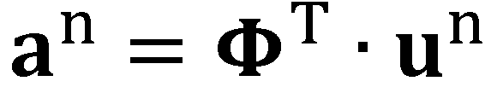
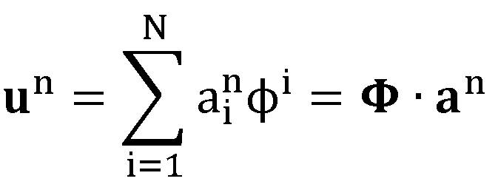
Free run PIV results analysis-Proper orthogonal decomposition (POD)
(3) Each mode is obtained by projecting matrix U onto each eigenvector and then normalized by its norm as:
So:
Reconstruct the snapshot:
(4) The coefficients of each mode can be obtained:
(5) A snapshot can be reconstructed as:
(6) An instantanous velocity fields can be reconstructed using the first Lth modes as:
where is the ensemble-averaged velocity

Slide 18
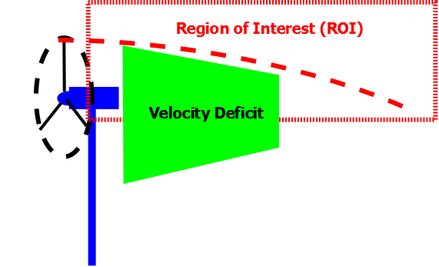
Selecting a Region of Interest (ROI)
A region in the wake was selected for POD analysis to minimize the outliers and measurement noise.
The region encompasses includes the shear layer, located between the wake and high momentum flow outside the wake.

Slide 19
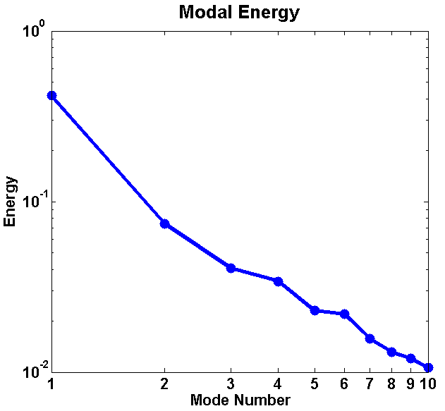
Free run PIV results analysis-Proper Orthogonal Decomposition (POD)
1. Each eigenvalue is proportional to its total kinetic energy of velocity fluctuations
2. The most important modes containing higher energy are in the first few modes, which correspond to large-scale flow structures
3. Other further modes containing lower energy are less dominant, sometime are merged into measurement noise.
Mode Number | Energy %
1 | 41.7
2 | 7.4
3 | 4.0
4 | 3.4
5 | 2.3
6 | 2.2
7 | 1.6
8 | 1.3
9 | 1.2
10 | 1.0

Slide 20
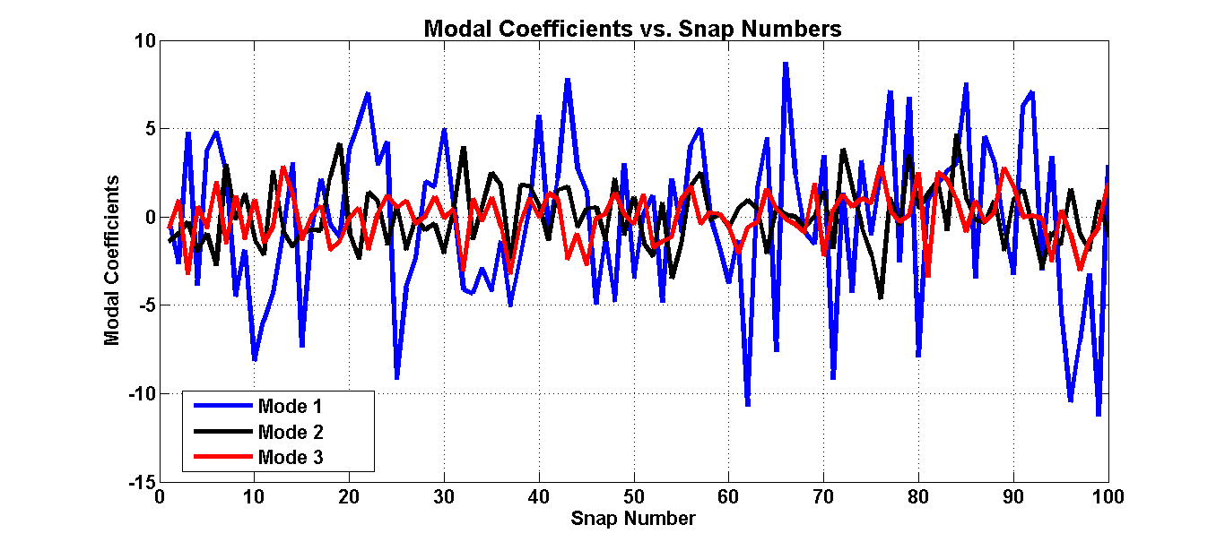
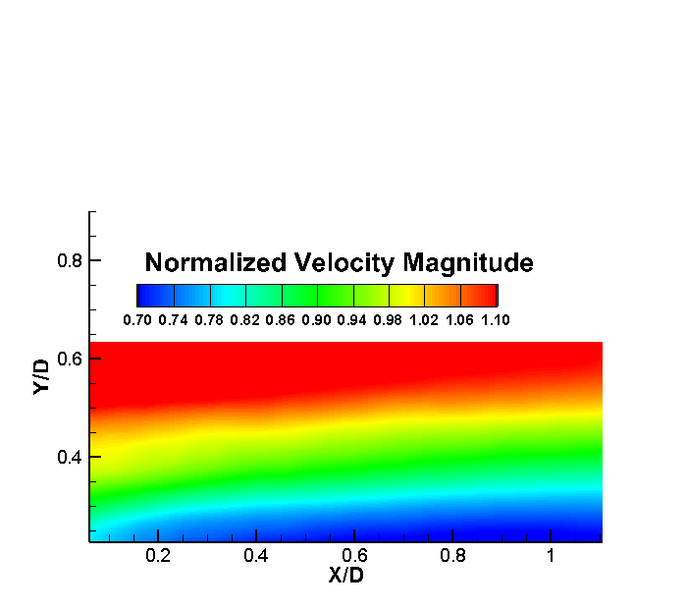
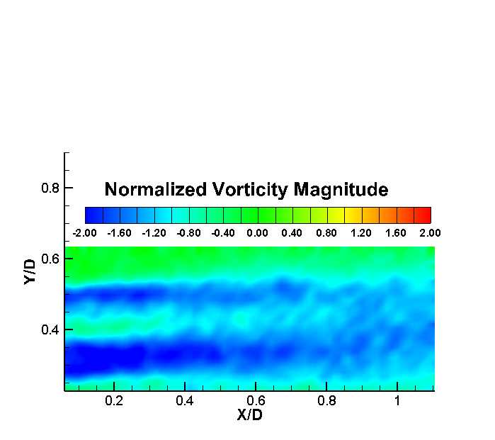
Proper Orthogonal Decomposition (POD)
Mode | Std. Dev
1 | 4.31
2 | 1.72
3 | 1.37
Time Averaged Solutions (Mode 0)

Slide 21
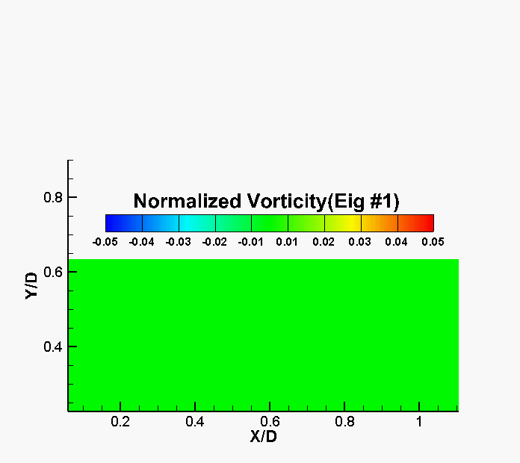
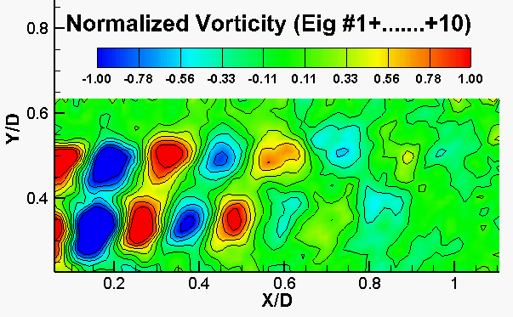
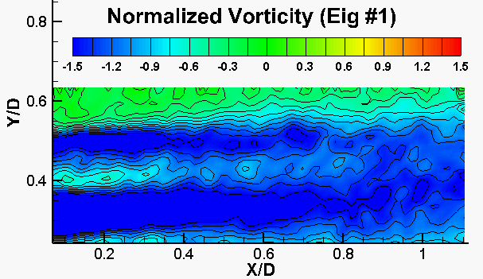
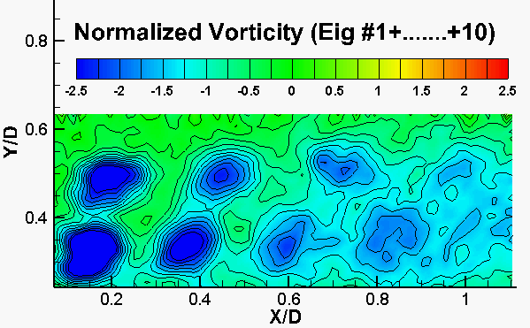
Fluctuations and Velocity Reconstructions
Reconstructed by using the first 1 mode ( 41% of total kinetic energy)
Reconstructed by using the first 5 mode ( 66% of total kinetic energy)

Slide 22
Conclusions
Proper Orthogonal Decomposition (POD) can be successfully used to identify principal components of the flow.
The principal components carry most of the kinetic energy and the low order reconstructions aid the design process of blades, rotor assemblies and vortex generators
Reynolds stress obtained from TD indicates vertical momentum transfer in the recovering wake.
The wind farm designer can use this information to determine the distance between turbines for max. performance.

Slide 23
Thank you for your attention!

Slide 24
APPENDIX

Slide 25
Future Work - DMD
Dynamic Mode Decomposition (DMD) is a new tool in dynamical systems that are used to investigate flow features of unsteady flows.
DMD assigns frequencies to the large scale structures while POD modes are ranked based on kinetic energy of the flow.
DMD is based on a temporal orthogonal framework while POD is based on a spatial orthogonal one.

Slide 26
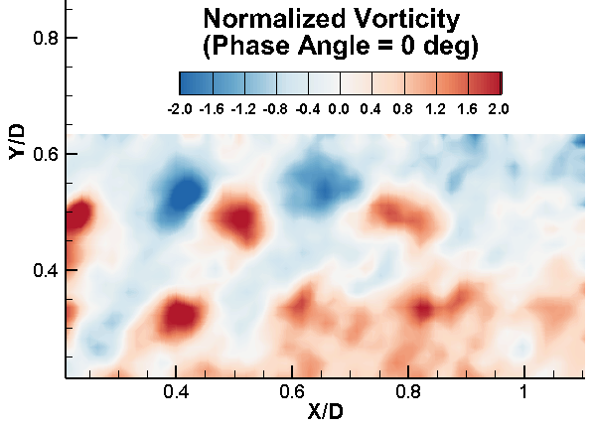
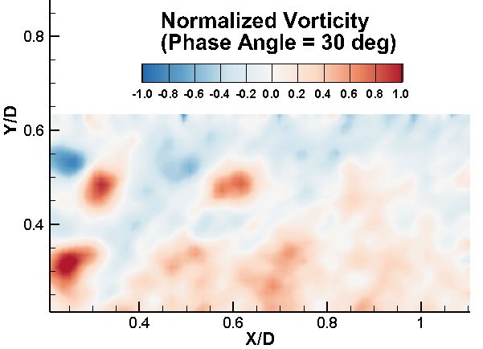
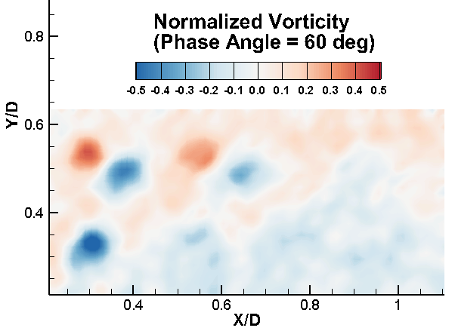
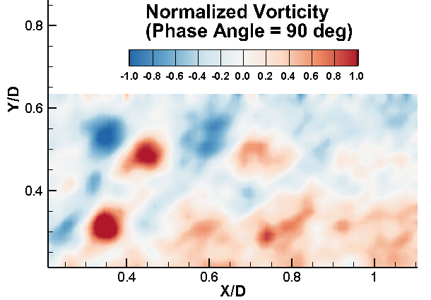
POD reconstructions on phase locked data

Slide 27


Swriling strength distributions in the turbine wake
Low turbulence inflow
Phase angle=0

Slide 28






Phase-locked PIV measurement results-Reynolds stress
$$−ρ<u^{′}v′>$$
$$−ρ<\tilde{u}\tilde{v}>$$
$$−ρ<u^{′}v^{′}+\tilde{u}\tilde{v}>$$

Slide 29







Phase-locked PIV measurement results-Reynolds stress
$$−ρ<u^{′}v^{′}+\tilde{u}\tilde{v}>$$
$$−ρ<u^{′}v^{′}+\tilde{u}\tilde{v}>$$
$$−ρ<u^{′}v^{′}+\tilde{u}\tilde{v}>$$
$$−ρ<u^{′}v^{′}+\tilde{u}\tilde{v}>$$

Slide 30
Observations
Reynolds stresses are distributed within the shear layer.
The shed vortices also contain turbulent mixing components.
Presence of a tower and a nacelle also contributes to T.K.E and Reynolds Stress in downstream wake.

