Slide 1
New Event Detection
CS 4624 Virginia Tech Spring 2015
Alex Cummins, Andrew Ciambrone,
Beakal Haile, Quinn Liu

Slide 2
Purpose
Automatically detect when a new world event has occurred based online news articles.
Reduce user bias
Increase confidence that an event has occurred.
Assist IDEAL project

Slide 3
Approach
Collect RSS feeds from respected news sources around the world.
Create groupings of articles utilizing natural language processing techniques.
Rank the groupings based on their perceived strength.
Provide a ranked list to the end user.

Slide 4
Ranking Criteria
Number of articles
Distinct publishers
Distinct dates
Parameters are imperfect

Slide 5
Moving Forward
Scraper will continue to collect data
Client will train the algorithm utilizing machine learning techniques.

Slide 6
Results

Slide 7
Results

Slide 8
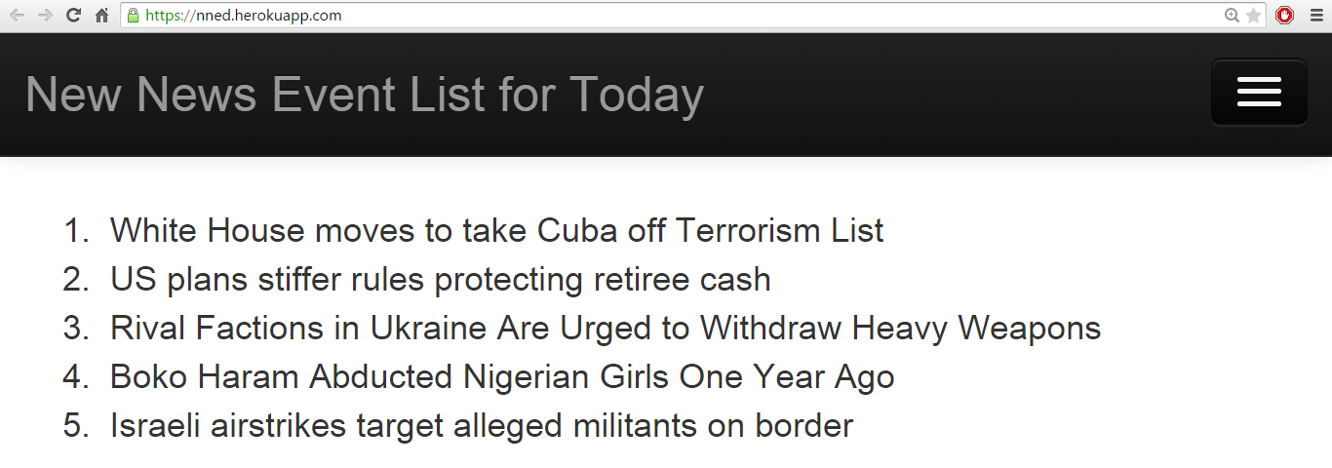
Website
https://nned.herokuapp.com/

Slide 9
Acknowledgements
Mohamed Magdy mmadgy@vt.edu
IDEAL project http://eventsarchive.org/

Slide 10
Questions?

