Slide 1

Lest We Forget: Exploring the Life and Legacy of Maceo Pinkard
Alan Munshower
Charles H. Templeton Jr. Business of Music Symposium
March 23, 2023

Slide 2
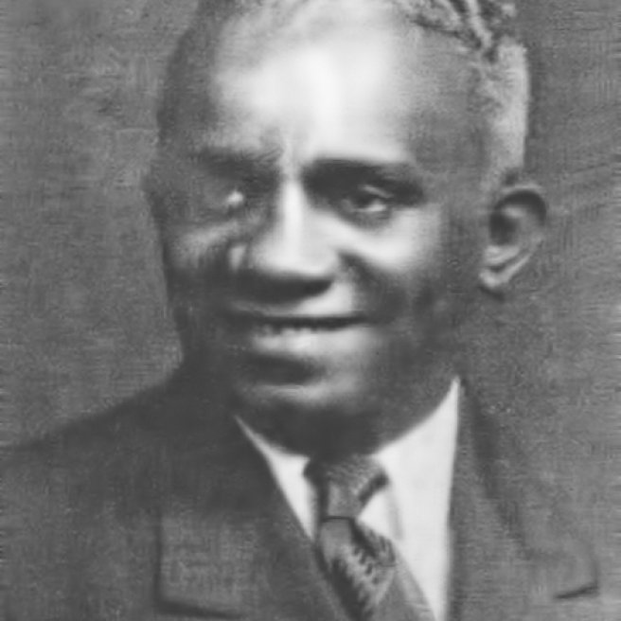
Maceo who?
June 27, 1897 – July 21, 1962
Born in Bluefield, West Virginia
Tin Pan Alley composer
National Academy of Popular Music Songwriters Hall of Fame inductee (1984)

Slide 3

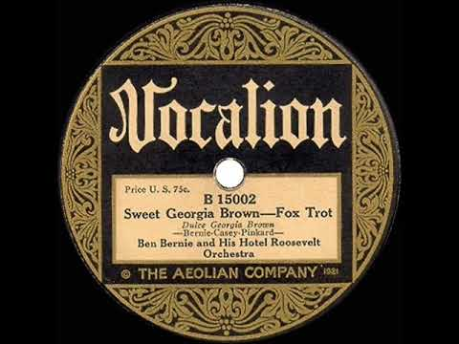
You may know his big hit
First recorded in 1925 by Ben Bernie and His Hotel Roosevelt Orchestra
Number 1 for 5 weeks

Slide 4
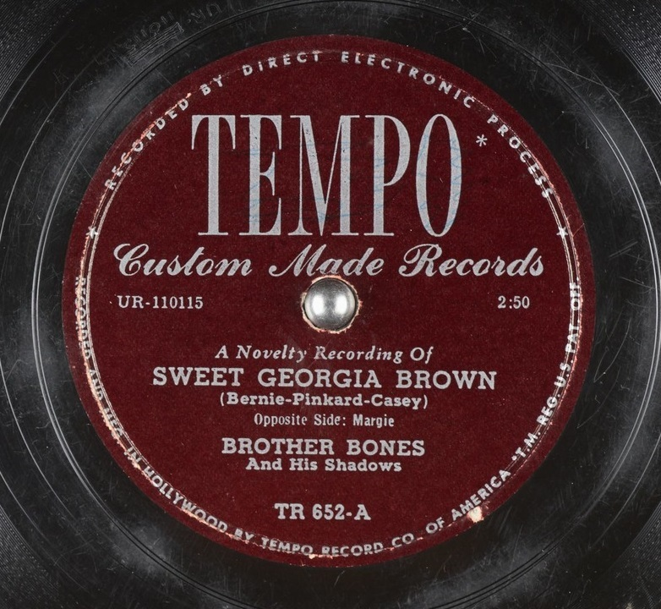
Maybe this version is more familiar
Brother Bones version (1949)
Yes, those are actual bones
Later adopted as the Theme for the Harlem Globetrotters

Slide 5
Beginnings in Bluefield, WV
Booming and prosperous new coal city in 1890’s
Segregated, but thriving Black community
Attended public school in Mercer County, Studied composition at Bluefield Colored Institute, graduated in 1914.

Slide 6
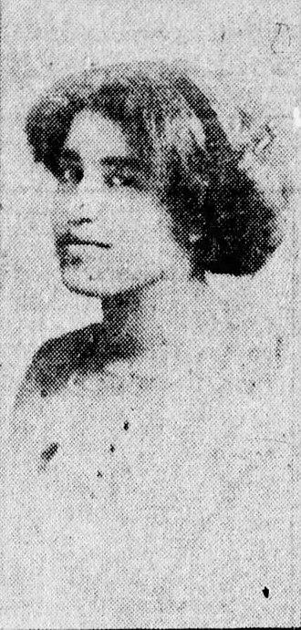
The Midwest Years
Omaha, Nebraska
  First published work
  Bandleader
Weds Edna Alexander in Iowa
Chicago
  Founds Maceo Pinkard Music
Edna Alexander

Slide 7
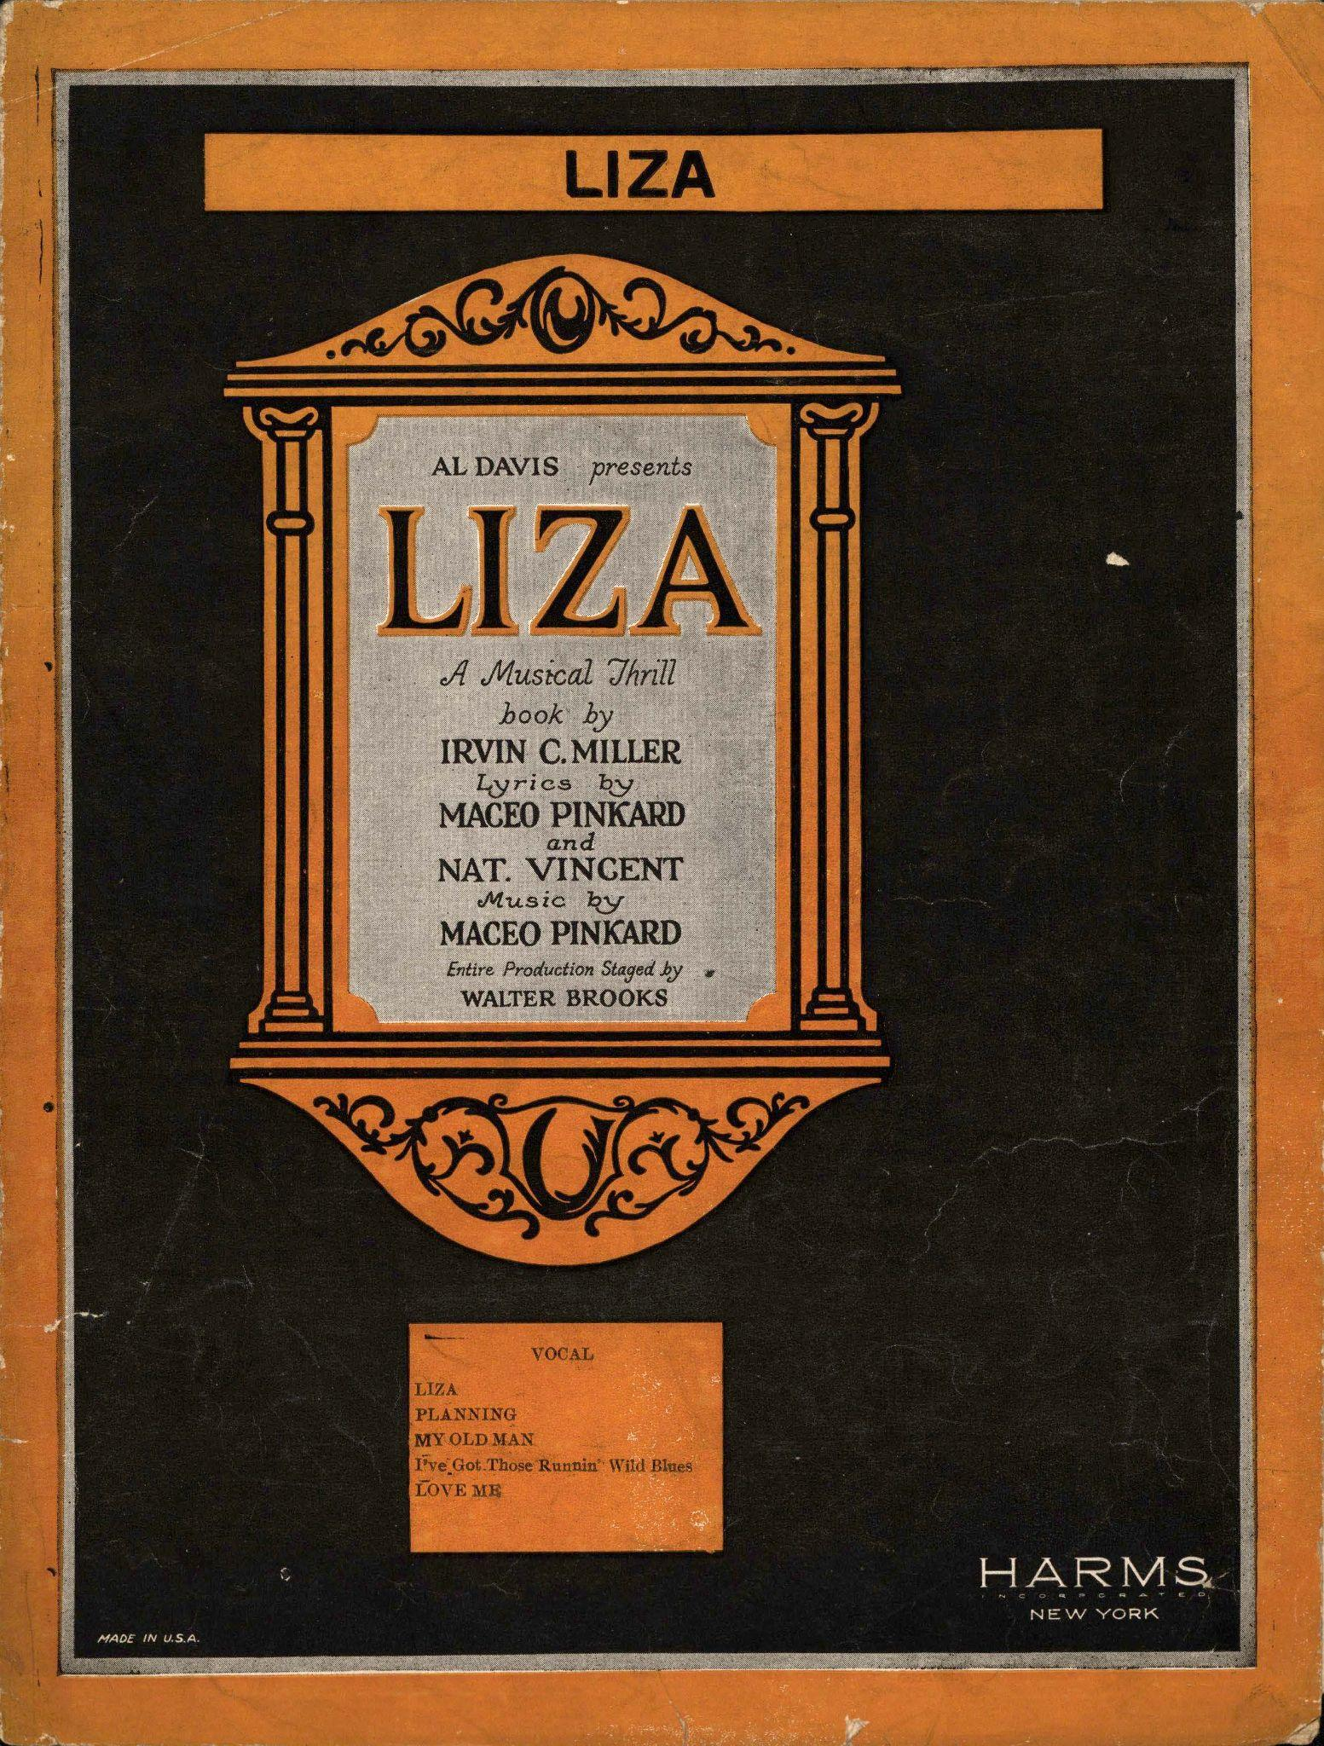
New York / Liza
Seized on the growing, though still underground popularity of The Charleston
First all-black show to make it to Broadway
Successful run of 172 shows

Slide 8
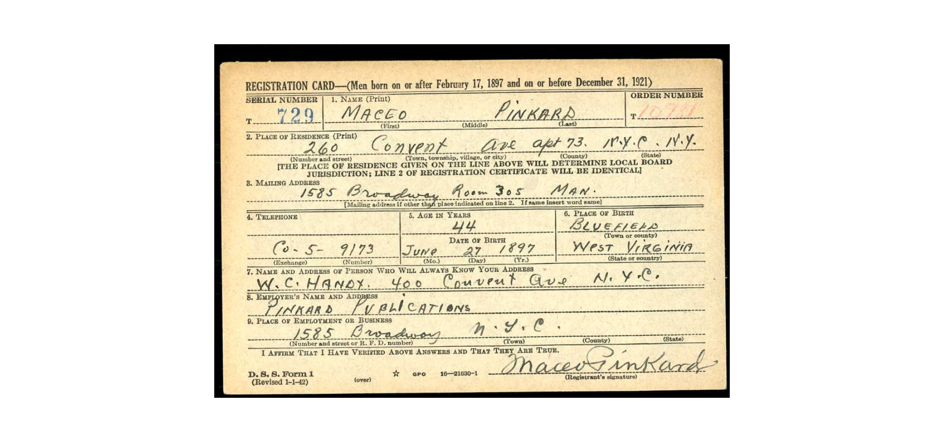
Center of the Scene
Prolific publication record
Relationships with white companies
Established veteran of the jazz community
Mentorship of Duke Ellington

Slide 9
Mentorship
“Maceo Pinkard was the first to take me to a studio for the purpose of recording our group. When I think of how wonderful those men at that period in New York were, and of the way in which they received me, I always feel a glow of gladness and gratitude.” - Duke Ellington

Slide 10
Later Life
Pansy / Bessie Smith
Copyright / Royalty disputes
  "Sugar: That Sugar Baby O'Mine" (Bing Crosby and Louis Armstrong)
  “Candy” (Jo Stafford and Johnny Mercer)
ASCAP event performance

Slide 11
Bluefield Legacy
Bluefield State University / Changing demographics
Joseph Bundy’s work
  Maceo Pinkard Music Festival
  Original Musical: “In the Pink”
Musicians working in Bluefield

Slide 12
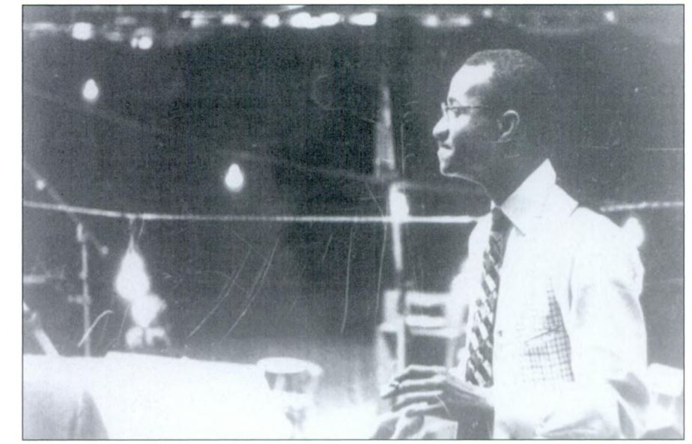
Thank you!
Contact:
Alan Munshower
Digital Collections Archivist
Virginia Tech
alanmun@vt.edu
Maceo Pinkard

