Slide 1
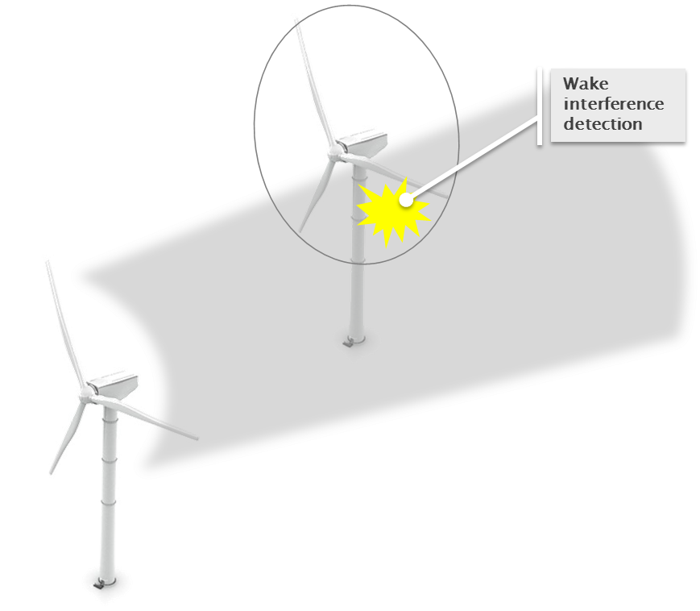

Detection of Wake Impingement in Support of Wind Plant Control
Carlo L. Bottasso
Technische Universität München & Politecnico di Milano
Stefano Cacciola, Johannes Schreiber
Technische Universität München
2015 Symposium, June 9-11, 2015 – Blacksburg, Virgina

Slide 2
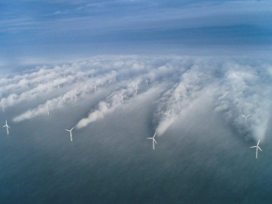
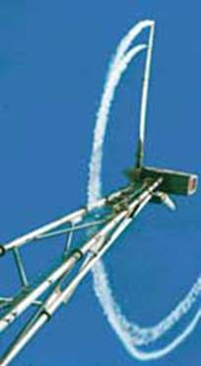

Flow Physics: Wakes and Turbulence
Suck-in from BL top due to low pressure in wake
Mixing due to speed gradient (shear-generated turbulence)
Mechanically generated turbulence (high frequency & fast decay)
Vortex breakdown
Recovery rate influenced by ambient turbulence
Speed deficit
Ambient turbulence
Notes:
To start I would like to have a few words on wakes and wind farm control.
First most people will know, that the wake behind a turbine is characterized by a reduced wind speed and a significant increase of turbulence.

Slide 3
Wind Farm Effects
Increased fatigue damage Reduced life
Reduced power output
Notes:
Those effects lead to unwanted effects in the wind farm...

Slide 4
Wind Farm Control
Set-point control to optimize:
Wind farm power production
Wind turbine loading
Active load alleviation in wake-interference conditions
Yaw and/or cyclic pitch to deflect wake
Notes:
To avoid or minimize those effects a smart wind farm control might be used...

Slide 5
Wind Farm Control
Cooperative control of wind farms, a vast and complex problem:
Understand/measure flow conditions
Control algorithms:
  Model based: accuracy/complexity of models?
  Model free: convergence time?
  Robustness in real operating conditions
  …
Testing and verification of performance
The rotor as a wind sensor:
Wake interference detection (this presentation) ▶
Reaction & wake redirection
1. Detect wind conditions and wake impingement
2. React on upstream wind turbine
Notes:
It is clear that this is a vast and complex problem and we think to solve it one has to –beside other things– understand and/or measure the flow conditions.
Those information may then be used by a feedback wind farm controller.

Slide 6
Outline
Local wind estimation from blade loads
Field validation
Wake impingement detection
Simulation studies in waked and meandering conditions
Conclusions and outlook

Slide 7
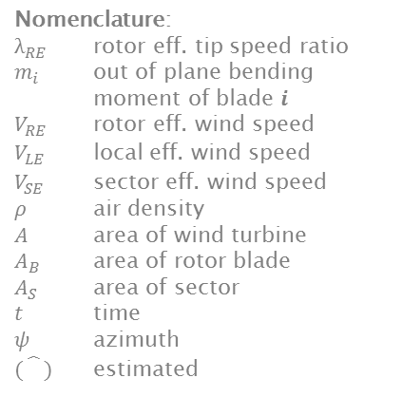
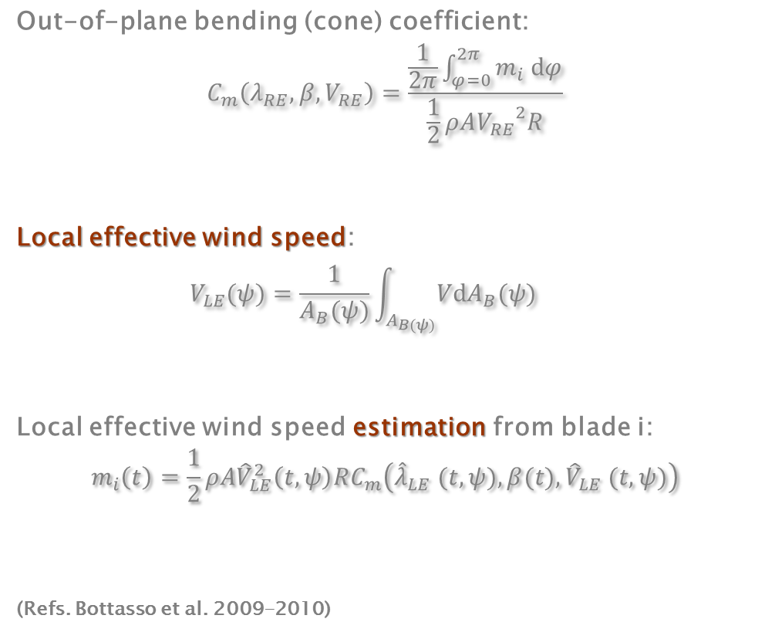



Wind Speed Estimation from Blade Loads
Out-of-plane bending (cone) coefficient:
$$C_{m}\left(λ_{RE},β,V_{RE}\right)=\frac{\frac{1}{2π}\int_{φ=0}^{2π}{m_{i} dφ}}{\frac{1}{2}ρA{V_{RE}}^{2}R}$$
Local effective wind speed:
$$V_{LE}(ψ)=\frac{1}{A_{B}(ψ)}\int_{A_{B(ψ)}}{VdA_{B}(ψ)}$$
Local effective wind speed estimation from blade i:
$$m_{i}\left(t\right)=\frac{1}{2}ρA{\hat{V}}_{LE}^{2}\left(t,ψ\right)RC_{m}\left({\hat{λ}}_{LE} (t,ψ),β(t),{\hat{V}}_{LE} (t,ψ)\right)$$
(Refs. Bottasso et al. 2009-2010)
Nomenclature:
$λ_{RE}$ rotor eff. tip speed ratio
$m_{i}$ out of plane bending moment of blade 𝒊
$V_{RE}$ rotor eff. wind speed
$V_{LE}$ local eff. wind speed
$V_{SE}$ sector eff. wind speed
$ρ$ air density
$A$ area of wind turbine
$A_{B}$ area of rotor blade
$A_{S}$ area of sector
$t$ time
$ψ$ azimuth
$(\hat{})$ estimated
$$ψ(t)$$
$$A_{B}$$
$$A$$
Notes:
Based on a newly defined out-of-plane bending coefficient (similar to the thrust coefficient, which can be obtained in a simulation environemnt), one can correlate the local effective wind speed with the blade load.

Slide 8







Sector Effective Wind Speed Estimation
Nomenclature:
$λ_{RE}$ rotor eff. tip speed ratio
$m_{i}$ out of plane bending moment of blade 𝒊
$V_{RE}$ rotor eff. wind speed
$V_{LE}$ local eff. wind speed
$V_{SE}$ sector eff. wind speed
$ρ$ air density
$A$ area of wind turbine
$A_{B}$ area of rotor blade
$A_{S}$ area of sector
$t$ time
$ψ$ azimuth
$(\hat{})$ estimated
Sector effective wind speed (SEWS):
$$V_{SE}(ψ)=\frac{1}{A_{S}}\int_{A_{S}}{VdA_{S}}$$
Calculate ${\hat{V}}_{SE}\left(\tilde{t}\right)$ after a blade leaves a sector:
$${\hat{V}}_{SE}\left(\tilde{t}\right)=\frac{1}{A_{S}}\int_{A_{S}}{{\hat{V}}_{LE}\left(t,ψ\right) dA_{S}}$$
$$ψ(t)$$
$$ψ_{1}$$
$$\hat{V_{SE}}\left(t\right)$$
$$V_{LE}(t, ψ)$$
Blade 1
$$A_{B}$$
Blade 3
$$A$$
$$A_{S}$$
Blade 2
Time $t$
$$ψ_{2}$$
Notes:
Using the estimations of the blades along with their azimuth position, on can obtain a SEWS...

Slide 9
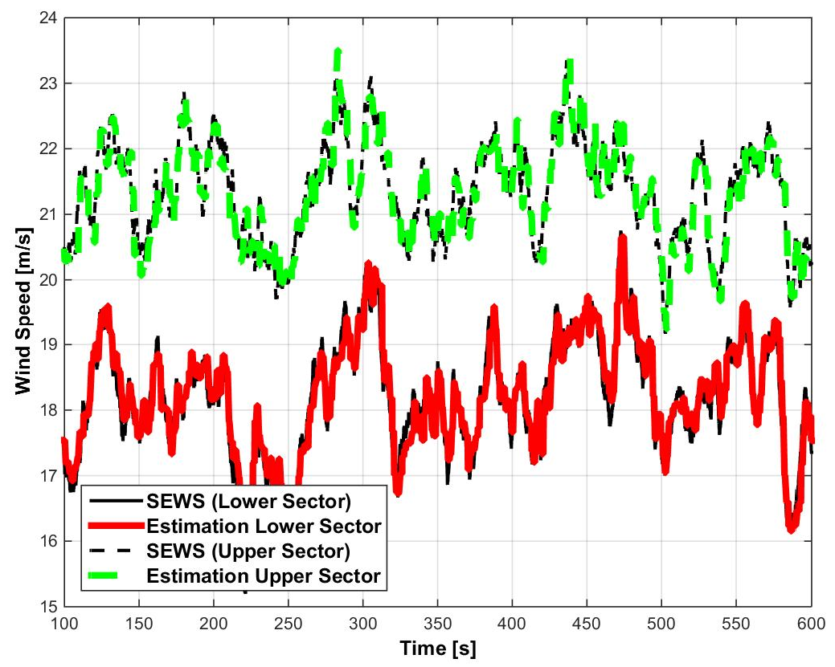
Simulation Results (3MW HAWT)
Define four sectors:
Simulation results:
Upper Sector
Wind turbine:
Rated power: 3 MW
Rotor radius: 47 m
Hub height: 80 m
Right Sector
Left Sector
Lower Sector
Shear (𝛼=0.2),
Turbulence (5%)
Notes:
Using that simple approach and defining 4 sectors on the rotor disc, one obtaines nice simulation results as shown here..

Slide 10
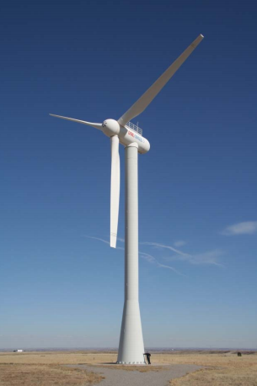
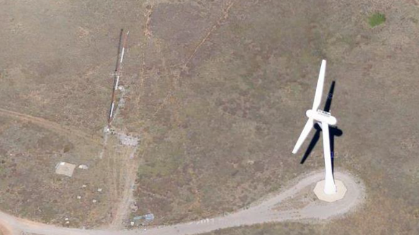
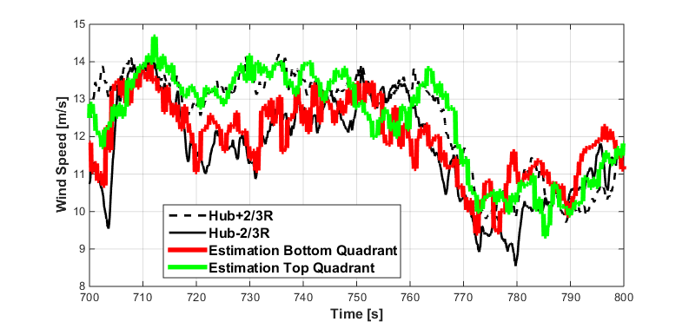
Field Data (CART 3)
Setup:
Met-mast
anemometers
Field test results:
40m
58m
40m
15m
https://maps.google.com/maps?q=39.909045,-105.222741
58m
Met-mast
Photo: Fleming et al., 2011
Wind turbine:
NREL Controls Advanced Research Turbine CART 3
3-bladed
Rated power: 600kW
Rotor radius: 20 m
Hub height: 40 m
*
*
*) Met-mast anemometer interpolation assuming linear shear
Notes:
But also on the field, using NRELs CART3, on obtaines a good correlation between an interpolated met-mast anemometer measurements and the estimations...

Slide 11
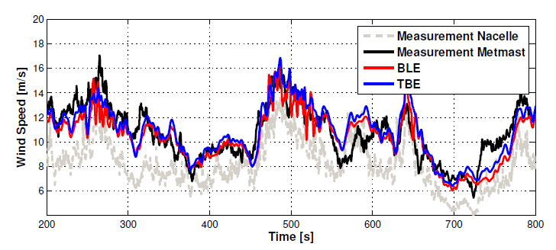

Rotor Effective Wind Speed Estimation
Rotor effective wind speed:
$$V_{RE}=\frac{1}{A}\int_{A}{VdA}$$
Rotor effective wind speed estimation from all blades:
$$\frac{\sum_{i=1}^{B}{m_{i}}(t)}{B} =\frac{1}{2}ρA{\hat{V}}_{RE}^{2}\left(t,ψ\right)RC_{m}\left({\hat{λ}}_{RE}(t,ψ),β(t),{\hat{V}}_{RE}(t,ψ)\right)$$
Field test results:
Notes:
Additionally that apprach can be further simplified to a rotor effective wind speed estimation which gives very similar results as the well known torque balance estimation based on the power curve..

Slide 12
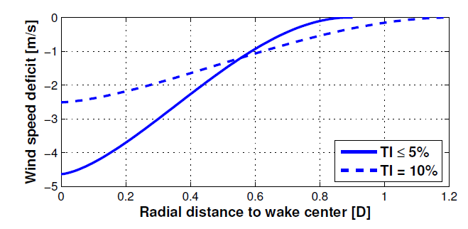
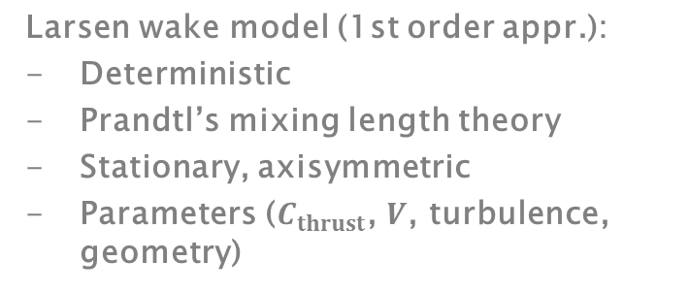
Wake Modeling
Superposition of Mann’s turbulent wind field with Larsen wake model
Larsen wake model (1st order appr.):
Deterministic
Prandtl’s mixing length theory
Stationary, axisymmetric
Parameters ($C_{thrust}$, $V$, turbulence,
geometry)
Wind farm layout:
Longitudinal
Distance=4D
Lateral
distance
Wind speed deficit for ambient wind speed
of 8m/s and 4D longitudinal distance:
Upwind
turbine
Wind direction
Downwind
turbine
Wind turbines:
Rated power: 3 MW
Rotor radius: 47 m
Hub height: 80 m
Notes:
But the aim is to detect a possible wake impingement on a turbine.
For the simulation study a wind farm layout is chosen as depicted.
The wake modeling bases on a superposition of the larsen wake model on a Mann‘s turbulend wind field.

Slide 13
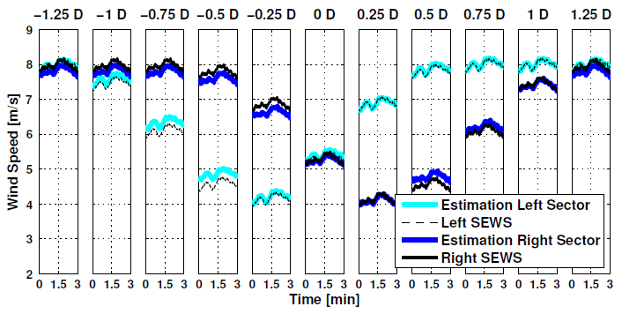
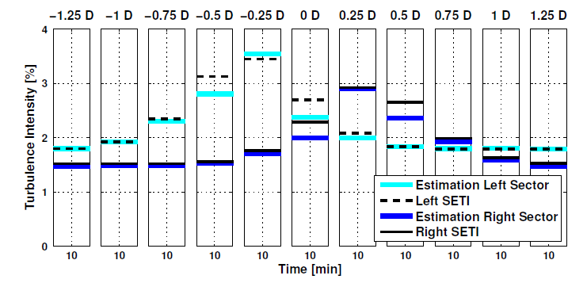
Simulation Results in Wake Interference
-0.5D
Each subplot represents a different wake overlap indicated by the lateral distance between rotor and wake center ▶
The estimator can also detect an increase in turbulence intensity ▶
Notes:
The upper figure shows what happens to the wind speed in the horizontal sectors in different wake overlap conditions.
Also an increase of the turbulence intensity can be detected.

Slide 14
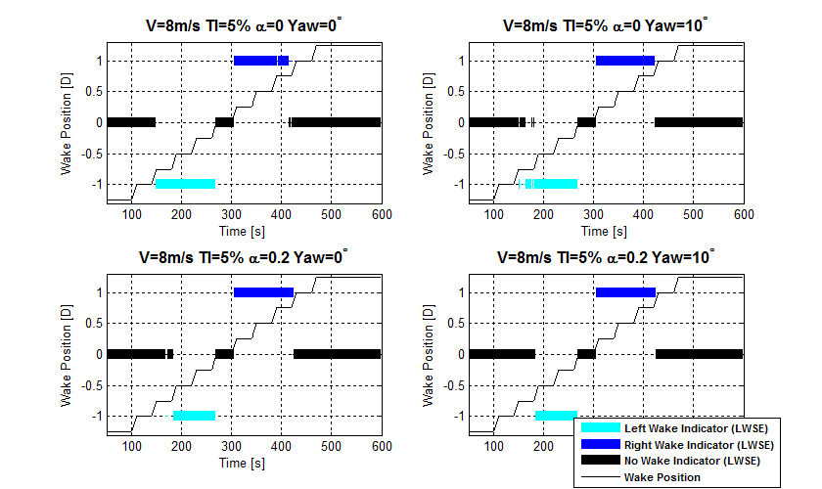
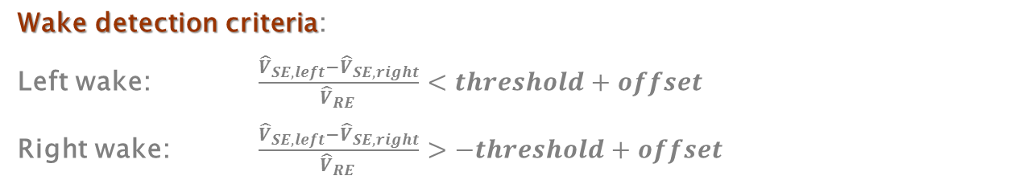
Wake Impingement Detection
Based on SEWS
Wake detection criteria:
Left wake: $\frac{{\hat{V}}_{SE,left}−{\hat{V}}_{SE,right}}{{\hat{V}}_{RE }}<threshold+offset$
Right wake: $\frac{{\hat{V}}_{SE,left}−{\hat{V}}_{SE,right}}{{\hat{V}}_{RE }}>−threshold+offset$
-1.25D
Shear exp. = 0.0
Shear exp. = 0.2
Yaw Misalignment = 0°
Yaw Misalignment = 10°
Notes:
The simplest way to detect a wake impingement is compare the wind speed estimation in the horizontal sectors and scale it with the REWS.

Slide 15
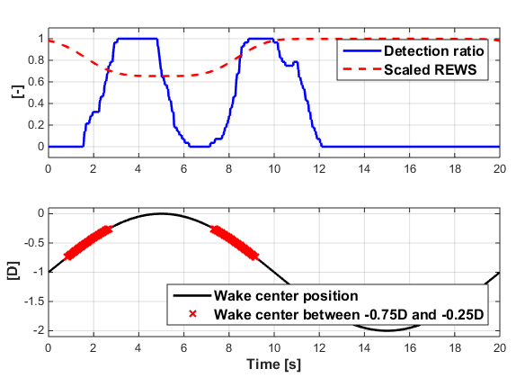
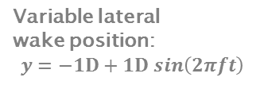
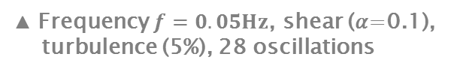
Wake Impingement Detection
Based on SEWS
Meandering wake between far out-of-wake and full-waked conditions:
Variable lateral
wake position:
$$y=−1D+1D sin\left(2πft\right)$$
Pros:
Simple, robust (in simulation) Small delay of 2 sec (~1/3 of a rotor rev.)
Cons:
Unable to estimate lateral distance to wake center Detection of full-wake requires wind direction wrt farm layout
▲ Frequency $f=0.05Hz$, shear (𝛼=0.1),
turbulence (5%), 28 oscillations
Remark: possible effect of wake model on results
Notes:
Now we assume that a meandering wake is moving from out of wake to full wake and backwards.

Slide 16
Conclusions
Local wind speed estimation from rotor loads:
Simple and free (if load sensors are available)
Concept validated in the field with CART3
Wake impingement: very promising results in simulation, can also handle dynamically meandering wakes
Outlook:
Validation using TUM scaled wind farm facility

Slide 17
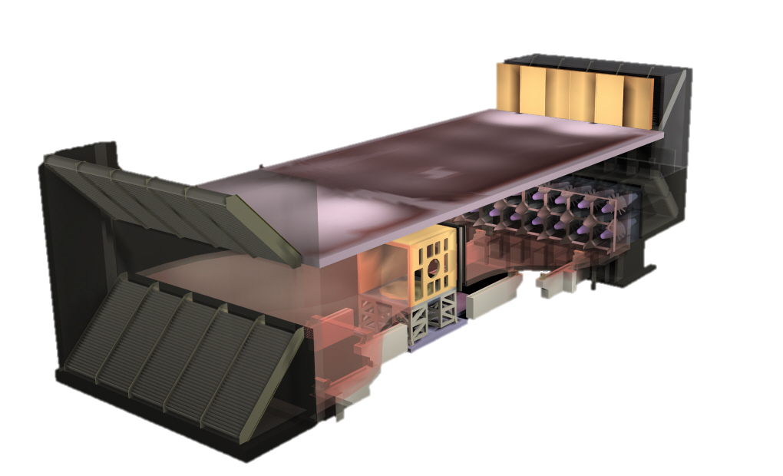
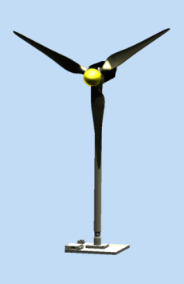
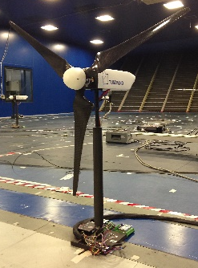
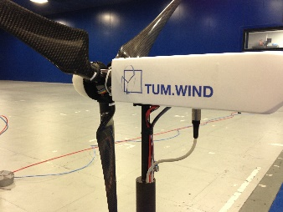
TUM Scaled Wind Farm Facility
Coordinated control for wind farm control testing
Boundary layer wind tunnel at Politecnico di Milano
Scaled 5-7MW wind turbines with active pitch, torque and yaw control
Notes:
Coordinated/Superior wind farm controller

Slide 18
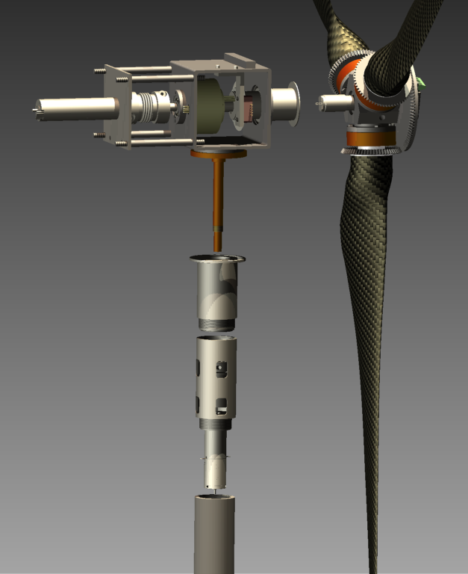
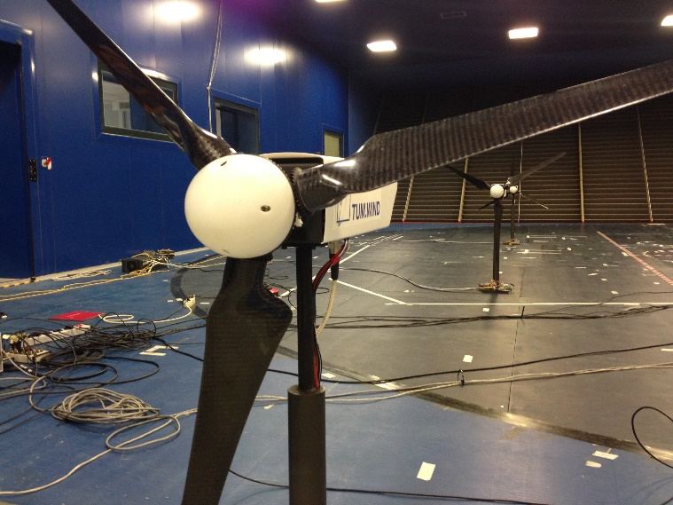
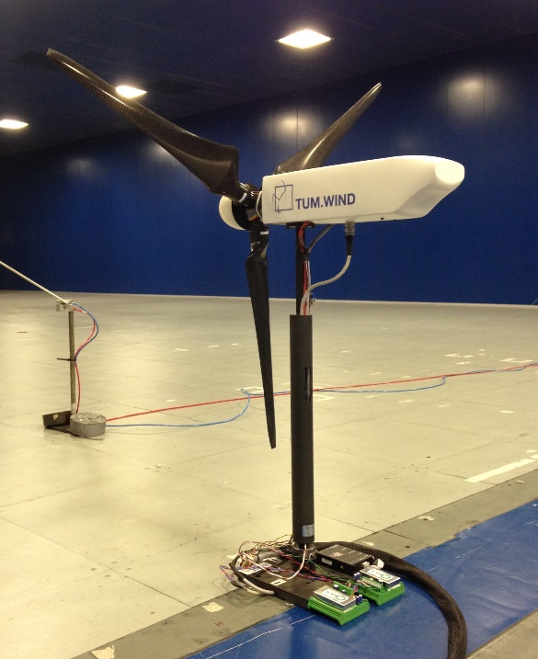
Scaled Wind Turbine Models
Gear-head
Torque actuation
Collective pitch actuation
Azimuth encoder
Slip ring
Yaw actuation (for wake deflection control)
Carbon fiber blades

Slide 19
Outlook
A comprehensive set of experiments is planned for 2015-16
  Wake detection
  Wake redirection by active yawing and IPC
  Induction control
  Load mitigation in wake interference conditions
  …
Supporting LES simulations using NREL’s SOWFA
Check back soon …

Slide 20




Thank you for your attention and…
TORQUE 2016
Munich, Germany, 5-7 October 2016
…see you
in Munich
Email: info@torque2016.org
Web: www.torque2016.org

