Slide 1
Background Check
Website for R4 OpSec, LLC
Zachary Tea, Alex Bierly, Philippe Gray,
Ted Yang, Tim Springsteen, Tommy Hyres
Client: Joe Romagnoli
April 27, 2017
CS 4624 Multimedia, Hypertext, and Information Access
Dr. Edward A. Fox
Virginia Tech
Blacksburg, VA 24061

Slide 2
Outline
Project overview
List of desired features
Usability testing results
Final project results (demo)
Potential future expansions
Acknowledgements
References

Slide 3
Project Overview
Client: Joe Romagnoli
Project proposal for website
What is a background check?

Slide 4
Desired Features
Website Design (front-end)
All sections of website on single page
Recenters to section based on user input
Website Functionality (back-end)
Accepting submissions
Admin login
Admin information management: search, order, delete
Notes:
Tommy
- What languages used in front/back-end

Slide 5
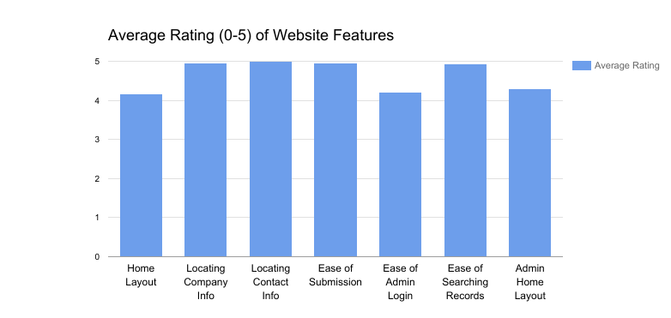
Usability Test Results
Most Common Negative Comment: “Admin Page difficult to find”
Notes:
ALEX. Draw a distinction between front end operations and admin operations.

Slide 6
Website Demo
www.r4opsec.com
Notes:
Add a database dump button and import button.
If r4opsec.com does not work, do http://66.228.37.235/

Slide 7
Potential Future Expansions
Help with resume searches and analysis
Extract key information directly from PDF file.
Multiple file type submissions
Could include Word documents, plain-text, etc.
Extend mobile support
Add FAQ and/or Customer Support
Notes:
-Possible explanation of first bullet

Slide 8
Acknowledgements
Joe Romagnoli for giving us this project.
Dr. Edward A. Fox for providing feedback.

Slide 9
References
[1] Backgroundchecks.com, "Backgroundchecks.com Learning Center." June 2016. Retrieved March 13, 2017, from: Backgroundchecks.com.
[2] Mark Otto, Jacob Thornton, and Bootstrap Contributors. "Bootstrap · The World's Most Popular Mobile-first and Responsive Front-end Framework." Bootstrap. June 2017. Retrieved March13, 2017, from MIT: http://getbootstrap.com/

