Slide 1
SharkValidatorGame
Aman Kothari | Feneel Patel | Ashutosh Tiwari | Ray Raya | Tirth Shroff
CS 4624 | Multimedia, Hypertext, and Information Access
Dr. Edward Fox
Group 9, Virginia Tech, Blacksburg, VA 24061
November 30, 2021

Slide 2
Outline
Project Overview
Deliverables
Backend
Database
  Flowcharts
Frontend and Workflows
Gamification
Challenges
Lessons Learned
Ideas For The Future

Slide 3


Project Overview
Data science initiative to crowdsource on sharks’ abundance and distribution
Create the largest global shark sighting database
Online shark photographs are processed into occurrence records
Users compete with each other in validating shark images
“sharkPulse Shark Validator Game,” Sharkpulse. [Online]. Available: http://sharkpulse.cnre.vt.edu/. [Accessed: 13-Dec-2021].

Slide 4
Deliverables
User Experience / User Interface
Gamification and Rewarding System
Streamline Data Sources
New System for Database Management
Social Media Authentication
Validation of User Input
User / Audience Demographics

Slide 5
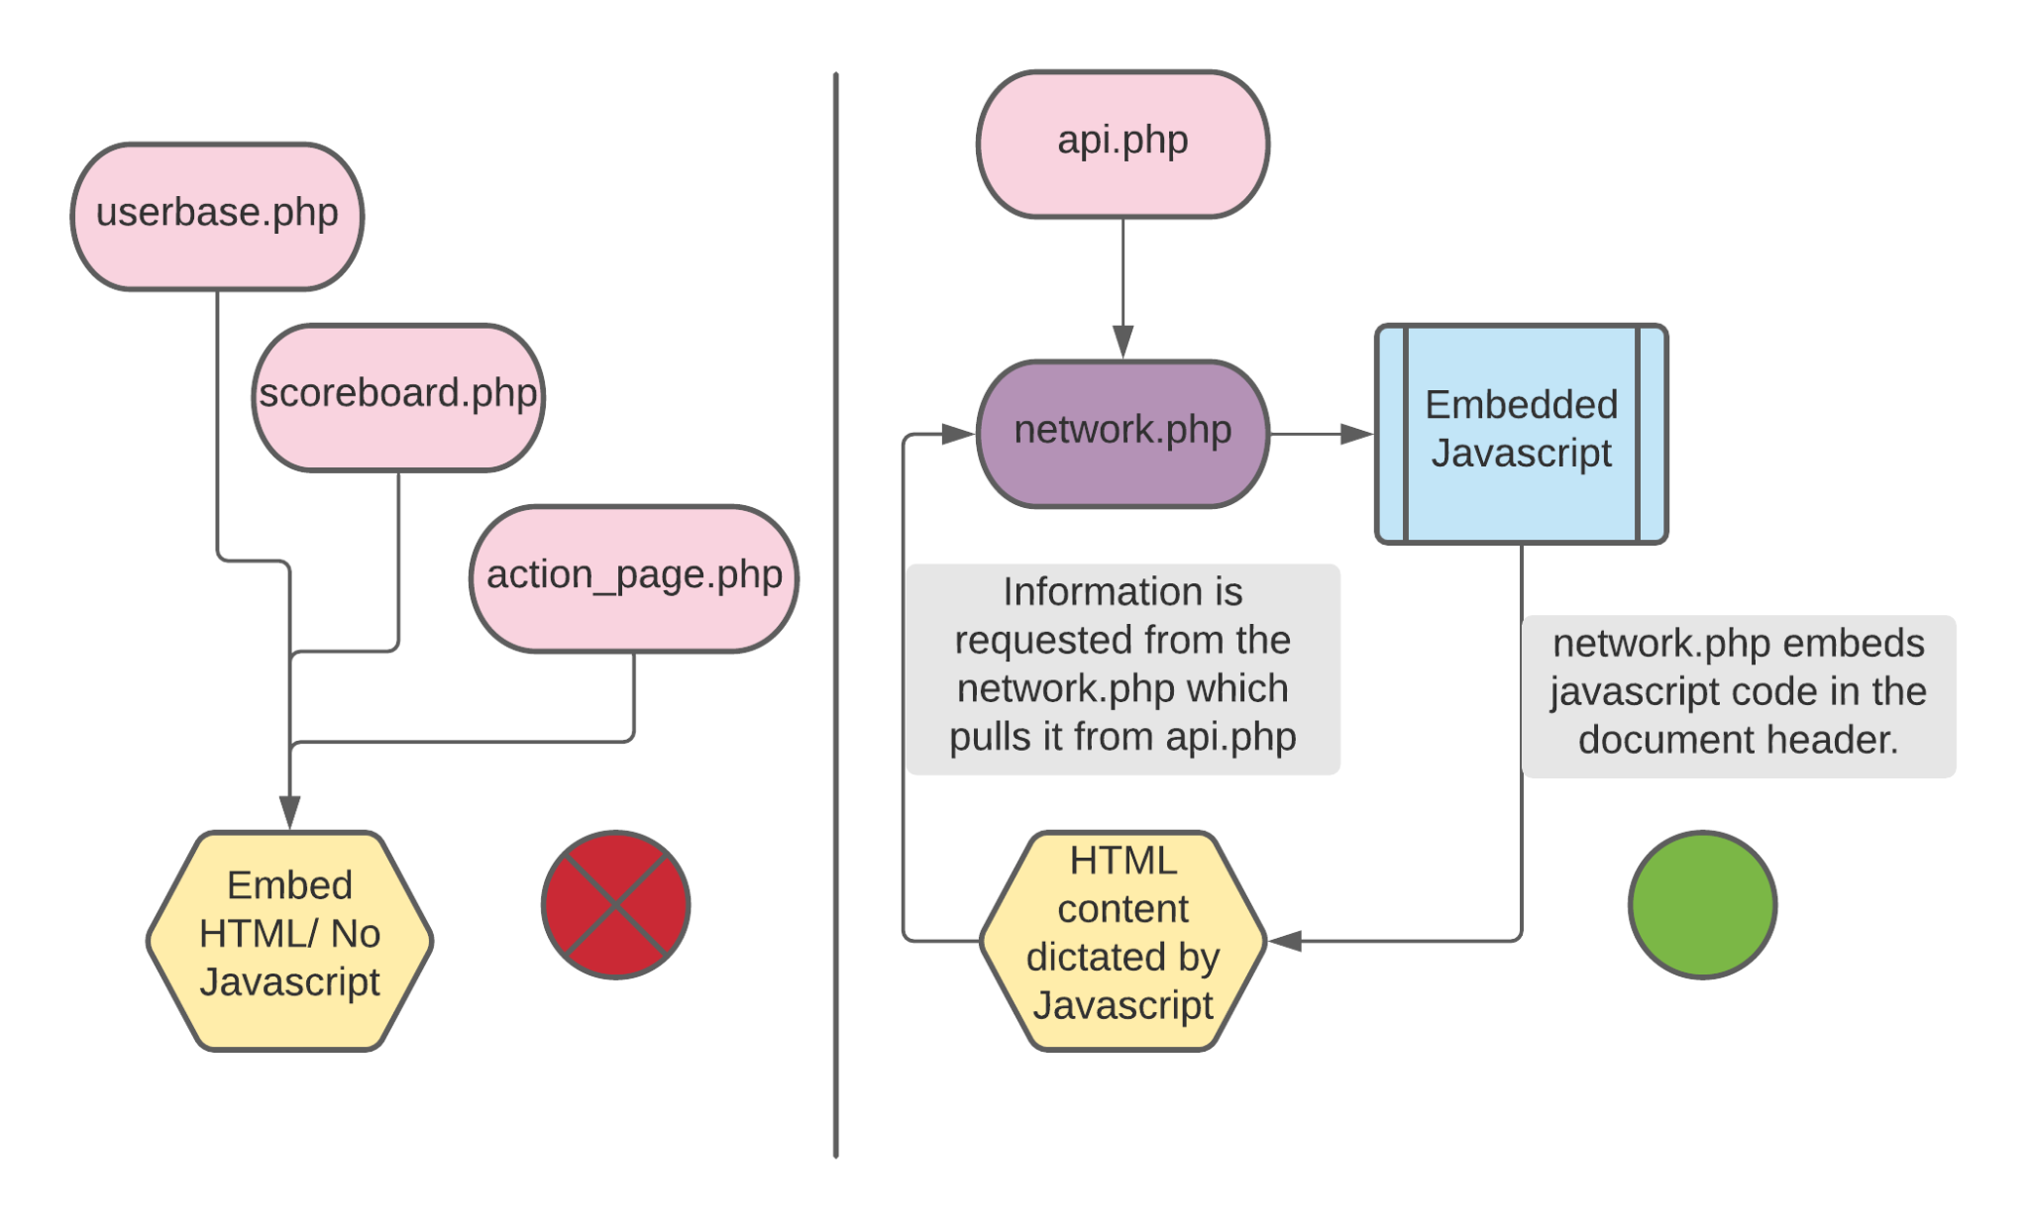
Backend

Slide 6
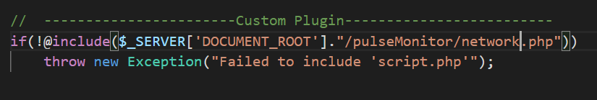
Validation map in Vanilla JavaScript
Built a standard API that can be called to/from the page and can be used as a standalone in itself.
Networked using AJAX calls.

Slide 7
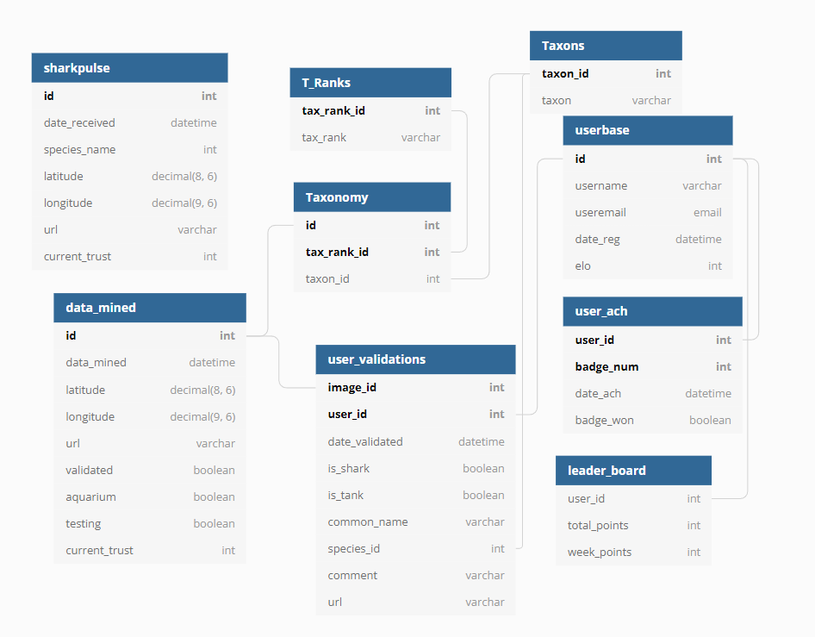
Database
“sharkPulse Shark Validator Game,” Sharkpulse. [Online]. Available: http://sharkpulse.cnre.vt.edu/. [Accessed: 13-Dec-2021].

Slide 8
Frontend and Workflows
User-Interface
  Redesigned WordPress pages
    Login Credentials
    Leaderboard
  Validation Monitor
    Before: Popup markers had an issue of appearing outside the map
    After: Modal box that is always centered on the middle of the screen
      Changed form layout and style

Slide 9
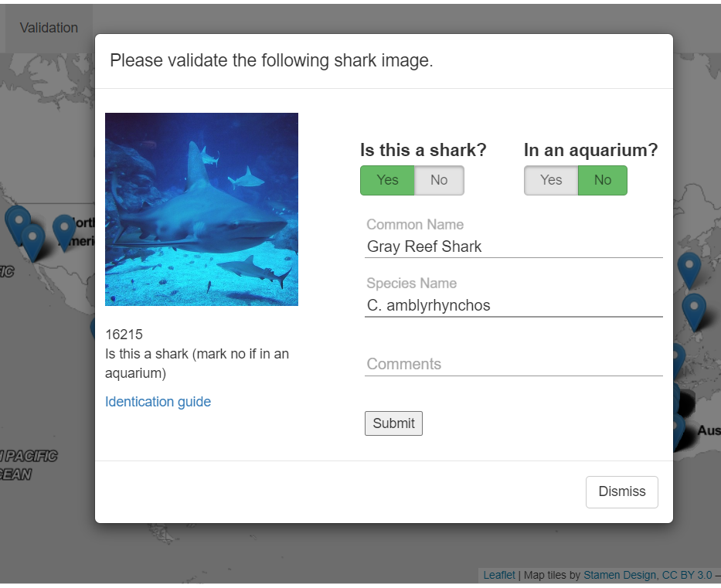
“sharkPulse Shark Validator Game,” Sharkpulse. [Online]. Available: http://sharkpulse.cnre.vt.edu/. [Accessed: 13-Dec-2021].

Slide 10
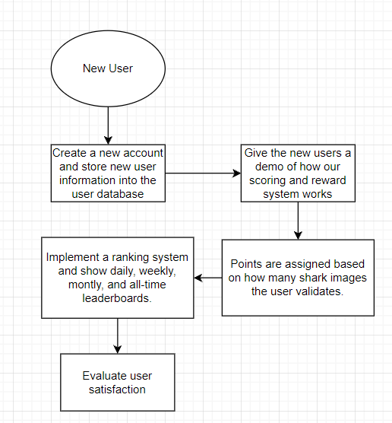
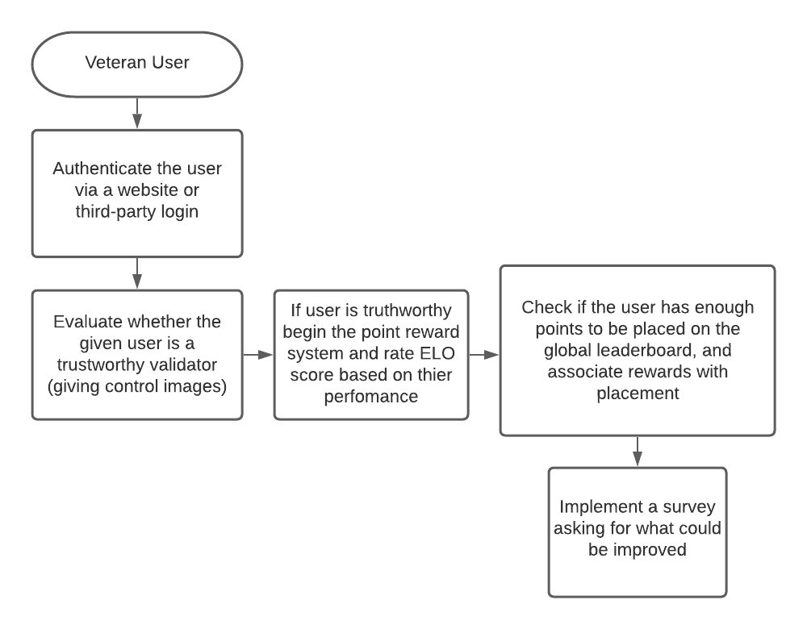
VETERAN USER
NEW USER

Slide 11
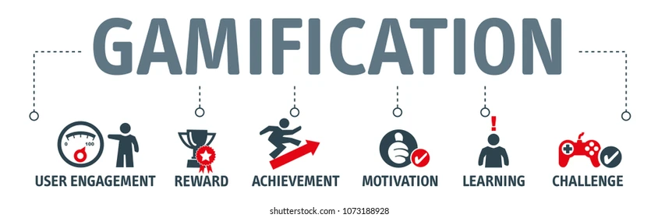

Gamification
Points
Rewards
Badges
Achievements
User Profiles
Leaderboards

Slide 12
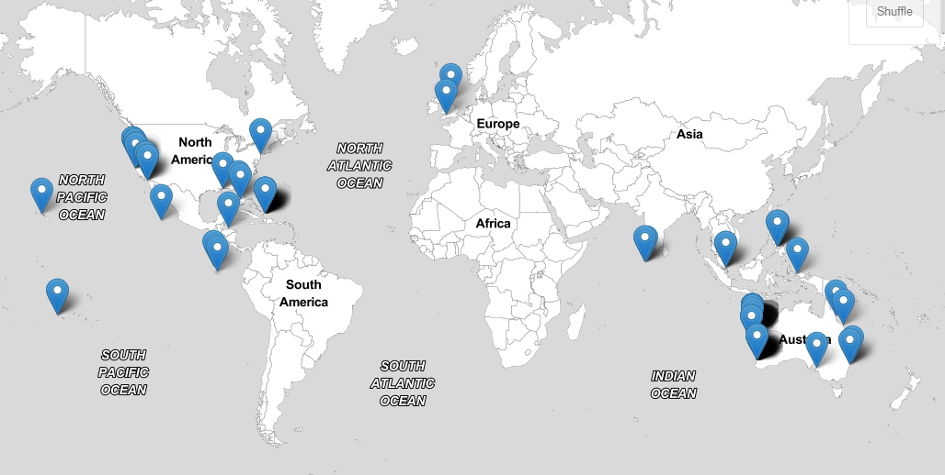
“sharkPulse Shark Validator Game,” Sharkpulse. [Online]. Available: http://sharkpulse.cnre.vt.edu/. [Accessed: 13-Dec-2021].

Slide 13
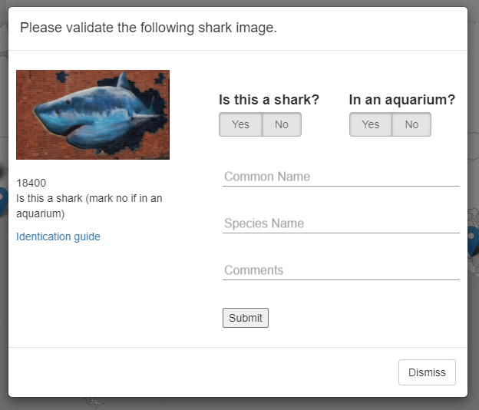
“sharkPulse Shark Validator Game,” Sharkpulse. [Online]. Available: http://sharkpulse.cnre.vt.edu/. [Accessed: 13-Dec-2021].

Slide 14
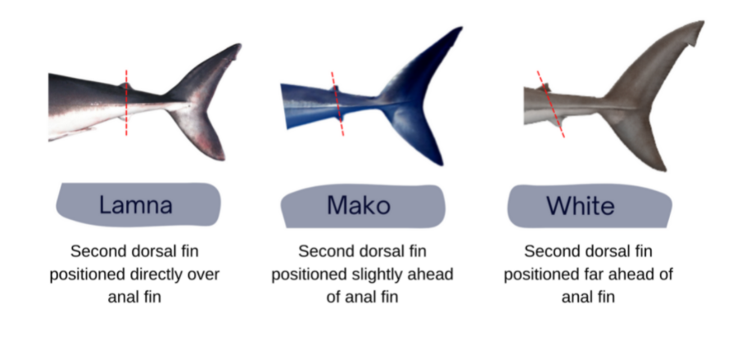
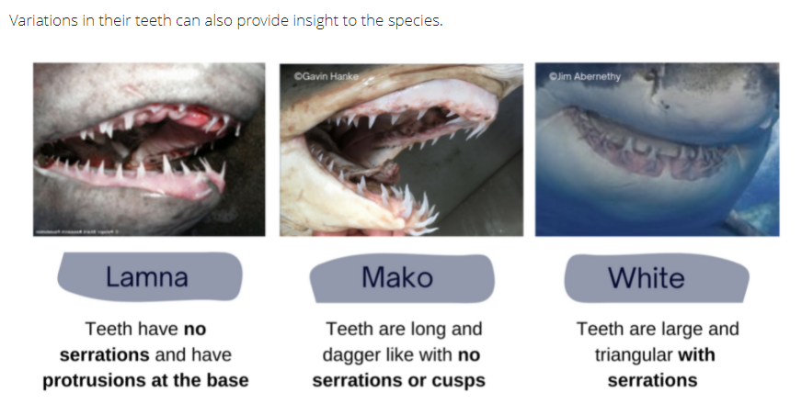
“sharkPulse Shark Validator Game,” Sharkpulse. [Online]. Available: http://sharkpulse.cnre.vt.edu/. [Accessed: 13-Dec-2021].

Slide 15
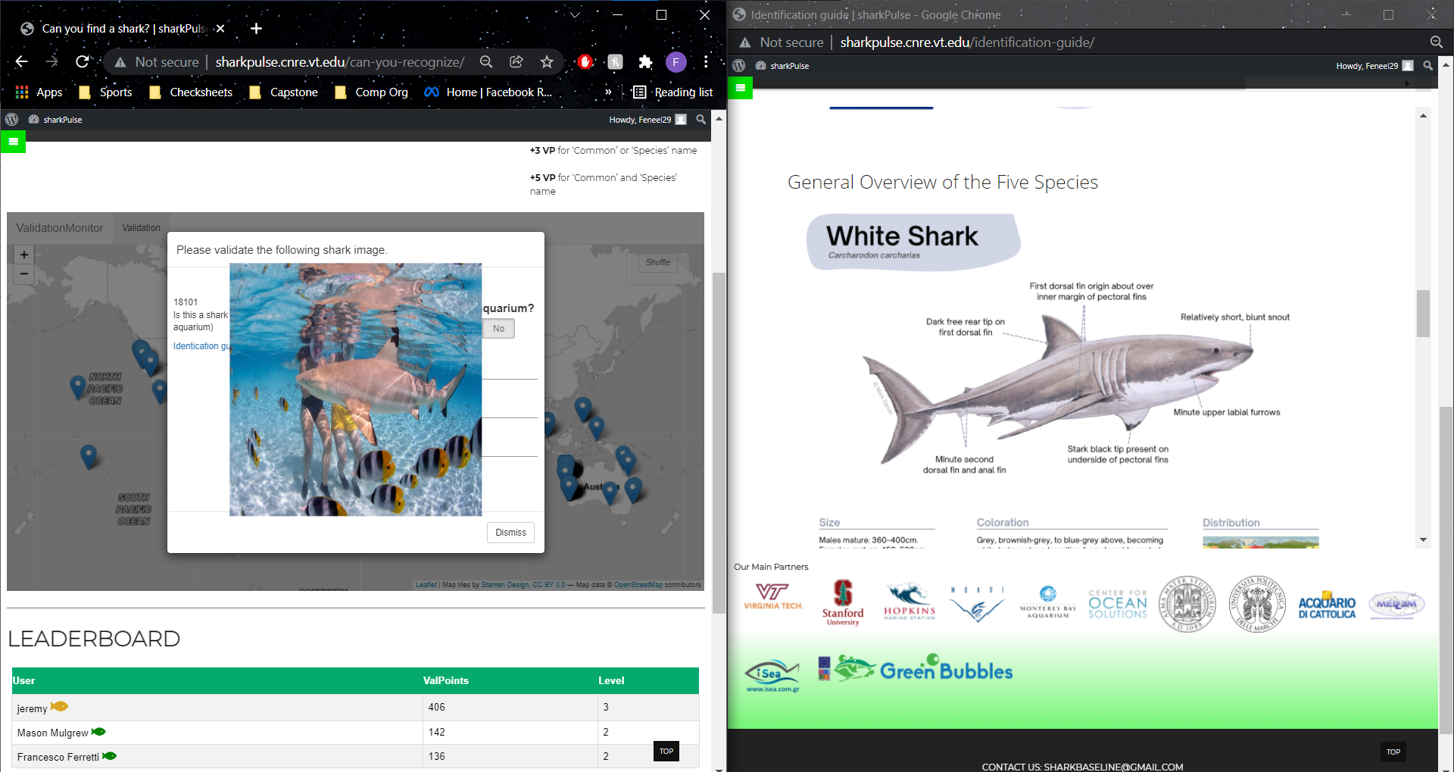
“sharkPulse Shark Validator Game,” Sharkpulse. [Online]. Available: http://sharkpulse.cnre.vt.edu/. [Accessed: 13-Dec-2021].

Slide 16
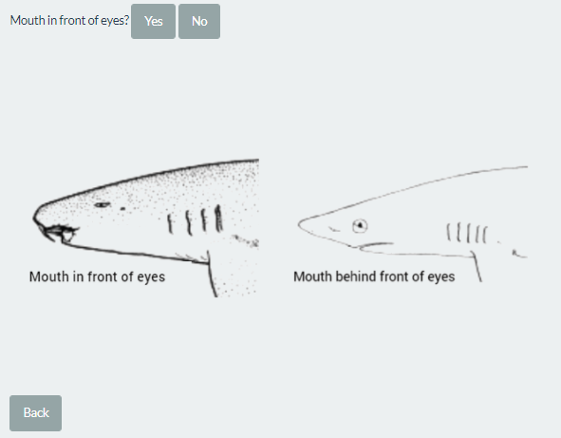
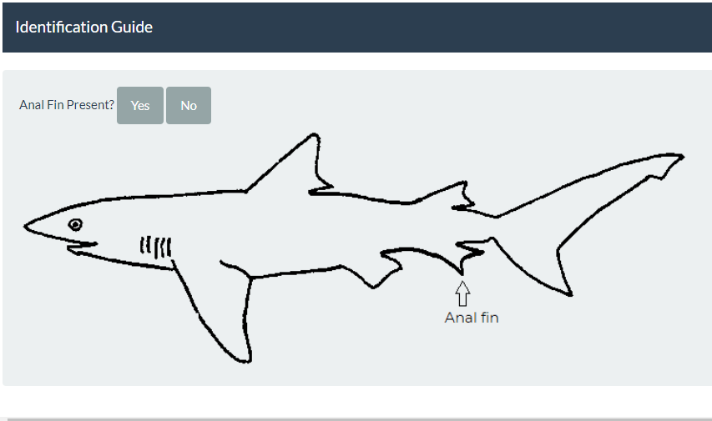
“sharkPulse Shark Validator Game,” Sharkpulse. [Online]. Available: http://sharkpulse.cnre.vt.edu/. [Accessed: 13-Dec-2021].

Slide 17
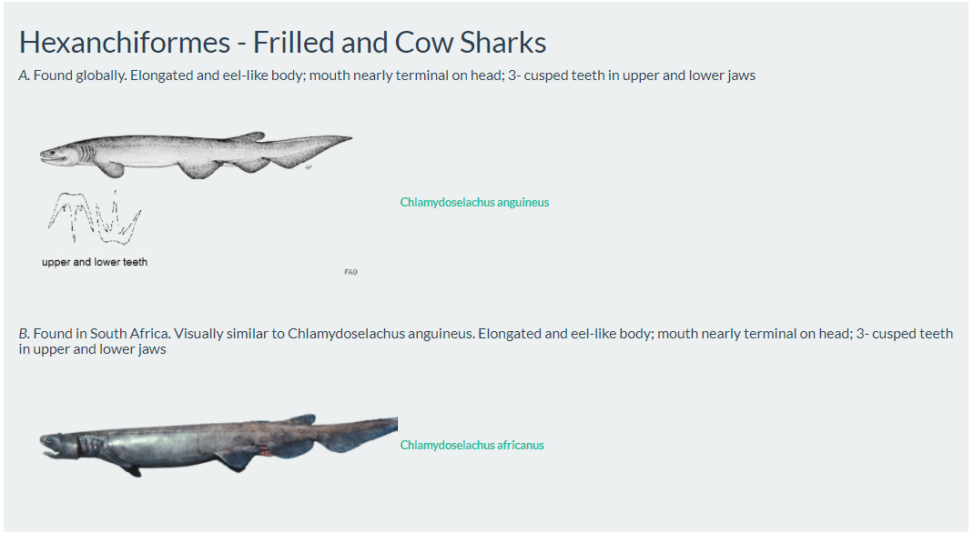
“sharkPulse Shark Validator Game,” Sharkpulse. [Online]. Available: http://sharkpulse.cnre.vt.edu/. [Accessed: 13-Dec-2021].

Slide 18
Challenges
RShiny
WordPress
React.js

Slide 19
Lessons Learned
Communication with the client was key
  Having a set schedule to meet weekly
Developing solutions and testing along the way
Adapt to the conditions as other courses in the semester progressed.
Survey stakeholders outside of the client
Documentation for future teams

Slide 20
Ideas For The Future
Improved Gamification
More interactive UI
Support for multiple Social Media Authentication
Methods to identify and save control images
Casual vs. Time Validator Game Modes

Slide 21
Acknowledgements
Dr. Edward Fox
Professor Francesco Ferretti
Jeremy Jenrette

Slide 22
References
http://hdl.handle.net/10919/103254
http://sharkpulse.cnre.vt.edu/
https://app.diagrams.net/
http://www.rstudio.com/shiny/
https://wordpress.com/
https://developer.mozilla.org/en-US/docs/Web/JavaScript
https://www.postgresql.org/

Slide 23
Questions?

