Slide 1
NAWEA Presentation
by
Dr. Chris Pattison
Texas Tech University
Wind Science & Engineering
Co-location of Wind and Solar Power Plants and Their Integration onto the US Power Grid

Slide 2
Outline
Approach and Methodology
Data
Wind Power
Solar Only
Combining Technologies
Design Options
Conclusion

Slide 3
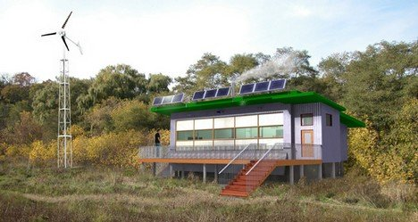
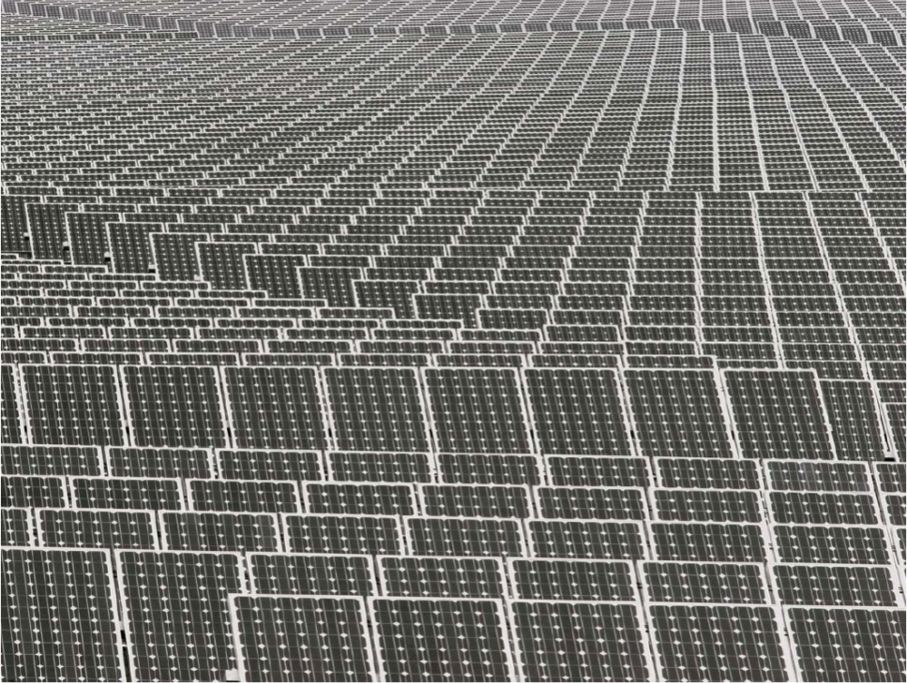
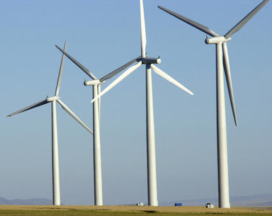
Approach and Methodology
To date, no Utility-scale study of the combined technologies
High-fidelity, hub-height wind data with co-located 5-minute solar data (MesoNet)
Estimate wind, solar, and combined output for 2009

Slide 4
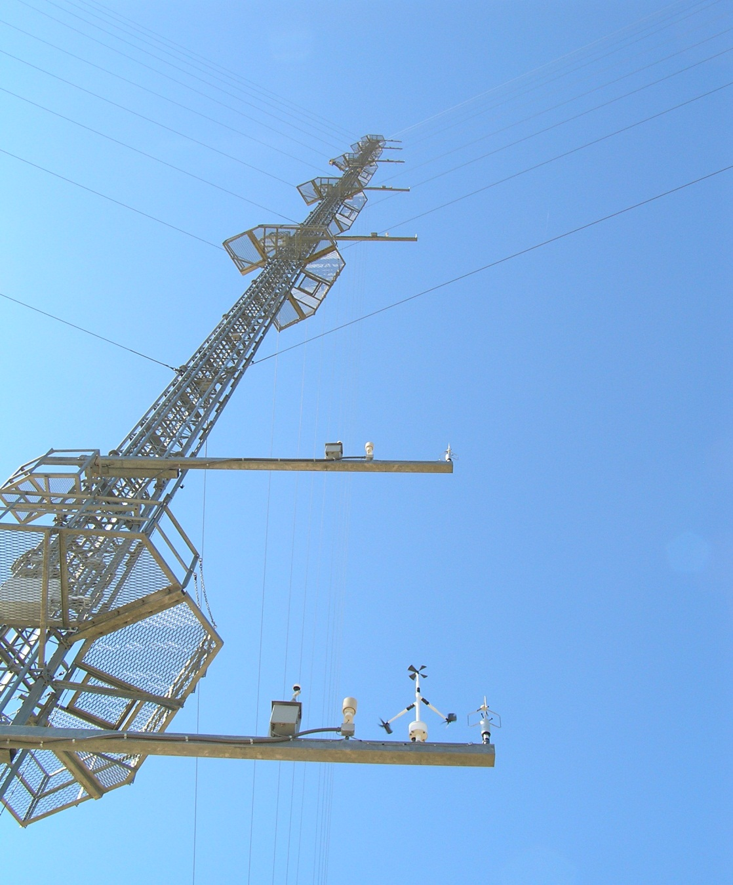
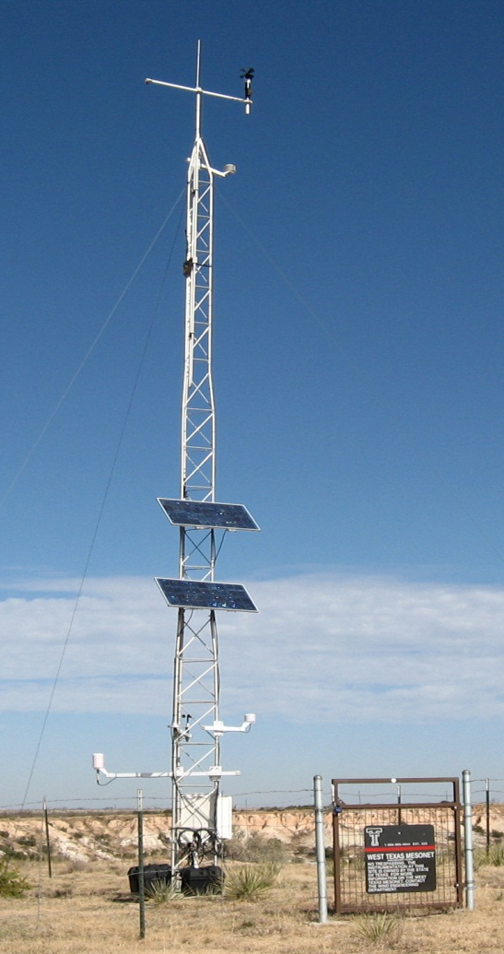
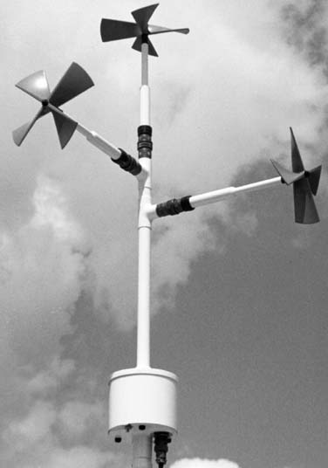
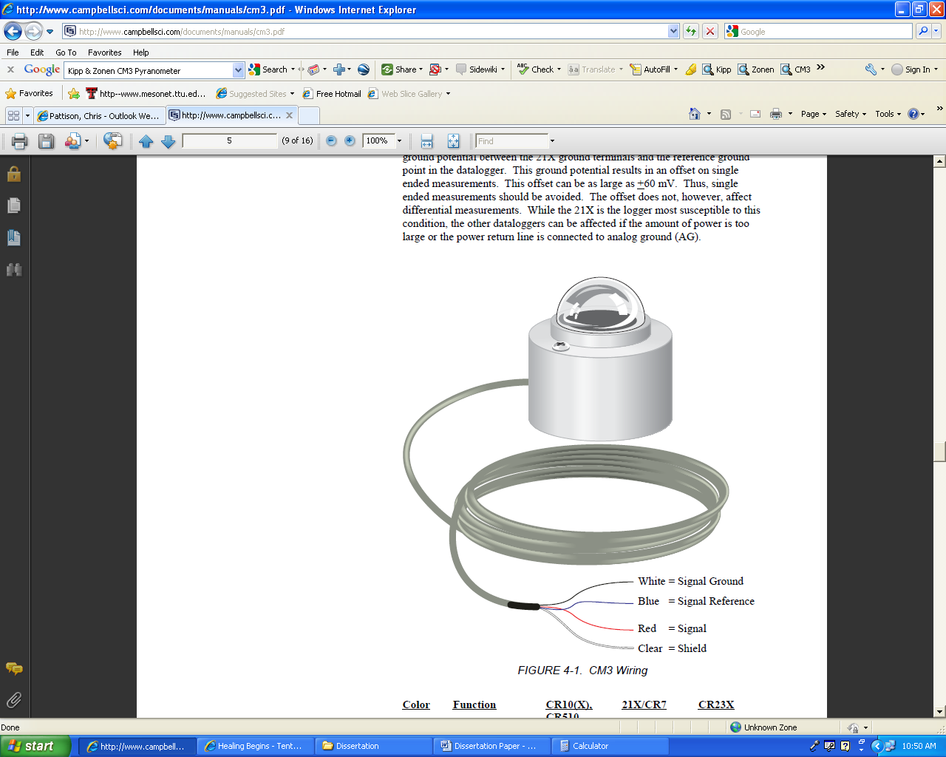
Data
High-fidelity Wind data at
10-199 m and at 74 meters
Correlated with 78-meter tower and 3-cup anemometer
10-meter wind speeds and solar from West Texas MesoNet
Photo curtsey Dr. Ian Giammanco
Photo curtsey Wes Burgett

Slide 5
Big Data
74-meter Histogram
Seasonality by location
74-meter shear exponent

Slide 6
Wind Power
CDF graph of wind power
Firming wind with diesel or natural gas generation

Slide 7
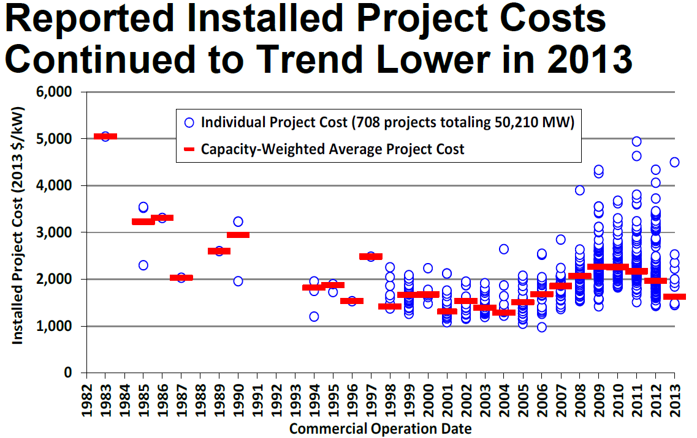
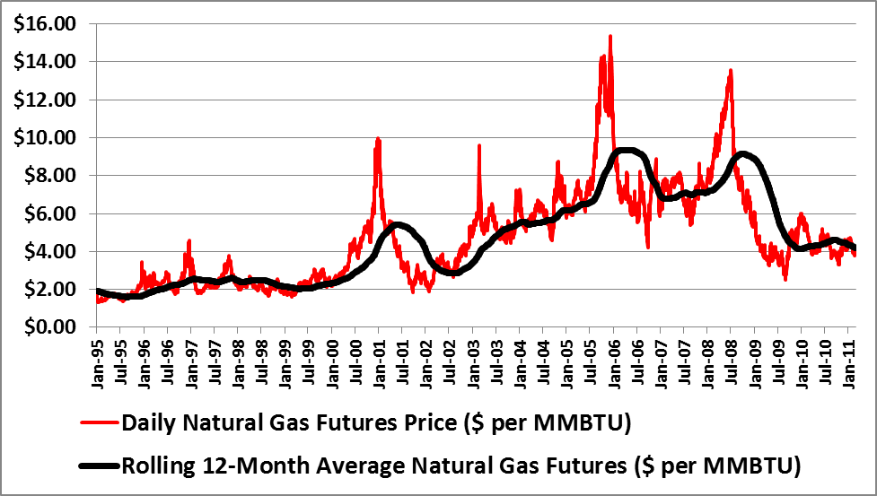
Economics
2009 Wind Technologies Market Report
1 Year | MWh Delivered | Capacity Factor | Estimated 2009 cost | Cost/Watt | One-year ICC/AEP
Wind | 3,564 | 40.7% | $2,120,000 | $ 2.12 | $ 0.60
2013 Average cost of $1,630/kW
Natural Gas Prices
PPA vs. Merchant Plan
Multi-year layout
IRR/NPV graphs (Combined)
http://emp.lbl.gov/sites/all/files/2013-wind-technologies-market-report-ppt.pdf

Slide 8
Solar Only
Fixed
Single-Axis
Dual-Axis

Slide 9
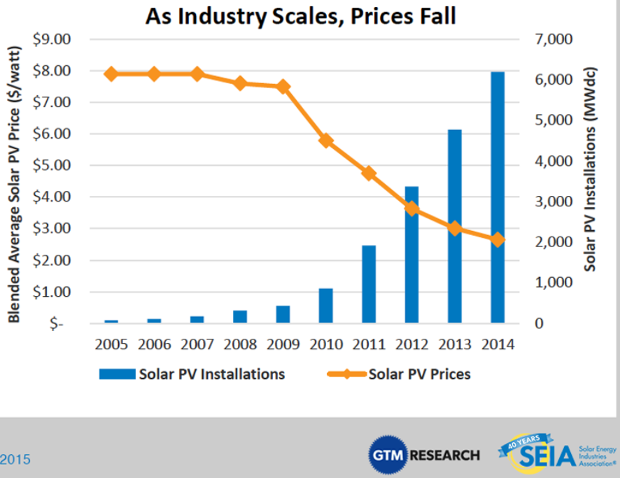
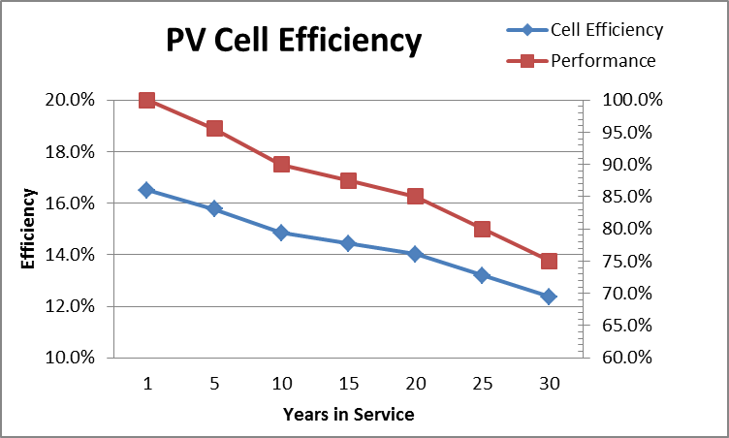
Economics
1 Year Compare | No. of Panels | MWh Produced | Net Cap Factor | % increase | Est. Cost w/o T-1603 | cost/Watt AC w/o T-1603 | One-year ICC/AEP
Fixed Solar | 6570 | 1,687 | 19.3 % | - | $5,303,715 | $ 5.15 | $ 3.14
Single-Axis | 5900 | 2,235 | 25.5 % | 32.5% | $4,809,090 | $ 4.94 | $ 2.15
Dual-Axis | 5600 | 2,341 | 26.7 % | 38.8% | $4,665,830 | $ 4.95 | $ 1.99
Modules: $2.25 / Watt
Labor: $2.90 / Watt

Slide 10
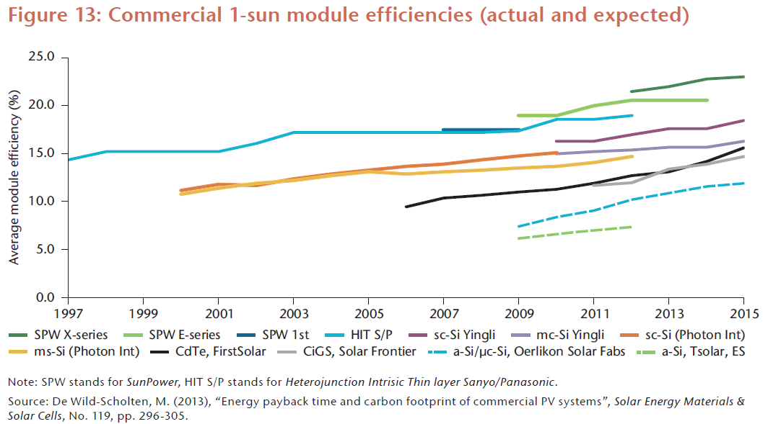
Solar Efficiency Trends
https://www.iea.org/publications/freepublications/publication/TechnologyRoadmapSolarPhotovoltaicEnergy_2014edition.pdf

Slide 11
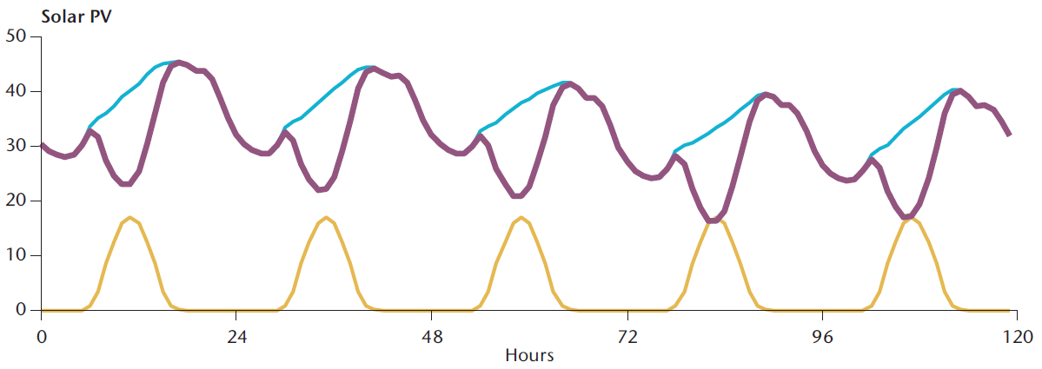
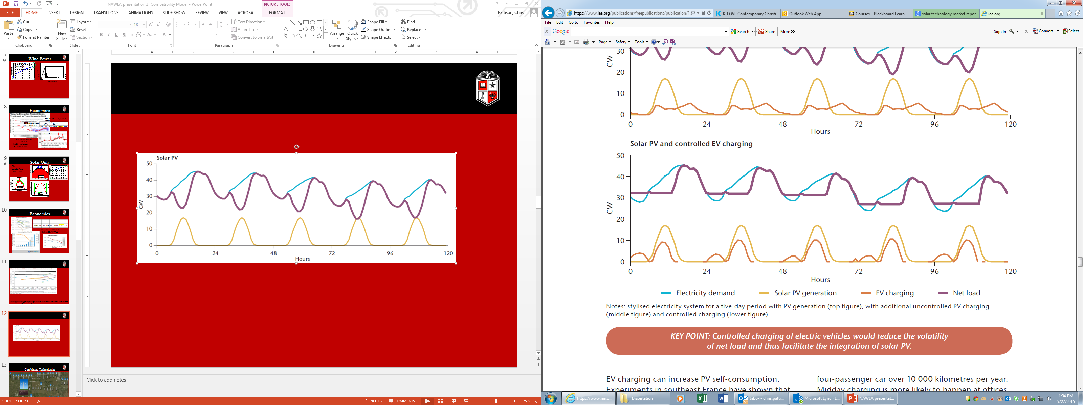
Ex: Solar’s Affect on the Grid
https://www.iea.org/publications/freepublications/publication/TechnologyRoadmapSolarPhotovoltaicEnergy_2014edition.pdf

Slide 12
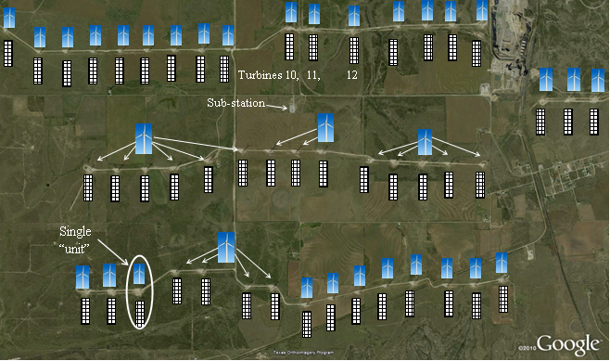


Combining Technologies

Slide 13
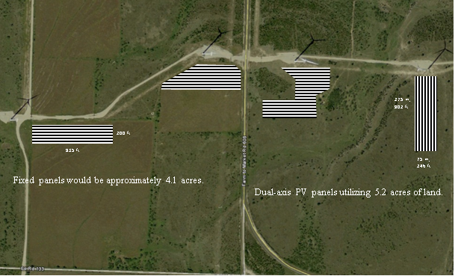
Combining Technologies
Wind and Fixed Solar
Wind and Single-Axis
Wind and Dual-Axis
4.5 to 5.5 acres of land necessary

Slide 14
Design Options
Option 1: Add-On
Shared transformer
Individual transformer, high-side bus
Shared larger transformer
Collection system, under-designed
Internal curtailment
Option 2: Co-construction/design
Individual transformers, high-side bus
Shared larger transformer
Collection system, correctly designed

Slide 15
Combined Technologies
Power Output Histogram
50%

Slide 16
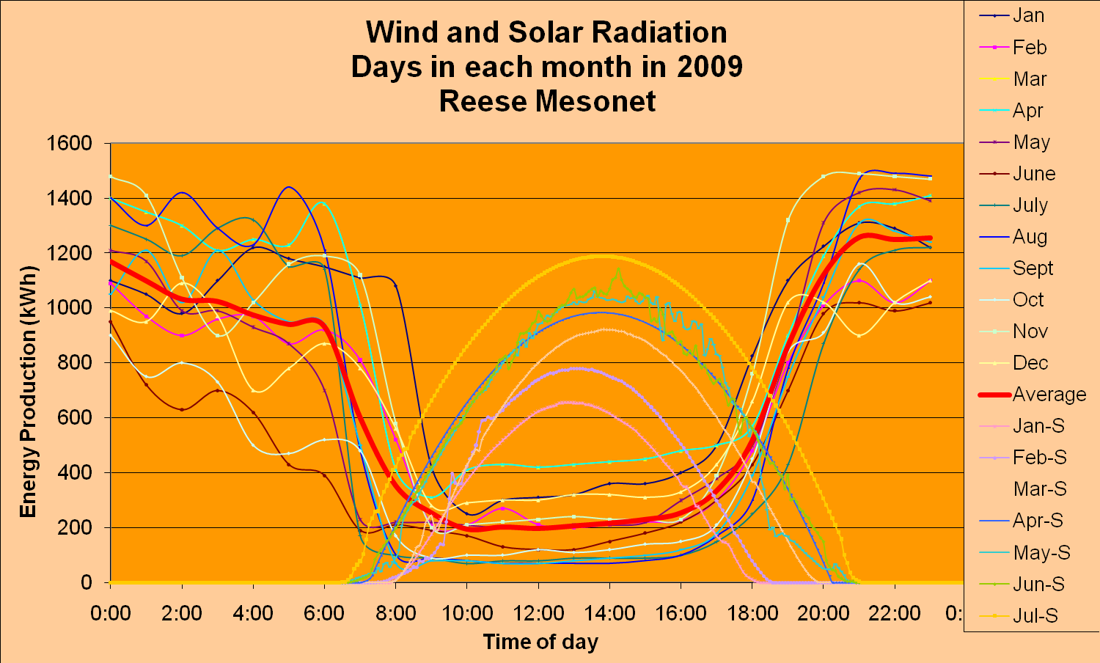
Combined Technologies
Seasonal Averages
Fixed Solar
Dual-Axis Solar

Slide 17
Combined Technologies
Leads to storage
Short-term storage
Long-term storage

Slide 18
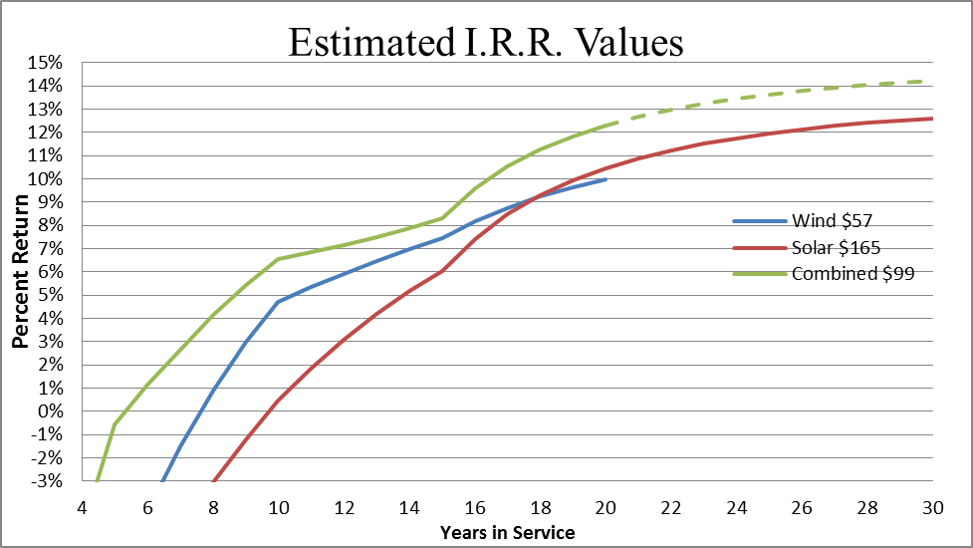
Econ Combined Technologies
Equal IRR’s-10% Wind PPA of $56 Solar PPA of $165 Combined $95
PTC
NCF
Wind: 0.407
Solar: 0.19-0.27
Combined: 0.592

Slide 19
Storage
Persistence leads to storage
Options
Concentrated Solar Power (water)
Super-Capacitors (voltage control)
Hydrogen (tanks & water)
Pumped Hydro (large amount of water)
Compressed air (temperature & geography)
Fly wheels (short duration)
Batteries

Slide 20
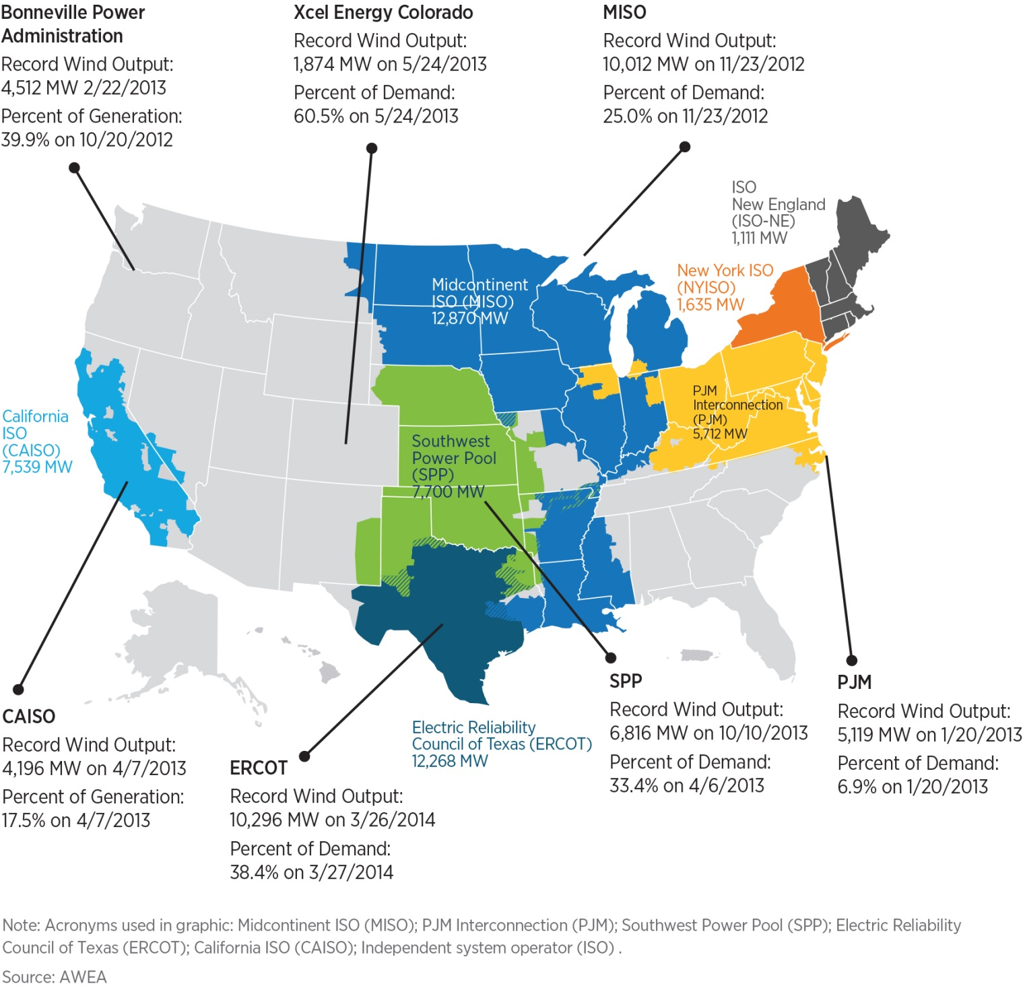
Conclusion
More reliable power being delivered closer to the loads stabilizes the grid and reduces losses.
However…

Slide 21
Arizona is imposing a monthly surcharge for net metering. New Mexico is considering one.
“If demand for solar continued to soar, traditional utilities could soon face serious problems, from ‘declining retail sales’ and a ‘loss of customers’ to ‘potential obsolescence,’ according to a presentation prepared for the group.”
“The warning… became a call to arms for the electricity providers in nearly every corner of the nation. …The industry and it’s fossil-fuel supporters are waging a determined campaign to stop a solar insurgency that is rattling the boardrooms of the country’s government-regulated electric monopolies.”

Slide 22
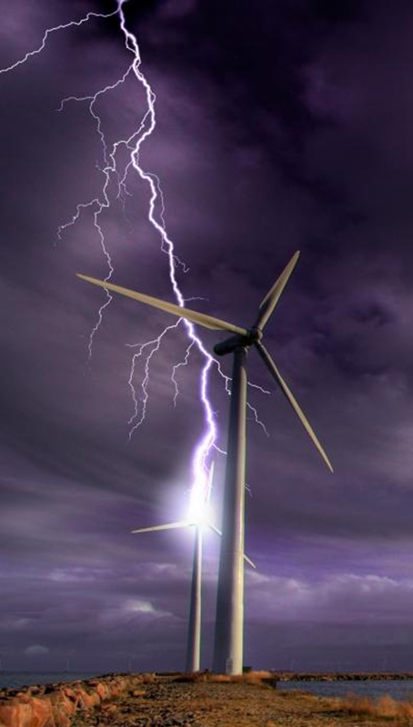
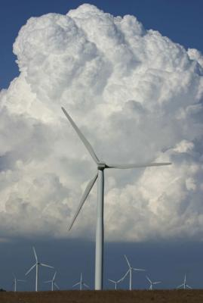
Thank you!

Slide 23


