Slide 1
CS5604: Final Presentation
ProjOpenDSA: Log Support
Victoria Suwardiman
Anand Swaminathan
Shiyi Wei
Department of Computer Science, Virginia Tech
December 4, 2012

Slide 2
Overview
OpenDSA Recap
Log Support Recap
Student View
Instructor View
Developer View
Future Work

Slide 3
OpenDSA Recap
OpenDSA active e-book project*
  goal: develop a complete online text book for data structures and algorithms (DSA) courses
Features
  instructional module (topic), e.g., a sorting algorithm
  interactive algorithm visualization
  interactive assessment activity (exercise)
    provides feedback on students’ proficiency with the material
Project Status
  The system is deployed for students in CS3114 to use.
*This project is led by Dr. Cliff Shaffer in Department of Computer Science, Virginia Tech

Slide 4
Log Support Project Recap
OpenDSA log data
  student interactions with the exercises
    timestamps for various actions, e.g., button click
    performance results, e.g., exercise score
Log support: log data reporting through visualization
  student view
    student’s own progress and performance in modules and exercises
  instructor view
    grades and students’ overall performance
  developer view
    usage statistics of modules and exercises
Technologies
  Python, Django, MySQL, HTML/CSS/JS

Slide 5
Progress
Midterm Presentation:
  Learned software tools
  Designed individual views
  Began developing views
Final Presentation:
  Developed each view
  Received client feedback
  Fixes and updates to each view

Slide 6
Development Process
Individual views worked on in parallel by individual team members
Weekly meetings with clients: Dr. Shaffer, Eric Fouh, Daniel Breakiron
Weekly updates based on feedback
GitHub
  https://github.com/cashaffer/Aalto--
http://opendsa.cc.vt.edu/

Slide 7
What does student view provide (http://opendsa.cc.vt.edu/student_view/)
A way for students to view their progress and grades.
The list of modules they are proficient in.
This list of exercises they are proficient in.
Their score based of proficient exercises.
The list of exercises the student needs to be proficient to be proficient in a module.
A list of non-proficient and uncompleted exercises.

Slide 8
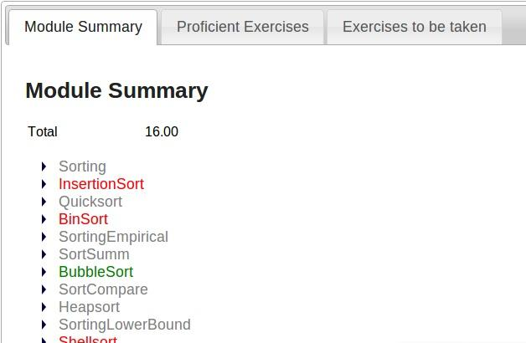
Student View - Overview

Slide 9
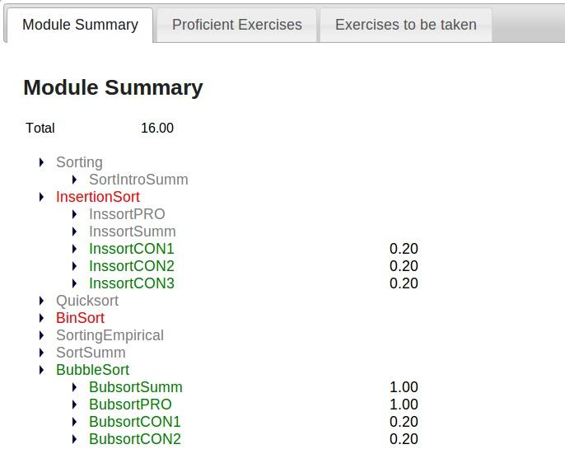
Module View

Slide 10
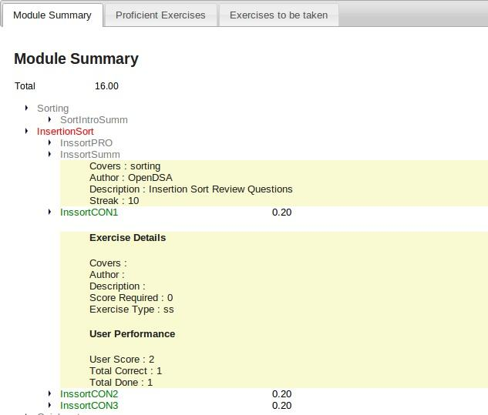
Module View - Expanded

Slide 11
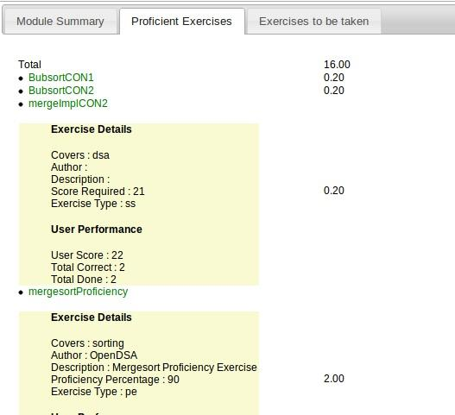
Proficient Exercises

Slide 12
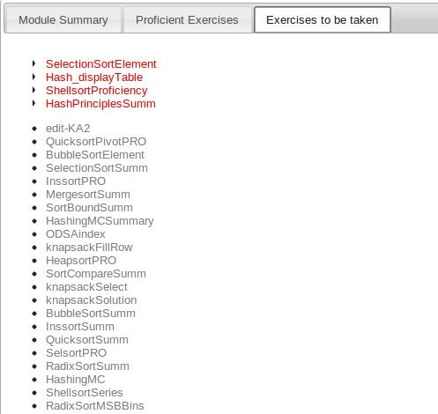
Exercises to be taken up

Slide 13
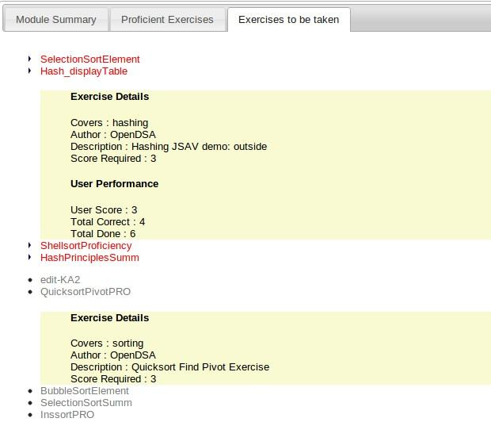
Exercises to be taken up

Slide 14
Challenges faced
(Mainly the performance of the system)
The data in database was not in proper format.
There were comma separated values in certain fields due to which inner join could not be performed.
The number of exercises is too high.
Also the number of user exercises- Entries of a exercise for each user is even higher.
Wrong testing data in the live database.
The exercises had to be merged into each modules.
The page took 20 seconds to load.

Slide 15
Solutions
Initially we tried to implement the page rendering through ajax. (didn't work)
Tried to paginate entries by filtering at the controllers. (Views.py) - (also didn't work)
Since SQL is the fastest, I filtered out the entries at the database level - (worked out pretty well).
A order of N is anytime better than order of N² irrespective of the extra space used.
After all the optimizations the page now loads in less than 1 second

Slide 16
Instructor View
http://opendsa.cc.vt.edu/teacher_view/
Allows instructor to see full students’ exercise summary, as well as exercises’ student summary
Displays each student’s statuses for exercises
Displays each student’s total score
Ability to export table to CSV file for records
Displays students in each category for each exercise

Slide 17
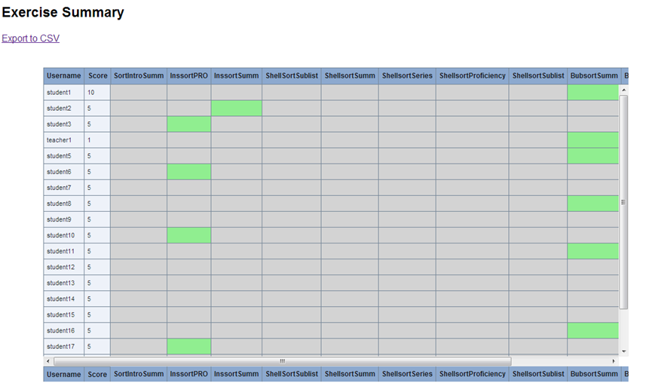
Exercise Summary

Slide 18
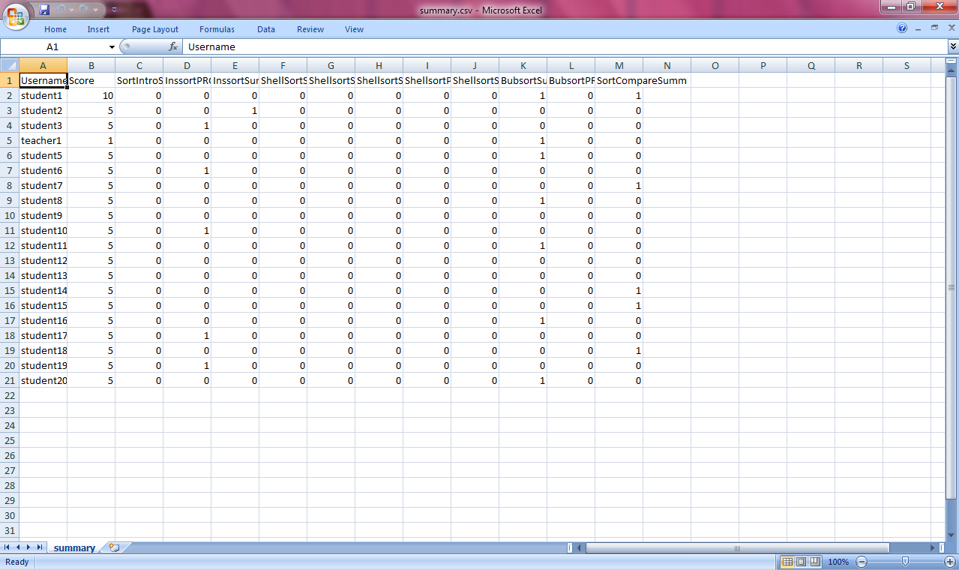
CSV File

Slide 19
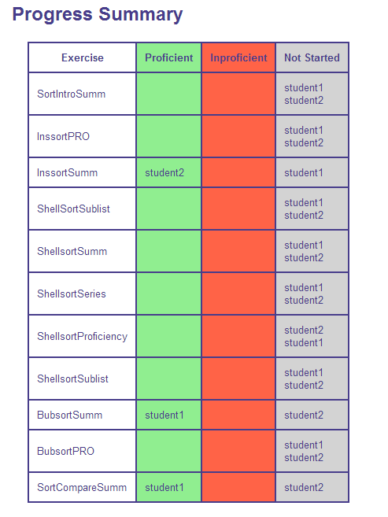
Progress Summary

Slide 20
Challenges
Display: because of extensive number of rows and columns for users and exercises, scrolling can cause lack of readability
Storage: having an online view is accessible, but not useful for an instructor’s recordkeeping
Performance: because of database schema, it is expensive to read information from various tables, causes the page to load very slowly

Slide 21
Solutions
Display: Fixed table headers, as well as columns in order to keep the labels fixed while looking at individual student’s row
Storage: Export to a CSV file option allows instructor to download the table and filter it for various purposes
Performance: Stored procedures in the database to query tables for single or subset of rows versus returning all entries to filter in view

Slide 22
Developer View
Developers/Researchers would like to
  Improve the system contents
  Summarize the student behavior
Visualization of individual student’s activity
  Overall performance
  Exercise summary and details
Information retrieval from log data
  More than 20 million button click interactions
The developer view is available at:
http://opendsa.cc.vt.edu/developer_view/

Slide 23
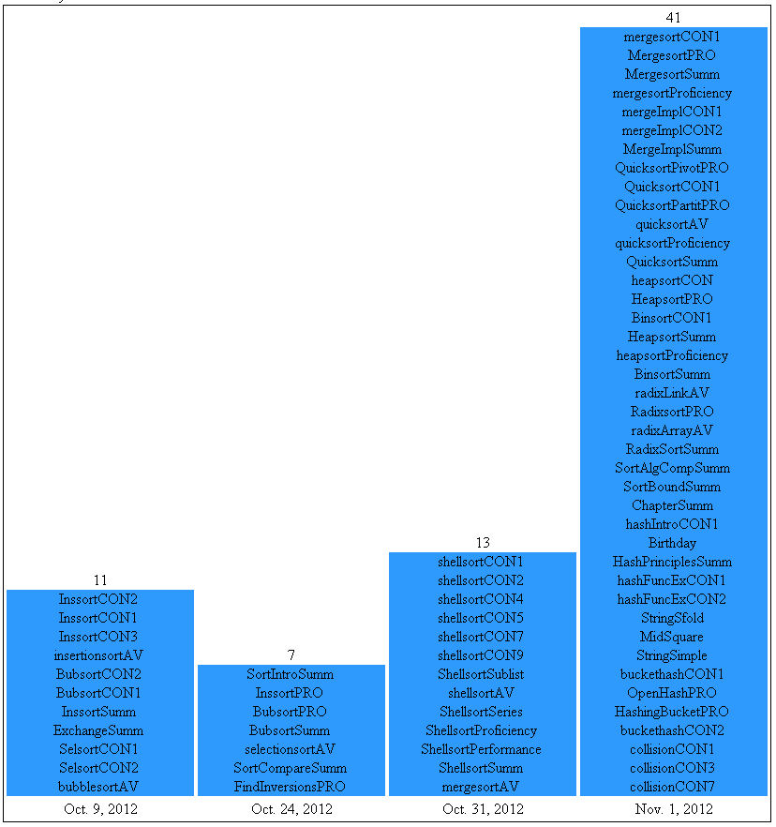

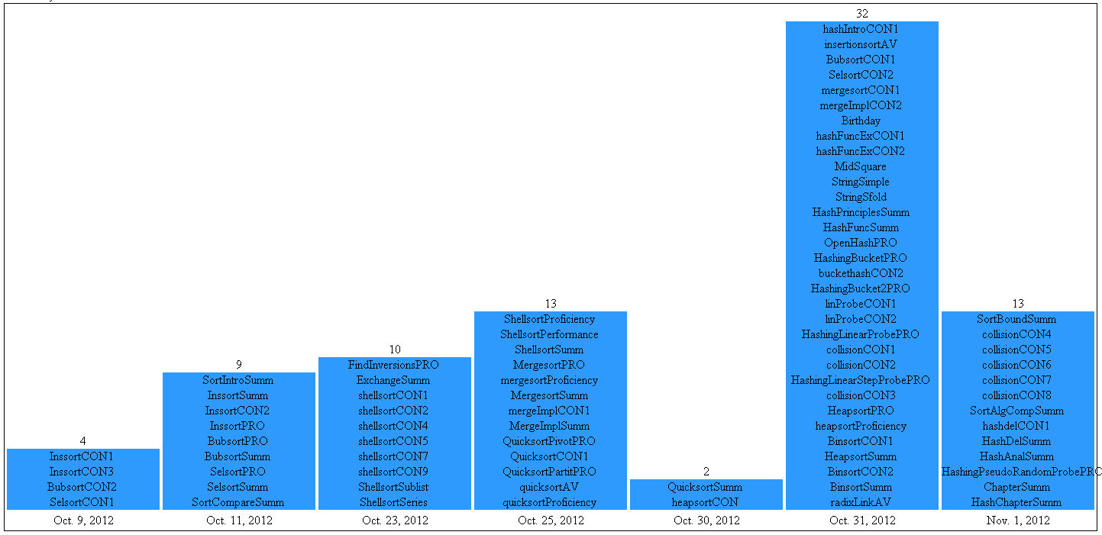

Proficiency Dates Distribution

Slide 24
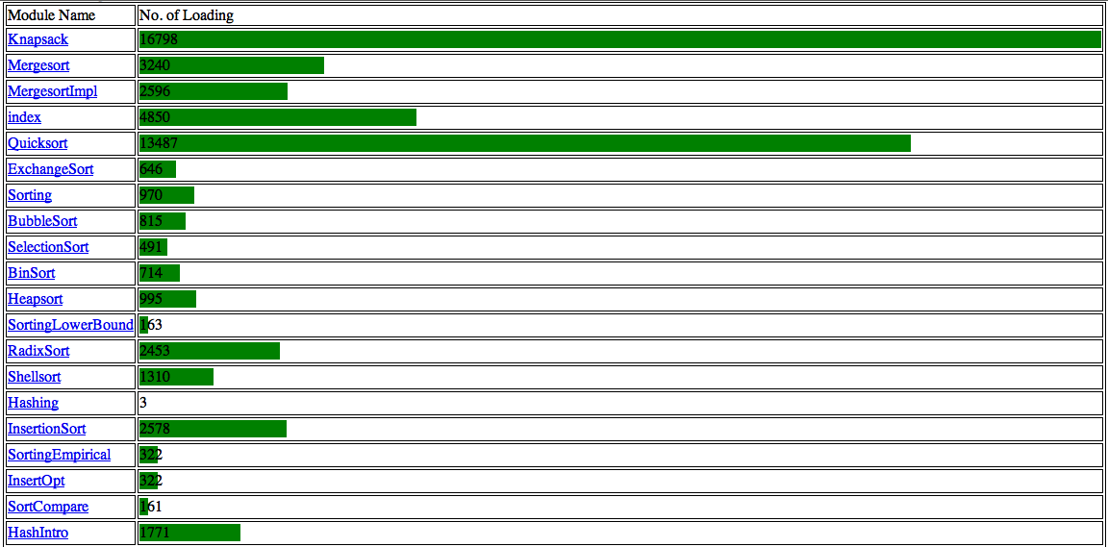
Module Loading Frequency

Slide 25
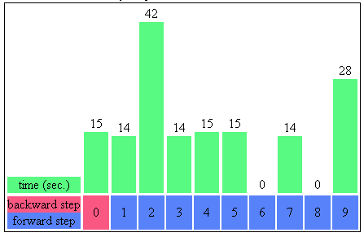
Exercise Summary: Time

Slide 26
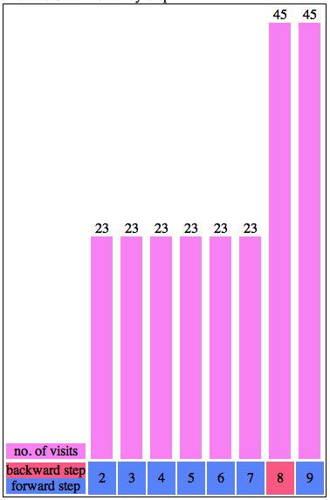
Exercise Summary: Visits

Slide 27
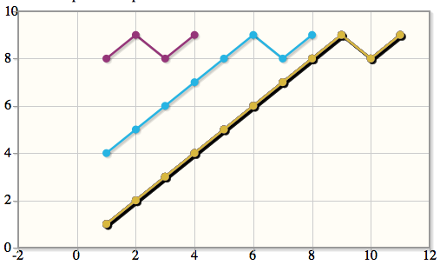
Exercise Details

Slide 28
Implementation
Challenges
  More than 20 million button events in one table
    document-load, document-unload
    forward, backward, etc.
  Interpret the data via. visualization
Implementation
  Precise query: necessary events are retrieved
  Bar graph: html & CSS
  Line graph: JavaScript

Slide 29
Future Work
Student View
Instructor View
  Progress summary view
Developer View
  Timeline view
Writing
  Documentation
  Final report

