Slide 1
News Event Detection Website
Joe Acanfora, Briana Crabb, Jeff Morris
CS 4624 Multimedia and Hypertext - a Capstone
May 5, 2015
Virginia Tech College of Engineering Department of Computer Science
Dr. Edward A. Fox

Slide 2
Overview
Project Purpose and Background
Twitter crawling script
Web crawling script
Reporting Service

Slide 3

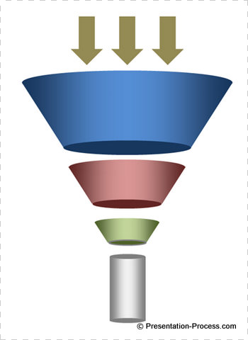
Project Background
The digital archive is a database to collect large amounts of articles about large events and to summarize those events.
Event Summary

Slide 4
Project Purpose
The overall objective of this project was to build a website front end to help the client automate the web archiving process for their big data doctorate research.

Slide 5
A Quick Walk Through

Slide 6
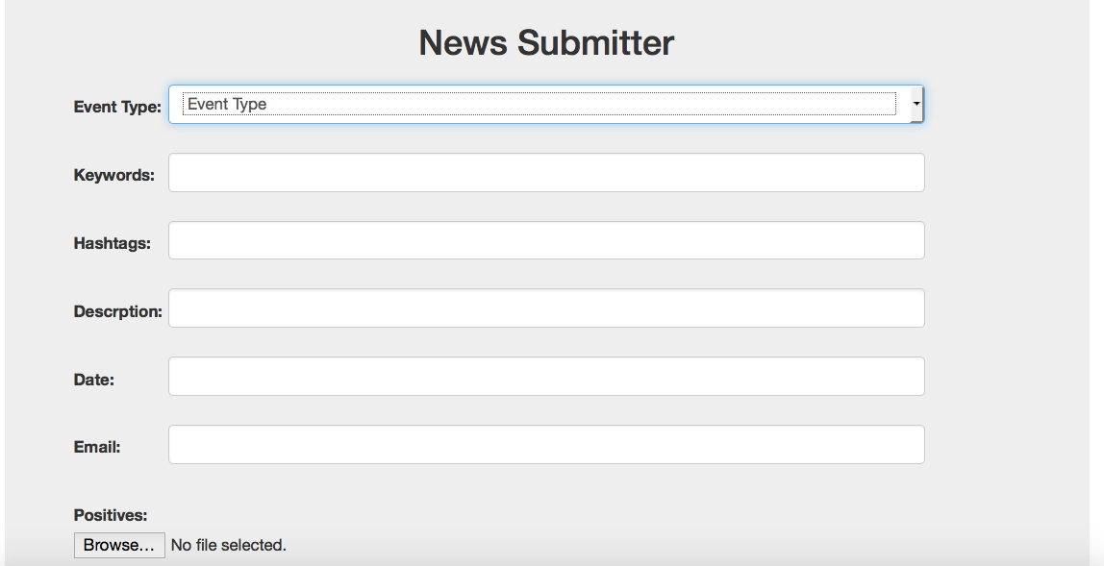
http://babs.dlib.vt.edu/twitter/index2.php

Slide 7
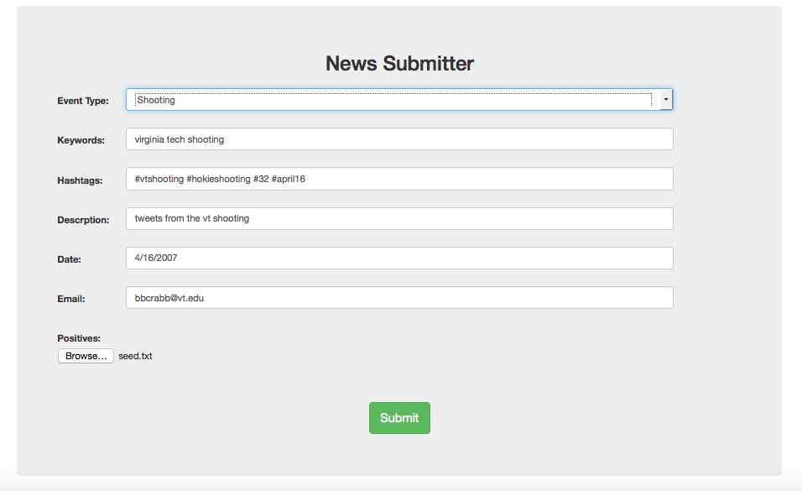
input data

Slide 8
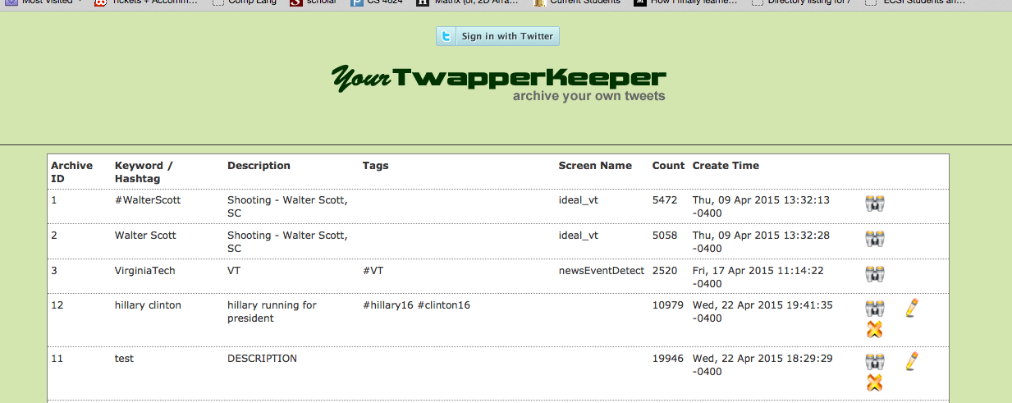
Brings us to yourTwapper

Slide 9
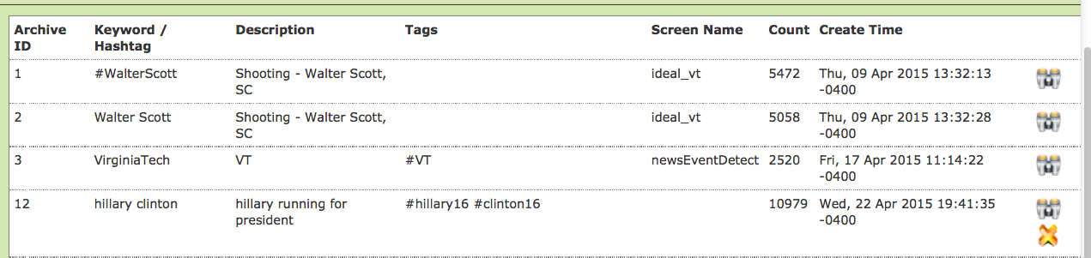
some of the previous twitter searches we have done

Slide 10
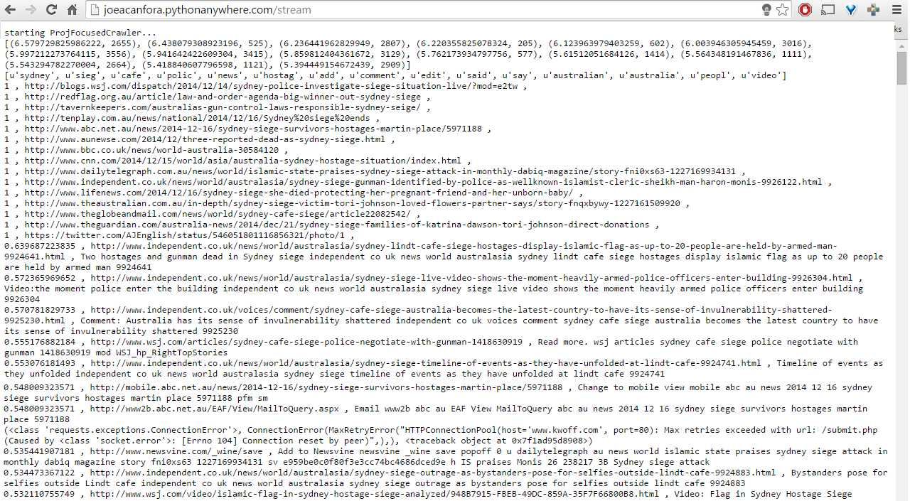
focused crawler output

Slide 11
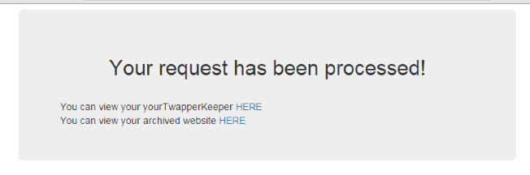
HTML email sent upon completion

Slide 12
Problems Faced
Cloud9/Bluehost
Blocking of PHP Functions
Lack of SSH
Calling PHP Scripts non locally
Calling Python Scripts from Flask

Slide 13
Acknowledgements
Mohamed Magdy Gharib Farag
project sponsor
mmagdy@vt.edu
PhD. Edward A. Fox
class professor
eafox@vt.edu
Sunshin Lee
extra resource
sslee777@vt.edu

