Slide 1
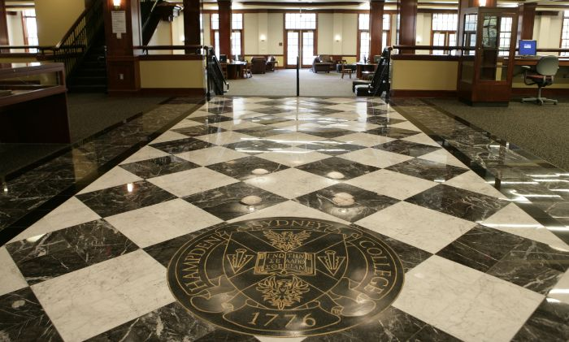

Moving the Needle:
Libraries Embracing a Culture of Open
SCHEV Library Advisory Committee
December 4, 2015
Bortz Library, Hampden-Sydney College
Image credit: Hampden-Sydney College. “HSC Map - Bortz Library Entrance.”

Slide 2
Speakers
Tara Cassidy, Coordinator of Library Services Virginia’s Community Colleges
Kathleen DeLaurenti, Scholarly Communications Librarian College of William & Mary
Anita Walz, Open Education, Copyright & Scholarly Communications Librarian Virginia Tech

Slide 3
Suggested Reading
Empirical research on the impacts of OER Adoption - Open Ed Group “Review” webpage
Babson/Pearson Report (2014) Opening the Curriculum: Open Educational Resources in U.S. Higher Education This report is the source of data regarding why faculty aren’t using OER. Top reasons include: Lack of awareness, difficulty locating OER etc.
The following two reports present findings regarding the impact of textbook costs on student purchasing behavior and its impacts.
Student PIRGs (2014) “Fixing the Broken Textbook Market: How Students Respond to High Textbook Costs and Demand Alternatives”
2012 Florida Student Textbook Survey
This 2005 report seeks to answer the question: “Why are textbooks becoming so expensive?”
Government Printing Office (2005) “College Textbooks: Enhanced Offerings Appear to Drive Recent Price Increases”
For institution-level specifics, the following training and resource materials are highly recommended
See also: Open Education Campus Action Plan (SPARC)
Becoming Open Ed Leaders (1 hour recorded webinar)
Keynote addresses from the 2015 Open Textbook Summit
ASERL Webinar: Your Invitation to Join the Lib-OER Community: Lessons from the Field (1.5 hour recorded webinar)
Sample OER “Reference Interview” (See “Faculty Conversation Video”)

Slide 4
Agenda and Outcomes
Defining Terms
Why Should Libraries be Involved?
Virginia Higher Education Open Initiatives
The State of Open in Virginia
Possible Strategic Areas of Action
Recommendations
Discussion

Slide 5

Getting to know you
I’m just learning about open education
I have a strong understanding
I feel strong philosophical alignment
I’m pragmatic about its applications
I’m skeptical but listening
I’m not sure what to do next
I have a vision and a plan
Image: Public Domain

Slide 6
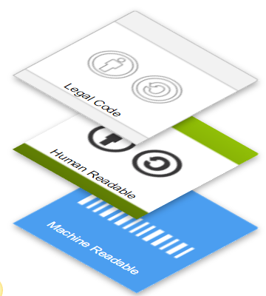
Open Educational Resources are:
Teaching, learning, and research resources that reside in the public domain or have been released under an intellectual property license that permits their free use and re-purposing by others.
http://www.hewlett.org/programs/education/open-educational-resources
CC BY http://creativecommons.org/licenses/

Slide 7
Open Educational Resources include:
Full courses, course materials, modules, textbooks, streaming videos, tests, software, and any other tools, materials, or techniques used to support access to knowledge.
http://www.hewlett.org/programs/education/open-educational-resources
Notes:
Not just textbooks.
Electronic, print, born digital or have license applied after the fact by their copyright owner.

Slide 8
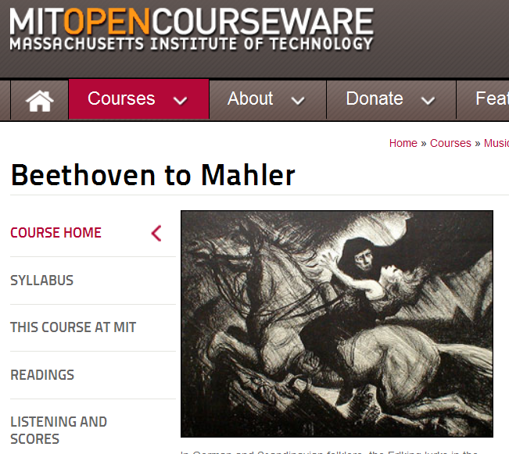

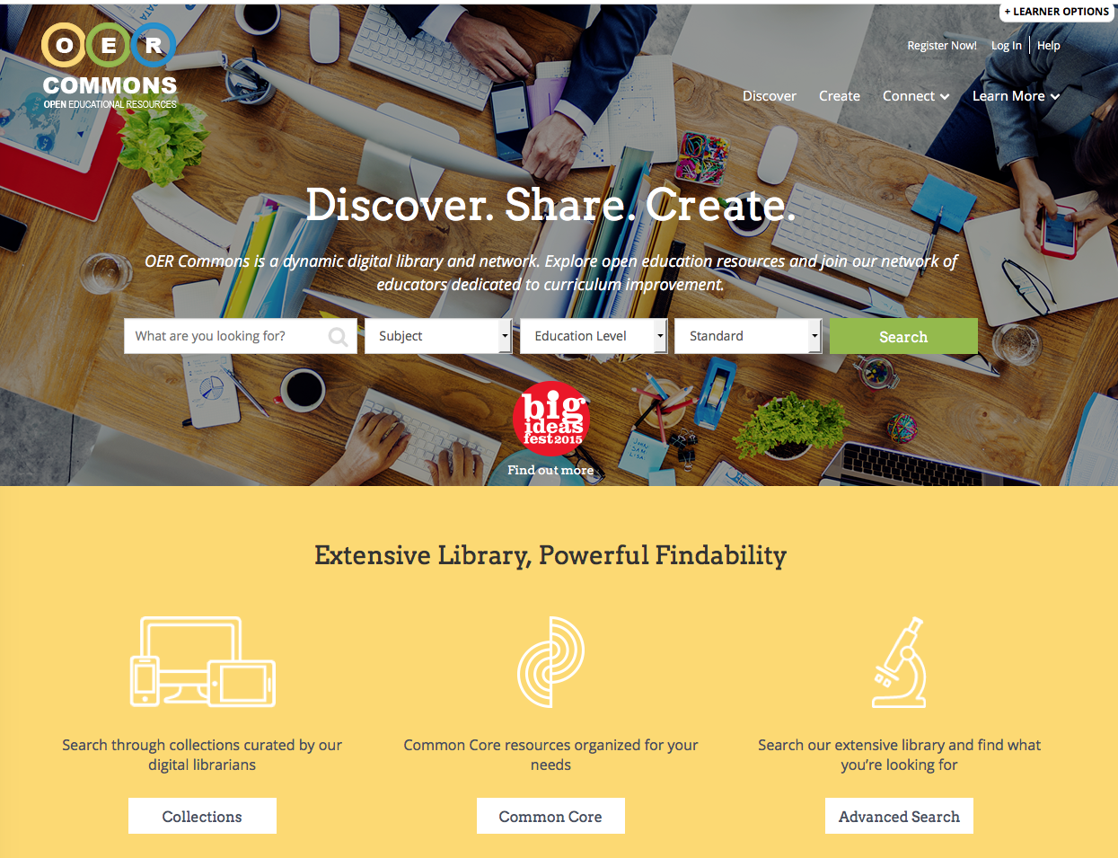
Examples
open courseware open textbooks open repositories

Slide 9
Like Open Access publications, OER are Free:
Gratis $0 (nominal cost for print)
AND
Libre (5 Rs: Retain, Reuse, Revise, Remix, Redistribute)
Wiley, David (2014) CC BY http://opencontent.org/blog/archives/3221
Notes:
“Openly licensed” is more than “free online.”
“Open Access” confusion.

Slide 10
The 5 Rs
Retain – the right to make, own, and control
Reuse – the right to use the content
Revise – the right to adapt, adjust, modify, or alter
Remix – the right to combine the original or revised content with other open content
Redistribute – the right to share copies of the original content, your revisions, or your remixes
Source: http://opencontent.org/blog/archives/3221

Slide 11


Slide 12
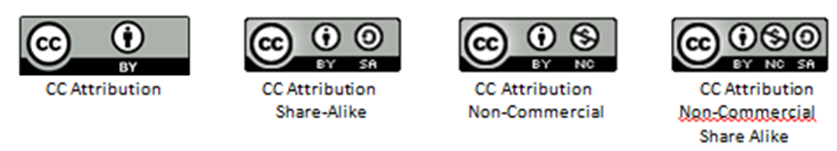
Most popular licensing scheme: Creative Commons
Copying / distributing materials with CC licenses
always requires attribution and
allows anyone to remix and redistribute a work
http://www.creativecommons.org/licenses
https://wiki.creativecommons.org/wiki/Best_practices_for_attribution

Slide 13

Clarification questions on Creative Commons?
Image Source
Notes:
Image credit: https://openclipart.org/detail/217532/question-mark

Slide 14

Why should libraries get involved?
Image: Public Domain

Slide 15
A solution to a problem, and an opportunity
open courseware open textbooks open repositories

Slide 16
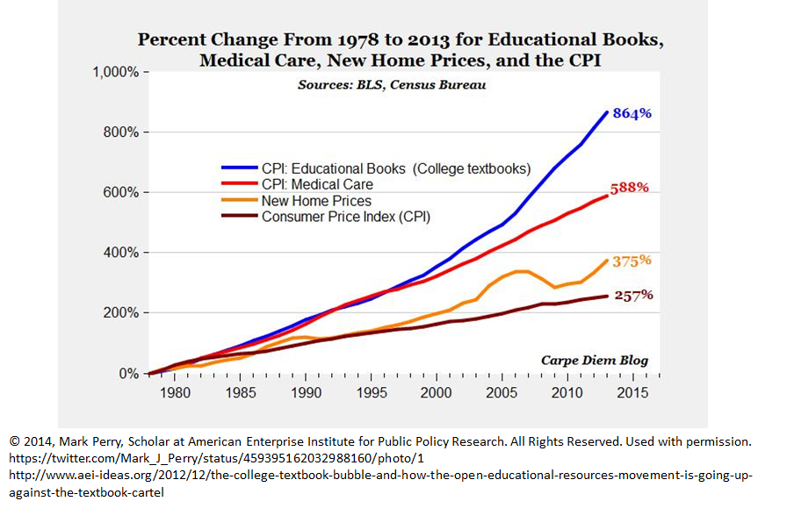
Problem Definition(s): Textbook costs

Slide 17

Problem Definition(s): Costs and student achievement
Has the cost of required textbooks caused you to:
63.6% Not purchase the required textbook?
49.2% Take fewer courses?
45.1% Not register for a specific course?
33.9% Earn a poor grade?
26.7% Drop a course?
17.0% Fail a course?
© Creative Stall, PK “Unknown Book” CC-BY

Slide 18
Problem Definition(s): Forgoing opportunities?
Enable new approaches for teaching & learning
Innovative pedagogy: student-led curriculum and course development as well as more opportunities for authentic assessment
Future opportunities not yet been dreamt of

Slide 19
Libraries are already involved!
Deeply concerned (and involved in) . . .
Curation and access
Search, search, and more search
Creative problem solving
Instruction
Advocating for our value -- and our sustainability

Slide 20
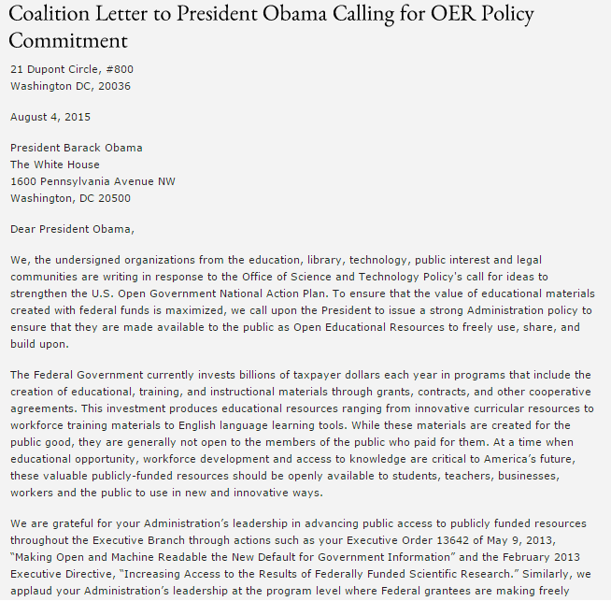
More Opportunities: Leverage Consensus
August 4, 2015
109+ signatories
education, library, technology, public interest and legal organizations
Read the letter here.

Slide 21



U.S. Policy response momentum
September 15 - U.S. Department of Education announces new Open Education Advisor
September 28 - International Open Education Workshop
(Sponsored by The White House OSTP, U.S. Dept of Education & U.S. Dept of State)
October 27 - The White House releases 2016-17 Open Government National Action Plan
(includes commitments to expand access to OER and results of federally funded research)
October 29 - U.S. Dept of Ed proposes Open Licensing Policy for grantees and announces #GoOpen
(Encourages states, school districts and educators to use openly licensed educational materials)
November 4 - Chesterfield County Public Schools selected an “Ambassador Districts” for #GoOpen by by U.S. Department of Ed
Notes:
https://www.whitehouse.gov/blog/2015/10/19/openly-licensed-educational-resources-providing-equitable-access-education-all
http://mychesterfieldschools.com/blog/chesterfield-county-public-schools-is-one-of-six-districts-nationwide-chosen-as-ambassador-districts-for-goopen/
http://www.sparc.arl.org/blog/white-house-commits-open-access-open-education-and-open-data-new-open-government-plan
http://www.sparc.arl.org/blog/education-department-hires-first-ever-open-education-advisor

Slide 22
ALA Core Values complement OER
Access
Privacy
Democracy
Social Responsibility
Professionalism
Public Good
ALA Core Values
Diversity
Service
Preservation
Intellectual Freedom
Education/Lifelong Learning
ALA “Core Values of Librarianship”
Notes:
We already curate resources

Slide 23


Virginia Higher Education Library Open Initiatives
2015 - workshops & stipends for open textbook review
2015 - revision & update of openly licensed textbook underway
2015 - “Provost’s Creative Adaptation Fund” - Swem Library & Dept. of Academic Tech
18 projects $1,000 each -- Teaching with OER & library-subscribed resources
Logos are the property of their respective institutions.
Notes:
In addition to “awareness raising” …

Slide 24




Virginia Higher Education Open Initiatives
Nov. 2015 - Northern Virginia / Extended Learning Institute (ELI) Open Degree Pathways
A.S General Studies
A.S. Social Sciences
Aug. 2015 - VCCS Zx23 Project Launch
Fall 2013 - Tidewater Z Degree
A.S. Business Admin
Logos are the property of their respective institutions.
Notes:
Z Degree is the nation's first textbook-free degree, an Associate of Science degree in Business Admin available through Tidewater Community College.
• There are No textbook costs
• All course content is openly licensed
• Courses are offered at all campus locations
Made possible by a generous grant from The William & Flora Hewlett Foundation, the Zx23 pilot will allow the VCCS to kickstart the process of building out the Z Degree model already in place at Tidewater by providing funding, support, and training to sixteen VCCS colleges to begin building pathways to their own Z Degrees. Zx23 is packaging OER to establish new pathways to existing credentials without traditional textbook cost. Degrees under development include:
1.business administration
2.business management
3.criminal justice
4.general education
5.liberal arts
6.social science
The VCCS will create a detailed “roadmap” to be used by other postsecondary institutions interested in scaling and sustaining a statewide effort.
NOVA is the first community college to fully share its OER degree pathways and courses:
https://www.nvcc.edu/news/press-releases/2015/eli-open-degree-pathway.html

Slide 25


Virginia Higher Education Open Initiatives
2010 - Nine courses (School of Business) Core curriculum
2015 - Faculty awareness workshops and individual consultations
Library’s One minute survey
“Has your department discussed the cost of textbooks in the last six months? If so, what are your plans?”
Logos are the property of their respective institutions.

Slide 26
The State of Open in Virginia
VIVA Resources for Users Survey (Spring 2015)
VLA OER PreConference (Fall 2015)
Dr. Cable Green, Creative Commons @ CWM (Fall 2015)
Notes:
(VIVA) - emphasize that people want VIVA to be involved. People want to see strategic investments in OER. This is the time/way to move this forward.
(VLA Workshop) - Attendee feedback was positive, and they would like to see specific follow-up on :
How to start on a smaller scale and build
Where to find/generate funding
Approaches to faculty relationship-building and OER buy-in
Less focus on the basics - information on moving forward at the institution level

Slide 27


Library contributions to the State of Open
Intro to OER Workshops
Networking
Listservs & awareness
Peer Groups (virtual & real)
Resource sharing (events)
Collaboration beyond librarians
Encouraging librarians+ to:
Explore
Collaborate
Learn
Teach
Leverage workflows & skills
Lead
Public Domain image
Logos are the property of their respective institutions.
Notes:
Round-up of all the things VA librarians are doing, patchwork-driven by individuals (outside of VCCS)

Slide 28





State-level OER Initiatives
Affordable Learning Georgia
OpenWashington
OpenOregon
California ALS
British Columbia OpenCampus
Logos are the property of their respective institutions.
Notes:
VA has done some institution-level implementation; some states are going bigger.

Slide 29

Coalition Principles - from Dr. Cable Green
Set common goals: z-degrees, highest enrolled courses etc.
Collect data: enrollments x textbook costs = $$$
Chose a few metrics, track, and report
Cost savings, time to degree, course completion rates, drop-out rates, credits taken/semester)
Report to institution, state, OER community
Respect local authority/expertise
Reuse, revise, build, commission
Shared repository / referatory space
Require CC BY 4.0 on anything you fund as a coalition - this maximizes reuse
Adopt institutional open licensing policies (CC BY)
NO OER mandate. OER is about more freedom, not less
Support faculty who want to shift to OER
Make heroes out of faculty that move to OER
Press, awards, website, present at conferences / to legislature.
- Dr. Cable Green, Director of Global Learning, Creative Commons @WM Nov. 2015
Image source
Slide text ©Cable Green CC BY
Cable Green’s blog

Slide 30
Strategic Areas of Action
Success requires strategic investment
Professional development related to OER
Promoting OER adoption and/or creation
Making Virginia-made OER discoverable (and editable)
Simplifying use of VIVA-licensed resources for teaching & learning
Collaborate to align OER goals with other stakeholders
Notes:
Our ideas on specific ways to ‘move the needle’

Slide 31
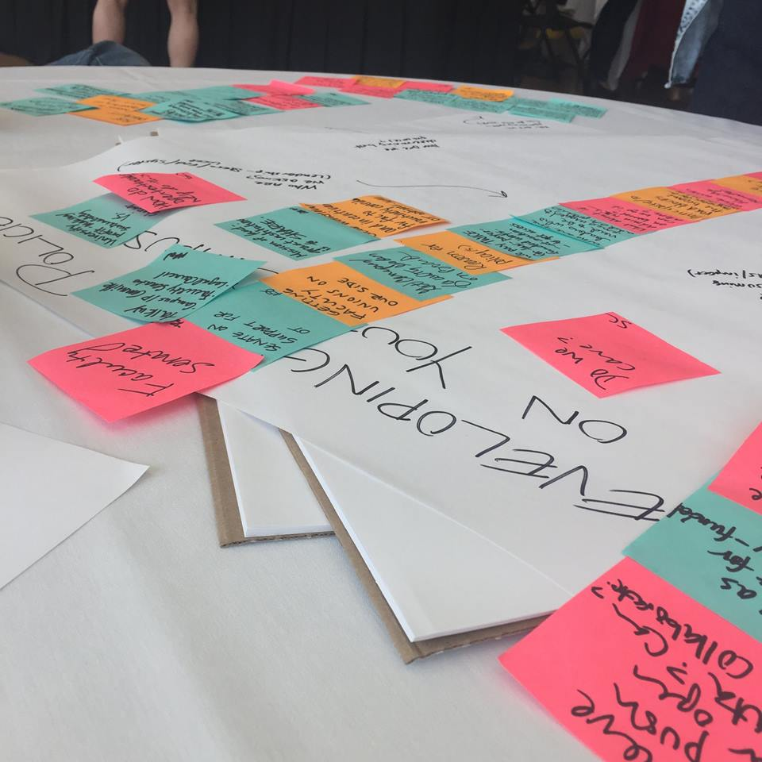
Professional Development Related to OER
No Co$t-bearing Actions
Develop a Virginia community of practice
Share OER adoption models, programs, documentation of what works
Support awareness-raising activities (Primary obstacle for faculty remains OER awareness)
Recognition awards for faculty adopters.
Co$t-bearing Actions
Negotiate statewide membership / subsidies to Open Textbook Network (OTN)
Offer competitive scholarship funding for VA librarians to attend Open Ed
Send VIVA/LAC members to Open Education Conference (or similar)
Image source
Notes:
Virginia Tech is an Open Textbook Network first round member ($5,000/school or $???/network).

Slide 32

Promoting OER Adoption / Creation
No Co$t-bearing Actions
Share OER adoption models, programs, documentation of what works
Develop a VA community of practice
Support awareness-raising activities (Primary obstacle for faculty remains OER awareness)
Recognition awards for faculty adopters.
Co$t-bearing Actions
Offer competitive statewide OER adoption stipends for faculty
Commission faculty OER creation
Open Textbook Network memberships to provide faculty with stipends for reviewing (40% of reviewers go on to adopt OER).
Image source
Notes:
Average stipend is $1,000-$2,500/adoption & course redesign (much lower at Community Colleges.) Faculty are more invested when projects are self-initiated, when grant money is available, and when they can list something on their CV for Evaluation / Promotion & Tenure.
re: commissions: (require CC BY licensing, editability and sharing) (Compare with what OpenSUNY, State-wide competitive buy out rate offer)

Slide 33

Make Virginia OER Discoverable and Editable
No Co$t-bearing Actions
Create and maintain a website of Virginia-made OER
Create a Virgina OER portal using OER Commons “Group” option.
Co$t-bearing Actions
Explore customized “hub” in OER Commons
~$25,000 for creation of statewide “Hub”
Minnesota example: https://www.oercommons.org/hubs/minnesota
May qualify for IMLS Spark grant?
© Robert Korener Binoculars
CC BY NC SA
Notes:
Compelling reasons:
-- Create an efficiency so people can see how OER is being used in Virginia. Shows local models that you can copy.
-- Sharing / editing
-- Showing work funded by state $
-- Prestige argument
-- Celebrate local expertise
-- Showcase faculty work (which also promotes adoption)

Slide 34

Clarifying Permitted Uses for VIVA Resources
No Co$t-bearing Actions
Clarify what can be done with VIVA-licensed resources in order to promote them for use in teaching & learning
Organize by topic, eligible for use in course reserves
Distinguish by license type(s)
Co$t-bearing Actions
Negotiate for licenses that don’t restrict legal classroom/online teaching and learning uses (including fair uses)
Notes:
OER does not meet every need.
Library resources are not OER, but -
using free OER in combination with library materials that bear no student cost contribute to student retention and completion.

Slide 35

Collaborate to Align OER Goals With Other VA Stakeholders
No Co$t-bearing Actions
Communicate to explore potential collaboration with other stakeholders
SCHEV Open Virginia Advisory Committee (OVAC) includes leaders in technology, instructional design, pedagogy, and libraries
Student voices such as Virginia 21
Other stakeholder groups
Image source

Slide 36
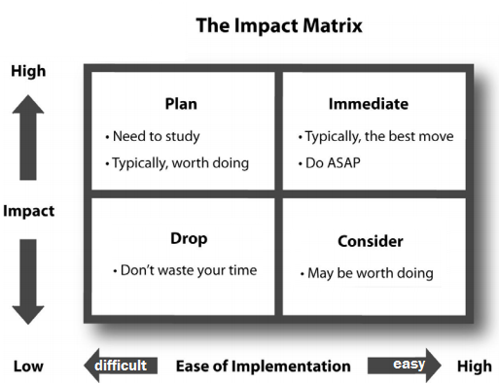
Adapted from: image source

Slide 37



Recommended Strategic Actions
High Impact, Lower Effort
High Impact, Some Effort
High Impact, High Effort
Participate in the Open Textbook Network (OTN).
Create a Virginia OER “Group” in OER Commons; Explore forming Virginia OER Commons custom “Hub.”
Offer OER adoption and creation grants.
Image source
Logos are the property of their respective institutions.

Slide 38
Thanks for your time -- and Discussion
Tara Cassidy, Coordinator of Library Services Virginia’s Community Colleges tcassidy@vccs.edu
Kathleen DeLaurenti, Scholarly Communications Librarian College of William & Mary kmdelaurenti@wm.edu
Anita Walz, Open Education, Copyright & Scholarly Communications Librarian Virginia Tech arwalz@vt.edu

