Slide 1

Chapter 7
Financial Evaluation of Sustainable Building Initiatives
Unless otherwise noted, this slide deck is (c) Erin A. Hopkins.
It is released under a Creative Commons Attribution NonCommercial ShareAlike 3.0 license (CC BY NC-SA 3.0).

Slide 2
Chapter Sections
7.1 Introduction
7.2 Statement of Cash Flow and Sustainable Property Management
7.3 Cash-on-Cash Return Analysis
7.4 Payback Period Analysis
7.5 Cost Benefit Analysis
7.6 Conclusion

Slide 3
Learning Objectives
Explain how sustainable property management initiatives affect the property statement of cash flow
Calculate the cash-on-cash return for sustainable initiatives
Calculate the simple payback period for sustainable initiatives
Calculate the discounted payback period for sustainable initiatives
Calculate a cost benefit analysis for sustainable initiatives

Slide 4
7.1 Introduction
This chapter takes a closer look at the economic sphere of sustainability
Multiple metrics within the accounting and finance function to account for sustainable initiatives

Slide 5
7.2 Statement of Cash Flow and Sustainable Property Management
Financial literacy of cash flow statement aids in understanding the financial impacts of various sustainable property management initiatives

Slide 6
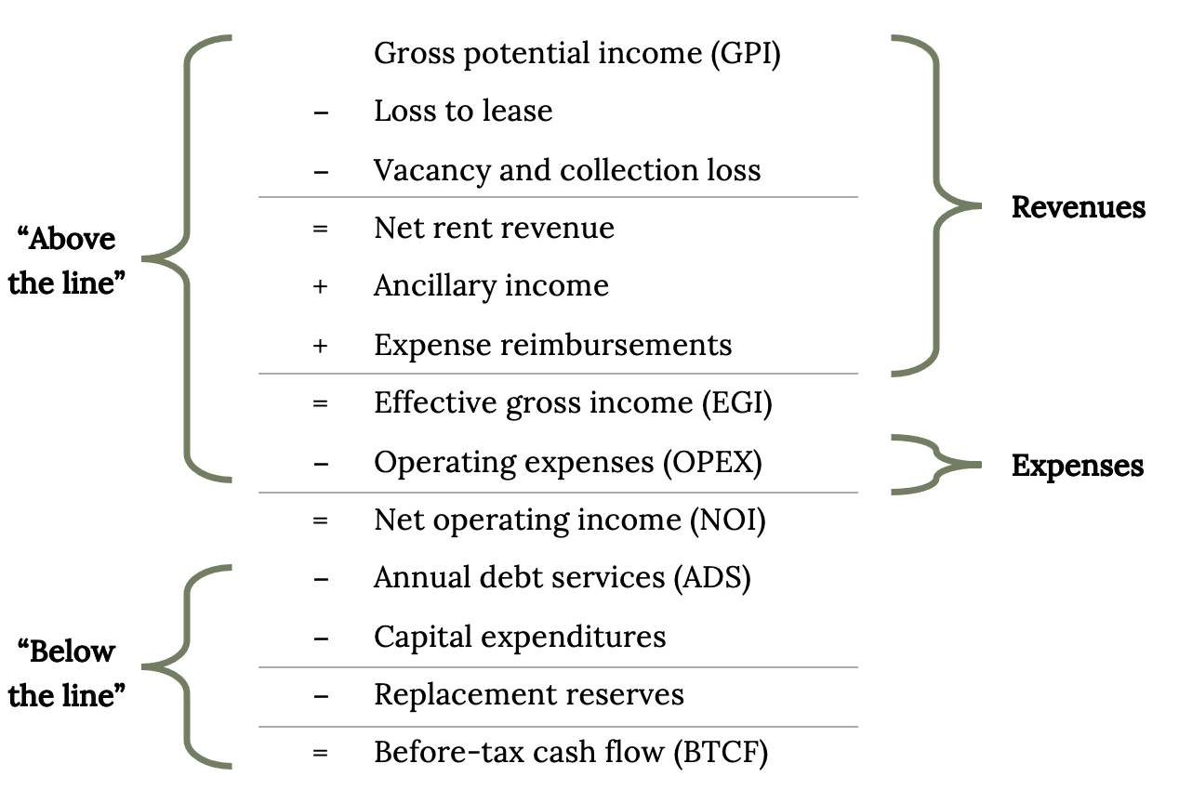
Common Operating Expense Line Items
Figure 7.1: Statement of cash flow example. Kindred Grey. 2023. CC BY 4.0.
Notes:
The text box above the slide is for accessibility purposes. If you edit this PPT, please leave it there. It doesn’t show up in preview mode.

Slide 7
7.3 Cash-on-Cash Return Analysis
Calculates the rate of return on the cash invested in a property based on the annual cash income earned

Slide 8
Cash-on-Cash Return = Annual Cash Income / Total Cash Invested

Slide 9
7.4 Payback Period Analysis
A calculation that determines the amount of time it takes to recover the upfront costs for sustainable initiatives that have upfront costs

Slide 10
Simple Payback Period = Initial Investment Costs / Annual Savings

Slide 11
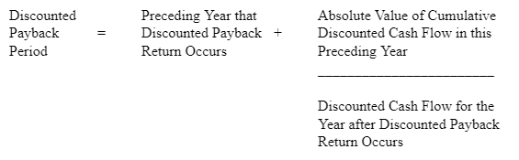
Discounted payback period calculation example
Notes:
The text box above the slide is for accessibility purposes. If you edit this PPT, please leave it there. It doesn’t show up in preview mode.

Slide 12
7.5 Cost Benefit Analysis
Provides a more holistic perspective

Slide 13
NPV = today’s value of expected cash flows – today’s value of cash invested

Slide 14
If NPV = 0, the investor achieves their required rate of return
If NPV > 0, the investor achieves a return higher than their required rate of return

Slide 15
BCR = discounted value of incremental benefits / absolute value of discounted value of incremental costs

Slide 16
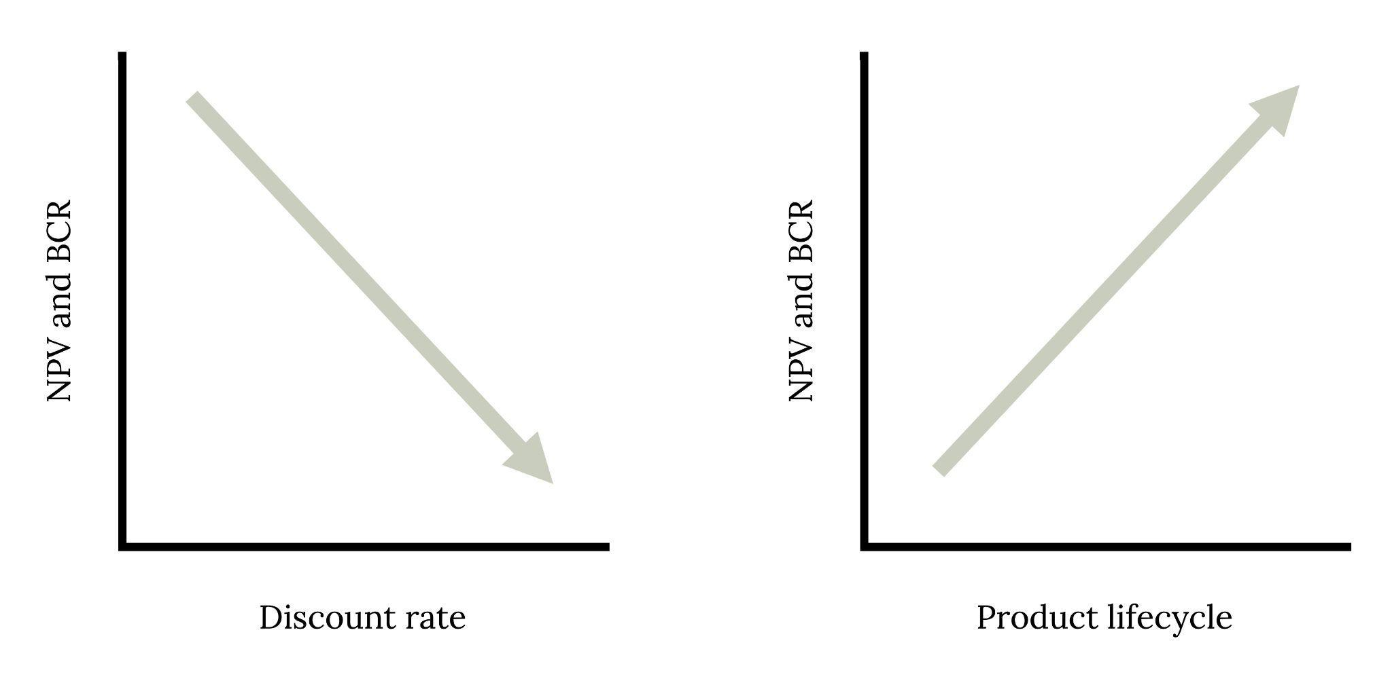
Discount rate and product lifecycle in relation to NPV and BCR
Figure 7.8: Discount rate and product lifecycle in relation to NPV and BCR. Kindred Grey. 2023. CC BY 4.0.
Notes:
The text box above the slide is for accessibility purposes. If you edit this PPT, please leave it there. It doesn’t show up in preview mode.

Slide 17
7.6 Conclusion
Property should be cognizant of the property owner’s goals and objectives as these can affect what analysis is relevant
No calculation can capture all costs and benefits due to intangible components

Slide 18
Chapter Activity
1. Consider the following scenario and then answer the questions below:
A property owner is evaluating a landscape transition from a traditional lawn to xeriscaping. Year 0 cost to change from lawn to a xeriscape landscape is $9.25/sf. There is 1,100 sf of lawn to be changed out. As this landscape design change is not considered a typical operating expense, the costs would not be part of NOI. The water savings from this landscape design change are $75/month and maintenance savings are $55/month. The life expectancy of this xeriscape landscape design is 10 years. The discount rate is 8.5%.
a. What statement of cash flow line items are affected from this scenario in both the current year and future years?
b. What is the cash-on-cash return?
c. What is the simple payback period?
d. What should be considered when advising the property owner on the financial viability of this project?
Notes:
a) Capex for initial outlay of $10,175 and Maintenance & Repairs (OPEX) for future years of $1,560; perhaps rental revenue due to attractiveness of this type of landscaping and appreciation of this sustainability feature from tenants. But difficult to quantify this although tenant surveys can help evaluate this amenity
b) 1,560 / 10,175 = 15.33%
c) 10,175 / 1,560 = 6.52 years
d) owner's goals and objectives. How long will the property be held? Any intangibles to consider? Does this project align with company values/mission ?

