Slide 1

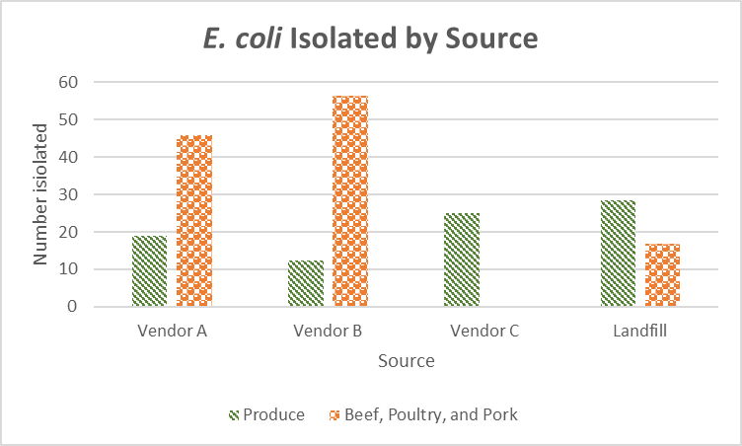
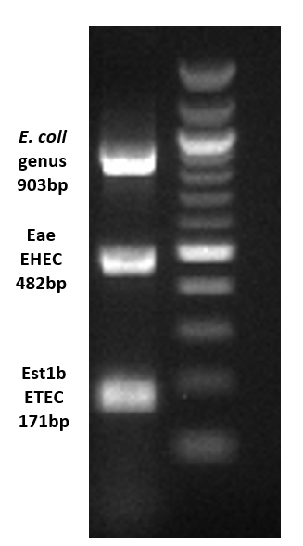
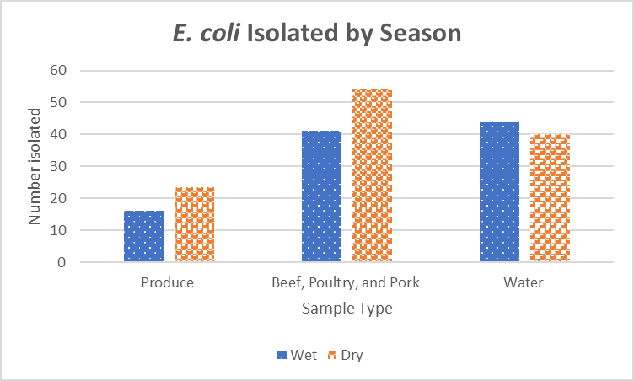
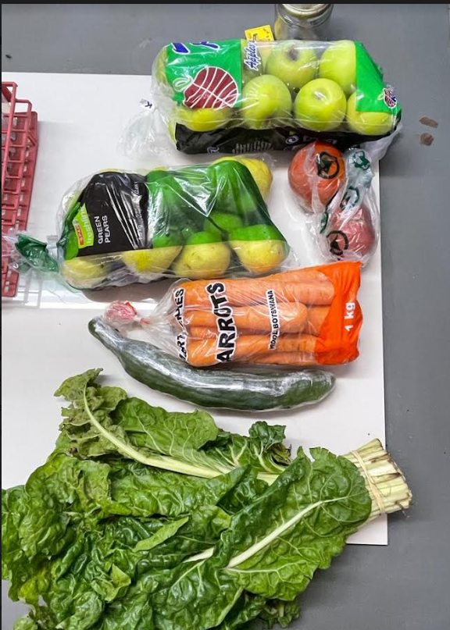
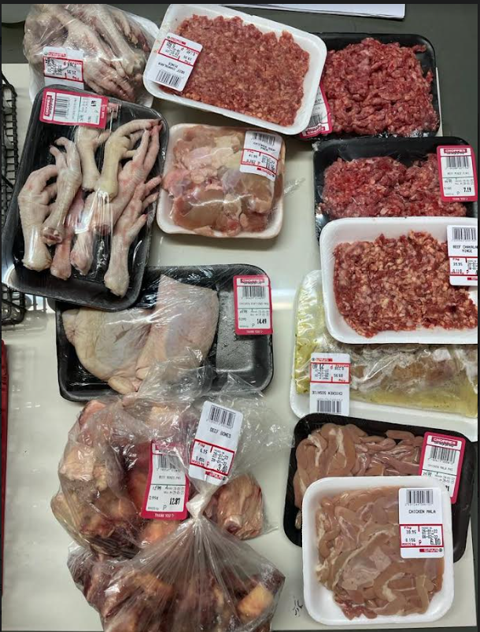
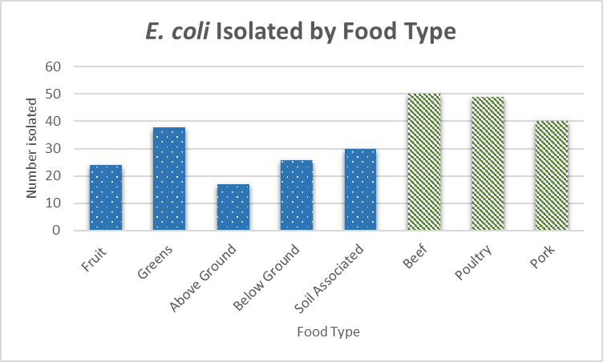

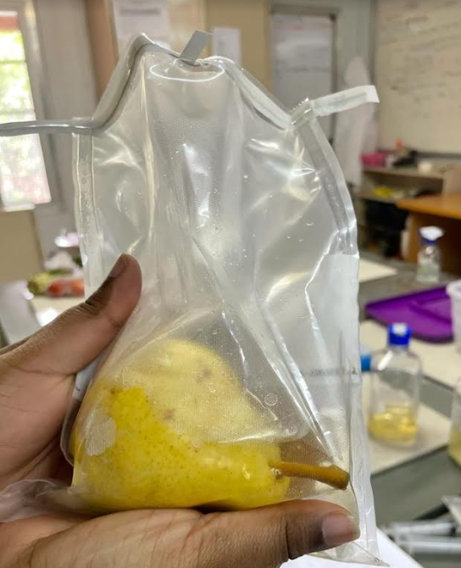
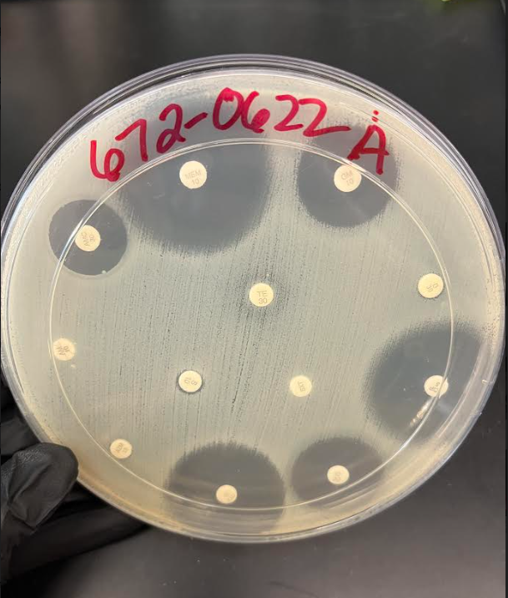
Characterization of Diarrheagenic Escherichia coli Isolated from Food, Food Waste, and Water from the Chobe Region of Botswana
Auja L. Bywater¹, Monica Ponder¹, and Kathleen Alexander²
⁽¹⁾ Virginia Tech, Department of Food Science & Technology ⁽²⁾ Virginia Polytechnic Institute and State University, Dept. of Fish and Wildlife Conservation
Introduction & Background
Results
Botswana is a diverse middle-income country located in Sub-Saharan Africa. Diarrheal disease, especially E. coli remains a problem with children being disproportionately affected. Antibiotic resistance is also a growing public health threat, especially in countries like Botswana where antibiotics are commonly available. This study is part of a long-term project to determine prevalence and characterize transmission of diarrheagenic E. coli in the region.
E. coli was isolated from 19% (60/294) of produce, 49% (68/138) of meat, and 84.7% (366/432) of water samples
The food source was significantly associated with E. coli isolation from produce (P=0.01) and meat (P=0.04)
  E. coli was more likely to be isolated from produce food waste collected from the landfill compared to the local vendors
  E. coli was more likely to be isolated from meat collected from local vendors compared to meat food waste from the landfill
The wet season was significantly associated with E. coli isolation from water (P=0.14), including pathogenic strains (P=5.7e-0.7)
Higher amounts of rain was significantly associated with all E. coli from water (P=0.02)
Objectives: Determine E. coli prevalence and antibiotic resistance in food, food waste, and water samples from the Chobe Region of Botswana
Methods
Table 1: Multiclass resistance in pathogenic E. coli isolates
Ampicillin
Amoxicillin
Azithromycin
Chloramphenicol
Ciprofloxacin
Cefotaxime
Doxycycline
Gentamicin
Meropenem
Streptomycin
Tetracycline
Trimethoprim/Sulfamethoxazole
Food, food waste, and water was collected in Botswana and rinsed to removed associated bacteria
Antibiotics tested
Sample Type | Pathogenic E. coli (eae or est1b) | Multiclass resistant
Water | 49 | 7
Apple | 4 | 2
Cucumber | 1 | 0
Carrot | 1 | 0
Chicken intestine | 1 | 1
↑
↑
Produce rinse pelleted down
E. coli was isolated from meat and water samples
PCR Development
A mPCR protocol was developed for E. coli for detection of E. coli genus, EPEC, EHEC, and ETEC. (Fig 1)
Primer concentrations, DNA concentrations, MgCl2, DSMO, and temperature were all manipulated until results were clear and reliable from purified DNA cultures.
.
Statistical Analysis
↑
↑
Figure 6: All E. coli isolation from different foods by their source. No beef, poultry, or pork samples were collected from Vendor C
R Studio was used for all analysis.
Fisher’s Exact test was used to determine significant association between E. coli presence and source attributes including source, season, and food type.
An independent T test was used to determine association between E. coli genes and rainfall.
Relationships considered significant at P ≤ 0.05
Shipping to Virginia Tech
↑
↑
Produce pellets were enriched in brilliant green bile broth for 24 hours
Meat and water E. coli isolates were enriched in LTSB w/ MUG at 37°C for 48 hours
Discussion
↑
All pathogenic food E. coli isolates were obtained from the same vendor, a local grocer. They were also all collected in the same month (August 2022). This could indicate a contamination event during that time or cross-contamination within the store.
All seven MCR water E. coli isolates were resistant to meropenem, an antibiotic of last resort. These samples were all collected in different locations in March 2022 during the wet season.
There was a low number of meat samples collected from the landfill, potentially due to the difficulty of finding protein scrap in areas where wildlife commonly scavenge. This could influence why E. coli in meat was more likely to be isolated from local vendors.
Brilliant green bile broth enrichments plated onto EMB
↑
Enrichments were checked for bioluminescence under UV light
Samples without bioluminescence were removed from further testing
Figure 1: The gel images from the developed mPCR protocols
Figure 7: All E. coli isolation from different foods by season
↑
Characteristic colonies with a green sheen were selected and streaked out for isolation
↑
Produce
↑
Meat
DNA extraction with Biobasic kit
Figure 2: Produce collection
in Botswana
Figure 3: Meat collection
in Botswana
Figure 8: All E. coli isolation by food type
Summary
↑
This study established prevalence of E. coli in food, food waste, and water in the region
Spatial and Temporal impacts on E. coli presence were established
PCR screening for target genes:
E. coli : phoA, eae, est1b
Moving Forward
This is part of a larger study to determine prevalence and characterize transmission of diarrheagenic E. coli, Salmonella, and Campylobacter from food, food waste, humans, and animals in the Chobe region of Botswana.
↑
Acknowledgements
Kirby-Bauer antibiotic disk diffusion testing of pathogens
Funding for this work was provided by the National Science Foundation under award number 2009717; the Virginia Agricultural Experiment Station; and the Hatch Program of the National Institute of Food and Agriculture, U.S. Department of Agriculture
Figure 4: Produce processing
in Botswana
Figure 5: Water isolate exhibiting multi-class resistance

