Slide 1

CS Advising Bot
5/7/2022
Dan Barzyk, Thomas Fitzhugh, Trey Orr, Pierre Sarabamoun
CS 4624 - Multimedia, Hypertext, and Information Access
Edward A. Fox, Virginia Tech, Blacksburg VA 24061

Slide 2
Outline
Project Overview
Timeline
Deliverables
Testing
Future Work
Acknowledgements & References

Slide 3

Project Overview
Virtual assistant for Virginia Tech Computer Science Advising
Provides answers to FAQs related to
Advising
Force add requests
Funding and more
Relieve a burden from advisors & professors
Less repetitive questions
More time for important work

Slide 4
Timeline
Early February
Late March
Mid April
Becoming used to IBM Watson Assistant & Setting up plan moving forward
Have a Working Advanced Chatbot (Text & Menu Navigation + Many Intents)
Conduct User Testing and make necessary changes
Have a Working Basic Chatbot
(Text + Limited Intents)
Polish Chatbot UI & Write Up User + Developer Manuals
Data Integration & personalized responses based on user data
Early March
Early April
Early May

Slide 5
Timeline
Early February
Late March
Mid April
Becoming used to IBM Watson Assistant & Setting up plan moving forward
Have a Working Advanced Chatbot (Text & Menu Navigation + Many Intents)
Conduct User Testing and make necessary changes
Have a Working Basic Chatbot
(Text + Limited Intents)
Polish Chatbot UI & Write Up User + Developer Manuals
Properly Document All work and write up guide for approaching data integration
Early March
Early April
Early May

Slide 6
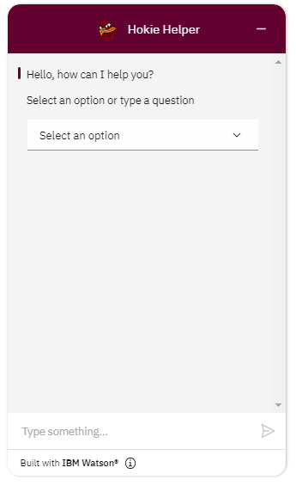
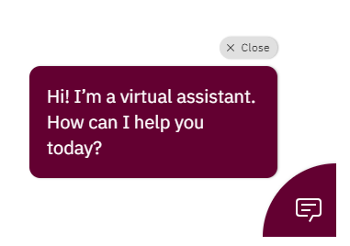

Deliverables
CS Advising Chatbot
Website Integration
Notes:
We were tasked with creating an advising chatbot to handle questions from newly admitted Computer Science students.
The chatbot must be an online chatbot that is able to be integrated with the CS department website.
IBM Watson provides a simple script to add into the HTML of any website which will allow for simple integration.
This is only a few lines of code and does not require any additional changes to a website.
On any website our chatbot will first display as a small icon as you can see on the left.
If the user does not click on the icon in about 10-20 seconds the icon will expand into the figure in the middle.
If the user clicks on the icon or the expanded view it will then expand into the actual chatbot as seen on the right.

Slide 7
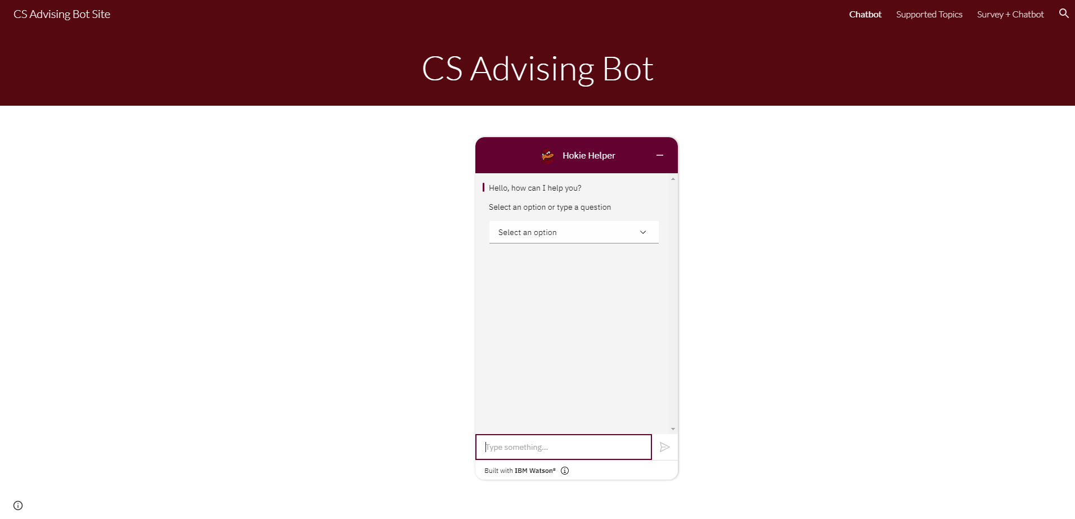
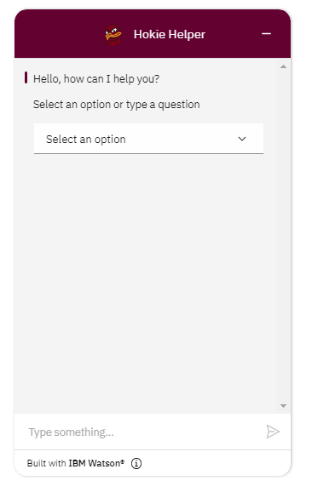
https://sites.google.com/vt.edu/csadvisingbot/chatbot
Notes:
We integrated our chatbot into a basic google sites website located at the URL at the bottom of the slide.
This is the homepage of the website which has a title, the chatbot in the middle, and in the top right is a bar where you can go to other pages such as the supported topics page and a page with a survey and the chatbot.

Slide 8
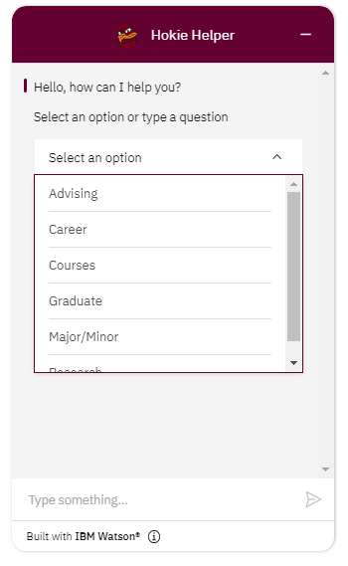
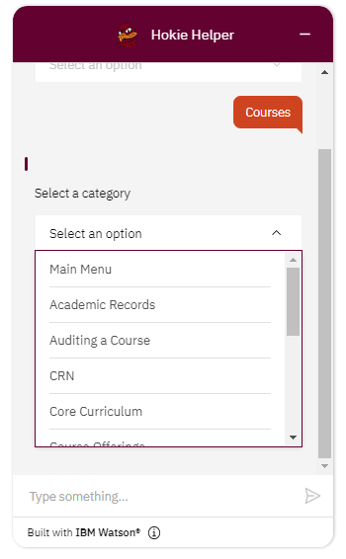
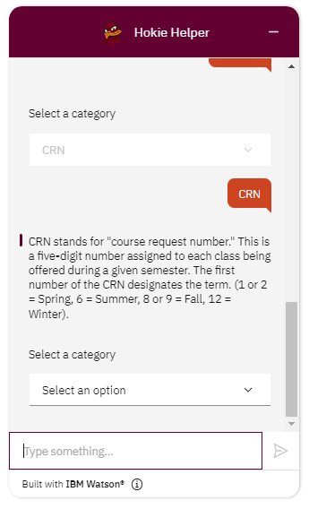
Option Navigation
Notes:
One way a user can use the chatbot is through option navigation. This means selecting a presented option and the chatbot will give a response.
The user will then select another option until they can an answer. There is always a Main Menu option in case the user wants to go back to the main menu and restart.
In this example the user is first greeted and given the choice to select and option or type a question.
Let’s say the user selects the Select an option button. This will then create a drop down menu displaying the current options the user can select from.
Let's say they select Courses. Then a then brought to another list of options related specifically to courses.
Let’s say they then select CRN. Since there is no more options available after CRN the chatbot outputs information about what a CRN is.
Then the chatbot displays another set of options for the user to continue using the option menu instead of having to reload the page.
This allows the user to get answers to multiple questions back to back without restarting the conversation or reloading the page.

Slide 9
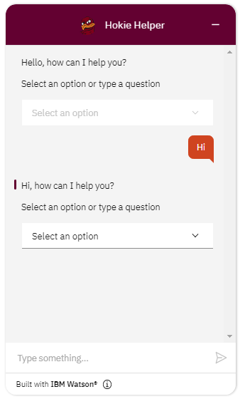
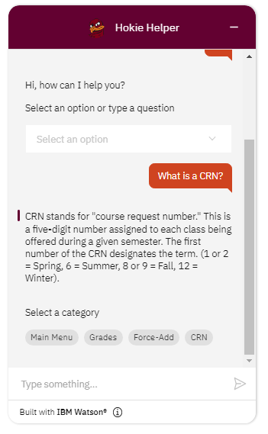
Text Recognition
Notes:
Another way a user can use the chatbot is through text input in which the chatbot will use text recognition. This means the user will type some text and the chatbot will give a response.
In this example the user is first greeted and given the choice to select and option or type a question.
Let’s say the user types in Hi. The chatbot recognizes this and replies with another greeting.
Now let’s say the user types What is a CRN?
The chatbot will then analyze the text to find a matching intent. From the matching intent it will output information about what a CRN is.
As you can see in these screenshots, the user is not limited to only options or only text. The user can switch between the two whenever they want. Just because the user started with text doesn’t mean the options menu will disappear, it is always there for flexibility.

Slide 10
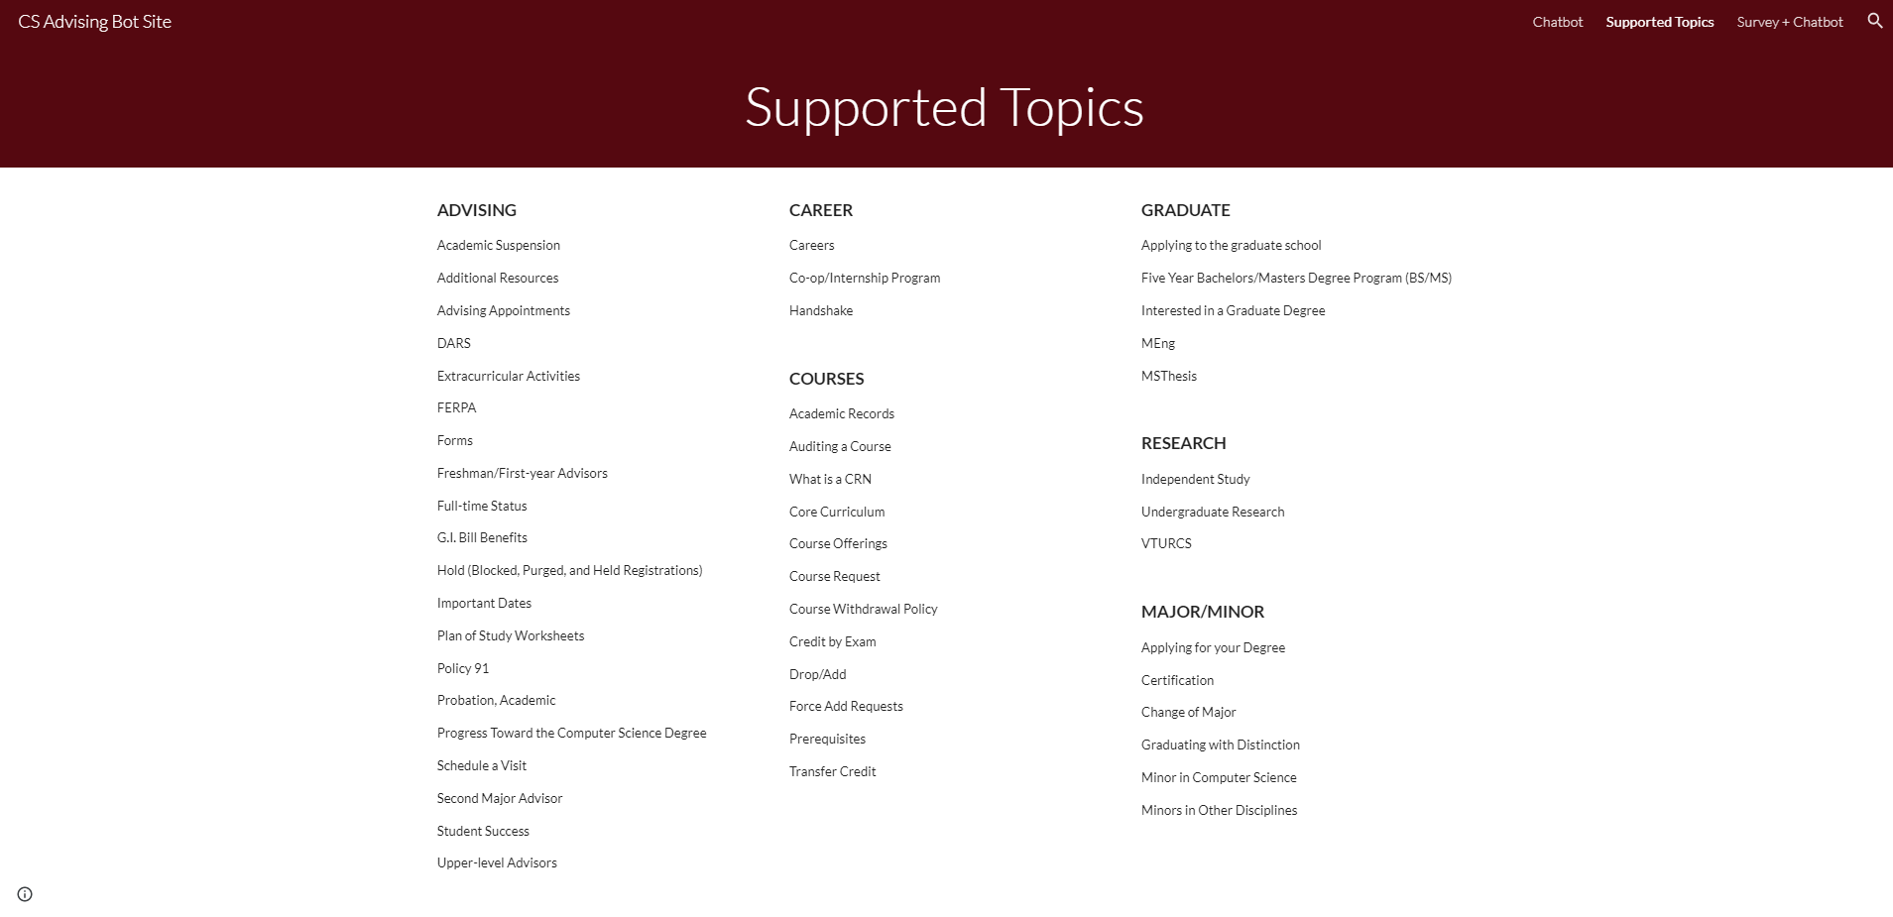
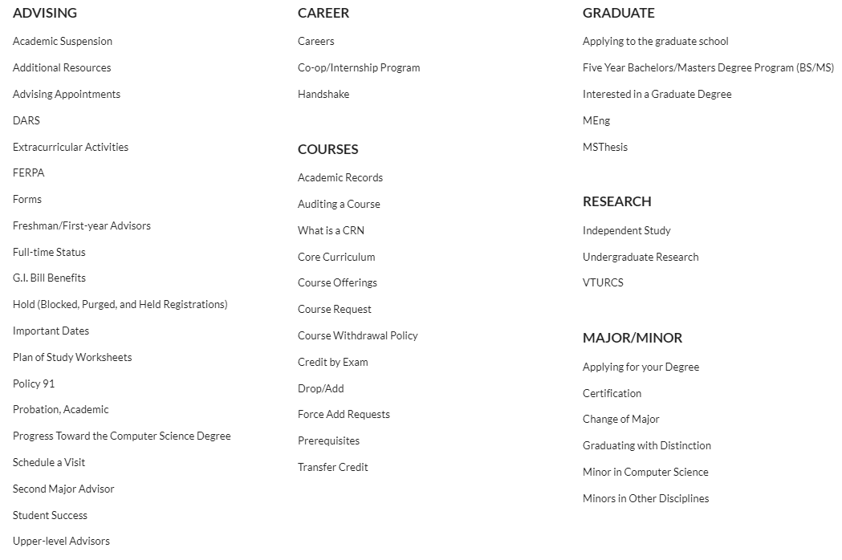
Notes:
Another page of our website lists the supported topics the chatbot can give responses to. You can visit this page from the menu bar in the top right corner.
We broke the list down into topics including Advising, Career, Courses, Graduate, Research, and Major/Minor.
In total we support around 50 topics.

Slide 11
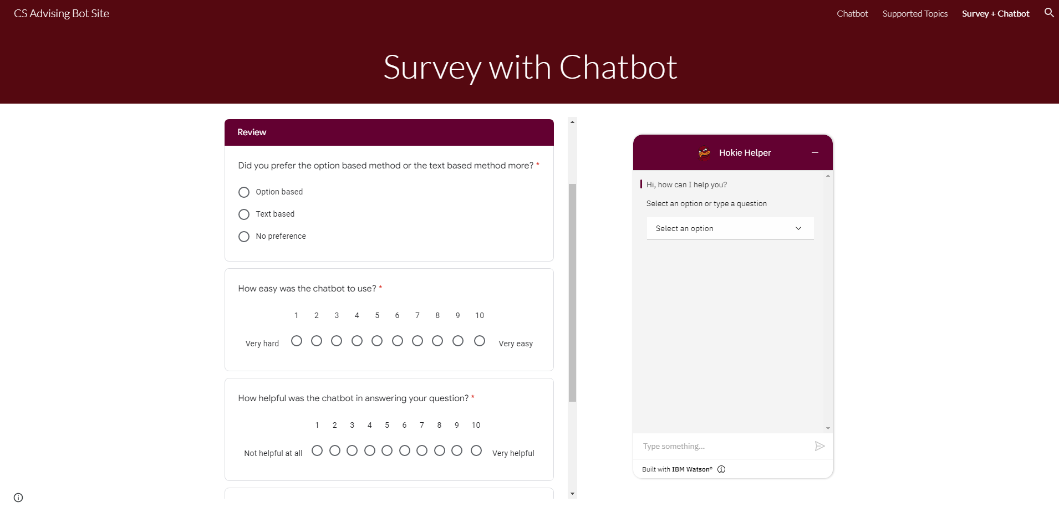
https://sites.google.com/vt.edu/csadvisingbot/survey-chatbot?
Notes:
Our final page on our website has a survey with the chatbot on the side. This way as you go through the survey you don’t have to switch between tabs with the chatbot.
The survey is somewhat of a user testing where the user will select a role to play and think of a question they want answered.
They will then use the chatbot to get an answer to the question by using both the options and by inputting text.
At the end they will rate how easy it was to use and give any feedback or suggestions.

Slide 12

Testing
Chatbot accuracy = ability to recognize intents
2 methods to test
Option Based - can be done locally
Text Based - requires extensive external testing
IBM Watson stores conversations for intent identification analysis
Chatbot correctly identifies Intent -> add to Examples

Slide 13

Future Work
Database integration
Personalized responses
Name of your advisor, GPA info, course recommendations, etc
Maintenance and upkeep
Update with new information
Add intents as they arise
More examples
Increase text recognition accuracy

Slide 14
Acknowledgements & References
Client - Professor Sally Hamouda
How Chatbots Work https://bigdata-madesimple.com/how-do-chatbots-work-an-overview-of-the-architecture-of-a-chatbot/
IBM Watson Assistant https://cloud.ibm.com/docs/assistant?topic=assistant-index
IBM Watson Assitant Forum https://community.ibm.com/community/user/watsonapps/communities/community-home?CommunityKey=7a3dc5ba-3018-452d-9a43-a49dc6819633
LUIS https://docs.microsoft.com/en-us/azure/cognitive-services/luis/what-is-luis
VT CS Advising https://cs.vt.edu/Undergraduate/StudentServices.html
VT CS Undergraduate Handbook https://cs.vt.edu/Undergraduate/Undergradhandbook.html

