Slide 1
Autism Support Portal
Members: Sib Quayum, Ryan Galliher, Ayumi Ritchie, Kenneth Nagies
Course: Multimedia, Hypertext, and Information Access (CS 4624)
Professor: Edward A. Fox
Virginia Tech, Blacksburg VA 24061
4/26/18

Slide 2
Outline
Project Overview
Assessment
Demo
Accomplishments/Lessons learned
Future Steps
Acknowledgements
References

Slide 3
Project overview
VTCAR Dr.Scarpa
Web Portal for Autism Support
Search Functionality
Resources

Slide 4
Client: VTCAR
Virginia Tech Center for Autism Research
Dr.Angela Scarpa
  NRV Autism Action Group Team
  Professor Gracanin
Mission Statement: “Our mission is to merge the science of autism with the service of diagnosis and treatment of autism.”
Notes:
Want to use research to better autism diagonsis, treatment, ect.

Slide 5
Deliverable: Web Portal
Create search that connects users with reliable information
Connect users to resources
Portal is easy to use and modify for non-technical people
Portal is easily modifiable by future groups and teams

Slide 6
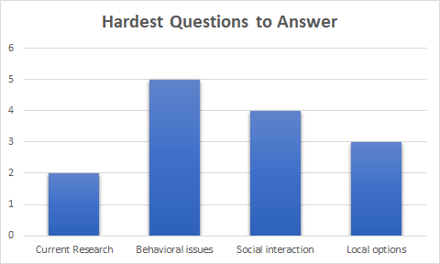
What People Need

Slide 7
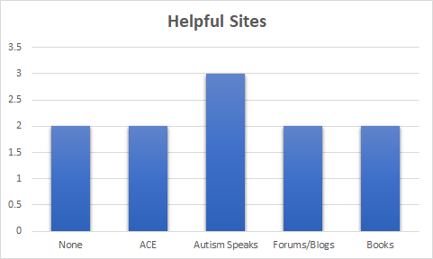
Sites that people want included in search

Slide 8
Assessment
Tested by future users
  Very positive feedback
    “Remarkably friendly”
    “Questions answered effectively”
    “Extremely relevant”
Other feedback: search proximity

Slide 9
Complications
VT Hosting
Simplifying plans to satisfy client
Virginia Tech Branding

Slide 10
Lessons Learned
Communication with client is very important
It is very hard to collect data
Working with a lot of people can take time
Users need to be guided

Slide 11
Final Steps
Finish Basic Design
  Client will update design and text
Finish Report

Slide 12
Future Features
Discussion Board (maybe)
Answers directly within the site based of frequent search terms
Whatever the client wants

Slide 13
Acknowledgements
Angela Scarpa, Ph.D.
Director, VT Center for Autism Research (VTCAR)
Denis Gracanin, Ph.D.
Associate Professor, Virginia Tech
Erica L. Whiting, Ph.D.
REACH Clinical Director

Slide 14
Acknowledgements
Anna R. Caldwell, LCSW, BCBA, LBA
Spectrum Therapeutic
Collene Webb
Community Autism Specialist/Risk Manager, Department of Behavioral Health & Developmental Services
Ben Pfountz
Has helped with the hosting of the site

Slide 15
References
Autism Speaks: Provides information for those with Autism and their families
URL: https://www.autismspeaks.org/
Medline Plus, Information on Autism Spectrum disorder
URL: https://medlineplus.gov/autismspectrumdisorder.html

