Slide 1
Knowledge Building and Sharing: A Metamodel for Guided Research, Learning, and Application
Kimberly Zeitz & Chris Frisina
Client: Randy Marchany
Director of the VT IT Security Lab
Prior Research Contact: Noha El Sherbiny
Blacksburg
May 6, 2013
CS6604

Slide 2
Motivation
Motivation
Metamodel Development
Proof of Concept
Evaluation
Clarify scattered field concepts
Guide decision making
Knowledge sharing and reuse
Teaching and learning
Uniform knowledge format for use and comparison

Slide 3
Metamodel
Motivation
Metamodel Development
Proof of Concept
Evaluation
What is it?
Schema for data
Construction and organization of domain concepts
Frames, rules, and constraints for formatting and sharing knowledge
How was it developed?
Motivations and envisioned contributions
Uniform Format for use with envisioned Digital Library System
Preservation & Expansion
Notes:
Access and communication of information
Mixed classification of data
Mixed classification of users
Circumstantial guidelines

Slide 4
Metamodel
Motivation
Metamodel Development
Proof of Concept
Evaluation
Utilization
Organization of research for sharing knowledge
Applications:
Industry application to needs
Academic course material organization for teachers and learning tool for students
Stakeholders Model
Notes:
Access and communication of information
Mixed classification of data
Mixed classification of users
Circumstantial guidelines

Slide 5
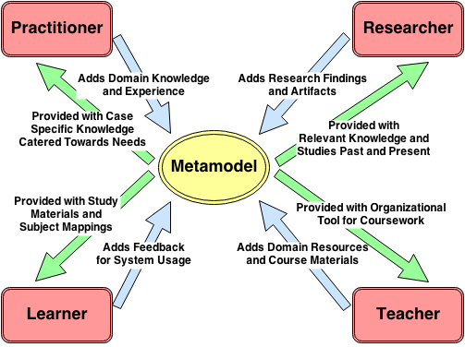
Stakeholders
Motivation
Metamodel Development
Proof of Concept
Evaluation
Notes:
Access and communication of information
Mixed classification of data
Mixed classification of users
Circumstantial guidelines

Slide 6
Metamodel
Motivation
Metamodel Development
Proof of Concept
Evaluation
Validation
Proof of Concept
Security domain concept overview
Preliminary Modeling with Co-occurrence Graph
Selected four sub areas
MOSAIC: Model of Securing Application Information Confidentiality
Further evaluation to be discussed later
Notes:
Access Controls
PIR
Threat Modeling
Data Classifications

Slide 7
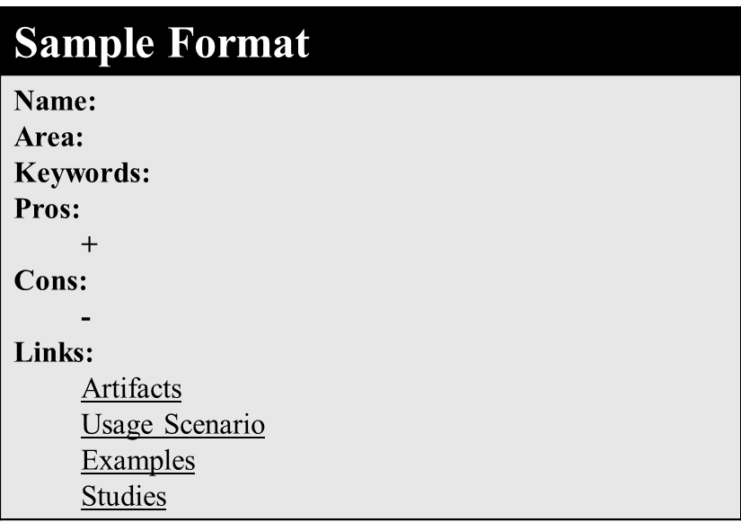
Metamodel Format
Motivation
Metamodel Development
Proof of Concept
Evaluation
Notes:
Format combines the research
- pros/cons/links form mckcrickard Making Claims info sharing/reuse
Content comes from experts (researchers and domain and field)
Keywords come from our domain categorizations form the co occurrence graphs

Slide 8
Proof of Concept
Motivation
Metamodel Development
Proof of Concept
Evaluation
MOSAIC: Model of Securing Application Information Confidentiality
Scenario: Sarah has been assigned to assess the security vulnerabilities of the company's internal digital library system and propose solutions
Notes:
Access and communication of information
Mixed classification of data
Mixed classification of users
Circumstantial guidelines

Slide 9
Metamodel Information Flow
Motivation
Metamodel Development
Proof of Concept
Evaluation
Expert
Knowledge
Access Controls
PIR
Domain link
Threat Modeling
Data Classification
User Criteria
Pertinent Information
MOSAIC
Guided
Decision
Flow
HCI
PIR
DC
HCI
PIR
AC
PIR
TM
Notes:
Access and communication of information
Mixed classification of data
Mixed classification of users
Circumstantial guidelines

Slide 10
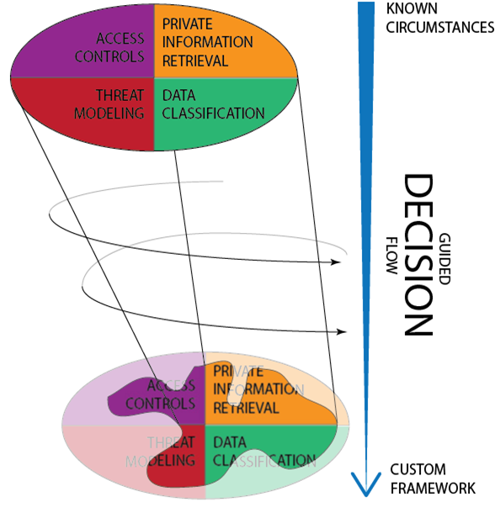
MOSAIC
Motivation
Metamodel Development
Proof of Concept
Evaluation
Notes:
Access and communication of information
Mixed classification of data
Mixed classification of users
Circumstantial guidelines

Slide 11
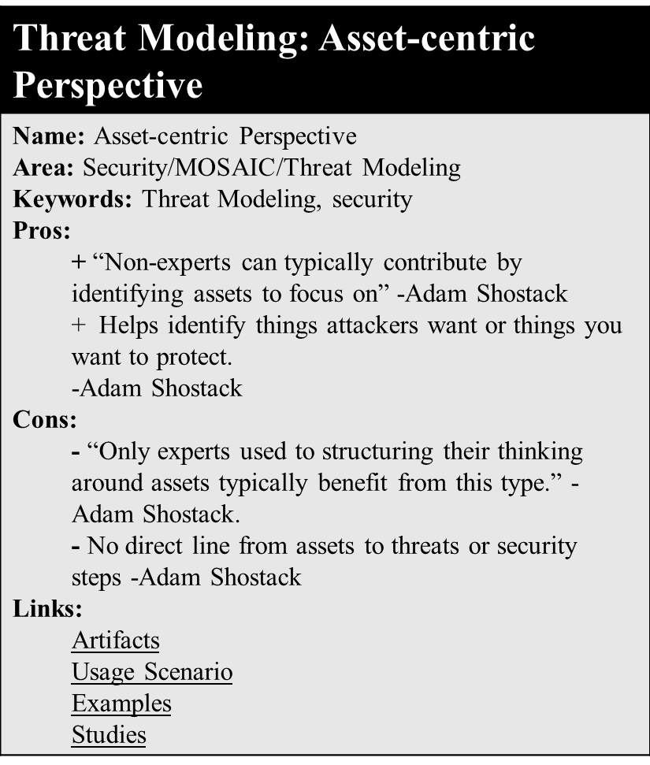
Motivation
Metamodel Development
Proof of Concept
Evaluation
Notes:
Access and communication of information
Mixed classification of data
Mixed classification of users
Circumstantial guidelines

Slide 12
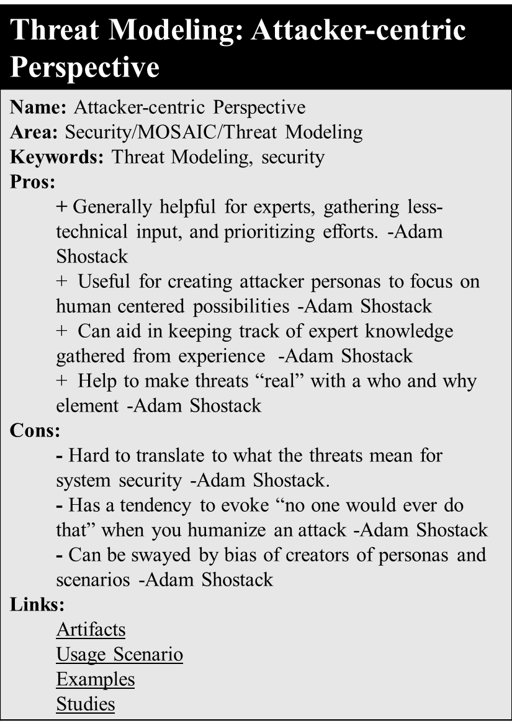
Motivation
Metamodel Development
Proof of Concept
Evaluation
Notes:
Access and communication of information
Mixed classification of data
Mixed classification of users
Circumstantial guidelines

Slide 13
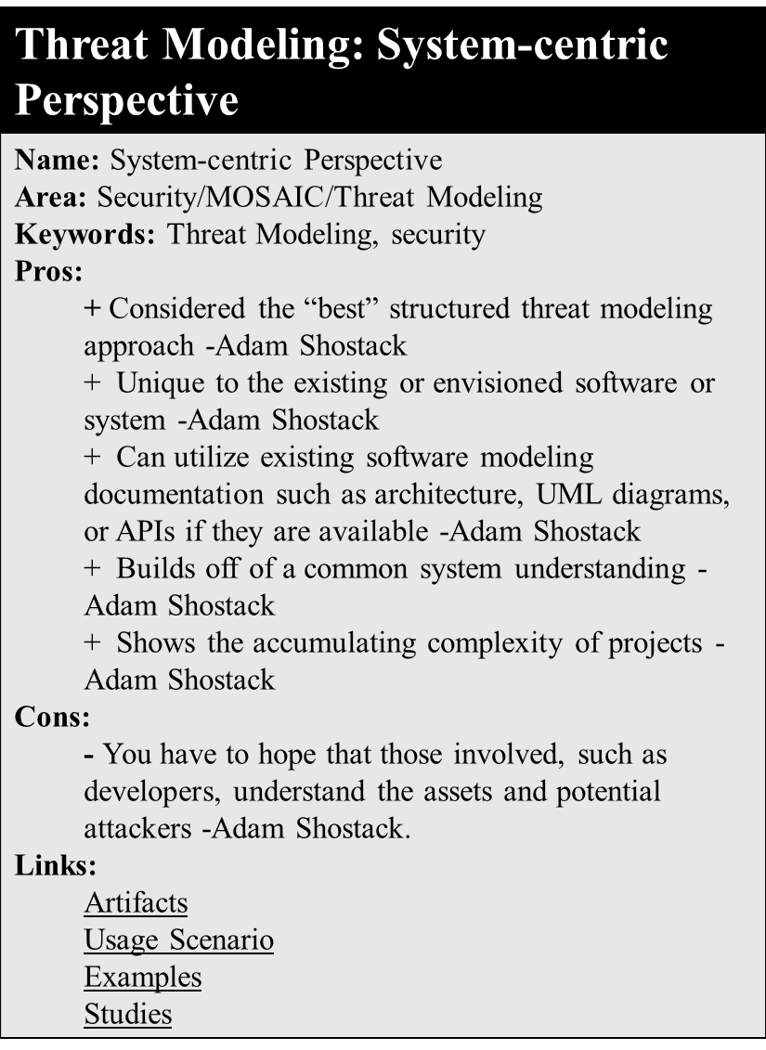
Motivation
Metamodel Development
Proof of Concept
Evaluation
Notes:
Access and communication of information
Mixed classification of data
Mixed classification of users
Circumstantial guidelines

Slide 14
Evaluation
Motivation
Metamodel Development
Proof of Concept
Evaluation
Can conduct an IRB approved study
Domain expert will organize course materials
Students in class learn two units of equal difficulty
Unit 1: Standard text and resources
Unit 2: Our metamodel
Look at student feedback and assess progress such as through student presentations or grades
Notes:
Access and communication of information
Mixed classification of data
Mixed classification of users
Circumstantial guidelines

Slide 15
Conclusion
Metamodel for information sharing, collaboration, and learning
Lookup and collaboration tool for researchers
Reference and learning tool for practitioners
Organization and modeling tool for teachers
Learning and studying tool for students
Need:
Digital Library for access and contributions
User participation both adding and receiving
Notes:
Access and communication of information
Mixed classification of data
Mixed classification of users
Circumstantial guidelines

Slide 16
Questions?

Slide 17
References
Metamodel Metamodel Development Phase
- J. Heaney, G. Dolsen, and J. Page. An environment for security model development. In Systems Integration '90. Proceedings of the First International Conference on Systems Integration, pages 320-329. IEEE Comput. Soc. Press, 1990.
J. Bau and J. C. Mitchell. Security Modeling and Analysis. IEEE Security & Privacy Magazine, 9(3):18-25, May 2011.
D. S. McCrickard. Making Claims: Knowledge Design, Capture, and Sharing in HCI (Synthesis Lectures on Human-Centered Informatics). Morgan & Claypool Publishers, 2012.
- M. A. Goncalves, E. A. Fox, L. T. Watson, and N. A. Kipp. Streams, structures, spaces, scenarios, societies (5s): A formal model for digital libraries. ACM Trans. Inf. Syst., 22(2):270-312, Apr. 2004.
Access Controls Proof of Concept Phase
- M. Ion, G. Russello, and B. Crispo, “Enforcing Multi-user Access Policies to Encrypted Cloud Databases,” in 2011 IEEE International Symposium on Policies for Distributed Systems and Networks, 2011, pp. 175–177.
N. K. Ratha, J. H. Connell, and R. M. Bolle. Enhancing security and privacy in biometrics-based authentication systems. IBM Systems Journal, 40(3):614-634, 2001.
K. Ren, W. Lou, K. Kim, and R. Deng. A Novel Privacy Preserving Authentication and Access Control Scheme for Pervasive Computing Environments. IEEE Transactions on Vehicular Technology. 55(4):1373-1384, July 2006.
R. Sandhu, E. Coynek, H. L. Feinstein, and C. E. Youman, “Role-Based Access Control Models,” IEEE Comput., pp. 38–47, 1996.
N. Adam, V. Atluri, E. Bertino, and E. Ferrari, “A content-based authorization model for digital libraries,” IEEE Trans. Knowl. Data Eng., vol. 14, no. 2, pp. 296–315, 2002.
Threat Modeling Proof of Concept Phase
- A. Shostack. Threat Modeling: Designing for Security. Wiley, 2014.

Slide 18
References
Data Classification Proof of Concept Phase
- S. Wiseman. Control of confidentiality in databases. Computers & Security, 9(6):529-537, Oct. 1990.
- Jun Zhang, Li-Jun Yun, and Zheng Zhou. Research of BLP and Biba dynamic union model based on check domain. In 2008 International Conference on Machine Learning and Cybernetics, volume 7, pages 3679-3683. IEEE, July 2008.
- X. Ma, Y. Huang, and D. Li. A Security Model Based on Lattice. In 2010 International Conference on Electrical and Control Engineering, pages 4958-4961. IEEE, June 2010.
- Q. Huang and C. Shen. A new MLS mandatory policy combining secrecy and integrity implemented in highly classified secure level OS. In Proceedings 7th International Conference on Signal Processing, 2004. Proceedings ICSP '04. 2004., volume 3, pages 2409-2412. IEEE, 2004.
- Y. Shen and L. Xiong. Lattice Based BLP Extended Model. In 2009 Second International Conference on Future Information Technology and Management Engineering, pages 309-312. IEEE, Dec. 2009.
- Yihe Liu and Xingshu Chen. A new information security model based on BLP model and BIBA model. In Proceedings 7th International Conference on Signal Processing, 2004. Proceedings. ICSP '04. 2004., volume 3, pages 2643-2646. IEEE, 2004.
- S. Wiseman. Control of confidentiality in databases. Computers & Security, 9(6):529-537, Oct. 1990.
Private Information Retrieval Proof of Concept Phase
A. Beresford and F. Stajano. Location privacy in pervasive computing. IEEE Pervasive Computing, 2(1):46-55, Jan. 2003.
- B. Chor, E. Kushilevitz, O. Goldreich, and M. Sudan, “Private information retrieval,” J. ACM, vol. 45, no. 6, pp. 965–981, Nov. 1998.
C. Devet, I. Goldberg, and N. Heninger. Optimally robust private information retrieval. In Proceedings of the 21st USENIX Conference on Security Symposium, Security'12, pages 13-13, Berkeley, CA, USA, 2012. USENIX Association.
- P. Mittal, F. Olumon, C. Troncoso, N. Borisov, and I. Goldberg. PIR-Tor: Scalable Anonymous Communication Using Private Information Retrieval. USENIX Security Symposium, 2011.

