Slide 1

Integrated Web App for Crisis Events Crawling
Developers: Sondra Rathje, Jordan Teaford
Michelle Hong, Stephen Angeley, Kristian Braun
CS 4624: Multimedia, Hypertext, and Information Access
Professor Mohamed Farag
Virginia Tech, Blacksburg VA 24061
April 25th, 2024

Slide 2
Outline
Project Overview
Deliverables
System Overview
  Tech Stack
  System Architecture Diagram
  Database Format
Project Features
  Automated Crisis Collection Builder
  Crisis Events One-Text Classification
  Integrated Web App for Crisis Events Crawling
  CRUD Operations
Demo
Timeline
Crawler Integration Challenges
Classifier Integration Challenges
Final Touches
Future Work
Acknowledgements
References

Slide 3
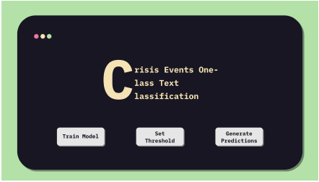
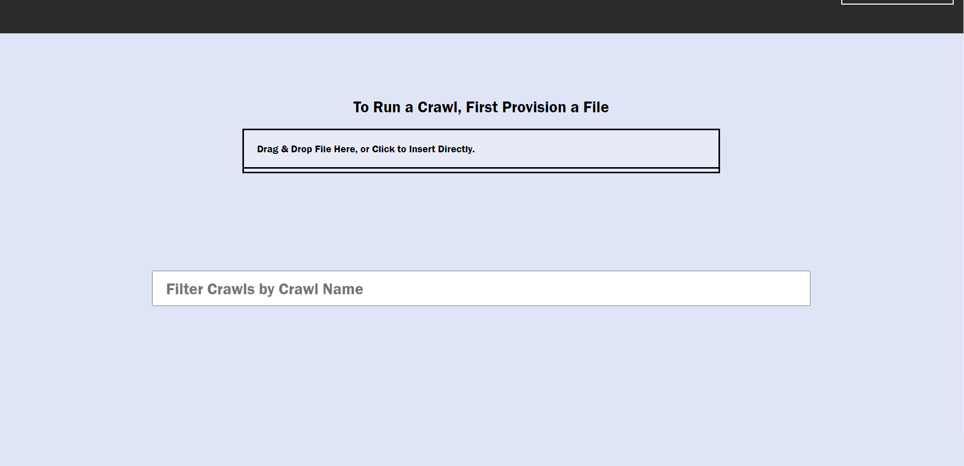
Overview
Combine the functionality of
+
Text Classifier
Web Crawler

Slide 4
Deliverables
Final report of project
  User Manual
  Developer Manual
Source code of combined final project

Slide 5
System Overview

Slide 6





Tech Stack
React based frontend
  Combined, redesigned
Flask API
Python Backend
Crawler utilizes classifier-trained models
  Autoencoder model training
  Loss-curve generation
Crawls and models save to MongoDB

Slide 7
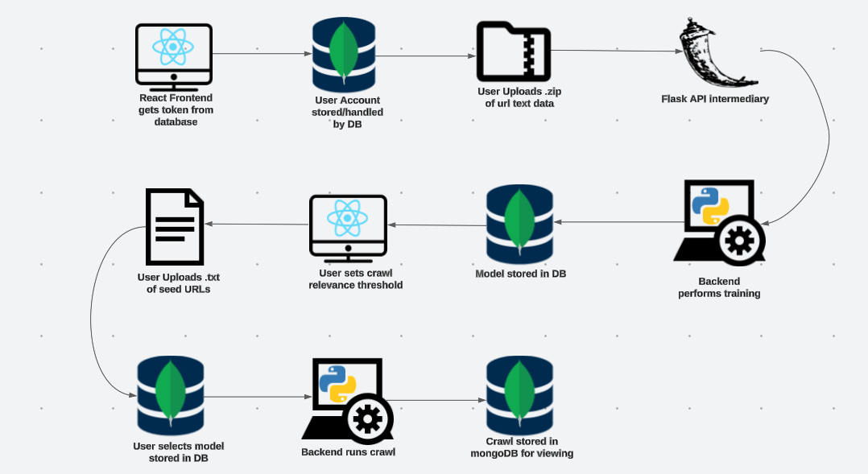
System Architecture Diagram

Slide 8
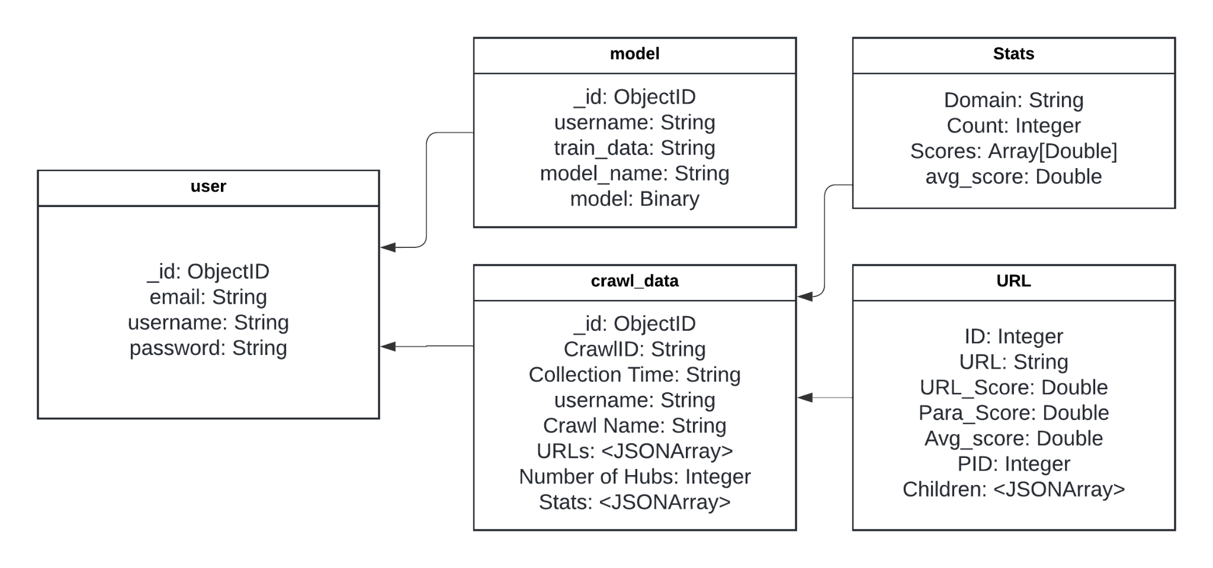
Database Format

Slide 9
Project Features

Slide 10
Automated Crisis Collection Builder
(Web Crawler)
Project runs after following setup instructions
User Authentication
User Customized Crawl
Run Crawl on Input File
Descriptive Statistics
View crawl history and details of crawls
Export Statistics as JSONArray
Filter by Specific Crisis Events
Visualization of hierarchy as a tree
User Storage
Cloud-based storage

Slide 11
Crisis Events One-Class Text Classification
(Text Classifier)
Project runs after following setup instructions
Multiple Supported Models
Model-based predictive text classification
Produces training results graph
Adjustable Model Threshold
Visualize datasets/labeling
Training a model from a txt file of URLs
Training a model from zip file of HTML pages
Training a model from zip file of .txt files

Slide 12
Integrated Web App for Crisis Events Crawling
(Combined Project)
Project runs after following setup instructions (new)
Account authentication with JWT (new)
User Customized Crawl with Model (modified)
Download crawl statistics
Train new autoencoder models with text files
Produces training results graph
User-customized crawls with input
Predictive classification with models (modified)
View crawl history and details of crawls
Local Storage (new)
Download Webpage Collection from crawl (new)
Bar Chart Visualization of Crawl (new)

Slide 13
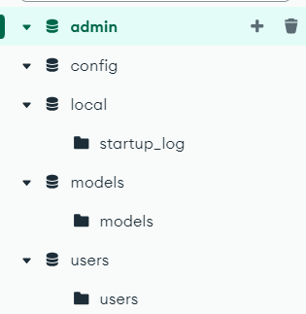
CRUD Functions
Create​
  User can create customized run​
  Run crawl on input file​
  Users can create accounts​
  User can train new models
Read​
  User can filter crawls by name
Update​
  No update operations​
Delete​
  Users can delete crawls

Slide 14
Demo

Slide 15
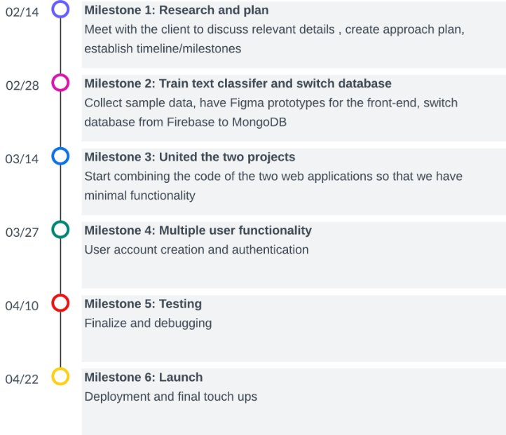
Timeline

Slide 16
Timeline

Slide 17
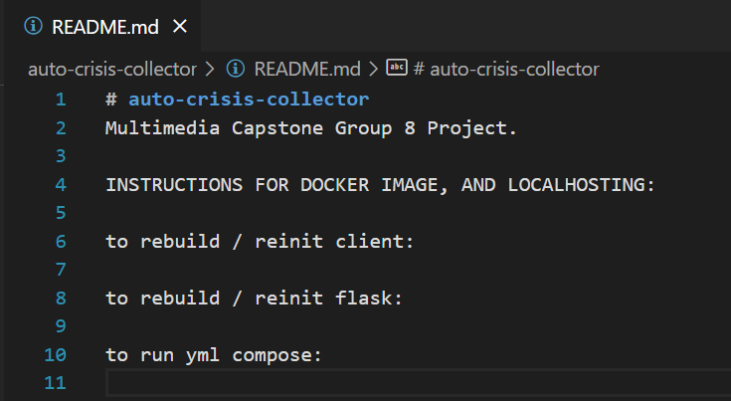
Crawler Integration Challenges
No Docker image
Blank readme
Tree outputting improperly

Slide 18
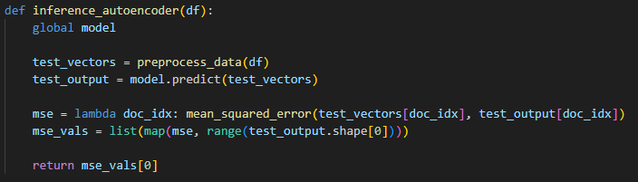
Classifier Integration Challenges
Retrieving model information to database
Converting model to/from binary
Inferencing algorithm
Changing from cosine similarity to model prediction

Slide 19

Future Work
Improve classifier scoring
Add account features (password reset/account recovery, security questions, change email)
View all models in the database (with deletion functionality)

Slide 20

Acknowledgements
Dr. Mohamed Farag
We thank Dr. Farag for meeting with our team to discuss our project's requirements and scope.

Slide 21
References
Automated Crisis Collection Builder:
https://vtechworks.lib.vt.edu/items/256c42c4-1705-4b48-b434-1dfe03395a78
Crisis Events One-Class Text Classification:
https://vtechworks.lib.vt.edu/items/70e088ad-5fd6-4ab1-931b-9a5f0482bd71

