Slide 1
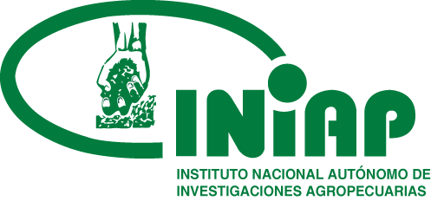





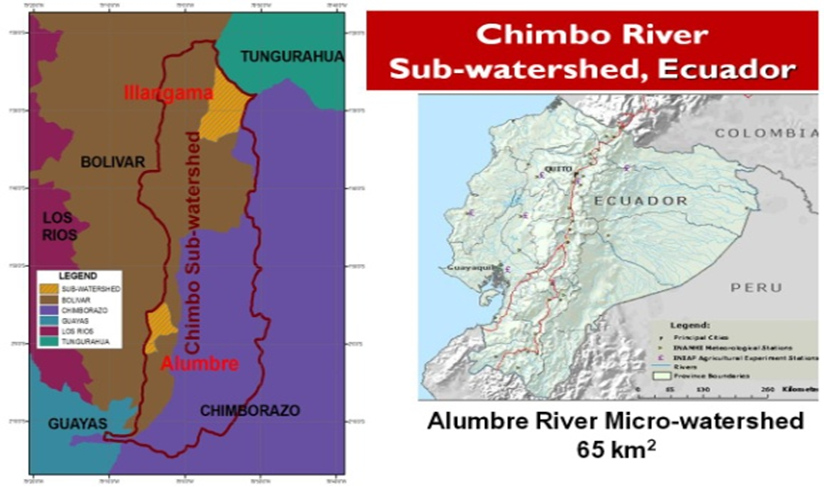
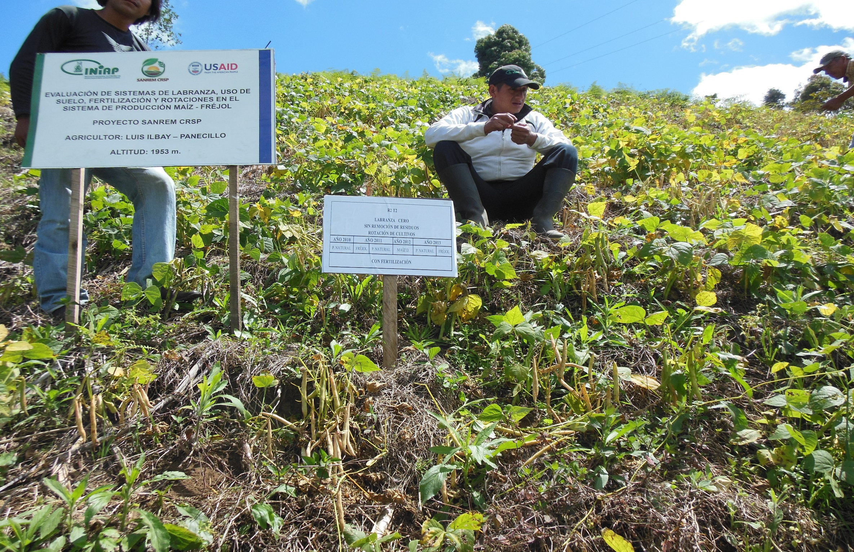
Evaluation of tillage systems, cover crops and rotations in the maize-bean production system in Alumbre-Ecuador
Barrera V., Escudero L., Valverde F., Célleri M., Chamorro F.*; Arévalo J.** ; Alwang J.***, Delgado J.****, Gallagher R.*****
Researchers INIAP; ** Student UEB; ***Professor Virginia Tech; **** ARS-USDA; *****Profesor Presbytarian College
ABSTRACT
The purpose of this poster is to describe research results for the SANREM project in Alumbre, Ecuador. Various conservation agriculture practices have been evaluated following more than four years of CA trials in the area. Parameters such as yield, soil physical and chemical properties, and overall economic benefits are presented.
INTRODUCTION
Table 1. Treatments and rotations in maize-beans system, Alumbre Ecuador, 2011-2013.
The population of the Alumbre river sub-watershed in Bolivar, Ecuador (Fig. 1) is increasingly invading fragile areas of the high plains of the Andes (the paramo). This expansion of the agricultural frontier is associated with environmental damages such as less water availability, loss of ground cover and forests, and increasing soil erosion (Barrera et al., 2010). Our project is seeking solutions involving increased intensification at lower elevations through environmentally sound conservation agriculture practices. The INIAP-SANREM IL is conducting experiments on farmer fields to evaluate CA practices in terms of impact on soil health, productivity and their economic viability. This poster presents some preliminary results.
Tratamientos | 1st cycle 2011 | 2nd cycle 2011 | 3rd cycle 2012 | 4th cycle 2012 | 5th cycle 2013 | 6th cycle 2013
T1= Minimum tillage with fertilization and with removal. | Natural grass | Beans | Natural grass | Hard maize | Natural grass | Beans
T2= No-till, with fertilization and without removal. | Natural grass | Beans | Natural grass | Hard maize | Natural grass | Beans
T3= No-till, without fertilization and with removal. | Oats-vetch | Beans | Oats-vetch | Hard maize | Oats-vetch | Beans
T4= No-till, without fertilization and without removal. | Oats-vetch | Beans | Oats-vetch | Hard maize | Oats-vetch | Beans
RESULTS
Table 2. Averages and Tuckey test to 5% on yield (t/ha). Alumbre River Micro-watershed, Ecuador, 2011–2013.
Tratamientos | Biomass GM natural grass and oast-vetch | Beans | Biomass GM natural grass and oat-vetch | Hard maize | Biomass GM natural grass and oat-vetch | Beans
T1= Minimum tillage, with fertilization and with removal. | 18.72 | 1.38 | 7.25 b | 4.71 a | 19.47 b | 1.81 b
T2= No-till, with fertilization and without removal. | 17.79 | 1.32 | 7.02 b | 3.99 b | 25.13 ab | 2.13 a
T3= No-till, without fertilization and with removal. | 19.57 | 0.99 | 12.43 b | 4.04 b | 24.00 ab | 1.23 c
T4= No-till, without fertilization and without removal. | 23.94 | 1.07 | 23.98 a | 4.69 a | 28.33 a | 1.45 c
Figure 1. Map of Chimbo River Sub-watershed, Ecuador.
Analysis of variance of mean yields of biomass (natural grass and oats-vetch), and maize and bean shows statistically significant differences (P<0.05) (Table 2). Treatments T4 and T2 have the highest yields, which we believe are due to the residuals from the cover crops.
In terms of potentially mineralizable nitrogen (PMN), prior to planting, T3 had the highest concentration (Figure 2) and, at 160 days, T2, T3 and T4 had the highest. There were no significant differences at 220 days.
No statistically significant differences between any of the treatments were found for bulk density, water-holding capacity and soil hydraulic conductivity.
The economic analysis showed that T4 is preferred to the other treatments and, at the margin, movement from T2 (the second best) to T4 would yield a net benefit of $6.79 for each dollar invested in the technology.
OBJECTIVES
Figure 2. Potentially Mineralizable Nitrogen (kg/ha) per treatment. Alumbre River Micro-watershed, Ecuador, 2013.
Evaluate the effects of conservation agriculture practices, including reduced tillage and rotations including a cover crop on physical and chemical soil properties
Measure the effects of conservation agriculture practices on yields of maize, beans and biomass
Conduct a plot-level economic evaluation of conservation agriculture for the Alumbre River area of Ecuador.
METHODOLOGY
Factors:
Tillage: Minimum and no-till.
Inclusion of a cover crop: Cover crop with removal and Cover crop without removal.
Fertilization: With fertilization and without fertilization.
Experimental Design:
Randomized block design, four treatments and three replications (Table 1).
Figure 3. No-till with beans.
CONCLUSION
Conservation agriculture has promise for the Alumbre area. It leads to higher maize and bean yields, and builds soil health over time. While no changes in physical soil properties were found, yield gains and cost savings associated with CA make it an economically viable alternative to conventional agricultural practices on steep slopes.

