Slide 1

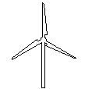
Model and Procedures for Reliable Near Term Wind Energy Production Forecast
Jiale Li and Xiong (Bill) Yu
Department of Civil Engineering
Case Western Reserve University

Slide 2

Outline
1
Research Motivation
2
Introduction and background
3
Wind power prediction procedures
4
Conclusions

Slide 3
Research Motivation
What is Distributed generation (DG)?
  Distributed generation (DG), also known as on-site generation, distributed resources (DR), distributed energy resources (DER) or dispersed power (DP) is the use of small-scale power generation technologies located close to the load being served.
What is advantages of Distributed generation (DG)?
  For some facilities, DG can lower costs, improve reliability and reduce emissions. DG may also add redundancy that increases grid security.

Slide 4
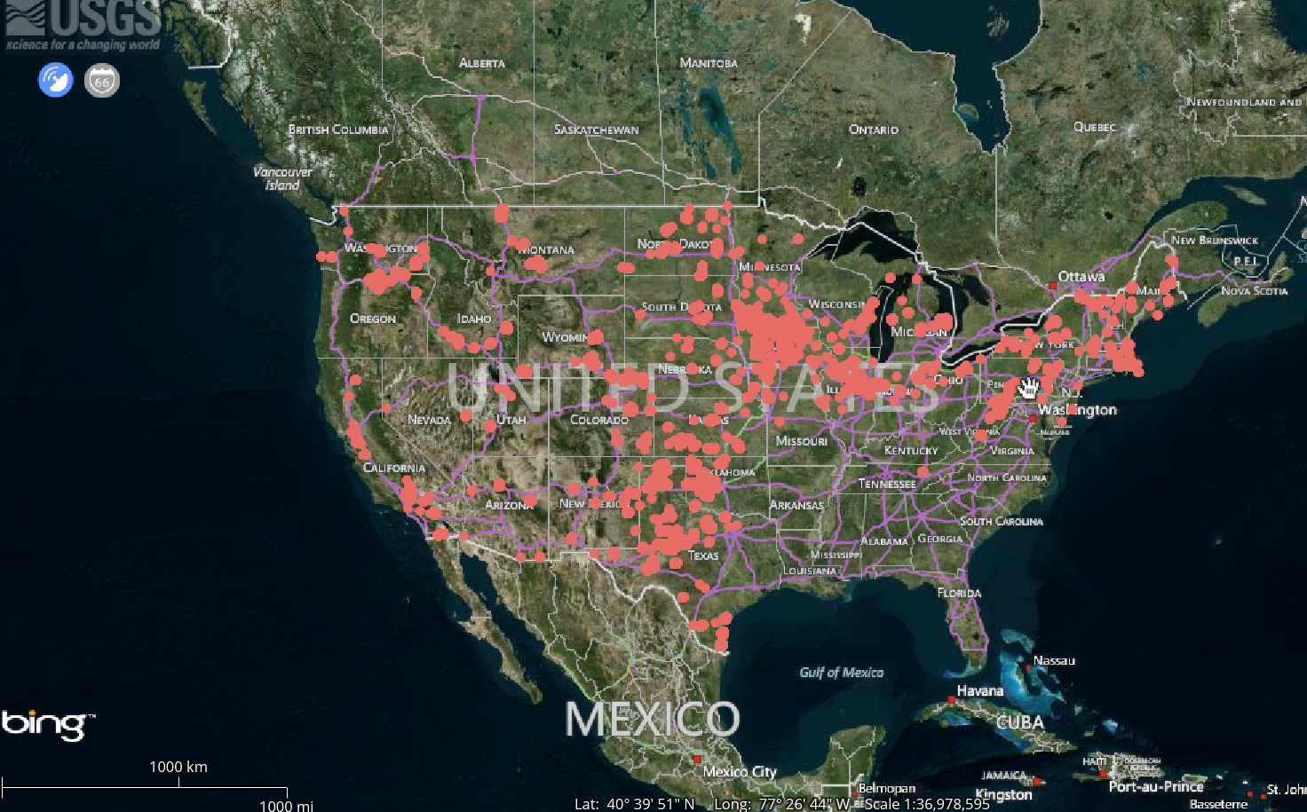
Research Motivation

Slide 5
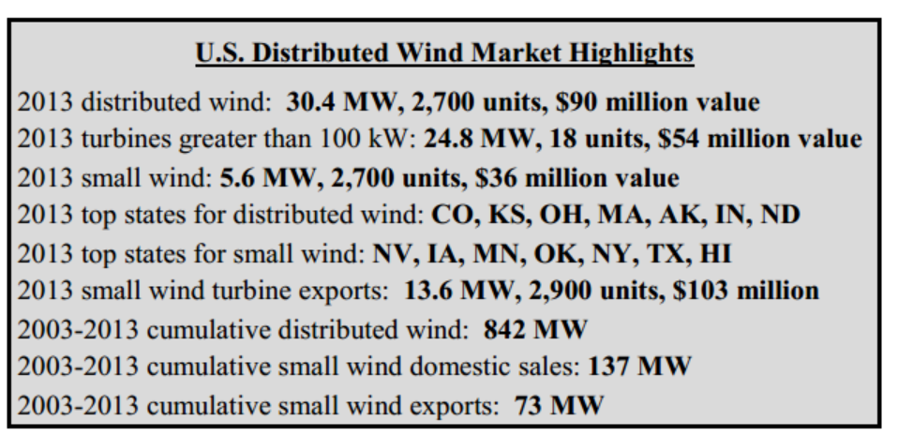
Research Motivation
What is current situation of Distributed wind turbines?
  In 2013, 30.4 megawatts (MW) of new distributed wind capacity was added, representing nearly 2,700 units across 36 states, Puerto Rico, and the U.S. Virgin Islands (USVI).---2013 Distributed Wind Market Report by DOE

Slide 6
Research Motivation
Why is it important to predict wind power output?
  In the electricity grid at any moment balance must be maintained between electricity consumption and generation - otherwise disturbances in power quality or supply may occur.
  Unexpected wind fluctuations increase requirements for spinning reserves and raise electricity system production costs
  Unexpected large ramp events can affect electricity system reliability and may cause safety issue
  It is required by next generation electric grid or smart grid---stability and security

Slide 7
Research Motivation
  Wind energy prediction current situation
Large wind farms: Have observation stations and commercial prediction systems which is quite accurate
Distributed wind turbine : Use directly by the commercial or industrial
  Research Goal
Provide more reliable and accurate prediction of distributed wind generation directly using weather forecast.

Slide 8
Research Motivation
  Advantages:
Weather forecast is easy to get and cost less. No need to pay extra for those distributed wind turbines.
The weather forecast will be more and more accurate as meteorology develops.

Slide 9
Introduction
Forecast system Overview
Weather forecast Wind speed & Temperature(Mean value for 3 hours)
Discrete wind speed over 3 hour period
Wind turbine Power output Prediction
Simulated wind turbine power curve

Slide 10

Introduction
Prototype wind turbine:
Installed in November 2010 financial support from the Ohio Third Frontier Program.

Slide 11
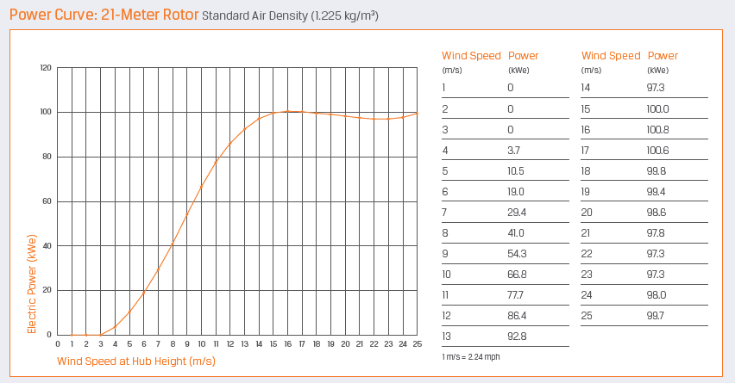
Introduction
Prototype wind turbine:
Configuration | Description
Model | Northern Power® 100
Design Class | IEC IIA
Design Life | 20 years
Hub Heights | 37m
Rotor Diameter | 21m
Rated Wind Speed | 14.5m/s
Rated Electrical Power | 100kw, 3 phase, 480 VAC, 60/50 Hz

Slide 12
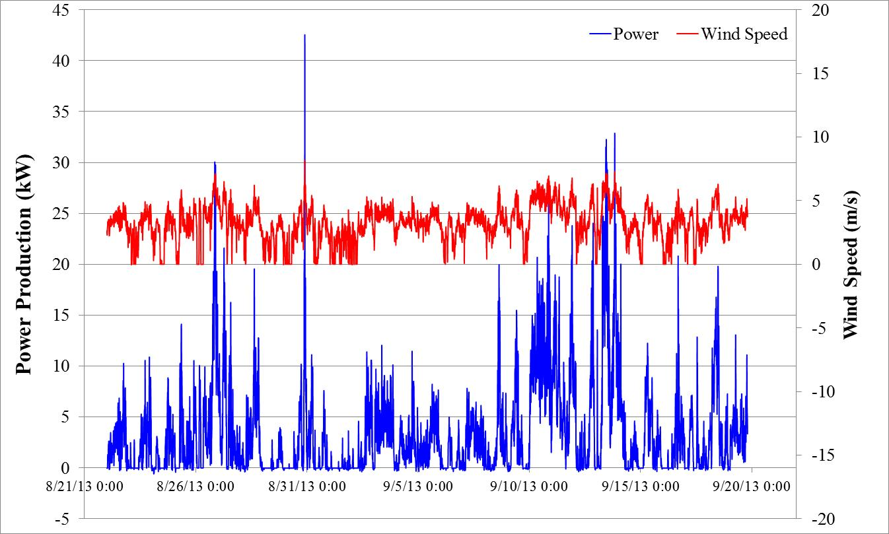
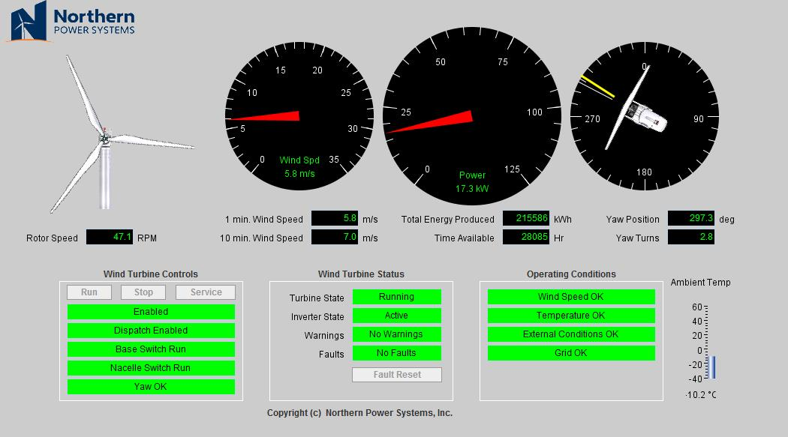
Introduction
Campbell-Scientific Data acquisition system(DAQ):

Slide 13
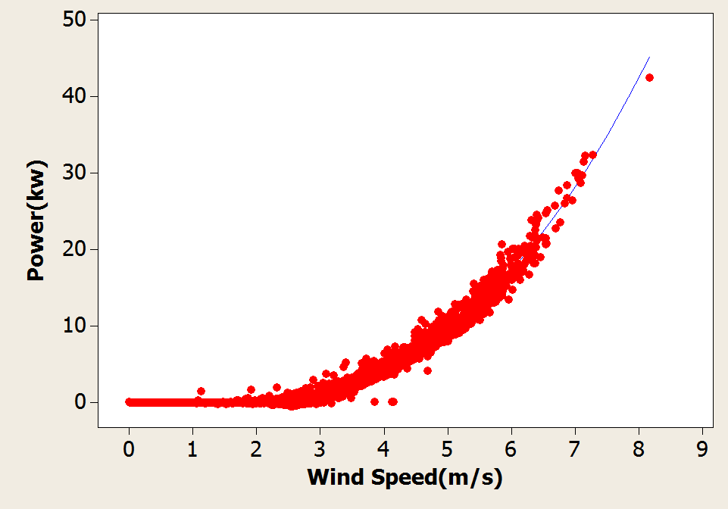
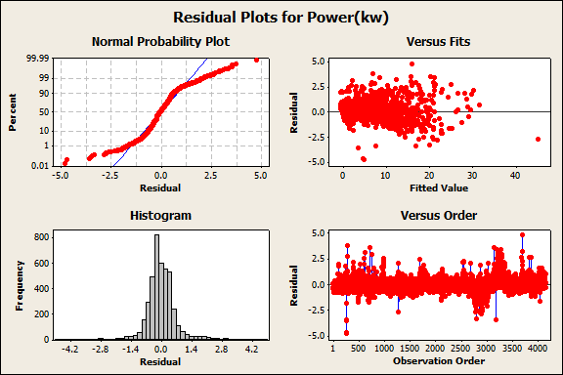
Power prediction Procedures
Measure wind turbine power curve based on one month data
Statistic analysis of simulate curve:
S = 0.629797 R-Sq = 98.1%
R-Sq(adj) = 98.1%
Analysis of Variance
Source DF SS MS F P
Regression 3 84447.1 28149.0 70967 0.0
Error 4143 1643.3 0.4
Total 4146 86090.4

Slide 14
Power prediction
Measure wind turbine power curve
The Pearson product-moment correlation coefficient (PPMCC or PCC) is used to measure the degree of linear dependence between two variables
where r is Pearson product-moment correlation coefficient, Pearson correlation of power and wind speed is 0.816 means there is a high correlation between wind speed and power output.

Slide 15
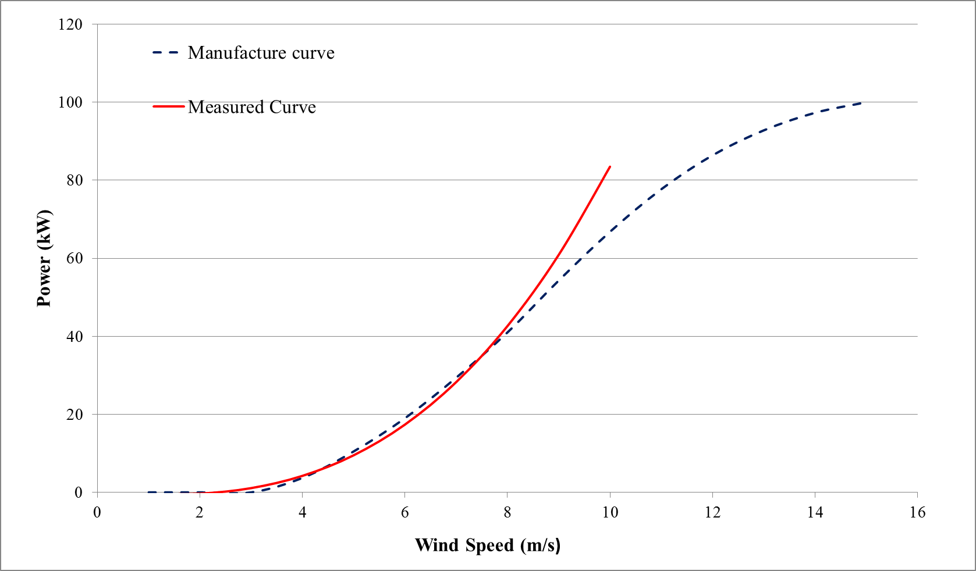
Power prediction
Measure wind turbine power curve
The measured curve exceeds 8m/s may not reliable because there is no real measured wind speed as shown as above.
Manufacture curve and measured curve

Slide 16
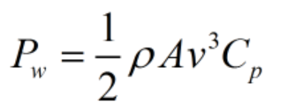
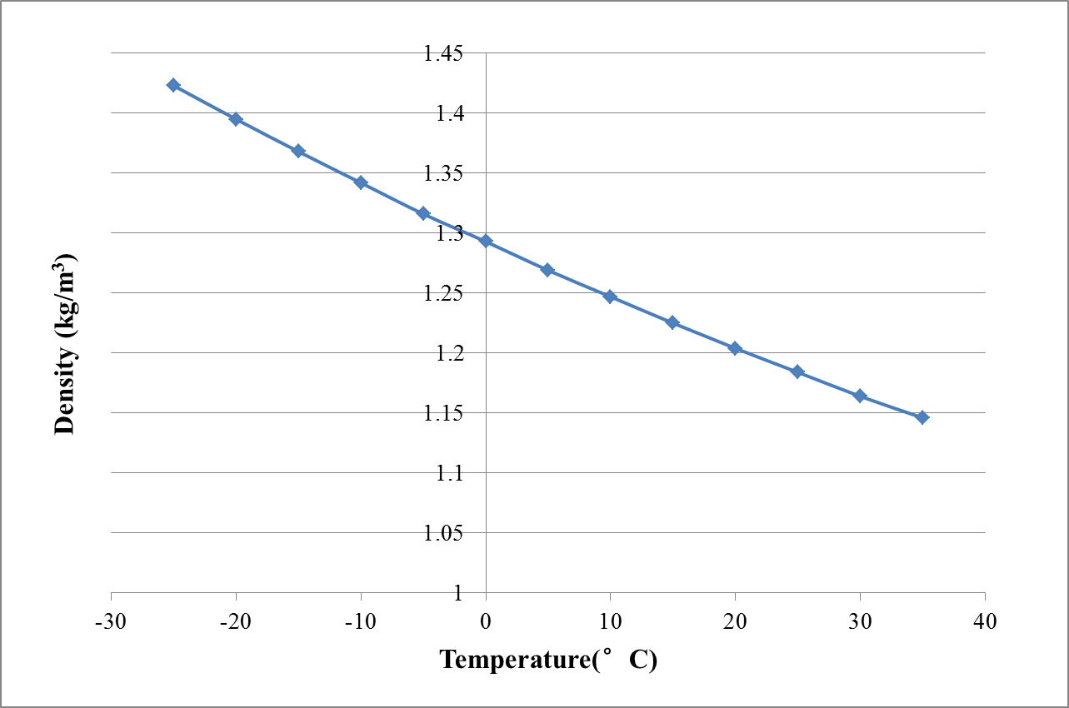
Power prediction
where ρ (kg/m³) is air density, p is absolute pressure, R_{Sp} is specific gas constant for dry air, 287.058 J/(kg·K) and T (°C) is temperature
Take temperature into consideration
The density of air changes with temperature, as shown in the figure for pressure at 1 atm:
where ρ (kg/m³) is air density, Rsp is specific gas constant for dry air and T (°C) is temperature

Slide 17
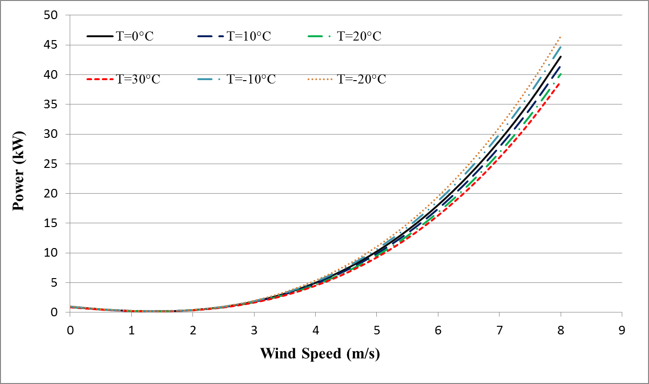
Power prediction
New power equation:
Power curve under different temperature

Slide 18
Power prediction
Wind Simulation
The transient wind velocities include two components:
(1) mean wind speed and
(2) turbulent wind speed,
where U_{tot}(t,z) is the total wind speed; U_{z}(z) is mean wind speed component which varies with height z above ground and u_{z}(t) is the fluctuating turbulent wind speed that varies with time t at a height of z above ground.

Slide 19
Power prediction
1. Mean wind Speed Adjust:
The NOAA (National Oceanic and Atmospheric Administration) provides mean hourly wind speed in Cleveland area which must be adjust over time period and height in order to use in the simulation.
The Durst curve is used here to convert wind speed data measured and averaged over one time interval to another time interval.

Slide 20
Power prediction
Mean wind Speed Adjust over height and terrain
Using the Power Law, the wind speed at any height above the ground can be determined using the following expression
Terrain type | Surface drag coefficient
Very flat terrain(dessert) | 0.002-0.003
Open terrain(grassland) | 0.003-0.006
Suburban terrain(buildings 3-5m) | 0.0075-0.02
Dense urban (buildings 10-30m) | 0.03-0.3
whereα is the power-law surface drag coefficient changing with terrain;
z_{ref} is reference height above the ground equals to 10m
U_{ref} is the reference wind velocity measured at reference height.

Slide 21
Power prediction
2. Turbulent wind speed component
The model used here to simulate turbulent wind speed was developed by Davenport, A. G.(1961) and utilizes the wind turbulence spectral density S_{k}(k,z) proposed by Kaimal, J. (1972):
whereφ_{k} is Gaussian random number distributed uniformly between 0 and 2π which is chosen for each central frequency; t is time value in the simulation, and n is the number of frequencies for which the given spectrum S_{k}(k,z) has been evaluated for specific frequencies f_{k}.

Slide 22
Power prediction
In which:
where Δf is frequency increment; k is the number of frequency increment; K is the surface drag coefficient. 0.4 here is an experimentally value known as von Karman’s constant.

Slide 23
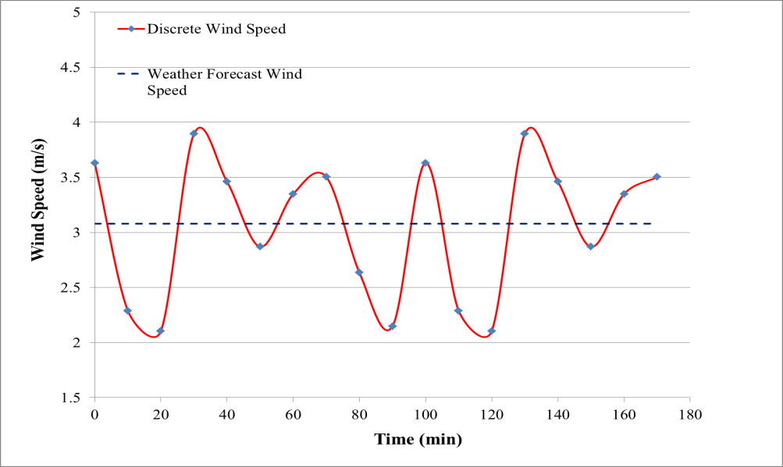
Finally, a 180 minutes wind history was simulated, the resulting simulated wind record, including the adjusted mean wind speed.
In the Figure, for a given mean wind speed of 3.1m/s, the wind velocity is predicted to vary between 2m/s to 4m/s.

Slide 24
Power prediction
Test Data:
In the research, six sets of data are used to make the power output forecast.
Three sets of data are from September 2013 and three are of Feb. 2013
Wind data are of one day ahead and temperature data are from real recorded data because lack of forecast temperature data

Slide 25
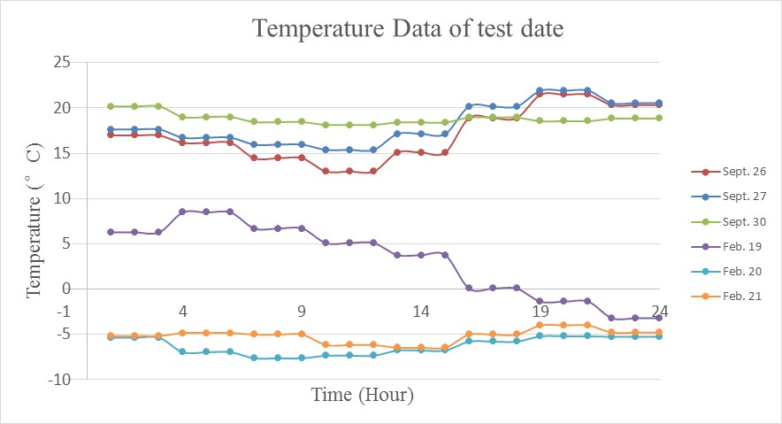
Power prediction
Temperature data:

Slide 26
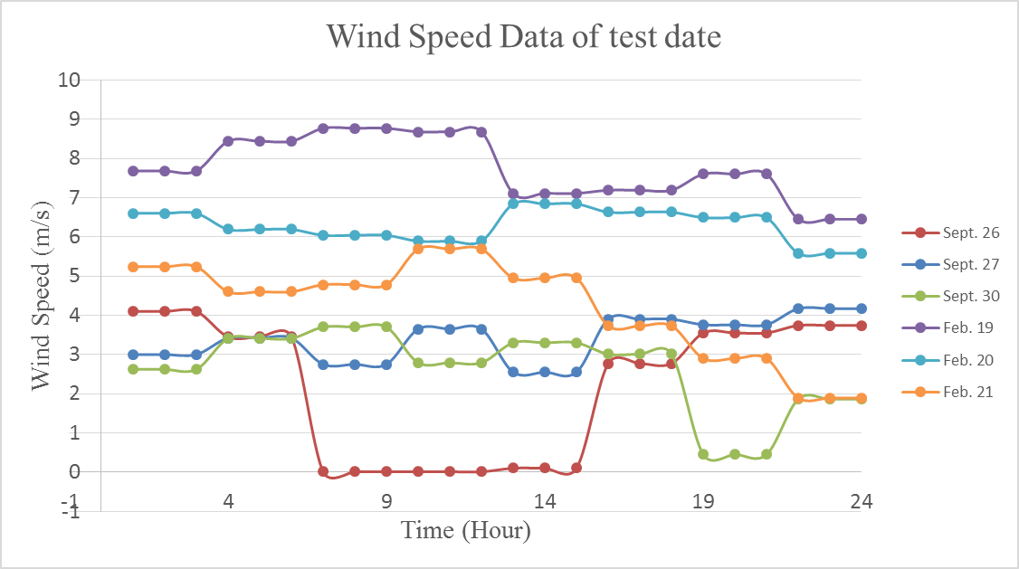
Power prediction
Wind forecast data:

Slide 27
Prediction
Predict methods:
Method 1: prediction using weather forecast directly with manufacturer turbine production curve;
Method 2: prediction using weather forecast directly with measured turbine production curve;
Method 3: prediction using simulated wind speed from weather forecast data and manufacturer turbine production curve;
Method 4: prediction using simulated wind speed from weather forecast and measured turbine production curve;
Method 5: prediction using discrete weather forecast data and measured turbine production curve considering temperature effects.

Slide 28
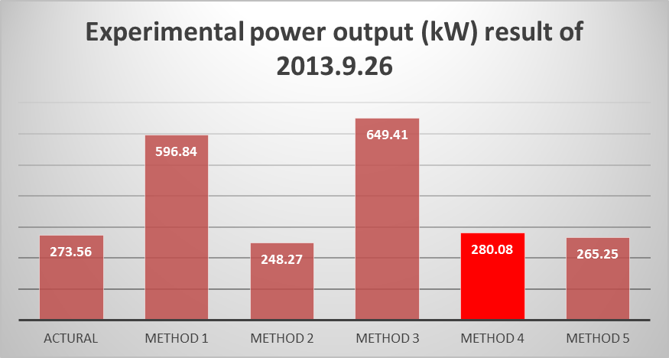
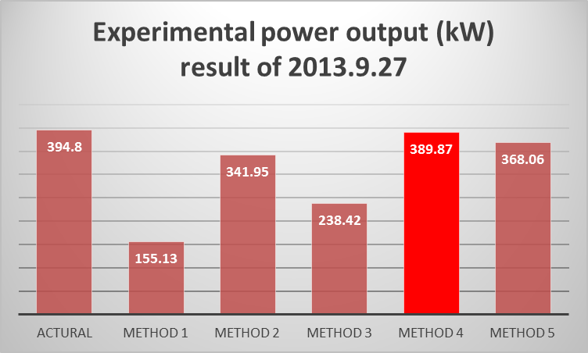
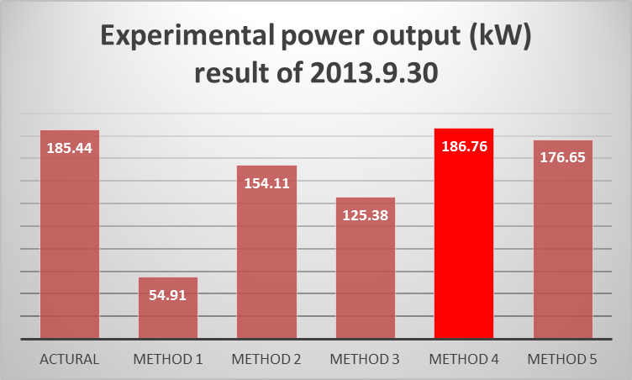
Results
Experiment result of summer time:

Slide 29
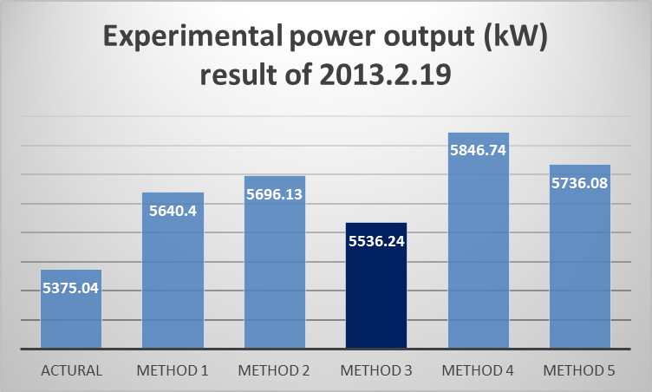
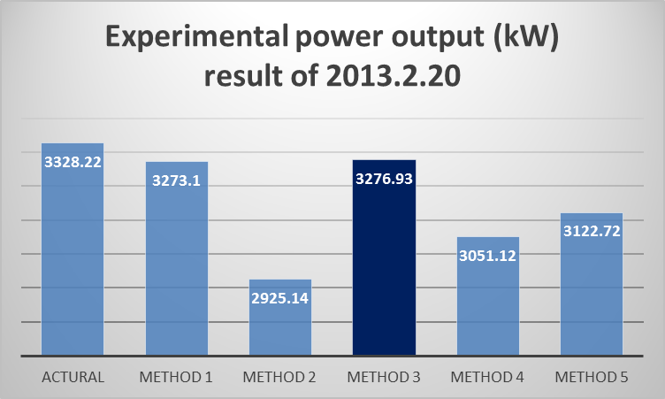
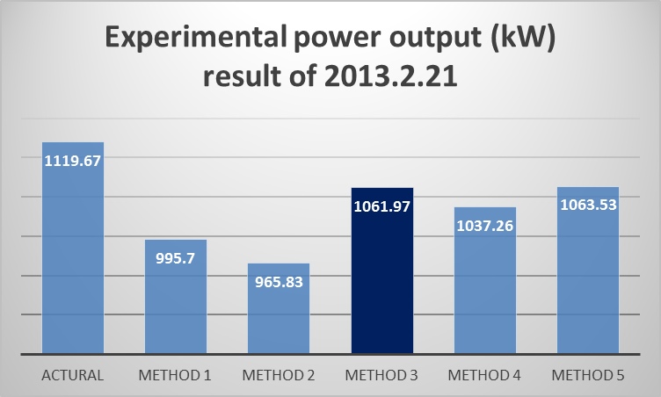
Results
Experiment result of winter time:

Slide 30
Results
Experiment result of summer time:
It is observed that predict use Method 4, i.e., prediction using simulated wind speed from weather forecast and measured turbine production curve, gives best result with an overall less than 3% from real power production. This method is about 10% more accurate than Method 2, i.e., prediction by directly using weather forecast.
This method is also more accurate than Method (5), which considers both wind speed and temperature.
Energy production prediction directly using manufacturer production curve and weather forecast data (Method 1) is unsatisfactory, which resulted in over 60% difference from actual energy production. Using simulated weather data from weather forecast data improved the accuracy, but still more than 30% difference.

Slide 31
Results
Experiment result of winter time:
Winter data illustrates that the most accurate method is the use of simulated wind speed and manufacture curve which is overall 3% more accurate than predict directly using manufacture curve and weather forecast.
Prediction using discrete weather forecast data and simulation curve in this case shows overall 8% difference than real number. The reason for the inaccuracy of method (4) in cold weather is that the measured curve is based on lower wind speed. In such case, the manufacture curve is more accurate.
Method (5), which considers both wind speed and temperature in this case is more accurate than method (4) but less accurate than method (3).

Slide 32
Results
Experiment result:
Method (5) in both Table 8 and Table 9 takes wind speed and temperature into consideration. It is the second accurate way in both warm and cold weather however not the most accurate way. This might be due to the reason that the ambient temperature also affects the efficiency of the wind turbine. Another reason is because the curve was simulated mainly based on lower wind speed level while the average wind speed is relatively high in the three chosen days.

Slide 33
Conclusion
Conclusion:
The power output curve of a single wind turbine is different under different temperature. In a certain range, the power output and temperature has a inverse relationship at same wind speed, i.e. the power output is higher under lower temperature at same wind speed.
In order to increase the accuracy of wind power predicts, different power curve should be used around the year. In this study, the manufacture power curve is more accurate to use in winter and simulation curve is more accurate to use in summer time.
By comparing Method (1) and Method (3); Method (2) and Method (4), the discrete wind speed method developed in this research can increase the accuracy of energy forecast effectively. Using the simulation wind speed method shows great advantage than predict directly using weather forecast.

Slide 34

Thank You !

