Slide 1
CINET¹ GDS-calculator
Graph Dynamical Systems Visualization
Group CINETgds
Sichao Wu, Yao Zhang
Virginia Tech
Dec. 2012
CS5604 Final Project Presentation
¹ CINET is supported by the NSF under Grant No. 1032677

Slide 2
Recap: What is GDS?
GDS: Graph Dynamic Systems.
Five elements:
  Graph.
  Vertices, which represent states.
  Edges, which indicate interacting vertices.
  Vertex functions, which quantify vertex state changes.
  Update scheme: synchronous, sequential, block, etc.

Slide 3
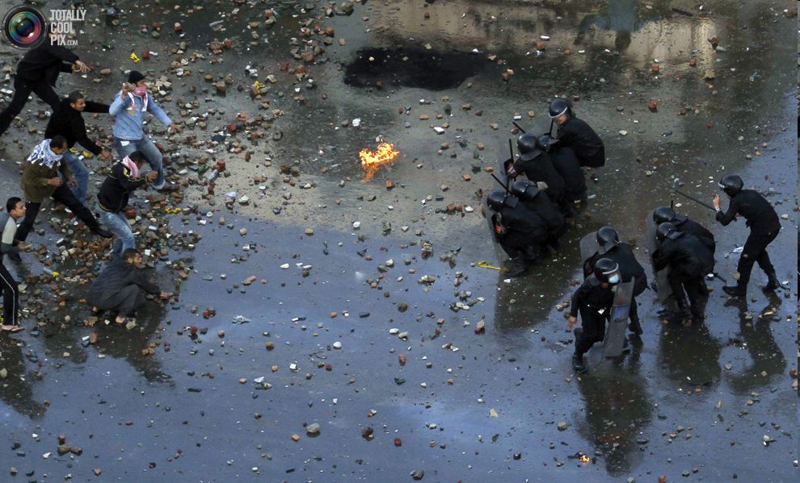

Motivation
Arab Spring
Egyptian Rebellion, 2011
(Reuters)
System behaviors are of practical interest.
  Examples
    How epidemics spread.
    How information spreads on Twitter.
Understanding of system dynamics provides insights on how to control them.
  Examples
    How to minimize the spread of epidemics.
    How to increase the probability that a marketing campaign goes viral.
    How to encourage healthy youth behavior (e.g., avoid smoking, excessive drinking).
Youth Smoking
Sociology and computer science community call these diffusing entities contagions.

Slide 4
GDS mapping: Reality to model
reality
model
agent
vertex
graph
interaction
edge
v₁
v₅
v₂
v₄
v₃
We are recasting the real problem in terms of a GDS

Slide 5
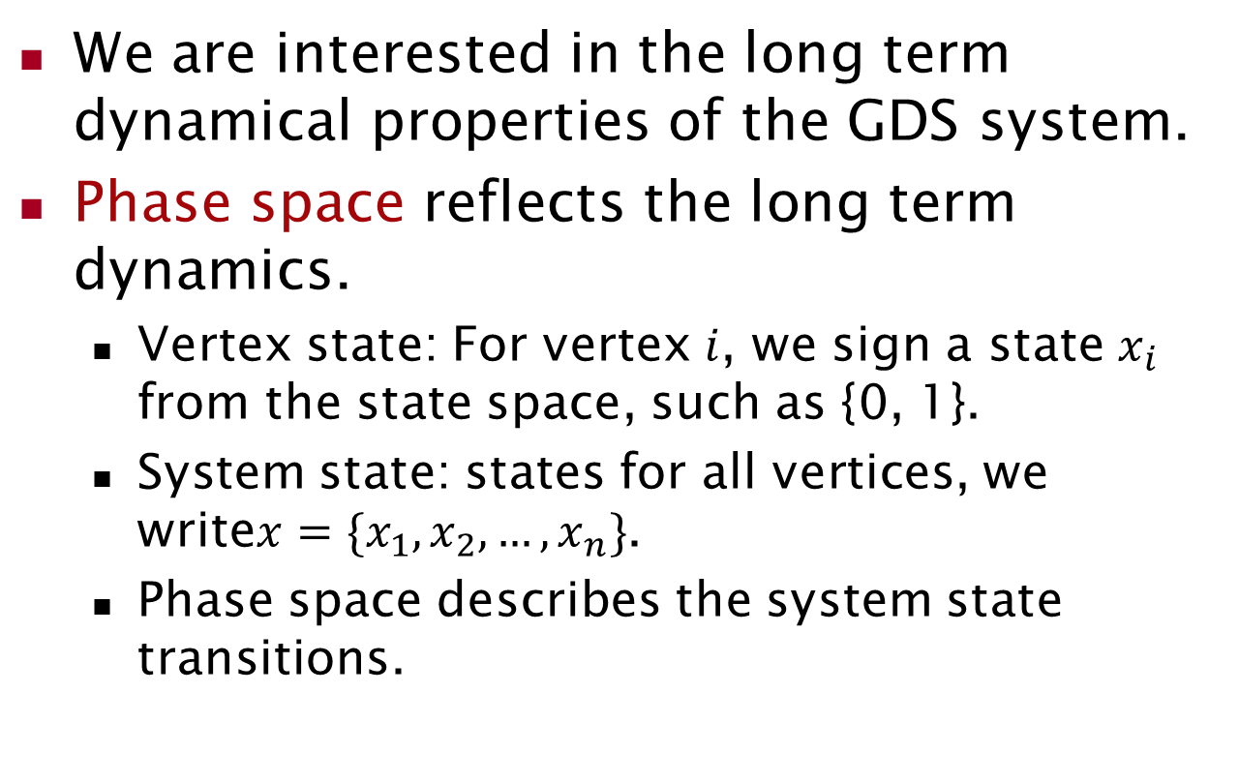
Have the model, then what?

Slide 6
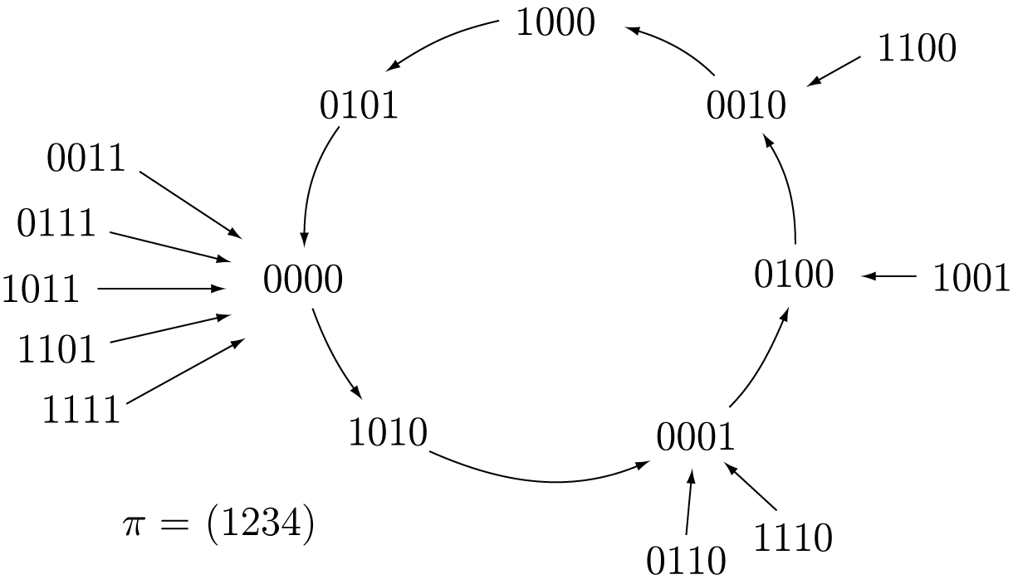
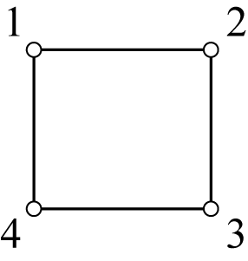
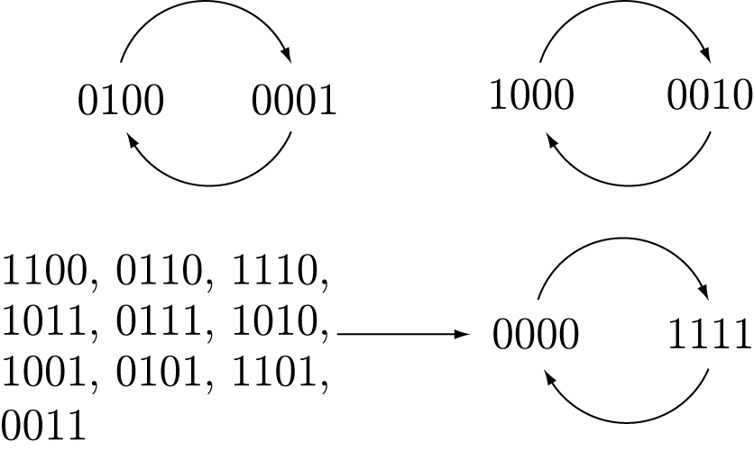
Phase space example
Phase space: sequential update
Inputs
  Graph: Circle₄
  Vertex state = {0,1}
  Vertex functions: nor₃
  Update scheme:
    Sequential with order (1,2,3,4)
    Synchronous
Phase space: synchronous update

Slide 7
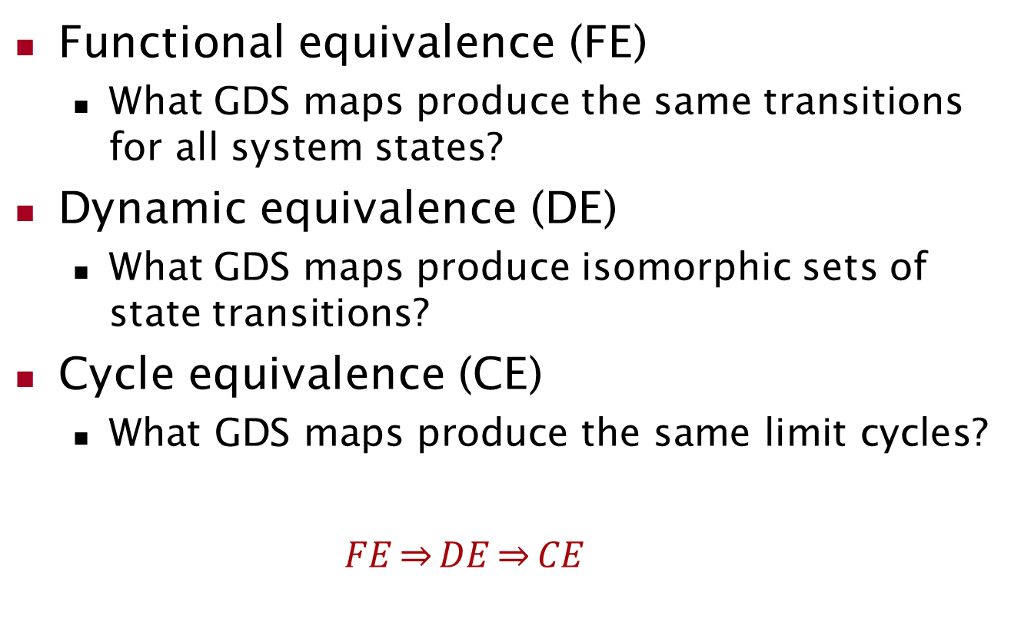
Character of phase space

Slide 8
Phase Space Analysis
begin
For each FEC, print the limit cycles.
Read in inputs.
Generate next permutation.
Compute transitions
From FEC, determine cycle equivalent classes (CEC).
Determine functional equivalence.
If GDS map J is functionally equivalent to an existing map H, put J into H’s equiv. class.
For each CEC, print cycle summary with multiplicities.
yes
Is another permutation?
no
Print to output the functionally equivalent classes (FEC).
end

Slide 9
Task - Overview
GDS calculator visualization system has three main tasks:
  Visualizing bar charts.
  Visualizing phase space transition graphs.
  Exporting to graphs and charts to files.

Slide 10
Task – Visualizing bar chars
Bar Charts we have implemented:
  the number of cycles for each cycle equivalent set.
  the number of permutations for each permutation equivalent set.
  the number of cycles for each permutation.
  the maximum cycle length for each permutation.
  the number of permutations for a specific cycle length.

Slide 11
Task – Visualizing graphs
Graph we have implemented:
  functional state transitions.
  cycle state transitions.
  Exporting to graphs and charts to files
  Export bar charts: png, pdf.
  Export graphs: png, gexf.

Slide 12
Design – MVC Architecture
View: visualization part for GDS-VIS System
  visualizing bar charts.
  visualizing state transition graphs.
Controller: manipulating data in the Model
  parsing configuration file to generate data.
  managing data.
    summarizing data to generate bar charts.
    collecting data to generate graphs.
  exporting graph to files.

Slide 13
Design - Model
Model: data used in GDS-VIS system
  Permutation
  Node state
  Functional transition
  Cycle transition
  Functional equivalence
  Cycle equivalence

Slide 14
Implementation - Environment
Implementation environment:
  Java version: JDK 1.7
  IDE: Eclipse Juno
Tools:
  jdom: parsing XML files
  jfreechart: visualizing bar charts
  gephi-toolkit: visualizing state transformation grph
  itext: exporting to pdf files

Slide 15
Implementation – Class diagram
Model

Slide 16
Implementation – Class diagram
Controller and View

Slide 17
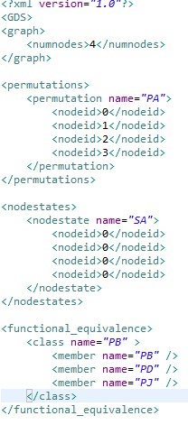
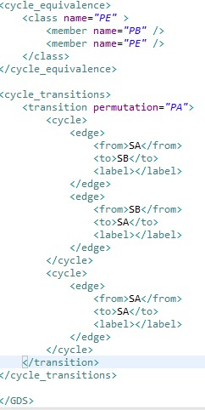
Implementation – Configuration file

Slide 18
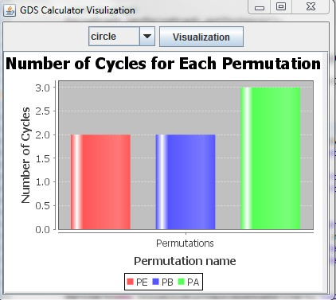
Implementation - GUI

Slide 19
Future work
Improving GUI implementation.
Visualizing more statistical charts.
Integrating with the CINET project.

Slide 20
Thanks

