Slide 1
RIS as Part of a Larger Environment of Systems
Virginia Tech’s RIS Ecosystem
Andi Ogier
Virginia (Ginny) Pannabecker
Peggy Layne
Acknowledgement: Thank you to Anne Lawrence, Repository Application Administrator at VT Libraries for providing a summary of Elements to DSpace implementation at VT.
This presentation is licensed CC BY 4.0 for reuse with attribution: https://creativecommons.org/licenses/by/4.0/
Notes:
Thanks to NISO for this opportunity. Peggy, Ginny, and I represent the partnership in implementing these systems at Virginia Tech; Ginny and I are in the Library and Peggy is in the Provost’s Office. We are here to speak a bit about the systems that make up our Research Information Ecosystem
Connecting these pieces of infrastructure into an Ecosystem is the product of many years with valuable input contributed by partners across campus. That the main takeaway we have: in our experience it’s nearly impossible to create this kind of ecosystem without breaking down silos. Creating lasting relationships and buy-in across campus is difficult to do, but vital to the success of these projects.

Slide 2
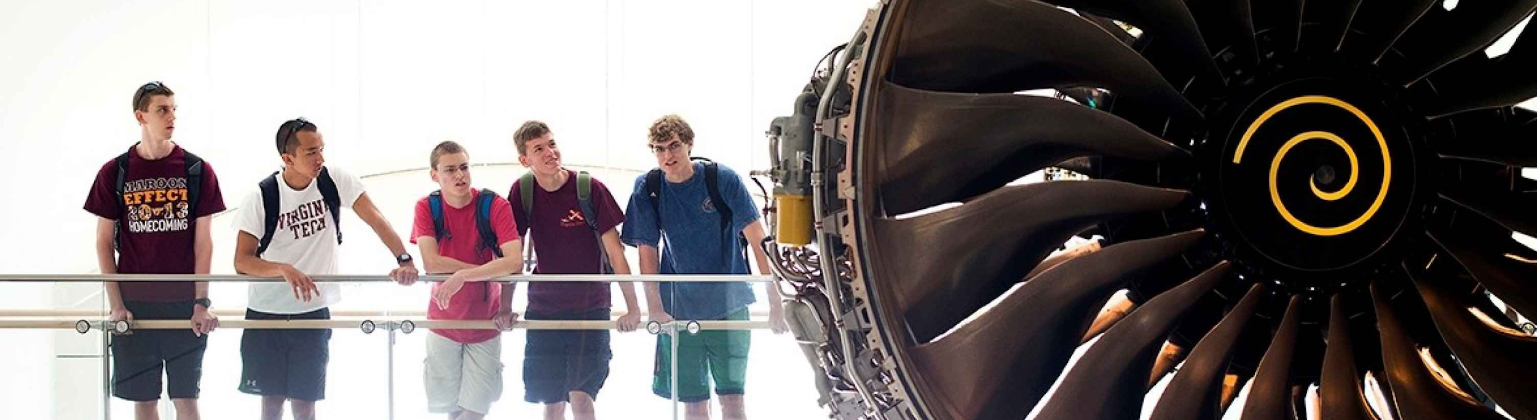
R1 Land-grant University located in Southwestern VA
250 undergraduate and graduate degree programs
33,000 students
9 Colleges + Graduate School
$504M in Research Funding 2015
Virginia Tech at a glance

Slide 3
Background and Current State
Notes:
I’d like to begin this presentation with a quick overview of who we’re working with and what our system currently looks like, and I’ll be addressing both at a very high level.

Slide 4
University Libraries
Provost’s Office
University IT
Office of Research
Departmental Support Staff
Partnerships, Roles, Responsibilities
Notes:
University Libraries
Support for:
moving data between systems
application administration
integration and testing of new connections, like VTechWorks
bibliographic data support
Liaison program provides advanced support for specific faculty
Provost’s Office
Leading the effort with Elements as an internal-use faculty data system
Enabling and promoting collaborations across campus to support new avenues of leadership in research and teaching
University IT
Gathering and providing data from trusted, verified enterprise systems
Office of Research
providing data about funded grants and contracts
Departmental Support Staff
Helping faculty navigate the system and represent their data effectively

Slide 5
Scholarly Reporting Environment & Data Flow
VTechWorks
Institutional Repository
Enterprise Systems
User Accounts through HR feed
metadata and
object deposit
through Elements
to VTechWorks
Teaching data from Registrar
Symplectic Elements
Faculty Activity Reporting
Publications from subscribed
databases
handle is returned
to Elements
Elements Synchronizer
CollabVT
VIVO Integrated Scholarly Profiles
Professional activities and publications not available via
Synchronizer
People, publications, grants via open source harvester
Manually entered data
Office of Research
Grants, publicity restricted and unrestricted
Grants, publicity unrestricted

Slide 6
The Future (we hope)
VTechWorks
Institutional Repository
VTechData
Data Repository
Enterprise Systems
OSF, other research environments
User Accounts through HR feed
Teaching data from Registrar
Symplectic Elements
Faculty Activity Reporting
Elements Synchronizer
Publications from subscribed
databases
CollabVT
VIVO
Manually entered data
Professional activities and publications not available via
Synchronizer
Office of Research
Other VIVOs,
Departmental Websites,
Visualizations

Slide 7
Implementing Symplectic Elements

Slide 8
Goals
Reporting tools for individual faculty
  Annual faculty activity reports
  Custom proposal bios
  Promotion & tenure dossier
Reporting tools for administrators
  Department, college, university reports
  Institute reports
  Benchmarking
Data feeds to other systems
  VTechWorks
  CollabVT
  Faculty & department web pages
Notes:
Provost office perspective: what are faculty doing? Need to automate data collection and reuse
Key goals for the system included activity reporting and other functionality for individual faculty members, data aggregation for institution level reporting, and the ability to both import data from existing systems and export data into other systems for reuse

Slide 9
Questions
Local or remote hosting?
Who gets an account?
Administrative rights?
Local data feeds?
Privacy & confidentiality concerns?
How can the data be used?

Slide 10
Outreach
Overview for administrators
Demonstrations for faculty
In-person and WebEx training
Help resources on web
Informal workshops

Slide 11

Next steps
Adjustments to data structure
Additional data feeds
More flexible reports
Assessment workflow

Slide 12




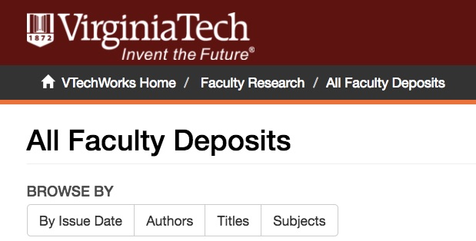
Making
Open Access Repository Deposit Easy (Connecting to DSpace)
Notes:
Hello, this is Ginny Pannabecker, and I’ll cover our connection of VT’s Elements system with our institutional repository. This was a key step for us - to make it easy for faculty to deposit publications and other works via the Elements system.

Slide 13
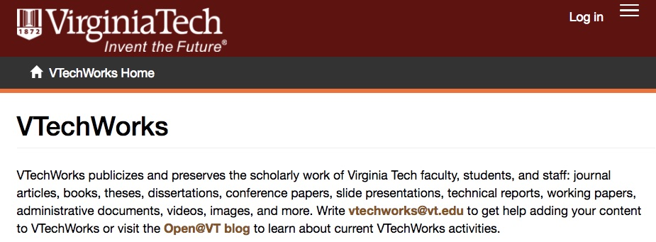
VTechWorks (DSpace) Institutional Repository
About VTechWorks
“VTechWorks was launched in 2012 and runs on the widely-used DSpace preservation platform. VTechWorks is managed by the Virginia Tech Libraries for the purpose of stewarding the intellectual output of the university in its land-grant mission to serve the Commonwealth of Virginia, the nation, and the world community through the discovery and dissemination of new knowledge. VTechWorks supports a hierarchical structure composed of Communities and Collections. Communities include colleges, departments, research centers, institutes, or other entities. Communities contain Collections and sub-communities, and Collections hold the digital works.”
Notes:
VTechWorks, Virginia Tech’s institutional repository was launched in 2012 and runs on the widely-used DSpace preservation platform. You can find out more about VTechWorks at the ‘About’ link on this slide.

Slide 14
Goals
Increase access to VT faculty works
  ✔ Easy file deposit into Institutional Repository
  ✔ In-system deposit guidelines for published works (Sherpa/Romeo)
  ✔ Creative Commons license choices
  ✔ Instant availability of record and file in IR
Automate connections between internal and external systems
  ✔ Elements → DSpace Repository (VTechWorks)
  ✔ VTW handle → back to Elements record
  CollabVT public profiles → open access works
Notes:
Many of the initial goals for connections between Elements and VTechWorks have been implemented, with the final step being to start internal roll out of CollabVT, our VIVO public profiles system this Fall. With public roll out starting in 2018.

Slide 15
Implementation
Symplectic Elements → DSpace
Rep Tools 1
  Installed on DSpace server
  Crosswalks and software support deposits of publications from Elements to DSpace
  ~19 Publication Content Types used in VT Elements
    ~15 fields used for VT (~60 possible fields)
  XSLT crosswalk defaults (customizable) for each type
    Support for customizing crosswalks
  One IR Collection for deposits: All Faculty Deposits
    Approval step can be added within your DSpace repository - we chose not to (for quick item availability)
  Map items in Faculty Deposits to Department Collections
  1,200+ items deposited in last fiscal year
Notes:
Anne Lawrence, Repository Application Administrator at VT Libraries provided a summary of our Elements to DSpace implementation. We are currently using Repository Tools 1, which is installed on our DSpace server. Repository Tools includes crosswalks and software support for deposits of publications from Elements to DSpace repositories. In the VT Elements system, we use about 19 Publication Content Types, each of which includes about 15 fields (though about 60 fields are possible). The XSLT crosswalk defaults available are customizable for each content type. We received support from Symplectic to customize crosswalks for our system. **At VT, the Elements system, described by Peggy earlier, is used for annual Faculty Activity Reporting and includes publications and works of all types. Here’s how it works for faculty to deposit items via Elements: When faculty go to their Publications list in their Elements profile, there is a button on each record to submit that work to the VTechWorks institutional repository. Clicking on this button brings up a page letting the faculty know if the item has been deposited via the Elements system earlier, as well as guidance on copyright and publisher policies, and File Description and Preparation steps. This last part also allows faculty to describe the type of file (Draft, Preprint, Accepted version, Publisher PDF, etc.), and allows them to add a comment or description about the work. This step allows them to choose to apply a Creative Commons license if they would like to do so, and, as a customized part, requests agreement to the Virginia Tech University Libraries Distribution License terms. **Deposits from the Elements system go to the All Faculty Deposits Collection in VTechWorks - this collection is linked on the slide above if you’d like to see examples. Once uploaded and submitted, a work is immediately available for viewing and download via the repository. *You can add an approval step within your DSpace repository, but we chose not to do this because it was important to us, and to our faculty, that works be immediately available for viewing and reference, with the option to contact VTechWorks staff later for edits to item information as needed. (To ensure we covered the possibility that something may be uploaded unintentionally or without sufficient permission, all item records show a ‘takedown or edit’ policy and contact address at the bottom of the page.) **In addition to publication metadata, items that come into the repository via Elements include affiliation information from the faculty’s Elements profile, such as College, Department, Institute, etc. This allows us to also map faculty deposit items to Department collections to keep those up to date as well. This deposit system has increased faculty initiated deposit, and over the last year (our first year trying this out), we’ve received about 1,200 items.

Slide 16
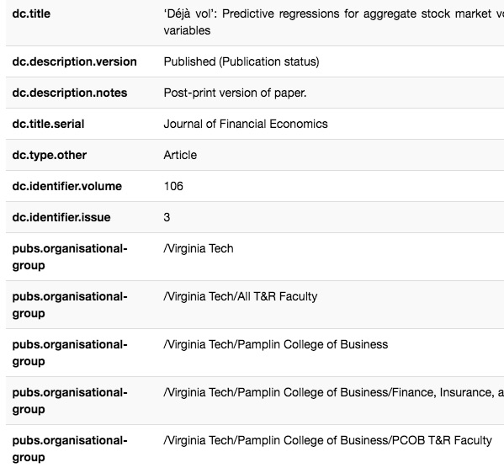
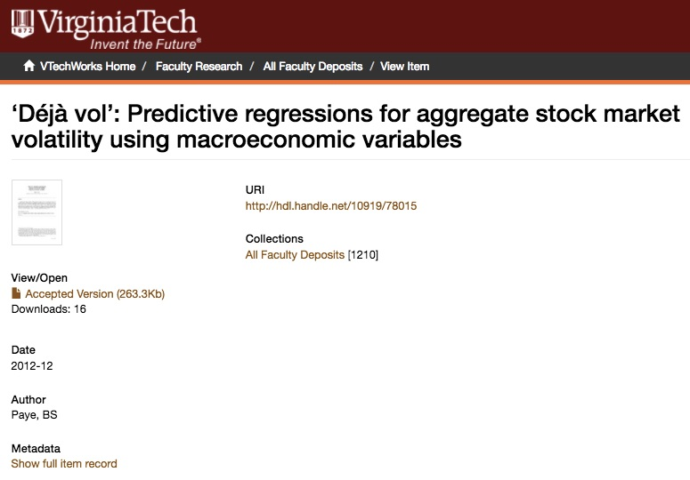
Implementation
Notes:
In this slide you can see an example of a publication record for an article that was deposited in VTechWorks via Elements. The left side image shows the brief view, and the right side image shows the full item record view. Each image is linked to VTechWorks if you’d like to see them in more detail. In the brief view, you can see that the file type selected by the faculty at submission shows (Accepted Version); and in the full item view you can see examples of the ‘organisational-group’ fields that came over from Elements, showing this faculty’s affiliations - for mapping this item to other collections later.

Slide 17
Implementation
DSpace → Symplectic Elements
Once file is deposited to VTechWorks and record is created:
  → A handle (permanent URI) to the record is added back to the appropriate Elements record
Next Steps
Repository Tools 2
Will allow for IR(s) to also be a data source → Elements
Crosswalks will be on Elements server rather than DSpace server, making repository upgrades and changes more efficient
Notes:
Currently, with Repository Tools 1, the handle, or the permanent link to the VTechWorks record comes back into Elements from VTechWorks. This will enable public access to such works when they display in the coming CollabVT VIVO public profiles system, which will source from Elements. **Our Next Steps include upgrading to Repository Tools 2, which will allow the repository to be a data source for Elements - for full publication records. Also, in Repository Tools 2, crosswalks are hosted on the Elements server, rather than the DSpace server, which will make repository upgrades and changes more efficient.

Slide 18
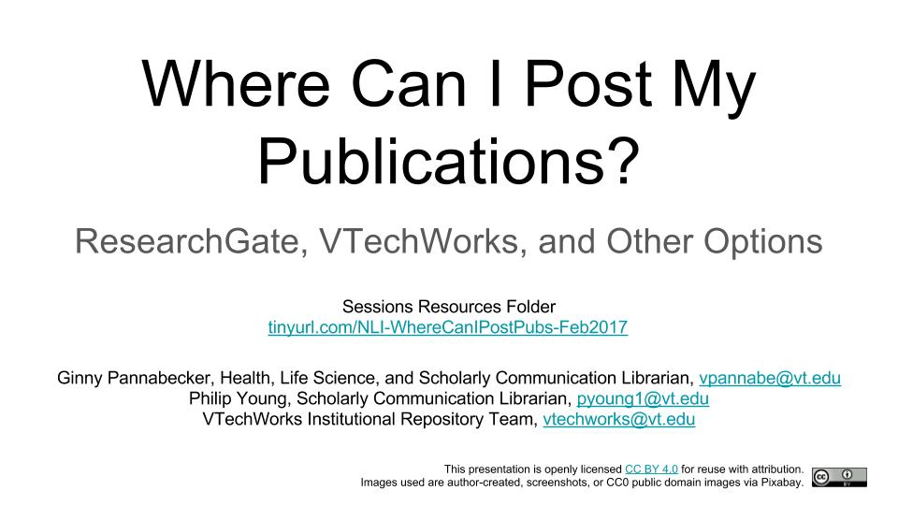
Policies & Outreach
VTechWorks Deposits
Any work (Content and other policies)
Publisher / copyright guidelines → Sherpa/Romeo guidelines display in Elements
  Institutional customization of guidelines message
VT Elements Policies
Overall guidelines on content types / categories
Specifics for Colleges/Depts
Open Access Policy
In development at VT
Will support right to deposit
Notes:
Related policies include VTechWorks content and other policies, which are available via the link in this slide. VT Elements policies are available via the VT Elements Faculty Activity Reporting site FAQ. **VT Faculty are developing an Open Access Policy in collaboration with the library, which will further support their right to deposit articles and other works. **We provide outreach via consultations, department meetings, and workshops, such as the ‘Where Can I Post My Publications’ session slides linked above.

Slide 19
Questions from faculty / Next Steps
Questions to address going forward
Can abstracts and full citations always show on IR brief record?
Can ETDs be incorporated into the data stream?
Publisher guidelines to reference for book chapters and other published works aside from articles?
Future implementation / policy plans
Open Access Monitor component in Symplectic Elements
  (to assess the adoption of OA practices on campus)
Notes:
Going forward, we hope to address questions from faculty, such as: Can abstracts and full citations always show on the IR brief record? Can ETDs be incorporated into the data stream? We also plan to implement the Open Access Monitor component in Elements once our OA policy is in effect.

Slide 20
Sharing with VIVO (CollabVT)

Slide 21
Goals
To support Communities of Discovery by enabling faculty to find and connect research across disciplines.
To increase the reach and impact of faculty research at Virginia Tech in support of its global land-grant mission through public profiles of researcher expertise.

Slide 22
Benefits of CollabVT/VIVO
Faculty and Departments have (more) control over their public-facing institutional data with very little effort
Attracting quality students and project collaborators
Improving and assuring the quality of data about researchers and research at VT
Increasing visibility and use of the Institutional Repository
Notes:
Integration with EFARS system allows faculty and department control over data.
Changes made in EFARS system will be pushed to CollabVT on a bi-weekly or monthly schedule
Data can be added, deleted, or hidden in EFARS
Faculty and research teams will attract quality students and project collaborators through searchable profiles containing data about research and teaching.
Increasing the visibility and connectedness of institutional data will improve the quality of data about researchers and research at VT.

Slide 23
Managing Faculty data in CollabVT
VTechWorks
Institutional Repository
Enterprise Systems
metadata and
object deposit
through Elements
to VTechWorks
Symplectic Elements
Faculty Activity Reporting
Elements Synchronizer
handle is returned
to Elements
CollabVT
VIVO Integrated Scholarly Profiles
People, publications, grants via open source harvester
Manually entered data
Professional activities and publications not available via
Synchronizer
Office of Research
Grants, publicity unrestricted

Slide 24
Driving Principles
Make it reasonably easy for faculty to update through normal process of updating EFARS system.
Respect privacy of faculty data through hide/show mechanism.
Provide time/space for VT faculty to test and use the system.
Implement and develop according to an iterative and scalable model.
Contribute innovations back to the development community.

Slide 25
Evolving roles in Research Information Systems

Slide 26
Integrating the RIS Environment
Open Science Framework
Connecting RIS to active research environments
VTechWorks
Institutional Repository
VTechData
Data Repository
HPC
Electronic Lab Notebooks
Enterprise Systems
Symplectic Elements
Faculty Activity Reporting
Elements Synchronizer
CollabVT
VIVO
Other VIVOs,
Manually entered data
Office of Research
University Relations, Development, etc
Trusted data for news stories, discovery expertise, data visualizations
Departmental Websites

Slide 27
Production & Outreach
Policies for transfer of data between systems
  MOUs
New ways of measuring the value-add of systems
New ways of embedding systems where users are
Upgrades, new integrations, changes
Methods for reporting problems, reviewing feedback
Evolving Roles and Responsibilities

Slide 28
Questions?

