Slide 1

Final Report:
Team 6
CS5604: Information Storage and Retrieval
Department of Computer Science, Blacksburg, VA 24061, November 30, 2023
Presented By: Mary Kate McGranahan and Sunday Ubur

Slide 2
Deliverables for Team 6
A single consistent UI to support all of the personas:
Curator
Experimenter
End-user doing research
Administrator working with reports and analyzing trends
Manager of system operations
Authentication System
Create a way for users to securely sign up and login to the system

Slide 3
Process
1. Create a single consistent user interface:
Redesign the user flow from last year taking into account new features and authentication
Create wireframe designs for a single consistent user interface
Communicate with teams and receive feedback on what end-user interactions their systems require
Implement these changes in the actual UI

Slide 4
Process
2. Authentication System
Edit previous signup interface
Design UML diagrams for login process and consult with other teams for feedback
Work with Team 5 to save user details in the database for signup
Work with Teams 2 and 3 on saving user preferences information during signup to enhance recommendation and topic modeling

Slide 5
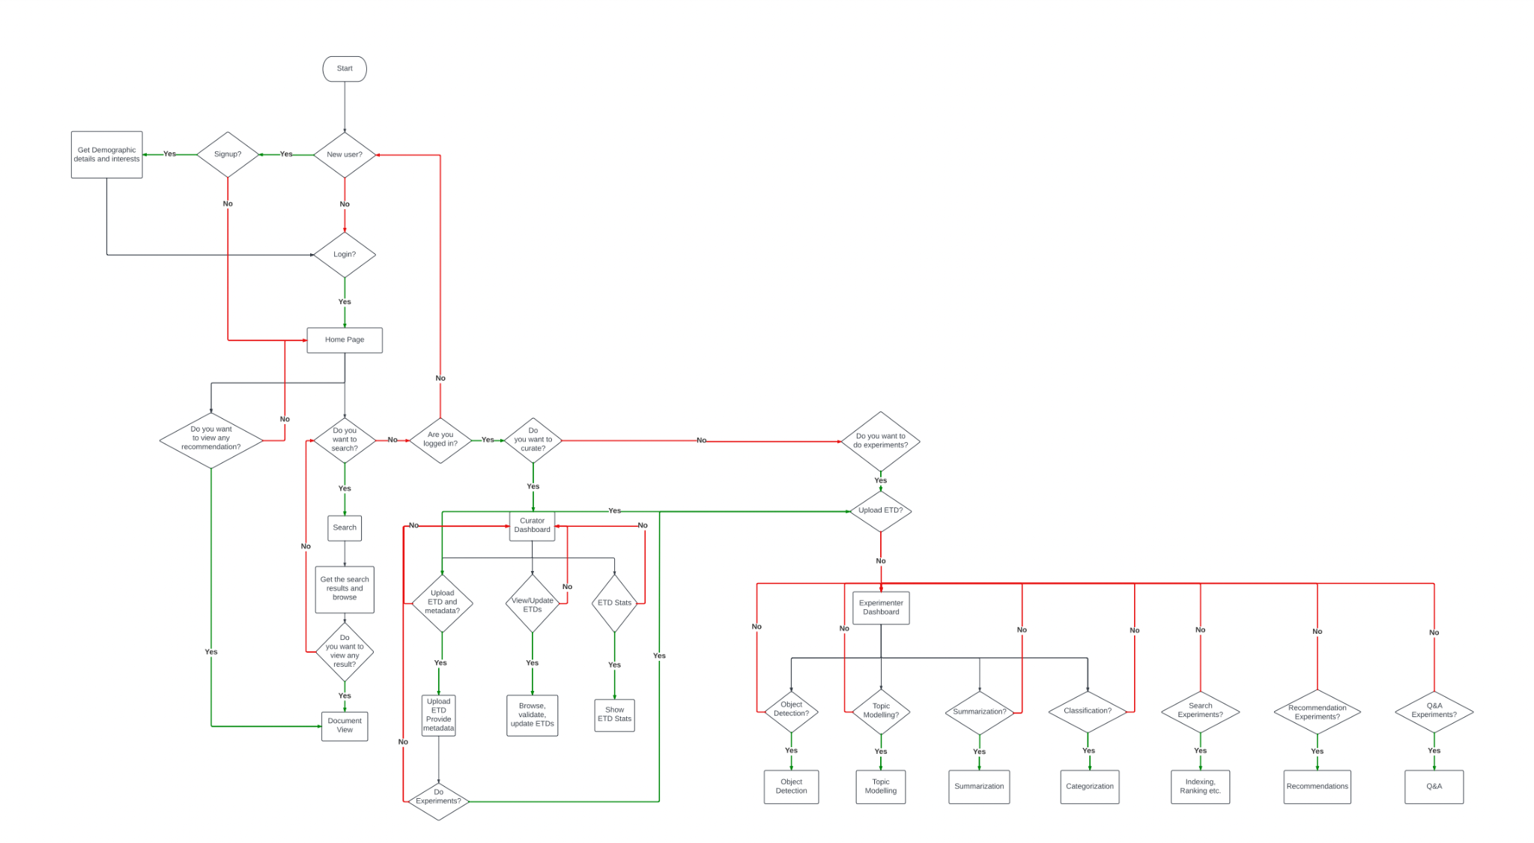
Quote Callout
Old User Flow Diagram
Problem:
Could access search without being logged in

Slide 6
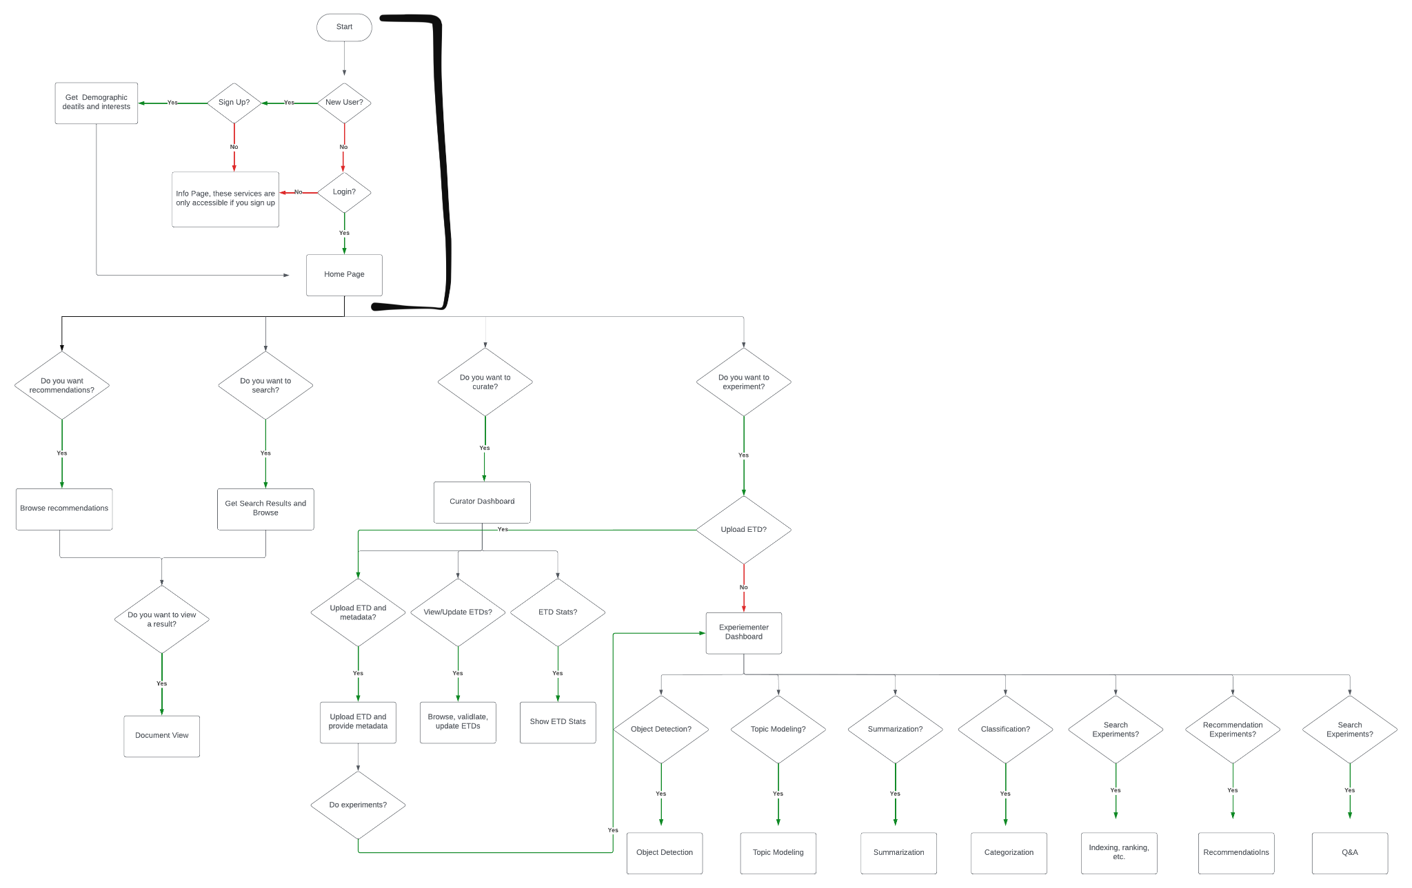
Quote Callout
New User Flow Diagram
Solution: Pages only accessible after Login

Slide 7
Wireframe Iterations

Slide 8
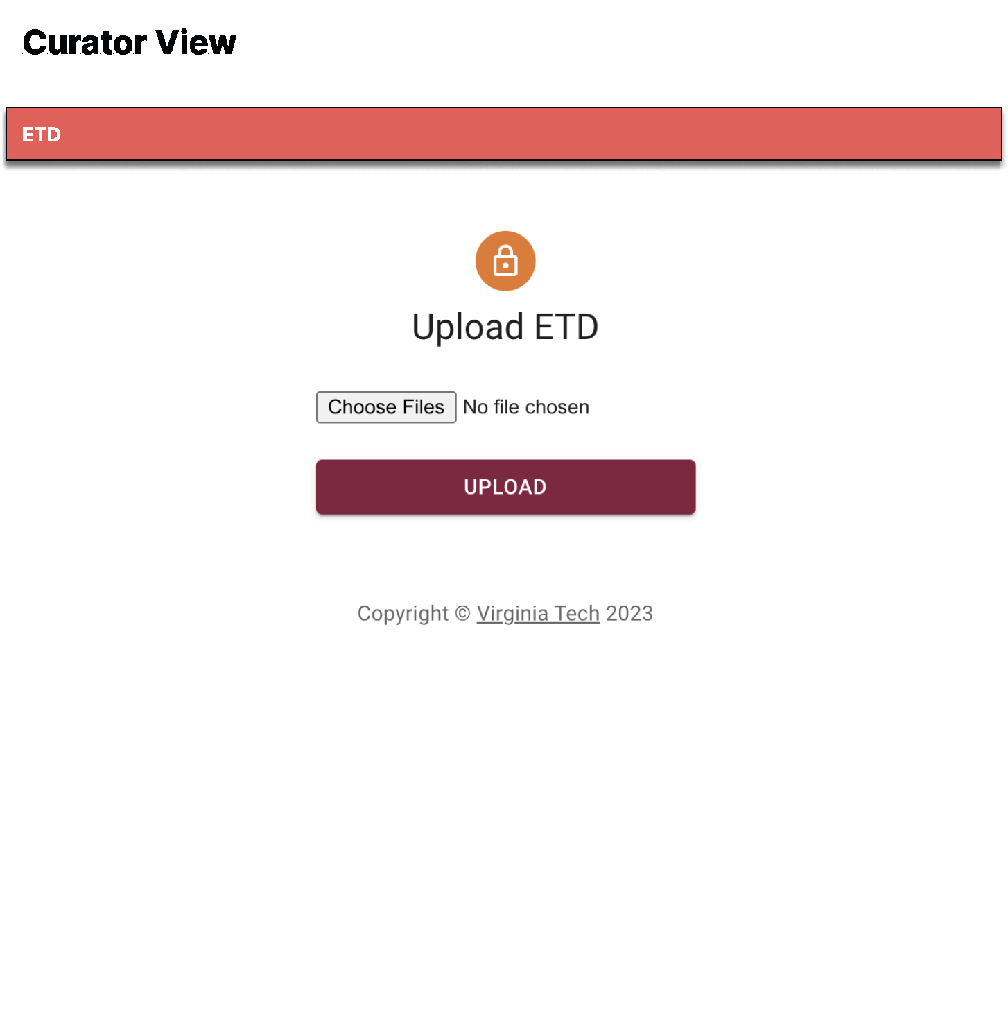
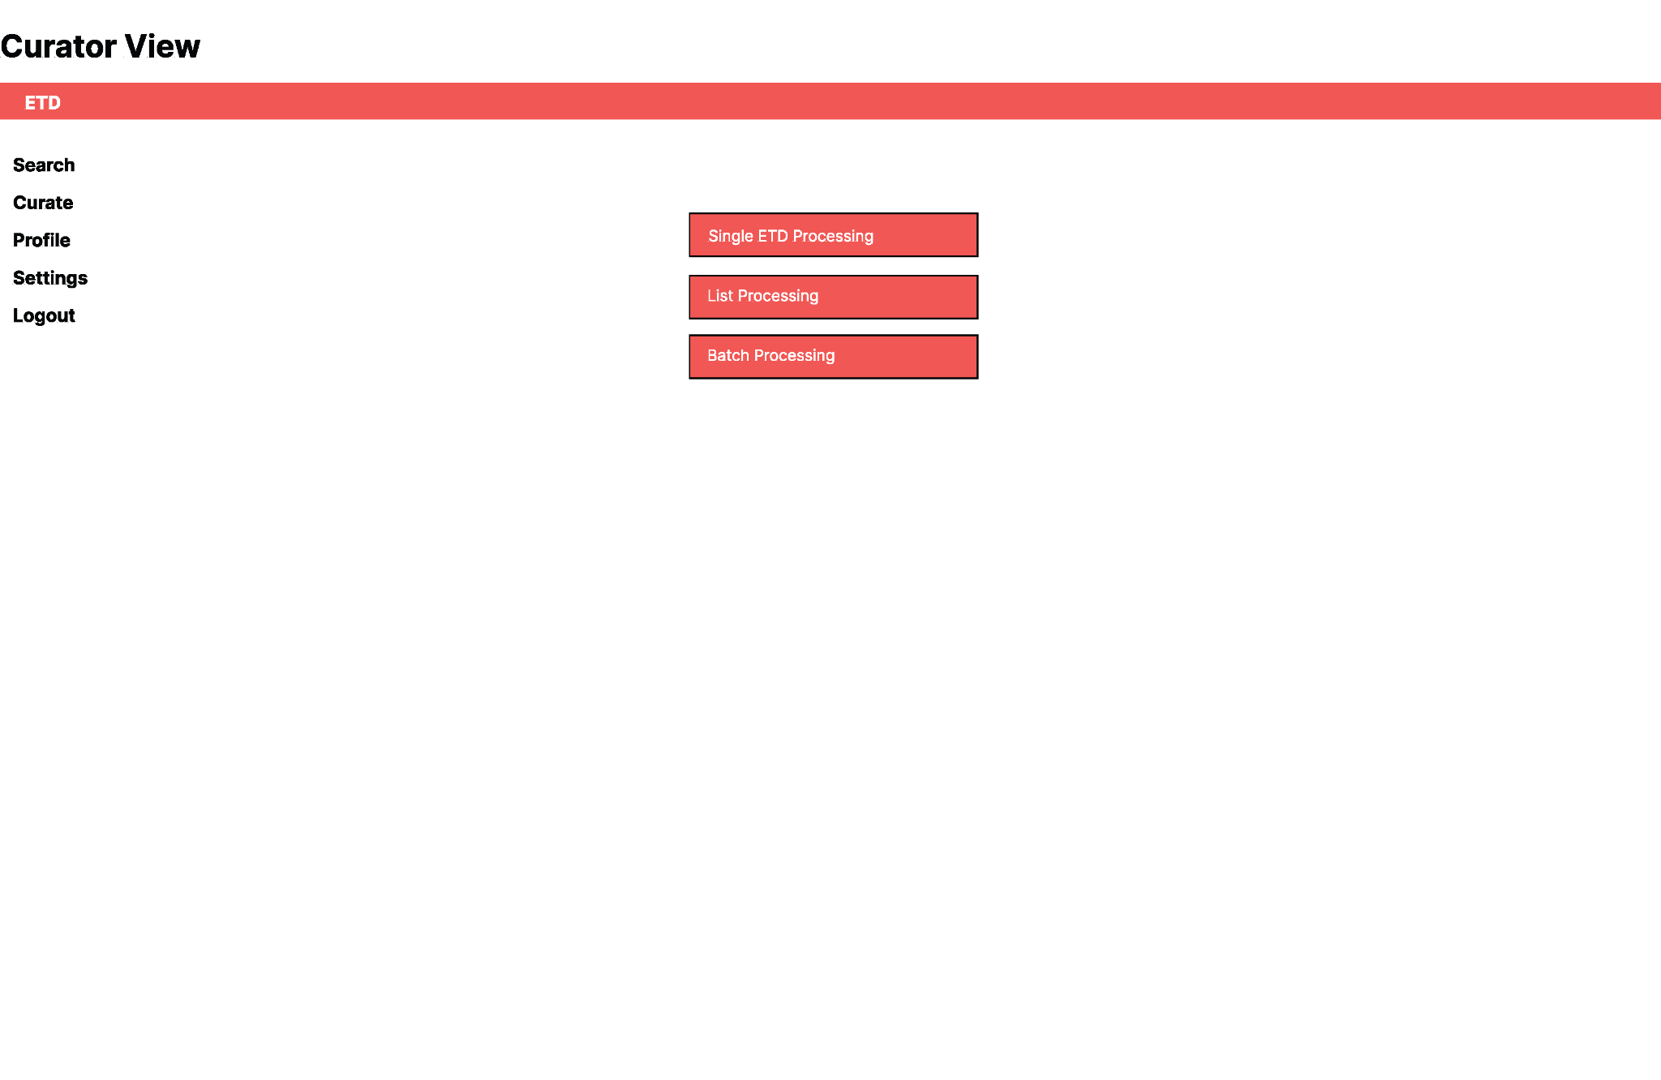
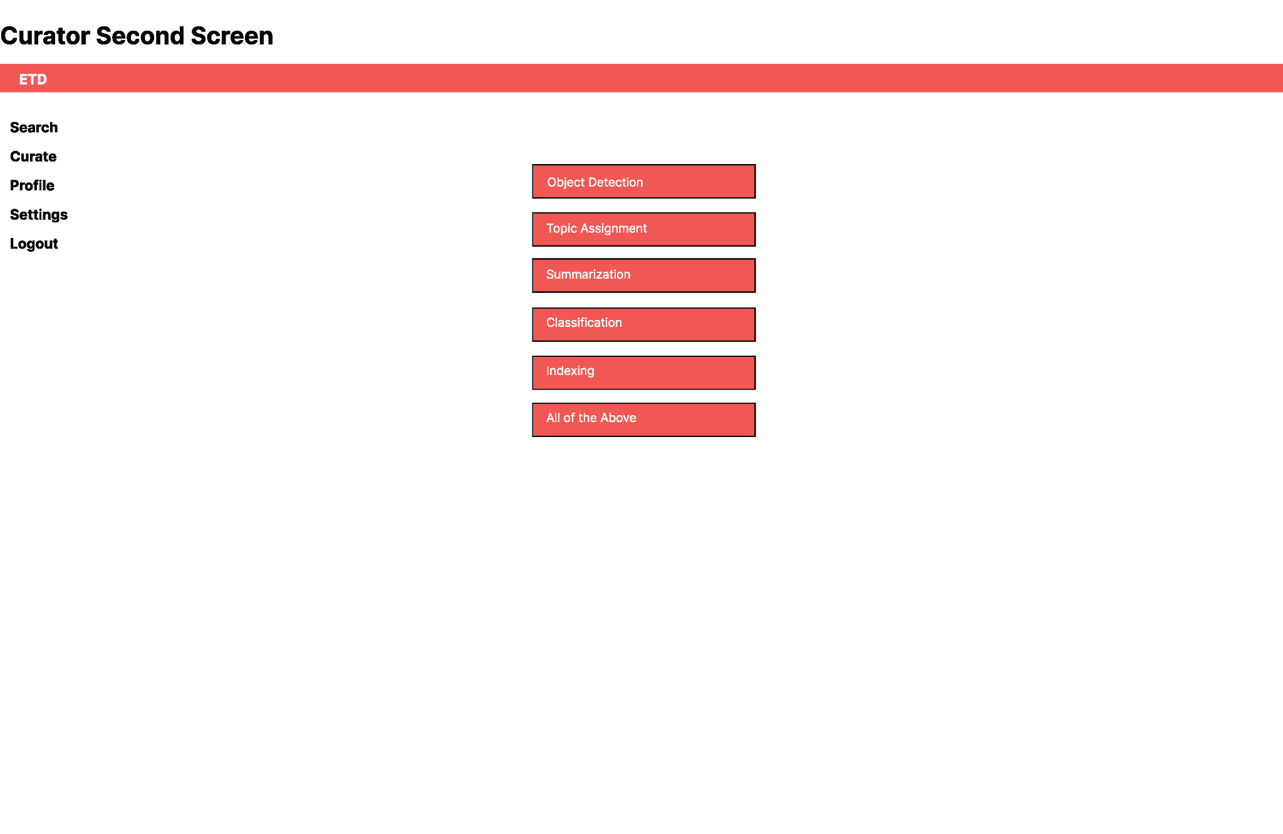
Quote Callout
Experimenter and Curator Page Designs
Original Curator Page Design
Two Page Design after Feedback

Slide 9
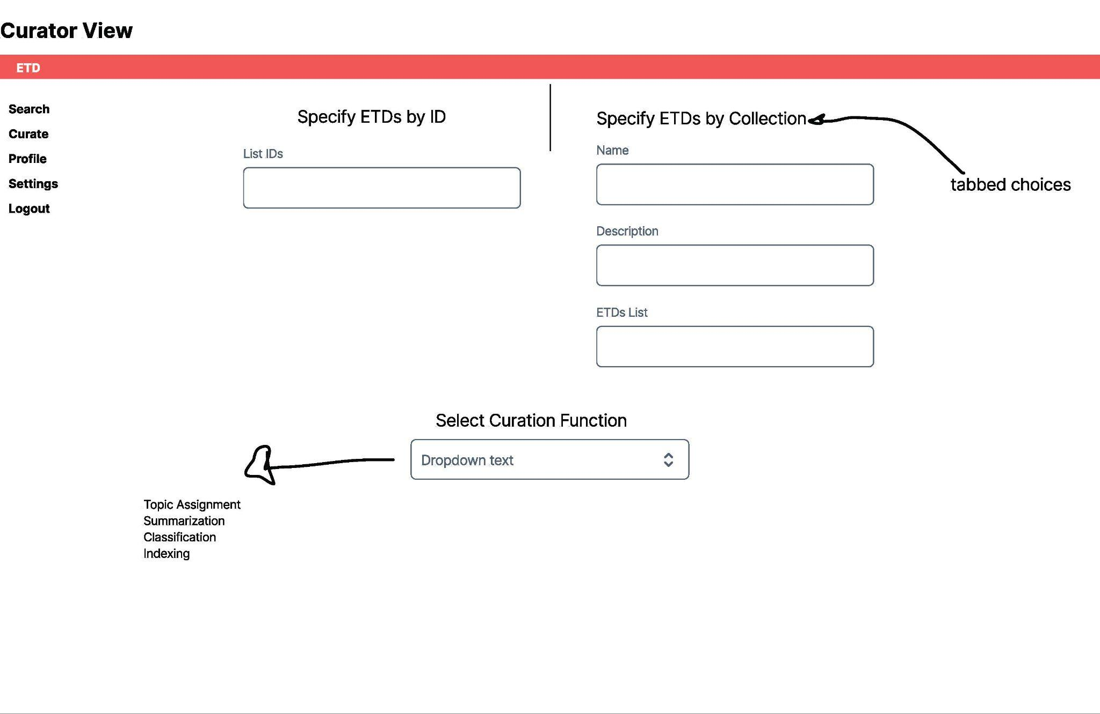
Quote Callout
Experimenter and Curator Page Designs
Final Design after more Feedback
Repeated a similar process for other screens

Slide 10
Final Screens

Slide 11
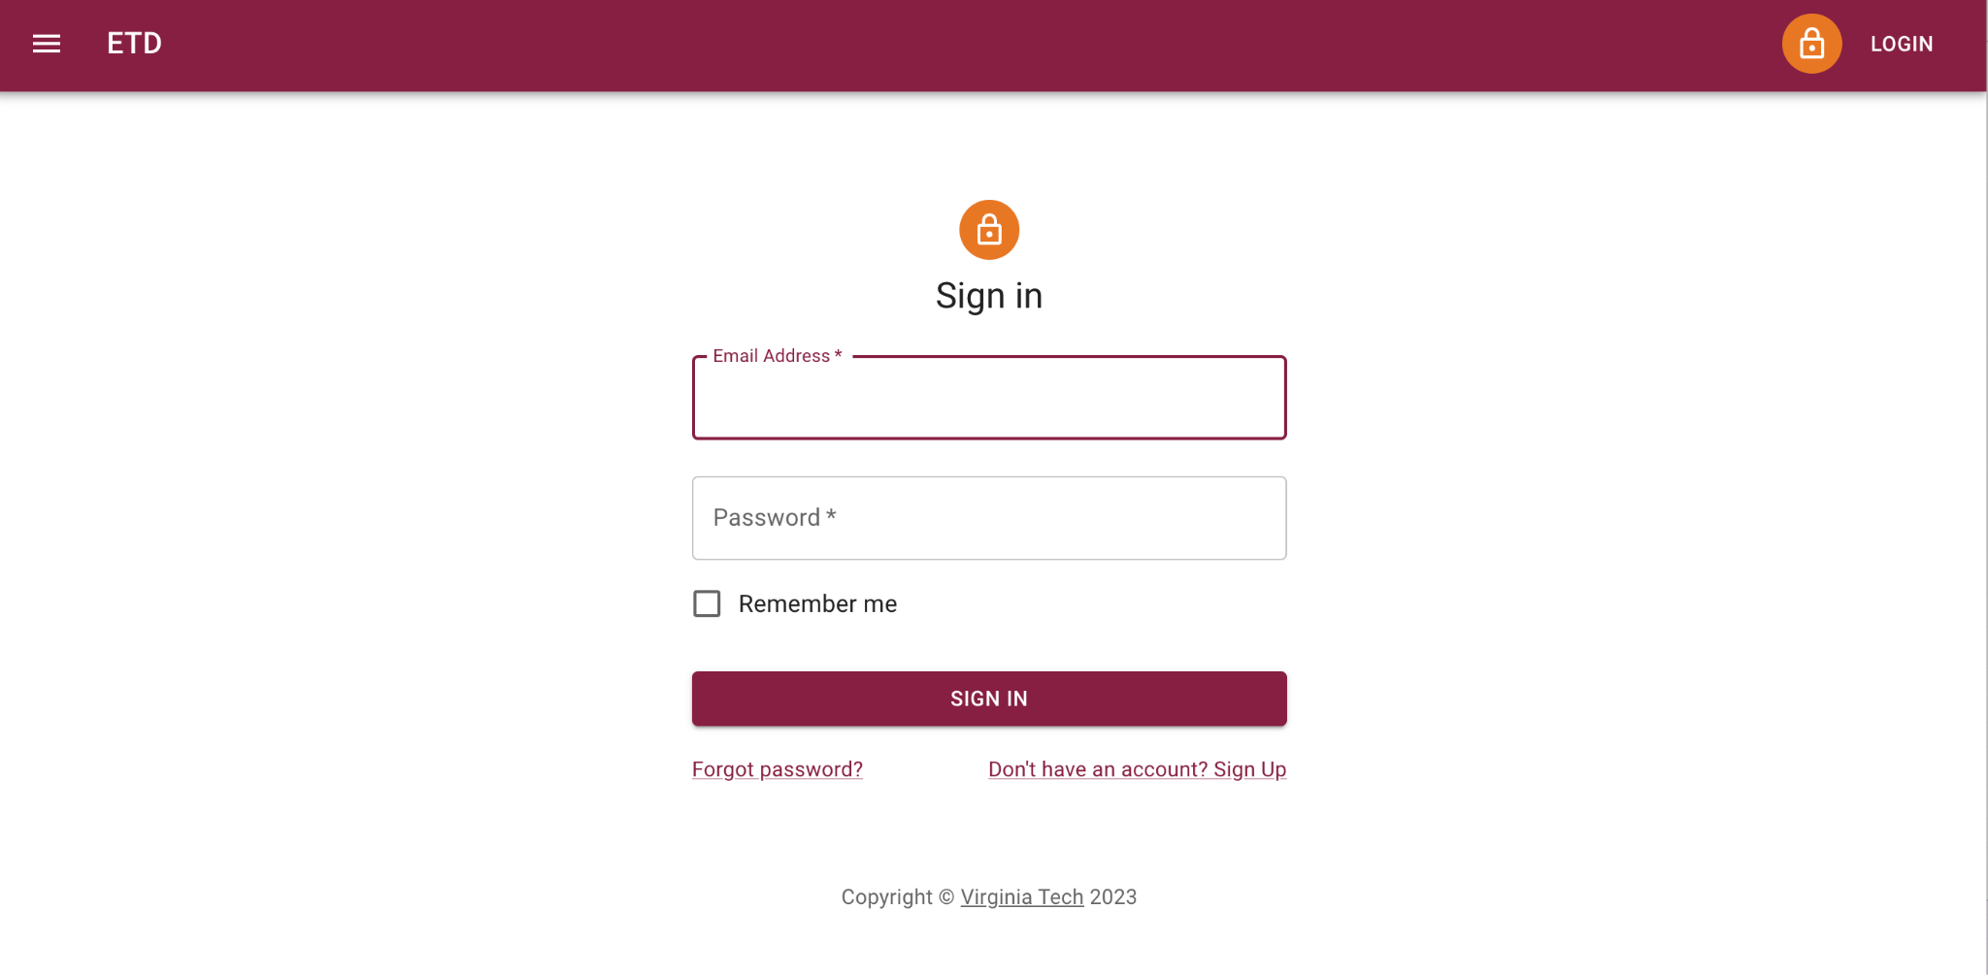
Sign in Page
The first page a user is taken to is the Sign in page; they will not be able to access any other pages until they get through this screen or chose to sign up
Figure 1

Slide 12
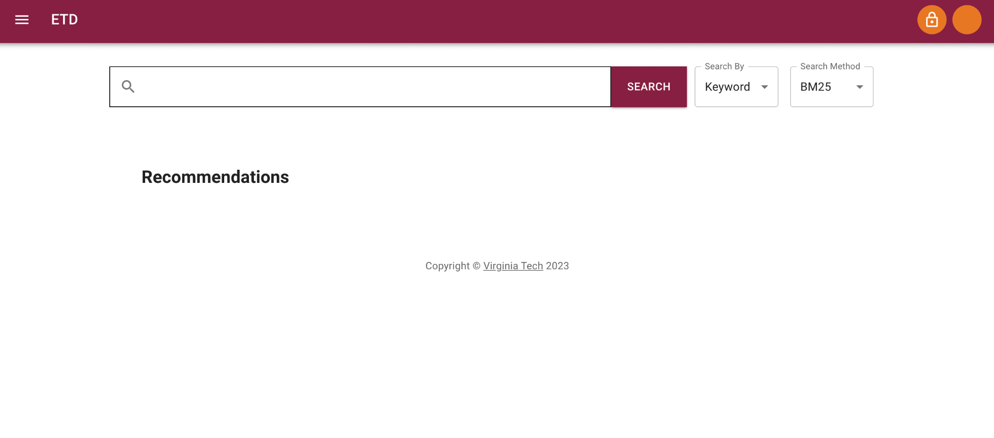
Interface for General User
Once a user is signed into the system, they are taken to the search and recommendations page
Figure 2

Slide 13
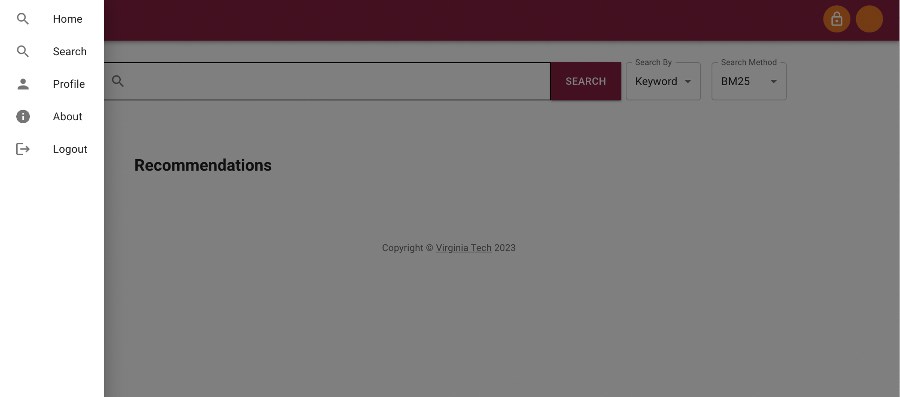
Menu for General User
If the user is a general user, these are the menu options they will be limited to (no access to experimenter or curator pages)
Figure 3

Slide 14
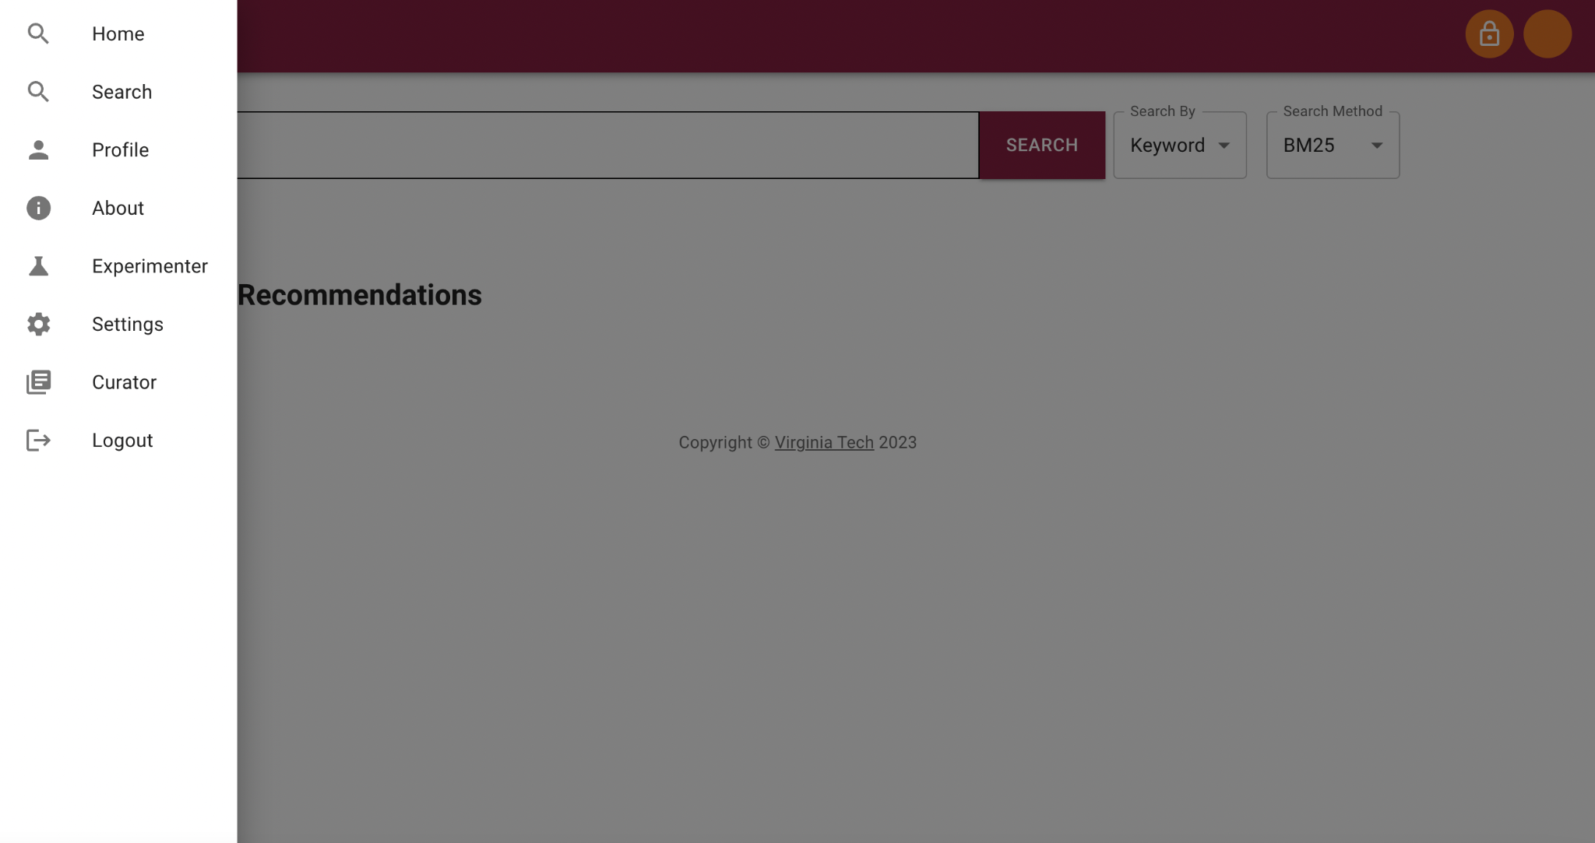
Menu for User with Experimenter and Curator Permissions
If the user is an experimenter or curator, they will be able to see more menu options including a Settings page that contains the admin interface
Figure 4

Slide 15
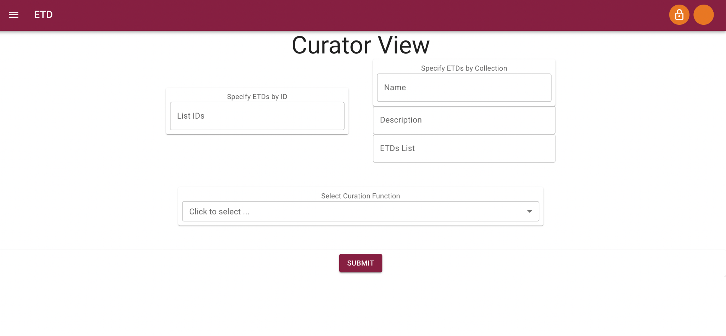
Curator Page
A curator can analyze the ETD system, change, update and upload contents to the collection, as shown in Figure 5
Figure 5

Slide 16
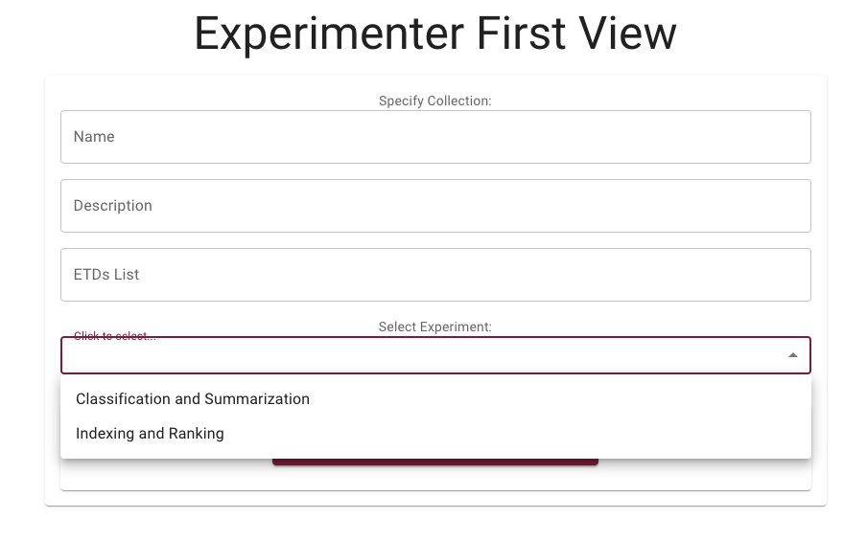
Experiment Type
With feedback from teams, we have created the experimenter pages, shown in Figures 6-9
Here, Experimenter can choose between Classification & Summarization OR Indexing & Ranking experiment
Figure 6

Slide 17
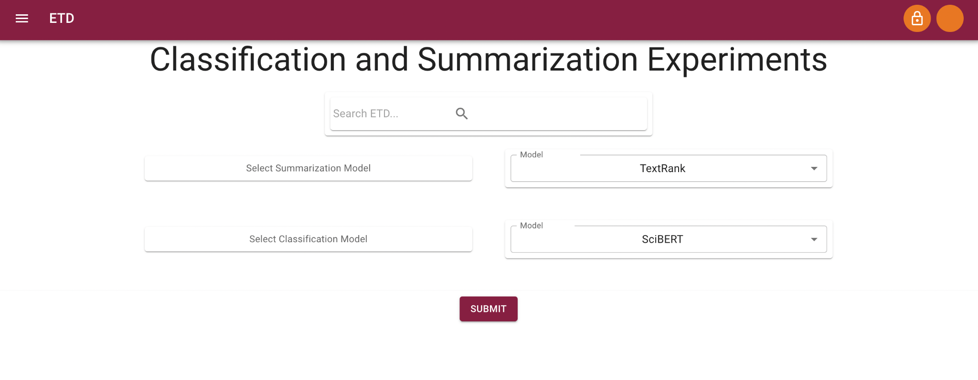
Classification & Summarization Experiment
Based on the Experimenter’s selection from the dropdown options, they are taken to a second page to make the selections specific to their experiment.
Figure 7 shows how an Experimenter can run a Classification and Summarization experiment.
Figure 7

Slide 18
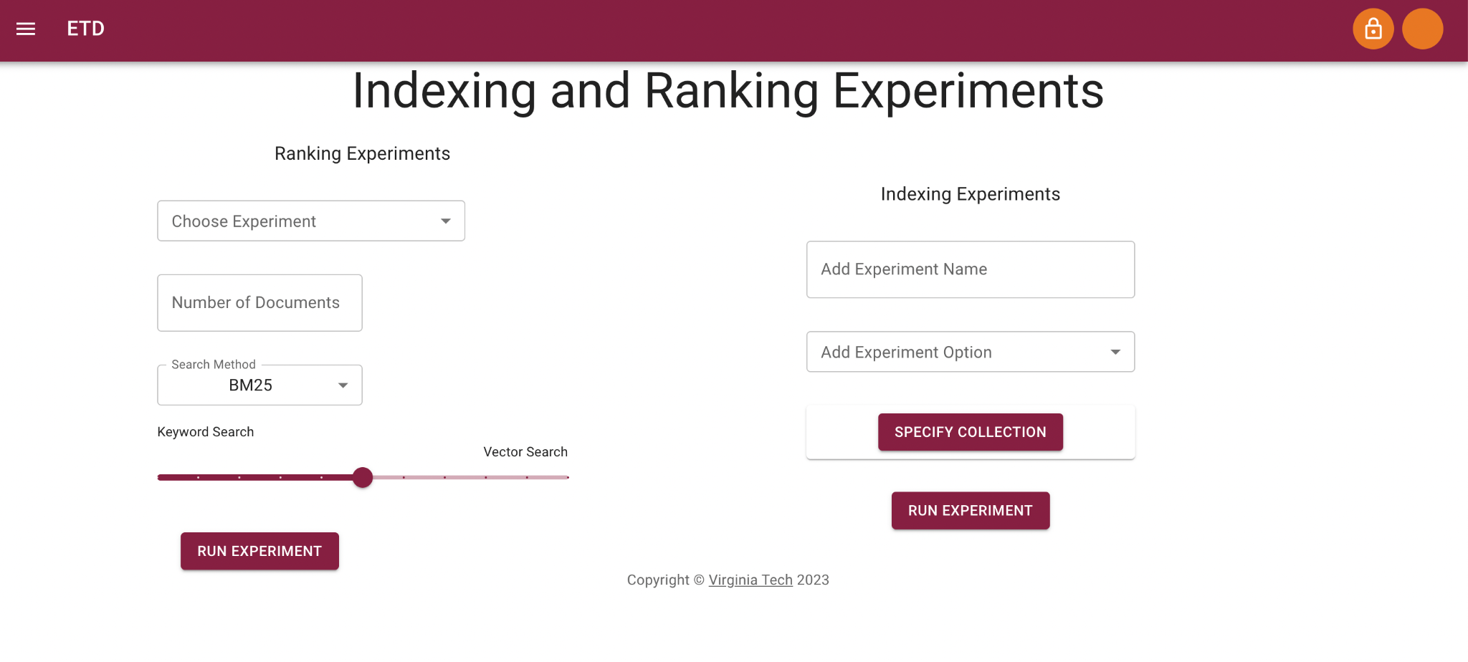
Indexing & Ranking Experiment
Figure 8 shows how an Experimenter can run Indexing and Ranking experiments
Figure 8

Slide 19
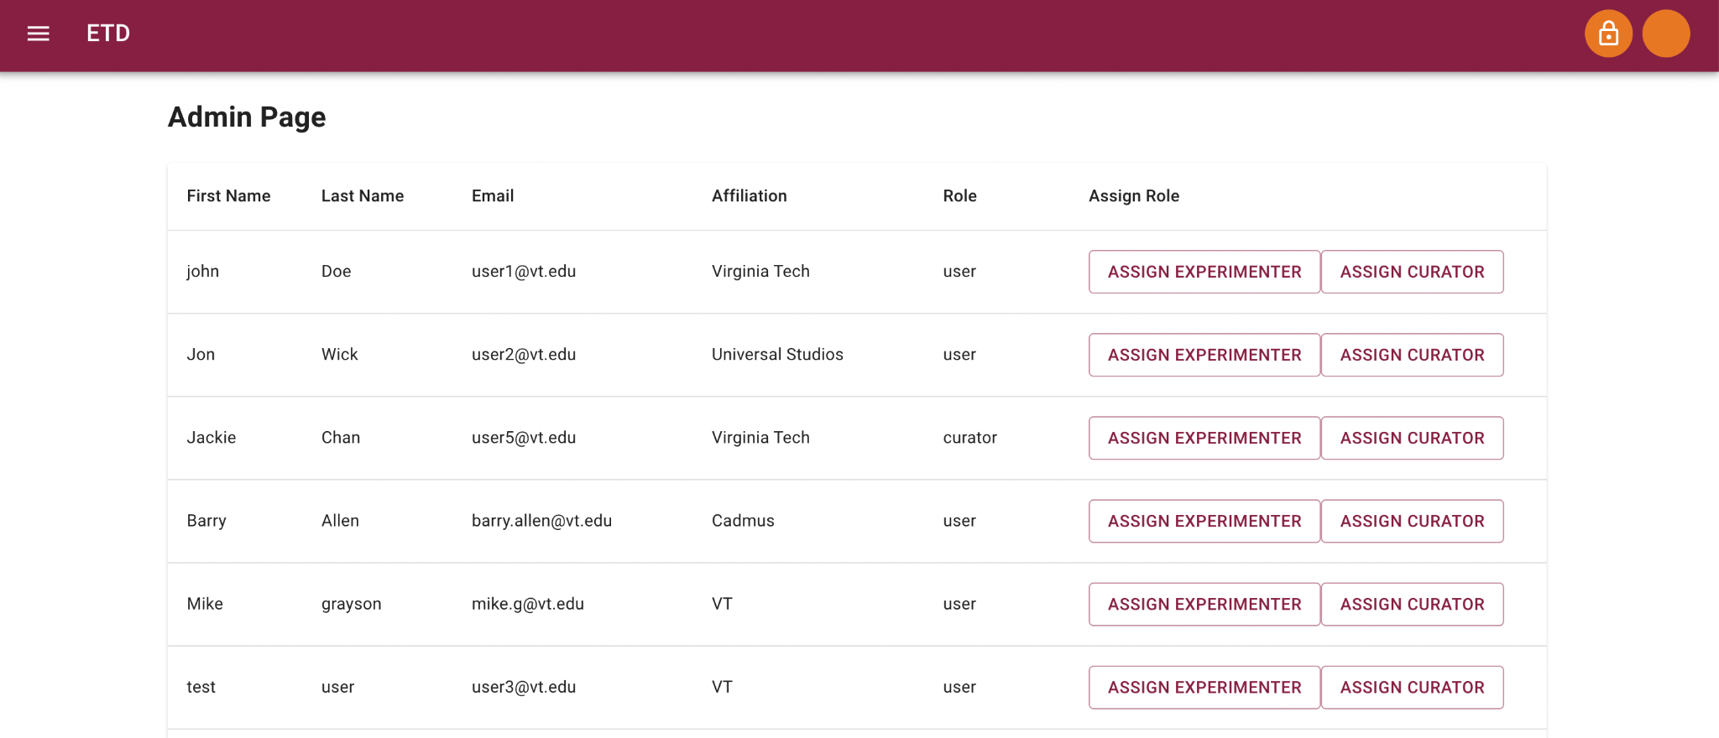
Admin Page
Users with an admin role can also access an admin page, shown in Figure 9, through the settings menu selection. They are then able to assign users experimenter and curator privileges
Figure 9

Slide 20
Signup and Authentication
Team 6 took on a crucial role in revamping the system by establishing a functional signup and authentication system for users. This component, previously dysfunctional in the system's earlier version, was deemed essential for both bolstering security measures and elevating the overall user experience.

Slide 21
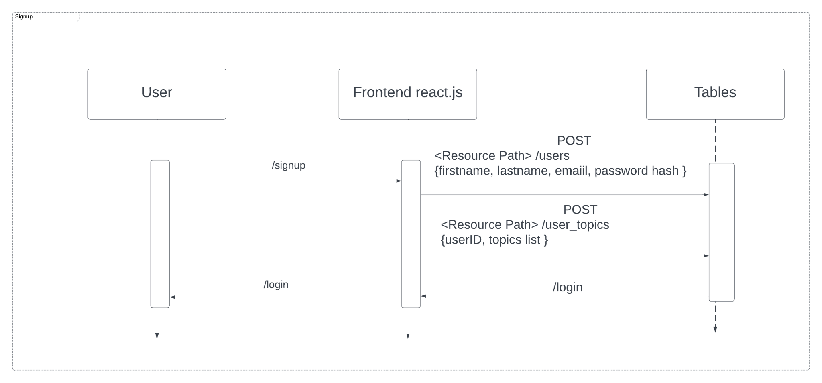
Quote Callout
Designing the Login and Signup Process
UMLs were created in collaboration with Team 5 to decide how the frontend would communicate with the database to handle permissions
Signup UML

Slide 22
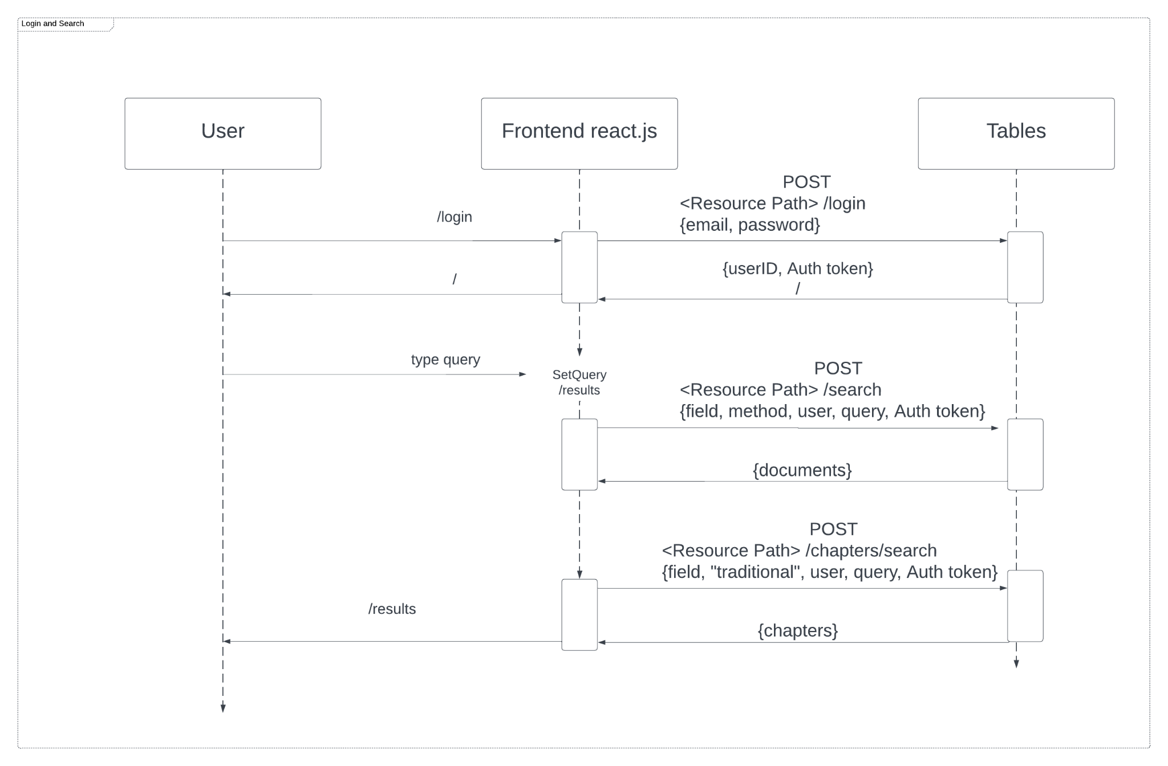
Quote Callout
Designing the Login and Signup Process
Login UML

Slide 23
Quote Callout
Designing the Login and Signup Process
Another addition to the signup were topics of interest a user could select based on topic modeling done by Team 3 and categories based on the ProQuest categories that would help with Team 2’s recommendation system.

Slide 24
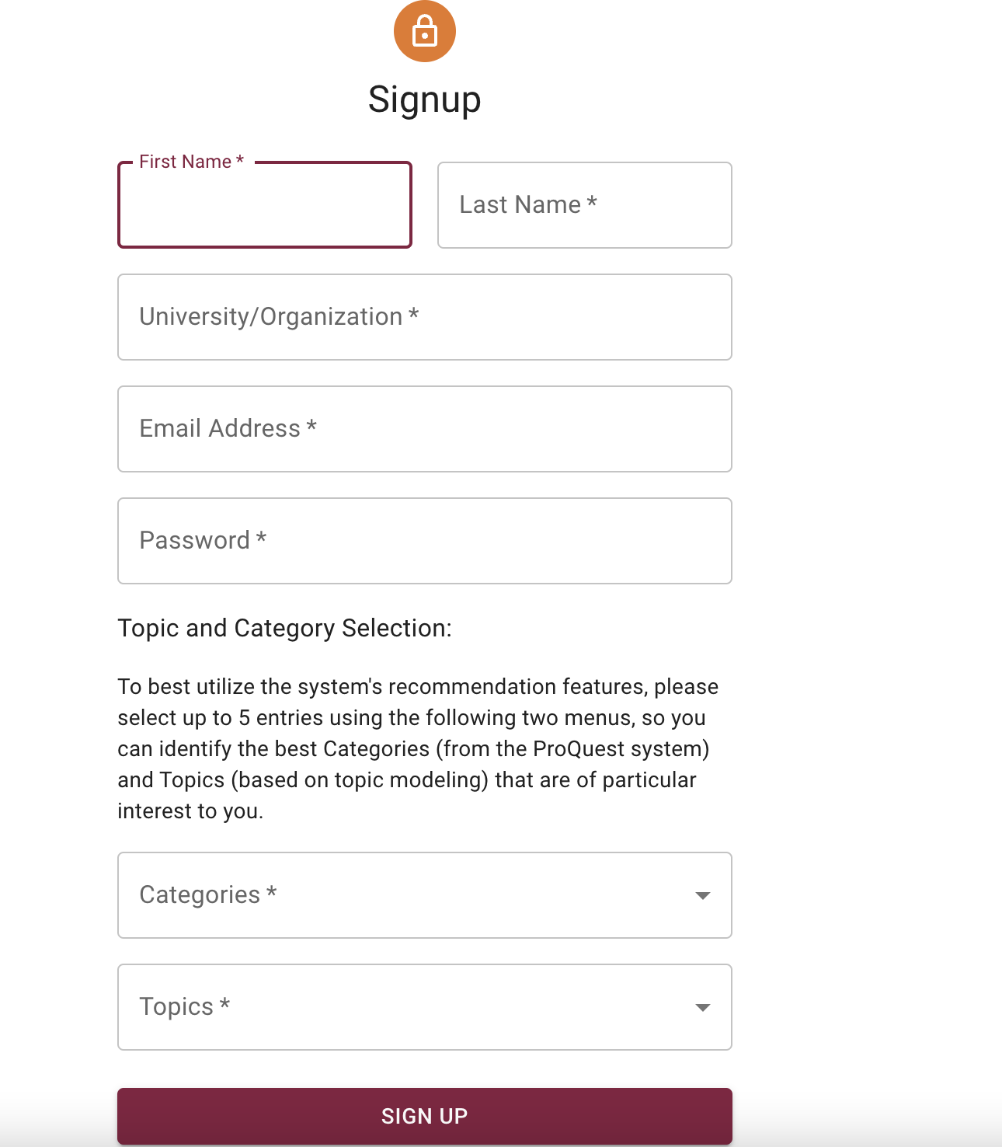
Quote Callout
Designing the Login and Signup Process

Slide 25
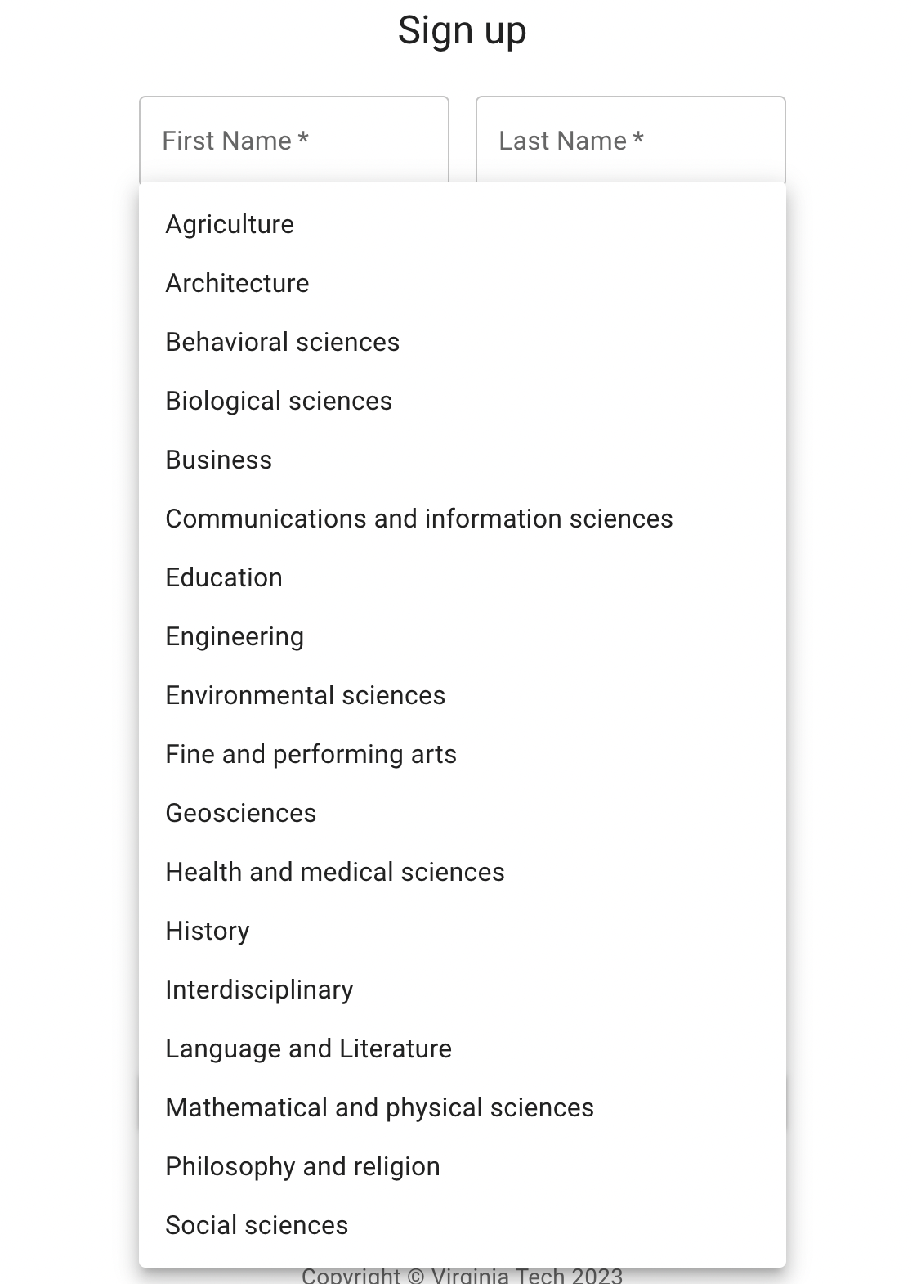
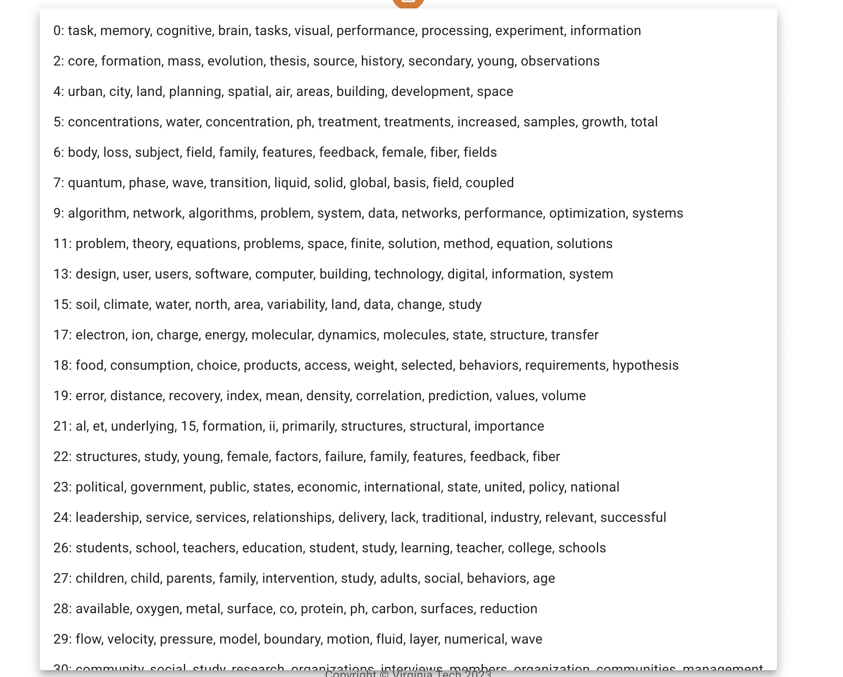
Quote Callout
Designing the Login and Signup Process
ProQuest Categories
Topic Modeling Topics

Slide 26
Summary of Main Accomplishments
In collaboration with other teams, we achieved the consistent single UI goal
Created the new curator UI
Created an Admin UI to view users and assign roles
Separated general user and user-specific recommendation searches
Created the new Experimenter pages
Enhanced the Authentication and restricted access to Curator, Experimenter and Admin pages
Improved the ProQuest categories and topics for user during signup to support user recommendations

Slide 27
For Future Work
Administrator working with reports and analyzing trends
Proper logging and recording of user actions
Topic Modeling User Interface
Testing and improving experiments pages
More secure login system
Limiting user access to only verified users

Slide 28
Thank You for Your Assistance
Professor Fox
Xiao Liang
Team 5
Nikhil Ram

Slide 29
Questions?

