Slide 1
CS4624
SharkPulse Enhancement
Multimedia, Hypertext, and Information Access Capstone
Instructor: Dr. Edward A. Fox
Virginia Tech, Blacksburg VA 24061
5/08/2022
By: Omar Kalbouneh and Madison Marshburn

Slide 2
Outline
Client
Problem
Deliverables
Timeline
Completed Work
Challenges
Acknowledgements
References

Slide 3
Quick Reminder- Client
Dr. Francesco Ferretti
Department of Fish and Wildlife conservation
Interested in building largest database of online shark sightings

Slide 4
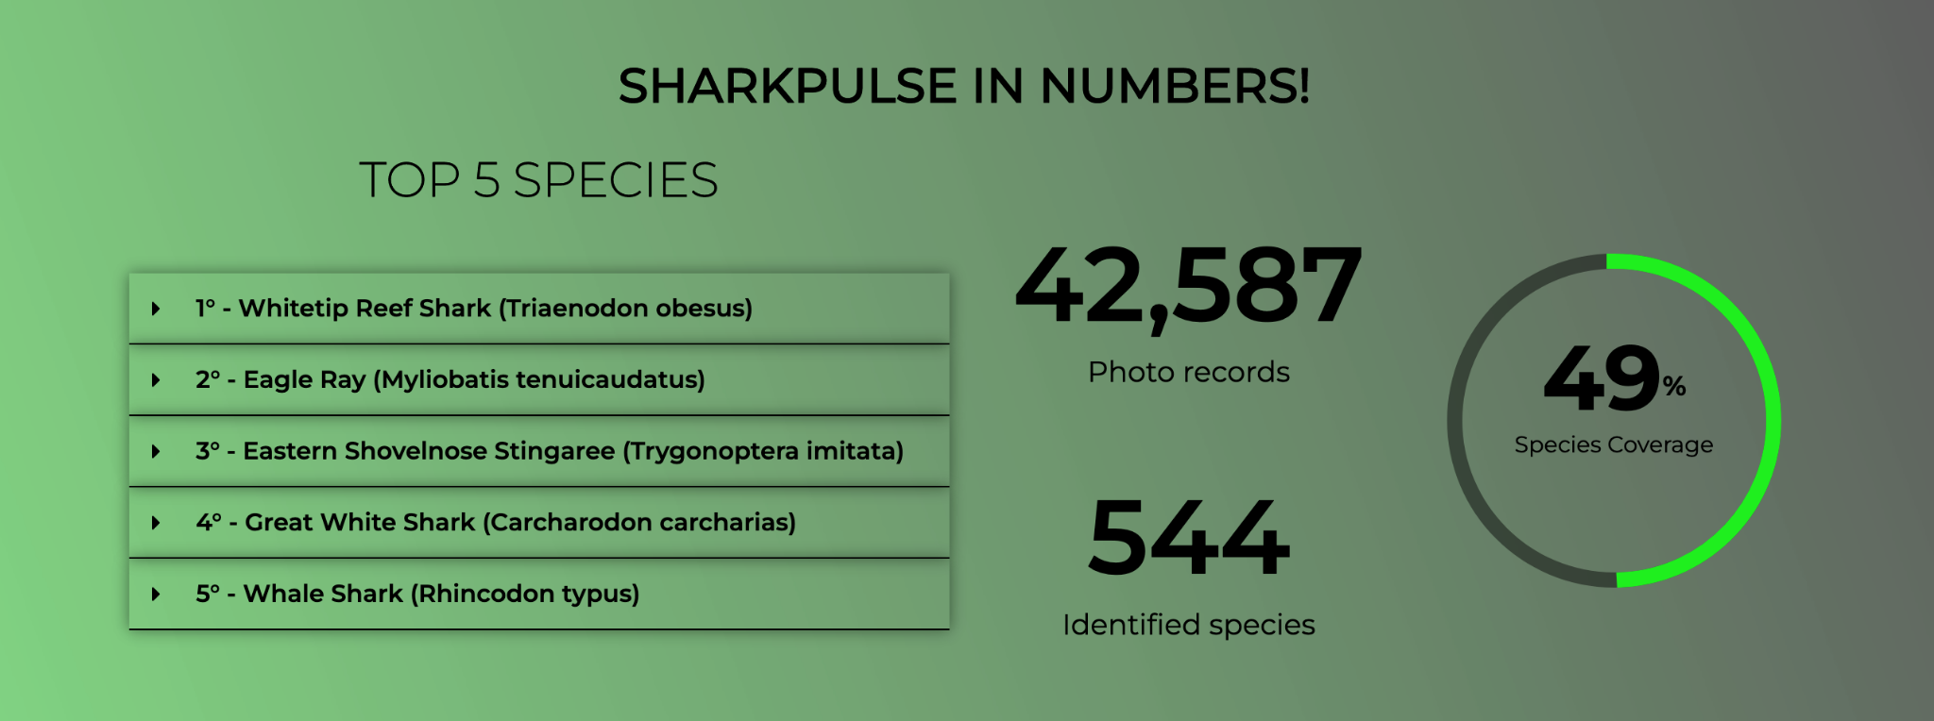
Problems
Improving/Gamifying validation monitor
Static Website
Current shark identification guide

Slide 5
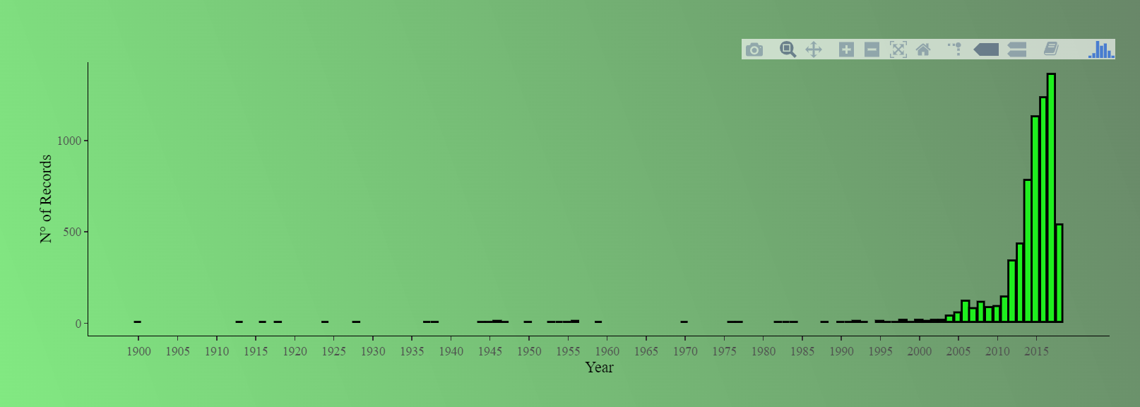
Deliverables
Dynamic Website
Improving/Gamifying validation monitor
Refining the point system for the validation monitor
Example of a figure in the webpage that is not dynamic

Slide 6
Timeline
February
  Familiarized ourselves with the codebase and R
March:
  Started enhancements on the validation monitor
  Begin adding dynamic functionality to website
April:
  Completed enhancements on the validation monitor
  Continue adding/optimizing features
  Started enhancements for the identification guide
May
  Complete website frontend/backend development
  Final meeting with client to ensure longevity of our work

Slide 7
Work Completed for the validation monitor
Added functionality in the backend to score points for
  Users who find rare species. 9 points
  Users who find threatened species that are:
    Vulnerable. 9 points
    Endangered. 10 points
    Critically endangered. 12 points.

Slide 8
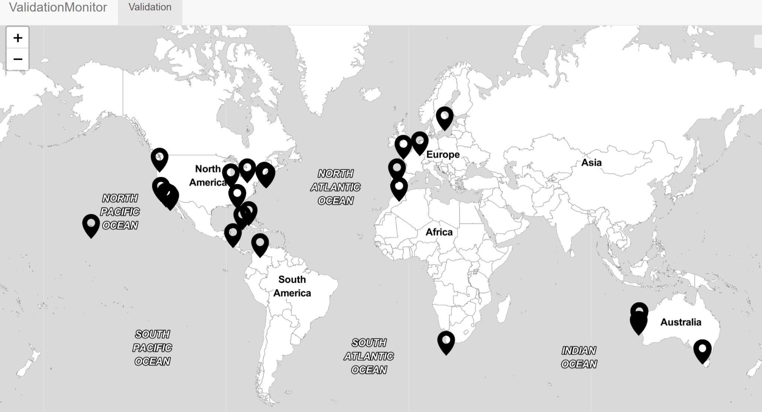
Validation monitor Map

Slide 9
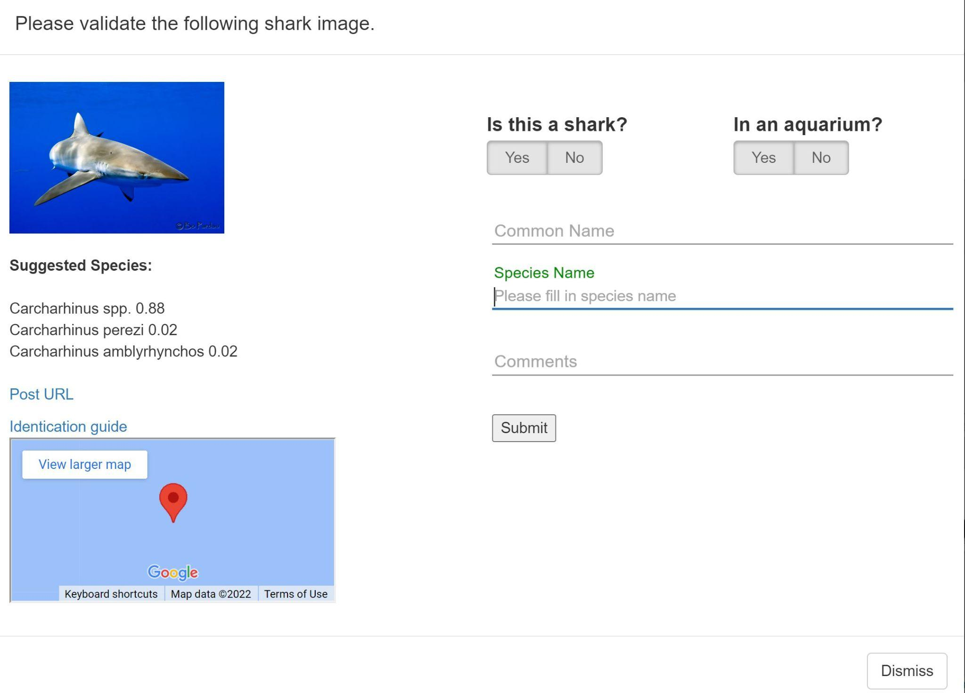
Validation Monitor User Questions

Slide 10
How was it done?
Rare Functionality
  Front end file sends a query to count number of user input species we have in the validated table in the database
  Front end file sends the query to count the total number of species in the database
  Both numbers will be divided
  Baseline is set at 30%. Anything less than that is rare

Slide 11
How was it done?
Endangered, critically endangered and vulnerable species
  Built an in memory web browser data structure to store these lists obtained from IUCN red list of threatened species
  User input is passed a POST request from a backend R file
  Input is checked if it fits either category
  Updates the user points in the database

Slide 12
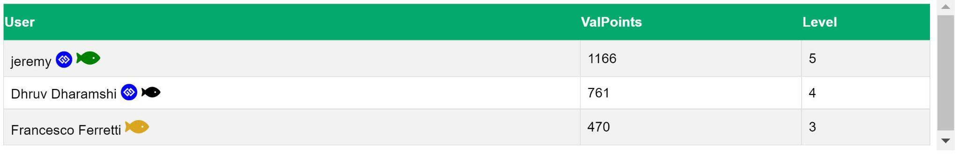
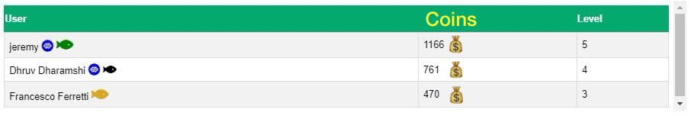
Leader-Board New Changes

Slide 13
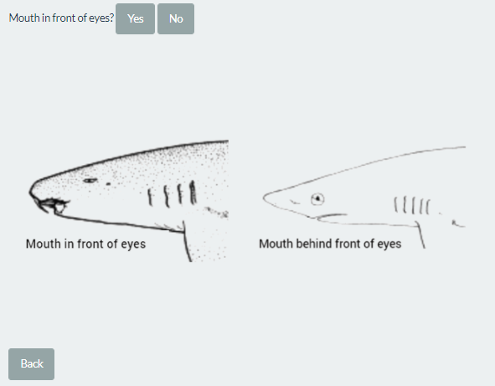
Identification guide

Slide 14
Identification guide
Implemented in an R script for using an Rshiny app
Filled a shark characteristics spreadsheet
Builds an in-memory data structure to process entries
Present new questions on the website

Slide 15
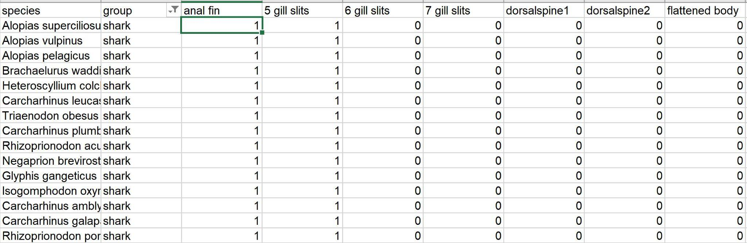
Spreadsheet example
1 = present
0 = not present

Slide 16
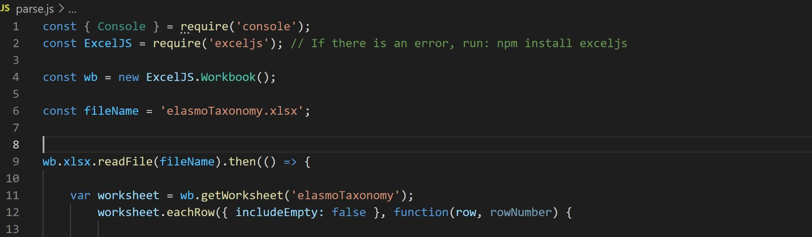
Small example of how contents were parsed

Slide 17
Challenges
New languages and frameworks
Not all team members were available
Website server often crashes because of too many database requests between PostgreSQL and R.

Slide 18
Acknowledgements
Dr. Francesco Ferretti
Jeremy Jenrette
Aman Kothari
Dr. Edward Fox

Slide 19
References
http://hdl.handle.net/10919/103254
IUCN. 2021. The IUCN Red List of Threatened Species. Version 2021-3. https://www.iucnredlist.org.
https://www.iucn.org/resources/conservation-tools/iucn-red-list-threatened-species
http://sharkpulse.cnre.vt.edu/

