Slide 1
PITDASH:
LIVE SURGERY
DASHBOARD
Capstone Project - Spring 2025
Group 4
Guided by Dr. Prof. Sara Hooshangi
Group Members:
Brandon Hoang
Keith Lowry
Hansa Pradhan
Revati Bhavsar
Sudarshan Manavalan
Tesha Yeboah
Yash Kulkarni
Asmi Panigrahi

Slide 2
Table of contents
01
02
03
04
Introduction
System Design
Demonstration
05
Conclusion
Lessons Learnt and Reflection

Slide 3
01
Introduction

Slide 4
Introduction
Live surgical videos often lack real-time feedback or analytics
Students struggle to identify tool usage patterns from raw footage
Manual video review misses frame-level tool movement insights
Our platform brings real-time and post-op intelligence to surgical learning
Notes:
Our goal is to transform how surgical videos are used in education. Traditionally, reviewing these videos doesn’t provide tool-specific insights or real-time analytics. Our platform livestreams surgeries and automatically detects instruments in use — tracking their movements, logging the frames they appear in, and showing where on the screen they were used. Students can also upload recorded surgeries to get deep post-op analysis, such as tool frequency, duration, and motion paths — all of which help them understand surgical techniques better. It’s a tool built for both professors and learners to make brain surgery education more visual, interactive, and data-driven.

Slide 5
Project Goals & Target Users
Goal: Provide automated analysis of live and recorded surgery videos
Targeted at professors, medical students, and surgical trainees
Aims to enhance surgical teaching with data-driven insights
Supports better understanding of tool usage patterns and importance
Notes:
Our platform is designed primarily for professors and students in medical education. It provides them with real-time or post-video statistics that break down how and when specific tools are used in surgery. This not only highlights the critical instruments for a given procedure but also allows students to follow patterns, understand techniques, and learn surgeries through precise frame-level feedback.

Slide 6
What Makes Our Platform Unique
Livestreams surgeries with real-time instrument detection
Upload video for deeper, frame-by-frame analytics
Tracks tools with precise XY coordinates and motion traces
Displays interactive graphs per tool and usage timeline
Our 90s commercial video: Click Here
Notes:
What makes our project unique is its ability to handle both real-time and recorded surgical videos, while giving users a detailed breakdown of what’s happening — moment by moment. The platform traces tools, logs their coordinates, and shows multiple graphs per tool for different types of insights. With a full-stack architecture powered by FastAPI and OpenCV on the backend and React on the frontend, it's fully deployable and ready to scale within the surgical education ecosystem.

Slide 7
02
System Design

Slide 8
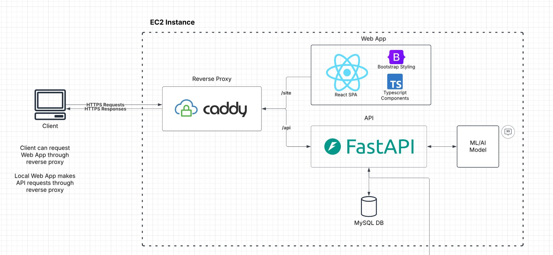
Project Deployment Block Diagram

Slide 9
Frontend
UI Pages:
Main page, Livestream page, Upload Video Page, Save Dashboard page
Tech Stack
Key Features
Focus
Pipeline
React.js
Recharts/Plotly
Tabulate
Responsive UI for desktop and tablet
Real-time data visualizations and charts
User-friendly dashboard navigation
Clean design
Easy navigation
Video Stream
|
Frame Extraction
|
ML Prediction
|
Annotation
|
API Response
Notes:
Slide: Frontend
Script:
Our frontend is built using React.js and styled with Bootstrap and Recharts for visualizations. It includes key pages like the main dashboard, livestream, and upload pages. The UI is designed to be responsive and intuitive, showing real-time tool usage data in charts. Our frontend pipeline starts from a video stream, extracts frames, runs ML predictions, and shows results instantly through annotated visuals and graphs.

Slide 10
Backend
Routes
Preprocessing Videos
DB Storage + Retrieval
/session: start, get, end an analysis session; sessions can be recorded (video upload) or (live)streamed
/video: upload video for analysis and get analysis tuples back
/stream: start or end a stream session, send individual images to get analysis on
Split video into a set number of frames and feed to model individually
Use MySQL connector Python library, use pool of connections
Hide query functionality in Repository file
Notes:
Slide: Backend
Script:
The backend is built with FastAPI and handles three main routes — for managing sessions, processing uploaded videos, and live streaming. Videos are split into frames, and each frame is sent to our ML model for analysis. Results are stored in a MySQL database using pooled connections, with queries abstracted in repository files for modularity and performance.

Slide 11
Machine Learning
Dataset
Accuracy
Cholect45
mAP@50: 87.2%
Precision: 91.2%
Recall: 83.2%
Model
YOLOV5
Notes:
Slide: Backend
Script:
The backend is built with FastAPI and handles three main routes — for managing sessions, processing uploaded videos, and live streaming. Videos are split into frames, and each frame is sent to our ML model for analysis. Results are stored in a MySQL database using pooled connections, with queries abstracted in repository files for modularity and performance.

Slide 12
03
Demonstration

Slide 13
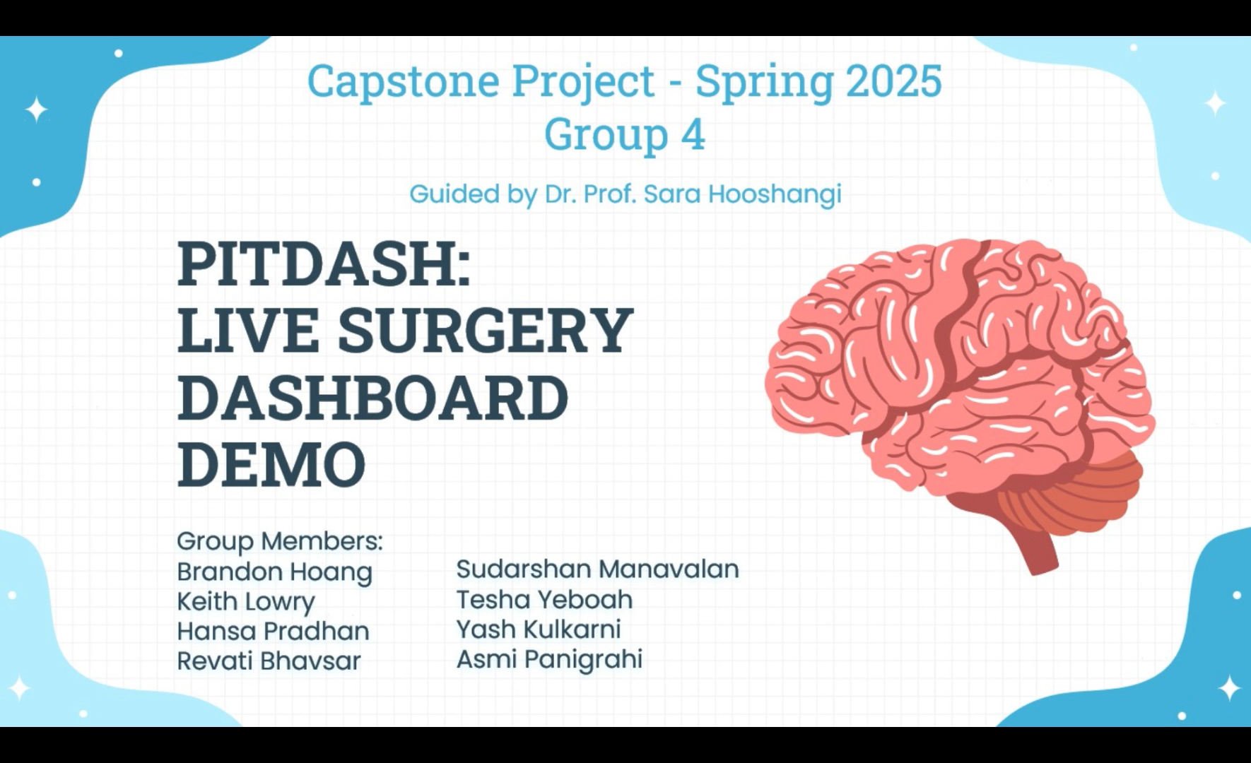
Demo Video

Slide 14
04
Lessons Learnt & Reflection

Slide 15
Reflections
Discovery of the problem
Early research
First Implementation
Minor Breakthroughs
MVP Building
External Challenges
Current refinement
Future directions

Slide 16
06
Conclusion

Slide 17

Lessons Learned
Clear Communication is Crucial Across Teams
Task Assignment and Ownership
Agile and Git Practices Matter
Learnt about AWS Deployment
Integrating ML prediction Model in Full stack project
Real time Livestream
Notes:
Our goal is to transform how surgical videos are used in education. Traditionally, reviewing these videos doesn’t provide tool-specific insights or real-time analytics. Our platform livestreams surgeries and automatically detects instruments in use — tracking their movements, logging the frames they appear in, and showing where on the screen they were used. Students can also upload recorded surgeries to get deep post-op analysis, such as tool frequency, duration, and motion paths — all of which help them understand surgical techniques better. It’s a tool built for both professors and learners to make brain surgery education more visual, interactive, and data-driven.

Slide 18
Resources
Datasets
https://github.com/CAMMA-public/cholect45
https://rdr.ucl.ac.uk/articles/dataset/PitVis_Challenge_Endoscopic_Pituitary_Surgery_videos/26531686
Research Papers and Inspiration
https://www.nature.com/articles/s41598-022-11549-2
https://jamanetwork.com/journals/jamanetworkopen/fullarticle/2790172
https://pmc.ncbi.nlm.nih.gov/articles/PMC11550325/

Slide 19
Thank You!
Capstone Project - Spring 2025
Group 4
Guided by Dr. Prof. Sara Hooshangi
Group Members:
Brandon Hoang
Keith Lowry
Hansa Pradhan
Revati Bhavsar
Sudarshan Manavalan
Tesha Yeboah
Yash Kulkarni
Asmi Panigrahi

