Slide 1
Creative Convergence
Conducting a systematic review project through cross-institutional, distance collaboration
This presentation is
licensed CC-BY 4.0

Slide 2
Objective
To reflect on a cross-institutional systematic review project:
What are effective collaboration methods for geographically dispersed research teams?

Slide 3

We compared our experiences to literature on collaborative research:
Benefits
Challenges
Team Characteristics
Success Factors
Best Practices
Notes:
We end with example tools for collaborative projects

Slide 4

Benefits
Our Team Experience
Our Project
Systematic Review on:
Effective Library Instruction for EBP Health Sciences Education
New Perspectives
International Networking
SR Experience
Build Technical Skills
Publication Opportunities
Notes:
We noted many benefits to our team experience - both for its goals and for the experience of working in a dispersed, collaborative research project
Diverse knowledge and experiences
International Networking
Working through entire systematic review process
Learning new software
EndNote
Applying lessons learned in using software, completing a systematic review to teaching about systematic reviews with students and faculty
Opportunity for publication/recognition in the greater profession
Contributing to a project that can have long term impact

Slide 5
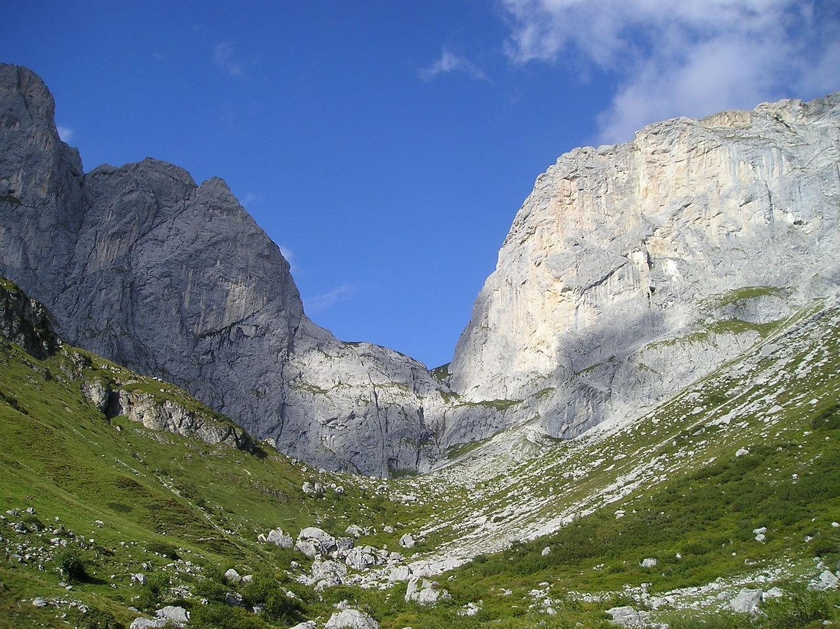
SR Project Specific Challenges
Ambiguity of concepts
Duplicate citations
Lack of abstracts
Varied Educational Interventions
Copyright questions
Notes:
Our project had several specific challenges
Ambiguity of concepts
Duplicate citations
Articles lacking abstracts
Educational intervention varied study methodologies
Copyright questions about sharing full text

Slide 6
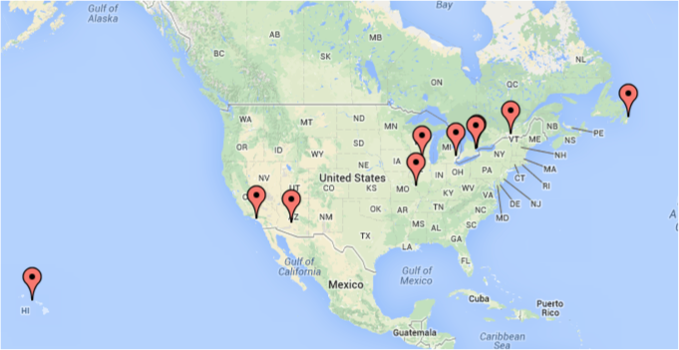
Team Collaboration Challenges
Large, Dispersed Team
Diverse knowledge & Experience
Geography
Methodology Development
Ambitious Timeline
Work/Life Conflicts
Decisions - Maintaining Consistency
Notes:
Large team
Diverse knowledge and experience
Geography and Time Zones
Did not have initial agreed upon method for conducting a SR
Ambitious timeline
People have different work/life priorities and it can be tricky to work as a team because of this
Recording and sharing group decisions in a manner that ensured subsequent consistency in following those decisions
MLA Research Agenda
2012
Delphi Study
Surveys to MLA leaders and researchers
Came up with 15 questions
Organized teams for each of the 15 questions to perform systematic reviews
Eldredge JD, Ascher MT, Holmes HN, Harris MR. The new Medical Library Association research agenda: final results from a three-phase Delphi study. J Med Libr Assoc. 2012 Jul;100(3):214-8. doi: 10.3163/1536-5050.100.3.012.

Slide 7
Lit Review
What is being written about effective methods for cross-institutional, distance research team collaboration, including:
dispersed locations and time zones?
different institutional resources and policies?
Notes:
We looked to the literature to find out: what challenges, benefits, and best practices have other teams found? Large, interdisciplinary, geographically dispersed research teams seem to be becoming more and more common - is there research on optimal methods for collaboration?

Slide 8
Searching the lit
After trying various options to get to literature *about* how research teams collaborate effectively, especially across institutions and space:
research collaboration
cross institutional collaboration
collaborative research
online collaboration
Notes:
Searching for collaboration methods for distance, inter-institutional collaboration was at first a bit tricky

Slide 9
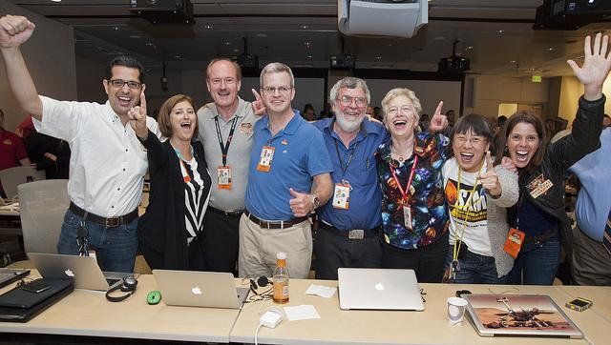
Team Science!
Notes:
Found an article by Stokols on Team Science. Team science is a growing research practice
https://flic.kr/p/dxvmRd

Slide 10
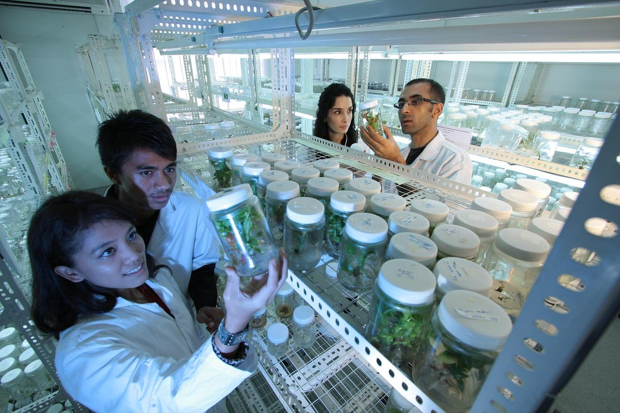


“The rapid proliferation of scholarly knowledge and the increasing complexity of social and scientifıc problems have prompted growing investments in team science initiatives.”
Team-based research with multiple disciplines may accelerate progress towards resolving complex societal and scientific problems
Hall, et al., 2012
Shift in how science is being conducted - teams increasingly dominate in production of high-impact, highly cited science; teams are growing in size, and are increasingly located across university boundaries rather than within them.
Borner, et al., 2010
Notes:
Team science seemed to reflect the concept we wanted to learn more about: dispersed research teams, related to the fields of science, health science, and education.

Slide 11
How might Med Libs
participate in
Team Science?
Notes:
Your own collaborative research
Librarians support collaborative research
Supporting team science
Supporting SR teams
Data management tie in
Online ed tie in
Health Sci Ed tie in

Slide 12
SciTS
Why developed
Definition
Momentum
Notes:
SciTS - The Science of Team Science is an expanding field that is closely linked to many areas of interest for medical librarians: embedded research team support, data management, knowledge management and transfer, research methods, collaboration and data collection tools, archiving and access to generated outputs
“Practical concerns about gauging the value added and the return on investment accruing from large research initiatives (4,26,32) have given rise to the science of team science , a rapidly emerging yet still-amorphous field characterized by a lack of consensus about its defining substantive boundaries and core concerns.” S77 Stokols sci of ts 08
The “science of team science” (SciTS, pronounced “sahyts”) is an emerging area of research centered on examination of the processes by which scientific teams organize, communicate, and conduct research (7–9). The field is concerned with understanding and managing circumstances that facilitate or hinder a range of collaborative research efforts—from determining the effectiveness of large-scale collaborative research, training, and translational initiatives to understanding how teams connect and collaborate to achieve scientific breakthroughs that would not be attainable by either individual or simply additive efforts. Borner 2010
“Analyses revealed differences in number and timing of publications, as well as coauthorship patterns, between NIH-funded transdisci-plinary center grants and investigator-initiated research grants in the same fıeld, suggesting that despite an initial lag in productivity, the transdisciplinary center grant-funding mechanism afforded overall advantages for productivity and collaboration.” Hall 2012

Slide 13
Characteristics of Team Science
Lit review
Large teams - from a few to 50, to 200, to more!
Multiple projects
Multiple disciplines
Different departments, institutions, and geographic locations
Diverse goals - discovery, training, translational/public health, policy
Team
Large team
Diverse knowledge and experience
Geography
Ambiguity of research focus
Methodology discussions
Notes:
The team’s view of its characteristics and that of science teams matches closely
--Although, our team is quite small compared to most science teams, and we are unidisciplinary as opposed to multi-, inter-, or transdisciplinary
Stokols sci of ts 2008

Slide 14
Benefits
Notes:
Lit review
Experience working with others
Build support skills for today’s scientific/research-based/collaborative workplace
Building relationships with other researchers
Expanding professional expertise
Receiving recognition for contributions
Increased productivity (over solo, smaller group or single institution projects)
Building transdisciplinary methods to address complex issues that are often global in scope
Team
Diverse knowledge and experiences
International Networking
Working through entire systematic review process
Learning new software
EndNote
Applying lessons learned in using software, completing a systematic review to teaching about systematic reviews with students and faculty
Opportunity for publication/recognition in the greater profession
Contributing to a project that can have long term impact
Learning about different teaching methods that have, and have not, worked when teaching health sciences students.

Slide 15
Challenges
Notes:
Lit review
Time spent overcoming disciplinary differences and arriving at common understanding of concepts
Communication methods
Distance = slower relationship building
Irregular timelines
Learning new technologies and software for project management, record keeping,
Lack of training for team leaders
Team
Large team
Diverse knowledge and experience
Geography and Time Zones
Did not have initial agreed upon method for conducting a SR
Ambitious timeline
People have different work/life priorities and it can be tricky to work as a team because of this
Recording and sharing group decisions in a manner that ensured subsequent consistency in following those decisions

Slide 16
Factors for success
Intrapersonal (internal motivations and individual attitudes)
Interpersonal (interactions among team members - communication, learning, work jointly to accomplish goals)
Physical environment (spatial distribution)
Technological (technical infrastructure and support)
Organizational (influence of team member’s institution as well as make-up and org of team itself)
Political/Societal
Stokols, D., Misra, S., Moser, R. P., Hall, K. L., & Taylor, B. K. (2008) Ecology of Team Science
Notes:
Stokols et al’s framework of success factors is a founding model for SciTS
Lit Review & Team
Sponsor support in vision, goals, infrastructure, ongoing assessment
Leadership styles of center directors (team leaders)
Leader’s project management, background knowledge, and regular communication and progress tracking
Generate and sustain trust
Inclusiveness and enthusiasm
Scientists’ (researchers’) commitment to team research
Extent of team members’ history working together on prior projects
Openness, adaptability, willingness to address and resolve conflict
Availability of shared research and meeting space
Electronic connectivity among team members
Allow time for start-up processes - develop collaborative strategies, articulate goals, build up communication and sharing methods and patterns
Group-based process with shared purpose
Clearly defined roles and responsibilities
Leaders: when these change, communicate changes and changed expectations to team
Good performance during project

Slide 17
Recommended Best Practices:
Attitudes
Be open and adaptable
Be willing to learn and participate
Communicate
Address and resolve conflicts
Persevere through difficulties
Additional Team & Lit Review Insights
Notes:
Many articles highlighted simliar ‘attitudes’ or dispositions that promote success in team science
Team
Take time up front to:
Build community - if possible with in-person or f2f video conferencing
Discuss and articulate shared goals
Create a structured plan
Solicit peer review and feedback on plan from those with experience in similar projects
Designate roles and responsibilities
Record keeper
Technology facilitator
Online meeting facilitator
Set up regular meeting times
Determine software to be used for collaboration and for team project
Allow time for or arrange for training
Estimate and commit to expected time requirements
Record, communicate, and reinforce decisions made to ensure consistency in processes and support shared trust
Plan for disruption
Plan to adapt and change tasks, timeline to some extent during project - example: different academic instituions have different leave times and periods of high activity; consider how to cover during unexpected circumstances (family emergencies, etc.)
SR-specific
Citation management - software choices early and consider options to share, comment, discuss within software
Make sure that team members have a clear understanding of the concepts within the research question, along with the exclusion and inclusion criteria.
Our team spent some time setting the parameters of the research question (e.g., medical, residents, continuing education, nursing, allied health, academic level, etc.) In particular, while we could agree on a definition of evidence-based practice (as a process), we struggled with separating out the concept of "information literacy" from EBP and determining how much or little of the EBP curriculum had to involve the librarian--all or is the literature searching part enough?

Slide 18
Top 3 Recommendations for
Team Research Sponsors
Train team leaders
Facilitate initial f2f meeting
Provide teams with technological support
Notes:
Provide team leaders with training in research team leadership and project management (including software)
Facilitate initial in-person or f2f (video) meeting introducing project, goals, and assessment
Provide teams with technological support, such as online meeting software, and/or online production/project management environments
Questions for other SR teams / other Science Teams
How many in your group?
How many at each institution?
Range of geographical distribution?
Communication methods and tools?
Project management, record keeping, and production tools?
Citation / Data Management tools?

Slide 19
Tools - What we used
Communication
Email
Online meeting software - …(often audio only)
Recommendation: Use video options when possible, include asynchronous methods such as Google group, discussion board
Record Keeping and Production
Google Drive
  Documents
  Spreadsheets
Wiki - some use at beginning, but set up and use had higher barrier than Google Drive options
Consider: project management platform
Citation Management
EndNote and EndNote Web
Recommendation: Consider platforms that allow for comment, annotation, and full text sharing within restricted group

Slide 20
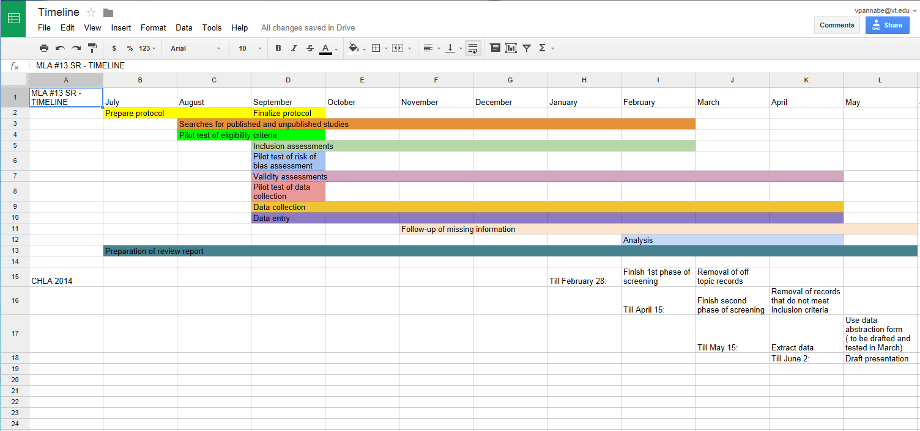
Project Planning
Example timeline at project level

Slide 21
Project Planning
Example task-specific timeline
Example:
Preparing a search strategy for 1 database (LISTA via EBSCOHost) based on the group’s model strategy for PubMed/Medline
  3 hours (mainly due to need to adjust MeSH to appropriate LISTA headings)
Conduct 1 database search and post the results for the group
  15 minutes
Set up an EndNote Web account and become familiar with using it
  30 minutes
Title/Abstract Review of 100 abstracts
  1.5 hours
Full Text Review of 10 articles (for inclusion/exclusion)
  1.5 hours
    Additional time to pull full text / request via ILL: 30 minutes with possible wait time of 1-14 days to receive ILL response
Data extraction for 1 article
  30 minutes
Critical appraisal for 1 article
  15 minutes
Example expectation - title/abstract review time for 500 results: 7.5 hours
Notes:
Consider how long individual tasks will take and adjust initial overall project timeline as needed

Slide 22
Tools: Communication
Consider Online Education recommendations
Asynchronous
  Discussion forum
  Email list - Google group
Synchronous
  Video, audio, chat meeting options

Slide 23
Tools: Communication
Consider Online Education recommendations
Stable
  Group project website, wiki, or planning platform
  Deadlines and goals on front page
Automated
  Shared calendar with reminders

Slide 24
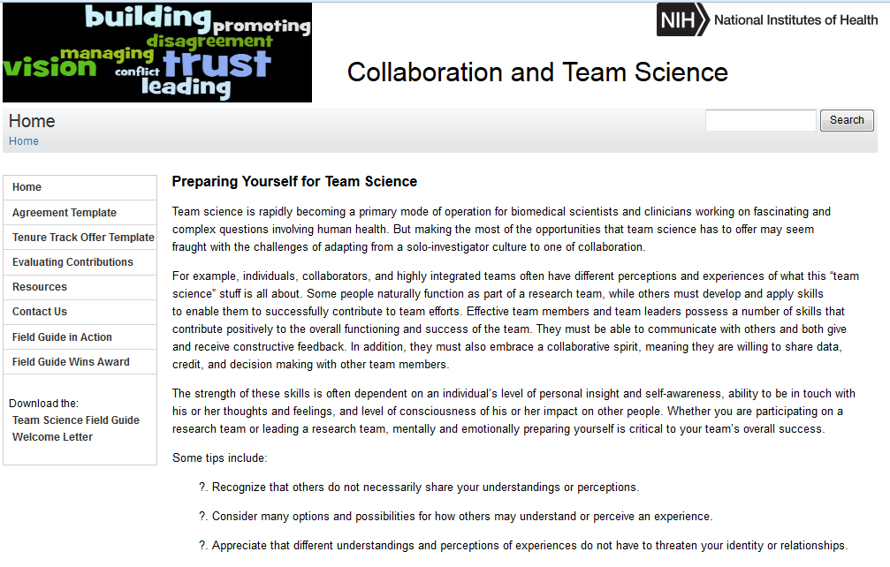
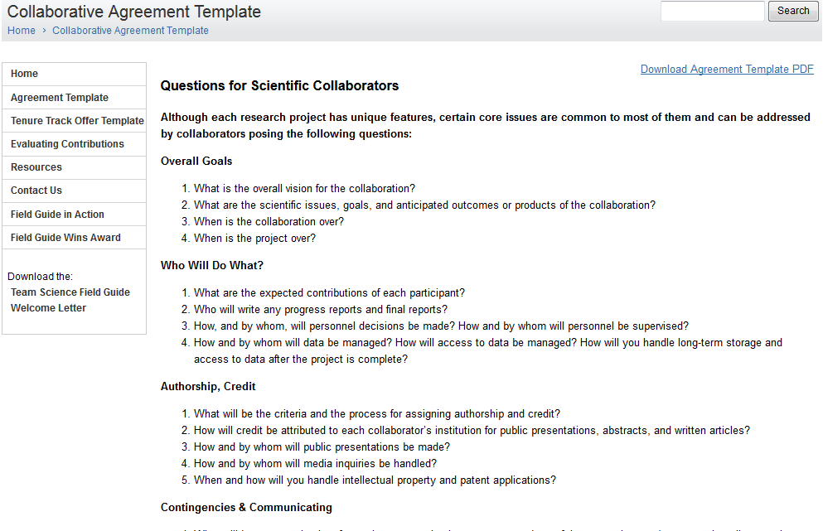
Tools: Project Planning
Prepare Yourself for Team Science
Template of questions to consider in preparation

Slide 25
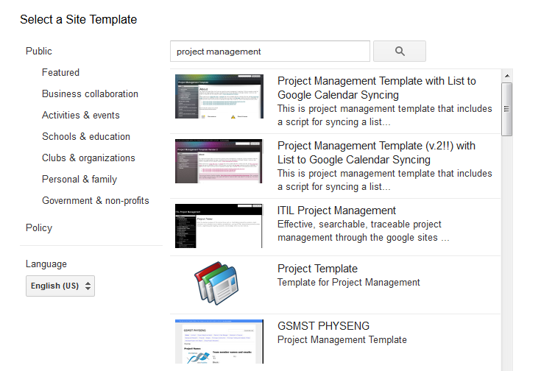
Tools
Google
Sites
  Project templates
Groups - discussion and email
Drive - documents, spreadsheets, forms, presentations
Calendar - reminders, list-calendar syncing

Slide 26
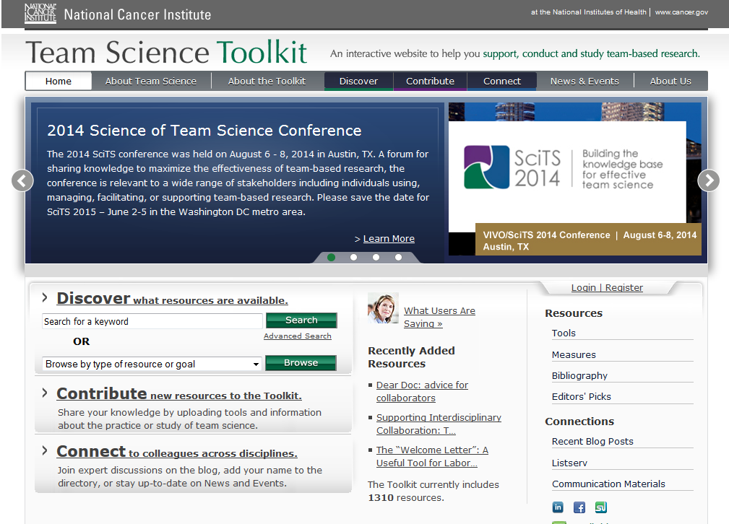
Tools
Team Science Toolkit
www.teamsciencetoolkit.cancer.gov

Slide 27
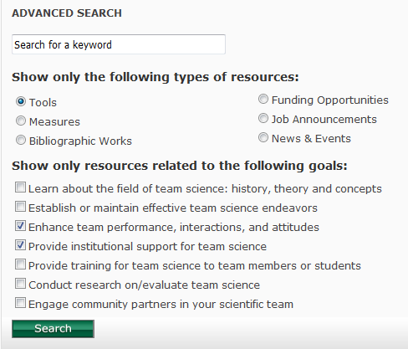
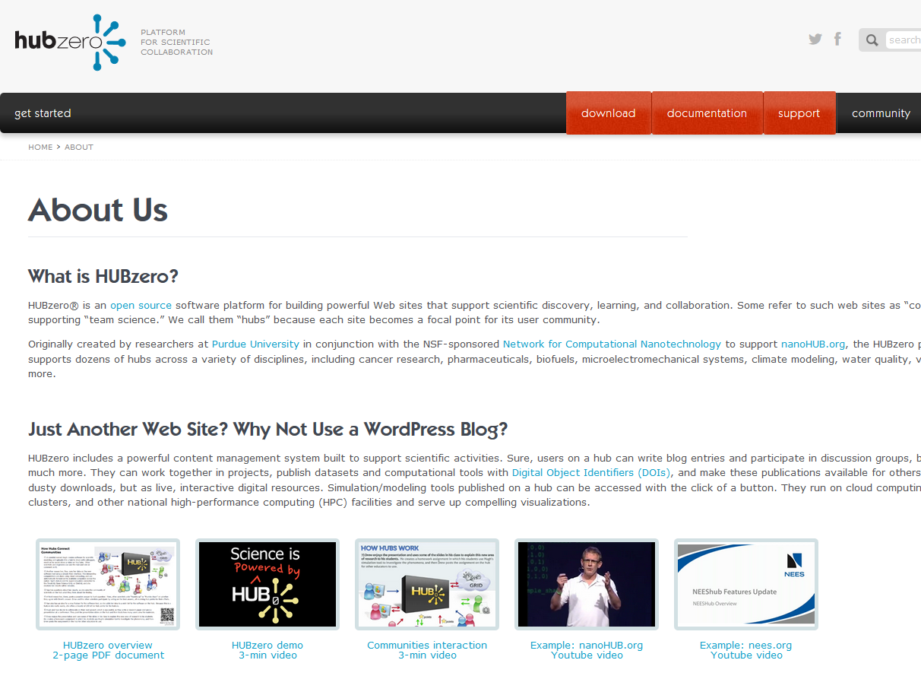
Tools
Team Science Toolkit

Slide 28
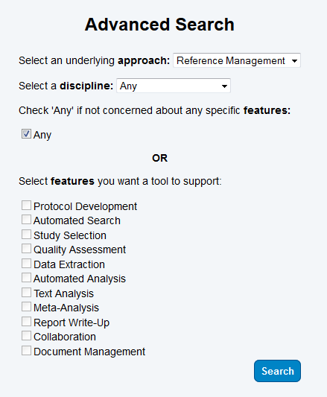
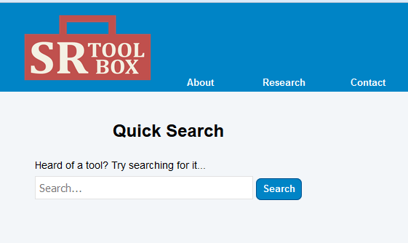
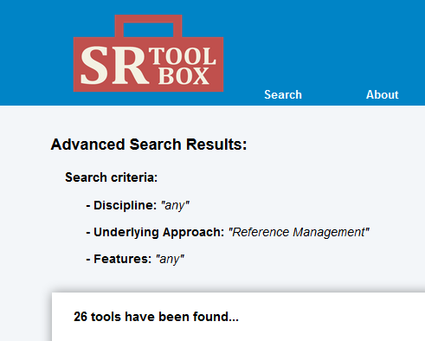
Tools
Systematic Review Toolbox
http://systematicreviewtools.com

Slide 29
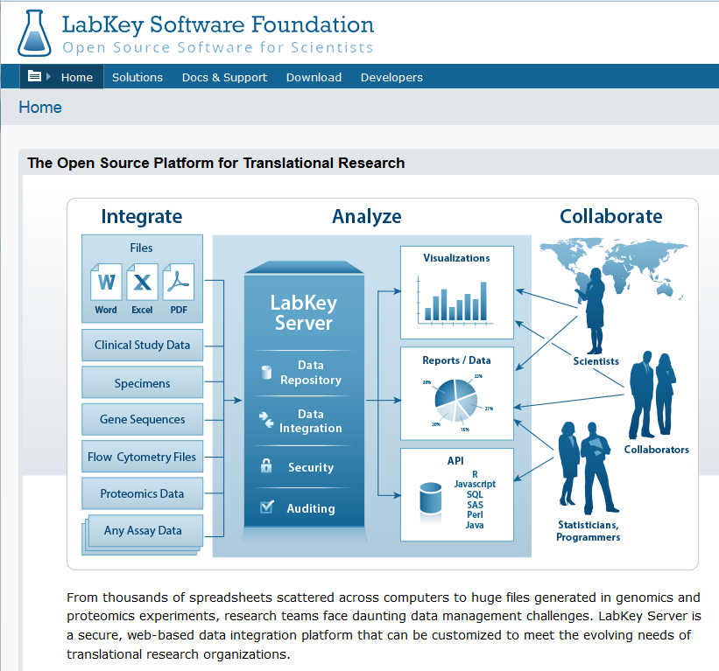
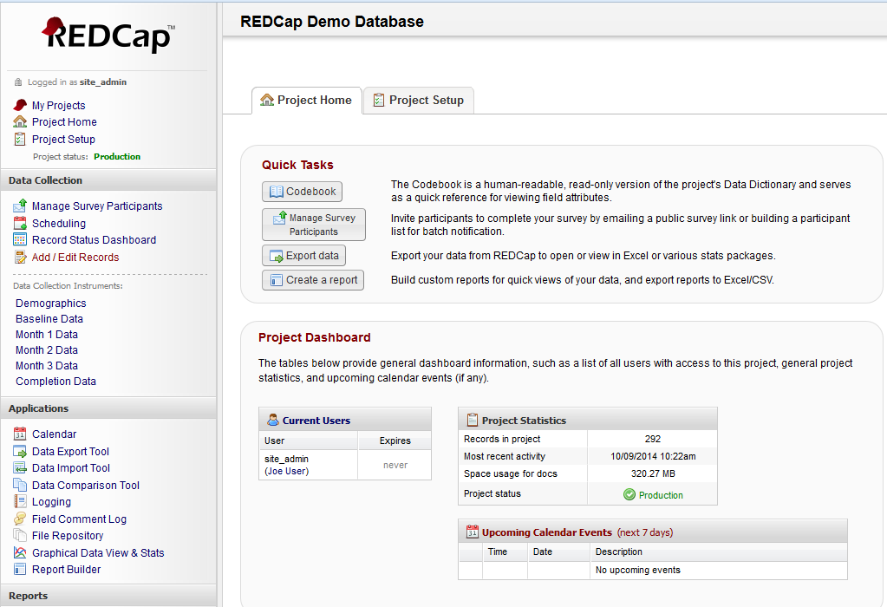
Tools - Data
Translate what you learn to support your users
Notes:
Librarians can learn about available platforms and make researchers aware of them if they aren’t already

Slide 30
Further questions
Possible roles for librarians in support of
team science
Data management
Collaboration methods
Researcher networks
Knowledge sharing and transfer
Open access support
SciTS research

Slide 31
Image Sources
Map image created by Alison Ferrell and Genevieve Gore
Project timeline example created by Genevieve Gore
All screenshots taken by Ginny Pannabecker using the Mac Grab utility application or Windows Snippy application.
Additional photo and image sources*
  http://pixabay.com/en/road-landscape-clouds-sky-348544/ - public domain image
  https://flic.kr/p/dUwB97 - CC-BY photo, Education Experts, AJ Cann
  http://pixabay.com/en/swiss-corner-kirchlispitzen-r%C3%A4tikon-57259/ - public domain image
  https://flic.kr/p/dxvmRd - CC-BY photo, SAM team celebrates landing, NASA Goddard Space Center
  http://pixabay.com/en/wave-circle-monitor-send-globe-376967/ - public domain image
  http://pixabay.com/en/biology-research-laboratory-220005/ - public domain image
  http://pixabay.com/en/laboratory-scientists-research-385349/ - public domain image

Slide 32
References
Lit Review
Breen, H. (2013, October). Virtual Collaboration in the Online Educational Setting: A Concept Analysis. In Nursing forum (Vol. 48, No. 4, pp. 262-270).
Börner, K., Contractor, N., Falk-Krzesinski, H. J., Fiore, S. M., Hall, K. L., Keyton, J., ... & Uzzi, B. (2010). A multi-level systems perspective for the science of team science. Science Translational Medicine, 2(49), 49cm24-49cm24.
Hall, K. L., Stokols, D., Stipelman, B. A., Vogel, A. L., Feng, A., Masimore, B., ... & Berrigan, D. (2012). Assessing the value of team science: a study comparing center-and investigator-initiated grants. American journal of preventive medicine, 42(2), 157-163.
García-Milian, R., Norton, H. F., Auten, B., Davis, V. I., Holmes, K. L., Johnson, M., & Tennant, M. R. (2013). Librarians as Part of Cross-Disciplinary, Multi-institutional Team Projects: Experiences from the VIVO Collaboration. Science & technology libraries, 32(2), 160-175.
Stokols, D., Hall, K. L., Taylor, B. K., & Moser, R. P. (2008). The science of team science: overview of the field and introduction to the supplement. American journal of preventive medicine, 35(2), S77-S89.
Stokols, D., Misra, S., Moser, R. P., Hall, K. L., & Taylor, B. K. (2008). The ecology of team science: understanding contextual influences on transdisciplinary collaboration. American journal of preventive medicine, 35(2), S96-S115.
Vogel, A. L., Hall, K. L., Fiore, S. M., Klein, J. T., Michelle, B. L., Gadlin, H., ... & Falk-Krzesinski, H. J. (2013). The team science toolkit: enhancing research collaboration through online knowledge sharing. American journal of preventive medicine, 45(6), 787.

Slide 33
Tools
Google Sites
http://www.google.com/sites/overview.html
NIH - Prepare Yourself for Team Science - Collaborative Agreement Template
https://ccrod.cancer.gov/confluence/display/NIHOMBUD/Collaborative+Agreement+Template
Team Science Toolkit
https://www.teamsciencetoolkit.cancer.gov/Public/Home.aspx
HUBzero
https://hubzero.org/
Systematic Review Toolbox
http://systematicreviewtools.com/
LabKey
http://www.labkey.com/
REDCap
http://www.project-redcap.org/

Slide 34
Recommended Best Practices
For institutions / funders / supporting groups
Plan ahead using templates
Clear vision of what constitutes success
Assessment to track project, adjust
Guage team member readiness toward teams science: openness and adaptability, previous experience with collaborative projects
Consider combining strangers and known colleagues
Provide training for leaders and team members
Provide platform/tools for project management, communication, and discussion

Slide 35
Recommended Best Practices
For team leaders
Communicate with open, enthusiastic, inclusive approach
Set regular meeting times
Provide opportunities for f2f meetings to build community
Utilize centralized planning and production platform
Plan ahead with team using templates
Designate roles and responsibilities - when changes, communicate to all along with changed expectations
Encourage open, frequent, explicit communication
  Decisions - reinforce group decisions for consistency
Address conflicts and work through to resolution

Slide 36
Recommended Best Practices
For individual team members
Attitudes: openness, adaptability, willingness to devote substantial time to learning and participating, egalitarian values
Commit time needed
Active participation in meetings, planning, and tasks
Keep up with progress and activities
Communicate openly, with empathy, explicitly, and often
Willingness to address conflicts and work to resolution

Slide 37

Presentation Contact for questions:
Virginia Pannabecker, GinnyP@vt.edu
Authors:
Virginia Pannabecker, Carolyn Dennison, Alison Farrell, Genevieve Gore, Assako Holyoke (SR Team Leader), Viola Machel, Christine Marton, Kelly O’Brien, Stephanie Swanberg, Mindy Thuna

