Slide 1
Discovery Twitter Portal
Christina Casey, Quinn Anderson, Abdul Omotosho, Kirti Patel, Adrian Johnson
CS 4624, Professor Farag, Virginia Tech, Blacksburg VA 24061
December 5, 2024

Slide 2
Outline
Recap
Roles
System Design
Work Completed
Web Application
Backend
Collection Data Confirmation
Demo
Challenges
Lesson Learned
Future Work
Acknowledgements & References
Notes:
Christina

Slide 3
Recap
Overarching Project Goal:
Provide an application to view twitter collections
Semester ‘scope’ Goals:
Display total collections on web application
Effectively extraction all of the SFM data to display on application
Confirmation of DMI and yTk data
Allow users to add their own collections with tweets
Semester ‘stretch’ Goals:
Admin/login functionality for adding collections
Functionality for admin to delete user collections
Fix issues with the collection filtering on the application
Improve aesthetics of web application
Notes:
Quinn

Slide 4
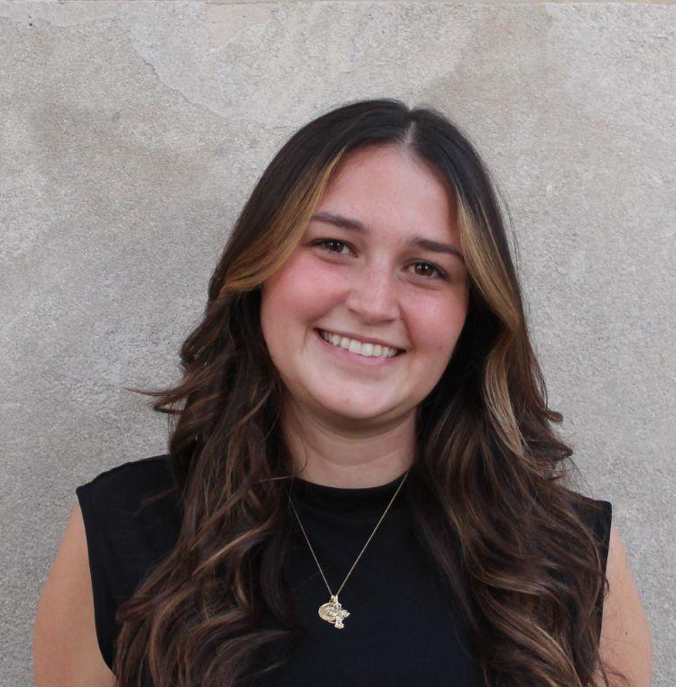
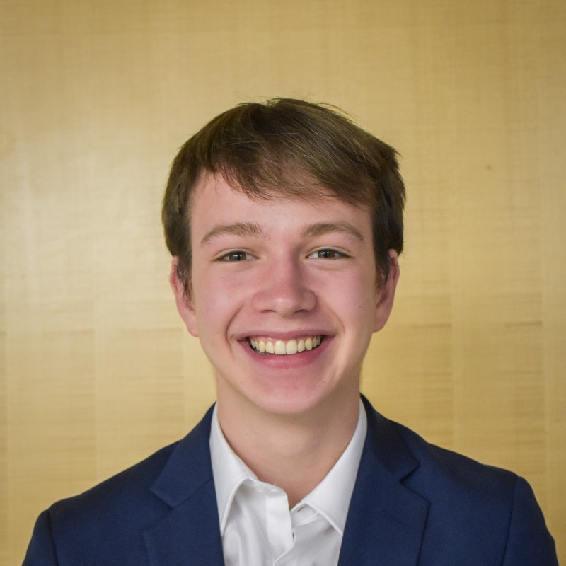
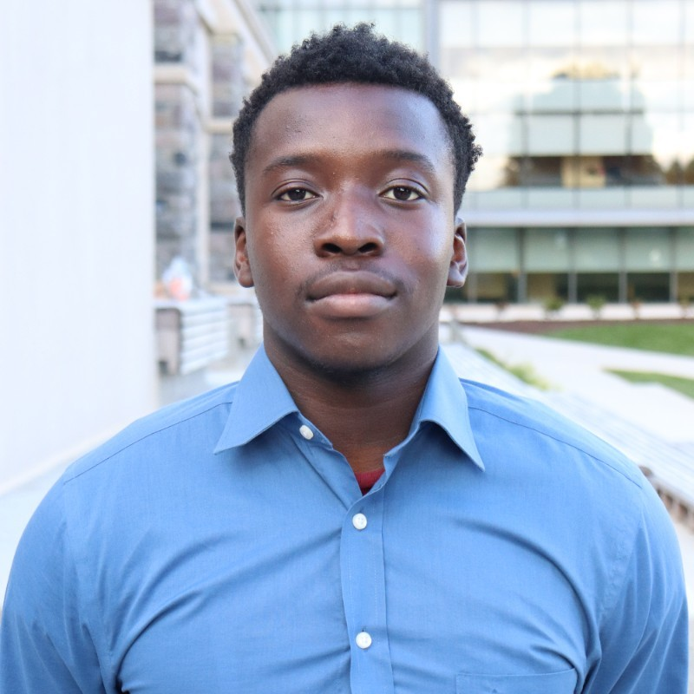
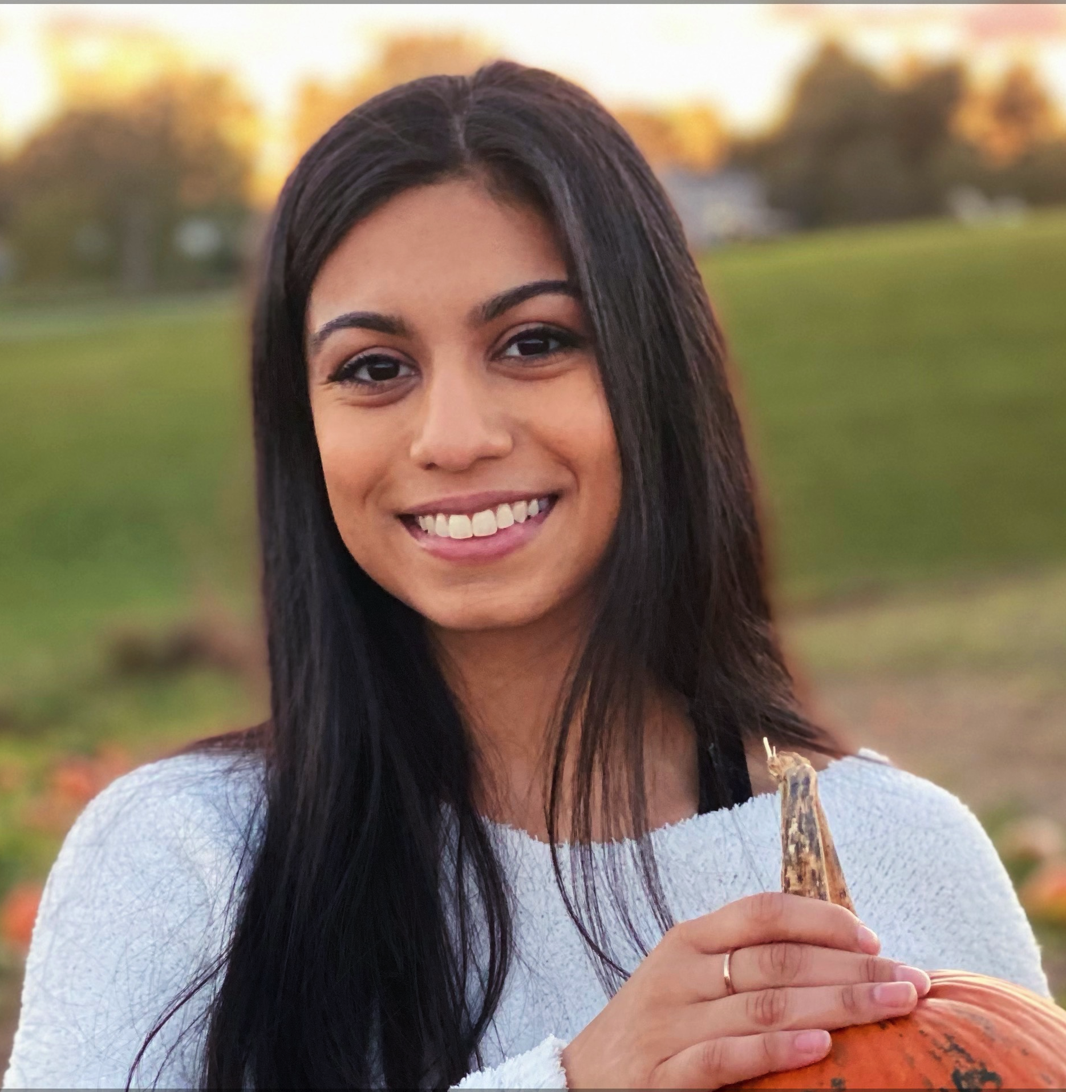
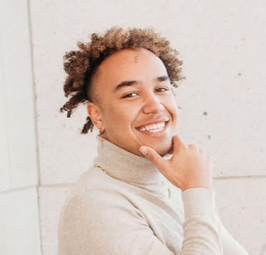
Roles
Christina Casey
Quinn Anderson
Abdul Omotosho
Kirti Patel
Adrian Johnson
Team Leader/Frontend Developer
Lead Frontend Developer
Backend Developer
Frontend Developer/ Confirmation of yTk, DMI data lead
Lead Backend Developer
Notes:
Christina

Slide 5








System Design Web Application (review)
User views data
FRONTEND
BACKEND
Users
DATA COLLECTION
user ‘search’
GET request
JSON list request
visualized data
JSON objects
JSON object list
User adds collection
FRONTEND
BACKEND
Users
DATA COLLECTION
user adds collection
POST request
save data
visualized data
JSON objects
JSON object list
Notes:
Abdul

Slide 6


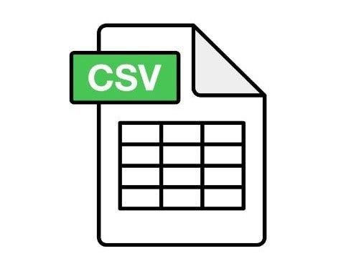
Data Collection (review)
DMI, YTK, SFM DATA
Collection Data CSV
DATA COLLECTION
python scripts / reverse engineering
Manual script csv to json
Notes:
Abdul

Slide 7
Work Completed

Slide 8
Web Application
Finalized user collection functionality
Effective display of jsonl tweet data from Twitter API 2.0
Deletion of user collection functionality
Only logged in user can add/delete collection
Admin functionality
Login for ‘admin’ to add/delete collections
No need for signup as then anyone can add and/or delete collections
Integration of SFM data
Support the new format from our SFM data collection work
Fix filtering issues for collection data
Particularly errors with filtering by date, and saving of filters
Aesthetic changes
Theme change
About Page
Notes:
Quinn + Christina

Slide 9
SFM Data Collection
Extraction of SFM data
Gained access to the database
Identified and analyzed the structure of data
Determined the optimal method for mapping the data
Wrote scripts to collect relevant data from the database
Organization of SFM data
Mapped the database structure into a spreadsheet
Standardized and cleaned the data for consistency
Uploading of SFM data
Converted the spreadsheet into JSON format
Successfully uploaded the JSON data into MongoDB
Notes:
Adrian + Abdul

Slide 10
yTk, DMI Confirmation
Verification process
Gained access to DMI and yTK MySQL databases on tweets.cs.vt.edu server
Used various SQL queries to obtain total amount of tweets per collections
Verification of DMI_TCAT databases
Verified 29 total unique collections
13 collections have more tweets in the database than in current web-app
Updating web-app to include these additional tweets are in-progress
Verification of yTK databases
Verified 1429 total unique collections
~1000 collections found to have more tweets than in current web-app
Updating web-app to include these additional tweets are in-progress
Notes:
Kirti? (Christina if not) DMI - Digital Methods Initiative; yTK- yourTwapperKeeper; EFC - Ethical Framework Compliance; SFM - Social Feed Manager

Slide 11
yTk, DMI Data Update
DMI_TCAT
Verified 29 total unique collections
13 collections have more tweets in the database than in current web-app
Web-app has been updated to include additional tweets
Verification of yTK databases
Verified 1429 total unique collections
~1000 collections found to have more tweets than in current web-app
Web-app has been updated to include additional tweets
Notes:
Kirti? (Christina if not) DMI - Digital Methods Initiative; yTK- yourTwapperKeeper; EFC - Ethical Framework Compliance; SFM - Social Feed Manager

Slide 12
Demo
Notes:
Quinn

Slide 13
Challenges
Miscommunication between team members, professor, and client
Insufficient information from previous teams regarding their processes
Difficulties in extracting SFM data from the database
Notes:
Adrian

Slide 14
Lessons Learned
Review Past Work:
Carefully analyze and understand all previous work to avoid redundancy or gaps.
Thorough Documentation:
Maintain detailed records to ensure continuity for future teams.
Effective Client Communication:
Engage with the client regularly to align expectations and clarify requirements.
Regular Meetings:
Schedule consistent check-ins with the team, client, and professor to stay on track.
Proactive Problem-Solving:
Ask questions and conduct research to address challenges effectively.
Notes:
Adrian

Slide 15
Future Work
Explore options for deploying the application for broader use
Updating the YTK and DMI_TCAT data on the web application to include additional tweets found during data confirmation
Enable users to upload larger JSONL data files seamlessly
Address client feedback to improve the functionality and user experience of the web application
Notes:
Quinn

Slide 16
Acknowledgements & References
Our Client & Professor: Dr. Mohamed Farag
Previous CS4624 Discovery Twitter Portal teams & their work:
H. Saif, F. Mustard, S. Duduru, K. Forest, and V. Agadkar, “Discovery Portal for Twitter Collection,” Vt.edu, May 2024. https://vtechworks.lib.vt.edu/items/035952fd-6b12-4133-92ff-c0d1b72a6ad9 (accessed Oct. 31, 2024).
M. Gonley, R. Nicholas, N. Fitz, G. Knock, and D. Bruce, “Twitter Collections,” Vt.edu, May 10, 2022. https://vtechworks.lib.vt.edu/items/37fbcced-f88c-441c-aa7c-4150a9c1949a (accessed Oct. 31, 2024).
P. Dhakal, Y. Bhargava, A. Herms, K. Powell, and D. Burdisso, “Library Tweets Conversion,” Vt.edu, Dec. 16, 2021. https://vtechworks.lib.vt.edu/items/b3c4e96e-94c0-4e25-8561-c90c9ec6c37d (accessed Oct. 31, 2024).
Notes:
Abdul

Slide 17
Questions?

