Slide 1
Disease Spread Simulator II
Archita Kadam, Evan McKnight, Pranav Patel, Yifan Chu
CS 4624 Multimedia, Hypertext, and Information Access
Professor Edward A. Fox
Virginia Tech, Blacksburg 24061
11/30/2021
Notes:
Pranav

Slide 2
Outline
Overview
Recap
Timeline
Implementation
  Statistics/Backend
  Modifiable Parameters
Deliverables / Accomplishments
Final Product
  CWD Simulator
  About Page
Testing
  Testing Phases
  Testing Survey
Lessons Learned
Ideas for the Future
Acknowledgements
References
Questions
Notes:
Pranav

Slide 3
Project Plan Overview
Client: Luis Escobar, Department of Fish and Wildlife Conservation
Our goal is to develop a website to display the model of the spread of infectious diseases. The website should encompass:
Display what-if scenarios
Modify specific parameters
See resulting outputs
Notes:
Pranav

Slide 4
Project Timeline
Understand software and statistical models
Prototype, test, and implement models in R Shiny
Revisions to ensure functionality, begin testing
Final presentation complete, finished project
9/30
10/28
11/4
11/30
10/14
11/2
11/18
Create wireframe and discuss UI
Completed prototype, Presentation 2 complete
Complete report
Notes:
Pranav

Slide 5
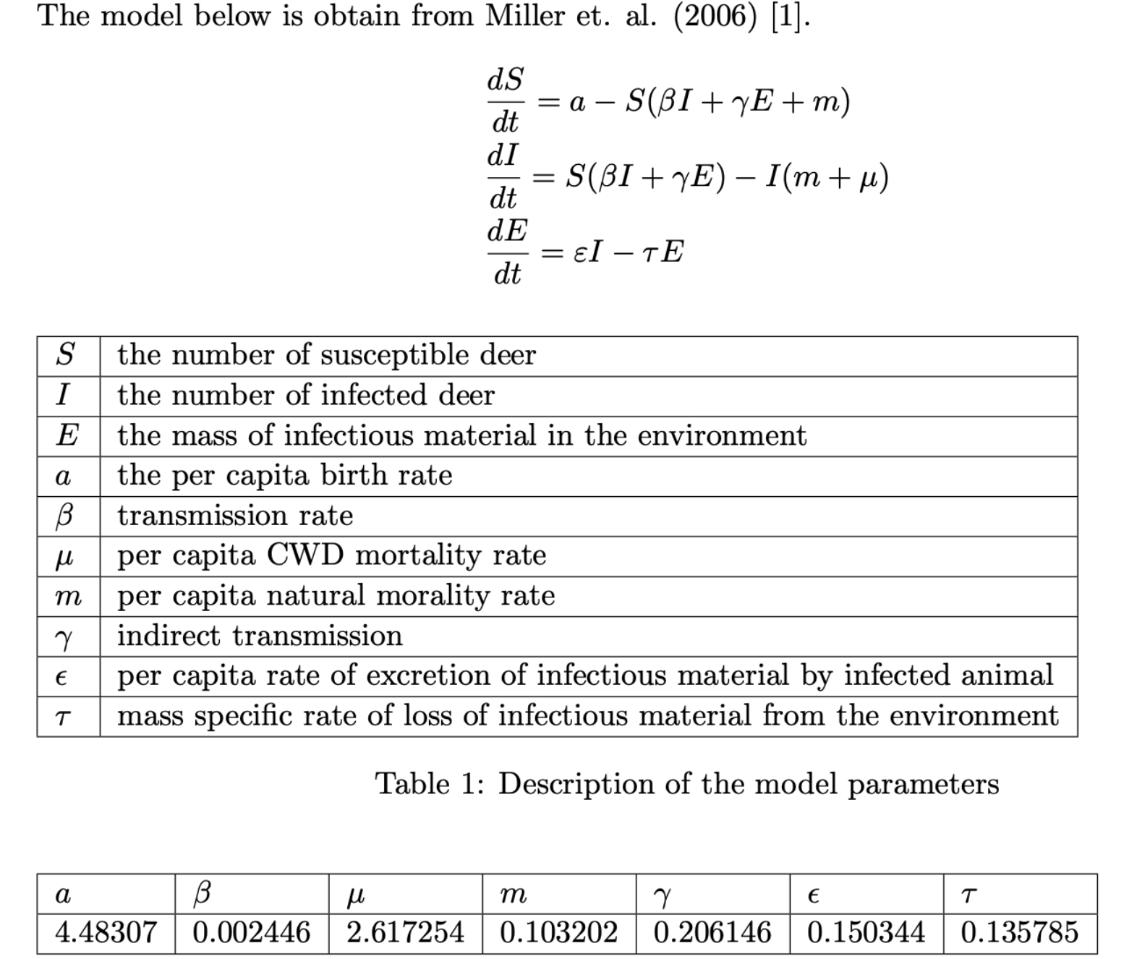
Implementation - Statistics
CWD Model
Notes:
Archita

Slide 6
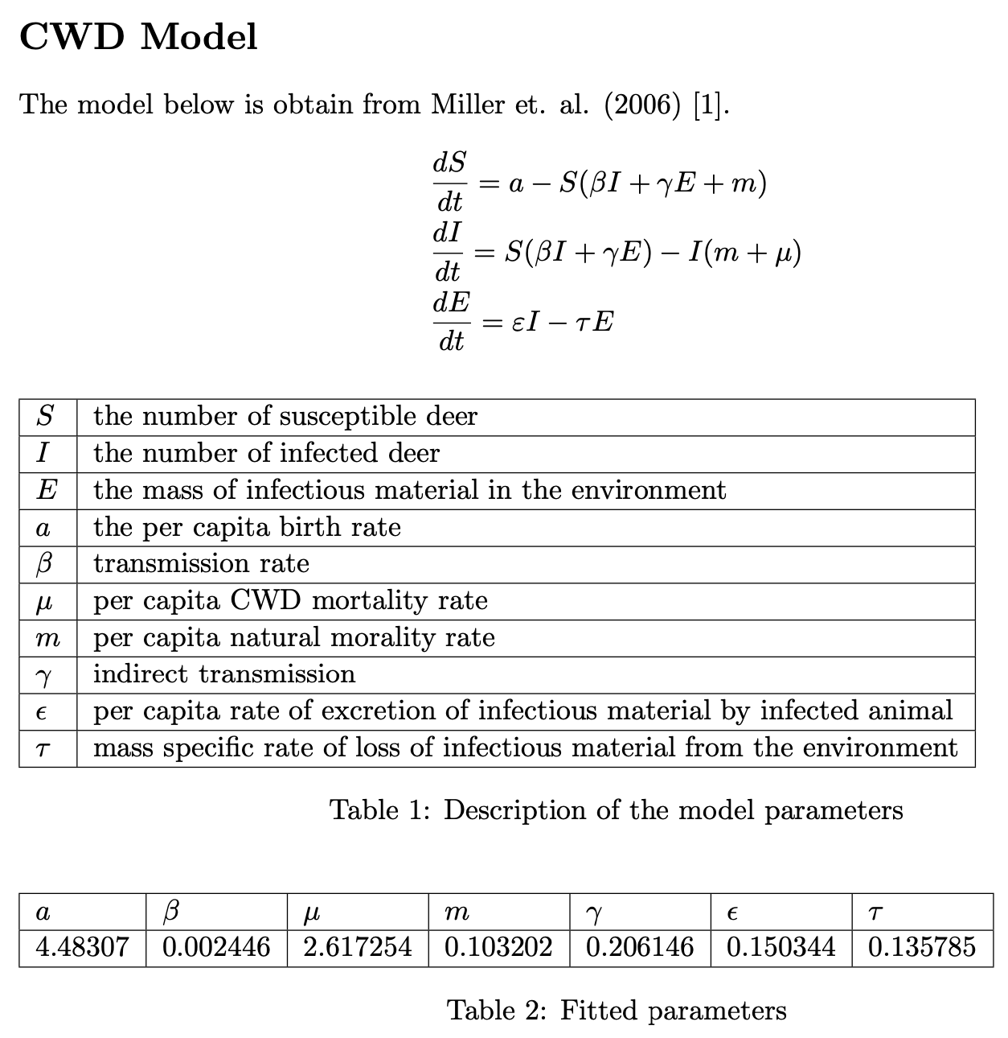
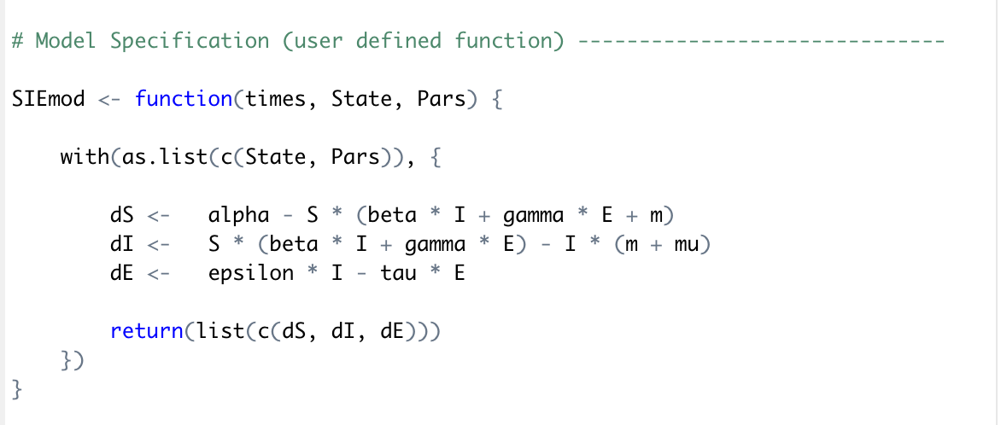
Implementation - Statistics
Formula:
Implementation in R:
Notes:
Archita

Slide 7
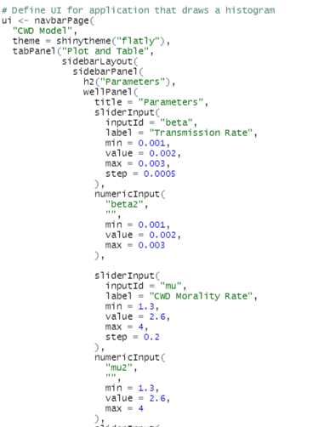
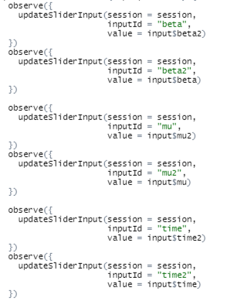
Implementation - Modifiable Parameters
Sliders allow users to see the graph output based on the input they want to test
Notes:
Archita

Slide 8
Deliverables / Accomplishments
Chronic Waste Disease (CWD) model website includes:
  Graphical outputs
  “What-if” scenarios
  Modifiable Parameters
Further Improvements we made:
  Text box to input exact values
  Table to track history of inputs
Notes:
Evan

Slide 9
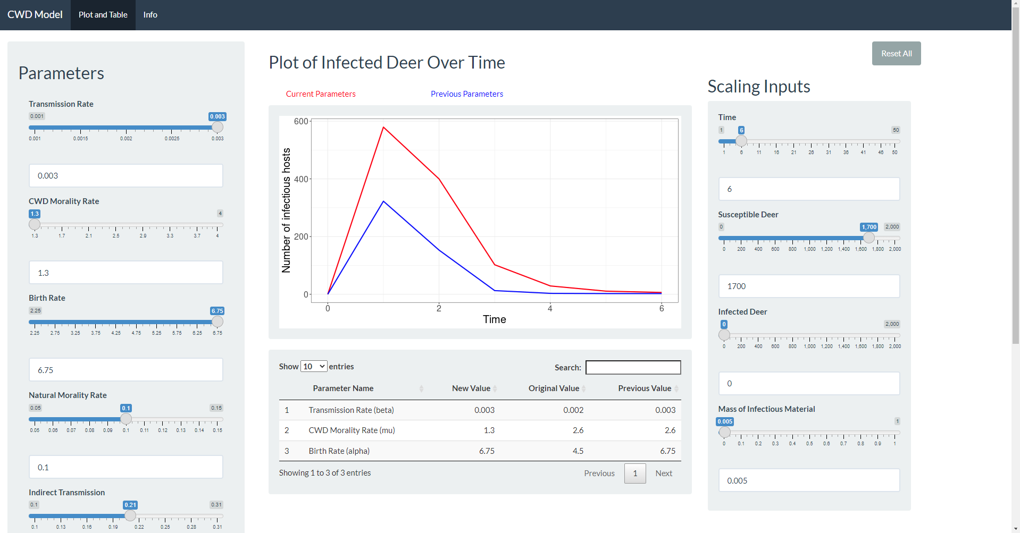
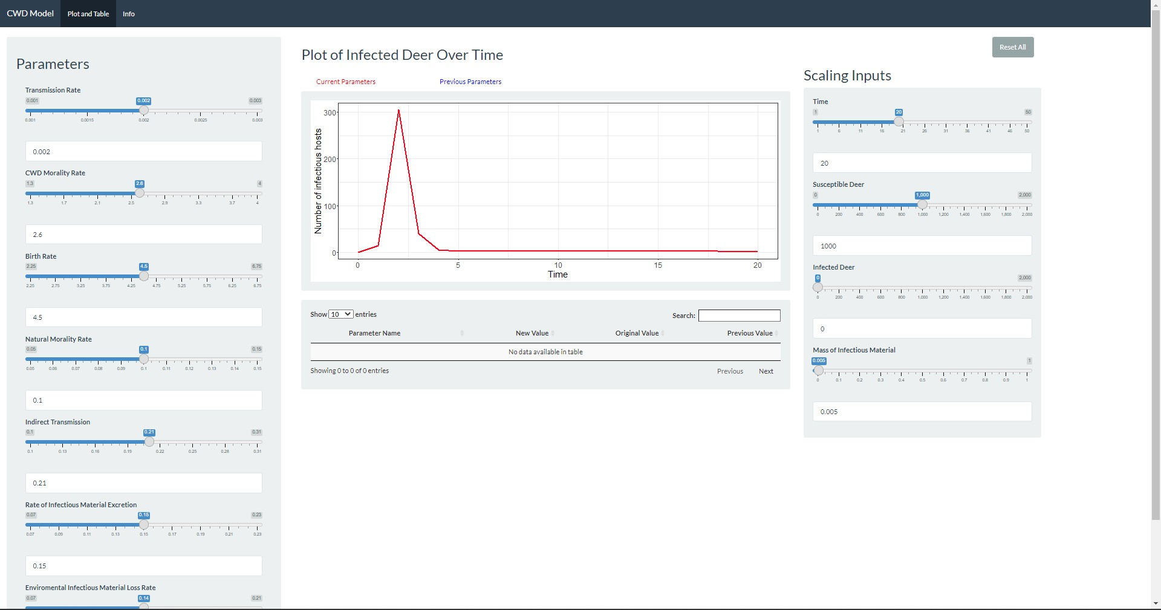
CWD Simulator
Notes:
Evan

Slide 10
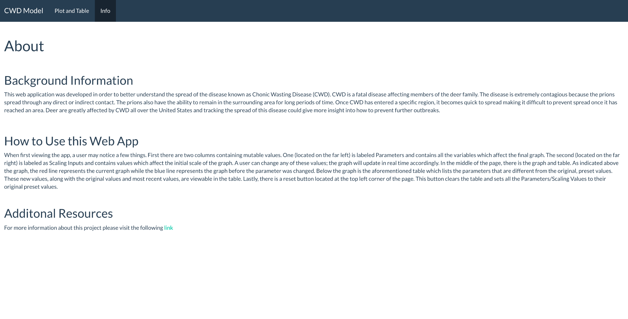
About Page
Notes:
Evan

Slide 11
Testing
First phase of testing is complete
Second and third phase are ongoing
Test within internal team
-Requirement analysis
-Test case development
Test with our client
-Further test case development
Test with prospective users
-Beta testing
-Identify/duplicate bugs
Notes:
Yifan

Slide 12
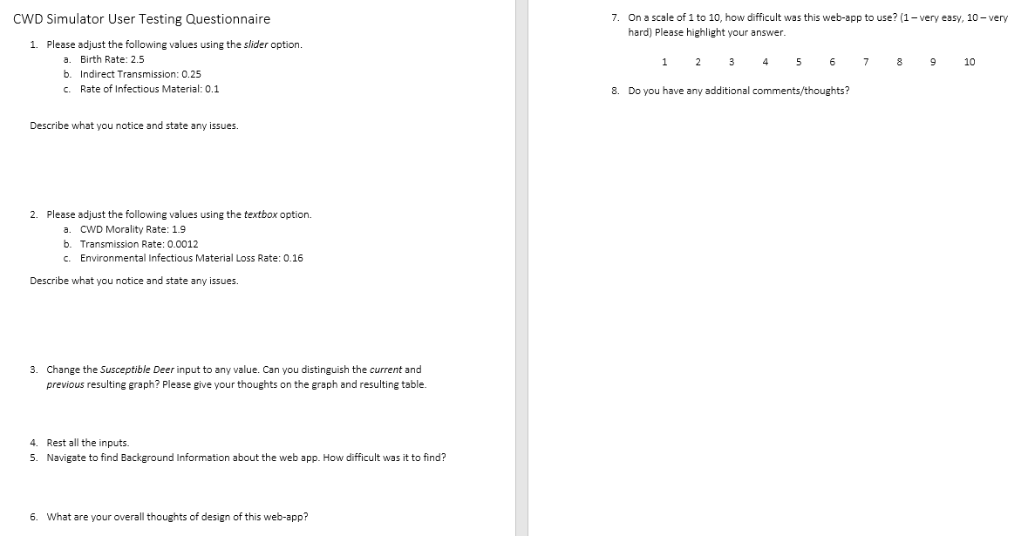
Testing - Survey
Notes:
Yifan

Slide 13
Lessons Learned
Establish good and consistent communication with the client
Constantly check up on teammates throughout the project and keep the team updated with your progress
Test functions while developing them
Use your resources and network to their full potential
Don’t be afraid to disappoint, come with a solution
Notes:
Yifan

Slide 14
Ideas
for the Future
Add a button to save both the graph and table
Create more plots to further visualize the data
Update model after user indication rather than automatically
Create visualizations to show correlation between parameters
Notes:
Yifan

Slide 15
Acknowledgements
Professor Luis Escobar, Department of Fish and Wildlife Conservation
Mariana Castaneda-Guzman, M.Sc. student, Department of Fish and Wildlife Conservation
Dr. Edward A. Fox, Professor of Computer Science
Carlos Augusto Bautista Isaza, Graduate Teaching Assistant
Notes:
Pranav

Slide 16
References
Statistical Model Research:
[1] https://github.com/castanedaM/DiseaseSpreadSimulator2/blob/main/CWD%20Fitting%20Results.pdf
Previous Work done on project:
[2]http://hdl.handle.net/10919/103298
Background Research:
[3] https://www.cdc.gov/prions/cwd/index.html
[4] https://www.usgs.gov/faqs/what-chronic-wasting-disease?qt-news_science_products=0#qt-news_science_products
Notes:
Pranav

Slide 17
Thank you!
Questions?
Notes:
Pranav

