Slide 1
Sterile Neutrino Searches with Sources and Reactors
Jonathan Link
Center for Neutrino Physics, Virginia Tech
3rd International Meeting for Large Neutrino Infrastructures
May 31, 2016
Impact
>
3rd International Meeting for Large
Neutrino

Slide 2
Sterile Neutrinos
Three neutrinos allow only 2 independent Δm² scales.
A sterile neutrino is a lepton with no ordinary electroweak interaction except those induced by mixing.
ν₄
ν₃
Atmospheric
Δm₂²
Sterile
mass²
Δm₃²
ν₂
Solar
ν₁
Δm₁²
mass²
ν₃
Atmospheric
But the sterile Δm² is at a completely different scales.
Δm₂²
ν₂
Solar
ν₁
Δm₁²

Slide 3
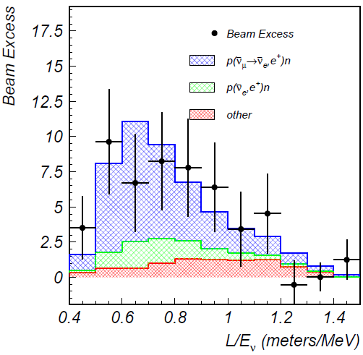
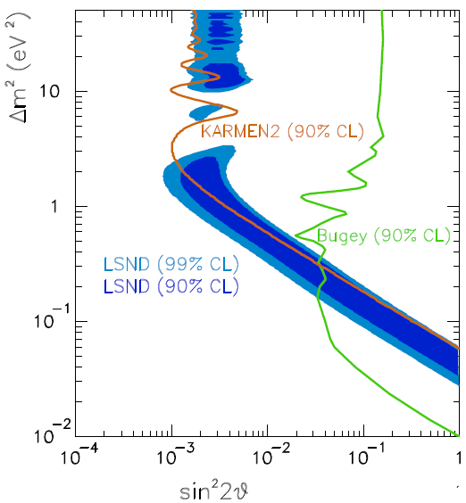
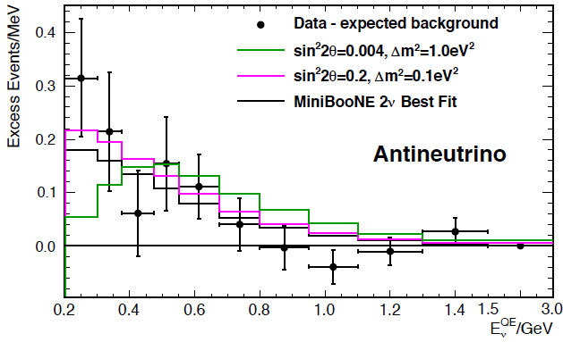
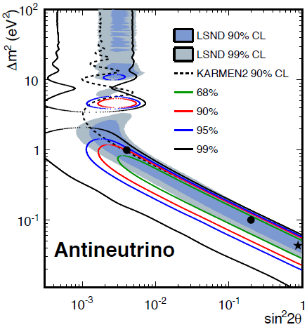
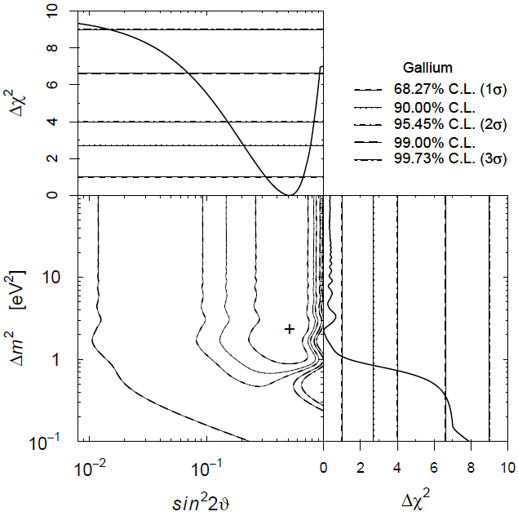
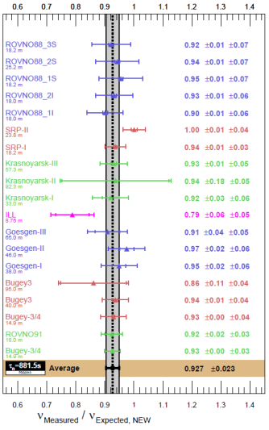
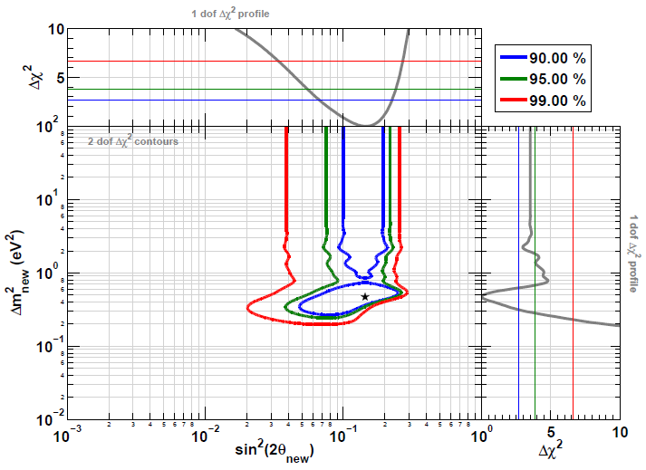
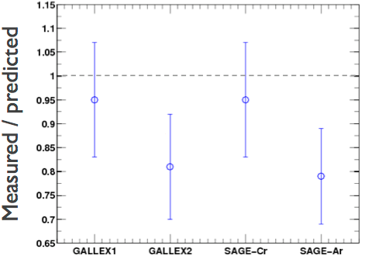




The Evidence for Sterile Neutrinos
LSND (${\overline{ν}}_{μ}→{\overline{ν}}_{e}$)
MiniBooNE (${\overline{ν}}_{μ}→{\overline{ν}}_{e}$)
Event Excess:
32.2 ± 9.4 ± 2.3
Event Excess: 78.4 ± 28.5
Aguilar-Arevalo et al., Phys.Rev.D64, 112007 (2001)
Aguilar-Arevalo et al., Phys.Rev.Lett. 110, 161801 (2013)
Gallium Anomaly ($ν_{e} Disappearance$)
Reactor Anomaly (${\overline{ν}}_{e}$ Disappearance)
Giunti and Laveder, Phys.Rev.C83, 065504(2011)
Mention et al., Phys.Rev.D83 073006 (2011)

Slide 4
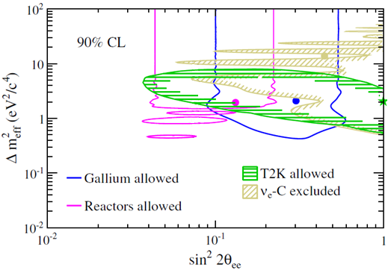
T2K Near Detector ν_{e} Disappearance
Although the T2K beam is predominantly a ν_{μ} beam, the small ν_{e} component can be used in the near detector for a ν_{e} disappearance search.
Phys.Rev. D91, 051102(R) (2015)
T2K actually reported this as a limit, but their limit was weaker than expected and their result is completely consistent with the prevailing ν_{e} disappearance anomalies.

Slide 5
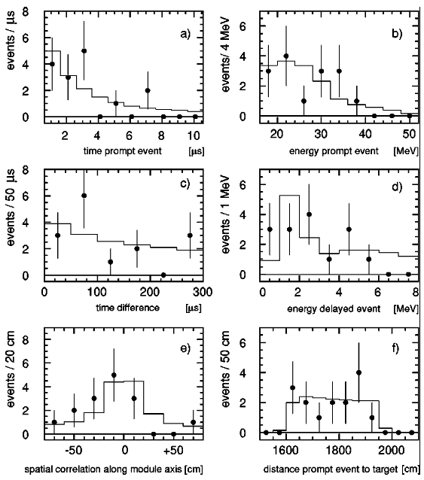
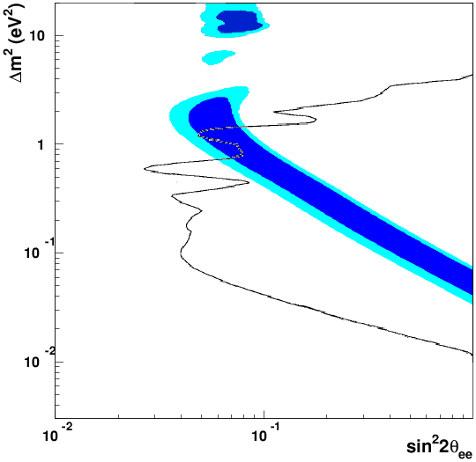
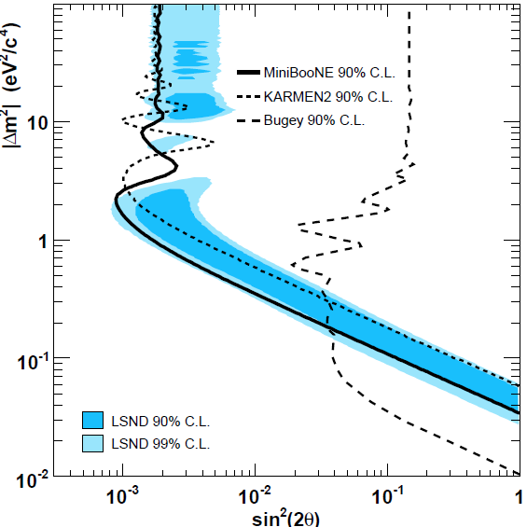

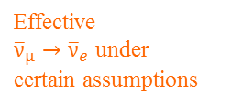
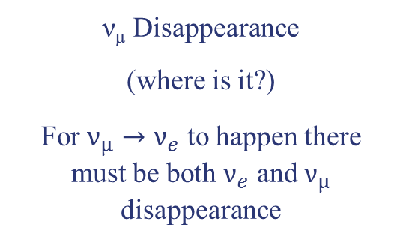


Evidence Against the ~1 eV² Sterile Neutrino
KARMEN (${\overline{ν}}_{μ}→{\overline{ν}}_{e}$)
Bugey Reactor (${\overline{ν}}_{e}$ Disappearance)
KARMEN (90% CL)
Effective
${\overline{ν}}_{μ}→{\overline{ν}}_{e}$ under
certain assumptions
No ${\overline{ν}}_{e}$ Excess
Armbruster et al., Phys.Rev.D65 112001 (2002)
Achkar et al., Nucl.Phys.B434, 503 (1995)
MiniBooNE (ν_{μ} → ν_{e} Appearance)
ν_{μ} Disappearance
(where is it?)
For $ν_{μ}→ν_{e}$ to happen there must be both $ν_{e}$ and $ν_{μ}$ disappearance
Phys.Rev.Lett. 98, 231801 (2007)

Slide 6




Relating Appearance and Disappearance Probabilities
With a single sterile neutrino we get a 4×4 PMNS mixing matrix and 3 independent Δm²s.
m₄
U_{e4}²
U_{μ4}²
U_{τ4}²
U_{s4}²
+ + + = 1 (PMNS Unitarty)
The appearance probability (ν_{μ}→ν_{e}):
Sterile
$$∆m_{43}^{2}$$
P_{μe} =
sin²2θ
sin²(1.27Δm₄₃²L/E)
4U_{e4}² U_{μ4}²
The ν_{e} disappearance probability:
m₃
P_{ee} = P_{es} + P_{eμ} + P_{eτ}
P_{ee} ≈ P_{es}
= 4U_{e4}² U_{s4}² sin²(1.27Δm₄₃²L/E)
Atmospheric
The ν_{μ} disappearance probability:
$$∆m_{32}^{2}$$
m₂
Solar
P_{μμ} ≈ 4U_{μ4}² U_{s4}² sin²(1.27Δm₄₃²L/E)
m₁
$$∆m_{21}^{2}$$
Notes:
Because P(mu, e) depends on both U(e,4) and U(mu,4), you can have nu_e disappearance without nu_e appearance, but you can’t have nu_e appearance without nu_mu disappearance.

Slide 7
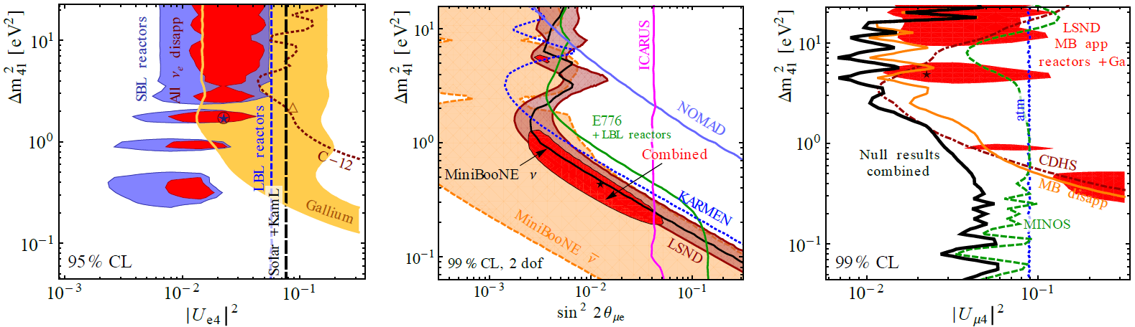

Appearance vs. Disappearance
Since any 4th mass state is predominantly sterile (U_{s4} ≈1),
$$P_{μe}≈\frac{1}{4}{ P}_{ee}×P_{μμ} \text{or} \text{sin}\text{2}\text{θ}\text{μ}\text{e} \text{= }\frac{1}{4} \text{sin}\text{2}\text{θ}\text{ee} \text{sin}\text{2}\text{θ}\text{μμ}$$
Since P_{μe} depends on both U_{e4} and U_{μ4}, you can have ν_{e} disappearance without ν_{e} appearance, but you can not have ν_{e} appearance without ν_{μ} disappearance.
The absence of ν_{μ} disappearance is a huge problem for the LSND and MiniBooNE signals, while the ν_{e} disappearance anomalies are consistent with all existing data.
ν_{e} Disappearance ν_{μ}→ν_{e} Appearance ν_{μ} Disappearance
Global fit from Kopp et al. JHEP 1305, 050 (2013)

Slide 8
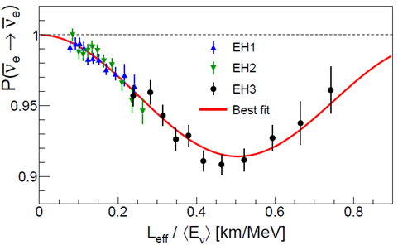
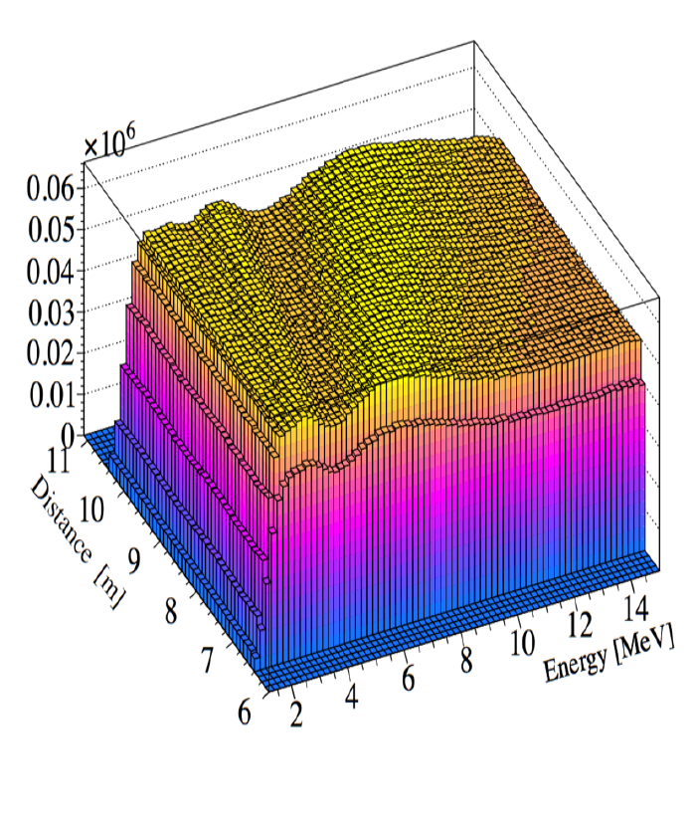
Requirement for Disappearance Experiments
“It don’t mean a thing if it ain’t got that swing”
–American jazz great Duke Ellington
Oscillometry: the observation and measurement of oscillations.
In disappearance experiments the existence of sterile neutrinos can only be convincingly established through oscillometry.
Daya Bay, Phys.Rev.Lett. 115, 111802 (2015)
Possible oscillations in a short-baseline reactor experiment

Slide 9
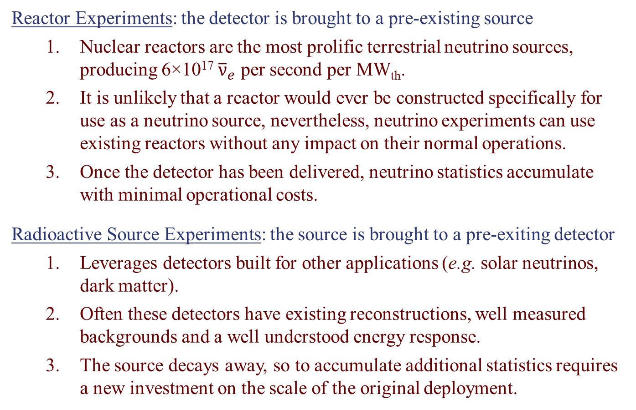
Bring the Source vs. Bring the Detector
Reactor Experiments: the detector is brought to a pre-existing source
  Nuclear reactors are the most prolific terrestrial neutrino sources, producing 6×10¹⁷ ${\overline{ν}}_{e}$ per second per MW_{th}.
  It is unlikely that a reactor would ever be constructed specifically for use as a neutrino source, nevertheless, neutrino experiments can use existing reactors without any impact on their normal operations.
  Once the detector has been delivered, neutrino statistics accumulate with minimal operational costs.
Radioactive Source Experiments: the source is brought to a pre-exiting detector
  Leverages detectors built for other applications (e.g. solar neutrinos, dark matter).
  Often these detectors have existing reconstructions, well measured backgrounds and a well understood energy response.
  The source decays away, so to accumulate additional statistics requires a new investment on the scale of the original deployment.

Slide 10
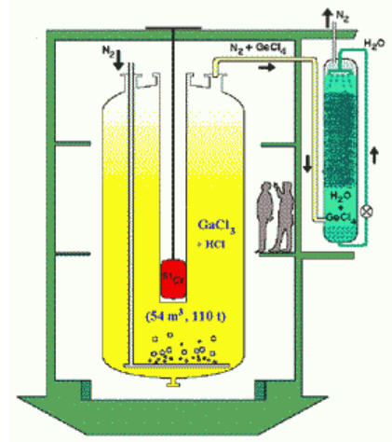
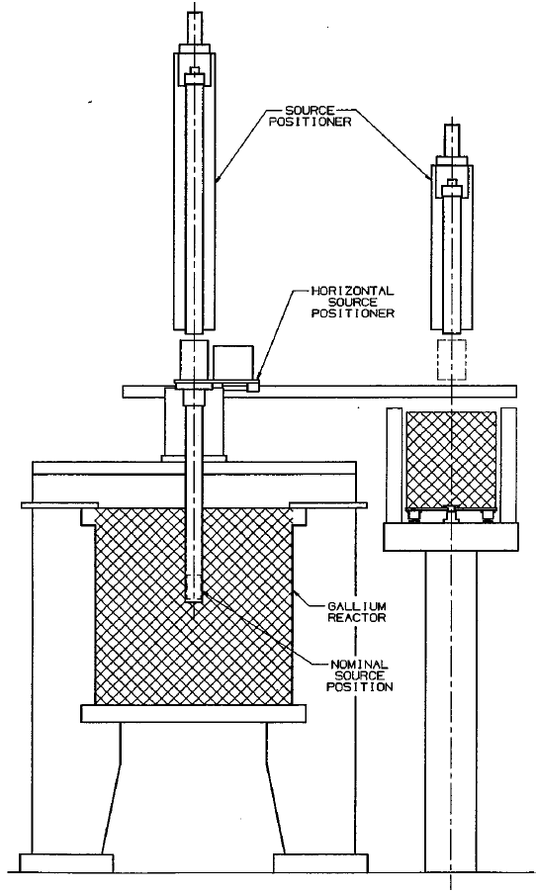
The GALLEX and SAGE Source Experiments
The solar radiochemical detectors GALLEX and SAGE used intense EC sources (⁵¹Cr and ³⁷Ar) to calibrate the ν_{e} detection efficiency.
GALLEX Sources: 1.7 MCi of ⁵¹Cr
1.8 MCi of ⁵¹Cr
SAGE Sources: 680 kCi of ⁵¹Cr
409 kCi of ³⁷Ar
Neutrinos interact in the CC process, ν_{e}+⁷¹Ga→⁷¹Ge, and are detected by the decay of ⁷¹Ge.

Slide 11
Ideas for Short-Baseline Source Experiments
There have been several ideas for short-baseline radioactive source experiments. Most use detectors designed (and funded) to do other physics.
Generally these proposals benefit from detectors designed for excellent low energy sensitivity.
Source Experiment Proposals | Source | Detector
LENS-Sterile (Phys.Rev.D 75, 093006, 2007) | ⁵¹Cr | LENS (Solar)
Zoned Radio-chemical (arXiv:1006.2103 [nucl-ex], 2010) | ⁵¹Cr | SAGE (Solar)
CeLAND (Phys.Rev.Lett. 107, 201801, 2011) | ¹⁴⁴Ce | KamLAND (Reactor)
Neutral Current Coherent (Phys.Rev.D 85, 013009, 2012) | ³⁷Ar or ⁵¹Cr | Bolometers (DM)
IsoDAR (Phys.Rev.Lett. 109, 141802, 2012) | ⁸Li | KamLAND (Reactor)
SOX (JHEP 1308, 038, 2013) | ⁵¹Cr & ¹⁴⁴Ce | Borexino (Solar)
Liquid Xe + Source (JHEP 1411, 261, 2014) | ⁵¹Cr | LZ (DM)
SOX (JHEP 1308, 038, 2013)

Slide 12
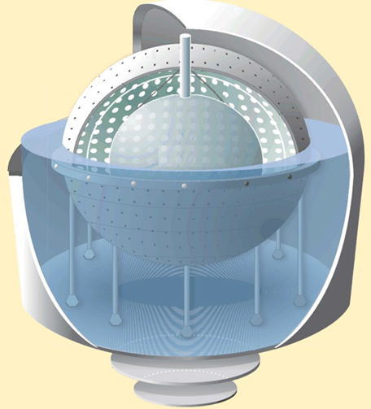
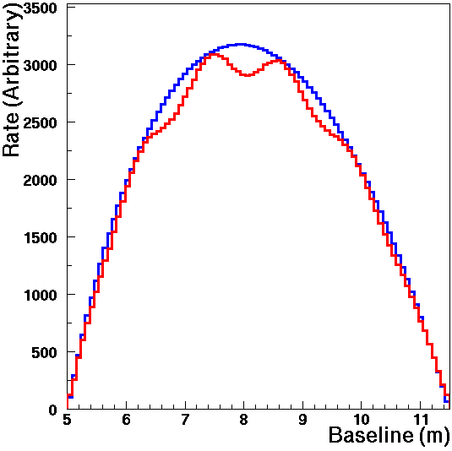
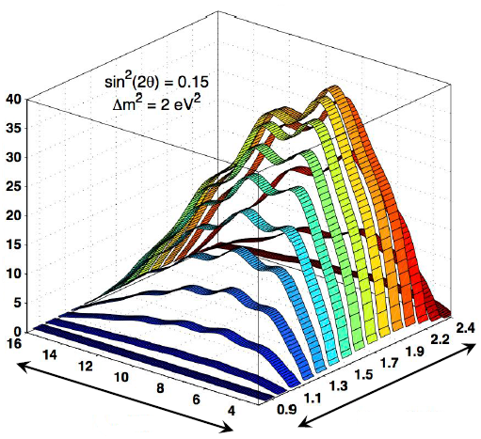
Source Experiment: SOX
Combines the Borexino detector with a ¹⁴⁴Ce ${\overline{ν}}_{e}$ source and/or a ⁵¹Cr $ν_{e}$ source.
At the typical sterile Δm², multiple oscillation wavelengths may be observed inside the detector.
JHEP 1308, 038 (2013)
⁵¹Cr Source
¹⁴⁴Ce Source
sin²2θ_{ee} = 0.12 Δm² = 1.5 eV²
8.25 m
L_{rec}(m)
E_{vis/rec}(MeV)
Source

Slide 13
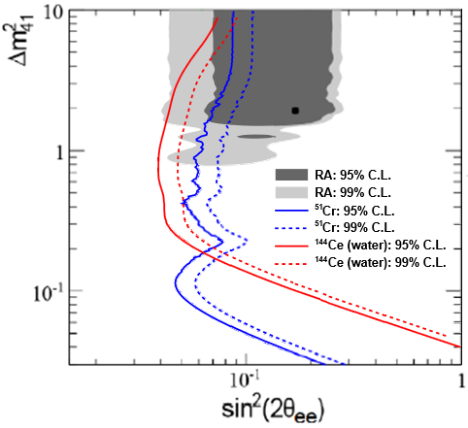
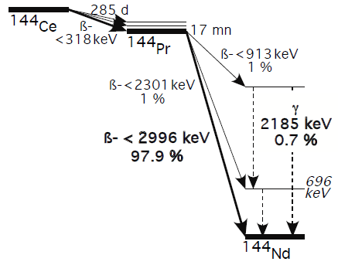
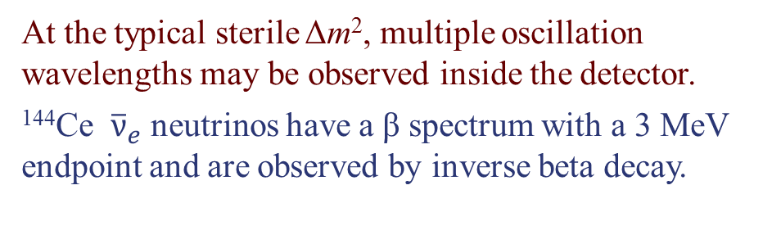
Source Experiment: SOX
Combines the Borexino detector with a ¹⁴⁴Ce ${\overline{ν}}_{e}$ source and/or a ⁵¹Cr $ν_{e}$ source.
At the typical sterile Δm², multiple oscillation wavelengths may be observed inside the detector.
¹⁴⁴Ce ${\overline{ν}}_{e}$ neutrinos have a β spectrum with a 3 MeV endpoint and are observed by inverse beta decay.
JHEP 1308, 038 (2013)
¹⁴⁴Ce-¹⁴⁴Pr Decay
8.25 m
Source

Slide 14
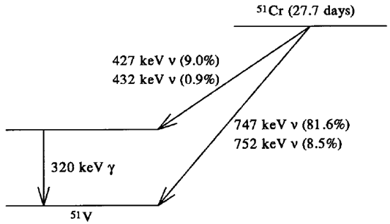
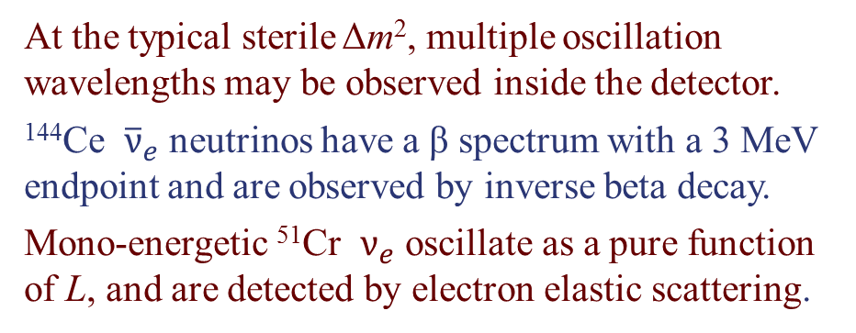
Source Experiment: SOX
Combines the Borexino detector with a ¹⁴⁴Ce ${\overline{ν}}_{e}$ source and/or a ⁵¹Cr $ν_{e}$ source.
At the typical sterile Δm², multiple oscillation wavelengths may be observed inside the detector.
¹⁴⁴Ce ${\overline{ν}}_{e}$ neutrinos have a β spectrum with a 3 MeV endpoint and are observed by inverse beta decay.
Mono-energetic ⁵¹Cr $ν_{e}$ oscillate as a pure function of L, and are detected by electron elastic scattering.
JHEP 1308, 038 (2013)
⁵¹Cr Decay
8.25 m
Source

Slide 15
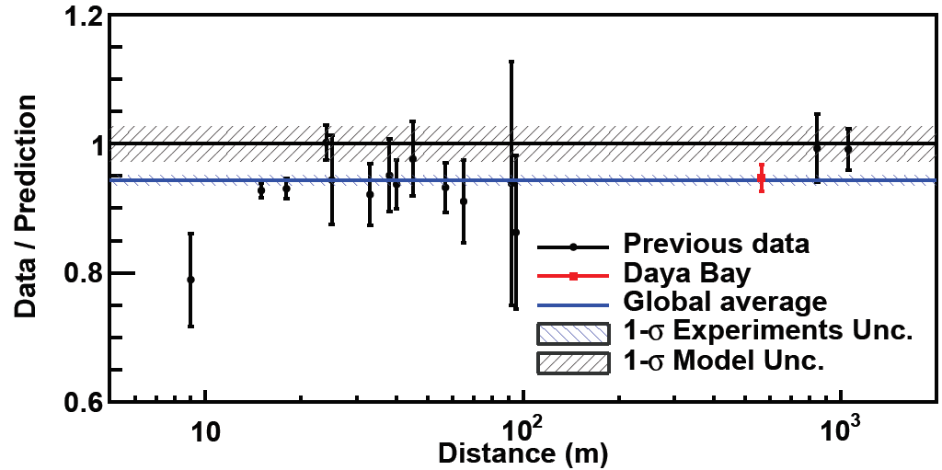
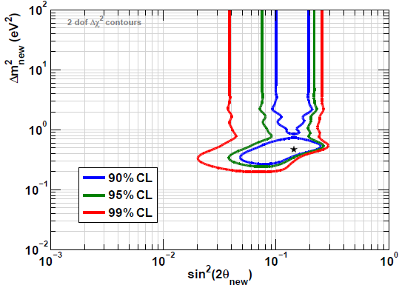
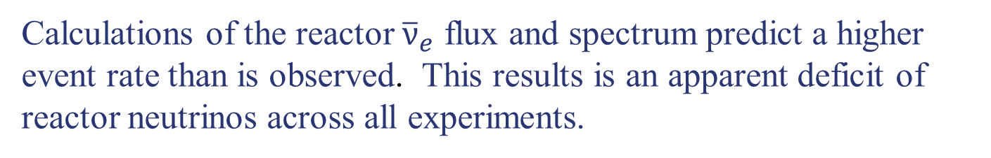
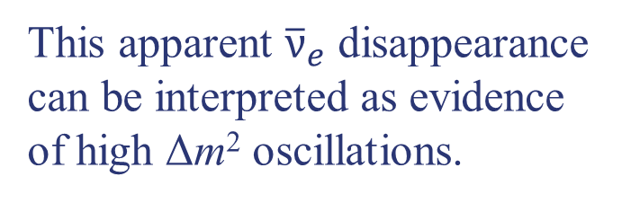
Reactor Anomaly (ν_{e} Disappearance)
Calculations of the reactor ${\overline{ν}}_{e}$ flux and spectrum predict a higher event rate than is observed. This results is an apparent deficit of reactor neutrinos across all experiments.
Daya Bay, Phys.Rev.Lett. 116, 061801 (2016)
Mention et al., Phys.Rev.D83 073006 (2011)
This apparent ${\overline{ν}}_{e}$ disappearance can be interpreted as evidence of high Δm² oscillations.
Rate only analysis

Slide 16
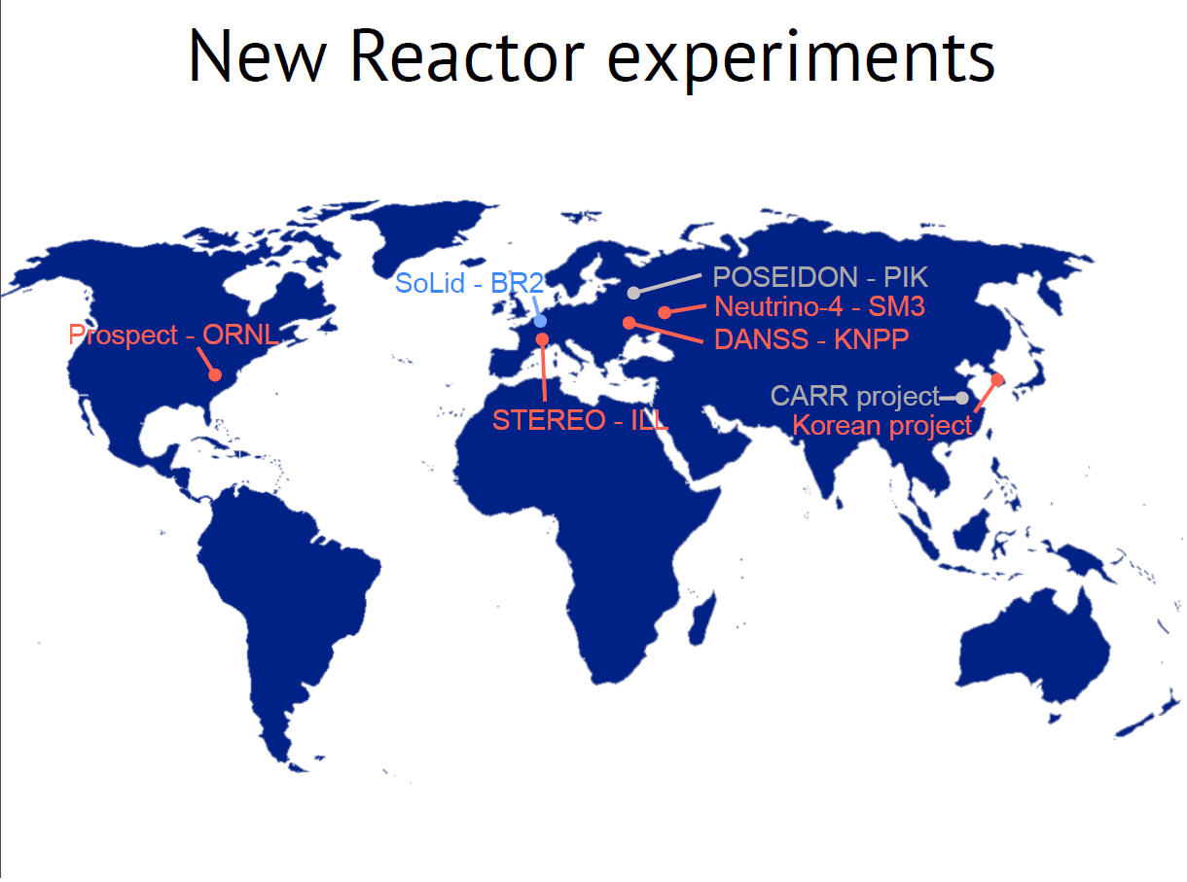
from Antonin Vacheret

Slide 17
Comparison of Reactor Experiments
 | Power (MW) | Compact Core? | Mass (tons) | n Tag | Spatial Resolution (cm) | Energy Resolution (@ 1 MeV) | Baseline (m)
Stereo | 57 | Yes | 1.75 | Gd |  | 11.5% | 9 to 12
DANSS | 3000 | No | 1 | Gd |  |  | 9.7
POSEIDON | 100 | Yes | 1.5 | Gd | 25 |  | 6
Neutrino-4 | 90 | Yes | 0.4 | Gd |  |  | 6 to 11
NEOS (Korea) | 2800 | No | 0.9 | Gd |  | 5% | 25
Prospect | 85 | Yes | 2.9 | ⁶Li | 15 | 4.5% | 7 to 12
SoLid/CHANDLER | 60 | Yes | 3 | ⁶Li | 5 / 6 | 14% / 6% | 5 to 12
NuLat | 50 | Yes | 0.23 | ⁶Li | 6 | 4% | 4.7
Important for background rejection and signal efficiency
Important for oscillometric coverage (L/E resolution and dynamic range)
18

Slide 18
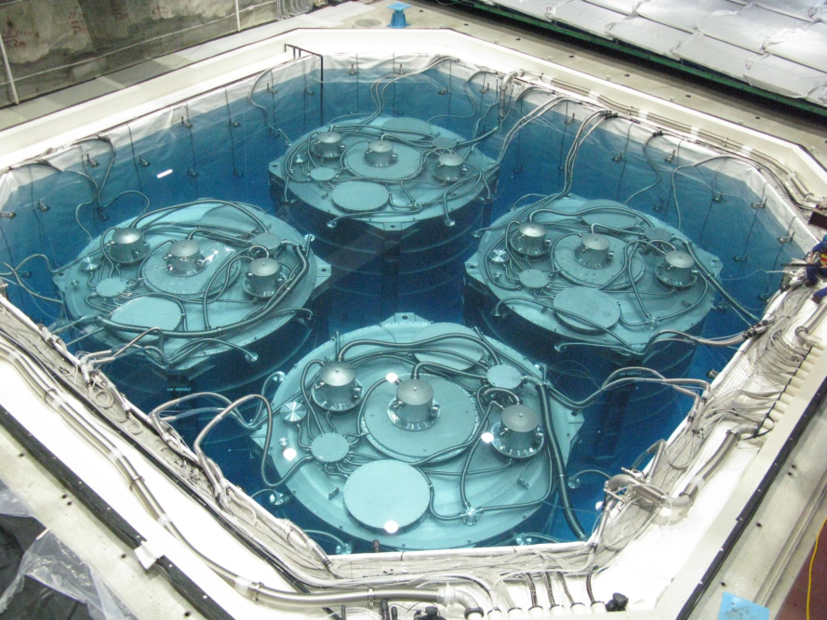
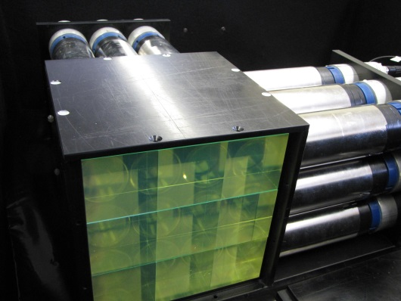
Keys to a Short-Baseline Reactor Experiment
Daya Bay Far Detectors
Unlike the reactor θ₁₃ experiments, short-baseline reactor experiments are done
  on the surface
  with smaller detectors
  without space for massive clean shielding
  or gamma catchers
Reducing random coincidence backgrounds is the most significant challenge.
Dealing with Random Coincidence Backgrounds:
Neutron and gamma shielding
Unbiased spatial resolution Segmentation
High neutron capture efficiency and purity
Gd → ⁶Li
Raghavan Optical Lattice Readout
MicroCHANDLER

Slide 19
Neutron Capture Options
Daya Bay, RENO and Double Chooz tag neutrons with Gd capture, in conjunction with a large gamma catcher to contain the gammas.
This may not work as well in the small short-baseline detectors without a gamma catcher.
Neutron Capture on Gadolinium
Neutron Capture on Lithium-6
γ
n
n
⁴He
γ
γ
⁶Li
Gd
E = 4.78 MeV
Electron Equivalent
~0.5 MeV
E = 8 MeV
³H
γ
γ
Poorly contained in small detectors
Contained in a few μm

Slide 20
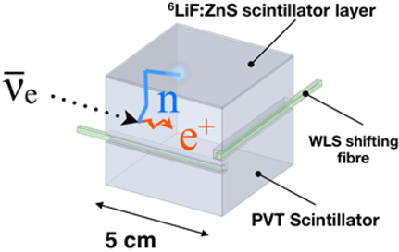
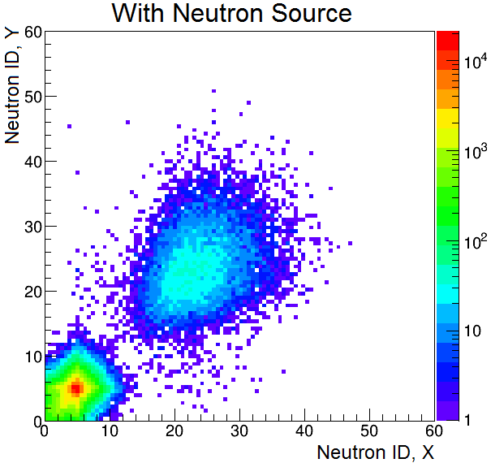
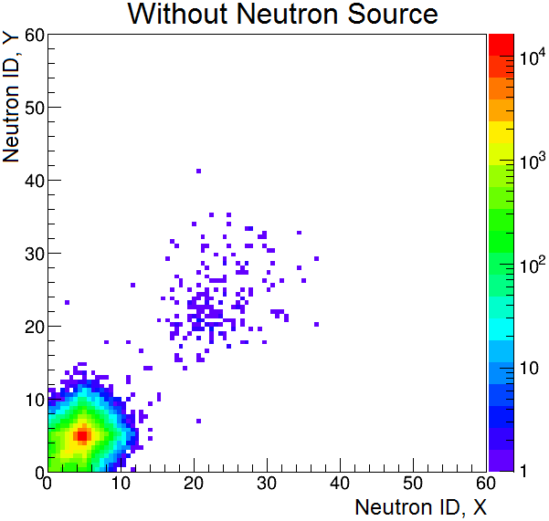
SoLid: Tagging with ⁶Li in ZnS:Ag Sheets
The SoLid detector tags neutrons in thin sheets of ⁶Li-loaded Zinc Sulfide scintillator (ZnS:Ag)
ZnS:Ag releases light with a 200 ns mean emission time which forms a very pure, high efficiency neutron tag.
SoLid achieves unprecedented spatial resolution by segmenting its scintillator in cubes which are readout in two dimensions by wavelength shifting fibers.
Neutron tag in the SoLid inspired CHANDLER detector, which is readout by total internal reflection.

Slide 21
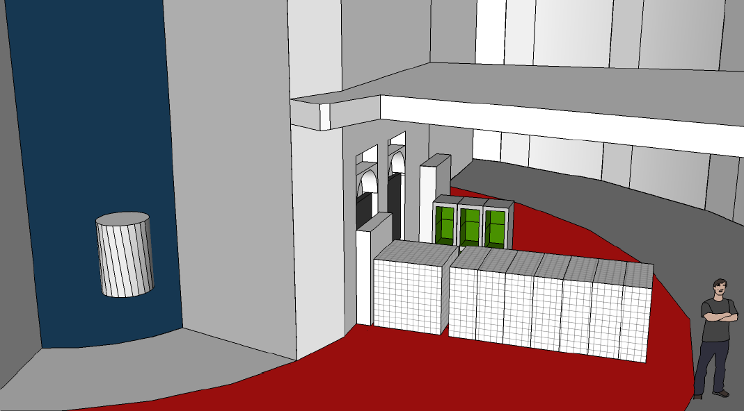
CHANDLER and SoLid
The two detectors will be deployed at the BR2 reactor operating as a single experiment.
50 cm
BR2
CHANDLER
5.5 m
SoLid

Slide 22
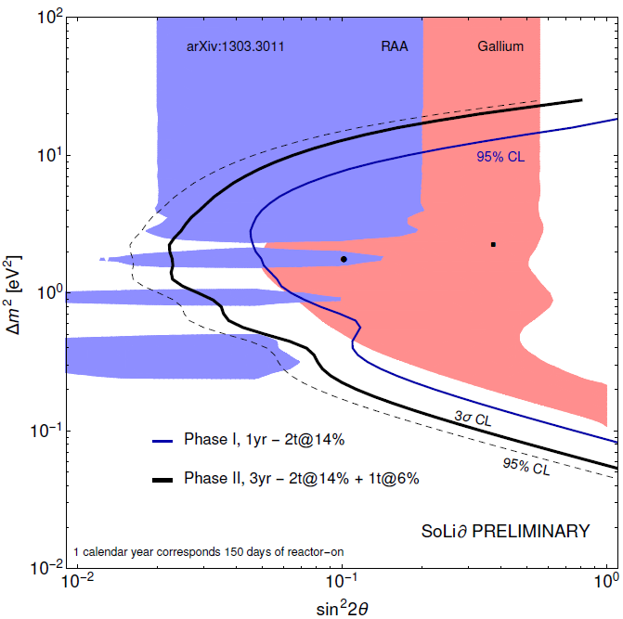
SoLid and CHANDLER Sensitivity
The combined sensitivity for the SoLid/CHANDLER deployment at BR2 is compared to the Gallium and Reactor Anomalies.
The one-year, Phase I SoLid deployment covers most of the low Δm² part of the Gallium Anomaly at 95% CL.
Adding CHANDLER to the three-year Phase II extends the coverage to higher Δm² and pushes the reach well into the Reactor Anomaly.
These sensitivities are purely oscillometric, based on energy spectrum and baseline information alone.
Oscillometric Sensitivity Only
d

Slide 23
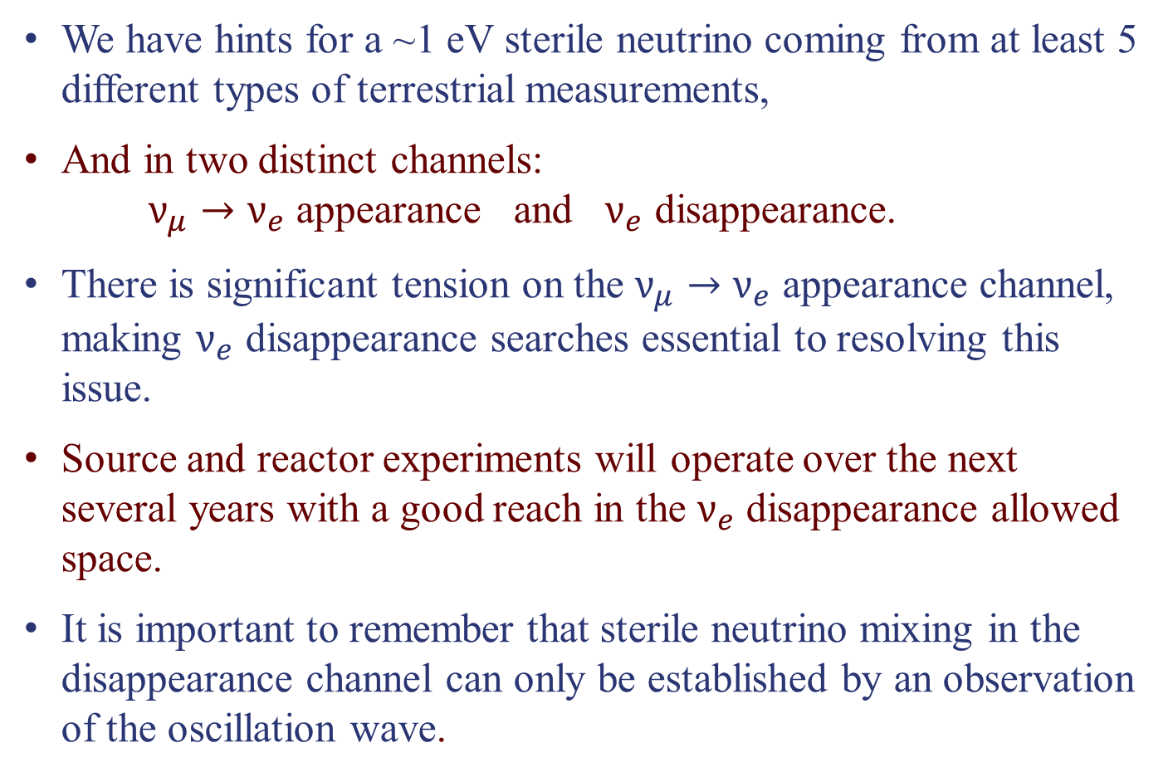
Conclusions
We have hints for a ~1 eV sterile neutrino coming from at least 5 different types of terrestrial measurements,
And in two distinct channels: $ν_{μ}→ν_{e}$ appearance and $ν_{e}$ disappearance.
There is significant tension on the $ν_{μ}→ν_{e}$ appearance channel, making $ν_{e}$ disappearance searches essential to resolving this issue.
Source and reactor experiments will operate over the next several years with a good reach in the $ν_{e}$ disappearance allowed space.
It is important to remember that sterile neutrino mixing in the disappearance channel can only be established by an observation of the oscillation wave.

