Slide 1
Xpantrac Connection with IDEAL
Sloane Neidig, Samantha Johnson, David Cabrera, Erika Hoffman
CS 4624
5/6/2014
Notes:
Erika

Slide 2
Project Specification
Short Description
  Integrating Xpantrac into the IDEAL software suite
  Applying Xpantrac to identify topics for IDEAL webpages
Primary Contact
  Seungwon Yang
Deliverable
  Xpantrac tailored for IDEAL
  Xpantrac tailored for Solr (explained later)
Notes:
Erika

Slide 3
What is Xpantrac?
Seungwon Yang’s dissertation topic
Based on Expansion-Extraction approach
Algorithm to identify topics in a given webpage
Purpose: Tag topics to easily understand document
Previously, only running on Seungwon’s personal data set
  1,000 NYT articles
Notes:
Erika

Slide 4
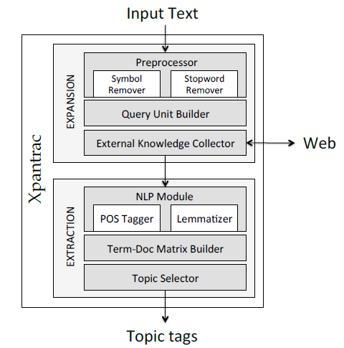
What is Xpantrac?
Input: text file
Build query
  Every 5 words, 1 word overlap
Send query to search API
Find topics in retrieved documents
  Frequency of words
Select most frequent as “topics”
Output: topics
Notes:
Erika

Slide 5
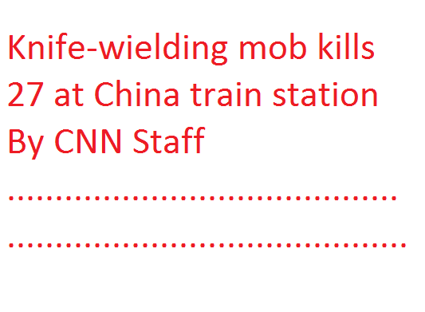
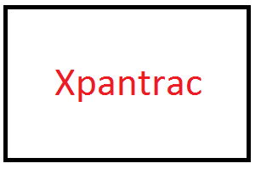
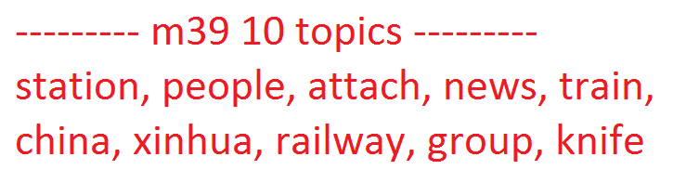

Example Input/Output
Input
Output
Notes:
Erika

Slide 6
Progress at Midterm
Python script written to get HTML out of WARC (web archive) files
Xpantrac currently runs on local data set (50 .txt files) and gives correct output, using Yahoo Web API
Became familiar with Solr and attempted to index CNN news articles
  Stores information like title, first 30 words, last 30 words, etc. to easily use as input for Xpantrac
Notes:
David

Slide 7
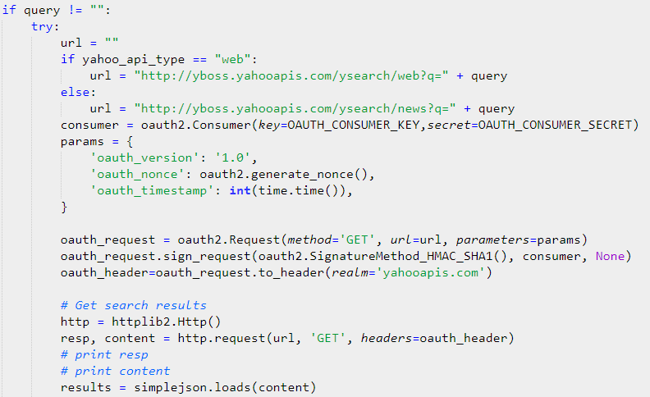
Progress at Midterm: Xpantrac with Yahoo Search API
Yahoo Search API authorization
Input: 0.txt - 50.txt (IDs in plain_text_ids.txt)
Notes:
David

Slide 8
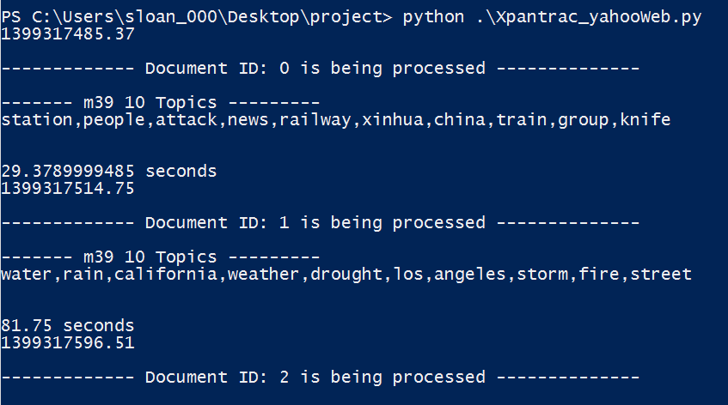
Progress at Midterm: Xpantrac with Yahoo Search API
Notes:
David

Slide 9
Final Progress
Indexed files into Solr
Connected Xpantrac to Solr collection
Evaluated extracted topics (current)
Notes:
David

Slide 10
Indexing files into Solr
Unsuccessful with IDEAL Pages script
Manually indexed files instead
Notes:
David

Slide 11
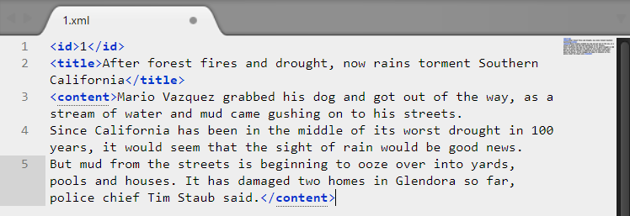
Indexing files into Solr
Indexed 50 CNN files in XML format
<id>, <title>, <content>
Notes:
David

Slide 12
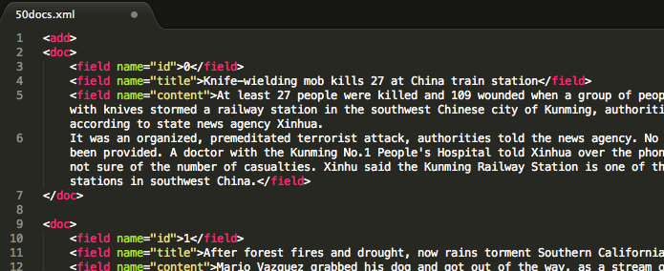
Indexing files into Solr
Errors
  Wrong XML format (<field name=”id” …>)
  Special characters (‘&’)
Notes:
David

Slide 13
Xpantrac for Solr
Successfully indexed files into Solr, but 50 is too small for Xpantrac
Use Seungwon’s Wikipedia collection
  2.8 million documents (and counting)
Modify Xpantrac code
Notes:
Sloane

Slide 14
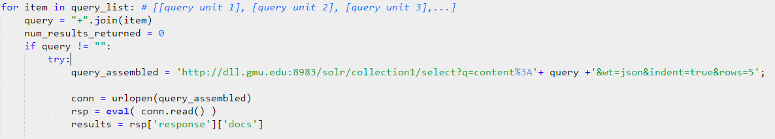
Xpantrac for Solr
Change URL to Seungwon’s collection
field : query
Parse document information from JSON response
Notes:
Sloane

Slide 15


Xpantrac for Solr
Number of topics to find: 10
Number of API results to return: 10
Query unit size: 5
Notes:
Sloane

Slide 16

Xpantrac for Solr
Change how ‘content’ field is handled
Only use first 30 words of content
Get ‘content’ field
Notes:
Sloane

Slide 17
Running Xpantrac
0.txt
(CNN) -- Nine Ringling Bros. and Barnum and Bailey circus performers were among 11 people injured Sunday in Providence, Rhode Island, after an apparatus used in their act failed, circus spokesman Stephen Payne said.
Eight performers fell when the hair-hang apparatus -- which holds performers by their hair -- failed, Payne added. Another performer was injured on the ground, he said.
The performers were among 11 people hospitalized with injuries related to the accident, Rhode Island Hospital spokeswoman Jill Reuter told CNN. One of those people was listed in critical condition, Reuter said.
It was not immediately clear who the other two victims were.
Multiple emergency units responded to the accident at the Dunkin' Donuts Center.
Eyewitnesses told CNN affiliate WPRI that they saw acrobats up on a type of aerial scaffolding doing a "human chandelier" when a cable snapped.
Payne told CNN's Fredricka Whitfield the apparatus had been used for multiple performances each week since Ringling Bros. and Barnum & Bailey lauched its "Legends" show in February.
"Each and every time that we come to a new venue, all of the equipment that is used by this performer -- this group of performers as well as other performers -- is carefully inspected. We take the health and safety of our performers and our guests very seriously, and our company has a safety department that spends countless hours making sure that all of our equipment is indeed safe and effective for continued use," he said.
The circus and local authorities are investigating the incident together, Payne said.
"Legends" began a short Providence residency on Friday. The final five performances there were slated for 11 a.m., 3 p.m. and 7 p.m. on Sunday, and 10:30 a.m. and 7 p.m. on Monday.
"The rest of the (11 a.m. Sunday) show was canceled and we're making a determination about the remainder of the shows for the Providence engagement," Payne said.
Notes:
Sloane

Slide 18
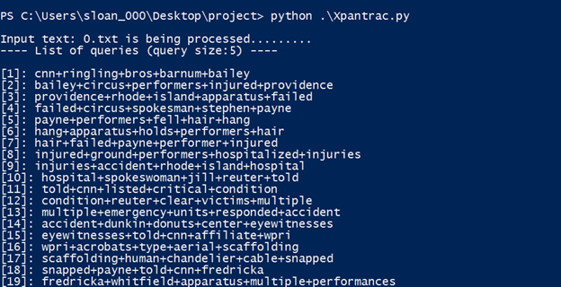
Running Xpantrac
Notes:
Sloane

Slide 19
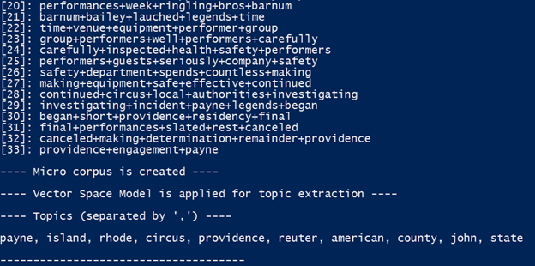
Running Xpantrac
Notes:
Sloane

Slide 20
Xpantrac with IDEAL
IDEAL Pages group given different indexing specifications
“Content” field contains all text in <body> of an HTML page
  We only need relevant article text
{ "content": [ "Google Newsvar GLOBAL_window=window;(function(){function d(a){this.t={};this.tick=function(a,c,b){b=void 0!=b?b:(new Date).getTime();this.t[a]=[b,c]};this.tick(\"start\",null,a)}var a=new d;GLOBAL_window.jstiming={Timer:d,load:a};if(GLOBAL_window.performance&&GLOBAL_window.performance.timing){var a=GLOBAL_window.performance.timing,c=GLOBAL_window.jstiming.load,b=a.navigationStart,a=a.responseStart;0<b&&a>=b&&(c.tick(\"_wtsrt\",void...”], "collection_id": "3650", "id": "7f74825401865487f671bd0fd388ce2b", "_version_": 1465938356823130000 },
Notes:
Erika

Slide 21
Xpantrac with IDEAL
First 30 words of “content” are not useful for our purposes
"Google Newsvar GLOBAL_window window function function d a this t this tick functiona a c b b void b b new Date getTime this t a b c this tick start null a var a new d GLOBAL_window jstiming”
Notes:
Erika

Slide 22
Xpantrac with IDEAL
As an alternative, a SOLR system could
be constructed with the following two constraints:
1. It should index a massive number of documents, so that any documents from users could
be expanded based on indexed information.
2. It should return the most relevant portion of the matching documents, for a query.
Notes:
Erika

Slide 23
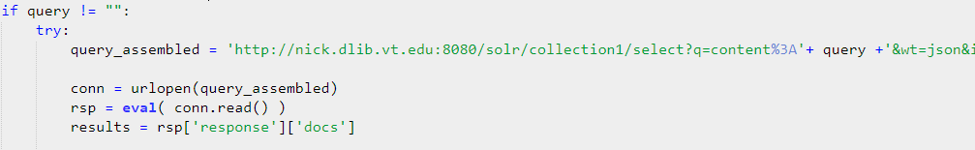
Future: Xpantrac with IDEAL
Solr collection with IDEAL to match our specifications
  “content” field
  “content” only contains actual article information
To connect that collection to Solr:
Notes:
Erika

Slide 24
Evaluating Xpantrac Topics
CTR_30, VARIOUS_30
  Collections of 30 files each
  Assigned topics by humans
gold_ctr30.csv, gold_various30.csv
  “Gold standard topics”, merged
Evaluation Metrics
  Precision, Recall, F1 (tag set score)
Compare
  computePRF1.py gold_ctr30.csv xpantrac.csv
  computePRF1.py gold_various30.csv xpantrac.csv
Notes:
Erika

Slide 25
References
Automatic Identification of Topic Tags from Texts Based on Expansion-Extraction Approach by Yang, Seungwon, Virginia Polytechnic and State University, 2013, 230 pages. (Seungwon’s dissertation)

Slide 26

Questions?

