Slide 1
Asynchronous Module on Zotero
Titilola Obilade
Instructional Design for Distance Learning
November 19, 2011
Notes:
This asynchronous module is to introduce the learners to the use of Zotero. Zotero is a free citation manager that is freely accessible over the Mozilla Firefox browser. There are other citation managers like EndNote, ProCite, Mendeley and Bookends but these are not free. EndNote is free for registered students at Virginia Tech.
This lesson would show you how to import articles into Zotero. It would also show you how to import articles using common formats like the APA 6th edition. Please note that Zotero or any citation manager is not fool proof. I would advise that in addition to importing your articles, you should manually check that the bibliographic format is correct.
There are many tools in Zotero. You can manually add records to your library. You can create in- text citations, add PDF and audio files.
However, for the purpose of this lesson we would only be learning how to import articles into Zotero.
This asynchronous module is self-paced and the estimated time of completion is 30 minutes. The language of instruction is available only in English.
In addition to this asynchronous module, I have made lesson notes in a word document available for those who might be interested.

Slide 2
You can contact me by email <obilade @vt.edu> Welcome to the asynchronous lesson on Zotero!
Please let me know if you have questions. Thank you!
Notes:
Welcome to the asynchronous lesson on Zotero! My name is Titilola Obilade. I would be your instructor for this asynchronous module on Zotero. You can contact me by email at obilade@vt.edu and I would respond to you within 24 hours. Technology can be fickle. If I do not respond to you within 24 hours, please resend your email.
I am a doctoral student at Virginia Tech in the department of Instructional Technology. I have taken online courses before and I know how disconnected students can be from other online students. I encourage students registered in this lesson to answer the following questions and post the answers on the forum on Scholar as a way of knowing one another.
What are your favorite pets?
What is your favorite food?
What is your favorite song and why?
Tell us anything about yourself.

Slide 3
1.) You would need a computer connected to the internet. 2.) You would also need a comfortable seat. 3.) The assessment would be based on the honor code. 4. ) I sent an email a week ago that for this lesson you would need to go to www. Zotero.org and download Zotero using Mozilla Firefox. If you have not already done so, please do so before you continue with this asynchronous module.
For this lesson
Notes:
For this lesson you would need a computer connected to the internet. You would also need a comfortable seat. The assessment would be based on the honor code. I sent an email a week ago that for this lesson you would need to go to www. Zotero.org and download Zotero using Mozilla Firefox. If you have not already done so, please do so before you continue with the lesson.

Slide 4
Lesson Objectives
At the end of the lesson, the learners should be able to:
1.) Download and install Zotero
2.) Import an article into Zotero from Google Scholar
3.) Import an article into Zotero from Summon
Notes:
At the end of the lesson, the learners should be able to
1.) Download and install Zotero
2.) Import an article into Zotero from Google Scholar
3.) Import an article into Zotero from Summon

Slide 5
RATIONALE
Organization of your work
Free Citation Manager
Necessary tool for your graduate work
Notes:
Zotero helps you to organize your work. It is a free citation tool and would be nice to have for graduate work.

Slide 6
1. Download Zotero 2. Install Zotero 3. Import into Zotero 4. Assessments 5. Survey 6. Additional lesson notes available for those that are interested 7. PowerPoint handouts on how to create a bibliography from an article in Zotero available in Scholar 8. Less than 3 minutes You Tube Video on Zotero
LESSON OUTLINE
Notes:
This lesson is divided into several parts;
1.) Download Zotero 2.) Install Zotero 3.) Import into Zotero 4.) Assessments 5.) Survey
6.) Additional lesson notes available for those that are interested
7.) PowerPoint handouts on how to create a bibliography from an article in Zotero available in Scholar
8.) Less than 3 minutes You Tube Video on Zotero

Slide 7
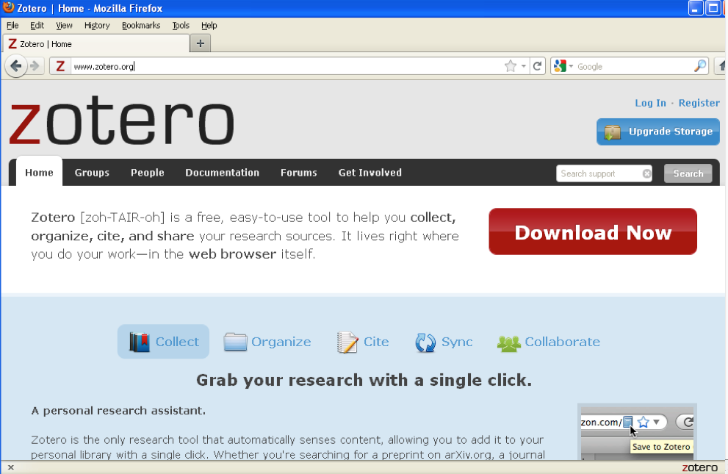
Notes:
On this PowerPoint slide, you will see the address bar that has www.zotero.org. Type this in your address bar. You would see a red box that has download written in it. Click on this download box and download Zotero.

Slide 8
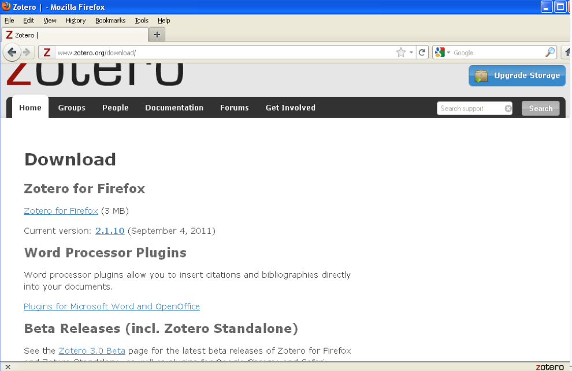
Notes:
After you click on download now you would see this page. Click on Zotero for Firefox.

Slide 9
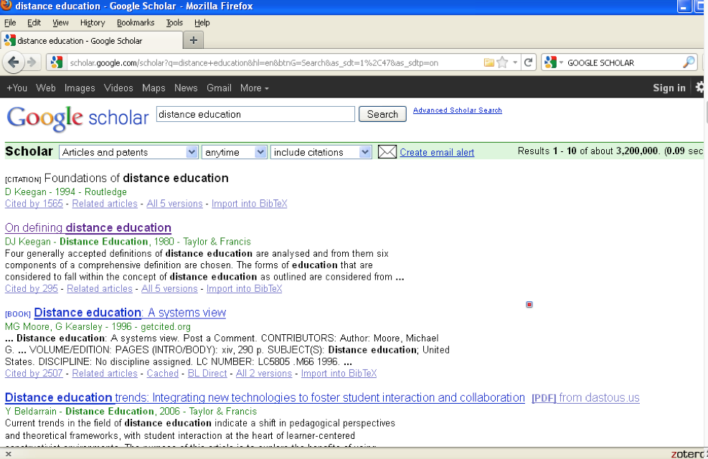
Notes:
In this slide, we shall be importing an article from Google Scholar. Go to Google Scholar by typing in www. Googlescholar.com. When you get into Google Scholar, type distance education inside the search box. You would notice the yellow, Zotero icon on the address bar. It is a yellow folder.
We are going to import the article On defining distance education by DJ Keegan. As soon as you click on the Zotero icon in the address bar, you will see select items box pop up. Inside this select items box you would see On defining distance education.
After you click on On defining distance education, you would notice a rectangular box at the bottom of your browser. This rectangular box indicates that Zotero is saving the selected article into the citation manager.

Slide 10
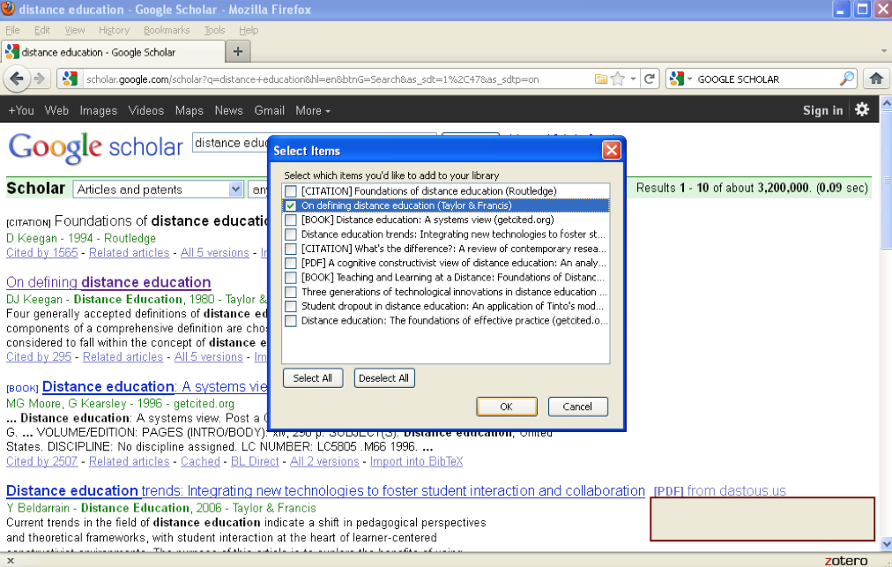
Notes:
In this slide, we shall be importing an article from Google Scholar. Go to Google Scholar by typing in www. Googlescholar.com. When you get into Google Scholar, type distance education inside the search box. You would notice the yellow, Zotero icon on the address bar. It is a yellow folder.
We are going to import the article On defining distance education by DJ Keegan. As soon as you click on the Zotero icon in the address bar, you will see select items box pop up. Inside this select items box you would see On defining distance education.
After you click on On defining distance education, you would notice a rectangular box at the bottom of your browser. This rectangular box indicates that Zotero is saving the selected article into the citation manager.

Slide 11
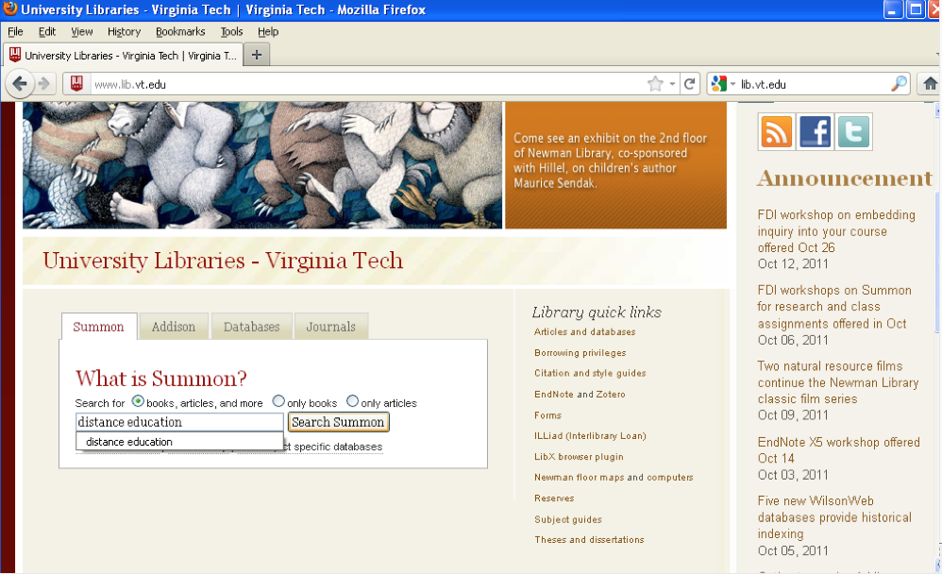
Notes:
In this slide, we shall be importing an article 2010 4th International Conference on Application of Information from Summon. Type, www.lib.vt.edu in your address bar. This should bring you to the home page of the Virginia Tech libraries. Inside the search box of Summon, type, distance education.
Click on Search Summon. You can also type 2010 4th International Conference on Application of Information in your search box but I have typed distance education in the search box.

Slide 12
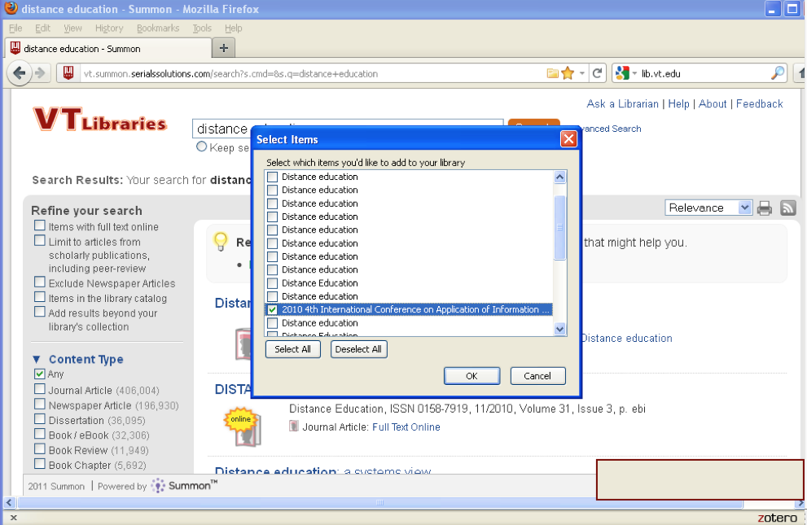
Notes:
In your address bar, you would notice the yellow, Zotero icon. This yellow icon looks like a folder. Click on this yellow icon and a select items box pops up as you can see on your slide.
Inside the select items box , click on 2010 4th International Conference on Application of Information. You would notice a rectangular box at the bottom of your browser indicating that Zotero is saving. You have now added 2010 4th International Conference on Application of Information into your library using Zotero. You would now be assessed in the next few slides.

Slide 13
ASSESSMENT
Import two articles into Zotero
1.) Using Google Scholar, find an article titled, Old concerns with new distance education research and import it into Zotero.
Notes:
We are now on the assessment page. You would import two articles into Zotero
1.) Using Google Scholar, find an article titled, Old concerns with new distance education research and import it into Zotero.

Slide 14
ASSESSMENT
2.) Using Google Scholar, find an article titled, No comparison: Distance education finds a new use for “no significant difference” and import it into Zotero.
Notes:
2.) Using Google Scholar, find an article titled, No comparison: Distance education finds a new use for “no significant difference” and import it into Zotero.

Slide 15
STOP HERE AND WAIT UNTIL YOU HAVE COMPLETED THE ASSESSMENT BEFORE MOVING TO THE NEXT SLIDE. THANK YOU !
Notes:
STOP HERE AND WAIT UNTIL YOU HAVE COMPLETED THE ASSESSMENT BEFORE MOVING TO THE NEXT SLIDE. THANK YOU !

Slide 16
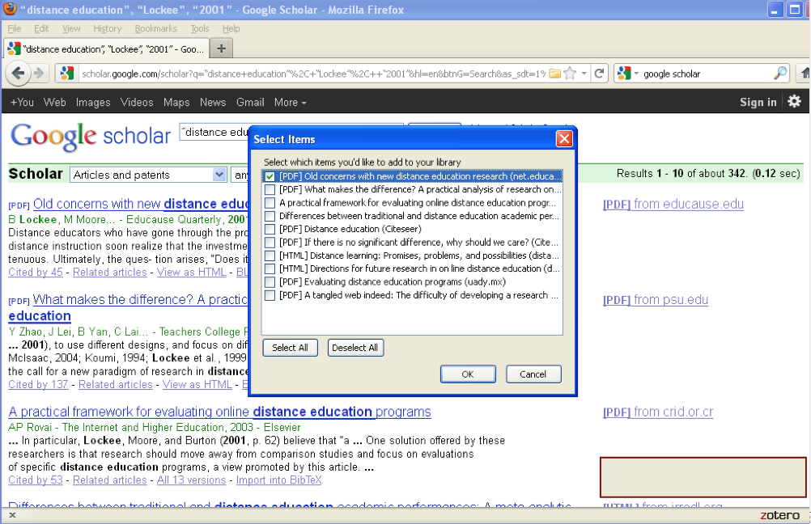
Notes:
This PowerPoint slide is a screen shot to the first assessment. You can see the box highlighted on Old concerns with new distance education research.
This is how your screen should look like if you have been able to correctly import the article and saved into Zotero.
I have put the red arrows indicating items that you should see.

Slide 17
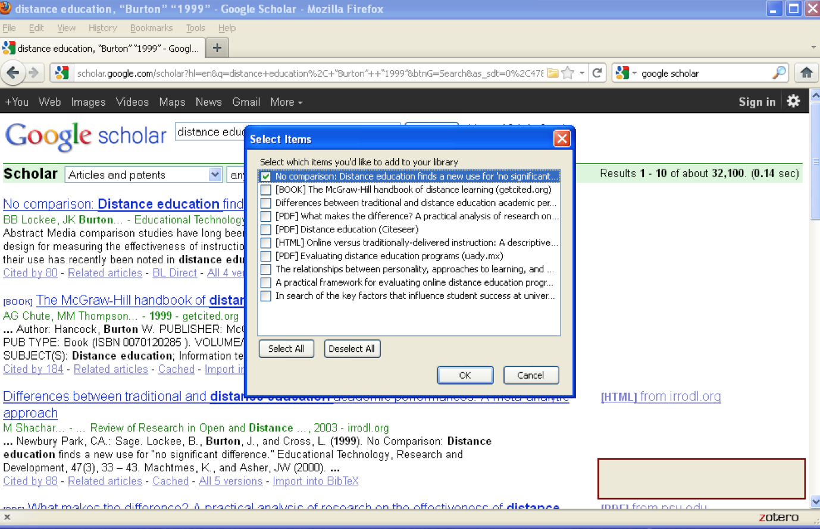
Notes:
This slide shows the screen shot to the second assessment on importing the article No Comparison: Distance education finds a new use for “no significant difference” into Zotero from Google Scholar.
If this has been successfully selected, it would be saved to Zotero.
I have put the red arrows indicating items that you should see.
The next slide is an evaluation of this asynchronous module.

Slide 18
Evaluation
1.) Based on today’s lesson would you begin to use Zotero? Yes No
2.) Based on your learning experience today, would you register for on line classes in the future? Yes No
3.) Was the lesson on Zotero easy to understand? Yes No
4.) Were the Power Point Slides adequate for the instruction? Yes No
5.) Were you able to complete the lesson on downloading and installing Zotero and importing into Zotero under thirty minutes? Yes No.
Notes:
The next two slides are on the evaluation of this lesson. This slide is a preview of the questions that you would see on the survey. This is an anonymous survey. : Based on today’s lesson would you begin to use Zotero? Yes No
2.) Based on your learning experience today, would you register for on line classes in the future? Yes No
3.) Was the lesson on Zotero easy to understand? Yes No
4.) Were the Power Point Slides adequate for the instruction? Yes No
5.) Were you able to complete the lesson on downloading and installing Zotero and importing into Zotero under thirty minutes? Yes No.

Slide 19
SURVEY TOOL
https://survey.vt.edu/survey/entry.jsp?id=1321564797594
The survey questions contain the exact questions in the previous slide. I included the survey questions in the previous slide under evaluation to familiarize you with the survey questions.
At the end of the survey questions, you would also be asked to give any additional comments.
Thank you.
Notes:
Please click on the link and answer the survey. Thank you for your time.

Slide 20
SCHOLAR (Asynchronous Module)
Additional Resources in Scholar
1.) Power Point handout on how to create a bibliography from Zotero (This asynchronous module was on how to import into Zotero).
2.) Less than 3 minutes You Tube Video on how to use Zotero
http://youtu.be/pq94aBrc0pY
**Don’t forget to post your answers on your favorite pets and favorite songs inside the forum on Scholar.
Wishing you my best,
Titilola
Notes:
You have successfully come to the end of the lesson on Zotero. However, I would like to remind you of the following resources. Inside Scholar, under asynchronous module, you would see the PowerPoint handout on how to create a bibliography from Zotero. (This asynchronous module was on how to import into Zotero).
You would also see a link to a You Tube Video on Zotero. The video is less than 3 minutes. The handout and the link can be found inside the resources folder of the asynchronous module inside Scholar.
As a way of being connected to other online students, I encourage you to post your answers on your favorite pets and favorite songs inside the forum. It has been nice working with you.
I wish you my best. Titilola

