Slide 1
Team 12: Final Report
Automatic Summarization of News Articles about Hurricane Florence
CS 4984/5984
Instructor: Dr. Edward Fox
Frank Wanye
Samit Ganguli
Joy Zhang
Matt Tuckman
Department of Computer Science
Virginia Tech
Blacksburg, VA 24061
December 4, 2018

Slide 2
Introduction
Hurricane Florence dataset - 10948 Records
Followed 10-step approach
Included steps to familiarize ourselves with NLP
  WARC to JSON conversion
  Finding frequent words
  Finding important words, collocations, named entities
  LDA
  Part-of-speech tagging
Tools used
  PySpark, TensorFlow, Python, Hadoop cluster, Anaconda, Gensim, NLTK^{[2]}, Solr, Screen
Notes:
FRANK

Slide 3
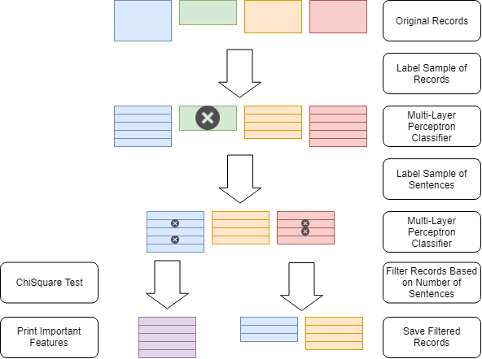
Identifying Discriminating Features
Notes:
FRANK

Slide 4
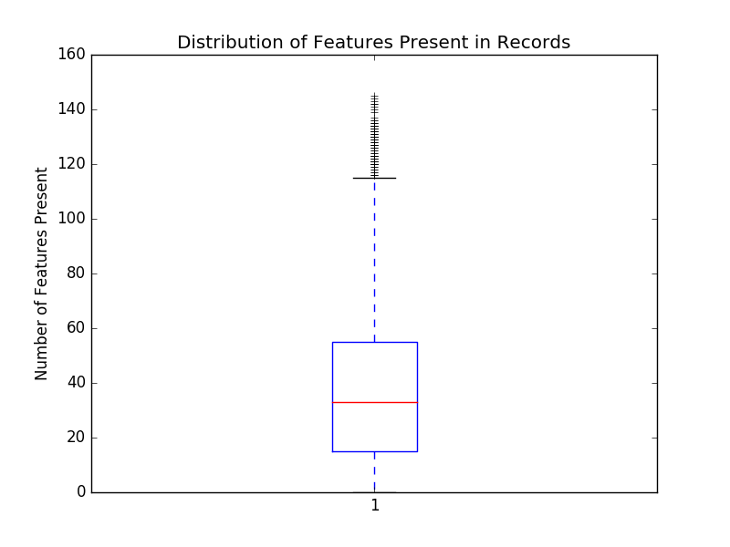
Sample Labeling
Multi-layer Perceptron Classifier
Based on number of features present
Use hard rules to label more irrelevant records
Labeled sample split into train and test set with 7:3 ratio
Train set imbalanced (more irrelevant records than relevant ones)
  Undersampling
  Add remainder of records to test set
Final results:
  42,017 relevant sentences
  2,465 relevant records
Notes:
FRANK

Slide 5
Template Summary Simple Questions
Questions based on Hurricane Metadata page
First approach was to use exclusively regular expressions
  ’Hurricane ([A-Z][a-z]+)’
  Frequency count / numerical analysis
Pros
  Very accurate results
Cons
  Difficulty in regular expression generation
  Too few results
Looked to spaCy to help extract specific values.
Notes:
MATT

Slide 6
Template Summary Remaining Holes
Basic sentence filtering to a certain subject
  Filter to all sentences with the word ‘landfall’
spaCy tag all entities in the sentences
  Now look at ‘DATE’, ‘QUANTITY’, and ‘GPE’ tags separately
Filter to relevant entities
  Only look at ‘DATE’ entities
Numerical analysis, regex matching, and unit conversions
  Find the most common year, then the most common month in that year, then the most common day in that month
Repeat for other entities / other information
  ‘GPE’ for what states the storm hit
  ‘QUANTITY’ for measurements at time of landfall’
  Regex for category of storm at landfall
Notes:
MATT

Slide 7
Template Summary Results
Hurricane Florence was a huge storm occurring during the month of September 2018 which peaked as a Category 4 hurricane. The storm was first detected around September 9, 2018 when it was known as Tropical Storm Florence and the storm grew in size and ferocity until it become known as a hurricane. As the storm progressed, wind speeds were seen to be ranging from as low as 79 miles per hour to an astounding 139 miles per hour at the peak of the storm. Most areas that were affected by the storm had winds of 109 miles per hour on average when the storm hit them. For rainfall, some areas experienced as much as 32 inches of rain, however other areas on the fringes of the storm only got 5 inches. On average however, most areas affected by the storm had 18 inches of rainfall. During the storm's lifetime, it averaged a diameter of 400 miles across and at its peak reached over 470 miles.
In preparation for the storm's approach, evacuation was determined necessary in South Carolina, Virginia, and North Carolina. About 1.5 million people were evacuated in total over this area and have moved out of the storms primary path. Hurricane Florence made landfall as a Category 1 hurricane on September 12, 2018. The storm landed in both North Carolina and South Carolina. Throughout it's vicious path, Hurricane Florence killed 55 people and caused billions of dollars in damages.
Paragraphs |  |  |  | Sentences
ROUGE-SU4 | ROUGE-L | ROUGE-2 | ROUGE-1 | ROUGE-2 | ROUGE-1
0.08537 | 0.2 | 0.03448 | 0.23333 | 0.42857 | 0.66667
Notes:
MATT

Slide 8
Extractive Summary
PyTeaser: Python port of TextTeaser
  Needs URL to scan webpage
  Scores sentence with regards to title, sentence length, position, and keyword frequency
  Preprocessing/filtering issues
Summa: Implementation of TextRank^{[1,6]}
  Does not need URLs
  Faster than PyTeaser
Lexical Chains: Attempted method following Dr. Hollingsworth of University of Georgia’s patent^{[3–5]}
  Used Skimcast to test summarize randomly selected records that were concatenated together and generated a cohesive summary
  Generated extractive summary seemed more personal
Notes:
JOY

Slide 9
Extractive Summary - Implementation
Clean the dataset
From the JSONs iteratively extract the URLs and get the summary from text in the corresponding webpage
Append the summaries in a list and then concatenate 20 such summaries to a single string that has 100 sentences
Repeat until final summary is generated ( ~1 page/20 sentences)
Manually clean summary

Slide 10
Extractive Summary - Results
Excerpts from generated summary:
Hurricane Florence becomes first major storm of 2018 Atlantic season. The sixth named storm of the 2018 Atlantic hurricane season gathered strength Wednesday to become the first major hurricane of the year.
A million told to flee as Hurricane Florence stalks US East Coast.
Trump: "We are totally prepared" for Hurricane Florence. President Trump just had a meeting with the Department of Homeland Security and Federal Emergency Management Agency officials as Hurricane Florence continues to barrel toward the East Coast.
Paragraphs |  |  |  | Sentences
ROUGE-SU4 | ROUGE-L | ROUGE-2 | ROUGE-1 | ROUGE-2 | ROUGE-1
0.06707 | 0.23333 | 0.0 | 0.26667 | 0.50 | 0.80
Notes:
These are our rouge scores

Slide 11
Abstractive Summary: Clustering
Can’t combine articles together - articles that are too long are harder to summarize
Used clustering to identify topics
  Different methods:
    LDA
    K-Means
    Bisecting K-Means (didn’t work)
  Different inputs:
    Word counts
    TF-IDF word scores
  Different number of topics
    5 - 10 - 15 - 20 - 25
Hard to compare b/n LDA and K-Means, since the measures were different
  Resorted to comparing how ‘balanced’ the clusters were
Picked LDA with TF-IDF word scores and 10 topics

Slide 12
Abstractive Summarization - Pointer-Generator
Used a pre-trained Pointer-Generator model^{[7]}
Selected ‘best’ article from each cluster
Combined resulting summaries
Manually edited the resulting summary
  Fixed punctuation
  Fixed capitalization
  Deleted duplicate sentences
  Deleted unrelated sentences
Notes:
SAMIT

Slide 13
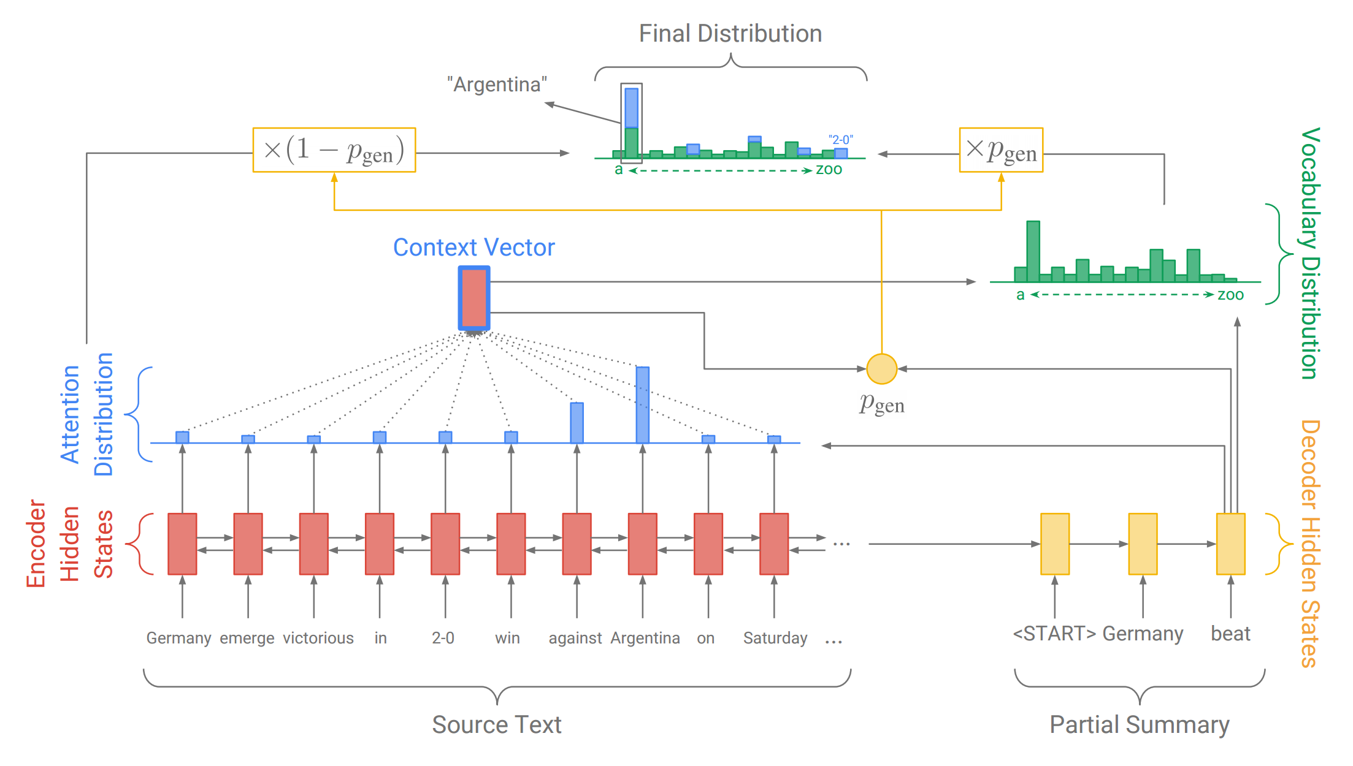
The Pointer-Generator Model^{[7]}

Slide 14
Abstractive Summary - Results
Excerpts from generated summary:
His wife Angie Wood said their home was also flooded by the nearby little river after Matthew, but not nearly to the same levels.
Florence will likely hit land as a category 4 hurricane late thursday evening before weakening again.
The storm was moving west at 13 mph (20 kmh) and expected to accelerate over the next 36 hours.
Flood waters from the cresting rivers inundated the area after the passing of Hurricane Florence.
Paragraphs |  |  |  | Sentences
ROUGE-SU4 | ROUGE-L | ROUGE-2 | ROUGE-1 | ROUGE-2 | ROUGE-1
0.08537 | 0.26667 | 0.06897 | 0.26667 | 0.25000 | 0.50000
Notes:
SAMIT

Slide 15
Lessons Learned / Challenges
Extractive and abstractive summaries contained too much irrelevant information
  Need better ways to clean our data
Extractive and abstractive summaries had poor flow/cohesion
  Could sort articles by date
Summaries contained duplicate information
  Find a way to remove duplicates
Hard to analyze clustering results
  Need a common metric between LDA and K-Means
Lots of time spent debugging PySpark errors
  Should have gone through some PySpark tutorials
Notes:
FRANK

Slide 16
Acknowledgements & Sponsor
Team 7
  For their help with the pointer-generator network
Team 9
  For generating a Golden Standard Summary
Michael Horning
  For his help with the Golden Standard Summary
James Xie, Lei Xu
  For making their sequence-to-sequence model available on GitHub
Abigail See
  For making the Pointer-Generator model available on GitHub
Xiao Hu
  For adapting TextTeaser into a Python library
Jolo Balbin
  For releasing the original TextTeaser API
Liuqing Li
  The GTA for the course
Dr. Edward Fox
  The instructor for CS 4984/5984
The SummaNLP organization
  For making the Summa library available on GitHub
Funding
  NSF Grant No. IIS-1619028.

Slide 17
References
[1] Federico Barrios, Federico López, Luis Argerich, and Rosita Wachenchauzer. 2015. Variations of the Similarity Function of TextRank for Automated Summarization. In Proceedings of Argentine Symposium on Artificial Intelligence, 65–72. Retrieved December 3, 2018 from http://sedici.unlp.edu.ar/handle/10915/52082
[2] Steven Bird, Ewan Klein, and Edward Loper. 2009. Natural Language Processing with Python. O’Reilly Media. Retrieved October 7, 2018 from http://www.nltk.org/book_1ed/
[3] W. A. Hollingsworth. 2008. Using lexical chains to characterise scientific text. University of Cambridge. Retrieved November 28, 2018 from https://ethos.bl.uk/OrderDetails.do;jsessionid=0D6EA59350E32781968819AF3DDB5D5F?uin=uk.bl.ethos.604174
[4] William Hollingsworth. Accessible Learning - With Artificial Intelligence. Accessible Learning. Retrieved November 28, 2018 from http://accessible.blog/
[5] William Hollingsworth. 2007. US8676567B2 - Automatic text skimming using lexical chains - Google Patents. Retrieved November 28, 2018 from https://patents.google.com/patent/US8676567
[6] Rada Mihalcea and Paul Tarau. 2004. TextRank: Bringing Order into Text. In Proceedings of EMNLP, 404–411. Retrieved December 3, 2018 from http://aclweb.org/anthology/W04-3252
[7] Abigail See, Peter J. Liu, and Christopher D. Manning. 2017. Get To The Point: Summarization with Pointer-Generator Networks. In Association for Computational Linguistics, 1073–1083. DOI:https://doi.org/10.18653/v1/P17-1099

