Slide 1
ATinstagram
Mason Barden
Steve Cho
Nicholas Halstead
Tashi Jeshong and
Zubin Joseph
CS 4624 Multimedia
Hypertext & Information Access
Edward Fox
Virginia Tech , Blacksburg VA 24061
May 9, 2022
Notes:
Zubin

Slide 2
Outline
Main Goal/Deliverables
Timeline
Project Results
  Sentiment Analysis
  Geo Locations
  Visualizations
Lessons Learned/Future Plans
Acknowledgements
References
Notes:
Zubin

Slide 3
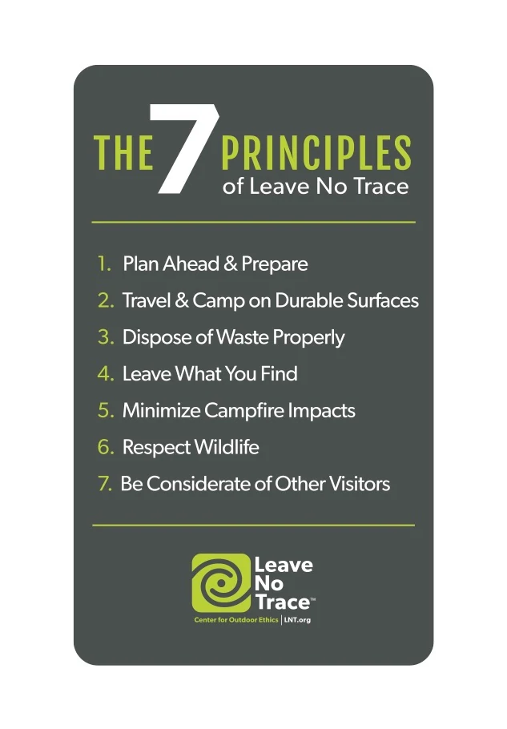
Main Goal/Deliverables
Visualization(s) of analysis on Leave No Trace (LNT) related posts
Quantitative analysis of distribution of hashtags

Slide 4
Timeline
January
February
March
April
Initiated data scraping and cleaning
Gathered requirements from sponsors
Completed data scraping and cleaning
~120k posts collected
Collected geo-locations of posts
Started working on sentiment analysis
Completed sentiment analysis
Created visualizations based off collected data

Slide 5
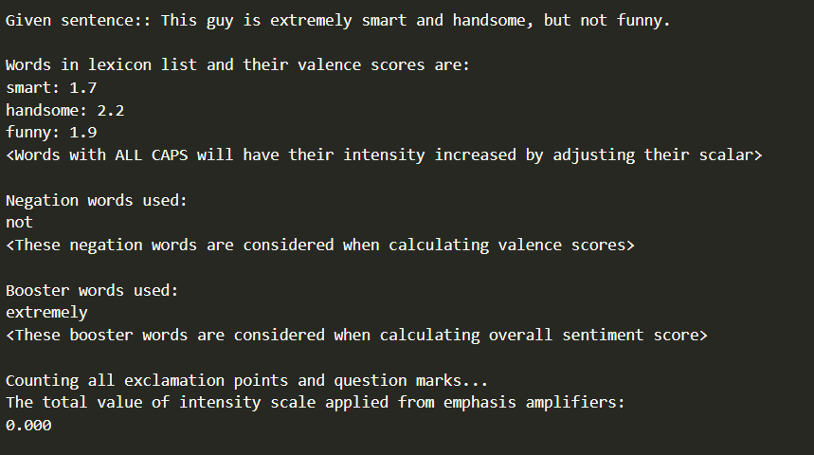
Sentiment Analysis Format (1)
Input sentence
Words in the lexicon list and their valence scores
Negation words
Booster words
Exclamation points/Question marks
Notes:
Steve

Slide 6
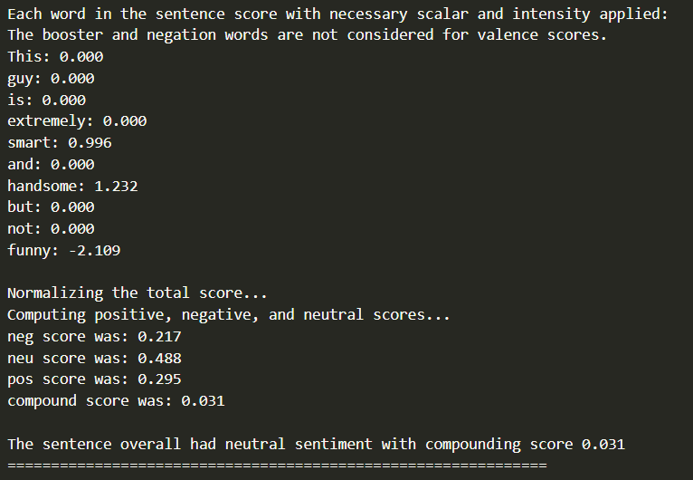
Sentiment Analysis Format (2)
Sentiment scores of each word
Positive, negative, and neutral scores
Total score
1.
2.
Notes:
Steve

Slide 7
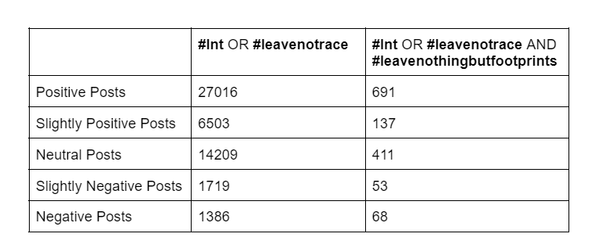
Sentiment Analysis Results
Notes:
Steve

Slide 8
Sentiment Analysis Results
 | #atsobo2021 | #atnobo2021 | #atclassof2021 | #appalachiantrail
Positive Posts | 48 | 73 | 89 | 796
Slightly Positive Posts | 15 | 15 | 24 | 163
Neutral Posts | 35 | 185 | 43 | 594
Slightly Negative Posts | 8 | 1 | 3 | 63
Negative Posts | 6 | 6 | 2 | 45
Notes:
Steve

Slide 9
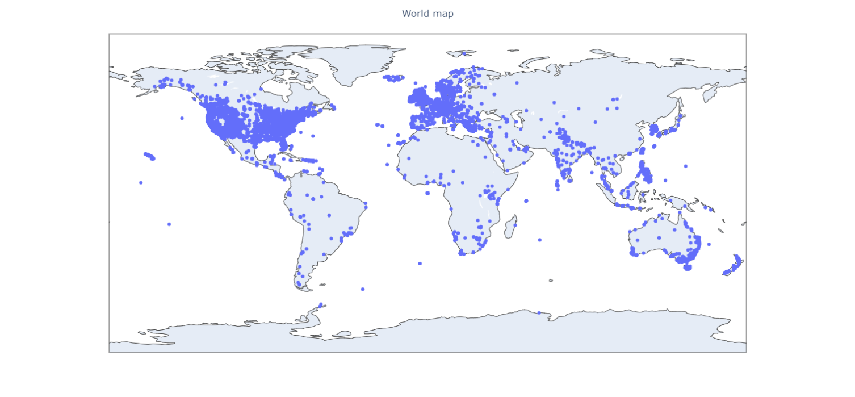
Geo-Location of Posts

Slide 10
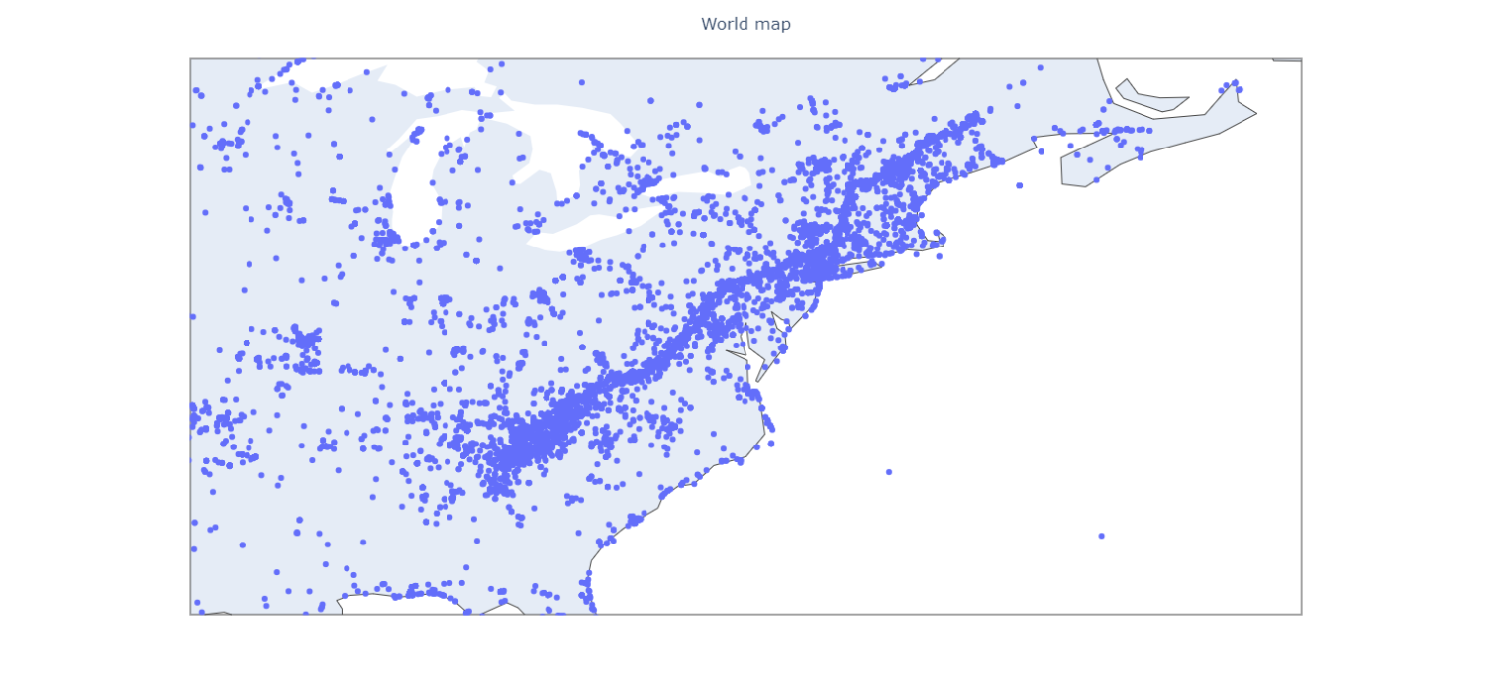
Zoomed in on Appalachian Trail

Slide 11
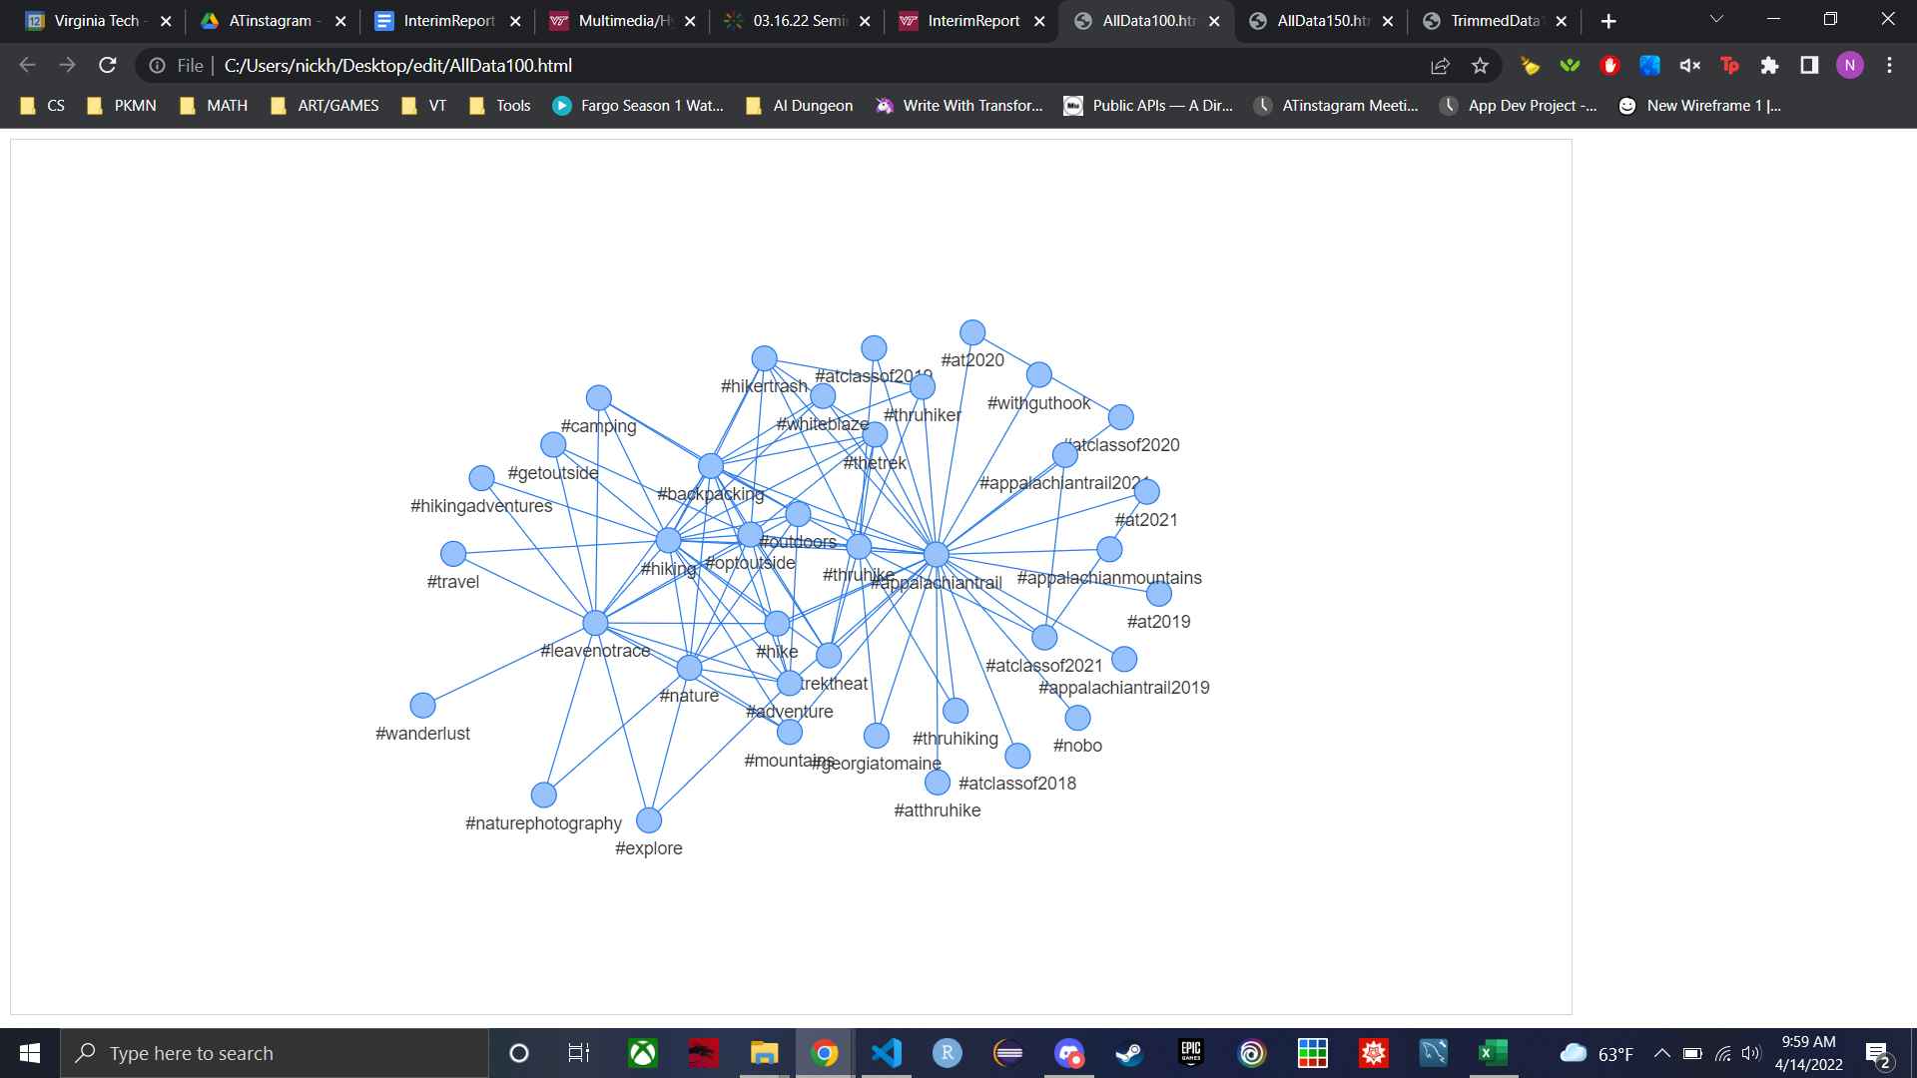
Visualization Results
Top 100 most
frequently occurring
tag combinations
from all of the data collected.

Slide 12
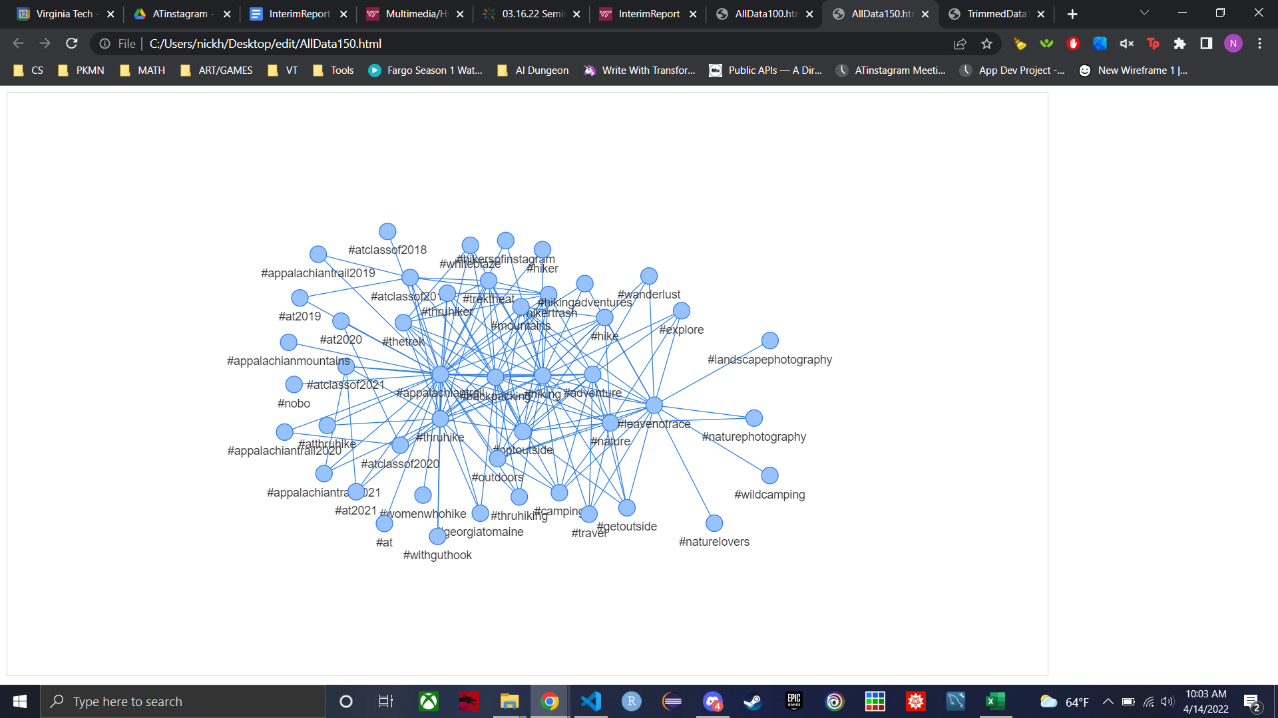
Visualization Results (2)
Top 150 most
frequently occurring
tag combinations
from all of the data collected.

Slide 13
Lessons Learned
Maintaining time management skills and communication
Planning
Add time for debugging
Comment code for future users

Slide 14
Future Plans
Use something other than Selenium to scrape Instagram data
Use a different sentiment analysis technique and compare results

Slide 15
Acknowledgements
CLIENTS
Primary Contact:
Computer Science Ph.D. student Morva Saaty, morvasaaty@vt.edu
Other Project Members:
Computer Science Professor, Scott McCrickard
School of Urban & International Affairs, Kris Wernstedt
School of Urban & International Affairs, Shalini Misra
USGS & Department of Forest Resources, Jeff Marion

