Slide 1

An Open Solution for Urgent Problems
Increasing Research Quality,
Reproducibility, and Diversity
Jeffrey Spies
@jeffspies
Presented at Virginia Tech, 2017/10/18

Slide 2
Background
Computer Science
Statistics
Psychology

Slide 3
About me
Research Technologist and Methodologist

Slide 4
I want to help people.
I want to reduce suffering.
I want to save lives.

Slide 5
How many lives can I help make better?
How many lives can I save?

Slide 6
Cumulative.
Exponential.
Longitudinal.

Slide 7

Mission
Increase openness, integrity, and reproducibility of scholarly research.
Notes:
Non-profit in Charlottesville, VA
Our mission…

Slide 8
…in service of increased research efficiency, quality, innovation, inclusion, and diversity.

Slide 9
Everything we do is free and open.
Notes:
Entirely grant and foundation funded

Slide 10








More at
http://cos.io/about/our-sponsors

Slide 11
Problem
The gap between scholarly values and practices.

Slide 12
Incentives for individual success are focused on getting it published, not getting it right.
Nosek, Spies, & Motyl, 2012

Slide 13
…not focused on
Rigor, reproducibility, replicability, reuse, and extension.

Slide 14
What is published? What is not?
Novel results
Positive results
Clean results
Replications
Negative/Nulls
Mixed evidence

Slide 15
Norms
Counternorms
Communality
Open sharing
Secrecy
Closed
Anderson, Martinson, & DeVries, 2007
Notes:
Here’s a great study by Anderson et al. really driving home how bad this problem is.
They laid out norms and counter norms as follows

Slide 16
Norms
Counternorms
Communality
Open sharing
Universalism
Evaluate research on own merit
Secrecy
Closed
Particularlism
Evaluate research by reputation
Anderson, Martinson, & DeVries, 2007

Slide 17
Norms
Counternorms
Communality
Open sharing
Universalism
Evaluate research on own merit
Disinterestedness
Motivated by knowledge and discovery
Secrecy
Closed
Particularlism
Evaluate research by reputation
Self-interestedness
Treat science as a competition
Anderson, Martinson, & DeVries, 2007

Slide 18
Norms
Counternorms
Communality
Open sharing
Universalism
Evaluate research on own merit
Disinterestedness
Motivated by knowledge and discovery
Organized skepticism
Consider all new evidence, even against one’s prior work
Secrecy
Closed
Particularism
Evaluate research by reputation
Self-interestedness
Treat science as a competition
Organized dogmatism
Invest career promoting one’s own theories, findings
Anderson, Martinson, & DeVries, 2007

Slide 19
Norms
Counternorms
Communality
Open sharing
Universalism
Evaluate research on own merit
Disinterestedness
Motivated by knowledge and discovery
Organized skepticism
Consider all new evidence, even against one’s prior work
Quality
Secrecy
Closed
Particularism
Evaluate research by reputation
Self-interestedness
Treat science as a competition
Organized dogmatism
Invest career promoting one’s own theories, findings
Quantity
Anderson, Martinson, & DeVries, 2007
Notes:
Then they asked researchers to endorse either the norm or the counter norm. Here’s what they found….

Slide 20
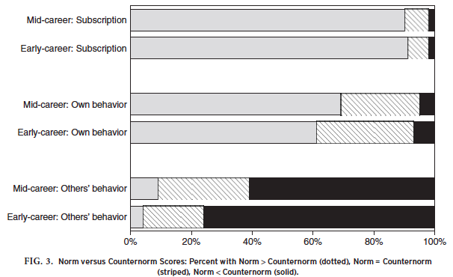
Anderson, Martinson, & DeVries, 2007
Notes:
When asking them what they subscribed to—what they believed—the majority endorsed more norms than counter norms

Slide 21
Anderson, Martinson, & DeVries, 2007
Notes:
However, when asked how they behaved, the story changed a bit—more people endorsed the same number of counter norms as norms or even more counter norms. And then the kicker…

Slide 22
Anderson, Martinson, & DeVries, 2007
Notes:
When asked what others did: they lie, cheat, and steal.
So what are researchers supposed to do? Incentives are skewed and everyone else is doing the counter normative behavior. They’re probably going to slip.
A lot of psychology to back this up: motivated reasoning, minimal accountability, people are busy.

Slide 23
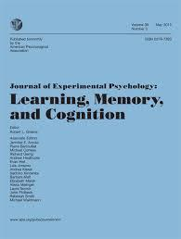
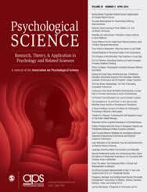

Reproducibility Project: Psychology http://osf.io/ezcuj
JEP:LMC
PSCI
JPSP
Notes:
-Project volunteers produced a list of feasible studies from the 2008 issues of 3 prominent journals (PSCI, JEPLMC, & JPSP)
-The 2008 issue was chosen because it’s recent enough that original authors should still have materials, but old enough to have impact metrics to use as predictors of reproducibility
-Replicators chose a study to replicate from this list.
-In the case of multi-study articles, the last study was the key target of replication unless it was not feasible, in which case the before last study was selected

Slide 24
97%
37%
xx
Open Science Collaboration, 2015, Science
Notes:
Lots of commentary; one of the virtues of open
Biomedical:
Amgen: 11, Bayer 21

Slide 25
97%
37%
xx
Open Science Collaboration, 2015, Science
Notes:
Doesn’t tell us much
Not fraud-–other issues: human psychology and incentives
Demonstration that science is working correctly

Slide 26
Open is the solution.
We’re making progress.

Slide 27



Signals Make Behaviors Visible
http://cos.io/badges
Notes:
Psychological Science (Jan 2014)

Slide 28
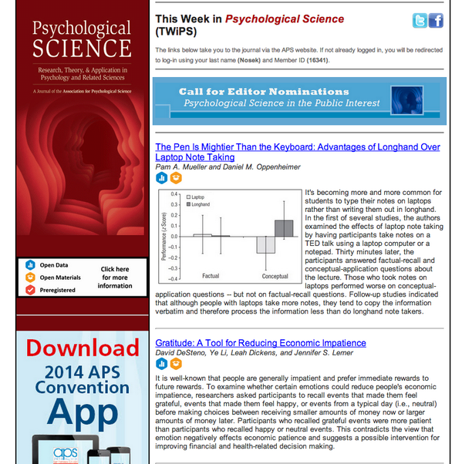

Slide 29
Data Availability in Psychological Science
Notes:
10x increase from 2013 to 2015

Slide 30
Grand challenges.
Notes:
Are we moving fast enough?
They call it grand challenges….

Slide 31


Slide 32
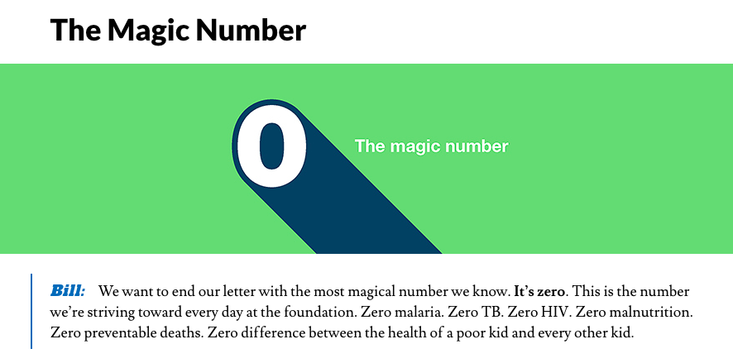

Slide 33
Notes:
A lot of people dealing with stuff on a day to day

Slide 34
Cervical Cancer in India
25% of all cases
74k deaths annually
1 in 53 women vs. 1 in 100
Preventable

Slide 35
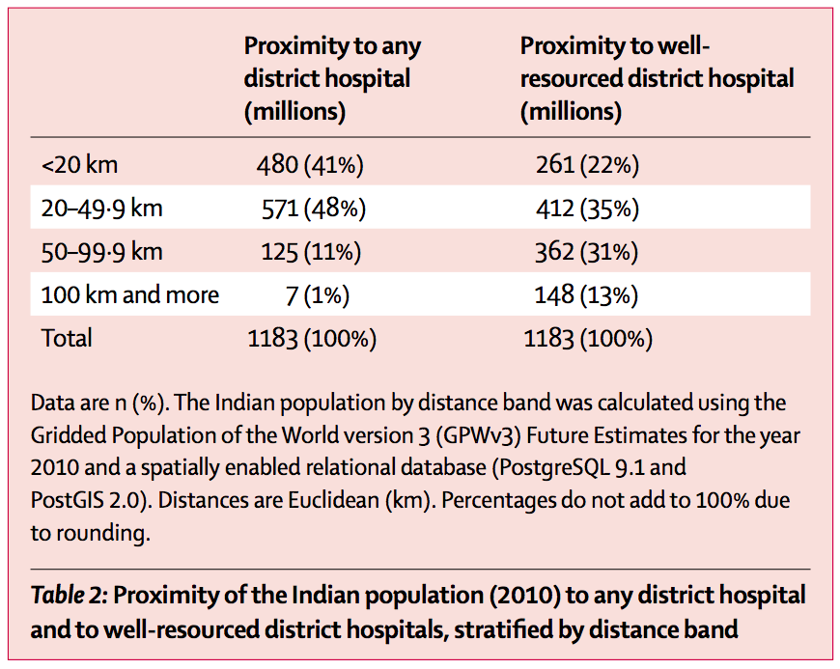
Dare et al., 2015
Notes:
.5 B

Slide 36
Notes:
Evidence based policy

Slide 37
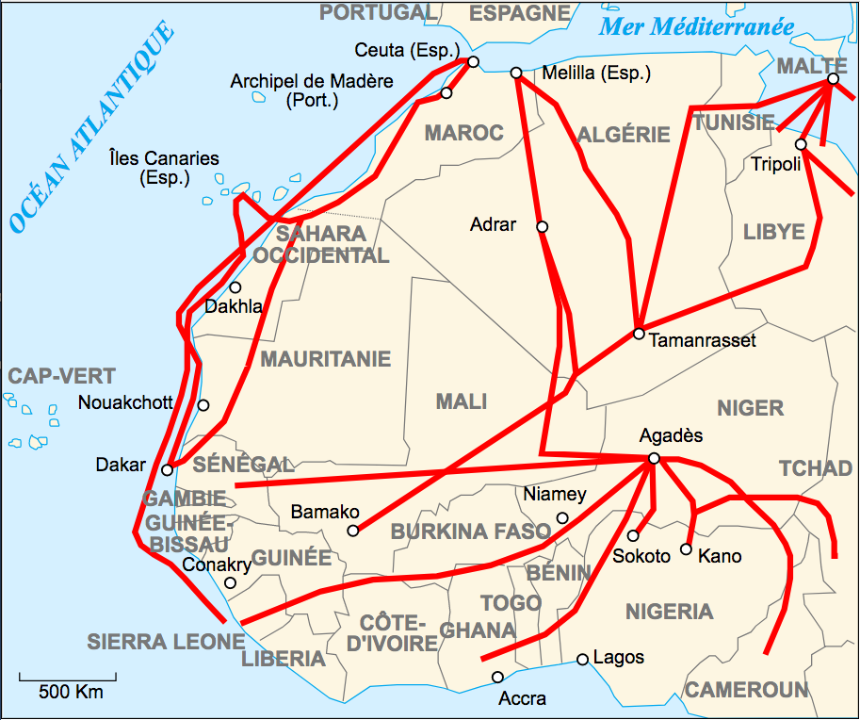
Notes:
In publication process
CC-BY-SA
https://en.wikipedia.org/wiki/Migrants%27_African_routes#/media/File:Carte_des_routes_d%27immigration_africaine_vers_l%27Europe.svg

Slide 38
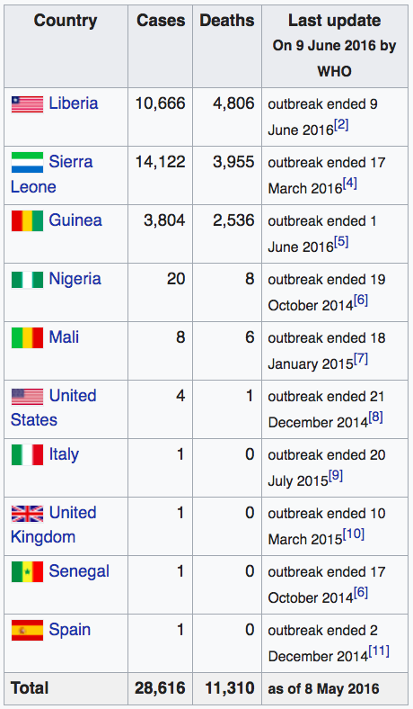
Notes:
Real problems.
I went to a fancy hotel in Washington DC, ate great meals, some at museums we rented out after-hours, and I feel this way
We are slowing things down

Slide 39
I want my work to be rigorous, reproducible, replicable, reusable, and extendable because of this.

Slide 40
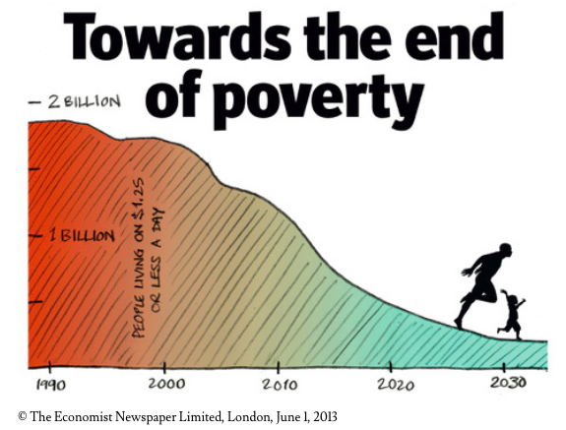

Slide 41
How many lives can I help make better?
How many lives can I save?

Slide 42
How many lives am I alright with NOT saving?

Slide 43
Cumulative.
Exponential.
Longitudinal.
Notes:
How much is a publication worth?

Slide 44
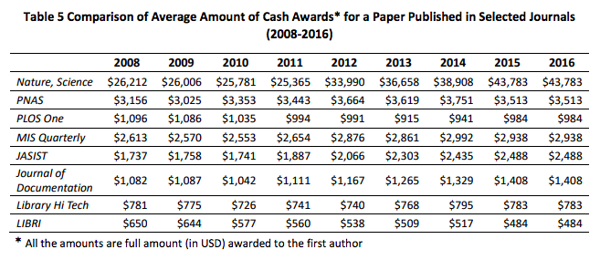
Quan, Chen, & Shu, 2017
Notes:
100 univerisites, Up to 165k
Avg basic salary of a prof 8,600 USD/3100
Not just china
Not just bonuses

Slide 45
Not just China.
Not just cash bonuses.

Slide 46
On physicians in the UC healthcare system:
A 2.40% increase in salary for every 10 publications after controlling for specialty, institution, rank, and chair.
Fijalkowski et al., 2013

Slide 47
How many lives is a Science or Nature publication worth?
How many lives is 10 publications worth?

Slide 48
Malaria
429k deaths worldwide
92% in Sub-Saharan Africa

Slide 49
Malaria
429k*1%
429k*.1%
429k*.01%
429k*.001%
= 4,290
= 429
= 42.9
= 4.29
Notes:
African lives

Slide 50
But it’s not.
What do I do?
How do I fix this?

Slide 51
We don’t always have the luxury of changing incentive structures.
Notes:
All of this in mind, there’s a more basic problem

Slide 52
Publish Report
Search / Discovery
Store Data
Analyze Data
Write Report
Collect Data
Develop Idea
Design Study
Notes:
Day to day success
Custom to the individual
Resistent to change

Slide 53
Openness
Publish Report
Search / Discovery
Store Data
Analyze Data
Write Report
Collect Data
Develop Idea
Design Study
Notes:
Try to append
Low quality-not going to happen at all
There’s integration costs,
Learning costs,
Transition costs

Slide 54
Reproducibility
Publish Report
Search / Discovery
Store Data
Analyze Data
Write Report
Collect Data
Develop Idea
Design Study
Notes:
If you try to append something to that workflow, it’s either going to done with low quality or ignored
There’s integration costs,
Learning costs,
Transition costs
Ask me to open data after publicaiton….

Slide 55
Curation
Publish Report
Search / Discovery
Store Data
Analyze Data
Write Report
Collect Data
Develop Idea
Design Study

Slide 56
Preservation
Publish Report
Search / Discovery
Store Data
Analyze Data
Write Report
Collect Data
Develop Idea
Design Study

Slide 57
Reporting
Publish Report
Search / Discovery
Store Data
Analyze Data
Write Report
Collect Data
Develop Idea
Design Study

Slide 58

Publish Report
Search / Discovery
Store Data
Analyze Data
Write Report
Collect Data
Develop Idea
Design Study

Slide 59
Publish Report
Search / Discovery
Store Data
Analyze Data
Write Report
Collect Data
Develop Idea
Design Study
Institutional Services/People

Slide 60
Publish Report
Write
Report
Search/
Discovery
Analyze
Data
OSF
Develop
Idea
Design
Study
Store Data
Collect
Data

Slide 61
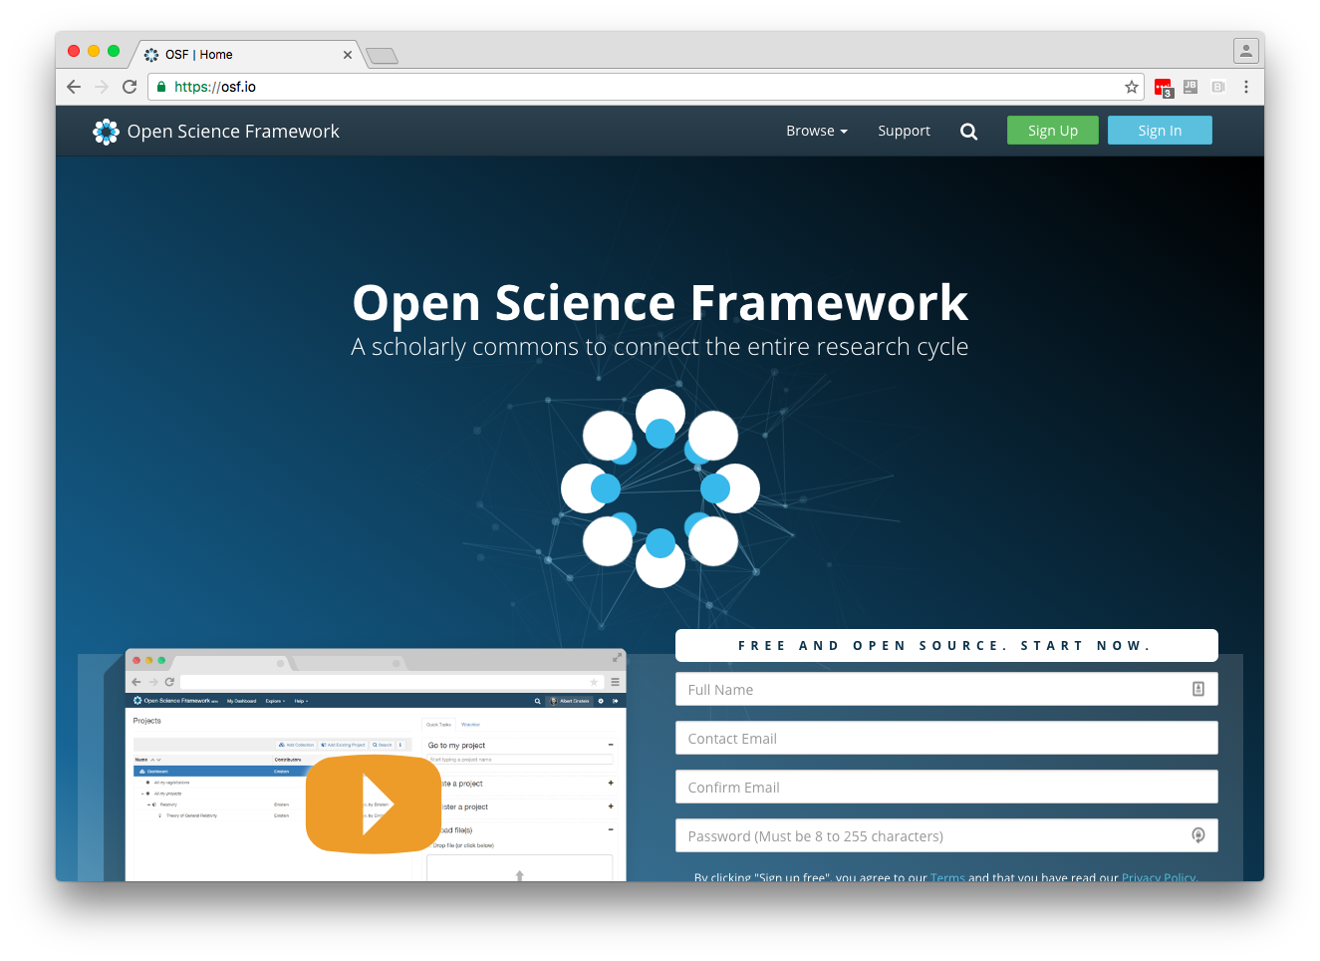
http://osf.io

Slide 62
A Workflow Integration Approach
Notes:
All of this in mind, there’s a more basic problem

Slide 63
1. Meet users where they are.

Slide 64
2. Respect current incentives.

Slide 65
3. Respect current workflow.
Notes:
This is where change happens

Slide 66
We could . . .
demonstrate that it makes research more efficient, of higher quality, and more accessible.

Slide 67
Better, we could . . .
demonstrate that researchers will get published more often.

Slide 68
Even better, we could . . .
make it easy.

Slide 69
Best, we could . . .
make it automatic.

Slide 70
Publish Report
Search / Discovery
Store Data
Analyze Data
Write Report
Collect Data
Develop Idea
Design Study
Notes:
Integrate compliance

Slide 71
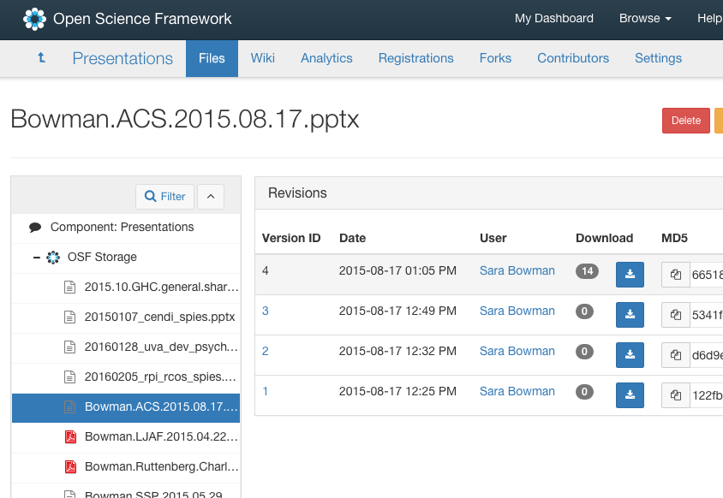
Notes:
To the user, it’s easy backup—drag and drop version control.
For the ideals, it’s important provenance.

Slide 72

It looks like you’ve you uploaded a data file with social security numbers in the “id” column.
How would you like to proceed?
Deidentify | Warn me before sharing this | Cancel

Slide 73
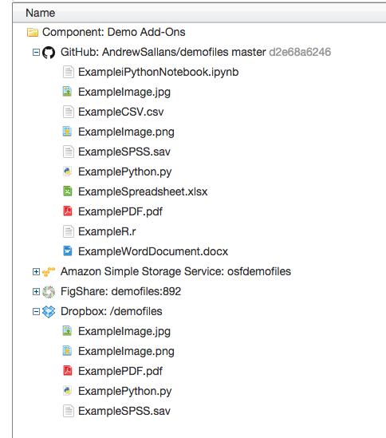
Notes:
Workflow is very custom—we can’t please everyone—so we try to connect to many services.
We also don’t want to reinvent the wheel--if there’s a good third-party option, researchers should use it.

Slide 74













Publish Report
Search / Discovery
Store Data
Analyze Data
Write Report
Collect Data
Develop Idea
Design Study
Now
Notes:
Meet users where they are
Increase adoption
Extend that ease of adoption to new tools

Slide 75













Publish Report
Search / Discovery
Store Data
Analyze Data
Write Report
Collect Data
Develop Idea
Design Study
Future

Slide 76
Research is hard.
Context is important.
Notes:
All of this in mind, there’s a more basic problem

Slide 77
If we seek to facilitate reproducibility, replicability, extension, and reuse…

Slide 78
We need to move beyond description of outcomes to description of process or, better, sharing actual process.

Slide 79
Open Access
Open Data
Open Materials
Open Data Cleaning Scripts
Open …
Open Workflow

Slide 80
Publish Report
Search / Discovery
Store Data
Analyze Data
Write Report
Collect Data
Develop Idea
Design Study

Slide 81
Open Workflow makes it easy to collaborate, integrate expertise, and give credit.

Slide 82
Big problems require big science—big research.

Slide 83
Big like “big data”:
Because of its size, it requires new tools, methods, and paradigms.

Slide 84
Team science/research.
Networked science/research.
Open science/research.
Urgent science/research.

Slide 85
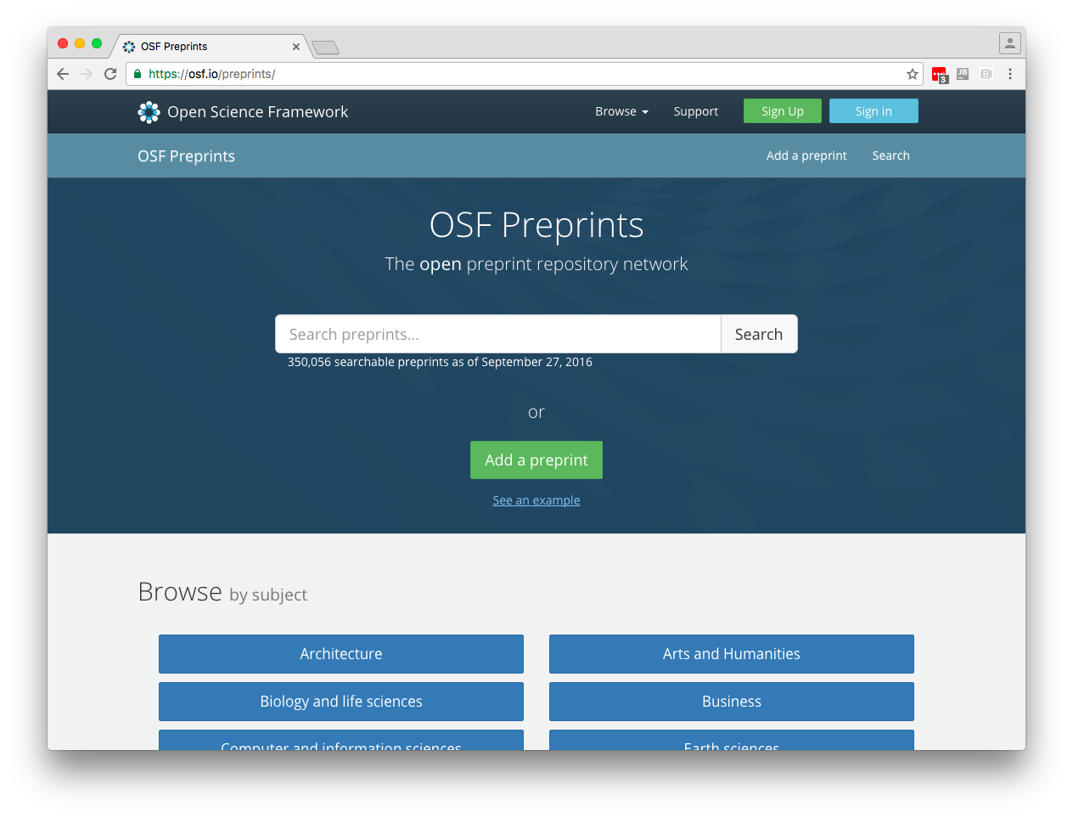

http://osf.io/preprints
Notes:
Aggregator: 5 non-COS sites

Slide 86
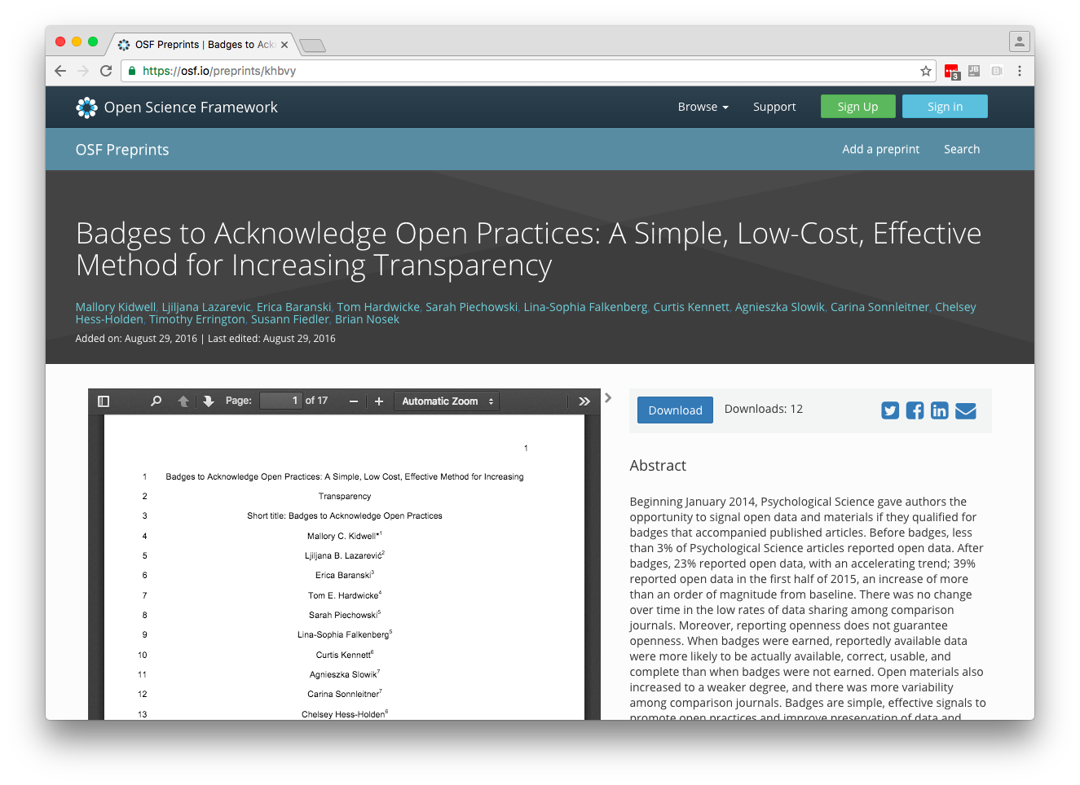

Slide 87
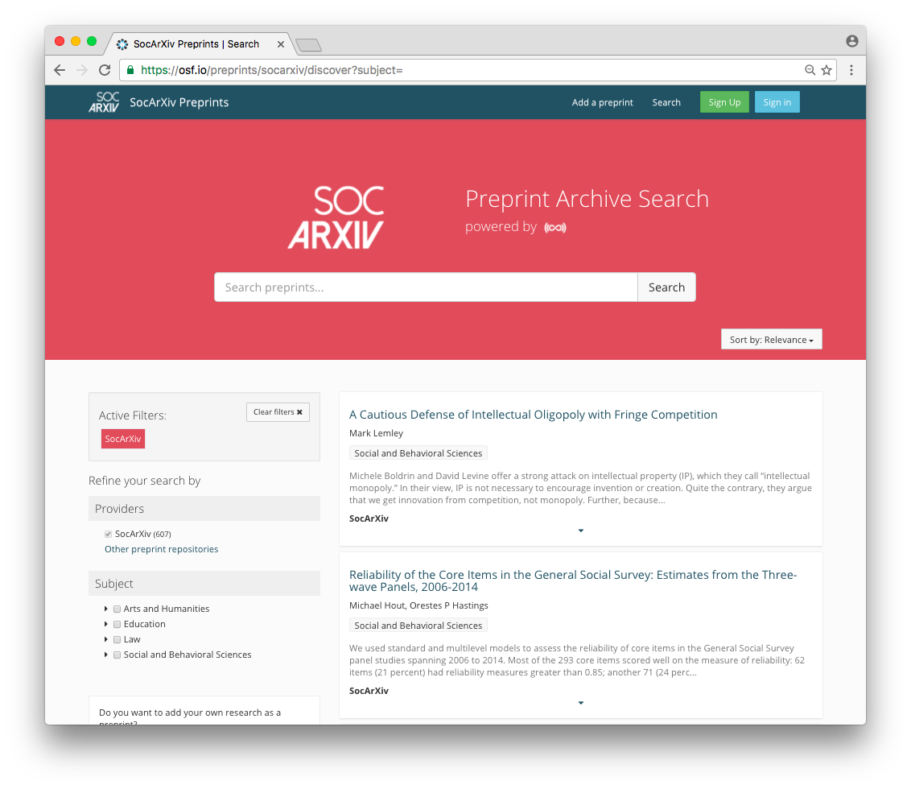
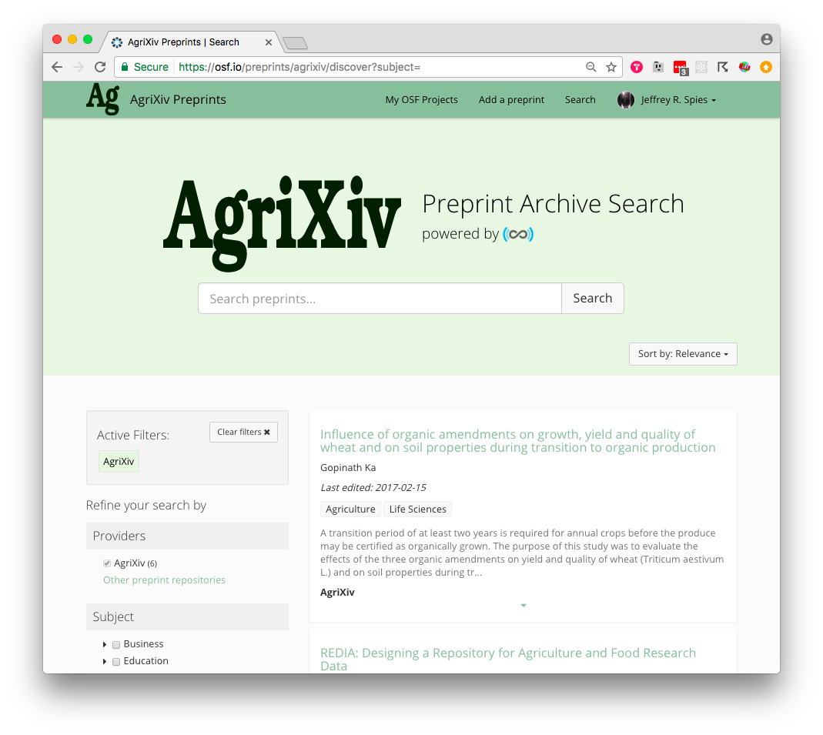
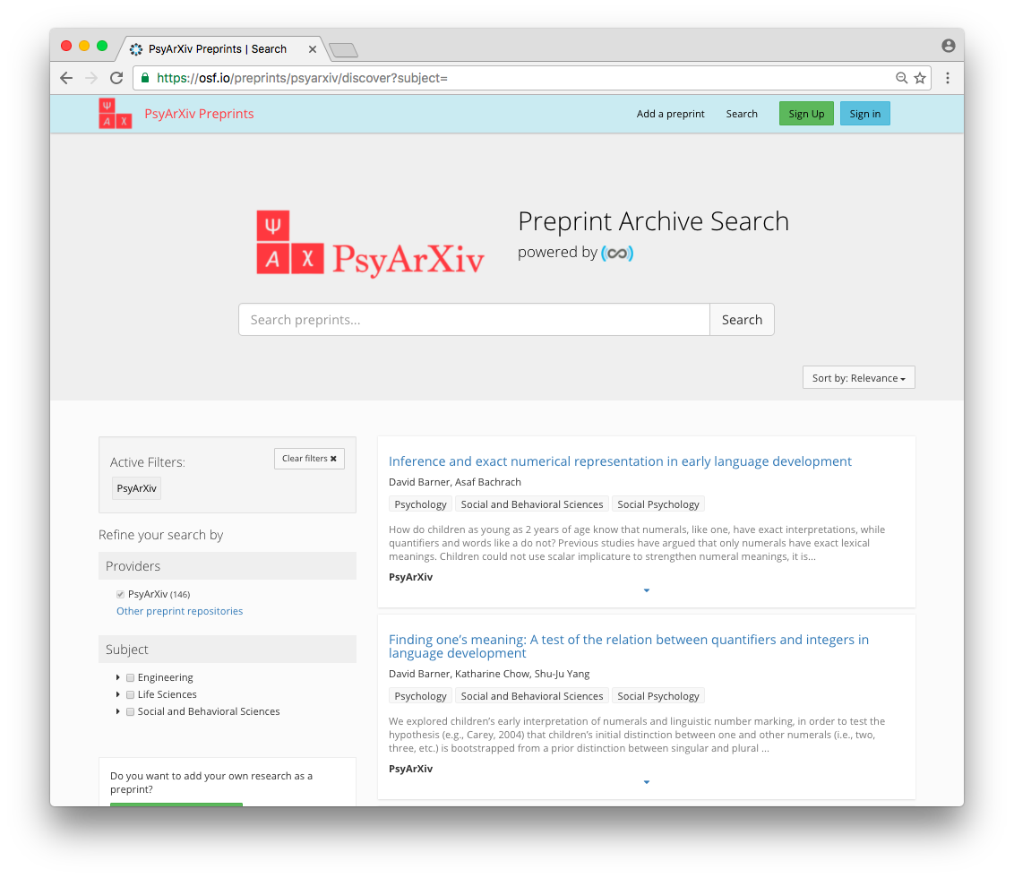
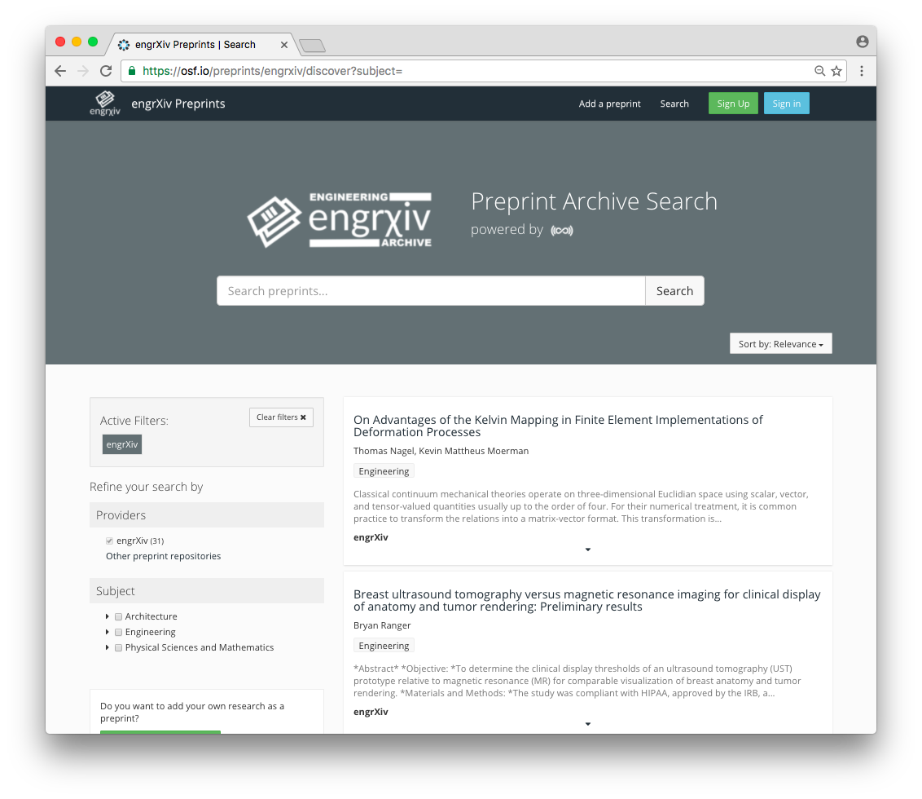

Slide 88


Slide 89
Support open access, open output, and open workflow policies.
Stop signing away copyright, exclusive licensing agreements.

Slide 90
State our values, make those statements public, and facilitate and resource practices that align with those values.

Slide 91
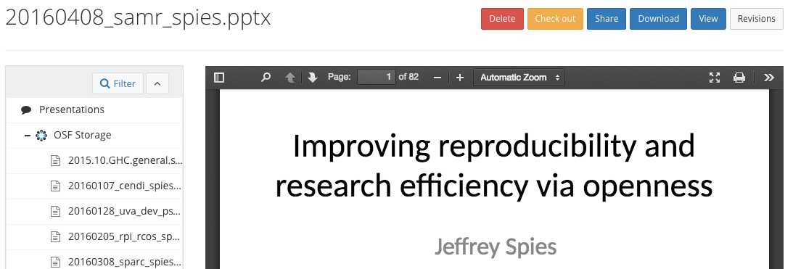
Find this presentation at
https://osf.io/9xndp
20171018_vt_spies.pptx
An Open Solution
for Urgent Problems
jeff@cos.io
@jeffspies
http://cos.io

Slide 92
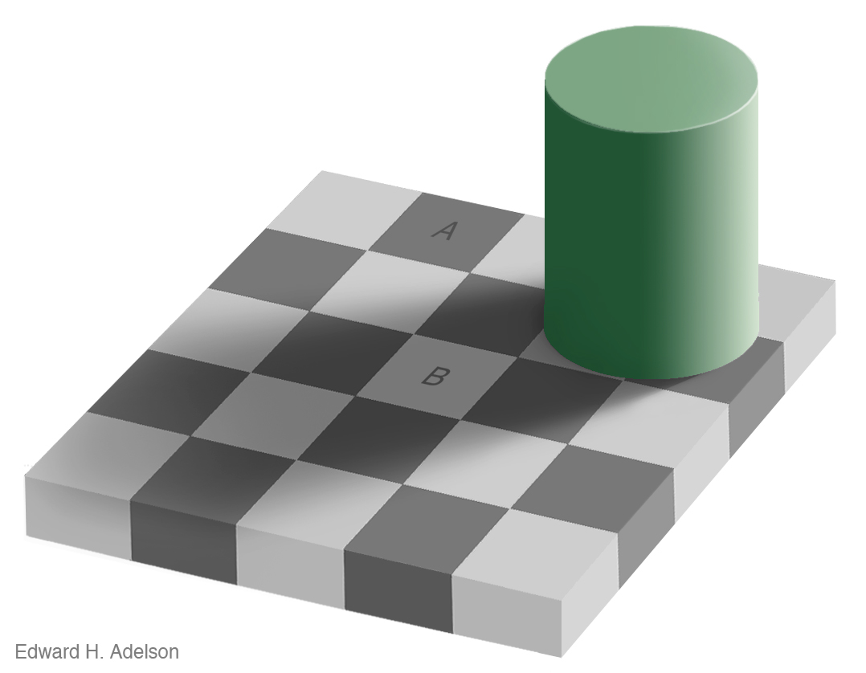


Adelson, 1995
Notes:
Would you say the squares where A and B sit are different colors?
I certainly would. But if I connect these squares….

Slide 93
Adelson, 1995
Notes:
They’re the same. What’s happening here? Your brain is doing exactly what it should be doing.
It’s interpreting the scene based on our knowledge and assumptions about the world.
Local contrast in the grid, there’s a 3d column with a right floating light source that is throwing a shadow on B—
the soft edges suggest it is a shadow.
There are X junctions suggesting changes at edges should be changes in surface color.
In everything we do, we process and interpret the world with assumptions, knowledge, and experience

Slide 95
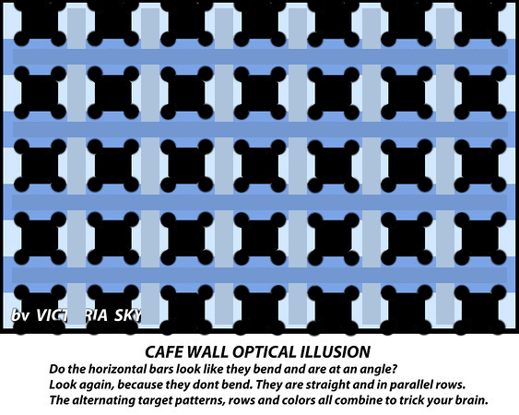

Slide 96
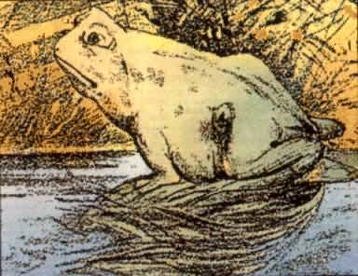
Notes:
What animal do you see?

Slide 97
Notes:
Sometimes we see different things.

Slide 98
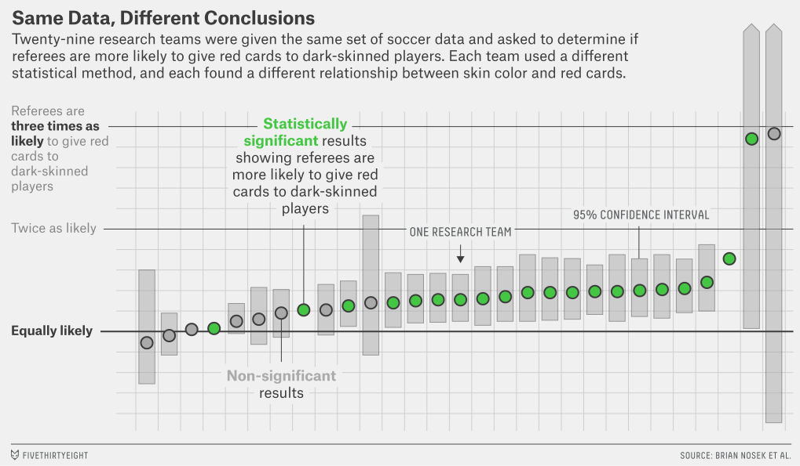
Figure by fivethirtyeight.com
Silberzahn et al., 2015
Notes:
29 statisticians, were refs more l ikely to give Red cards
Many decisions
This isn’t art! Not engineered to trick us.
Perspective, Perceptions, motivations, and biases
Knowledge and experience we bring
That can lead us –even from our values
Subtle—may not even know it

